Slide 1
Housekeeping
Please turn off cameras and make sure you are on mute.
If you are joining us via phone, please provide your name in the chat.
Please type all questions in the chat. We will be answering all questions during the presentation.

Slide 2
Presented by: Roxanne Garcia Bureau of Workforce Development Administration Phone: (717) 783-4827 Email: roxagarcia@pa.gov
PY 2022 – 2023 (July 1, 2022 – June 30, 2023)
Temporary Assistance for Needy Families (TANF) Youth Development Program

Slide 3
The Preliminary Screening Tool
The Preliminary Screening Tool within the Commonwealth Workforce Development System (CWDS) is a tool for TANF Youth Development Program (YDP) providers to identify if an applicant may be served using TANF Youth Development Funds (YDF). The tool communicates with the electronic Client Information System (eCIS/CIS).
This tool will replace the current eligibility spreadsheet process as of September 1, 2022.
Notes:
The Preliminary Screening Tool within the Commonwealth Workforce Development System (CWDS) is a tool for TANF Youth Development Program (YDP) providers to identify if an applicant may be served using TANF Youth Development Funds (YDF).
The Preliminary Screening Tool will allow TANF YDP providers to identify if an applicant may be served using TANF YDP funding instantly and securely within CWDS.

Slide 4
Tool Eligibility
TANF YDP providers must ensure that the applicant meets the age eligibility requirements of the TANF YDP prior to utilizing this tool. Applicant must be between ages of 12 (or have completed the 5th grade) and 24 years at the time of application.
If the applicant meets the age requirements for TANF YDP, the provider will proceed with the Preliminary Screening Function Instructions.
If applicant does not meet age requirement, the applicant is INELIGIBLE for services using TANF YDF. The provider will not proceed with Preliminary Screening Function but will review the applicant's eligibility for other funded services.

Slide 5
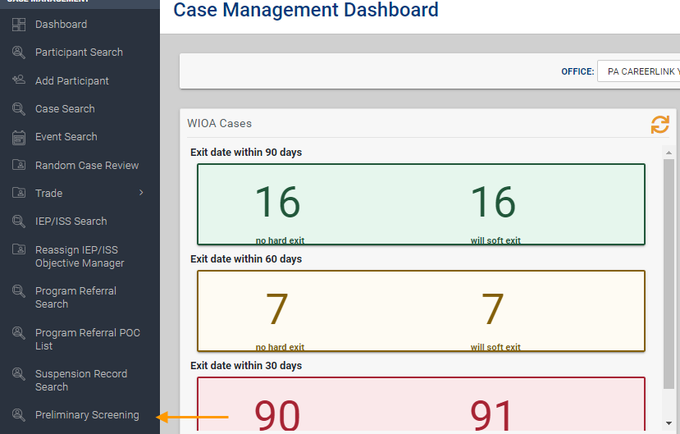
CWDS Instructions
Notes:
The Preliminary Screening Tool is now accessible in CWDS 2.0 in two ways. Under the “Quick Links” to the far left under the CWDS icon on the CWDS 2.0 homepage and at the bottom of the list options on the Case Management Dashboard. This link will take you to the Preliminary Screening inquiry homepage.

Slide 6
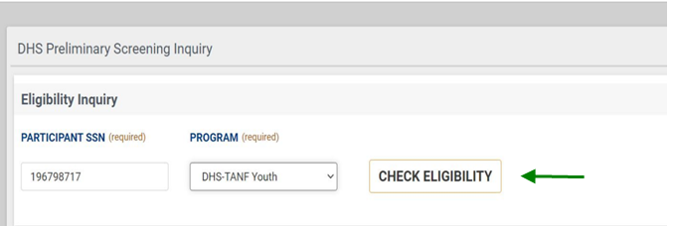
DHS Preliminary Screening
Notes:
The DHS Preliminary Screening will appear and requires staff to enter the participant’s social security number, choose a program which is “DHS-TANF Youth” and click “Check Eligibility”

Slide 7
Preliminary Screening Eligibility Results The “Preliminary Screening Eligibility” will display one of five eligibility results.
Notes:
The Preliminary Screening Eligibility Tool will display one of five of the following results.
Each Preliminary Screening Eligibility Results will determine if the applicant is eligible for TANF YDP funded services (assuming that staff have already confirmed Age eligibility) and if any additional verifications are needed. This process will be very similar to the spreadsheet where the applicant's names were color-coded, and the specific color indicated the next steps.

Slide 8
Eligible for Preliminary Screening: Yes – TANF Recipient
This indicates that the applicant is eligible for TANF YDP funded services because they are receiving TANF benefits.
Notes:
Receiving an “Eligible for Preliminary Screening: Yes – TANF Recipient” result means the applicant is ELIGIBLE for TANF YDP funded services because they are receiving TANF benefits. The provider is not required to collect further verification, and the applicant may be served immediately using TANF YDF.
NOTE: If the applicant is not known to CWDS, the creation of a CWDS base record will be required. Further instructions on the creation of a CWDS base record will be provided further below.

Slide 9
Eligibility for Preliminary Screening: Yes – Other Benefit
Receiving an “Eligible for Preliminary Screening: Yes – Other Benefit” result means the applicant is ELIGIBLE for TANF YDP funded services because they are receiving Supplemental Nutrition Assistance Program and/or Medical Assistance benefits AND are under the age of 15 or age 18 or older.
Notes:
Receiving an “Eligible for Preliminary Screening: Yes – Other Benefit” result means the applicant is ELIGIBLE for TANF YDP funded services because they are receiving Supplemental Nutrition Assistance Program and/or Medical Assistance benefits AND are under the age of 15 or age 18 or older. The provider is not required to collect further verification, and the applicant may be served immediately using TANF YDF.
NOTE: If the applicant is not known to CWDS, the creation of a CWDS base record will be required.

Slide 10
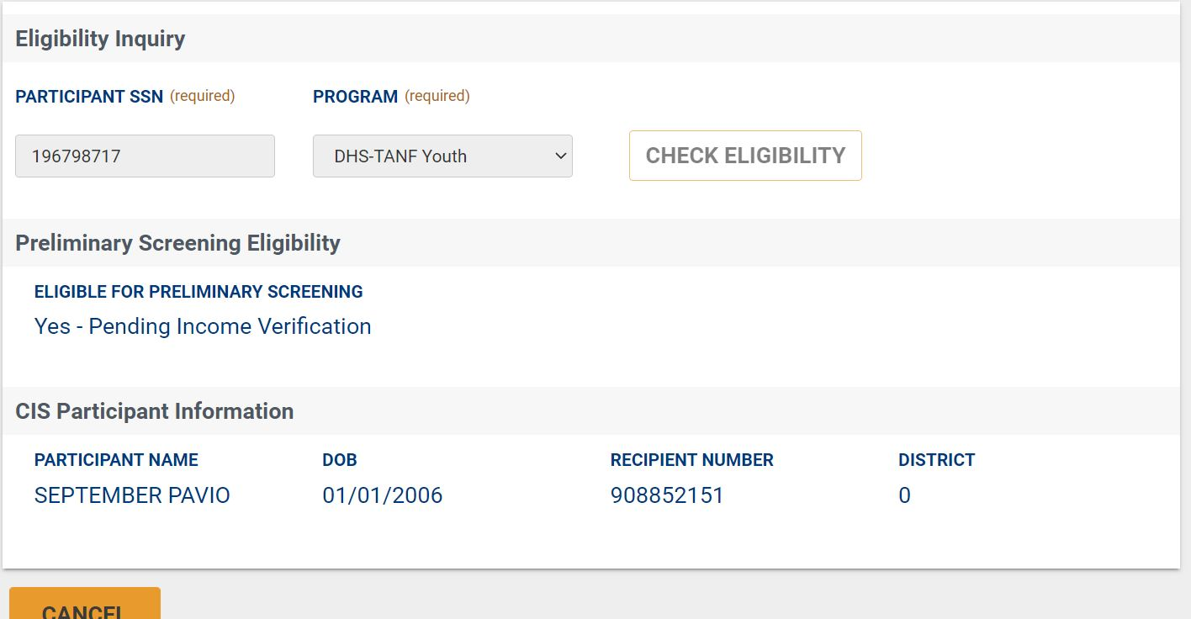
Eligible for Preliminary Screening: Yes – Pending Income Verification
Receiving an “Eligible for Preliminary Screening: Yes – Pending Income Verification” result means that the provider must verify the applicant’s household size and personal monthly gross earned income to determine eligibility*.
Notes:
Receiving an “Eligible for Preliminary Screening: Yes – Pending Income Verification” result means that the provider must verify the applicant’s household size and personal monthly gross earned income to determine eligibility*.
The provider must verify and document that the applicant’s personal monthly grossed earned income is under 235% FPIG*. The provider may utilize the “235% FPIG Calculator” to determine if the applicant is income eligible for TANF YDP funded services.
Receiving an “Income Eligible” result on the “235% FPIG Calculator” means that the applicant is ELIGIBLE for TANF YDP funded services. The provider is not required to collect further verification, and the applicant may be served.
Receiving an “Income Ineligible” result on the “235% FPIG Calculator” means that the applicant is INELIGIBLE for TANF YDP funded services. If the applicant is income ineligible, the provider must verify that the applicant resides in a High Poverty Area, using the most current version of the Pennsylvania High Poverty Area Verification tool, and has an additional barrier*.
If the applicant meets the High Poverty Area Verification, the applicant is ELIGIBLE for TANF YDP funded services and may be served. If the applicant does not meet the High Poverty Area Verification, the applicant is INELIGIBLE for TANF YDP funded services. The provider will then review the applicant’s eligibility for services through other funding streams.
*Please see the TANF YDP Manual for additional information.
A copy/screenshot of All verifications must be retained in the participant’s TANF YDP Data File and be made available upon request to confirm program eligibility and allowable expenditures.
NOTE: If the applicant is not known to CWDS, the creation of a CWDS base record will be required.

Slide 11
Eligible for Preliminary Screening: Yes – Pending Full Verification
Receiving an “Eligible for Preliminary Screening: Yes – Pending Full Verification” means that the provider must verify all eligibility requirements: residency, citizenship status, household size, and personal monthly gross earned income.
Notes:
Receiving an “Eligible for Preliminary Screening: Yes – Pending Full Verification” means that the provider must verify all eligibility requirements: residency, citizenship status, household size, and personal monthly gross earned income*.
The provider must verify and document that the applicant meets TANF YDP residency and citizenship requirements*. If the applicant does not meet the residency and/or citizenship status requirements, the applicant is INELIGIBLE for TANF YDP funded services. The provider will review the applicant’s eligibility for services through other funding streams.
If the applicant meets the TANF YDP residency and citizenship requirements*, the provider must verify that the applicant’s personal monthly grossed earned income is under 235% FPIG*. Providers may utilize the “235% FPIG Calculator” to determine if the applicant is income eligible for TANF YDP funded services.
NOTE: A copy/screenshot of All verifications must be retained in the participant’s TANF YDP Data File and be made available upon request to confirm program eligibility and allowable expenditures.
NOTE: If the applicant is not known to CWDS, the creation of a CWDS base record will be required.

Slide 12
Eligible for Preliminary Screening: No
Receiving an “Eligible for Preliminary Screening: No” means the applicant is known to eCIS and/or CWDS but does not meet the age requirements to participate in TANF YDP. Therefore, the applicant is INELIGIBLE for TANF YDP funded services.
Notes:
Receiving an “Eligible for Preliminary Screening: No” means the applicant is known to eCIS and/or CWDS but does not meet the age requirements to participate in TANF YDP. Therefore, the applicant is INELIGIBLE for TANF YDP funded services.

Slide 13
Creating a CWDS Base Record
The DHS Preliminary Screening Tool will only allow providers to “Create a Base Record” for individuals not already known to CWDS.

Slide 14
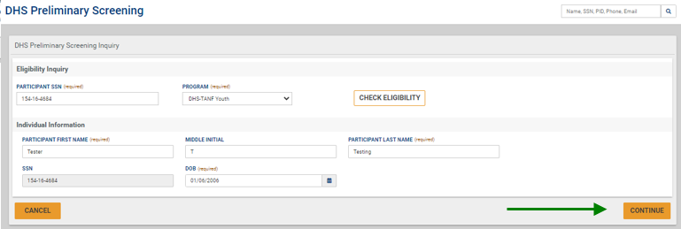
Create a CWDS Base Record – Not Known in System
Notes:
In the scenario where an individual is not known to CIS or CWDS and receive a “Yes – Pending Full Verification Result”, the provider will be required to “Create CWDS Base Record”. Only the Preliminary Screening Eligibility will display. There will be no Participant Information listed under the Eligibility result as the individual is unknown to both systems.
In this situation, you will want to click on “Create CWDS Base record, after completing this initial eligibility inquiry. Next, you will enter the Participant First Name, Participant Last Name, and Date of Birth and click on “Continue”

Slide 15
Creating a CWDS Base Record – Not Known in System
Notes:
We will then be promoted to complete all required fields under “Create Personal Information”. Once all required fields have been completed, you will want to scroll down to the bottom of the screen and click on “Save and Continue”

Slide 16
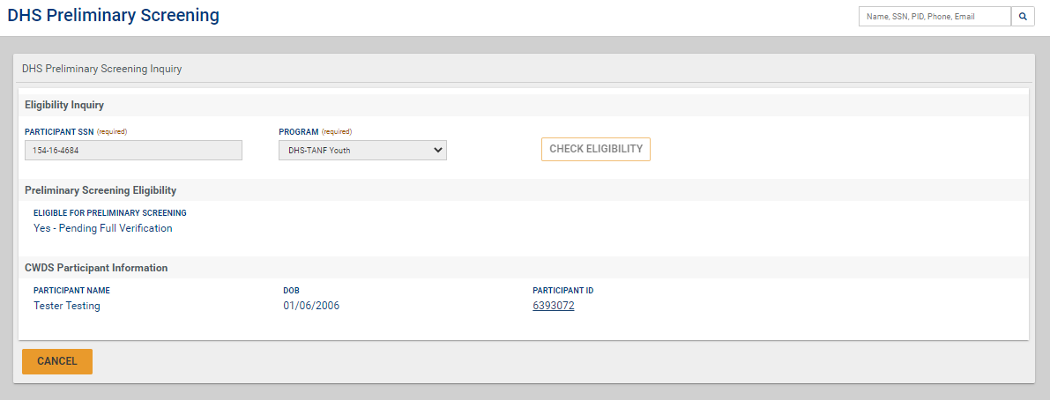
Creating a CWDS Base Record – Not Known in System
Notes:
A notification will display indicating that participant data was modified, and the provider must check eligibility again. Click on “Check Eligibility”
Final Preliminary Screening results under “Eligible for Preliminary Screening” will display and a base record has been created.
The provider will take the appropriate next step based on the final Preliminary Screening Eligibility result.
The “Eligibility for Preliminary Screening” will not change unless the date of birth the provider entered into the base record does not meet TANF YDP age requirements. A final Preliminary Screening Eligibility result of “No” means the date of birth the provider entered in the CWDS base record does not meet TANF YDP age requirements and therefore is INELIGIBLE to receive TANF YDP funded services.

Slide 17
Creating a CWDS Base Record – Not Known in System
Review “Possible Matches”
Determine if an existing base record matches the applicant’s VERIFIED information
If no records match, move forward with creating a new participant record
If a matching record is confirmed to be the applicant, then choose the toggle next to the matching individual and select “Matches CWDS Profile”
Notes:
If you have entered the participant’s information into the system to create a CWDS base record and are directed to the Participant Clearance screen, it means that there is an existing record for an individual with the same Name and Date of Birth but a different SSN. The Participant Clearance screen only appears when the participant in not known in the system.
In this case you would review the possible matches to determine if an existing base record matches the applicant’s verified information.
If an existing base record does not match the applicant’s verified information, click “Create New Participant Record”. Providers will be redirected to “Create Personal Information” and will complete the remaining steps.
If an existing base record under “Possible Matches” is confirmed to be the applicant, then click on the toggle next to the matching individual and select “Matches CWDS Profile”. Review

Slide 18
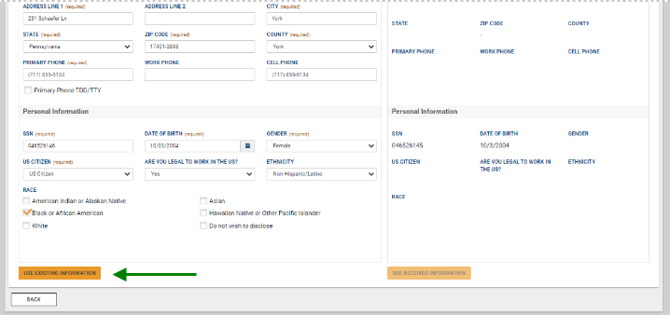
Creating a CWDS Base Record – Not Known in System
Notes:
Once a matching record is confirmed and you have selected “Matches CWDS Profile”. The Provider will then review “CWDS Information” on the “Resolve Conflict” screen, make any verified updates, and click on “Use Existing Information”
Providers will be redirected to re-assess eligibility by clicking “Check Eligibility” for the final Preliminary Screening result

Slide 19
Creating a CWDS Base Record – Individual known to CWDS and NOT eCIS
The provider will not receive a “Create CWDS Base Record” option as a CWDS base record already exists. The CWDS Participant Information will be displayed.
Notes:
In the scenario where the individual is known to CWDS but not to the CIS system, the screen will display, “Yes – Pending Full Verification“. The provider will not receive a “Create CWDS Base Record” option as a CWDS base record already exists. The CWDS Participant Information will be displayed.

Slide 20
Creating a CWDS Base Record – Individual known to CWDS and eCIS
The provider will not receive the “Create CWDS Base Record” option as a CWDS base record already exists. The CWDS and eCIS Participant Information will be displayed.
Notes:
In the scenario where the individual is known to both CWDS and to the CIS system, the provider will not receive the “Create CWDS Base Record” option as a CWDS base record already exists. The CWDS and CIS Participant Information will be displayed.

Slide 21
Creating a CWDS Base Record – Individual known to CWDS and eCIS
The provider will be prompted to “Resolve Conflict” when the CWDS and eCIS Participant information are displayed for the SSN entered but the individual’s name and/or date of birth do not match in CWDS and eCIS.
Notes:
If the participants information identified on CWDS and CIS do not match, such as the participants name and or date of birth, you will be prompted to “Resolve Conflict”.
When this occurs select, “Resolve Conflict”.

Slide 22
Creating a CWDS Base Record – Individual known to CWDS and eCIS
Review “Possible Matches” on the “Participant Clearance” screen to identify errors.
Then take a screen shot and send to the L&I Resource Account, ra-litanf-ydp@pa.gov, for resolution.
Notes:
Review “Possible Matches” on the “Participant Clearance” screen to identify errors. Then take a screen shot and send to the L&I Resource Account, ra-litanf-ydp@pa.gov, for resolution.

Slide 23
Creating a CWDS Base Record – Known to eCIS but not CWDS
Individual is known to eCIS but not known to CWDS, the provider will be required to “Create CWDS Base Record”. The eCIS Participant Information will be displayed.
Notes:
In the scenario where the individual is known to CIS but not known to CWDS, the provider will be required to “Create CWDS Base Record”. The CIS Participant Information will be displayed.
First click on “Create CWDS Base Record” .

Slide 24
Creating a CWDS Base Record – Known to eCIS but not CWDS
Notes:
Complete all required fields under “Create Personal Information” and click on “Save and Continue”

Slide 25
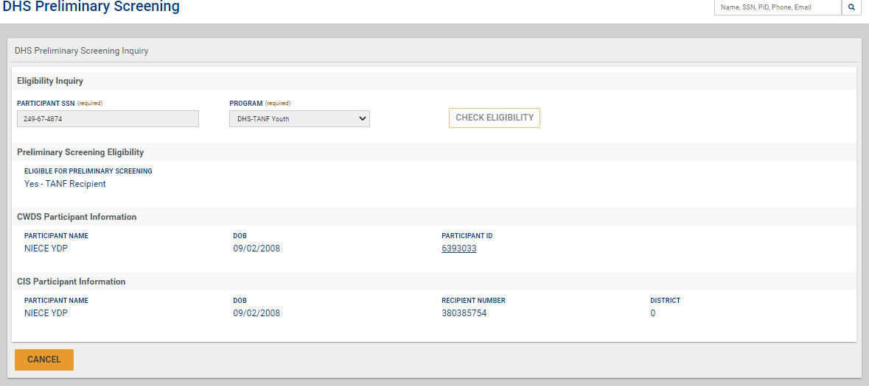
Creating a CWDS Base Record – Known to eCIS but not CWDS
Notes:
A notification will display indicating that participant data was modified, and the provider must check eligibility again. Click on “Check Eligibility”.
A final Preliminary Screening Eligibility results for “Eligible for Preliminary Screening” will display, and a base record has been created.

Slide 26
Eligibility Flow Chart
Notes:
This flow chart gives a quick visual of the eligibility processes we just discussed.

Slide 27
Question?
Questions, comments, concerns?
Please email to resource account:
ra-litanf-ydp@pa.gov
Notes:
Let us know if you have additional topics or send to resource account

