Slide 1
Policies & Agreements
Oversight Reviews
Notes:
Welcome to all. I are so glad you reserved time to listen in on this Oversight Touchpoint topic. As we continue to review various components of monitoring activities, it is my hope that you all will provide questions and feedback to validate that you all are receiving the information you need to provide compliant and fiscally responsive services and supports to Commonwealth stakeholders. Today, I will be reviewing the policies and procedures aspects of our monitoring processes.

Slide 2
Training Objectives
Identify specific requirements outlined in federal and state laws
Review BWDA Oversight monitoring tool
Identify patterns or consistent concerns or findings in this information
Provide possible resources for technical support in reviewing/updating local agreements and policies
This Photo by Unknown Author is licensed under CC BY-ND
Notes:
As we review information, I hope to address the following: Specific requirements under federal & state laws, look at the monitoring information reviewed, provide feedback on some past patterns, concerns, and/or findings specific to this topic, as well as provide you all with some resources that may be helpful in the local area monitoring of policies & agreements.

Slide 3
Definitions
Keeping language consistent
Notes:
It is always a good idea to ensure all parties understand the information of what we are reviewing today. As such, definitions will provide a baseline.

Slide 4
Agreement
Definition – A negotiated and typically legally binding arrangement between parties as to a course of action.
Example(s) – Local Elected Official (LEO) Agreement, Memorandum of Understanding (MOU), Infrastructure Agreement, Operating Budget, Professional Services Contract(s), Resource Sharing Agreement
This Photo by Unknown Author is licensed under CC BY-SA
Notes:
This definition comes straight from the dictionary. When we look at agreements, we seek to ensure that the local areas have mechanisms in place to establish funding resources, payment processes, and partner supports. Agreements are in essence the bridge between two entities. Structural integrity is essential in determining the load the bridge can bear. Annual reviews help to identify potential areas of weakness and/or risks.

Slide 5
Policy
Definition – a course or principle of action adopted or proposed by a government, party, business, or individual
Example(s) – Financial Management Policy, Local Procurement Policy, Governance Policy, Program Management Policy
Notes:
All entities receiving federal funds are required to establish policies specific to the services and supports provided through the grant. These are only a few examples of the policies established to align with local plans.

Slide 6
BWDA Oversight Expectations
This Photo by Unknown Author is licensed under CC BY-SA
Notes:
We at Oversight really hope to avoid the perception depicted in this illustration. This is a collaborative effort in addressing the needs of your local areas while ensuring compliance to the requirements under laws and policies.
Oversight aligns document requests with the required policies and agreements defined by federal statutes, state policies and procedures, and local policies & plans. Just as a point of reference and awareness that all services and payments should be aligned with the approved local plan.

Slide 7
Information reviewed
Presence / Existence of required agreements
Date(s) of initial and/or updated agreement(s)
Establishment of required policies
Date(s) of policy and/or updated policy
Local policies align with state and federal requirements
Local procedures align with local, state, and federal policies
Agreements include all required information
Agreement/contract compliance with procurement laws
Notes:
We are in essence seeking to ensure program elements align with the requirements of federal, state, and local policies and regulations. As we review the next few slides indicating required agreements and policies, I would like to note that
Required information may take form of policy, guidance, or a paragraph within a specified document.

Slide 8
Required Agreements
CLEO Agreement – Agreement between the chief elected official (CLEO) and the local workforce development board (LWDB).
LEO Agreement (if applicable) – Agreement between all counties and other local governments establishing the consortium of local elected officials.
Fiscal Agent Agreement – Agreement between the chief elected official(s) and the fiscal agent, if a fiscal agent is designated.
Local Area MOU – Agreement that outlines roles and responsibilities of all required workforce partners
Infrastructure Funding Agreement – Generally included as a part of the MOU
Operating Budget – Reviewed according to policy
Notes:
These agreements are required to be in place and your agency may be requested by various departments within L&I to verify existence. It is worth mentioning that the level of funding directly determines the type and method of agreements. Specific procurement rules, guidelines and regulations can be found in the Pennsylvania Department of Labor & Industry Fiscal Management Guide (also referred to as the FMG), pp. 122-134.

Slide 9
Required Policies
Program Management – Policy & processes addressing, at a minimum: equal opportunity for customers; complaints and grievances; supportive services; incentives; file management; eligibility determination and verification; self-sufficiency criteria; self-attestation and certification random sampling; priority of service; training verification/refunds; individual training accounts; contracts for training services; statewide training providers list and eligibility verification; local area training provider list and eligibility criteria and process; “additional assistance” definition; work-based training policies including incumbent worker training, OJT, CT, and apprenticeship.
LWDB Governance – Bylaws; Policy & process for the nomination, appointment, and removal of board members; Resolutions; Code of Conduct; and Conflict of Interest in accordance with L&I Governance Policy.
Financial Management – Policy & processes that include a cost allocation plan, internal controls, cash management, receipts of goods, cost reimbursement, inventory and equipment, program income, travel reimbursement, audit requirements and resolution, annual report, property management, debt collection, and allowable costs in accordance with L&I’s Financial Management Policy and the corresponding guide.
Procurement – Policy & processes describing formal procurement procedures.
Risk Management – Policy and processes addressing records retention & public access, public records requests, monitoring, grievance, incident, and disaster recovery planning.
Notes:
As discussed in a previous presentation, policies are essential pieces in the internal control process. Included on this slide are required local area policies and procedures. Local policies are required to be aligned with the local plan.
The Local policies form a baseline to ensure stakeholder awareness of the mission, goals, and values. While policies are required to contain specific elements, each local area can additionally include processes unique to the populations served. As an example, if a local area does not establish a travel policy, they must follow the requirements of GSA.

Slide 10
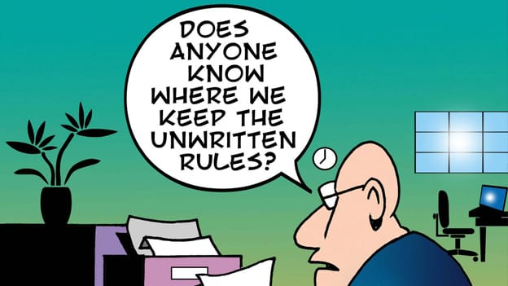
Additional Considerations for Best Practice
Human Resources – Policy and processes addressing employee classification, benefits, holidays and PTO, recruitment and selection, employee development, discipline, layoffs, termination and severance, sexual harassment, and equal opportunity/non-discrimination for staff.
Professional Services Contract(s) – Agreement for specialty administrative services. These would include contracts with staffing agencies or payroll supports.
This Photo by Unknown Author is licensed under CC BY-SA-NC
Notes:
As indicated in the illustration on this slide, the establishment of policies and procedures increases transparency and awareness of expectations. Established policies also reduces the loopholes that often result in preferential or inconsistent service provision. The policies listed on this slide are examples of best practice policies and agreements.

Slide 11
Agreements/Policies Worksheet
Completed Agreements/Policies Worksheet
Have the Local Board’s policies been updated since the Bureau’s review of the LWDB’s Local/Regional plan during PY2020? Please indicate yes or no below and enter date of change(s). Any polices or agreements updated since the Bureau’s review of the LWDB’s Local/Regional plan during PY2021 should be provided to the Bureau. (See section 5.9 of the Local Plan Appendix to confirm LWDB attestation of policies/agreements completed.)
Agreement between all counties and other local governments, if applicable, establishing the consortium of local elected officials (LEO Agreement)?
Last Updated:
Agreement between the chief elected official(s) and the fiscal agent, if a fiscal agent is designated?
Last Updated:
Agreement between the local elected official(s) and the local workforce development board?
Last Updated:
Memorandum of Understanding?
Last Updated:
Infrastructure Funding Agreement? (Should be part of MOU)
Last Updated:
Operating Budget(s)?
Last Updated:
Notes:
The next two slides contain the worksheet we (at Oversight) are using for program year 2021. For those who have been around for a few years, this document should look familiar.

Slide 12
Agreements/Policies Worksheet (cont.)
Local workforce development board policy and process that provides for nomination, appointment and removal of board members; resolutions; bylaws; code of conduct; and conflict of interest?
Last Updated:
Financial management policy and process including cost allocation plan, internal controls, cash management, receipts of goods, cost reimbursement, inventory and equipment, program income, travel reimbursement, audit requirements and resolution, annual report, property management, debt collection, and allowable costs?
Last Updated:
Local procurement policy?
Last Updated:
Program management policy and process including equal opportunity for customers, supportive services, needs-related payments, file management, eligibility, self-sufficiency criteria, individual training accounts, layoff assistance, priority of services, grievance for eligible training providers list, transitional jobs, stipends, and training verification/refunds?
Last Updated:
Risk management policy and process including records retention and public access, public records requests, monitoring, grievance, incident, and disaster recovery plan?
Last Updated:
Human resources policy and process including employee classification; benefits; holidays and PTO; recruitment and selection; employee development; discipline; layoffs, terminations and severance; sexual harassment; and equal opportunity/non-discrimination?
Last Updated:
Professional services contract(s) for administrative services such as staffing and payroll, if applicable?
Last Updated:
Notes:
Oversight is reviewing the policies and agreements established by the LWDB as defined by the approved local plan.

Slide 13
Patterns or Concerns
What to implement and what to avoid

Slide 14
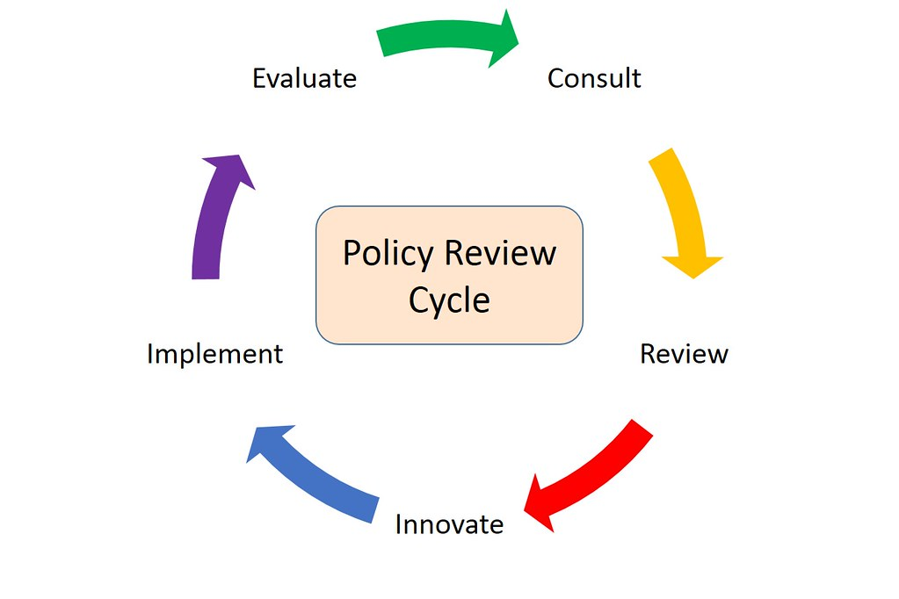
Policy & Procedural Review
This Photo by Unknown Author is licensed under CC BY-NC-ND
Notes:
Christopher did a great job reviewing this information last month. As a review, local areas should schedule to review at a minimum one time per year. Include representation of persons impacted by or most often implement the policy or procedure. Seek feedback from local monitoring teams. Agreements need to be reviewed and potentially updated when signatories change. Bylaws should be included in this review.

Slide 15
Recent Findings & Concerns
Findings
Agreements lacking all the required partners – HUD, PathStone, 2nd Chance (Local Governance Policy (12-18-15))
Use of PA CareerLink® Common Identifier on an Unapproved Alternative Web-based system (WSP No. 121-06, Change 2)
Missing the required sections in the Bylaws (WSP No. 02-2015)
Missing required agreement between the LEO and the LWDB (WSP No. 02-2015)
Discrepancy between local board policy and approved local plan (WIOA 2021-2024 Regional and Local Plans (2-9-21))
Concerns
Need to update agreements, policies, procedures and/or bylaws to reflect current laws and policies
Updates to the local Continuity of Operations/Disaster Recovery Plan
Notes:
All policies are reviewed in conjunction with updates to the local plan, LEO agreements, & Bylaws.

Slide 16
Technical Assistance
Who can best answer your questions
Notes:
It is always helpful to have a listing of who is assigned to assist in your local areas.

Slide 17
Oversight – Monitoring & CAP reviews
Greg Hart, Workforce Development Supervisor
Celebridi Jones – Clerical Assistant
Melanie Erb – North-Central Region (Central, Lackawanna, North Central, Northern Tier + South Central)
Jennifer Nestor - Southwest Region (Allegheny, Pittsburgh, Southwest Corner, West/Fay + Southern Alleghenies)
Robert Pisko - East Region (Bucks, Lehigh Valley, Luzerne-Schuylkill, Pocono Counties + Berks)
Victoria Smith - Southeast Region (Chester, Delaware, Montgomery, Philadelphia + Lancaster)
Rebecca Gardner - Northwest Region (Northwest, Tri-County, West Central)
Notes:
Oversight monitors are available to provide technical assistance concerning findings noted in monitoring reviews. The South-Central Region (Berks, Lancaster, South Central, Southern Alleghenies) is currently being covered by the identified oversight personnel.

Slide 18
Questions/Thoughts
This Photo by Unknown Author is licensed under CC BY-SA

Slide 19
References
Code of Federal Regulations - eCFR :: 20 CFR Part 679 Subpart D -- Regional and Local Plan
Financial Management Guide Pennsylvania Department of Labor & Industry - Financial-Management-Guide-2021.pdf (pa.gov)
Uniform Administrative Requirements, Cost Principles, and Audit Requirements for Federal Awards - eCFR :: 2 CFR Part 200 -- Uniform Administrative Requirements, Cost Principles, and Audit Requirements for Federal Awards
Workforce Delivery System – Memorandum of Understanding Policy (May 11, 2022) - MOU-Policy.pdf (pa.gov)
Workforce Innovation and Opportunity Act – BILLS-113hr803enr.pdf (congress.gov)
Workforce System Policy (WSP) 02-2015, December 18, 2015, Local Governance Policy - WSP 02-2015.pdf (pa.gov)
Workforce System Policy (WSP) No. 03-2015, December 22, 2015 - WSP 03-2015.pdf (pa.gov)
Workforce System Policy (WSP) No. 183.01 (C1) Oversight and Monitoring - WSP No. 183-01 (C1).pdf (pa.gov)
Workforce System Policy: Program Years 2021-2024 WIOA Regional and Local Area Plans - WIOA-2021-2024-Regional-and-Local-Plans.pdf (pa.gov)

