Slide 1
BWDA-Oversight, Touchpoint Series: Case File Monitoring
Presented by: Greg Hart

Slide 2
A Note About This Training
The purpose of this training is for BWDA to provide technical assistance on areas of case file monitoring. This presentation is a review and refresher to assist in implementing effective training of service delivery staff that will help negate repeat findings. Eliminating findings should have the desired effect of lowering a local area’s risk levels.
The case file monitoring training is meant to serve multiple purposes, which will benefit the local workforce development boards (LWDBs):
The training can be used by LWDB monitoring staff to conduct additional trainings to service delivery staff to ensure overall compliance.
The training will give LWDB monitoring staff time to appropriately resolve case file issues and recognize areas of concerns prior to BWDA monitoring.
The training recording and PowerPoint presentation will be made readily available and sent to each local area for future reference. A link to the recording will be provided as soon as administratively possible.
For PY 2022, in lieu of performing full case file reviews, BWDA is requiring LWDBs to attend this training. Once complete, LWDB case file monitors will have a more complete understanding of required case file monitoring.
BWDA case file reviews will resume in PY 2023 during the spring of 2024.

Slide 3
WIOA Eligibility Determination
Case Progress Notes and Services
Individual Employment Plan, Individual Service Strategy, and Assessments
Supportive Services and Incentives
Agenda Topics
Youth Service Delivery

Slide 4
Introduction
Topics and technical assistance in this presentation are based on case file monitoring issues, concerns, and findings observed during monitoring and/or issued on the PY monitoring reports.
Technical assistance for specific case file monitoring is available by contacting Oversight Services. Requests for future technical assistance presentations and touchpoint sessions can be made by contacting the assigned Oversight Services monitor or via email to the Oversight Services resource account: RA-LI-BWDA-OS@pa.gov.

Slide 5
WIOA Eligibility Determination
Case File Monitoring

Slide 6
References
20 Code of Federal Regulations (CFR) §683.600
Training and Employment Guidance Letter (TEGL) No. 39-11: Guidance on Handling and Protection of PII
Pennsylvania’s Employment Services and Employment-Related Law Complaint System
Pennsylvania Guidelines for PA CareerLink® Employment Services Customer Complaints
Pennsylvania’s Priority of Service Policy
Pennsylvania’s Workforce System of Record Policy
Pennsylvania’s Self-Certification and Telephone/Document Inspection Verification Policy

Slide 7
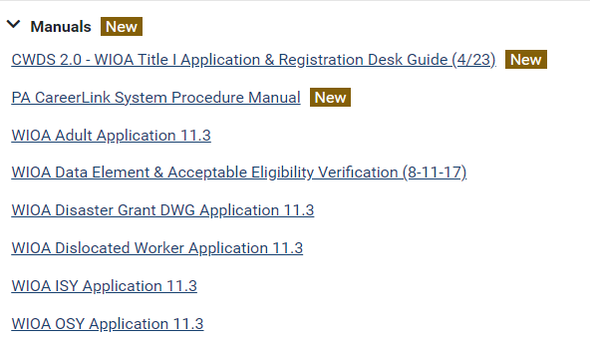
References cont.
8. CWDS → Help → Documents → How-Tos → PA WIOA
9. Common Measures Data Validation Guide → CWDS → Help → Documents → How-Tos → Manuals:

Slide 8
WIOA Eligibility Determination
L&I establishes and maintains a data validation system pursuant to US Department of Labor instruction.
LWDBs must ensure the accuracy of the data entered into the system of record as the elements required for data element validation focus on eligibility, outcomes, services, and program follow-up.
Workforce system staff must verify WIOA eligibility prior to the provision of WIOA services.
Documentation may be required as supporting the legitimacy of an individual’s acceptability for participation
Staff must confirm eligibility through an examination of provided documentation, which must be uploaded into the system of record.
Self-Certification is only permissible; however, except for some documentation required of out-of-school youth, it must be limited and only available after all other sources of eligibility verification are exhausted.
Prior to the use of self-certification all efforts to secure the verification must be documented in the CWDS case progress notes.

Slide 9
Self-Certification/Self Attestation
Definitions (From L&I’s Self-Certification and Telephone Document/Inspection Verification Policy)
Self-Attestation: Self-attestation (also referred to as an applicant statement) occurs when an individual states his or her status for a particular data element, such as “runaway youth,” and then signs and dates a form acknowledging this status. The key elements for self-attestation are: (a) the individual identifying his or her status for permitted elements and (b) signing and dating a form attesting to this self-identification.
Self-Certification: Self-certification means an individual’s signed attestation that the information said individual submitted to demonstrate eligibility for a program under title I of WIOA is true and accurate. (Exception: Per WIOA Section 167 ‘National Farmworker Jobs Program’ (NFJP) self-certification is performed when an eligible migrant and seasonal farmworker (MSFW) signed attestation that the information he/she submits to demonstrate eligibility for the NFJP is true and accurate).

Slide 10
Self-Certification/Self-Attestation
Self-Certification is permissible as a last resort for the following elements:
Dislocated Worker
Date of Actual Dislocation
Displaced Homemaker
Reemployment Opportunity is poor / unlikely to return-to-work
Youth
English Language Learner
In/Aged Out of Foster Care
Offender
Pregnant or Parenting
Requires additional assistance
Runaway
School Status at time of Registration
Adult and Youth
Homeless
Limiting the use of self-certification assists in ensuring eligibility determinations are valid.

Slide 11
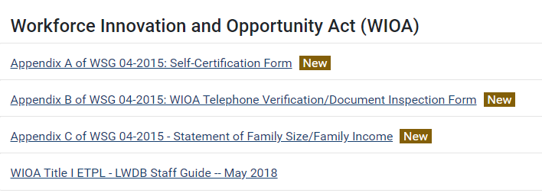
Statement of Family Size/Family Income
Effective June 24, 2022: An applicant statement is a form of self-attestation and may be used to validate family size and income if other means are not available. The statement is to be used as a last resort and attempts to secure verification prior to the use of the statement must be documented in the CWDS case progress notes.
The Department has developed standardized forms for self-attestation and self-certification. Locally developed forms are not acceptable. The standardized forms can be found at: CWDS 2.0 → Help → Policy & Procedures:

Slide 12
LWDBs must develop a local eligibility policy with self-certification determination and verification procedures clearly articulated and reflective of state policy and guidance. To avoid disallowed costs and/or administrative findings, each local workforce development area must adopt a statistically valid random sampling methodology with a reasonable range of tolerance to verify applicant self-certification usage and to monitor self-attestations.
Workforce system staff must verify eligibility prior to individuals receiving WIOA services. For individuals who need verification/documentation, (i.e., Social Security Card, Birth Certificate, Photo ID) workforce system staff should document referrals to agencies and services. While eligibility determination is pending, Wagner-Peyser services may serve as a bridge to ensure individuals maintain access to services.
A standard verification source must be selected for each eligibility item in the CWDS 2.0 WIOA application. Staff must upload verification sources via a PDF file. To protect sensitive information, non-sensitive PII, and protected PII, program staff must upload only the corresponding verification source to each field. For example, the data element of Social Security Number (SSN) must only have the verification of SSN uploaded to that field. The upload cannot contain additional documents (i.e., birth certificate, passport, driver’s license, layoff letter, etc.) that are unrelated to the data element.

Slide 13
Local workforce areas are required to have Adult priority of service policies and procedures in place that include the following:
Local procedures for determining priority during the eligibility process and enrollment.
What criteria and procedures will be used to assess priority for basic skills deficient individuals.
Any local discretionary priorities that will be established in addition to the three (3) statutory priority groups, the data to support the need for the local priority, and the documentation that will be required from an individual for the local priority.
Local procedures for internal monitoring of the goal to serve a minimum of 50.1% of Adult participants from the priority targeted groups.
During the WIOA eligibility/intake process, an Employment Services (ES) System handout indicating complaint system information such as customer rights must be made available to all PA CareerLink® customers. Customers must acknowledge the receipt of the ES complaint system handout.

Slide 14
Second-Level Review
Once eligibility is determined by the case manager, the participant’s file must be reviewed by a second-level reviewer.
A second level reviewer is an individual such as a supervisor, manager, or other designated quality assurance staff, whose function is to review the eligibility documentation for accuracy.
This is done to ensure the accuracy and appropriateness of the eligibility determination and to reduce the risk of providing WIOA services to ineligible individuals, which may lead to disallowed costs.
L&I’s second-level review requirement is outlined in email guidance dated April 27, 2012, which requires each LWDA to establish a written supervisory/second-level review policy for all WIOA participants, including documentation or notated the review was conducted, when, and by whom.
This requirement will appear in a future service-delivery related policy.

Slide 15
Case Progress Notes and Services
Case File Monitoring

Slide 16
References
Pennsylvania’s Workforce System of Record Policy
CWDS → Help → Documents → All Staff → CWDS 2.0 Case Notes Best Practices
CWDS → Help → Documents → Manuals → PA CareerLink® System Procedure Manual
CWDS → Help → How-Tos → WIOA → WIOA → CWDS Guidance for WIOA Title I-B Programs.

Slide 17
PA’s Workforce System of Record and Case Notes/Services
CWDS/PA CareerLink® is the system of record. All participants, employers, and providers served by WIOA, Wagner-Peyser, and TAA programs must have their services and/or activities entered into CWDS/PA CareerLink® within 30 calendar days to ensure a common record.
The use of alternative systems is prohibited for all workforce investment data entry and tracking.
Workforce investment activity includes participant and employer registrations, job postings, job matching, career planning, case progress notes, activities and outcomes pertaining to workforce programs funded through the authorization of WIOA, the Wagner-Peyser Act, TAA and related grants.
Pandemic procedures have resulted in the workforce system staff being equipped with mobile devices and virtual platforms to connect with PA CareerLink® customers, which promotes flexibility in service delivery and supports immediate opportunity for data entry into the system of record.
LWDBs must reflect Pennsylvania’s Workforce System of Record Policy in their bylaws and policies.

Slide 18
Case Note Considerations
(from the Case Notes Guidance in CWDS Help)

Slide 19
Case Note Considerations Cont’d.
Keep in mind that case progress notes are viewable to many of the PA CareerLink® required partners. Individuals may take advantage of various services, through several partners, and effective/clear case notes prevent duplication of services/efforts while enhancing the ability for workforce system staff to develop efficient strategies for individuals to achieve their goals.
Effective case notes also benefit the second-level review and monitoring processes.

Slide 20
Individual Employment Plan (IEP), Individual Service Strategy (ISS) and Assessments
Case File Monitoring

Slide 21
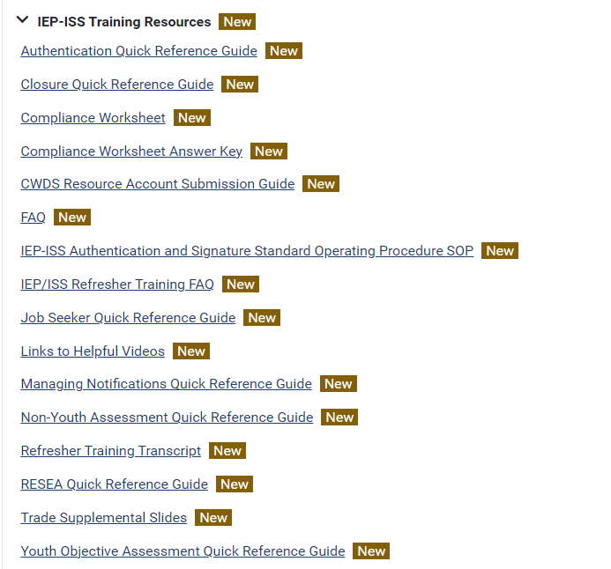
References
WIOA §129 (c)(1)(A)
WIOA §134 (c)(2)(iii)
Pennsylvania’s Workforce System of Record Policy
CWDS → Help → Documents → Desk Guides & Training Materials → IEP-ISS Training Resources:→→→

Slide 22
Individual Employment Plan (IEP) Explained
An IEP is a jointly developed agreement between the WIOA case manager and the non-youth job seeker as a detailed reflection of the following:
Assessment results
Skills
Barriers and referrals to overcome the barriers
Referrals to partner programs and/or local resources
Interests
Employment goal
Planned services
Supportive services
Training, if needed
The IEP is an ongoing strategy with regular updates that assess the participant’s skills and abilities, measures progress, and authentication that reflects the accountability of all parties to achieve the employment goal.

Slide 23
Individual Services Strategy (ISS) Explained
An ISS is a jointly developed, action-planning document resulting from a thorough review of the information discussed by a case manager and youth during an objective assessment. An ISS can be developed to address goals for employment, education, and/or individual development and reflect details of the following:
Youth objective assessment
Employment, Education, and/or Individual Development goal
Planned services
Assessment results
Age-appropriate goals
Appropriate service strategies
Skills
Barriers and referrals to overcome the barriers
Referrals to partner programs and/or local resources
Interests

Slide 24
IEP/ISS Considerations
It is required that an IEP/ISS, plan updates, and applicable authentication be entered into CWDS within 30 calendar days of the actual date of occurrence.
Assessments are required for all WIOA participants.
Workforce system staff are required to conduct and document an assessment of WIOA Youth participant’s basic skills, occupational skills, prior work experience, employability, interests, aptitudes, supportive service needs, and developmental needs.
Workforce system staff are required to conduct and document an assessment of the WIOA Adult and Dislocated Worker participant’s skill levels, aptitudes, abilities, and supportive service needs.
Assessment tools include but are not limited to: CASAS, TABE, and the exploration and assessment tools available through the PA CareerLink® site.

Slide 25
IEP/ISS Authentication
Authentication is used in CWDS 2.0 to identify the IEP/ISS is valid.
Authentication is triggered in CWDS 2.0 when:
A new barrier is identified.
An existing barrier is overcome.
A new assessment is completed and added to the IEP/ISS.
An existing assessment is updated with post-test information.
A new goal or objective is entered on the IEP /ISS.
When the last objective is updated as Met or Not Met.
When prompted with the option for authentication in CWDS 2.0, users must select YES.
Electronic signatures must be obtained when any of the above items occur. CWDS case progress notes must properly document if a signature is not obtained, if there is anything out of the ordinary, or if a situation does not align with policy guidance provided in order to maintain compliance. Again, those case notes are required to be input in CWDS within 30 calendar days of the provision of the service.

Slide 26
IEP/ISS Closure
The IEP/ISS must only be closed when the following occurs:
Once all planned services and required WIOA follow-up are delivered, the Objective Status for all objectives on the IEP/ISS must be updated to Met or Not Met.
All requested authentications are obtained for participants and staff.
Further guidance on IEP/ISS closures can be found on the CWDS Help using the following path:
CWDS → Help → Documents → Desk Guides & Training Materials → IEP-ISS Training Resources

Slide 27
A comprehensive IEP/ISS Refresher Training and virtual office hours were provided by Deloitte in May 2022. The procedural guidance and the training videos remain available via CWDS Help:
The videos identified below are helpful and the links can be found at: CWDS → Help → Documents → Desk Guides & Training Materials → IEP-ISS Training Resources

Slide 28
Supportive Services and Incentives
Case File Monitoring

Slide 29
References
WIOA §134(d)(2)
20 CFR §680.900
20 CFR § 663.805
Pennsylvania’s Workforce System of Record Policy
Financial Management Policy
Financial Management Guide (FMG) 2021
WSP No. 183-01 (Change 1), Oversight and Monitoring

Slide 30
Supportive Services/Incentives Policy
LWDBs must have a written policy which addresses both supportive services and incentives.
This policy must address the internal controls in place to protect cash-equivalents, which refer to any items that hold immediate cash value (e.g., gift cards, signed or certified checks, bus passes, gas cards, etc., or non-cash assets, which are items that have no immediate cash value (e.g., work boots needed to complete an OJT) all of which could be either supportive services or incentives.
The policy must also address the following:
How the need to purchase is determined
Where the assets will be purchased (the store location(s), the authorized website, etc.)
What approval process is used to authorize the purchase
Secure storage, including, where they are stored, who has access to them, and how they are distributed
How they are logged including the following information:
Asset by number (if applicable), gift card number, or any other identifying feature;
Funding source (cash equivalents issued to participants must have been purchased from the same funding stream as participant’s eligibility determination);
The issuing agent and the recipient; and
Provisions that this log must be secured and treated as Personally Identifiable Information (PII).
Procedures for distribution, including:
Eligibility statements/certificates, regarding the reason for the distribution. (All completion certificates and/or eligibility statements must be verifiable.); and
Signature sheets verifying the participant’s receipt of a cash equivalent must include 3 signatures, including the participant, the issuing agent, and a supervisor or authority that can verify the participant’s eligibility and witness the receipt.
Monitoring and audit process.
Additionally, the LWDB must have procedures to review and update this policy, as necessary, on a regular basis.

Slide 31
Documentation Requirements
Documentation authorizing or supporting the dispersal of assets for incentives and supportive services must be retained in accordance with the Records Retention provisions outlined in the FMG or a locally adopted policy, whichever ensures the greater period of retention.
WIOA costs shall be limited to allowable costs that are adequately documented.
Adequate and sufficient source documentation must be maintained at the grantee or fiscal agent level to ensure cash disbursement requests are allowable, reasonable, necessary, and allocable.
Sub-recipients must be able to provide all source documentation related to these costs within a reasonable time as determined by L&I.

Slide 32
Supportive Service Considerations
WIOA Adult and Dislocated Worker participants are eligible for supportive services when the participant is:
Participating in career or training services as defined in WIOA 134(c)(2) and (3).
Unable to obtain supportive services through other programs providing such services.
Meets any additional requirements included in the LWDB’s supportive services policy
WIOA Youth participants are eligible for needs-related payments and supportive services when they enable the individual to participate in WIOA activities.
Case managers must enter a case note into CWDS for supportive services to:
Substantiate the issuance and explain that all other resources/referrals have been exhausted and the individual is unable to obtain supportive services through other programs providing such services.
Detail a one-time issuance.
Detail the first issuance in a series of supportive services or incentives (Ex: bus passes).

Slide 33
Supportive Service Entry
A WIOA service must be entered into the system of record for the issuance of every supportive service.
Supportive Service entries include but are not limited to:
WSS01 Transportation
WSS02 Childcare
WSS03 Dependent Care
WSS04 Housing
WSS05 Needs Related Payments
WSS06 Needs Based Payments
WSS07 Stipend
WSS08 Assistance with Uniforms/Work Attire and Work-Related Tool Costs
WSS09 Other 1
If a participant case file is selected for review, supportive service/incentive/needs-based payment documentation must be submitted with the request.

Slide 34
Youth Service Delivery
Case File Monitoring

Slide 35
References
WIOA §129(c)(3)(A)
TEGL No. 16-16, Change 1: One-Stop Operations Guidance for the American Job Center® Network.
23 PA C.S. § 6344
PA 2012 Act 151 – Child Labor Act
Pennsylvania’s Minimum Wage Act
Pennsylvania’s Equal Pay Law
Pennsylvania’s Unemployment Compensation Law
Pennsylvania’s Workers’ Compensation Act
Pennsylvania’s Workforce System of Record Policy

Slide 36
Youth Service Delivery Considerations
WIOA Youth service providers must ensure that participants are:
Fully enrolled in the PA CareerLink® system.
Introduced to the full array of available services through the PA CareerLink® partner system (Document with a service and/or a case progress note within the system of record).
Referred to applicable and beneficial services/trainings through the PA CareerLink® partner and referral system (Document with a service, a case progress note, and an IEP/ISS referral within the system of record).
These items must be monitored by the service provider and by the LWDBs.
All minors, as defined by the Pennsylvania Child Labor Act, must obtain a work permit upon entering employment.

Slide 37
WIOA Youth Service Provider Requirements
All employees that supervise minors through an internship, externship, co-operative, work study, or similar program must obtain the following required clearances:
Report of criminal history from the Pennsylvania State Police.
Child Abuse History Clearance from the PA Department of Human Services.
Fingerprint-based federal criminal history submitted through the Pennsylvania State Police or its authorized agent (FBI).
Clearances must be less than 60 months, or five years, old.
The employer is responsible for maintaining the documentation and producing it to the LWDB staff upon request and when conducting monitoring.

Slide 38
Required Employer Postings
Employers are required to post the following notices in a conspicuous place:
Abstract of the Pennsylvania Child Labor Act (Form No. LLC-5 & Form No. LLC-5 (ESP)).
Hours of Work for Minors Under Eighteen (Form No. LLC-17 & Form No. LLC-17 (ESP)).
Minimum Wage Law Poster and Fact Sheet (Form No. LLC-1)
Abstract Law of Equal Pay (Form No. LLC-8 & Form No. LLC-8 (ESP)).
Unemployment Compensation (Form No. UC-700 & Form No. UC-700 (ESP)).
Worker’s Compensation Insurance Posting (Form No. LIBC-500).

Slide 39
Questions?
Case File Monitoring
Case File Monitoring
Case file Monitoring
Case file Monitoring

Slide 40
Thank you!
Greg Hart
ghart@pa.gov
Oversight Services
RA-LI-BWDA-OS@pa.gov
https://www.dli.pa.gov/Businesses/Workforce-Development/Pages/default.aspx
Case File Monitoring

