Slide 1
.
OVERVIEW OF LOCAL MONITORING
Prepared and Presented by Jennifer Nestor and Robert Pisko – Bureau of Workforce Development Administration, Oversight Services

Slide 2
Local Monitoring Documentation Request
BWDA request generated 3/3. Due 3/24.
Items requested:
A copy of the local area’s 2021-2022 Local Oversight/Monitoring Plan. This must include the local area’s provider risk-assessment process if contracted providers are monitored less frequently than annually.
Copies of completed monitoring tools, reports, and corrective action plans for monitoring of the WIOA Title I program, including formula-funded activities, activities using WIOA discretionary funds, and specialized WIOA-funded National Dislocated Worker Grant programs. This includes monitoring of ITA providers and OJT employers and for PY 2021, COVID-19 NDWG monitoring.
Copies of completed monitoring tools, reports, and corrective action plans pertaining to the certification of each PA CareerLink® comprehensive site, affiliate site, or specialized center, including mobile service sites within the local area.
Copies of completed monitoring tools, reports, and corrective action plans for the monitoring of the One-Stop Operator and its performance.
Blank copies of any relevant monitoring tools not used to monitor the local workforce system in PY 2021.
Youth Program Elements and System of Record Monitoring Form.
Information regarding the Case File Review.

Slide 3
What does BWDA do with the documentation that is submitted for review?
Select an answer…
A. Complete BWDA monitoring tools.
B. Compare information when conducting case file reviews.
C. Review for best and promising practices.
D. Provide technical assistance when deficiencies are present.
E. Store the information for future reference and drafting monitoring reports.
F. All of the above
Please take the poll in the chat panel.

Slide 4
Monitoring of Plans, Tools, & Risk Assessments
BWDA will review that LWDB subrecipient monitoring plans, tools, and local policies comply with the Bureau’s Oversight and Monitoring Policy, Financial Management Policy, and Financial Management Guide (FMG).
LWDBs must have completed monitoring tools for each subrecipient during the Program Year to verify:
Completed Administrative, Programmatic, and Fiscal monitoring for compliance with federal, state and local laws, regulations, contract provisions/grant agreements, policies, and official directives, and compliance with the appropriate uniform administrative requirements for grants and agreements.
Risk Assessment which determines the frequency of subrecipient monitoring.
Reporting and resolution requirements which may include corrective action plans.
Documented controls through documented monitoring reports and follow-up meetings with subrecipients.

Slide 5
Evaluate Your Local Monitoring Plans
Conducting monitoring early in the program year
Allows local areas to accurately determine the sub-recipient risk assessment level in order to develop the monitoring schedule/frequency.
Ensures that an entity can meet the requirements of the grant agreement on time and within cost limitations.
Identifies instances of noncompliance and provides recommendations for corrective action for timely resolution within the program year.
Evaluates the effectiveness of oversight processes.
Provides timely and required monitoring documentation to BWDA and ETA.
At minimum, monitoring of administrative functions must be completed at least once per program year, monitoring of programmatic activities must be conducted at least quarterly, and fiscal monitoring must be conducted at least once during the contract period.

Slide 6
Adult and Dislocated Worker Monitoring
BWDA will monitor required documentation and conduct case file reviews for the following:

Slide 7
Youth Monitoring
BWDA will monitor required documentation and conduct case file reviews for the following:

Slide 8
COVID-19 Pandemic NDWG Monitoring
The grant will end on June 30, 2022.
BWDA will conduct monitoring to verify compliance with the appropriate uniform administrative requirements and contract/grant provisions through the review of:
The local plan for COVID-19 funding
Implementation of the local plan for COVID-19 funding
Expenditures: Alignment with the budget and budget narrative
Expenditures: Verify allowable costs
Case files, case notes, and services

Slide 9
SYSTEM OF RECORD POLICY
Requires that all WIOA, Wagner-Peyser, and Trade Adjustment Act participant, provider, employer and financial data be recorded in the Commonwealth’s PA CareerLink® System of Record.
The System of Record Policy must be reflected in the LWDB bylaws.
It is recommended that the data be entered as soon as possible to ensure accuracy.
Pandemic restrictions have highlighted the importance of complete electronic case records.

Slide 10
If service providers are located offsite of a PA CareerLink® Center:
It is the responsibility of the service provider to ensure that participants are:
Fully enrolled in the PA CareerLink® system
Introduced to the full array of available services through the PA CareerLink® partner system (Document with a service and case note within the PA CareerLink® system of record)
Referred to applicable and beneficial services throughout the PA CareerLink® partner and referral system (Document with a service and case note within the PA CareerLink® system of record)
These items must be monitored by the service provider and by the Local Workforce Development Boards

Slide 11
Historically Common Local Monitoring Findings
Incomplete Subrecipient Monitoring. It is concerning when the LWDB and the BWDA monitoring findings do not align.
Missing Elements in the Monitoring Tools
Untimely, Deficient, or Missing Data in the System of Record
Incomplete documentation for Eligibility Determinations
Incomplete IEP and ISS documents
Deficient documentation for Supportive Services

Slide 12
How to prevent future and repeat local monitoring findings
.

Slide 13
REFERENCE POLICY
WIOA Section 129
Mandates the use of funds for Youth Workforce Investment Activities
WIOA Section 134
Mandates the use of funds for Employment and Training Activities
WSP No. 183-01 (Change 1), April 15, 2019
Oversight and Monitoring policy
WSP No. 03-2015, December 22, 2015
This Financial Management Policy includes the Financial Management Guide AKA ‘The FMG’
Regularly review the Bureau’s Workforce System Policies and use them to conduct regularly scheduled reviews of local policies, procedures, trainings, and monitoring tools.
Protect Personally Identifiable Information (PII) and handle as required.

Slide 14
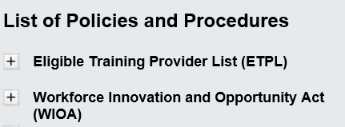
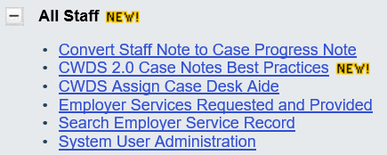
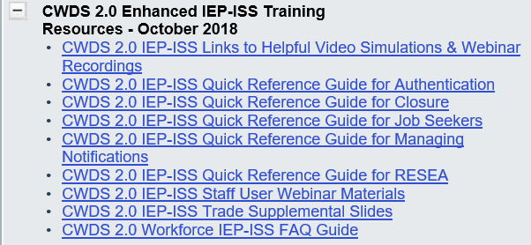
REVIEW PROCEDURAL GUIDANCE
Visit the CWDS Help Center
.
UPCOMING: Additional procedural references for IEP – ISS will be added to the CWDS Help Center, and a full IEP-ISS training will be conducted for all staff (anticipated in May).

Slide 15
PLAN AND EXECUTE
Document in the System of Record
Monitor subrecipients early, on schedule with policy, and as the risk assessments determine.
Remember: A complaint, poor performance, negative managerial patters, or unusual data may also prompt an unscheduled monitoring for a subrecipient.
Take note of concerns from monitoring reports which may develop into findings.
Provide regularly scheduled and relevant trainings, along with updated policy, guidance, and technical assistance to LWDA Fiscal Agents, PA CareerLink® One Stop Operators, Administrators, Title I Contractors, Program and Partner Staff.
Actively engage the Commissioners, LWDB members, and committee members with information, reporting, potential issues, and promising practices relevant to workforce.
.

Slide 16
ASK US Resource Accounts BWPO – Labor Exchange: RA-LI-BWPO-LXSTAFF@pa.gov BWPO – WIOA: RA-LI-BWPO-PCS@pa.gov BWDA – Oversight Services: RA-LI-BWDA-OS@pa.gov BWDA – Policy: RA-LI-BWDA-POLICY@pa.gov BWDA – Fiscal and Grants: RA-LI-BWDA-GRANTSFISC@pa.gov
BWDA Oversight Services LWDA Field Assignments, Effective March 7th, 2022
Supervisor: Greg Hart: ghart@pa.gov
Melanie Erb – North Region: Central, Lackawanna County, North Central, Northern Tier, & (interim) South Central.
Rebecca Gardner – Northwest Region: Northwest, Tri-County, West Central.
Jennifer Nestor – Southwest Region: Allegheny County & City of Pittsburgh, Southwest Corner, Westmoreland-Fayette, & (interim) Southern Alleghenies.
Robert Pisko – East Region: Bucks County, Lehigh Valley, Luzerne/Schuylkill, Pocono Counties, & (interim)Berks.
Victoria Smith – Southeast Region: Chester County, Delaware County, Montgomery County, Philadelphia, & (interim) Lancaster.

