Slide 1
Internal Controls
What is the big deal?

Slide 2
Training Objectives
Explain the importance of the topic
Introduce the Green Book framework including the principles and components of internal controls
Initiate discussion concerning the essential development and use of internal controls within agencies
Encourage operational improvements through the effective use of internal controls
This Photo by Unknown Author is licensed under CC BY-SA-NC

Slide 3
Definitions
Internal Controls are only fiscal – Right?

Slide 4
Internal Controls Defined
A process effected by an entity’s oversight body, management, and other personnel that provides REASONABLE assurance that the objectives of an entity will be achieved.
A continuous built-in component of operations, effected by people, that provides reasonable assurance, not absolute assurance, that an entity’s objectives will be achieved.
A series of actions that occur throughout an entity’s operations. Internal control is recognized as an integral part of the operational processes management uses to guide its operations rather than as a separate system within an entity. In this sense, internal control is built into the entity as a part of the organizational structure to help managers achieve the entity’s objectives on an ongoing basis.

Slide 5
Internal Control Terms Differentiated
A PROCESS is a series of steps to initiate, recognize and disclose information within a set time frame. Errors CAN occur in a process activity.
A CONTROL is an activity that MITIGATES processing risks either directly or indirectly. Designed to PREVENT OR DETECT an error.

Slide 6
The Why Behind the What

Slide 7
Role of Internal Controls
Protection of assets
Ensure accuracy of records
Achievement of organizational mission and goals
Ensure compliance with policies, rules, regulations, and laws
This Photo by Unknown Author is licensed under CC BY-SA-NC

Slide 8
Components of Internal Controls

Slide 9
GAO Green Book

Slide 10
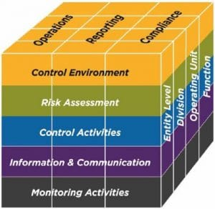
COSO Internal Control Framework
Notes:
1st published in 1992 (did not include 17 principles) and gained greater acceptance following the fiscal issues presented in the 2000s. The current COSO model was published in 2013. COSO = Committee of Sponsoring Organizations of the Treadway Commission. Five facing components with 17 underlying principles. A lack of one of the principles can significantly impact the entire system.
Who would use the Green Book model?
1. those who manage programs for federal, state or local government;
2. Those who conduct a performance audit or a financial audit; and
3. A person responsible for making sure that personnel follow policies and procedures related to any and all job responsibilities.

Slide 11
Five Components of Internal Controls
Control Environment - Discipline & structure to assist in the achievement of objectives
Risk Assessment - Basis for developing appropriate responses to identified risks in achieving objectives
Control Activities - Actions established through policies and procedures designed to achieve objectives and respond to risks
Information & Communication - Ensures the quality of internal and external information sharing
Monitoring - Designed to assess the quality of performance over time and promptly resolve the findings of audits and other reviews

Slide 12
Control Environment
Notes:
If an organization lacks the principles of control environment (foundation of an internal control system), the best-designed process controls may not likely be executed effectively. This step establishes the culture, values and expectations of your organization.

Slide 13
Control Environment
Five Principles
Demonstrate Commitment to Integrity & Ethical Values Tone at the Top - standards of conduct & adherence to standards of conduct
Exercise Oversight Responsibility - oversight structure, Internal Control System and input for remediation of deficiencies
Demonstrate Commitment to Competence -Expectations of Competence - recruitment, staff development and retention as well as succession & contingency planning
Enforce Accountability – Management takes defined action to address violations of policy, procedures, and codes of conduct
Establish Structure, Responsibility, & Authority Organizational Structure – assignment of roles, delegation of authority and documentation of the internal control system

Slide 14
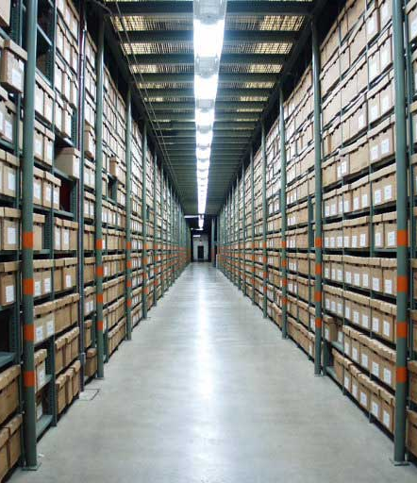
Example of weak control environment
An audit of a grantee found deficiencies in six of seven contracts reviewed. Problems included insufficient evidence that contracts were adequately competed, missing contract forms and provisions, lack of justification supporting sole-source contracts, and board of commissioners’ approvals signed after contract execution or missing. Further, auditors discovered that forms were added to the contract files after the request to review them and evidenced the use of correction fluid to conceal the date printed. The executive director acknowledged that the former purchasing director removed files from the organization. The executive director decided to create or reproduce the documentation before giving the files to the auditor.
This Photo by Unknown Author is licensed under CC BY-ND
Notes:
The audit recommended referral of the executive director to HUD’s Departmental Enforcement Center for appropriate action regarding the questionable ethical conduct.
This is an example of what can occur when an agency does not have policies concerning documentation, record archival, and removal of official records from the office.

Slide 15
Risk Assessment

Slide 16
Risk Assessment
Four Principles
Define Objectives & Risk Tolerance - Discipline & structure to assist in the achievement of objectives
Identify, Analyze & Respond to Risks - Basis for developing appropriate responses to identified risks in achieving objectives
Assess Fraud Risk - Actions established through policies and procedures designed to achieve objectives and respond to risks
Identify, Analyze & Respond to Change - Ensures the quality of internal and external information sharing
Notes:
Management needs to define and establish clear objectives that enable the identification of risks and define risk tolerances, they should identify, analyze and respond to the risks, consider the potential for fraud when identifying, analyzing and responding to risks. Management needs to respond to significant changes that could impact the entire system.

Slide 17
Enterprise Risk Management

Slide 18
Examples of Risk in Governance
Weak leadership resulting in lack of risk identification (ignoring management problems)
Missed or unclear project goals
Pressure on staff that undercuts integrity
Ineligible project activities
Hiring for positions of trust without proper vetting
Weak organizational structure
Failure to monitor goals and finances

Slide 19
Examples of Financial Risks
Poor budget controls or poor accounting systems
Unsupported payments
Access to cash and accounting records
Purchase or travel card abuse
Contractor billing issues
Allowing conditions for embezzlement & or other financial fraud

Slide 20
Examples of Risks in Operations
Human capital problems (hiring, performance, training, diversity issues, etc.)
Information technology issues (Equipment systems, programs, etc.)
Poor recordkeeping
Untimely or inaccurate reports and communications
Lack of quality control processes
Contractor performance issues
Lack of or outdated policies and/or procedures

Slide 21
Examples of Legal & Compliance Risks
Ignoring audit or monitoring findings
Lack of awareness of rules and regulations
Lawsuits and health & safety issues
Allowance for discriminatory practices
Faulty procurement processes
Federal law violations
Conflicts of interest
Data security and privacy issues
Inadequate monitoring of sub-awardees

Slide 22
Examples Stakeholder Risks
Congressional funding and passage of new laws
New state and/or local laws
New Federal regulations
Political pressures
Citizen/customer complaints
Bad publicity posing reputational risks

Slide 23
Examples Physical Environment Risks
Poor safeguarding of physical assets (buildings, equipment, etc.) from loss, damage, and theft
Physical location risks – Natural disasters, Super fund site, Flood prone site, Economically depressed site
Distances to sites
Access difficulties
Deteriorating or aging assets (buildings, equipment, and infrastructure)

Slide 24
1 – Lack of a formal process 2 – Lack of clearly defined and accepted risk levels 3 – Timing of assessment(s) 4 – Team member representation 5 – Lack of authority to impact change
Possible reasons for risk assessment failures
https://blog.creativesafetysupply.com/5-most-common-reasons-why-risk-assessments-fail/

Slide 25
Control Activities

Slide 26
Control Activities
Three Principles
Design control Activities – Response
Design of Appropriate Types of Control Activities at various Levels (Segregation of Duties)
Design Activities for the Information System - Appropriate Types of Control Activities, IT Infrastructure, Security Management, and Technology Acquisition, Development, and Maintenance
Implement Control Activities – Documentation of responsibilities through local policies and periodic reviews of control activities

Slide 27
Control Activities Example
A grantee city spent $284,649 in program funds on projects that did not have required executed written agreements with its internal departments and subrecipients. Agreements or memorandums of understanding for these projects should have included the purpose statements and the national objectives they would meet. This condition occurred because the city did not have internal controls to ensure that internal departments and subrecipients signed agreements before spending program funds. The lack of agreements kept the city from having the authority to monitor the work.
Notes:
The city should have had written policies and checklists to ensure that it had agreements or memorandums of understanding for these projects in place and should have included the purpose statements and the national objectives the projects would meet. It also should have had controls over spending to ensure that program staff could not spend funds before signed agreements were properly in place.

Slide 28
Information & Communication

Slide 29
Information and Communication
Three Principles
Use Quality Information
Identification of Information Requirements; Relevant Data from Reliable Sources; Data Processed into Quality Information
Communicate Internally - Communication throughout the agency
Control Activities - Communication with external parties and feedback gained from recipients of services.

Slide 30
Information & Communication Example
Seven years after a local government grantee got $10 million in Federal money to build a cemetery and bus station, neither had been completed. Local authorities claimed they had no documentation about the projects, such as approved work drawings and as-built plans. The local government said it had no information about its own decisions because contractors had the only copies of the paperwork and were holding them for “ransom.” The contractors said they did not cooperate because the local government had not paid them for completed work

Slide 31
Monitoring

Slide 32
Monitoring
Two Principles
Perform Monitoring Activities
Establishment of a baseline Internal Control System Monitoring
Evaluate Issues & Remediate Deficiencies
Reporting and evaluation of issues; Corrective Actions

Slide 33
Monitoring Example
An audit noted that a grantee had inadequate management oversight of its property and financial records. In addition, the grantee lacked adequate policies, procedures, and internal controls governing the use of vehicles, cellular phones, and credit cards. Staff regularly used these assets for personal activities. Paperwork was incomplete and supervisory review was nonexistent. Factors contributing to this noncompliance were the board of commissioners' failure to exercise its leadership and monitoring function.
Notes:
The board or other leadership should have had policies and procedures for the review and approval of expenses and use of assets. They should also have had a means to check that these controls were working through spot checks or other independent means such as audits. If management had monitored expenditure reports, it would have been alerted to the unauthorized spending.

Slide 34
Review of Internal Controls
Additional Thoughts
Notes:
How are these concepts incorporated in current processes? How often are controls & processes reviewed? What innovations and improvements in technology could improve processes?

Slide 35
The Uniform Guidance over federal grants, Section 200.303 mandates that a recipient of federal funds must “establish and maintain effective internal control over the federal award…” and “evaluate and monitor the nonfederal entity’s compliance with statute, regulations and the terms and condition of federal awards.”
Legislative mandates
This Photo by Unknown Author is licensed under CC BY-NC-ND

Slide 36
Additional Considerations
Senior management establishes line managers who self assess the controls and/or implement a monitoring function (quality assurance/internal audit group) to test and confirm that controls are operating as designed.
Assessments of internal controls can identify opportunities to revise controls and/or processes which are redundant and could be streamlined
Annual reviews could indicate areas that would benefit from the use of new and innovative technologies

Slide 37
Local Workforce Development Board Check Review
Expectations

Slide 38
Information Request
List of the Program Year expenditures generated by the fiscal agent functionary
Copies of the completed Statements of Financial Interest forms (all are due May 1 for LWDB staff directors and senior-level fiscal agent personnel at the LWDB office possessing the authority to review or approve expenditures or the allocation of funds
All timesheets and payroll documentation for LWDB staff, which shows distribution of time and pay across program and administrative funding streams (annual salary for calendar year)
A completed copy of the Oversight Separation of Duties worksheet
A copy of the most recent single audit report

Slide 39
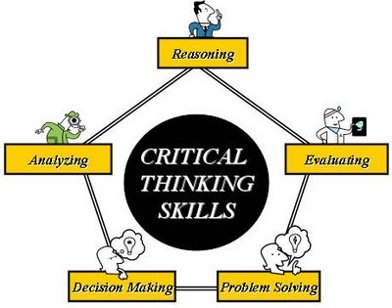
Check Review
Using the list of expenditures sent by the fiscal agent, the analyst will select a variety of local WIOA expenditures
All supporting documentation for chosen expenditures will be reviewed identifying reasonable, necessary, allowable, and appropriate allocation (program vs. administrative)
At least one check will be chosen for tracing of expenditures
This Photo by Unknown Author is licensed under CC BY-SA-NC

Slide 40
Payment Review
General Ledger & Cost Allocation – Review listed items and identify a sample selection to review for follow-up. Review cost allocation statistics to ensure costs are in accordance with the cost allocation plan.
Payroll & Personnel – Review payroll maintenance of records to verify salary, bonuses, performance bonuses, raises and benefit costs are approved, reasonable, necessary and allocable.
Gain an understanding of the internal control processes in order to assess whether controls reasonably assure compliance with federal, state, and local laws, regulations, and policies.
Review salary and bouses paid to employees and charged to grant programs adhere to established salary and bonus CAP
Determine if transactions comply with the appropriate federal, state and local procurement laws and policies
Review local monitoring activities to ensure compliance with federal, state and local laws and policies
Notes:
“Connecting the dots” – Show FSR Review worksheet. We are monitors and NOT auditors. We are reviewing costs as they align with the Uniform Guidance 200.320.

Slide 41
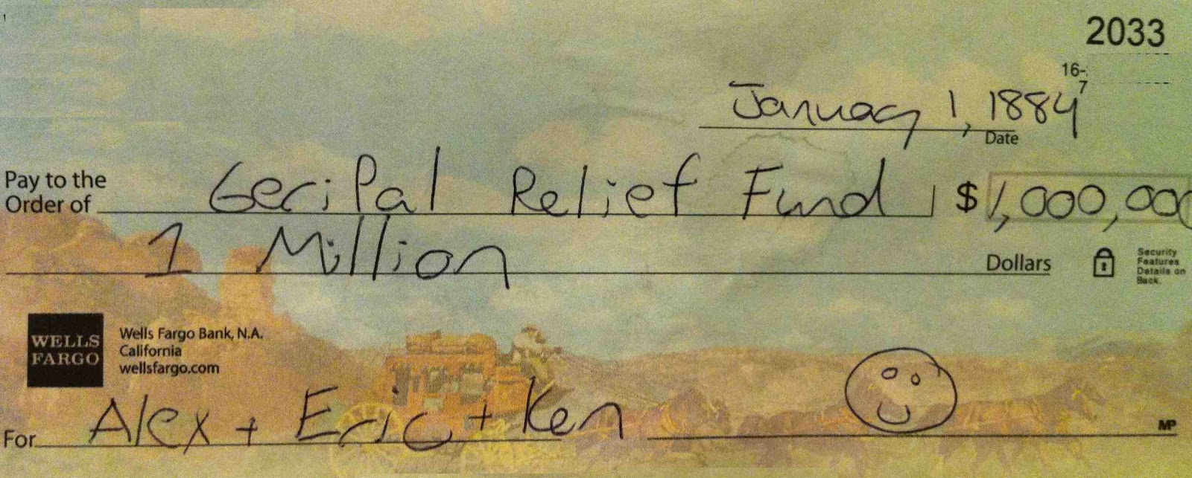
Tracing Expenditures
Oversight analyst will choose at least one check for focused review
The fiscal agent functionary will provide a step-by-step approach used to trace individual costs
Trace from expenditure back to Request for Funds (RFF)
Trace to the Financial Status Report (FSR)
This Photo by Unknown Author is licensed under CC BY-SA

Slide 42
Example of Check Review Worksheet
Check/Payment Number | Dates of Service/Goods Received | Date Invoice Received | Date of Check/ Payment | Date of CWDS RFF | Date of CWDS FSR | Payee | Amount | Program/ Admin | Date reported as Obligation (If Applicable)
Comments:

Slide 43
Fiscal Controls
All invoices must provide sufficient documentation PRIOR to requesting funds
“Sufficient documentation” for time must include the following: date(s) of service, hour(s) of service, and a complete description of the work performed.
Documentation MUST include the level of detail necessary to justify funds are allocated appropriately and as required under the law.
Evidence of management controls through separation of duties. Whenever possible, different individuals are completing each of the steps – initiating purchases, approving payments, signing checks, and updating financial records.
Separation is required between the following activities:
1. Initiation / Approval of transactions
2. Preparation / Approval of financial records
3. Reconciliation / Recordkeeping functions
Notes:
If only minimal separation of fiscal duties can be achieved, specific compensating controls must be in place and adequately documented. Those grantees with smaller staffing levels must implement compensating controls to ensure an adequate separation exists within its financial processes. The compensating control can be as simple as requiring additional reviews and approvals at different times during each process. For example, with the accounts payable process, a grantee with limited staff could implement a review step between the processing of the invoices, printing of the checks, and application of signatures.

Slide 44
Questions/Thoughts

Slide 45
Federal Legislation Reference
2 CFR Part 200 - https://www.ecfr.gov/current/title-2/part-200
Title 2 Subtitle A Chapter II Part 200 Subpart D § 200.303 Internal controls – https://www.ecfr.gov/current/title-2/section-200.303
§ 200.507 Program-specific audits – https://www.ecfr.gov/current/title-2/section-200.507
§ 207.8 Management cost funding oversight - https://www.ecfr.gov/current/title-44/section-207.8
Title 20 Chapter V Part 618 Subpart H § 618.860 General fiscal and administrative requirements and cost classification - https://www.ecfr.gov/current/title-20/section-618.860
Title 20 Chapter 5 Part 683 Subpart B § 683.220 Internal controls - eCFR :: 20 CFR 683.220 -- What are the internal controls requirements for recipients and subrecipients of Workforce Innovation and Opportunity Act title I and Wagner-Peyser Act funds?
Title 45 Subtitle A Subchapter C Part 164 Subpart C § 164.308 - eCFR :: 45 CFR 164.308 -- Administrative safeguards.
Title 29 Subtitle A Part 97 Subpart B § 97.12 - eCFR :: 29 CFR 97.12 -- Special grant or subgrant conditions for “high-risk” grantees.
Title 20 Chapter V Part 679 Subpart C - eCFR :: 20 CFR Part 679 Subpart C -- Local Workforce Development Boards

Slide 46
Federal Memorandum References
OMB Circular No. A-123 “Management Accountability and Control” – (March 13, 1995) 95-6024.pdf (govinfo.gov) ; (December 21, 2004) OMB Circular A-123 Revised (archives.gov) ; (December 21, 2004) OMB Circular A-123 - Management's Responsibility for Internal Control | The White House (archives.gov)
OMB Circular A-123 “Implementation Guide” (July 2005) - Implementation Guid for OMB Circular A-123 (whitehouse.gov)
Memorandum to the Heads of Executive Departments & Agencies – Appendix A, Management of Reporting and Data Integrity Risk – (June 6, 2018) M-18-16 (aferm.org)
Memorandum to the Heads of the Executive Departments & Agencies – OMB Circular No. A-123, Management’s Responsibility for Enterprise Risk Management and Internal Control (July 15, 2016) - ReviewerDoc-1-2016-OFFM-430-Final-Review-Round-2To-Email-1.docx (whitehouse.gov)
Memorandum to the Heads of Executive Departments & Agencies – Reducing Burden for Federal Agencies by Rescinding and Modifying OMB Memoranda (June 15, 2017) - Modified - Financial Management: (whitehouse.gov)
Memorandum to the Heads of Executive Departments & Agencies – Transmittal of Appendix C to OMB Circular A-123, Requirements for Payment Integrity Improvement (June 26, 2018) - M-l8-20 (whitehouse.gov)

Slide 47
Commonwealth References
Internal Control Management and Evaluation Tool (August 2001) - GAO-01-1008G Internal Control Management and Evaluation Tool
Workforce System Policy (WSP) No. 183-01 (C1) – Administration, Oversight and Monitoring (April 15, 2019) - WSP No. 183-01 (C1).pdf (pa.gov)
Workforce System Policy (WSP) No. 03-2015, December 22, 2015 – Financial Management Policy - WSP 03-2015.pdf (pa.gov)
Financial Management Guide (FMG – 2021) - Financial-Management-Guide-2021.pdf (pa.gov)
Workforce System Policy (WSP) No. 184-02 (Change 1) - WSP-No-184-02-Sanctions-Change-1.pdf (pa.gov)

Slide 48
Additional references
How to do a Green Book assessment of your internal controls (March 2018) - How to do a Green Book assessment of your internal controls (kpmg.us)
Integrity Bulletin, U.S. Department of Housing and Urban Development Office of Inspector General – (Fall 2016) Internal Controls Integrity Bulletin CPD.pdf (hudoig.gov)
Internal Control Management and Evaluation Tool (August 2001) - GAO-01-1008G Internal Control Management and Evaluation Tool
Ferraro, T., 5 Most Common Reasons Why Risk Assessments Fail | Creative Safety Supply Blog, September 26, 2014

Slide 49
Example Risk Assessments
Federal Financial Institutions Examination Council (FFIEC) - FFIEC_CAT_May_2017_Inherent_Risk_Profile.pdf
Housing & Urban Development (HUD) - IC_QUESTIONNAIRE_ATOOL.PDF (hud.gov)
Almeda County, CA - AppendixB-InternalControlQuestionnaires.pdf (acgov.org)
University of Southern Indiana (USI) - Microsoft Word - Internal Controls Questionnaire.docx (usi.edu)
Florida Dept. of Economic Opportunity - 2019-20-icq-and-assessment.pdf (floridajobs.org)

