Slide 1
WORKPLACE VIOLENCE
Bureau of Workers’ Compensation
PA Training for Health & Safety (PATHS)
Notes:
According to the Bureau of Labor Statistics, “Workplace violence is a serious recognized occupational hazard, ranking among the top four (4) causes of death in workplaces during the past 15 years. More than 3,000 people died from workplace homicide between 2006 and 2010.”
This same study indicated “an average of more than 15,000 nonfatal workplace injury cases were reported annually during this time.”
(http://workplaceviolenceawareness.org/)

Slide 2
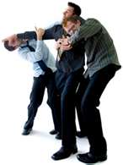
Workplace Violence - Defined
A violent act (or acts) including physical assaults and threats of assaults directed towards a person/persons at work or while on duty*
*CDC/NIOSH, Occupational Hazards, 2002
Notes:
The definition of Workplace Violence according to the Center for Disease Control (CDC) would be:
“A violent act (or acts) including physical assaults and threats of assaults directed towards a person/persons at work or while on duty.”
(CDC/NIOSH, Occupational Hazards, 2002)

Slide 3
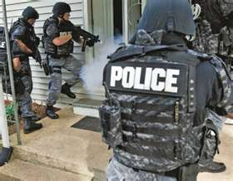
Those at Risk
Some 2 million American workers are victims of workplace violence each year. In particular:
- Those who work in high crime areas (groceries, pharmacies, gas stations)
Notes:
Persons at risk to workplace violence is based on location, jobs which interact with the public, and the likelihood of opportunity.
Some 2 million American workers are victims of workplace violence each year. In particular:
-Those who work in high crime areas, for example, groceries, pharmacies, gas stations)
“Bureau of Labor Statistics measured fatal and nonfatal statistics for 1992 to 2010. Of the 13,827 workplace homicide victims, the largest number occurred in 1994 (1,080) with the lowest number of 518 in 2010. From 2003 to 2010, over half of the workplace homicides occurred within three occupation classifications:
Sales and related occupations (28%)
Protective service occupations (17%) and
Transportation and material moving occupations (13%)”
(http://www.cdc.gov/niosh/topics.violence/

Slide 4
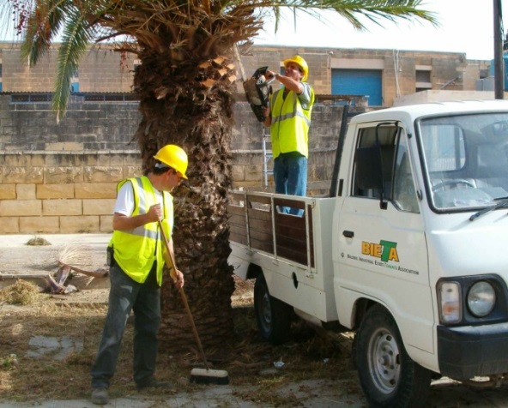
Those at Risk
Community workers (utility, cable TV, telephone, mail carriers, taxi and bus drivers)
Notes:
“…More than 137,000 workers were treated in emergency departments for nonfatal assaults in 2009.”
The population grouping included:
Community workers (utility, cable TV, telephone, mail carriers, taxi and bus drivers)
http://www.cdc.gov/niosh/topics.violence/

Slide 5
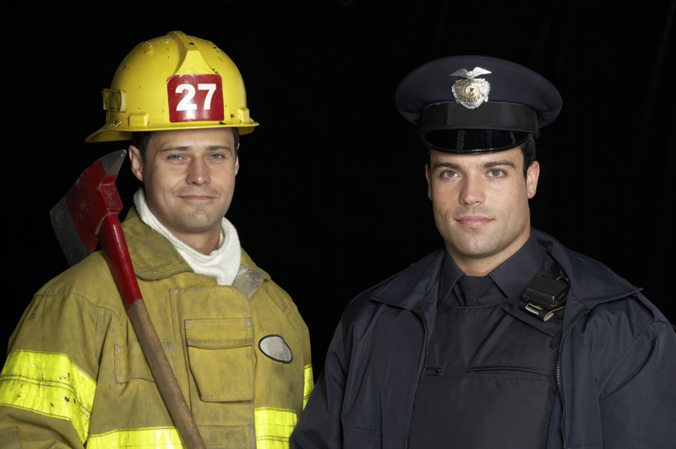
Those at Risk
Others at risk include:
- Emergency response personnel
(police, fire, ambulance, volunteers)
Notes:
Others at risk are those who, by their duties, interact with the public during chaotic situations such as those interjecting themselves into incidents where strife and disagreement are already ongoing. This includes law enforcement, fire fighters, and ambulance personnel.
Volunteers may become victimized by persons intruding into their work environment with bad attitudes, prejudices or political agendas.

Slide 6
Data and Statistics
Men and women working in government have greater number and higher rate of assaults than private sector employees
Assaults against women working in state government is 8.6 times higher than women in the private sector*
*National Crime Victimization Survey, BLS
Notes:
Men and women working in government have a greater number and higher rate of assaults than private sector employees.
Assaults against women working in state government is 8.6 times higher than women in the private sector. This may stem from the fact
that females may be seen as a weaker “target.”
“National Crime Victimization Survey estimated the number of nonfatal violent crimes occurring against persons 16 or older while they were at work in 2009 at 572,000.”
http://www.cdc.gov/niosh/topics.violence/

Slide 7
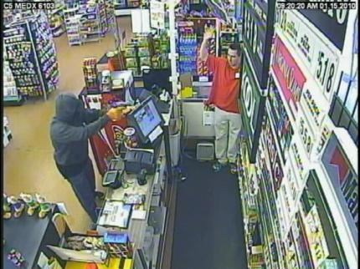
Types of Workplace Violence
Stranger violence – has no business relationship with the workplace
Notes:
Stranger violence – has no business relationship with the workplace
Criminal activity, crimes of opportunity, “rip and run” operations make it easier to victimize due to hours of operation, usually only 1 person is on duty and the neighborhoods where persons work.

Slide 8
Types of Workplace Violence
Client/Customer violence – recipient of, or providing a service to the workplace
Notes:
Client/Customer violence may erupt due to misunderstandings, preconceived notions by a complainant of what is “owed to them” by the agency.

Slide 9
Types of Workplace Violence
Employee violence – related to the workplace (may also be ex-employee or associate of an employee)
Notes:
Bullying can also be included in such violence. “Ninety-six % (96%) of American employees experience bullying in the workplace.”
“Responses of 2,283 people and the results indicate:
96% say they have experienced workplace bullying
89% of those bullies have been at it for more than a year
54% have been bullying for more than five (5) years
80% of bullies affect five (5) or more people.”
(“What Workplace Bullying Looks Like in 2014—And How To Intervene,” Forbes: http://www.forbes.com/sites.naomishaving/2014/06/25/what-workplace-bullying-looks-like)

Slide 10
Types of Workplace Violence
Domestic violence – related to employee (family member, spouse, or partner, significant other)
Notes:
Domestic violence is related to violence between an employee and a family member, spouse, partner, or significant other.
Home violence can intrude the workplace from a psychological standpoint; the violated brings the impact of their home confrontation to work.
It is also common for a domestic partner to show-up at a workplace to continue their verbal or physical assaults on their partner.

Slide 11
Examples of Workplace Violence
Threats – intent to cause physical harm
- Verbal (in person or by telephone)
Notes:
Threats are an intent to cause physical harm either verbally or remotely by phone or device.
Of 2,283 respondents to a bullying survey:
“62% saw sabotaging of others’ work or reputations
52% saw browbeating, threats, or intimidation
4% saw physical intimidation or assault”
(“What Workplace Bullying Looks Like in 2014—And How To Intervene,” Forbes: http://www.forbes.com/sites.naomishaving/2014/06/25/what-workplace-bullying-looks-like)

Slide 12
Examples of Workplace Violence
Threats
Written (by letter, by fax, or by e-mail)
Notes:
Written threats are usually used by a coward who fears a face-to-face confrontation; these threats are generated to ruin reputations or make unfounded accusations.
Company policies should address employee actions upon receipt of such threats. As an example:
TELEPHONED SUICIDE OR BOMB THREATS
Stay calm. Keep talking
Do not hang up
Signal a coworker or supervisor to contact security personnel
Ask the caller to repeat the message; write it down
For a bomb threat, ask where it is and when it will go off; repeat these questions if necessary
Listen for background noises; write down what you hear
Write down whether it is a man or a woman; pitch or tone of voice or accent; anything you notice
Try to get the caller's name, location, and phone number
http://www.usgs.gov/humancapital/hr/wvhappendix1.html

Slide 13
Examples of Workplace Violence
Intimidation/Harassment
Psychological – making statements that are:
- False - Disrespectful
- Malicious - Abusive
- Disparaging - Obnoxious
- Derogatory - Insubordinate or
- Rude - With intent to hurt other’s reputation
Notes:
Intimidation and harassment are also included in the workplace violence repertoire.
The intent is to disrupt the psychological security of a person by making statements which may be false, derogatory, abusive or malicious to name but a few.

Slide 14
Examples of Workplace Violence
Intimidation/Harassment-Physical
Holding
Impeding
Blocking one’s movement
Following
Stalking
Touching
Any other inappropriate contact or advances
Notes:
Physical intimidation and harassment involve the invasion of what a work perceives to be his/her personal space.
Holding, blocking or impeding a person against their will. In some criminal codes such impeding can be construed as false arrest and, if it persists, may be determined to be false imprisonment.
The need for administrative policies and against such actions are warranted to guard not only the employee but the reputation of the agency.

Slide 15
Examples of Workplace Violence
Assault – causing physical or emotional injury, pain, or distress:
Hitting, slapping, punching, pushing, poking, and kicking
Notes:
Assaults may be viewed as causing physical or emotional injury, pain, or distress, such as hitting, slapping, punching, pushing, poking, and kicking.
Legally, assaults may be viewed as a verbal message to commit such an action with Battery being the action. Again, dependent upon the jurisdiction.

Slide 16
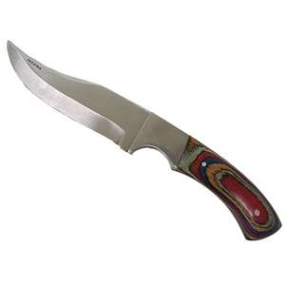
Examples of Workplace Violence
Assaults
Also shouting, name-calling, use of derogatory language
May include use of a firearm, bomb, or knife
Notes:
Assaults may also include shouting, name-calling or the use of derogatory language.
A deadly or dangerous weapon may be an instrument involved as well.
As the magnitude of the violence may increase, so, also, must the method to counteract it be able to escalate.
Businesses with a potential of having such occurrences must have access to immediate response by law enforcement.

Slide 17
Direct Effects of Violence
Minor or major physical injuries
Temporary or permanent physical disability
Psychological trauma
Death
Notes:
The direct effects of violence may be minor or major injuries resulting in either temporary or permanent physical disability.
The psychological trauma, in itself, may be the more debilitating result.
Also, depending upon the extent of the physical or psychological impact, death may result due to the injury or by the victim’s own hand in suicide.

Slide 18
Indirect Effects of Violence
Low worker morale
Increase in job stress
Notes:
Indirect effects of violence may lead to low worker morale especially if the situation was reported through the proper network and no action was taken.
People will think they’re under a double standard; that the justice they’re seeking is not forthcoming.
This can lead to an increase in job stress wondering when the next attack will come and in what fashion.
In some cases, workers take things into their own hands since management seems unwilling or unable to handle the situation.

Slide 19
Indirect Effects of Violence
Increase in worker turnover
Reduced trust of management/co-workers
A hostile work environment
Notes:
Unresolved violence can indirectly lead to an increase in worker turnover; reduced trust of management and coworkers, and a hostile work environment.
Management needs to ask itself if the integrity and operation of the company can stand being held captive to such actions by supervisors or coworkers.

Slide 20
Risk Factors
Working with volatile people (those under the influence of alcohol or drugs, have a history of violence, have been diagnosed as psychotic)
Working when understaffed/working alone
Notes:
The risk factors when a variety of persons and personality types come together in a work environment are as numerous as the personality types.
Risks may be increased by introducing other variables into workplace dynamics. These may include:
Working with volatile people (those under the influence of alcohol or drugs, with a history of violence, or who have been diagnosed as psychotic)
Working when understaffed or working alone can only compound the potential of a problem.

Slide 21
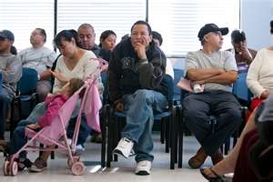
Risk Factors
Waiting a long time for service (e.g. DMV)
Overcrowded waiting rooms
Notes:
The environment may also be a risk factor.
Waiting in a long line, or waiting for a long time for service can be a real test on patience.
Add overcrowding to the mix and the situation could become volatile.

Slide 22
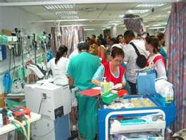
Risk Factors
Poorly lit areas (parking lots, corridors)
Inadequate security
Unrestricted movement of the public
Notes:
The engineered design or lack thereof may also serve as a possible risk factor.
Poorly lit areas such as parking lots, or corridors
Inadequate security
Unrestricted movement of the public
Each or all may provide an opportunity for a violence scenario.

Slide 23
Signals
Verbally expressed anger or frustration
Body language/threatening gestures
Signs of alcohol or drug use
Presence of a weapon (firearm, knife, etc.)
Notes:
Some possible risk signals to watch for in your work environment may include:
1. Verbally expressed anger or frustration
2. Body language and/or threatening gestures
3. Signs of alcohol or substance abuse
4. The presence of a weapon such as a knife or firearm.

Slide 24
How to Prevent Violence
Develop a comprehensive prevention program, which includes:
Zero tolerance policy
Management commitment/enforcement
Notes:
If we can prevent violence, we reduce the costs and damages on our staff and facility. However, even the best intentioned agency may fall short by not utilizing policies it has created.
51% of the group of 2,283 survey respondents indicated their “company had a policy dealing with how to respond to bullies and only 7% know of anyone who ever used that policy.”
“Some 20% of survey responders reported … workplace bullying cost them upwards of seven (7) hours a week, which the study valued at $8,800 in lost annual wages.”
As indicated by the Forbes article: “Silence is not gold-Silence is permission.”
Construct policies against workplace violence, train staff on the policy and use it when necessary!
(“What Workplace Bullying Looks Like in 2014—And How To Intervene,” Forbes: http://www.forbes.com/sites.naomishaving/2014/06/25/what-workplace-bullying-looks-like)

Slide 25
How to Prevent Violence
Employee participation
Hazard identification
Training
Hazard prevention
Accurate and timely reporting
Notes:
Preventing Violence requires the input and involvement of your staff. They’re closest to situations which may breed workplace violence.
Train each on hazard identification, stressful situations and past episodes where violence was actual or a real possibility.
Determine means of workplace violence prevention and structure the administrative reporting system. As an example:
For a person shouting, swearing, and threatening
Signal a coworker or supervisor that you need help
Have someone call security personnel
Do not make any calls yourself
Avoid statements and/or behaviors that could escalate the individual's threatening statements/behavior
http://www.usgs.gov/humancapital/hr/wvhappendix1.html

Slide 26
Workplace Violence
Prevention Training
Should include the following:
Review of facility’s relevant policies
Techniques to de-escalate/minimize violent behavior
Prohibited actions and consequences
Reporting requirements/procedures
Location/operation of safety devices
Resources to cope with post-incidents
Notes:
Workplace Violence Prevention Training should include, at a minimum, the following topic areas:
Facility’s relevant policies
Techniques to de-escalate/minimize violent behavior
Prohibited actions and consequences
Reporting requirements and procedures
Location and operation of safety deices
Resources to copy with post-incidents

Slide 27
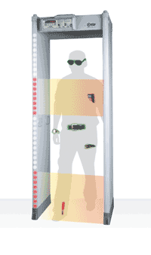
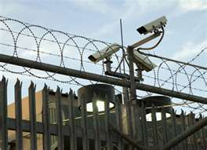
Prevention Strategies
Engineering - Installation of:
Emergency alarms
Signaling and monitoring systems
Security devices (metal detectors, cameras)
Better lighting
Bulletproof/shatterproof glass enclosures at reception areas
Notes:
Some prevention strategies may include adopting engineered safeguards. For some establishments, the costs are often prohibitive. Some engineered safeguards some businesses include in their physical plant would be:
1. Emergency alarms
2. Signaling and monitoring systems
3. Security devices such as cameras and metal detectors
4. Better lighting, and
5. Bulletproof or shatterproof glass enclosures at reception areas.

Slide 28
Prevention Strategies
Changing Behavior
Creating ”buddy system”
Providing security escorts to parking lots
Preventing personnel from working alone
Restricting movement of public using controlled access cards
Training in hazard awareness, resolving conflicts, recognizing potential signs
Make counseling available to reduce worker’s fear
Having open communication with workers
Notes:
In addition to engineered safeguards, individuals or groups depending upon the environment, time of day or seasonal conditions may consider :
Buddy systems ensure people aren’t vulnerable due to being alone.
Restricting non-employee access on the premises to guard against physical contact as well as possible thefts.
Counsel and provide training on security measures to reduce employee fear.

Slide 29
Prevention Strategies
Administrative controls:
Comprehensive written procedures for reporting and for responding to occurrences
Enforce zero tolerance policy
Update program as necessary
(continuous improvement)
Notes:
Remember:
Administrative controls construct and enforce a zero tolerance to workplace violence.
Policies provide contact names and numbers should an event occur.
Updating of the program should be done on a periodic or as-needed basis.

Slide 30
What to Do
Present a calm, caring attitude
Don’t match the threat
Don’t give orders
Acknowledge what the person feels
Avoid aggressive behavior
Notes:
In summary, your actions if approached or confronted with a possible workplace violence event;
Present a calm, caring attitude
Don’t match the threat
Don’t give orders
Acknowledge what the person feels
Avoid aggressive behavior

Slide 31
Other Preventive Actions
Evaluate each situation
Be vigilant, alert of your surroundings
Do not isolate yourself
Always keep an open path for exiting
Notes:
Evaluate each situation
Be vigilant and alert to your surroundings
Do not isolate yourself-leave yourself a means of escape
Example:
For an angry or hostile encounter
Stay calm by taking deep, slow breaths
Listen attentively
Maintain eye contact
Be courteous and patient
Keep the situation in your control
Maintain a calm, quiet tone of voice
Attempt to avoid arguing or making statements that might intensify the individual's angry or hostile demeanor
http://www.usgs.gov/humancapital/hr/wvhappendix1.html

Slide 32
If Situation Can’t be Defused
Remove yourself from the situation
Call security for help
Report any violent situations to management
For someone with a weapon:
Stay calm - Maintain eye contact
Stall for time
Keep talking...but follow instructions of the person with the weapon
Don’t risk harm to yourself or others
Never try to be a hero or try to grab a weapon
Watch for an opportunity to escape safely
Notes:
If a situation can’t be defused:
Remove yourself from the situation,
Call security for help,
Report any violent situations to management
For someone with a weapon
Stay calm - Maintain eye contact
Stall for time
Keep talking...but follow instructions of the person with the weapon
Don’t risk harm to yourself or others
Never try to be a hero or try to grab a weapon
Watch for an opportunity to escape safely

Slide 33
References
Occupational Safety and Health Administration
www.osha.gov
Center for Disease Control/National Institute for Occupational Safety and Health
www.cdc.gov
National Safety Council
www.nsc.org
Notes:
Here are some references for workplace violence that you can
Occupational Safety and Health Administration
www.osha.gov
Center for Disease Control/National Institute for Occupational Safety and Health
www.cdc.gov
National Safety Council
www.nsc.org
use:

Slide 34
References
Commonwealth Management Directive 205.33
Building a Safe Workplace: Preventing Workplace Violence – United Behavioral Health & The Commonwealth of PA
Notes:
Further references include:
Commonwealth Management Directive 205.33
Building a Safe Workplace: Preventing Workplace Violence – United Behavioral Health & The Commonwealth of PA

Slide 35
References
http://workplaceviolenceawareness.org/
CDC/NIOSH, Occupational Hazards, 2002
“What Workplace Bullying Looks Like in 2014—And How To Intervene,” Forbes: http://www.forbes.com/sites.naomishaving/2014/06/25/what-workplace-bullying-looks-like
http://www.usgs.gov/humancapital/hr/wvhappendix1.html
(action checklist)
http://forms.uno.edu/PDF/Violence%20Checklist.pdf

Slide 36
Contact Information
Health & Safety Training Specialists
1171 South Cameron Street, Room 324
Harrisburg, PA 17104-2501
(717) 772-1635
RA-LI-BWC-PATHS@pa.gov
Like us on Facebook! - https://www.facebook.com/BWCPATHS

Slide 37
Questions

