Slide 1
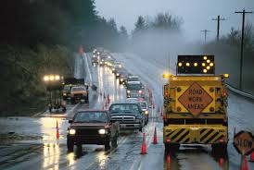
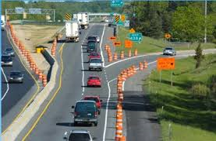
Work Zone Safety
Bureau of Workers’ Compensation
PA Training for Health & Safety (PATHS)
Notes:
Roadway work zones are hazardous both for motorists who drive through the complex array of signs, barrels, and lane changes and for workers who build, repair, and maintain our Nation’s streets, bridges, and highways. In a recent eleven year period Pennsylvania ranked third in the U.S. for the number of workers killed in a work zone.

Slide 2
Session Objectives
You will be able to:
• Recognize the hazards of flagging
• Identify different sections of a temporary
traffic control zone
• Understand the temporary traffic control
plan and your responsibilities
• Use signaling devices effectively
• Position warning signs, tapers, and
flagging stations safely
Notes:
During this session the following topics will be covered:
• Recognizing the hazards of flagging
• Identifying different sections of a temporary traffic control zone
• Understanding the temporary traffic control plan and your responsibilities
• Using signaling devices effectively
• Positioning warning signs, tapers, and flagging stations safely

Slide 3
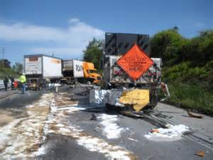
Work Zone Safety Statistics
More than 40,000 people are hurt in work zone crashes per year
There are almost three deaths per day that occur within work zones
Notes:
The statistics listed are certainly something that employees within work zones as well as drivers going through those zones need to be aware of and keep in mind. Injuries can occur very quickly and just one moment of reduced concentration can lead to a serious situation.

Slide 4
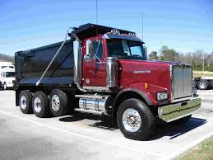
Roadway Workers’ Deaths
54% of fatalities occurred due to the worker being struck by a truck
36% were dump trucks
21% were pickup trucks
17% were semi-trailer, tractor trailer, or trailer trucks
26% were automobiles
Notes:
Here are more statistics to consider.

Slide 5
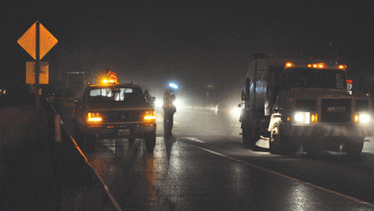
Struck By Objects
A frequent cause of disabling injuries and
fatalities in the road construction industry occur when workers are struck by:
Passing motorists
Construction vehicles
3. Equipment
Notes:
Passing motorists, construction vehicles and related equipment were frequent causes of disabling injuries and fatalities during road work.
According to PennDOT, there are approximately 1,800 work zone crashes resulting in 16 deaths and approximately 1,200 injuries each year within Pennsylvania. Out of those numbers approximately 48% of work zone crashes resulted in deaths or injuries.

Slide 6
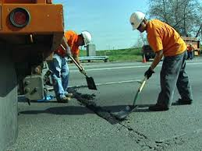
Activity Being Performed
Constructing
Repairing
Cleaning
Walking in or near a roadway
Directing or flagging
Resurfacing or blacktopping
Notes:
Some of the activities being performed when injuries or death occurred were:
Constructing
Repairing
Cleaning
Walking in or near a roadway
Directing or flagging
Resurfacing or blacktopping

Slide 7
Struck By Objects Prevention
Have policies that require mobile equipment operators to follow the safety instructions in the equipment operator’s manual
Conduct pre-work safety meetings each day to discuss the work on tap that day, the potential safety hazards, and safe work practices
Ensure that PPE such as high-visibility cloth is provided and used in accordance with company policy
Notes:
To prevent workers from being struck by objects an employer can:
Have policies that require mobile equipment operators to follow the safety instructions in the equipment operator’s manual
Conduct pre-work safety meetings each day to discuss the work on tap that day, the potential safety hazards, and safe work practices
Ensure that PPE such as high-visibility cloth is provided and used in accordance with company policy

Slide 8
Struck By Objects Prevention
Planning for safe operations within work zones
Safe operation of construction vehicles and equipment in highway/roadway work zones
Providing for the safety of workers on foot around traffic vehicles and construction vehicles
Compliance with the Manual on Uniform Traffic Control Devices (MUTCD)
Compliance with OSHA construction industry regulations (29CFR*1926, Subpart 0)
Struck By Objects Prevention
Notes:
In addition employers should consider:
Planning for safe operations within work zones
Safe operation of construction vehicles and equipment in highway/roadway work zones
Providing for the safety of workers on foot around traffic vehicles and construction vehicles
Compliance with the Manual on Uniform Traffic Control Devices (MUTCD)
Compliance with OSHA construction industry regulations (29CFR*1926, Subpart 0)

Slide 9
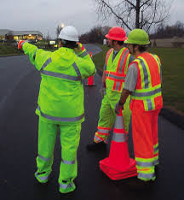
Work Zone Safety Considerations
Lighting
Visibility
Inclement weather
Congested areas
Constantly changing work conditions
Notes:
Some things to think about when looking at safety within a work zone include but are not limited to:
Lighting
Visibility
Inclement weather
Congested areas
Constantly changing work conditions

Slide 10
Traffic Control Principles
A prepared detailed plan appropriate to the complexity of the work project or incident and understood by all responsible parties
Individuals knowledgeable in principles of proper traffic control should be assigned responsibility for safety in the traffic control zone
As the work progresses and conditions change, the traffic control should be modified to provide reasonably safe and efficient road user movement and worker safety
Notes:
To ensure the safety of those working within a work zone some traffic control principles need to be adhered to:
A prepared detailed plan appropriate to the complexity of the work project or incident and understood by all responsible parties
Individuals knowledgeable in principles of proper traffic control should be assigned responsibility for safety in the traffic control zone
As the work progresses and conditions change, the traffic control should be modified to provide reasonably safe and efficient road user movement and worker safety

Slide 11
Traffic Control Awareness
Cover the nature of the work when there’s equipment used to communicate with motorists and pedestrians
Explain the duration of the project
Address anticipated effects on road users
Offer alternative routes of travel or modes of transportation
Notes:
When providing information for those who will be involved with traffic control information should be provided which will:
Cover the nature of the work when there’s equipment used to communicate with motorists and pedestrians
Explain the duration of the project
Address anticipated effects on road users
Offer alternative routes of travel or modes of transportation

Slide 12
Traffic Control
Depends on the type of highway
Driving conditions
Duration of operation
Physical constraints
The distance between the workspace and the drivers
Notes:
Traffic control:
Depends on the type of highway
Driving conditions
Duration of operation
Physical constraints
The distance between the workspace and the drivers

Slide 13
Internal Traffic Control Plan (ITCP)
Hazard Assessment Control Element
Schematic diagrams depicting the movement of construction workers and vehicles within the work space
A checklist of site-specific hazards with a description of how these hazards will be minimized, what procedures, safety equipment, and control strategies will be used
A reporting system for all close-calls and incidents related to internal traffic control plan
Notes:
An Internal Control Plan (ITCP) involves:
A hazard assessment control element –
Schematic diagrams depicting the movement of construction workers and vehicles within the work space
A checklist of site-specific hazards with a description of how these hazards will be minimized, what procedures, safety equipment, and control strategies will be used
A reporting system for all close-calls and incidents related to internal traffic control plan

Slide 14
Internal Traffic Control Plan (ITCP)
Hazard Assessment Control Element
A plan for safely handling intermittent traffic stoppages; e.g., for equipment turn-around
Anticipated traffic volume and speed, as well as speed limit for operation within the work space
Specifications for lighting inside the work space
Notes:
A hazard assessment control element also addresses:
A plan for safely handling intermittent traffic stoppages; e.g., for equipment turn-around
Anticipated traffic volume and speed, as well as speed limit for operation within the work space
Specifications for lighting inside the work space

Slide 15
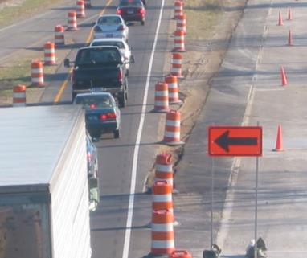
Temporary Traffic Control Plan (TTCP)
Four areas to consider:
Advance warning area
2. Transition area
Activity area
4. Termination area
Notes:
When developing a Temporary Traffic Control Plan (TTCP) there are four (4) areas to consider:
1. Advance warning area
2. Transition area
3. Activity area
4. Termination area

Slide 16
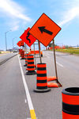
Temporary Traffic Control Plan (TTCP)
• Avoid abrupt lane changes
• Encourage alternate routes
• Schedule road work at night
• Provide adequate warning for motorists
• Use flagging to guide motorists
Notes:
A Temporary Traffic Control Plan should also:
• Avoid abrupt lane changes
• Encourage alternate routes
• Schedule road work at night
• Provide adequate warning for motorists
• Use flagging to guide motorists

Slide 17
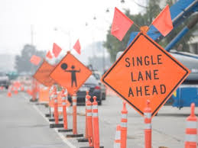
Advance Warning Area
• Road users informed
of work zone
• Warning sign corridors are
longer on freeways
• Sign A—
1,000 feet from transition
• Sign B—
1,500 feet from sign A
• Sign C—
2,500 feet from sign B
Notes:
When setting up an advance warning area consideration should be given to sign placement. The following procedures should be used:
• Road users informed of work zone
• Warning sign corridors are longer on freeways
• Sign A—
1,000 feet from transition
• Sign B—
1,500 feet from sign A
• Sign C—
2,500 feet from sign B

Slide 18
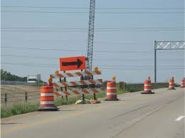
Transition Area
• Road users are redirected out of the normal path
• Mobile operations— transition area moves
• Tapers are used to transition traffic
• Space taper devices properly
Notes:
Within a transition area from “active roadway” to work zone:
• Road users are redirected out of the normal path
• Mobile operations— transition area moves
• Tapers are used to transition traffic
• Space taper devices properly

Slide 19
Activity Area
• Work space is for workers, equipment, and
material
• Traffic space routes and road uses through activity
area
• Buffer space separates road user flow from work
space
Notes:
Within an area where road work/construction activities are being performed:
• Work space is for workers, equipment, and material
• Traffic space routes and road uses through activity area
• Buffer space separates road user flow from work space

Slide 20
Termination Area
• Returns road users to normal path
• “END ROAD WORK” sign
• Longitudinal buffer and taper
Notes:
A road work zone termination area:
• Returns road users to normal path
• “END ROAD WORK” sign
• Longitudinal buffer and taper

Slide 21
Traffic Tapers
• Minimum taper length: L = WS
• Merging taper requires longest distance
• Shifting taper is used where shoulder is closed
• Downstream taper is used in termination area
Notes:
For three-lane roadways having a posted or statutory speed limit of 70 km/h (45 mph) or greater, the lane transition taper length should be computed by the formula L = 0.62 WS for speeds in km/h (L = WS for speeds in mph). For roadways where the posted or statutory speed limit is less than 70 km/h (45 mph), the formula L = WS²/155 for speeds in km/h (L = WS²/60 for speeds in mph) should be used to compute taper length. Under both formulas, L equals the taper length in meters (feet), W equals the width of the center lane or offset distance in meters (feet), and S equals the 85th-percentile speed or the posted or statutory speed limit, whichever is higher.
http://mutcd.fhwa.dot.gov/htm/2003r1r2/part3/part3b1.htm

Slide 22
Routine Inspections
• Implement traffic control plan properly
• Monitor plan under varying conditions
• Keep channelizing devices clean and reflective
• Check for missing traffic control devices
• Look for evidence of near misses
Notes:
When performing routine road/bridge inspections:
• Implement the traffic control plan properly
• Monitor the plan under varying conditions
• Keep channelizing devices clean and reflective
• Check for missing traffic control devices
• Look for evidence of near misses

Slide 23
Temporary Traffic Control Zones
Setup and Inspection
Need to understand:
• Advance warning area, transition area, activity area, termination area
• Importance of routine inspections in temporary traffic control zones
• What inspections should cover
Notes:
To ensure the safety of all concerned a temporary traffic control zone should be set up and then inspected.
When setting up and inspecting these areas those involved should have an understanding of:
• Advance warning areas, transition areas, activity areas, termination areas
• Importance of routine inspections in temporary traffic control zones
• What inspections should cover

Slide 24
Hazards of Flagging
• Risk from equipment and passing vehicles
• Statistics support high risk of injury
• More than 100 workers killed and 20,000
injured each year
• More motorists than workers killed or injured in temporary traffic control zones
Notes:
Being assigned as a “flagger” within a work zone can be one of the most hazardous jobs an employee can perform. Employees serving as flaggers should remember the following information:
• There is a risk from equipment and passing vehicles
• Statistics support a high risk of injury
• More than 100 workers killed and 20,000 injured each year
• More motorists than workers killed or injured in temporary traffic control zones

Slide 25
Flagger Responsibilities
Stop traffic
Reduce the speed of and/or direct traffic through the work zone
Protect yourself, work crew, the general public, motorists and pedestrians
Notes:
Some of the responsibilities an employee has when serving as a flagger include but are not limited to:
Stopping traffic
Reducing the speed of and/or direct traffic through the work zone
Protecting themselves, work crew, the general public, motorists and pedestrians

Slide 26
Criteria for Flaggers
Criteria for Flaggers
You are responsible for public safety and must:
• Communicate instructions clearly
• Maneuver quickly
• Control signaling devices
• Understand safety traffic control
Notes:
Since a flagger is responsible for public safety they must:
• Communicate instructions clearly
• Maneuver quickly
• Control signaling devices
• Understand safety traffic control

Slide 27
Criteria for Flaggers
Recognize dangerous traffic situations
Know the traffic control plan
Be identified as flaggers by motorists
Notes:
Flaggers must also:
Recognize dangerous traffic situations
Know the traffic control plan
Be identified as flaggers by motorists

Slide 28
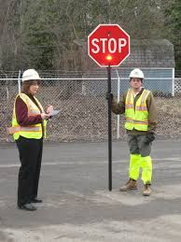
Flagger Authority
• Monitor operations in the work area
• Communicate with traffic control supervisor
• Halt operations if hazard arises
Notes:
A flagger has the authority to:
• Monitor operations in the work area
• Communicate with traffic control supervisor
• Halt operations if hazard arises

Slide 29
Flagger Stations
• Position
• Signals
• Approaching the centerline
• Release
• Leaving
Notes:
When at their “station” a flagger should take into account their:
• Position
• Signals
• Approaching the centerline
• Release
• Leaving

Slide 30
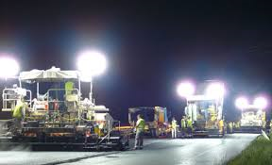
Flagger Stations
• Road users must have sufficient distance to stop
• Errant vehicle can stop before entering work space
• Advanced warning signs
• Lighted at night
Notes:
In addition flaggers should also ensure:
• That road users must have sufficient distance to stop
• An errant vehicle can stop before entering work space
• There are advanced warning signs in place
• The area is lighted at night

Slide 31
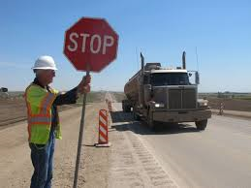
Flagger Stations
Stand on shoulder next to road
Enter road only after vehicles have stopped
Be able to warn workers of danger
Stand away from shade and shadows
Keep workers away
Notes:
A flagger should also:
Stand on shoulder next to road
Enter road only after vehicles have stopped
Be able to warn workers of danger
Stand away from shade and shadows
Keep workers away

Slide 32
High-Visibility Apparel
All workers must wear high visibility apparel
Worker visibility during dawn or dusk conditions will be enhanced by fluorescent colored high-visibility apparel
The use of colors such as yellow-green for the worker apparel will help to differentiate the worker from the orange colored work vehicles, sign, drums, etc.
Notes:
To ensure the safety of all involved all workers must wear high visibility apparel and this apparel needs to be kept “clean and serviceable (e.g. in good repair).”
All workers should remember that their visibility during dawn or dusk conditions will be enhanced by fluorescent colored high-visibility apparel.
The use of colors such as yellow-green for worker apparel will help to differentiate the worker from the orange colored work vehicles, sign, drums, etc.

Slide 33
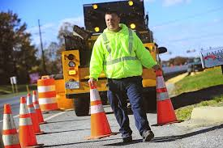
Worker Safety and Visibility
High-visibility apparel
Worker training
Activity area planning
Speed control
Positive separation
Lighting
Worker safety planning
Special devices
Notes:
To enhance worker safety and visibility use the following:
High-visibility apparel
Worker training
Activity area planning
Speed control
Positive separation
Lighting
Worker safety planning
Special devices

Slide 34
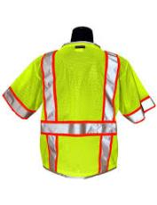
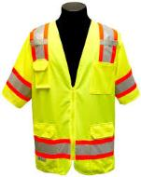
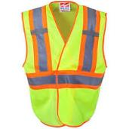
High-Visibility Apparel
• Clothing meets safety standards
• Fluorescent background color
• Reflective materials
• Designed to identify a person
• High-visibility armbands, hats, vests, gloves
• Inspect reflective material regularly
Notes:
High visibility apparel should:
• Meet safety standards
• Have a fluorescent background color
• Be reflective
• Be designed to identify a person
• Include high-visibility armbands, hats, vests, gloves
• Be inspected regularly (especially to ensure it is still highly reflective)

Slide 35
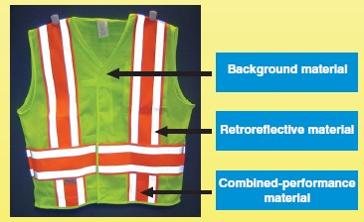
Class 1
Notes:
Class 1 safety vests are for workers in low impact areas, where traffic flow does not exceed 25 mph and where personnel are working a good distance away from it. Parking service attendants, delivery vehicle drivers, and sidewalk or roadside maintenance workers are examples of jobs who would qualify for a class 1 safety vest. These vests should have a mandatory minimum of 155 square inches of reflective tape. Dimensions of the reflective tape can be either 6.46 linear feet of 2 inch tape or 9.39 linear feet of 1 3/8 inch tape. The reflective stripes should be around the middle in a 360º stripe and above each shoulder. Vests should be either a safety yellow or safety orange color.

Slide 36
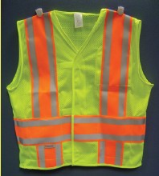
Class 2
Notes:
Workers who are involved in jobs where there is heavier traffic are required to wear a Class 2 vest. Jobs that require workers to work in areas where there is poor visibility due to weather will also need a more reflective Class 2 safety vest. Class 2 vests will have a minimum of 201 square inches of reflective tape that is 2 inches in diameter. Dimensions of the reflective tape can be 8.373 linear feet of 2-inch tape or 12.2 linear feet of 1 3/3 inch tape. Examples of jobs that require Class 2 vests are airport baggage handlers and ground crew, forestry workers, high-volume parking or toll-gate personnel and law enforcement personnel. Reflective stripes will be over the shoulders and round the middle in either one or two 360º horizontal stripes.

Slide 37
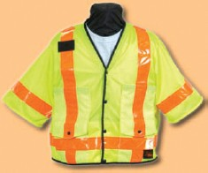
Class 3
Notes:
Jobs that require workers to be the most visible are ones that put personnel in close contact with heavy traffic. High risk jobs include accident site investigators, emergency responders, railway workers, utility workers, and survey and flagging crews. These workers will often be close to traffic exceeding 50 miles an hour, so it is important for them to be as visible as possible. Class 3 safety vests and garments must have a minimum of 310 square inches of reflective tape that is 12.92 linear feet and 2-inches thick. Class 3 garments also provide more coverage to the arms and legs than do class 1 and class 2 safety vests.

Slide 38
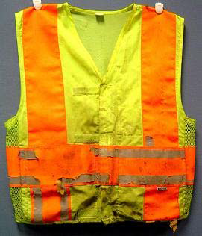
Is this Apparel Acceptable?
Worn, dirty
No!
Notes:
This picture shows high-visibility apparel that is not very safe because it’s dirty and worn. It should be replaced.

Slide 39
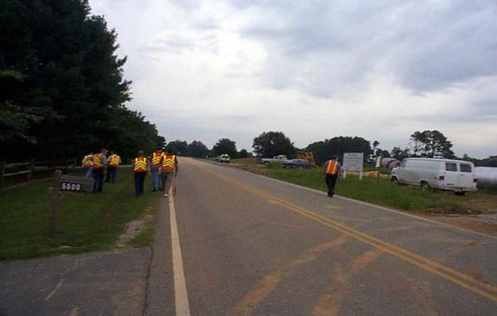
Safety Issue
Anything wrong?
Yes, individual walking with back to oncoming traffic
Notes:
The problem here may not seem that important, but one of the people on this inspection team is walking on the wrong side of the road. So what is the big deal about walking with your back to traffic? Because you can’t see traffic coming and will probably get run over! We are all guilty of overlooking our personal safety, if even for a few moments. All it takes is a split second for something bad to happen, and it will change your life and your family’s lives forever.

Slide 40
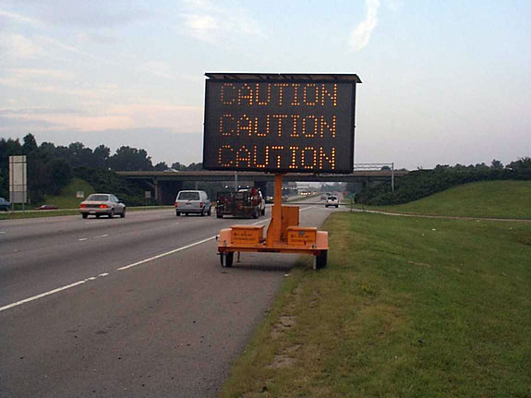
Changeable Message Sign
Message signs are being used more and more:
Easy to read
Readily changed
Moved easily
Downside: Sometimes messages not recently updated
Notes:
The use of changeable message signs is increasing with the United States. There are many advantages to these signs since they are:
Easy to read
Readily changed
Moved easily
However there is a downside to these signs – sometimes messages have not been recently updated or cannot be read clearly due to bulbs/lighting devices being burned out.

Slide 41
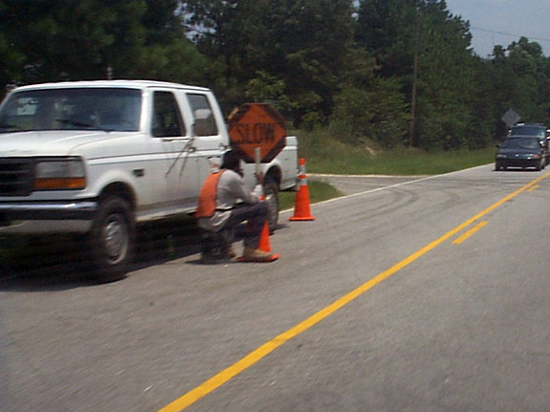
Flagger
What are the issues here?
Flagger stationed in the travel way
Flagger is sitting
Flagger has no escape route
Traffic vest illegal
Notes:
So what’s wrong with the picture! There could well be a list of problems: the flagger is stationed in the travel way, the flagger is sitting, the flagger has no escape route. However, there is another problem his vest is illegal.
Flaggers are required to wear a vest that meets the requirements of ISEA’s high-visibility apparel and labeled as meeting the ANSI standard for Class 2 risk exposure. The Manual used to require that a flagger had to wear a vest, shirt or jacket (with some alternative colors to choose from) and that the garment had to be retroreflective for nighttime work.
Vest are required to :
incorporate at least 775 square inches of background material and 201 square inches of retroreflective material,
the background material shall be either fluorescent orange-red or fluorescent yellow-green, and the retroreflective material shall be either orange, yellow, white, silver, yellow-green, or a fluorescent version of these colors,
the retroreflective material must provide 360 degrees visibility of the wearer, and be designed to clearly identify the wearer as a person, and
last, don’t forget that the vest must have a Class 2 tag.

Slide 42
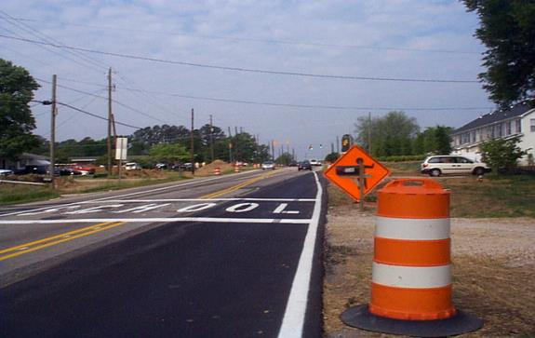
Flagger Symbol Sign
Flagger warning sign is obstructed by mailbox
Warning barrel not on roadway
No flaggers in area – construction finished?
Can you identify what's wrong?
Notes:
Here’s another picture that shows a situation that is not very safe. The issues with this situation are:
Flagger warning sign is obstructed by mailbox
Warning barrel not on roadway
No flaggers in area – construction finished?

Slide 43
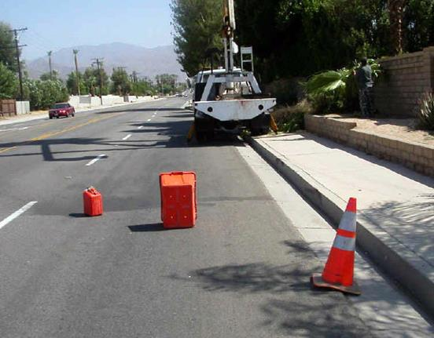
Unsafe Situation
Enough said!
Notes:
Here’s a situation that is definitely not safe! Using non-reflective and non-standard devices is not a very good idea nor do they attract the attention of those who need to see them.

Slide 44
Summary
Individuals within roadway work zones must use caution and be constantly aware of the hazards associated with moving vehicles and equipment
Workers must wear the necessary Personal Protective Equipment (PPE) including and especially compliant traffic vests
Necessary signage should be in place to warn drivers approaching a work zone
A good communication system must be used between flaggers and equipment operators
Notes:
To make sure employees in work zones are safe:
Individuals within roadway work zones must use caution and be constantly aware of the hazards associated with moving vehicles and equipment
Workers must wear the necessary Personal Protective Equipment (PPE) including and especially compliant traffic vests
Necessary signage should be in place to warn drivers approaching a work zone
A good communication system must be used between flaggers and equipment operators

Slide 45
Contact Information
Health & Safety Training Specialists
1171 South Cameron Street, Room 324
Harrisburg, PA 17104-2501
(717) 772-1635
RA-LI-BWC-PATHS@pa.gov
Like us on Facebook! - https://www.facebook.com/BWCPATHS

Slide 46
Questions
?????
Questions
&
Answers

