Slide 1
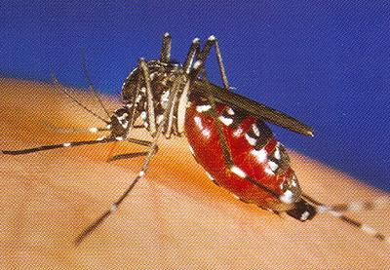
West Nile Virus Awareness
Bureau of Workers’ Comp
PA Training for Health & Safety (PATHS)
PPT-052-01
Notes:
West Nile Virus causes an infection that is spread by certain kinds of mosquitoes. Most often, mosquitoes get infected when they bite infected birds. Then the mosquitoes spread the virus when they bite people or other animals, such as horses. West Nile cannot spread from these animals to people or from person to person through casual contact.
http://www.webmd.com/a-to-z-guides/west-nile-virus-topic-overview

Slide 2
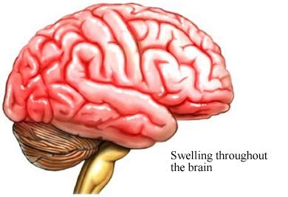
West Nile Virus
Strain of encephalitis (an inflammation of the brain): serious and deadly disease that can be carried by some mosquitoes
PPT-052-01
Notes:
West Nile can spread through an organ transplant or a blood transfusion. So all donated blood in the United States is screened to see if the virus is present. Some evidence suggests that West Nile can spread from a mom to her baby during pregnancy, at birth, or through breast milk. Signs and symptoms of West Nile fever usually last a few days, but signs and symptoms of encephalitis or meningitis can linger for weeks, and certain neurological effects, such as muscle weakness, may be permanent.
http://www.mayoclinic.org/diseases-conditions/west-nile-virus/basics/symptoms/CON-20023076

Slide 3
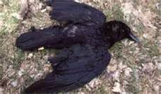
West Nile Virus
First identified in 1937 in Uganda in the eastern region of Africa; outbreaks spread to Europe, Asia, and the Middle East
Virus is spread when a mosquito bites an infected bird and then bites a person
Mosquitoes carry highest amount of the virus during early fall (late August to early September)
PPT-052-01
Notes:
First identified in 1937 in Uganda in the eastern region of Africa; outbreaks spread to Europe, Asia, and the Middle East
Virus is spread when a mosquito bites an infected bird and then bites a person
Mosquitoes carry highest amount of the virus during early fall (late August to early September)

Slide 4
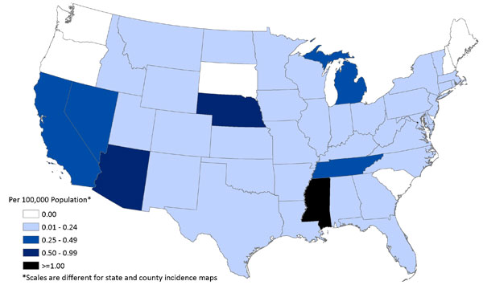
West Nile Virus
West Nile Virus was first found in the United States in 1999, reported in 46 states
In 2007, was responsible for 115 deaths in the United States (CDC)
Final West Nile virus (WNV) Neuroinvasive Disease Incidence by state, 2011
PPT-052-01
Notes:
West Nile Virus was first found in the United States in 1999, reported in 46 states
In 2007, was responsible for 115 deaths in the United States (CDC)
In 2000, West Nile virus appeared for the first time in Pennsylvania in birds, mosquitoes and a horse. To combat the spread of West Nile virus, which is transmitted by mosquitoes, Pennsylvania has developed a comprehensive network. This network, which covers 40 counties, includes trapping mosquitoes, collecting dead birds and monitoring horses, people and, in past years, sentinel chickens.
http://www.westnile.state.pa.us/

Slide 5
At Risk
People over the age of 50
Young children
PPT-052-01
Notes:
Those at risk who have less ability to combat the disease are:
People over age 50
Young children
Anyone who is bitten by a mosquito may get West Nile. Most of the time people fully recover from it. But permanent problems such as seizures, memory loss, and brain damage can occur, especially in children and older people. As you get older, you have a higher risk for getting encephalitis and other serious problems from West Nile. In a few cases, West Nile can be fatal.

Slide 6
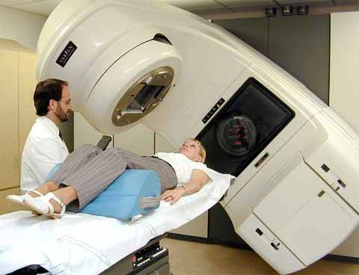
At Risk
Pregnant women
Those who have conditions
that compromise their immune system (HIV, organ transplants, chemotherapy)
PPT-052-01
Notes:
Others at risk include:
Pregnant women
Those who have conditions that compromise their immune system (HIV, organ transplants, chemotherapy)

Slide 7
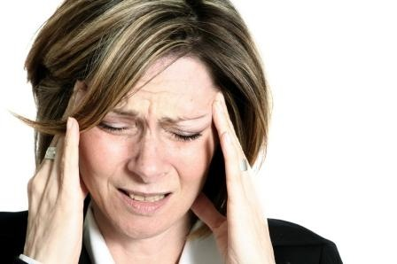
Symptoms
Usually appear between five to 15 days after being bitten
Severe headaches
PPT-052-01
Notes:
Most people who have West Nile have no symptoms. Or the symptoms may be so mild that people may not even realize that they have the virus.
In rare cases, West Nile can lead to swelling of the brain (encephalitis), swelling of the spinal cord (myelitis), or swelling of the tissues around the brain and spinal cord (meningitis).
But very few people with West Nile will get a severe illness that affects the brain or spinal cord.

Slide 8
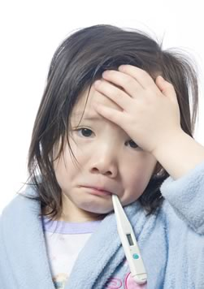
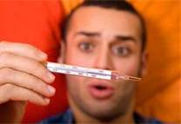
Symptoms
Fever
PPT-052-01
Notes:
In mild cases of West Nile, symptoms usually last for 3 to 6 days. If you get a more severe case of West Nile, symptoms can last for weeks or months. Severe cases that involve problems with the brain and spinal cord are rare, but they may cause:
Headaches.
A high fever.
A stiff neck or paralysis.
Confusion.
Reduced attention to surroundings.
Tremors, convulsions, or muscle weakness.
A coma.

Slide 9
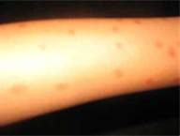
Symptoms
Nausea and vomiting
Rash
PPT-052-01
Notes:
Serious symptoms.
In less than 1 percent of infected people, the virus causes a serious neurological infection. Such infection may include inflammation of the brain (encephalitis) or of both the brain and surrounding membranes (meningoencephalitis). Serious infection may also include infection and inflammation of the membranes surrounding the brain and spinal cord (meningitis), inflammation of the spinal cord (West Nile poliomyelitis) and acute flaccid paralysis — a sudden weakness in your arms, legs or breathing muscles.
http://www.mayoclinic.org/diseases-conditions/west-nile-virus/basics/symptoms/CON-20023076

Slide 10
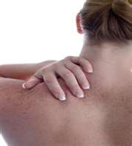
Symptoms
Chills
Muscle aches, pains, stiffness
PPT-052-01
Notes:
About 80 out of 100 people who have West Nile have no symptoms and only about 1 out of 150 people infected develops serious illness. When symptoms do appear, they begin 3 to 14 days after the mosquito bite.
Mild symptoms include:
A fever.
Headaches, body aches, or pain in your eyes.
A rash, usually on the chest, back, and arms.
Feeling very tired.
Not feeling hungry.
Feeling sick to your stomach or throwing up.
Swollen glands (lymph nodes), in rare cases.

Slide 11
Symptoms
Must seek medical attention if these conditions exist
In mild cases (20 percent), called West Nile fever, symptoms usually last 3 to 6 days
In severe cases (about one in 150), called West Nile
encephalitis, the following symptoms may also occur:
Confusion or change in ability to think clearly
Loss of consciousness or coma
Muscle weakness
Stiff neck
Weakness of one arm or leg
PPT-052-01
Notes:
If the following symptoms occur-seek medical attention:
In mild cases (20 percent), called West Nile fever, symptoms usually last 3 to 6 days
In severe cases (about one in 150), called West Nile encephalitis, the following symptoms may also occur:
Confusion or change in ability to think clearly
Loss of consciousness or coma
Muscle weakness
Stiff neck
Weakness of one arm or leg

Slide 12
Testing for the Virus
Tests to diagnose West Nile Virus include:
Complete blood count (CBC)
Head CT scan
Head MRI scan
Lumbar puncture and cerebrospinal fluid testing (CSF)
Serology test, which checks the blood or CSF sample for
antibodies against the virus
Because illness is not caused by bacteria, antibiotics do not help treat the West Nile Virus infection
Standard hospital care may help decrease the risk of complications in severe cases
PPT-052-01
Notes:
Tests to diagnose West Nile Virus include:
Complete blood count (CBC)
Head CT scan
Head MRI scan
Lumbar puncture and cerebrospinal fluid testing (CSF)
Serology test, which checks the blood or CSF sample for
antibodies against the virus
Because illness is not caused by bacteria, antibiotics do not help treat the West Nile Virus infection
Standard hospital care may help decrease the risk of complications in severe cases

Slide 13
Prognosis and Expectations
In mild cases (West Nile fever), most recover within a week
In more severe cases (West Nile encephalitis),
complications may lead to:
Brain damage
Permanent muscle weakness
Death
About 10 percent of patients with brain inflammation do not survive
PPT-052-01
Notes:
In mild cases (West Nile fever), most recover within a week
In more severe cases (West Nile encephalitis), complications may lead to:
Brain damage
Permanent muscle weakness
Death
About 10 percent of patients with brain inflammation do not survive

Slide 14
Prevention Tips
Repellents are an important tool to assist people in protecting themselves from mosquito-borne diseases
Use insect repellent with EPA-registered active ingredient, such as:
DEET
Picaridin
Oil of Lemon Eucalyptus
IR3535
PPT-052-01
Notes:
Repellents are an important tool to assist people in protecting themselves from mosquito-borne diseases
Use insect repellent with EPA-registered active ingredient, such as:
DEET
Picaridin
Oil of Lemon Eucalyptus
IR3535

Slide 15
Prevention Tips
Read and follow manufacturer’s directions for use of repellent
Do not allow children to apply repellent to themselves
PPT-052-01
Notes:
Read and follow manufacturer’s directions for use of repellent
Do not allow children to apply repellent to themselves

Slide 16
Prevention Tips
Precautions when using repellents:
Apply only to exposed skin and/or clothing, do not apply under clothing
Never use over cuts, wounds, or irritated skin
Do not apply to eyes or mouth (spray on hands first, then apply to face)
When using on children, apply to your own hands first, then put on child (do not apply on children’s hands)
After returning indoors, wash treated skin with soap and water or bathe; wash treated clothing before wearing it again
If rash/bad reaction from repellent: wash repellent off with soap and water, take repellent with you to a health care provider (HCP)
PPT-052-01
Notes:
Other precautions when using repellents:
Apply only to exposed skin and/or clothing, do not apply under clothing
Never use over cuts, wounds, or irritated skin
Do not apply to eyes or mouth (spray on hands first, then apply to face)
When using on children, apply to your own hands first, then put on child (do not apply on children’s hands)
After returning indoors, wash treated skin with soap and water or bathe; wash treated clothing before wearing it again
If rash/bad reaction from repellent: wash repellent off with soap and water, take repellent with you to a health care provider (HCP)

Slide 17
Prevention Tips
Take cover!
Wear shoes
Long pants
Long-sleeve shirt
PPT-052-01
Notes:
Cover exposed skin when outdoors. This mandates you
Wear shoes
Long pants
Long-sleeve shirt

Slide 18
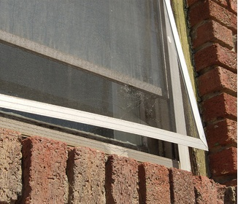
Prevention Tips
Make sure window screens fit tightly and are in good repair
PPT-052-01
>
Notes:
Inspect your home and make sure necessary repairs are made to “tighten” the home.
All doors and windows and window covers such as screens should fit tightly and not allow entry points for mosquitoes.

Slide 19
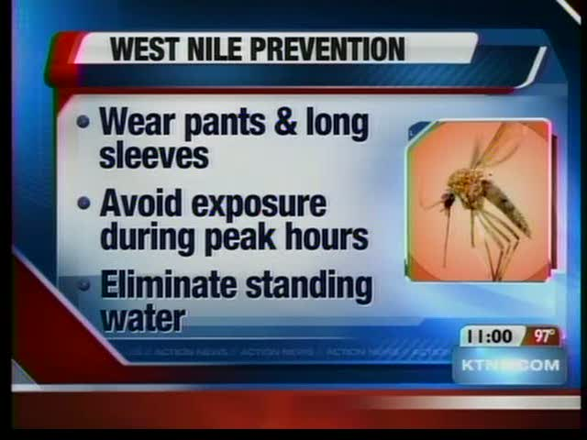
Prevention Tips
Monitor the news for current insect conditions
PPT-052-01
Notes:
Bti for Home Use
State DEP and county mosquito control professionals have been using Bti, a naturally occurring bacteria, to kill mosquito larvae for years. This material is now becoming widely available for you to buy and use yourself at home.
Bti can be purchased in small, donut-shaped form, often called "mosquito dunks", which are useful in small areas of standing water, such as a birdbath or small puddle of water that may gather in a low spot on your property. A granular form of Bti is available, and effective for larger areas, such as backyard ponds.
Bti can be purchased in many lawn and garden, outdoor supply, and home improvement stores. The great thing about this bacteria is that it kills only mosquito and black fly larvae. It is not harmful to people, pets, aquatic life (such as fish) or plants.

Slide 20
Prevention Tips
Be aware of increased sightings of dead birds in your area and contact local health department if necessary
PPT-052-01
Notes:
Be aware of increased sightings of dead birds in your area and contact local health department if necessary

Slide 21
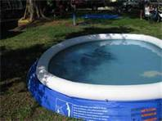
Tips to Prevent Breeding
Empty buckets, cans and other receptacles to prevent water from collecting
Cover wading pools, drain water from pool covers
PPT-052-01
Notes:
Remove or close water receptacles; buckets, swimming pools, small ornamental lawn ponds where water may serve as a breeding ground for mosquitoes.

Slide 22
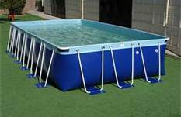
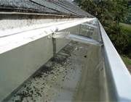
Tips to Prevent Breeding
Clean and chlorinate swimming pools, outdoor saunas and hot tubs
Keep empty and covered when not in use
Keep roof gutters clear and
draining properly
PPT-052-01
Notes:
For swimming pools, you can
Clean and chlorinate swimming pools, outdoor saunas and hot tubs
Keep empty and covered when not in use
Keep roof gutters clear and draining properly

Slide 23
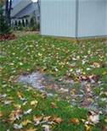
Tips to Prevent Breeding
Remove standing water from lawn, property
NOTE: Mosquitoes breed in standing water!
PPT-052-01
Notes:
Remove standing water from lawn and property since mosquitoes breed in standing water.

Slide 24
Resources
Centers for Disease Control and Prevention
www.cdc.gov
Consumer Specialty Products Association
www.aboutbugsbugsbugs.com
Alliance for Consumer Education
www.stopgerms.org
U.S. Environmental Protection Agency
www.epa.gov
PPT-052-01
Notes:
The above are resources to assist you and provide additional information on this topic.

Slide 25
Resources
http://www.webmd.com/a-to-z-guides/west-nile-virus-topic-overview
http://www.mayoclinic.org/diseases-conditions/west-nile-virus/basics/symptoms/CON-20023076
http://www.westnile.state.pa.us/
PPT-052-01
Notes:
The above are resources to assist you and provide additional information on this topic.

Slide 26
Contact Information
Health & Safety Training Specialists
1171 South Cameron Street, Room 324
Harrisburg, PA 17104-2501
(717) 772-1635
RA-LI-BWC-PATHS@pa.gov
Like us on Facebook! - https://www.facebook.com/BWCPATHS
PPT-052-01
>
Notes:
We invite you to contact us for additional information concerning available free training.

Slide 27
Questions
PPT-052-01
>

