Slide 1
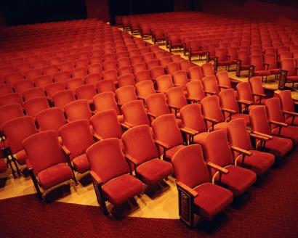
Theatre Safety
Bureau of Workers’ Compensation
PA Training for Health & Safety (PATHS)
Notes:
While working in the theatre can be fun and exciting, it can also be dangerous due to the types of hazards that may be encountered.

Slide 2
What We’ll Talk About
Basic Safety
Maintenance & Set Up Safety
Personal Safety
Emergency Plan & Fire Safety
Confined Spaces
Chemical Safety
Notes:
This presentation will discuss:
Basic Safety
Maintenance & Set Up Safety
Personal Safety
Emergency Plan & Fire Safety
Confined Spaces
Chemical Safety

Slide 3
Understanding Your Business
Technical Theatre is hard work and takes effort and training!
Just by the nature of the work there are many hazards present; anyone can be injured if they are not working safely.
Theatre work can be very challenging and stressful, but also fun and rewarding as well!
The teamwork it takes to produce a show must also be used to ensure everyone’s safety.
Notes:
Theatre work can be very hard but yet rewarding, however the amount and type of hazards present can lead to injuries, some even serious, if those involved aren’t working safely.
The teamwork involved in planning for, producing and putting on a show must also be used to ensure everyone’s safety as well as the safety of those viewing the show.

Slide 4
Nature of Work
Basic Stage Safety.
Elevated platforms and workspaces.
Scaffolds and Ladders.
Stage Preparation.
Possibly long hours.
Excessive heat due to lights.
Equipment can be awkward and heavy.
Chemical Safety.
Notes:
There are many things to consider when getting ready for and giving a show such as:
Basic Stage Safety.
Elevated platforms and workspaces.
Scaffolds and Ladders.
Stage Preparation.
Possibly long hours.
Excessive heat due to lights.
Equipment can be awkward and heavy.
Chemical Safety.

Slide 5
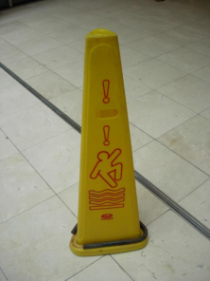
Who’s Responsible for Safety?
Who’s Responsible for YOUR Safety?
First = YOU!!!
Next = Your employer, to provide a safe workplace free from hazards.
Finally = Your fellow employees, to ensure they are working safely.
Notes:
Everyone should be responsible for their own safety! While the overall employer is responsible to ensure a safe and hazard free work area, everyone involved should be concerned with safety while preparing for and putting on a show.

Slide 6
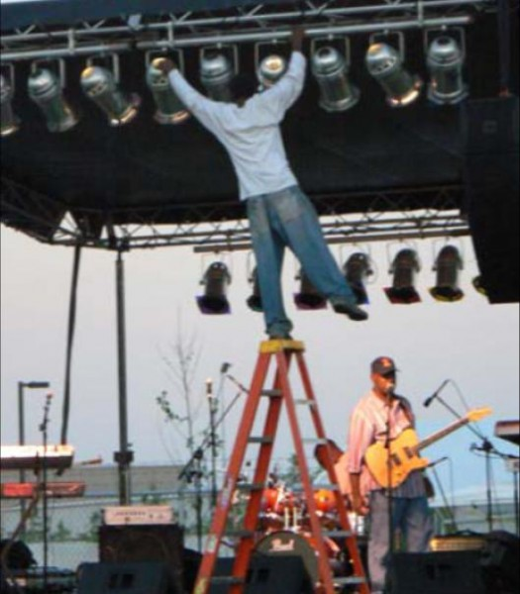
Basic Safety Rules
Keep mechanical guards in place.
Wear proper clothing and footwear.
Use personal protective equipment (PPE).
No smoking within buildings.
Maintain good housekeeping.
Notes:
To ensure the safety of all involved some basic safety rules should be followed such as:
Keep mechanical guards in place.
Wear proper clothing and footwear.
Use personal protective equipment (PPE).
No smoking within buildings.
Maintain good housekeeping.

Slide 7
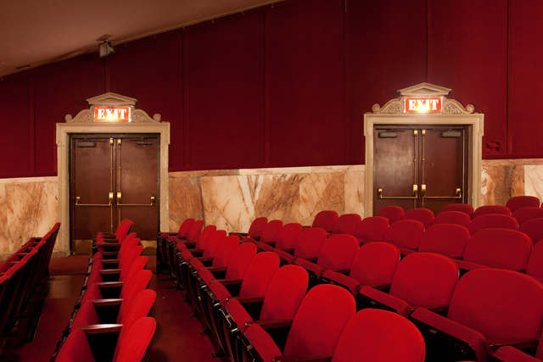
Basic Safety Rules
Keep exits and aisles unobstructed.
No horseplay.
Practice fire prevention.
Maintain proper storage.
Notes:
More basic safety rules to follow include:
Keep exits and aisles unobstructed.
No horseplay.
Practice fire prevention.
Maintain proper storage.

Slide 8
Job Related Safety Rules
TWO KINDS:
◦ Maintenance
◦ Set up
PERFORMANCE:
Sometimes total compliance with OSHA standards may be difficult to achieve during performances (due to effects desired)
Safety should always be the #1 priority!
Notes:
The two types of job related safety rules involve maintenance and set up.
It is understood that there are times during a performance when complying with related OSHA regulations may be difficult due to the effects desired, however safety should always be given top priority.

Slide 9
Maintenance & Set-up Safety
Fly rail, batten & arbor weighting and rigging:
Don’t load or unload pipes until given okay.
“Heads up” call – falling objects, flying battens.
Know who you are answering to (e.g. Master Carpenter, Master Electrician, Master Fly).
Be alert, pay attention!
“Heads Up!”
Notes:
Safety while working with fly rails, arbor weighting and rigging involves:
→ Not loading or unloading pipes until given the okay.
→ Calling “Heads up” if there are falling objects or flying battens.
→ Knowing who you are answering to (e.g. Master Carpenter, Master Electrician, Master Fly).
→ Being alert and paying attention!

Slide 10
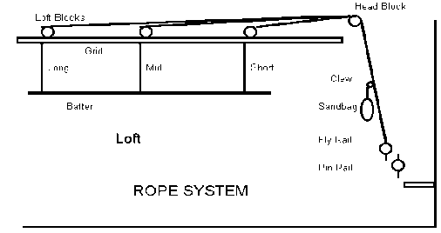
Rigging Safety
Fly or rigging system: allows safe support and quick change scenery and lighting used in theatres
◦ Today the main system is rarely a rope system; but often included
auxiliary system.
◦ Used for temporary or custom rigging; rope systems easier to adapt
than counterweight or winch systems.
◦ Well equipped theatre, often a flyrail on both stage left and right.
Notes:
A fly or rigging system allows safe support and quick change scenery and lighting used in theatres.
Today the main system is rarely a rope system; but often included auxiliary system.
Used for temporary or custom rigging; rope systems easier to adapt than counterweight or winch systems.
Well equipped theatre, often a flyrail on both stage left and right.

Slide 11
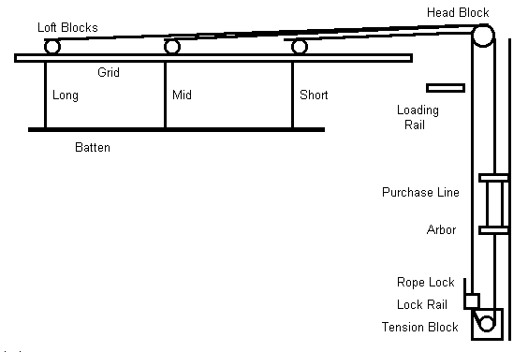
Rigging Safety
Counterweights are usually iron or steel, cast or flame cut from heavy plate.
Counterweights are often referred to as "bricks" or as "pigs" (for pig irons).
Come in semi-standard sizes, e.g. 10, 20, 30, and 50 lbs.
Cast weights usually made to an actual weight.
Cut weights may be uneven size, such as 26 or 38 lb.
Notes:
Counterweights are usually iron or steel, cast or flame cut from heavy plate.
• Counterweights are often referred to as "bricks" or as "pigs" (for pig irons). • Come in semi-standard sizes, e.g. 10, 20, 30, and 50 lbs. • Cast weights usually made to an actual weight.
• Cut weights may be uneven size, such as 26 or 38 lb.

Slide 12
Rigging Safety
Proper procedure for loading battens should ALWAYS be followed when remotely possible.
Send loading crew to loading gallery (rail).
Flyman calls "Heads Up" loudly and lowers empty batten to floor.
Flyman gives clearance to deck crew to hang load on batten.
Crew loads the batten.
AFTER load is on batten, flyman estimates weight and calls up command to the loading gallery to load the arbor with appropriate weights to equal the load.
Loaders raise and secure locknuts and spreader plates, leaving one plate on top of the batten weight, and add the required number of bricks.
If many bricks are needed, another spreader plate should be slid down between the bricks about every two feet or so.
Notes:
The proper procedure for loading battens should ALWAYS be followed when remotely possible.
The following rigging safety procedures should be followed:
Send loading crew to loading gallery (rail).
Flyman calls "Heads Up" loudly and lowers empty batten to floor.
Flyman gives clearance to deck crew to hang load on batten.
Crew loads the batten.
AFTER load is on batten, flyman estimates weight and calls up command to the loading gallery to load the arbor with appropriate weights to equal the load.
Loaders raise and secure locknuts and spreader plates, leaving one plate on top of the batten weight, and add the required number of bricks.
If many bricks are needed, another spreader plate should be slid down between the bricks about every two feet or so.

Slide 13
Rigging Safety
When weights are on, loaders slide down remaining plates and lower and lock off lock nuts, and call down that the arbor is locked and secured.
Flyman calls to deck to "Clear the batten", then carefully unlocks rope and tries to fly goods to see if it is heavy or light.
If weights are off, flyman calls corrections up to the loading rail, who follow above procedure to adjust weight to suit.
Once weight is correct, flyman calls "clear the batten" and flies batten out to trim, locking ropelock and securing handle with keeper ring.
Notes:
Rigging safety procedures also include:
When weights are on, loaders slide down remaining plates and lower and lock off lock nuts, and call down that the arbor is locked and secured.
Flyman calls to deck to "Clear the batten", then carefully unlocks rope and tries to fly goods to see if it is heavy or light.
If weights are off, flyman calls corrections up to the loading rail, who follow above procedure to adjust weight to suit.
Once weight is correct, flyman calls "clear the batten" and flies batten out to trim, locking ropelock and securing handle with keeper ring.

Slide 14
Rigging Safety
To unload, reverse the procedure:
Bring in batten, unload counterweights to batten weight, THEN unload the goods from the batten.
Always call "Heads Up" when flying things in and "Clear" when flying things out.
Notes:
To unload, reverse the procedure:
Bring in batten, unload counterweights to batten weight, THEN unload the goods from the batten.
Always call "Heads Up" when flying things in and "Clear" when flying things out.

Slide 15
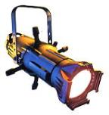
Maintenance & Set Up Safety
Electricity and Lighting Equipment:
Only use properly grounded tools.
Only use electrical cords in good condition.
Do not overload extension cords or circuits – overloading is a hazard!
Inspect all electrical equipment and cords to ensure they are not damaged.
Wait until lamps cool; unplug them prior to changing.
Notes:
When using electricity and lighting equipment:
Only use properly grounded tools.
Only use electrical cords in good condition.
Do not overload extension cords or circuits – overloading is a hazard!
Inspect all electrical equipment and cords to ensure they are not damaged.
Wait until lamps cool; unplug them prior to changing.

Slide 16
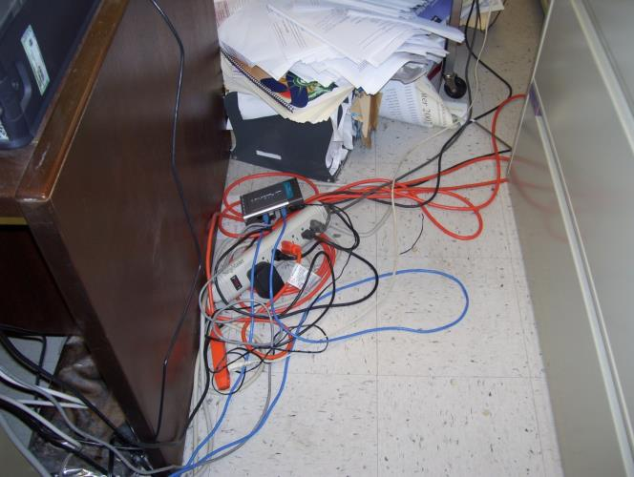
Any Safety Issues?
Extension cord plugged into “tap” – possible overload
Cords across walkway
Notes:
Are there any safety issues in this picture?

Slide 17
Maintenance & Set Up Safety
Low light levels, noise levels, obstructions:
Use caution in low light situations.
Use a flashlight when necessary.
Wear appropriate hearing protection.
Do not block aisles, hallways, fire exits, doorways, fire extinguishers, or electrical panels.
Notes:
When there are low light levels, excessive noise or obstructions:
Use caution in low light situations.
Use a flashlight when necessary.
Wear appropriate hearing protection.
Do not block aisles, hallways, fire exits, doorways, fire extinguishers, or electrical panels.

Slide 18
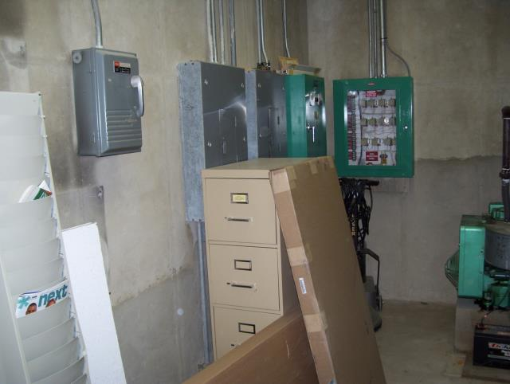
Safe Situation?
NO! Storage in Mechanical Room not allowed; also, items against electrical panels
Notes:
Do you see any safety issues in this picture?

Slide 19
Maintenance & Set Up Safety
Ladders & Personnel Lifts:
Inspect ladders for defects/damage before using; remove it from service if defects/damage.
Always face a ladder when climbing up or down and maintain “3 points of contact.”
Only one person on a ladder at a time.
Ensure personnel lifts are on level/even ground before raising; ensure outriggers are in place.
Do not stand on the railings of the lift to do work
Notes:
When using ladders and personnel lifts:
▪ Inspect ladders for defects/damage before using; remove it from service if defects/damage.
▪ Always face a ladder when climbing up or down and maintain “3 points of contact.”
▪ Only one person on a ladder at a time.
▪ Ensure personnel lifts are on level/even ground before raising; ensure outriggers are in place.
▪ Do not stand on the railings of the lift to do work.

Slide 20
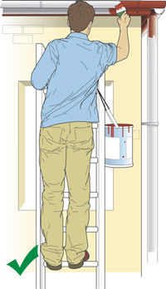
Maintenance & Set Up Safety
Ladders & Personnel Lifts:
Do not stand on the top rung/step of ladder.
Do not lean or overreach while on a ladder or in a personnel lift.
Make sure the ladder is firmly in place before climbing.
Never move a ladder or lift while someone is on it.
Employee is maintaining three points of contact while working
Notes:
Here are additional safety tips when using ladders or personnel lifts:
▪ Do not stand on the top rung/step of a ladder.
▪ Do not lean or overreach while on a ladder or in a personnel lift.
▪ Make sure the ladder is firmly in place before climbing.
▪ Never move a ladder or lift while someone is on it.

Slide 21
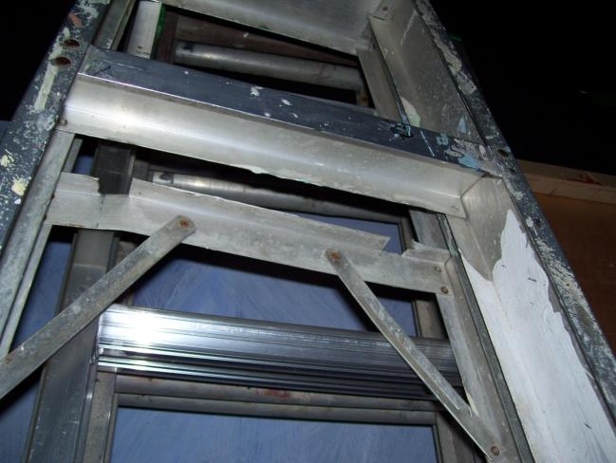
See Any Problems?
Ladder bent, damaged
Notes:
Are there any safety issues with the ladder pictured?

Slide 22
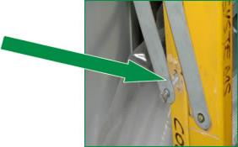
What About Here?
Pin Loose- Coming Out
Notes:
What safety problems can be observed with this ladder?

Slide 23
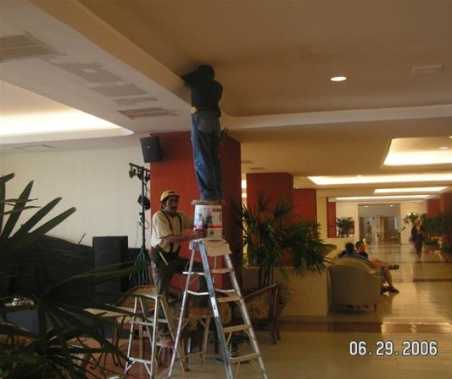
And This?
Man standing on bucket on top step of ladder
Other man holding bucket and standing on two step ladders
Is this an accident waiting to happen?
Notes:
What safety issues do you see in this picture?

Slide 24
Personal Safety
Lift an object using your legs, not your back.
Squat to pick something up, don’t bend at waist.
Avoid reaching forward over a long distance.
Avoid bending backward to reach for something.
Clean up spilled liquids immediately.
Do not use a tool/equipment unless you’ve been trained on its proper operation.
Notes:
In order to work in a theatre setting and avoid an injury keep the following in mind:
Lift an object using your legs, not your back.
Squat to pick something up, don’t bend at waist.
Avoid reaching forward over a long distance.
Avoid bending backward to reach for something.
Clean up spilled liquids immediately.
Do not use a tool/equipment unless you’ve been trained on its proper operation.

Slide 25
Personal Safety
Avoid wearing loose fitting clothing that may get caught in moving parts of machinery/equipment.
Wrist watches, rings, and necklaces should not be worn while operating power tools/machinery.
Long hair should be tied back when operating power tools/machinery.
Wear appropriate footwear when cutting, using power tools, lifting, etc.
Never leave machinery running when it is unattended.
Use the proper tool for the job/task.
Notes:
Additional safety tips include:
Avoid wearing loose fitting clothing that may get caught in moving parts of machinery/equipment.
Wrist watches, rings, and necklaces should not be worn while operating power tools/machinery.
Long hair should be tied back when operating power tools/machinery.
Wear appropriate footwear when cutting, using power tools, lifting, etc.
Never leave machinery running when it is unattended.
Use the proper tool for the job/task.

Slide 26
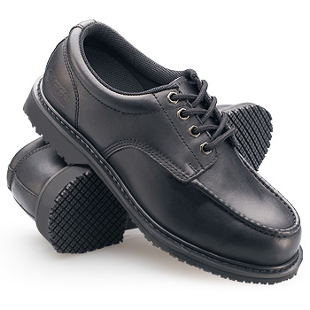
Which is Safer for Work?
These shoes are much safer!
Notes:
What shoes are safer in a work environment?

Slide 27
Personal Safety
Avoid running electrical or other cords across walkways–if unavoidable, tape down or place in a rubber or plastic channel.
Inspect hand tools before using to ensure they are not defective/damaged.
Inspect ropes/cables to ensure they are not frayed or otherwise damaged.
Use handrails while going up/down stairs.
Notes:
Here are more theatre safety tips:
Avoid running electrical or other cords across walkways–if unavoidable, tape down or place in a rubber or plastic channel.
Inspect hand tools before using to ensure they are not defective/damaged.
Inspect ropes/cables to ensure they are not frayed or otherwise damaged.
Use handrails while going up/down stairs.

Slide 28
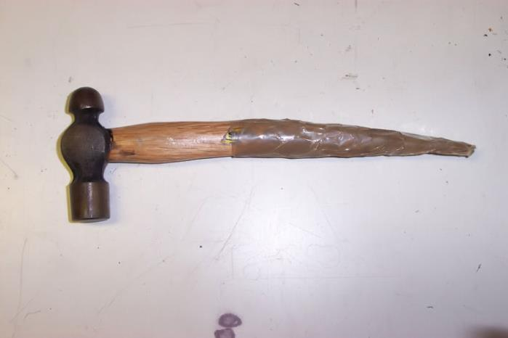
Would You Use This Tool?
Hopefully not! Handle unsafe, needs to be replaced.
Notes:
The tool pictured is not safe and should not be used whether in the theatre or at home.

Slide 29
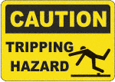
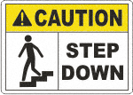
Pay Attention to Signs!
Notes:
There are many signs in use within buildings and especially in theatres. All theatre workers should pay attention to any and all signs and in particular any safety related signs as these signs could literally safe someone’s life!

Slide 30
Show & Performance Safety
SAFETY FIRST – ALWAYS!
Ensure appropriate lighting is in place to prevent accidents.
Never turn off or dim exit signs, stair lights, or hall lights.
Ensure fire protection equipment is not compromised.
At no time should a fire exit be obstructed, blocked, or locked!
Notes:
Safety during shows and performances should be given a top priority! The ensure the safety of all concerned the following should be observed:
Ensure appropriate lighting is in place to prevent accidents.
Never turn off or dim exit signs, stair lights, or hall lights.
Ensure fire protection equipment is not compromised.
At no time should a fire exit be obstructed, blocked, or locked!

Slide 31
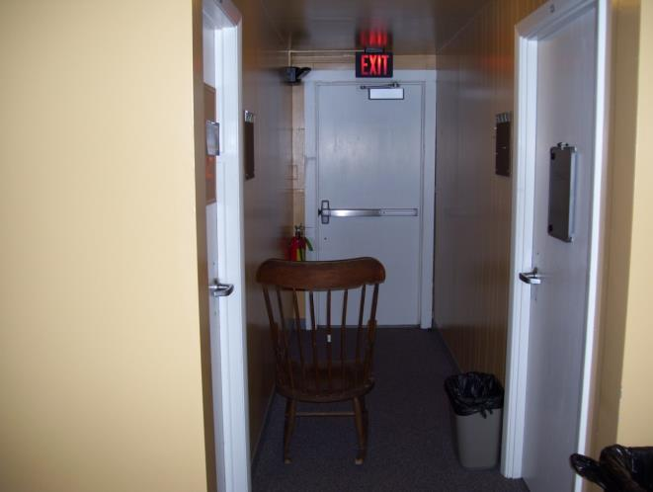
What’s the Hazard?
Chair & trash can obstruct exit access.
Notes:
Rocking chair obstructs exit access/corridor width. Would interfere with safe exit of building occupants. Unsafe condition.

Slide 32
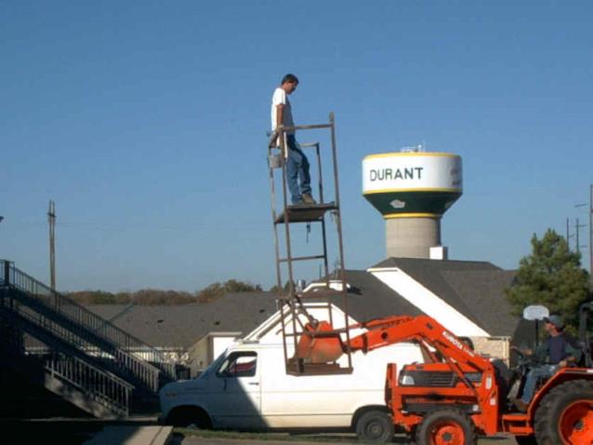
Safety Concerns?
Notes:
In many instances workers take shortcuts when completing tasks. Just because a person has been doing something a certain way and has never been injured does not make their actions safe. Safety should always be given top priority whether completing tasks at work or at home.

Slide 33
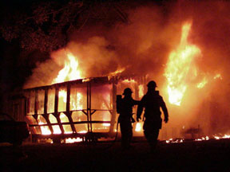
Emergency Plan
Know where first aid kits are located.
Know the location of the nearest Automated External Defibrillator - AED (if available).
Know who to contact during an emergency (911, on-site Security/Police, etc.).
Know what actions to take during an emergency.
Know where exits are located.
Notes:
To prepare for emergencies that can occur all workers need to:
Know where first aid kits are located.
Know the location of the nearest Automated External Defibrillator - AED (if available).
Know who to contact during an emergency (911, on-site Security/Police, etc.).
Know what actions to take during an emergency.
Know where exits are located.

Slide 34
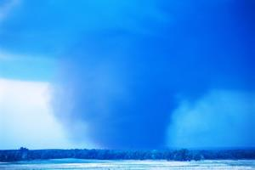
Emergency Plan
Know the locations of fire alarm pull boxes and fire extinguishers and how to use them.
Know where “safe areas” are located to direct audience or crews during an emergency.
Know your “designated meeting place” after evacuation.
Know the local forecast and be alert for drastic changes in weather.
Notes:
In addition, everyone involved should:
Know the locations of fire alarm pull boxes and fire extinguishers and how to use them.
Know where “safe areas” are located to direct audience or crews during an emergency.
Know your “designated meeting place” after evacuation.
Know the local forecast and be alert for drastic changes in weather.

Slide 35
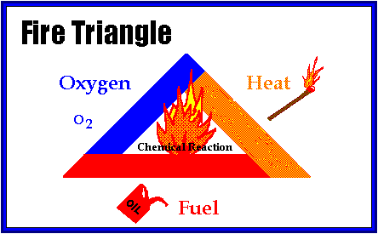
Fire Safety
Basic elements necessary for combustion – remove one and fire eventually goes out.
Notes:
When considering fire safety within a theatre the basic “Fire Triangle” and “Fire Tetrahedron” need to be kept in mind.
The Fire Triangle consists of the three basic elements, oxygen, heat and fuel, that come together to allow for optimum conditions for a fire to occur.
The Fire Tetrahedron adds a “chemical chain reaction” to the equation.
Removing any of the basic elements will allow the fire to eventually go out.

Slide 36
Fire Safety
Class of fires:
Wood, paper, cloth
Gasoline, Kerosene
Energized electrical equipment
Titanium, Aluminum
Notes:
Fires are put into classes which relate to the types of materials that burn.
The four basic classes are A, B, C and D and are broken down as follows:
Class A = Materials that leave an ash when burned such as wood, paper, and cloth
Class B = Involve flammable and combustible liquids and gases such as gasoline and methane
Class C = Include fires that involve energized electrical equipment (i.e. “plugged in” – electrical power going to)
Class D = Fires in combustible metals such as aluminum (these fires are rare in a normal work setting)
There is a fifth class of fires, Class K, that involve cooking equipment.

Slide 37
Portable Extinguisher Picture Labels
Class A
Class BC
Class ABC
Notes:
Most fire extinguishers in the workplace have a picture type label that indicates what class of fires they can be used on. It’s a very good idea to become familiar with these labels which will assist in identifying what types of fire extinguishers are in the area.

Slide 38
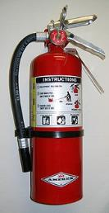
Fire Safety
Fire Extinguisher Use:
P.A.S.S.
P = Pull the Pin
A = Aim the nozzle-horn at the “base” of the fire
S = Squeeze the handles together
S = Sweep the extinguisher from side to side
Notes:
To properly use a fire extinguisher the word “PASS” should be kept in mind which stands for:
P = Pull the Pin
A = Aim the nozzle-horn at the “base” of the fire
S = Squeeze the handles together
S = Sweep the extinguisher from side to side

Slide 39
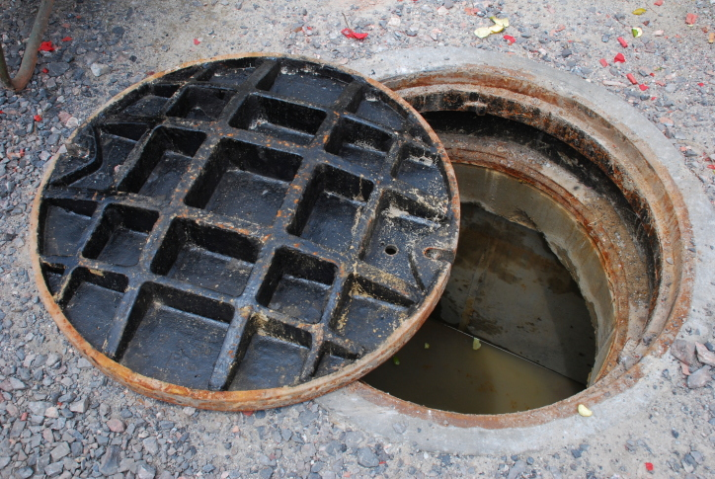
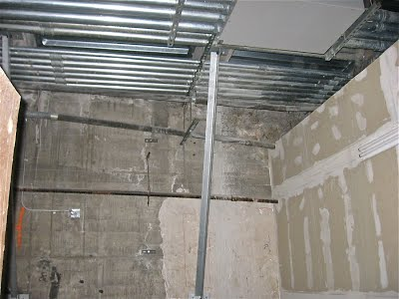
Confined Spaces
A confined space is defined as a space that:
Is large enough and so configured that an employee can bodily enter and perform assigned work;
Has a limited means for entrance and exit;
Is not designed for continuous employee occupancy.
Notes:
There are more confined spaces in buildings than most workers realize, and safety while entering or working within a confined space should always be practiced.
A confined space is one that:
• Is large enough and so configured that an employee can bodily enter and perform assigned work;
• Has a limited means for entrance and exit;
• Is not designed for continuous employee occupancy

Slide 40
Permit Required Confined Space
Is a confined space with one or more of the following characteristics:
Contains or has potential to contain a hazardous atmosphere (i.e. atmosphere that may expose employees to the risk of injury or death, ability to self-rescue, or acute illness).
Contains a material that has the potential for engulfing an entrant.
Notes:
A Permit Required Confined Space (PRCS) takes special training and consideration to enter.
A PRCS has one or more of the following characteristics:
Contains or has potential to contain a hazardous atmosphere (i.e. atmosphere that may expose employees to the risk of injury or death, ability to self-rescue, or acute illness).
Contains a material that has the potential for engulfing an entrant.

Slide 41
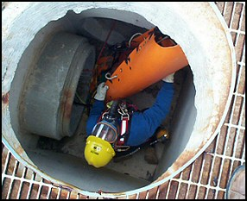
Permit Required Confined Space
Entrant could become trapped/asphyxiated by inwardly converging walls or a floor that slopes downward and tapers to a smaller cross section.
Contains any other recognized serious safety or health hazard.
Notes:
In addition to those already listed, a Permit Required Confined Space can also have one or more of the following characteristics:
Entrant could become trapped/asphyxiated by inwardly converging walls or a floor that slopes downward and tapers to a smaller cross section.
Contains any other recognized serious safety or health hazard.

Slide 42
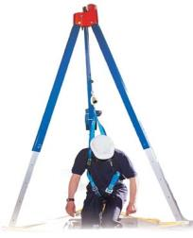
Entry of PRCS
ONLY INDIVIDUALS WITH PROPER TRAINING AND PERSONAL PROTECTIVE EQUIPMENT SHOULD ENTER PERMIT REQUIRED CONFINED SPACES!
IF ENTRY IS NECESSARY CONTACT APPROPRIATE DEPARTMENT FOR ASSISTANCE!
Notes:
ONLY INDIVIDUALS WITH PROPER TRAINING AND PERSONAL PROTECTIVE EQUIPMENT SHOULD ENTER PERMIT REQUIRED CONFINED SPACES!
If entry to a Permit Required Confined Space is necessary, contact the appropriate department for assistance!

Slide 43
Chemical Safety
Hazardous chemical/material = any element, chemical compound or mixture of elements and/or compounds, which can produce adverse effects on humans.
Includes both physical and health hazards.
Notes:
There are many chemicals in use within a theatre and some can be considered hazardous even though many can and are used at home. A hazardous chemical/material is any element, chemical compound or mixture of elements and/or compounds that can produce adverse effects on humans. These adverse effects include physical and health hazards.

Slide 44
Chemical Safety
Ensure all hazardous materials (e.g. paints, solvents, epoxy, etc.) are properly labeled and stored.
Choose water or latex based paints, inks, etc. when possible.
Ask vendor for Safety Data Sheet (SDS) for reference.
Ensure lids are securely fastened when product not in use.
Notes:
Safety should be given top priority when using any chemical and includes:
Ensuring all hazardous materials (e.g. paints, solvents, epoxy, etc.) are properly labeled and stored.
Choosing water or latex based paints, inks, etc. when possible.
Asking the vendor for Safety Data Sheet (SDS) for reference.
Ensuring lids are securely fastened when product not in use.

Slide 45
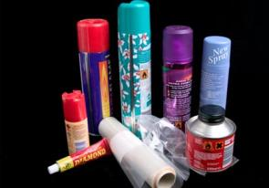
Chemical Safety
If solvent must be used, check threshold limit values, evaporation rates, and any other health and safety information on the label when choosing.
Avoid products that create dust or mist such as aerosol and never use them in an enclosed space.
Avoid anything with known cancer-causing chemicals.
Notes:
Chemical safety also involves the following:
If a solvent must be used, check threshold limit values, evaporation rates, and any other health and safety information on the label when choosing.
Avoid products that create dust or mist such as aerosol and never use them in an enclosed space.
Avoid anything with known cancer-causing chemicals.

Slide 46
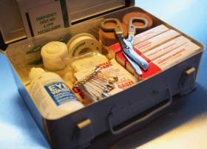
On the Job Injuries/Accidents
If you are injured while working you should notify your Supervisor immediately!
Get medical attention (if necessary).
Ensure an appropriate “Injury Report” is completed.
Report hazards associated with your injury to the appropriate person for correction.
Notes:
On the job injuries can and do occur, especially when individuals are working quickly and not safely. If an employee is injured on the job they should:
Notify their Supervisor immediately!
Get medical attention (if necessary).
Ensure an appropriate “Injury Report” is completed.
Report hazards associated with the injury to the appropriate person for correction.

Slide 47
Protect Your Best Asset-YOU!
Be aware of your surroundings.
Good housekeeping is important for preventing accidents.
Replace all tools and supplies after use.
Stretch to limber up before working.
Notes:
In summary:
Be aware of your surroundings.
Good housekeeping is important for preventing accidents.
Replace all tools and supplies after use.
Stretch to limber up before working.

Slide 48
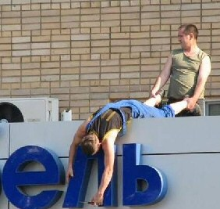
Remember
SAFETY IS EVERYBODY’S
RESPONSIBILITY
DON’T TAKE SHORTCUTS
WHEN IT COMES TO
SAFETY
WORK SAFELY ALL THE
TIME, EVERY TIME
Notes:
Remember:
SAFETY IS EVERYBODY’S RESPONSIBILITY
DON’T TAKE SHORTCUTS WHEN IT COMES TO SAFETY
WORK SAFELY ALL THE TIME, EVERY TIME

Slide 49
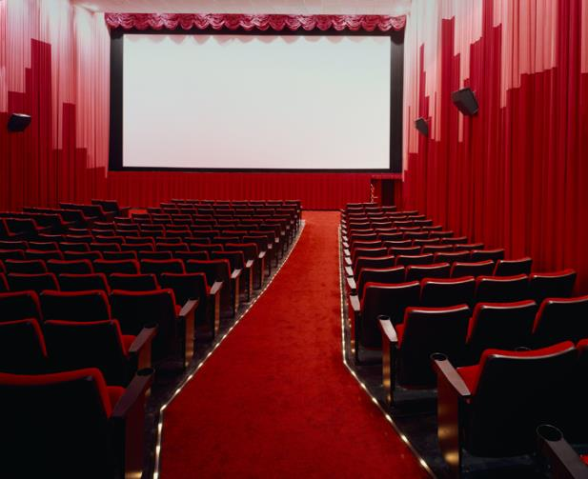
Thank You for Attending!
THE END!

Slide 50
Contact Information
Health & Safety Training Specialists
1171 South Cameron Street, Room 324
Harrisburg, PA 17104-2501
(717) 772-1635
RA-LI-BWC-PATHS@pa.gov
Like us on Facebook! - https://www.facebook.com/BWCPATHS

Slide 51
Questions?

