Slide 1
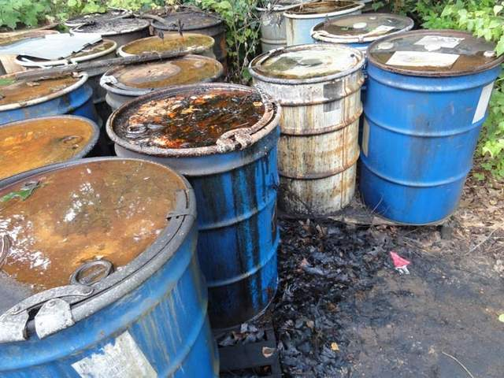
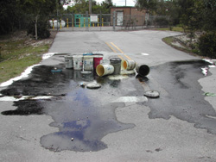
Spill Control and Containment
Bureau of Workers’ Compensation
PA Training for Health & Safety (PATHS)
Hazardous Waste Operations and Emergency Response
29 CFR 1910.120(q)
Notes:
In the industrial setting, worker safety is contingent on the stability of the containment vessel as well as the integrity of processes. Containers are closely regulated by various state and federal agencies concerning construction and markings. Based on the history of events, these agencies have compiled results from testing of specific materials to insure that, under normal conditions, the substance named will not chemically weaken the container designed for the material.
However, occasionally, accidents happen.

Slide 2
Introduction
The presence of chemicals in today’s society, be it manufacturing, storage, or use situations, may present hazards to persons upon its unplanned release from containment.
Even with the myriad regulations governing containers, shipping, and marking, the prudent firm must consider actions should hazardous materials be released.
Notes:
The presence of chemicals in today’s society, be it manufacturing, storage, or use situations, may present hazards to persons upon its unplanned release from containment.
Even with the myriad regulations governing containers, shipping, and marking, the prudent firm must consider actions should hazardous materials be released.

Slide 3
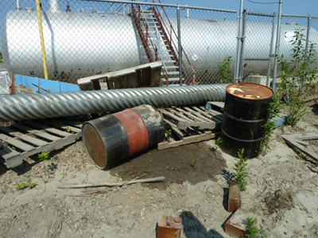
Topics
Containers
Hazard Identification
Response Actions
Emergency Response Zones
Mitigation Methods
Chemical Control
Physical Control
PPE
Overpacking
Decontamination

Slide 4
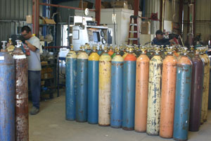
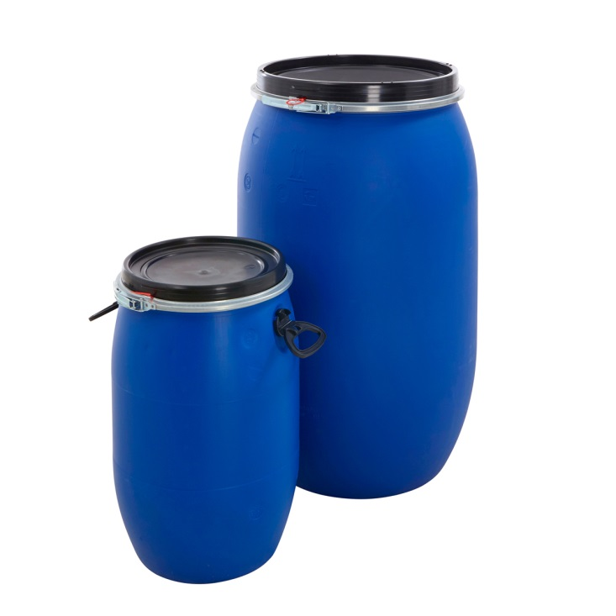
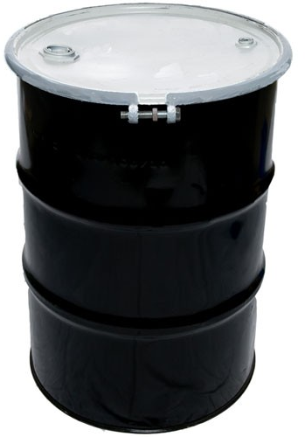
Containers
Various types are used to contain solids, liquids or gases.
Notes:
The type of container will be based on the material’s physical state, i.e. solid, liquid or gas as well as its pressure.
Other characteristics, such as corrosivity, will dictate the container material.

Slide 5
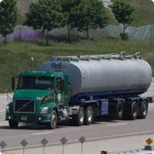
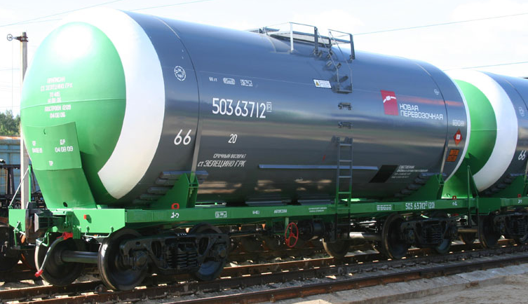
Containers
Also include transport containers which may be making pick-ups or deliveries to your facility.
Notes:
Large containers, such as tank cars and tank trucks, are used for economy to ship large volumes of materials. A spill from one of these conveyances can be extreme and require a large response effort of specialists and time to stabilize.

Slide 6
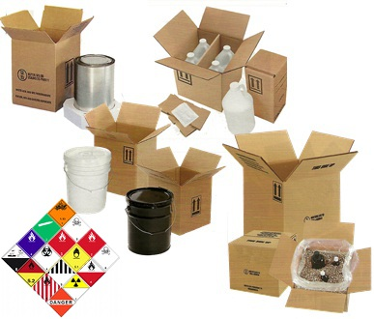
Containers
Fiberboard and cardboard packaging can also contain hazardous materials.
Notes:
Fiberboard and cardboard packaging can also contain hazardous materials.
Each will be properly marked according to DOT requirements.
An SDS may or may not accompany the shipment.

Slide 7
Containers
Can also be processes and vessels containing production materials.
Know the valving and shutdown logics for the plant’s processes.
Notes:
Containers can also be processes and vessels containing production materials.
Know the valve line-ups and shutdown logics for the plant’s processes to isolate leaks.

Slide 8
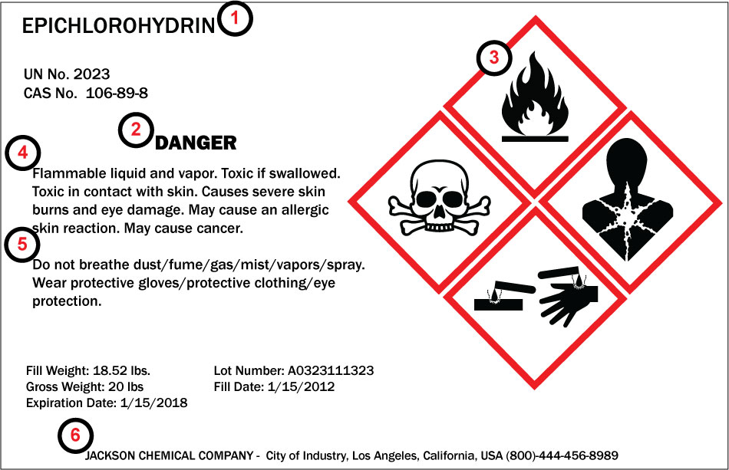
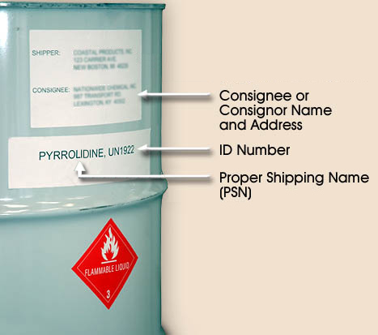
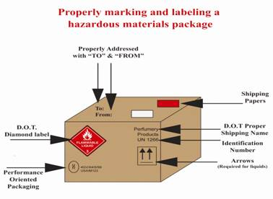
Hazard Identification
Identify hazards by markings, labels or shipping papers.
Notes:
During an emergency (although practicality dictates such identification should take place during pre-planning), hazards can be identified by markings, labels or shipping papers.
The physical state may also be an indication; color of vapor-if such is produced or color of liquid spills.
Labels as shown will provide product name, Danger or Warning indication, Precautionary and Hazard Statements as well as manufacturer information.

Slide 9
Hazard Identification
Once material is identified, other sources may be used to determine spill response actions.
Notes:
Once material is identified, other sources may be used to determine spill response actions.
If you have an in-house spill response team, obtain an Emergency Response Guidebook for your Response Library. This indicates first-line defensive actions to promote safety for team members and other staff.
Please see our PPT, “Hazard Communication including GHS.”

Slide 10
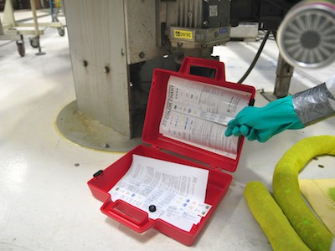
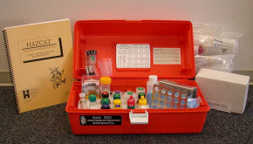
Hazard Identification
Identification can also be made in the field with sampling and testing kits. This, however, is time-consuming.
Notes:
Identification can also be made in the field with sampling and testing kits. This, however, is time-consuming.
Often used by hazmat teams called to incidents presenting unknown materials.

Slide 11
Hazard Identification
Once the material is identified, levels and amounts can be determined by using the correct air monitoring instruments.
Notes:
Please see our PPT program “Basic Air Monitoring.”

Slide 12
Containment: Defined
Act or process of containing and/or preventing the expansion of a substance.
Purpose:
Prevent contaminating surrounding areas
Prevent material entering sewers or waterways
Reduce contamination of adjacent chemicals
Reduce extent of hazard to human life
Ensure responders practice A.L.A.R.A. concept
(As Low As Reasonably Achievable)
Notes:
ALARA concerns exposure to persons, environment and equipment.
Purpose:
Prevent contaminating surrounding areas
Prevent material entering sewers or waterways
Reduce contamination of adjacent chemicals
Reduce extent of hazard to human life
Ensure responders practice A.L.A.R.A. concept (As Low As Reasonably Achievable)

Slide 13
A.L.A.R.A. Concept
A concept used during control and clean-up is borrowed from the nuclear industry:
The A. L. A. R. A. Concept - “As Low As Reasonably Achievable.”
This means that in all actions we should attempt to minimize exposure, contact, and contamination as well as the amount of waste generated by the control operation
Notes:
This means that in all actions we should attempt to minimize exposure, contact, and contamination as well as the amount of waste generated by the control operation

Slide 14
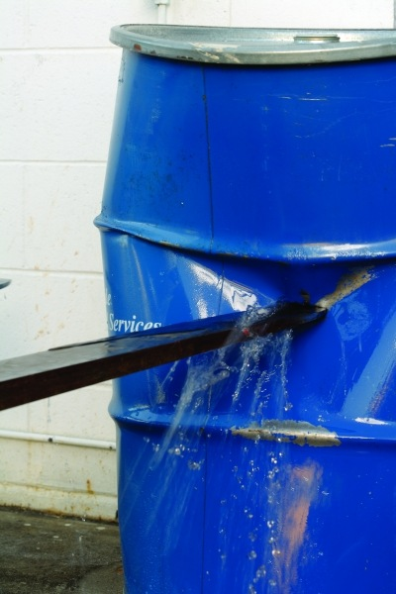
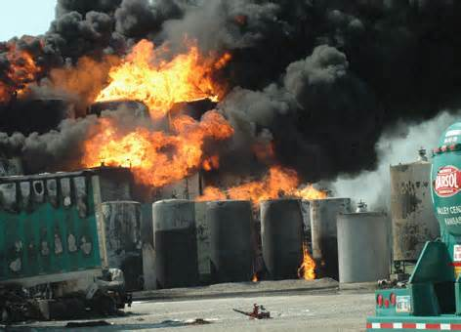
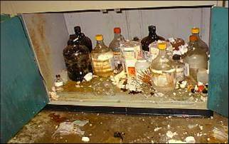
Loss of Containment
Factors contributing to the loss of containment include:
Mechanical damage,
Thermal damage,
Chemical reactions in the container.
Loss of containment requires proper response!
Notes:
Factors contributing to the loss of containment include:
Mechanical damage,
Thermal damage,
Chemical reactions in the container.
Loss of containment requires proper response to minimize additional damage or injury.

Slide 15
Types of Contaminants
Something which contaminates or “makes impure, unclean, or corrupt by contact; to corrupt; to pollute; to sully; to tarnish; to taint.”
Precautions are taken to minimize exposure:
Proper size-up of situation
Proper PPE
Understanding hazards of materials involved
Physical state of release and resulting complications.
Notes:
Contaminants are defined as:
Something which contaminates or “makes impure, unclean, or corrupt by contact; to corrupt; to pollute; to sully; to tarnish; to taint.”
Contaminants can come in various physical states.
Precautions are taken to minimize exposure:
Proper size-up of situation
Proper PPE
Understanding hazards of materials involved
Physical state of release and resulting complications.
Check the TLVs (Threshold Limit Values) for chemicals with which you work as well as the PELs (Permissible Exposure Limits) for unprotected persons.
Realize a release may permit more exposure which exceeds allowable limits. This would necessitate using PPE and monitoring.

Slide 16
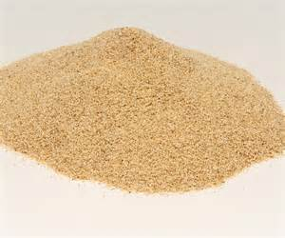
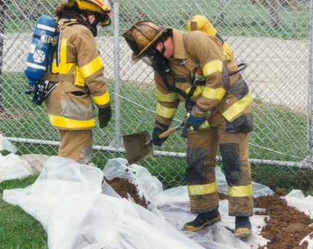
Solid Release
Solid materials easy to recover if kept dry and air movement is minimized. Once wet or damp, adverse reactions may complicate containment.
Cover with compatible material to minimize spread.
Notes:
Some solids, if moistened, will product various gases and/or uncontrolled reactions. These could endanger responders. Some materials can act as a catalyst, causing further dangers.
If incompatible liquids combine, violent reactions are possible. Some are delayed while others are immediate and devastating. Adding water to sulfuric acid causes an immediate reaction. Some metals, reacting with acids evolve hydrogen gas which is explosive. Acetylene mixing with chlorine gas will result in a large fire with toxic fumes being released

Slide 17
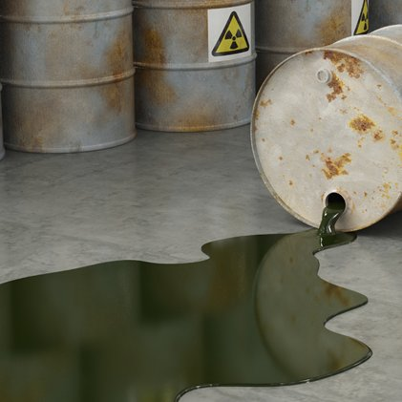
Liquid Release
Complicated by amount of spilled material and inherent characteristics.
Surfaces are contacted and vapors or gases produced.
Additionally;
Vapors in confined areas may form explosive amounts, or
Displace oxygen for breathing
Terrain may aid spread; liquids follow the path of least resistance to storm drains, sewers or waterways.
May also contaminate water strata.
Notes:
Liquid Release
Complicated by amount of spilled material and inherent characteristics.
Surfaces are contacted and vapors or gases produced.
Additionally;
Vapors in confined areas may form explosive amounts, or
Displace oxygen for breathing
Terrain may aid spread; liquids follow the path of least resistance to storm drains, sewers or waterways.
May also contaminate water strata.

Slide 18
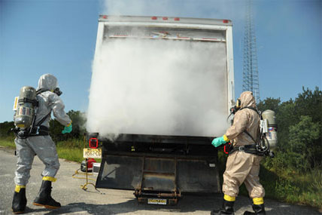
Gas Release
Often compartments can not be tightly sealed. In engineered facilities, this attempt to “seal” the location is achieved to some degree by shutting-down ventilation and air exchange systems.
Notes:
Gas Releases may occur from cylinders or from processes.
Often compartments can not be tightly sealed in trucks.
In engineered facilities, this attempt to “seal” the location is achieved to some degree by shutting-down ventilation and air exchange systems.

Slide 19
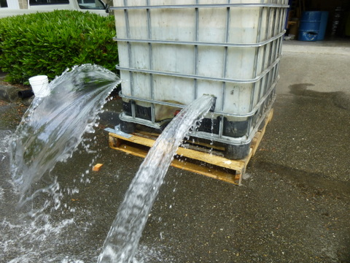
Types of Damage
Thermal
Chemical
Mechanical
Notes:
Types of damage causing releases include:
Thermal: impinged upon by fire.
Chemical reactions inside a container or by mixing with other materials upon release.
Mechanical due to punctures by forklifts or by being dropped in transit.

Slide 20
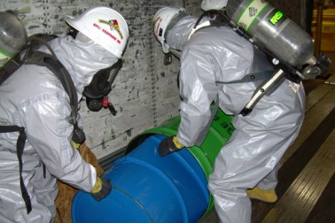
Response Actions
Goals of spill response are to:
Eliminate additional loss.
2. Prevent further contamination.
3. Avoid unnecessary exposure of workers.
Prevent contact with other chemicals.
Minimize down-time, loss of stocks, raw materials or finished product.
Notes:
Response goals include:
Eliminate additional loss.
Prevent further contamination.
Avoid unnecessary exposure of workers.
Prevent contact with other chemicals.
Minimize down-time, loss of stocks, raw materials or finished product.

Slide 21
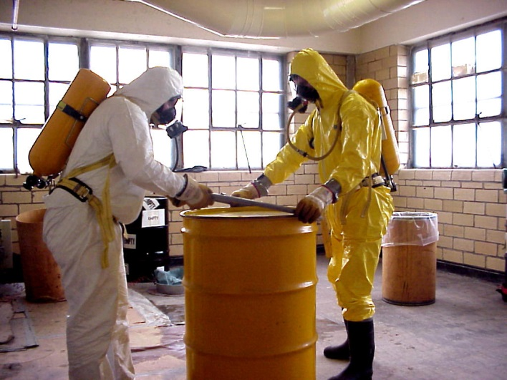
Proper Response Steps
Identify spilled material
Size-up incident severity
Determine mitigation methods
Implement methods
Notes:
Proper response requires the responder to:
Identify spilled material
Size-up incident severity
Determine mitigation methods
Implement correct control/mitigation methods

Slide 22
Proper Response Steps
Notes:
Create Decision Logics for the chemicals you have on-site. This will safely speed your response and can be used as a training tool.

Slide 23
Emergency Response Zones
Isolation
Release must be isolated against intrusion by unnecessary and untrained persons.
During containment operations, the Incident Commander should deny entry to the hazard zone to all but those required to conduct the control operations.
Also, such isolation is a guard against contamination of persons, vehicles, and equipment.
Notes:
Emergency Zones determine what actions by which team members will take place in each zone.

Slide 24
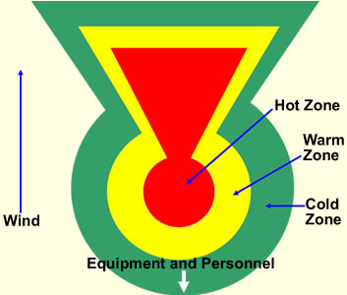
Emergency Response Zones
These are generally 3 in number:
Hot Zone
Warm Zone
Cold Zone
Notes:
Industrial and emergency services responders, for standardization during combined operations, call these the HOT, WARM, AND COLD ZONES. (NFPA 471)
The EPA has other designations which may confuse responders.

Slide 25
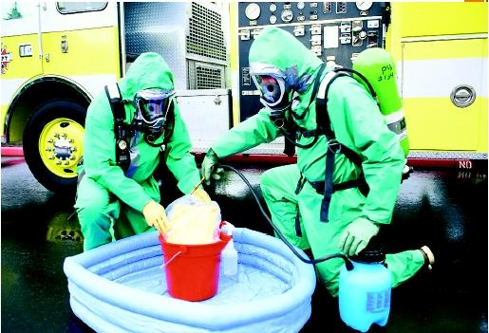
Hot Zone
Area immediately surrounding and including the contaminated area. Greatest hazard to life and/or property is located here.
When identifying this zone, view:
Wind direction and speed
Topography of land
Ventilation systems
Potential for release increasing
Notes:
No persons shall be permitted in this zone without wearing the required level of PPE for that release.

Slide 26
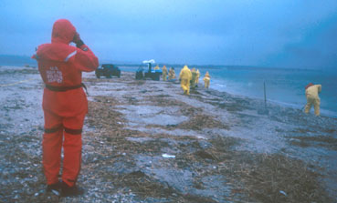
Warm Zone
Area immediately surrounding the hot zone. A danger of contamination still exists, however, the danger may be reduced by the distance from the release.
Located in this zone:
Team Leader
Safety Officer,
Rescue Team,
Decon Team,
Tool Depot
Notes:
The Emergency Response Guidebook indicates distances for certain materials which also include a safety factor.)
This zone also includes the entry corridor for entry and rescue personnel (in the same level PPE as the entry party) as well as
the decontamination corridor. A Safe Haven is also established should entrants need to quickly go to a point of safety.
Those located in this zone may be evaluated as needing either the same level of PPE or one level less.

Slide 27
Cold Zone
Immediately surrounds the Warm Zone. Relatively no danger of contamination or exposure. This is also a buffer zone to insure a safe barrier is maintained around the release.
Personnel in this area generally are not required to wear PPE.
Located in this zone:
Command Post and Incident Commander
Support Services and Agencies
Staging Area for resources
Notes:
The configuration or contour of these zones will depend upon the type of material and amount released, as well as topography and wind characteristics.
Only after the area has been isolated and these zones established, should further containment measures begin.
Those in this zone have the least chance of being contaminated by the event.

Slide 28
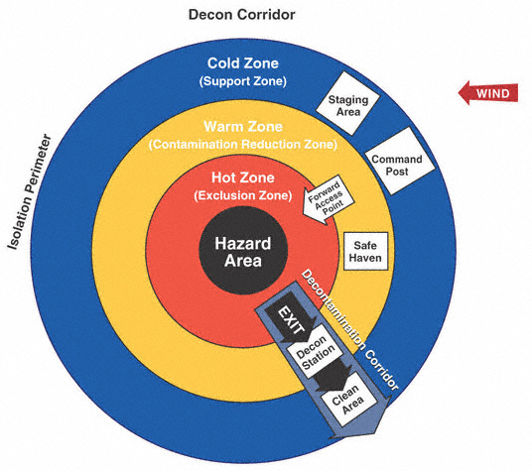
Duties by Zone
Notes:
The types of duties, by zone, are shown. Although configured as a circle, these zones may take on the configuration of your event. Example, there have been inside events where these configurations were square or rectangular making use of the “built environment” to include walls.

Slide 29
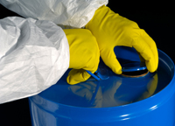
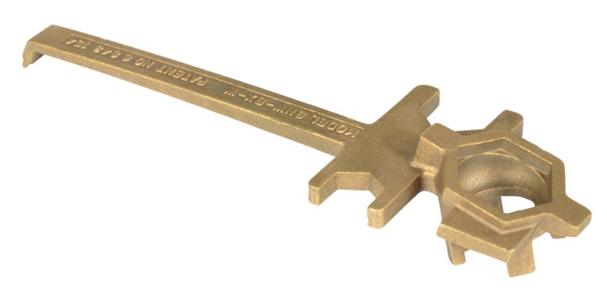
Mitigation Techniques
The method by which a substance, once released, is controlled by entry personnel. These are:
Chemical Control, and/or
Physical Control
Sometimes the easiest control method is to tighten the cap on
the container.
Notes:
The method by which a substance, once released, is controlled by entry personnel are designated as either,
Chemical Control, and/or
Physical Control
Sometimes the easiest control method is to tighten the cap on the container.
Make sure you have the proper wrench to do the job.

Slide 30
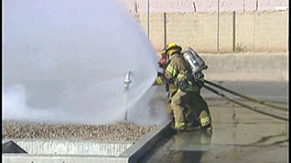
Chemical Control
Diluting: mixing so many parts of a liquid with the challenge liquid to reduce that chemical’s hazards. This can be done with alcohols and other chemicals to reduce their threat.
Notes:
Chemical control also involves Dilution.
Diluting involves mixing so many parts of a liquid (usually water) with the challenge liquid to reduce that chemical’s hazards. This can be done with alcohols and other chemicals to reduce their threat. Research those chemicals you work with which will permit this method. Caution: 1 gallon of a liquid usually generates a 20 square foot spill. If the required dilution is a 5:1 mix, you will end up with 5 gallons of water (100 square feet) added to the 1 gallon (20 square feet) of spill. This will result in a spill area of 120 square feet! Will this result in over riding the freeboard of your entrapment area? Will it create a larger hazardous waste concern? Perhaps absorbents would better work to your advantage.

Slide 31
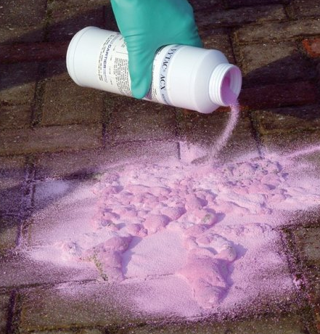
Chemical Control
Neutralization:
Mixing an acid with a basic material or base with an acid to return their pH levels toward a reading of 7 (neutral).
Notes:
Premixed materials are available for this. Laboratories will generally have,
“A” kits used on Acid spills,
“B” kits used on Basic (alkaline or caustic) spills, and
“Universal” kits used on either.
This method should only be accomplished by trained or qualified persons since this process will generate heat.
Neutralization should not be performed on human skin or on entry suits; skin can be chemically burned and suits may be degraded.
pH of 1 to 6 is acidic;
pH of 8 to 14 is basic (also called caustic or alkaline)
pH of 7 is neutral which is sought during this process.

Slide 32
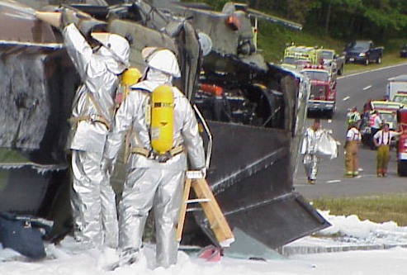
Physical Control
Remote shut-offs
Vapor suppression fog covering, cooling cylinders
Absorbents
Damming
Diking
Diverting
Transferring
Transfilling
Plugging and patching
Booming and damming on waterways.
Notes:
Physical control is using materials or equipment to interrupt the flow of a liquid spill. Some methods can also be used on powdered material. Gas or vapor releases can be reduced through physical means such as capping with specialty kits. Often, cylinders can be cooled thereby reducing their pressures and reducing their release.
Some of these methods are labor-intensive and may require numbers of persons and types of equipment you should have available prior to an event.
Other methods are available from bioremediation, chemical dispersion, and biological degradation.

Slide 33
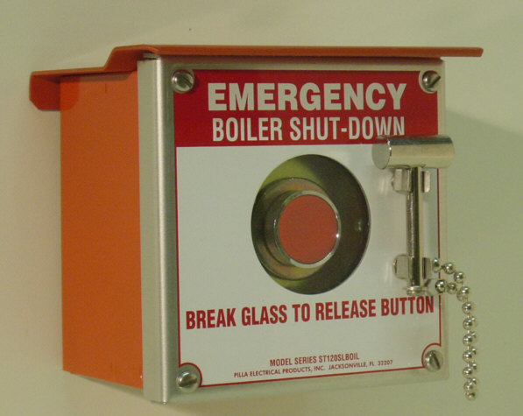
Remote Shut-Offs
These exist to shut down processes or pipe-runs to secure product flow. Use flow diagrams in your pre-plan and know the location of these shut-offs prior to an emergency.
Notes:
If remote shut-offs exist outside the threatened area, this option should be considered during pre-planning and actual response. Such an option will assist in personnel safety by prohibiting entry to the hot zone and permit additional time for the Incident Commander to size-up response options. This option may also reduce the amount of material released thereby reducing the amount to be diluted, neutralized, or recovered.

Slide 34
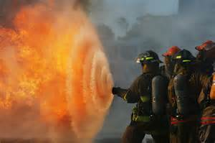
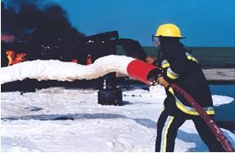
Vapor Suppression
Fog streams,
Covering with foam,
Notes:
Fog is used for cooling containers to reduce vapor production or to keep cylinders cool thus reducing their internal pressure. Liquid spills can be covered with compatible foam to reduce vapor production and spread. These 2 actions are usually accomplished by Fire Personnel from a distance.

Slide 35
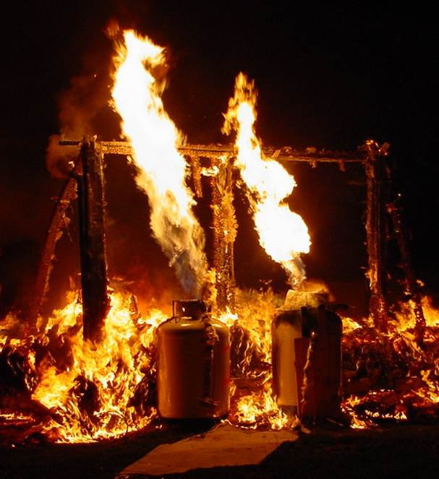
Vapor Suppression
Cooling cylinders.
Notes:
Fog also disperses gases and vapor to keep the gas below its LEL % (Lower Explosive Limit). The potential threat of pressure vessel ruptures is understood in regulations which segregate materials as well as requirements for sprinkler protection to cool cylinders and adjacent exposures.

Slide 36
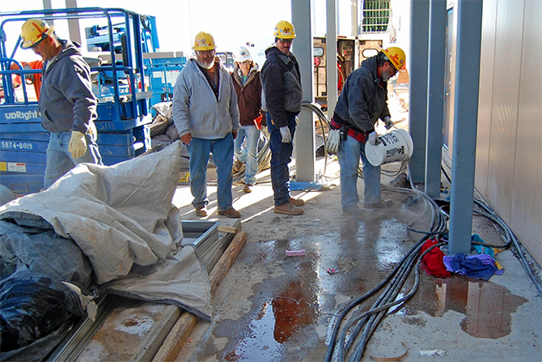
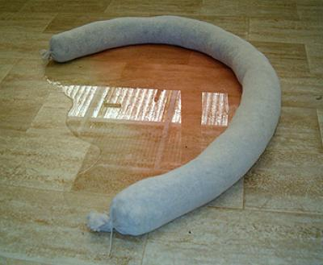
Absorbents
Materials in a solid or granular form which can absorb a certain volume of liquid spill on a pound-per-pound basis. Once introduced to the Hot Zone, they need to be retrieved and disposed of as hazardous waste.
Notes:
These are materials in a solid or granular form which can absorb a certain volume of liquid spill on a pound-per-pound basis. Once introduced to the Hot Zone, they need to be retrieved and disposed of as hazardous waste. When planning your response, plan for the safety of all involved, however, you should also consider economic issues.

Slide 37
Damming
Involves constructing a downstream impediment to flow. The 2 most often used are the 1) overflow and 2) underflow dam depending on the Specific Gravity (SG) of the liquid flowing.
Notes:
Damming involves constructing a downstream impediment to flow. The 2 most often used are the 1) overflow and 2) underflow dam depending on the Specific Gravity (SG) of the liquid flowing.
You can also completely dam the flow of a moving product. This is difficult to do on streams and may increase the upstream hazard.
Plan all the points on your facility where a spill could enter a waterway or storm drains. Make plans and provisions to impede or stop such intrusions.

Slide 38
Overflow Dam
The Overflow dam permits water to flow over the dam when heavier-then-water materials will be trapped at the base of the dam.
If the SG is more than 1.0, the material is heavier than water necessitating the construction of an overflow dam
Notes:
The Overflow dam permits water to flow over the dam when heavier-then-water materials will be trapped at the base of the dam.
If the SG is more than 1.0, the material is heavier than water necessitating the construction of an overflow dam.
When constructing an earthen dam, cover the dirt with plastic to eliminate erosion by upstream flowing water.

Slide 39
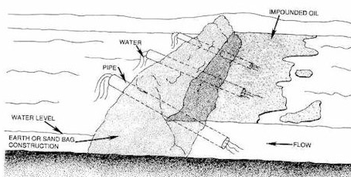
Underflow Dam
The Underflow dam is used when lighter-then-water materials will be trapped on the surface and the dewatering of the flow occurs at the stream bed.
Notes:
Therefore, during the analysis of the threat, one should know if the liquid flowing has a specific gravity less than 1.0 (which is assigned to water). Liquids with a SG less than 1.0 will float on the surface (necessitating the construction of an underflow dam). These dewater from beneath the floating material.
You will note that these constructions can be labor-intensive, requiring many people delivering the dam material to the location.
Some facilities anticipate where the spill will go and create interceptors within the course of travel. Pre-fabricated, fewer people are required to install them.

Slide 40
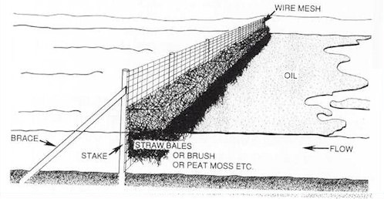
Underflow Dam
Another method to construct the Underflow dam.
Notes:
Another method to construct the Underflow dam and simultaneously absorb the floating contaminant.
Some materials may mix completely with water which means the flow may need to be stopped completely; impounded.
Research the control requirements for your on-site chemicals before an event occurs.

Slide 41
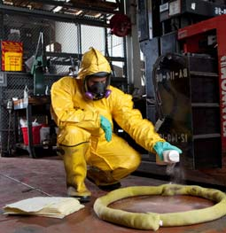
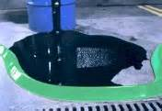
Diking
Placing a physical barrier around the material’s perimeter to prevent its spread. This guards against the intrusion of the material to other products, drains, or the environment
Also called Retention
Identify potential travel paths for releases before an occurrence!
Notes:
While barriers are created to impede a liquid flow, the responder should always be aware of potential vapors from the product. The generation of vapors or gases may require additional steps such as spreading a compatible covering (tarp) or foam over the material. This will serve as a vapor seal or blanket.
Liquid spills inside a building will follow the floor contours. In industrial settings, floors are generally pitched toward the floor drains. Also, doors may be elevated due to containment curbing constructed into the room or zone. Further vapor travel will be dependent upon the vapor density of the material as well as engineered ventilation systems and air exchanges. Other turbulences at doors, windows, and other openings may be the result of outside building contours and “drag” factors created due to the facility’s location and predominant wind factors or weather conditions. Liquids, vapors, gases, and smoke will follow the path of least resistance

Slide 42
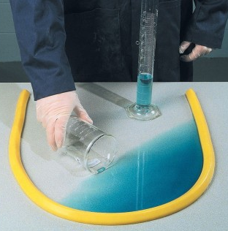
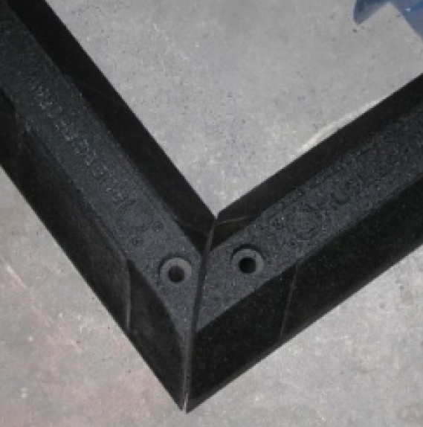
Diking Types
“U” Shaped Dike: used when you have enough time to plan the size of the dike.
“V” Shaped Dike: used on fast moving product which allows you to construct something immediately and if magnitude increases, you can extend the “wings” of the dike.
Notes:
“U” Shaped Dike: used when you have enough time to plan the size of the dike.
“V” Shaped Dike: used on fast moving product which allows you to construct something immediately and if magnitude increases, you can extend the “wings” of the dike.
These types can be used in labs, loading docks and other surfaces. Exterior incidents may require they be constructed with dirt or gravel. This would necessitate digging equipment; shovels and tarps to construct the dike. As shown, pre-fabricated diking materials exist.

Slide 43
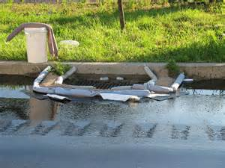
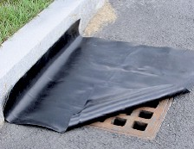
Protecting Drains
Control/removal considerations can be as particular as using sand in plastic bags for diking material rather than loose sand.
Notes:
Control/removal considerations can be as particular as using sand in plastic bags for diking rather than loose sand.
The plastic bags would be exposed to the product, but not necessarily the sand. Therefore, rather than disposing of bulk contaminated sand, only the plastic bags would be treated as contaminated. And, the plastic bags might be decontaminated and not included as waste!
Commercial, pre-assembled damming products are available from vendors. Many actions include,
Cover the drain with plastic,
Surround with a berm of absorbent materials,
Divert spill away from drain.
If the liquid is lighter than water, some have put a water covering over the plastic. If the spill breaks through the diking material, it will flood on the water surface for retrieval.

Slide 44
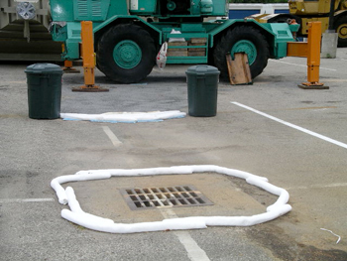
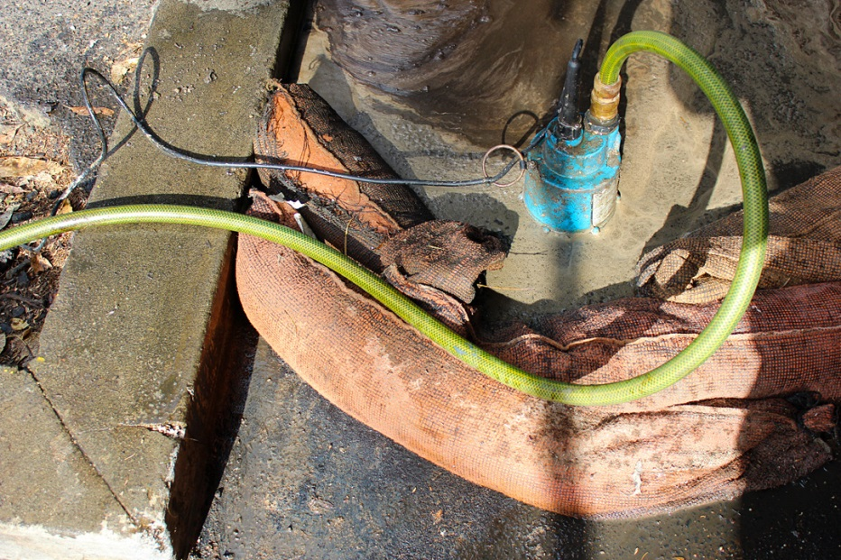
Protecting Drains
We can further protect this drain by covering with plastic and using diversion measures between the drain and leak source to take product away from the drain.
Notes:
Left slide: a submersible pump is used to pump-off product before it inundates the dam.
Right slide: reinforce this drain with a plastic covering as well as diverting the spill away from the drain. Covering with sheet plastic works best with liquids that float on water. Some have put a water cover over the plastic that if any product breaches the dike, it will float on the water and not go down the drain.
If you know the flow schematic for the drain, go down range and use absorbent materials to limit the distance the spill travels in the piping network. (Create an interceptor system.)

Slide 45
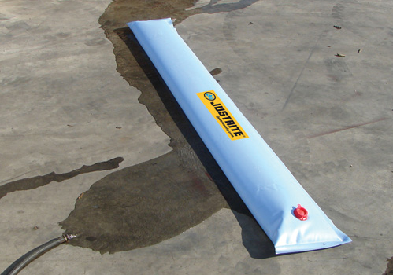
Diverting
Diverting of materials includes arranging a physical barrier to direct the product flow toward a desired location for control. This control location may be an impoundment basin, chemical drain and sump system, or low point on the facility.
Notes:
If a decision is made to divert a product to a given location, actions must also be considered once it has arrived at that point. Will you use absorbent materials? Neutralizing agents? Dilution techniques? How accessible is the location to which you’ve diverted the product? What hazard does it now pose to adjacent properties, products, or systems?
Diverting of materials includes arranging a physical barrier to direct the product flow toward a desired location for control. This control location may be an impoundment basin, chemical drain and sump system or low point on the facility.

Slide 46
Transferring
Removal of product from its damaged containment to another containment or container. Possible hazards:
Characteristics of the material being transferred,
Possibility of spillage,
Vapor production,
Electrical ignition hazard.
Notes:
Transferring is the removal of product from its damaged containment to another containment or container. Possible hazards:
Characteristics of the material being transferred,
Possibility of spillage,
Vapor production, and
Electrical ignition hazard
Planning should include the potential equipment needs to relocate the damaged container, pumps and siphoning equipment, protective diking around the container to be emptied and the new receiving container. Also, a determination of grounding and bonding of containers should be made.

Slide 47
Transfilling
Used to move cylinderized product from one cylinder to another.
Set-up requires
receiving cylinders,
means to convey the contents
from the leaking cylinder and
methods to cool the receiving cylinder.
A very involved method and only properly trained persons should initiate this.
Notes:
Transfilling is used to move cylinderized product from one cylinder to another.
Some gas companies move leakers to a cubical and allow gas to vent up through filters and thus be “scrubbed.”
If a cylinder is to be transfilled, drilling of leaking cylinder can be done.
Set-up requires
receiving cylinders,
means to convey the contents from the leaking cylinder and
methods to cool the receiving cylinder.
A very involved method and only properly trained persons should initiate this.

Slide 48
Cylinder Control
Cylinders may be controlled by turning the valve off
The bonnet nut can be tightened
The cylinder can be cooled to reduce internal pressure
Extreme caution is required when working around any pressure vessel.
Notes:
Cylinders may be controlled by turning the valve off
The bonnet nut can be tightened
The cylinder can be cooled to reduce internal pressure
Extreme caution is required when working around any pressure vessel.
Commercial kits also exist to control cylinderized leaks. Special Chlorine kits rated “A”, “B” and “C” kits are for:
“A” for controlling cylinders up to 100 lbs;
“B” for 1 ton cylinders, and
“C” kits for tank car operations.
Pressurized gases can also be reduced (eliminated) by burning in-place, called “flaring.” This is very dangerous and requires specialized personnel.

Slide 49
Plugging and Patching
Plugging and patching is the use of compatible materials applied to the container to result in either a temporary or permanent seal at the point of damage.
Notes:
This operation is usually performed on non-pressurized drums or other containers. Before plugging or patching, evaluate the container to determine the condition of the area around the leak. If the leak is due to a chemical reaction weakening the shell, then plugging or patching may be a wasted effort due to the entire shell being affected. If the leak is due to mechanical forces (puncture, tear, impact) then plugging or patching can be accomplished if enough of the original container shell is available to serve as an anchor point for the plug or patch.
Remember: If you use plugs, you may have to saw them off as close to the damaged drum wall as possible so the damaged container will fit into the overpack drum.

Slide 50
Plugging and Patching
Ensure actions are coordinated for safety.
Notes:
Wooden plugs and commercially available plugs in kits may not clear the interior side walls of recovery drums.
Ensure actions are coordinated for safety.

Slide 51
Selecting a Plug or Patch
Will hazardous material deteriorate the material?
Is container integrity such to serve as an anchor point?
Will the plug or patch deteriorate the container wall?
Will the plug or patch material be of sufficient size to complete the seal?
Notes:
Commercial kits exist to make your control job easier.
Completely cover the leak area with a patch which has a 20% overage to extend well beyond the edges of the breech.
Before affixing a patching compound to the container, reduce the flow by
rolling the container so the level of the material is below the leak area, or
b) closing a valve to slow the flow.
DO NOT remove the bung or vent opening on a drum, it will allow product to more rapidly flow.
If the material must be disposed, use an overpack drum and ensure it is properly labeled and segregated for disposal. This requires enacting Hazardous Waste provisions for disposal in:
40 CFR Part 261-274
49 CFR 171-173 or HM-181 for marking and transport
Check our ppt program “Hazardous Waste Management” for additional information pertaining to 1) conditionally exempt small quantity generators,
2) small quantity generators and 3) large quantity generators.

Slide 52
Booming
Booming on waterways must deal with not only trapping the spill but guiding it to a collection point on the stream, creek or river bank. This may become a “2-sided” operation requiring one team working each bank.
Notes:
Booming spills on waterways must deal with not only trapping the spill but guiding it to a collection point on the pond, stream, creek or river bank. This may become a “2-sided” operation requiring one team working each bank of the stream or creek. If the spill is on a lake, boats may be required as well as personal flotation devices for responder safety.
These operations will require greater numbers of personnel and specialty equipment. They may also require hours, days or weeks to stabilize depending upon the material spilled.
If your team will be required to create dams or dikes by shoveling dirt, gravel and other containment materials, consider pre-constructed control materials.
Ask yourself; “How many shovels-full and people would be required to construct something that one person could deploy?”
This may well be a job for a professional contractor.

Slide 53
Booming
Survey possible release types, direction of flow and destination. Provide access to these points for spill control teams and support equipment.
Notes:
Survey possible release types, direction of flow and destination. Provide access to these points for spill control teams and support equipment.
Some companies use skimmers which float on the surface and vacuum up the liquid spill.
For heavier than water materials, pumps can be used as well as weighted skimmers to extract material from the floor of the water source.

Slide 54
Booming
Small intrusions into water can be handled with booms and absorbent pads.
Notes:
Small intrusions into water can be handled with booms and absorbent pads.
Booms are made to overlap to contain the product. The ones shown have clips at each end to permit their locking together to shape the arrangement and minimize the material bypassing through the booms. They allow minimizing the spread and aid in “herding” the spill to a collection point.
If you concentrate on creating a major stop point, have a team construct smaller catchalls or stoppage points between this large stop point and the spill. This will help to minimize the total amount which could break through the major stop point.

Slide 55
Other Mitigation Methods
These can be specific by industry. There are also pipe sleeves which can be used for breeched piping.
Transportation industry may use the following:
Notes:
This is a pre-fabricated berm or collection pool to collect on-board product. The slide on the right shows a berm or pool to more specifically capture saddle (fuel) tank leaks.
Whenever attempting to catch drippage, determine if static electricity could build up from the free falling fuel. This will require grounding and bonding to be enacted.

Slide 56
Responder Levels and Actions
Diluting or Neutralizing a spill Specialists or Technicians with Operations support
Vapor suppression via
fog stream,
covering with foam,
cooling cylinders.
Usually accomplished by Fire Personnel from a distance.
Notes:
Specific duties are delineated for each level of responder in NFPA Standard 472.
When planning your response resources, if you wish to reinforce your plant’s team, many volunteer fire companies require their personnel to be certified in Level 2-Operations as a minimum to respond to HazMat events.
Check the qualifications of the off-site responders who will assist you. If specialty training is required for them to assist you, consider providing this training.

Slide 57
Responder Levels and Actions
Physical Control. These can be done remote from the spill, anticipating the direction of flow by Operations level personnel.
Remote shut-offs
Absorbents
Damming
Diking
Diverting
Notes:
Remember, if you can put distance between the hazard and responders, this will have a bearing on the level of PPE which may be required.
Example: Your on-site team is told a spill will enter the on-site creek in 10 minutes and will hit the plant boundary in another 10 minutes. Your team will have 20 minutes (approximately) to construct damming and diking downstream at the plant boundary wearing their normal work uniform. As the spill gets closer to their location, they will need to withdraw to a safe location or wear the proper level of PPE to continue with their efforts.
If such is elected, someone upstream should be monitoring to determine the material’s location to warn the damming or diking team when to withdraw.

Slide 58
Responder Levels and Actions
Physical Control
These may best be handled by Technicians.
Transferring
Transfilling
Plugging and patching
Booming and damming on waterways.*
Notes:
*This can also be done by Operations Level personnel if properly trained and equipped.

Slide 59
PPE
The level of PPE required for each response level will be dictated by the material’s hazard. Cite EPA charts and information on the SDS to determine proper types.
Notes:
The level of PPE required for each response level will be dictated by the material’s hazard. Cite EPA charts and information on the SDS to determine proper types.
Indicate in your Action Plan which agency you’ve elected to follow; OSHA or NFPA. If you are regulated by OSHA, your question is already answered; you’ll comply with OSHA.

Slide 60
PPE
Some industries have their own levels of safety for general employees and response personnel.
Notes:
Some industries have their own levels of safety for general employees and response personnel.
The above wallet card shows the determined work clothing required by this facility based on the hazard of the material.
The “X” in the lower right column is usually used to direct staff to emergency requirements in PPE and actions for a material.

Slide 61
Overpacking
Placing leaking or repaired container into a larger vessel
Overpacks may be made of steel, fiberglass composite material, or a polymer. Verify the correct type of resistant material to use.
Notes:
Incompatible materials will deteriorate the overpack drum shell and permit the product to escape the container.
Ensure the container to be overpacked has no protrusions that would obstruct overpacking or create damage to the plug or patch.
Determine if special overpack polyethylene liners are needed and available to insert into the overpack prior to placing the leaking container inside.
Depending upon the specific gravity of the liquid and the drum’s volume, a drum may weigh between 450 and 740 pounds! Placing the damaged drum into an overpack may require
rolling at an angle into the overpack,
using a forklift with drum gripper, grappler, or picker arrangement, or
using a forklift to ease the drum into the overpack.
Provide lifting equipment to eliminate strains and sprains in your team.

Slide 62
Overpacking: Inverting
With two people in proper protection, invert the overpack drum slowly over the leaking drum.
With the overpack drum completely covering the leaking container, slowly tilt the overpack to its side and up-right it.
Notes:
With two people in proper protection, invert the overpack drum slowly over the leaking drum.
With the overpack drum completely covering the leaking container, slowly tilt the overpack to its side and up-right it.
This is NOT the preferred method! Hazardous materials waste remediation firms do NOT like receiving drums like this. It makes their job more difficult to extract and treat the
Hazardous Waste.

Slide 63
Overpacking: Mechanical Lifting
Where space and equipment permit, special lifting devices can be attached to a forklift, lift, or crane.
Notes:
Where space and equipment permit, special lifting devices can be attached to a forklift, lift, or crane. Place the lifting device on the leaking drum and slowly lift it to a height above the top of the overpack drum. Position the overpack drum underneath the leaking drum. Slowly lower the leaking drum into the overpack drum. Place compatible absorbent (shim) material into the overpack between the leaking drum. Seal, label, and remove the overpack to a segregated storage point for disposal.
You only want to move the drum 1 time if possible to solve your problem.

Slide 64
Overpacking: Mechanical Lifting
Place lifting device on leaking drum and slowly lift it to a height above the top of the overpack drum.
Position the overpack drum underneath the leaking drum.
Notes:
Mechanical lifting entails using a lifting device on a leaking drum and to slowly lift it to a height above the top of the overpack drum.
Position the overpack drum underneath the leaking drum.
Slowly insert the damaged drum into the overpack.

Slide 65
Overpacking: Mechanical Lifting
Slowly lower the leaking drum into the overpack
Place compatible absorbent (shim) material into overpack between the leaking drum.
Seal, label, and remove the overpack to a segregated storage point for disposal.
Notes:
Place compatible absorbent (shim) material into the overpack between the leaking drum. This will cushion the internal drum and absorb whatever small amount of leakage may issue from the damaged drum.
Seal, label, and remove the overpack to a segregated storage point for disposal.

Slide 66
Overpacking: Slide Method
With both the overpack drum and leaking drum on their sides, place the open end of the overpack drum to face the bottom of the leaking drum.
With two people, slowly lift the leaking drum from the bottom and slide it inside the overpack drum slightly.
Notes:
With both the overpack drum and leaking drum on their sides, place the open end of the overpack drum to face the bottom of the leaking drum.
With two people, slowly lift the leaking drum from the bottom and slide it inside the overpack drum slightly.
While one persons holds the overpack from sliding, the other person gently slides the leaking drum inside.
When it is completely inside the overpack, slowly upright the overpack.
A wedge of wood 2” x 4” can be used as a pivot.
Lay the wood perpendicular to the overpack opening.
Roll the leaking drum onto the wood.
This will permit the leaking drum to sit above the overpack lip.
Match the overpack opening to the bottom of the drum and slide it into the overpack.

Slide 67
Overpacking: Roll or “V” Method
With both the overpack and leaking drum on their sides, position both drums at a 45 degree angle to each other.
The open end of the overpack will face the bottom of the leaking drum.
Notes:
A wooden wedge may be initially required to get the leaking drum up into the overpack.
With both the overpack and leaking drum on their sides, position both drums at a 45 degree angle to each other.
The open end of the overpack will face the bottom of the leaking drum.
Seal, label and segregate the overpack.
Use compatible absorbent (shim) material between the leaking drum and overpack interior walls.
When placing the lid onto the overpack, ensure the gasket is in place and the ring contacts both the lid and overpack lip. If there are bungs on the overpack lid, it may be wise to loosen to relieve any pressure inside the overpack.
Properly complete a hazardous waste label and affix it to the overpack. Fulfill all other provisions required for the storage and transport of hazardous waste per salient laws and regulations.

Slide 68
Preplanning Response
Engineer Safeguards where you can to eliminate more costlier spills.
Notes:
Engineer Safeguards where you can to eliminate more costlier spills. These come in the form of prefabricated drum pallets all the way to constructing a room so the dimensions can hold one third of the product in the room. (Containment rooms.)
Example: a room of 55 gallon drums with a net cubic volume at grade, (measuring 20 ft by 20 ft with a 1 foot freeboard). This equals 20 x 20 x 1=400 cubic feet (gross volume).
Knowing there are 7.48 gallons per cubic foot, this room, at grade, should hold, 7.48 (round off to 7.5 gallons) 7.5 gallons per cubic foot x 400 cubic feet= 3,000 gallons.
With a 55 gallon drum: 3,000 gallons / 55 gallons= 54.5 drums could be held in this room.
BUT, since the room’s gross volume is 400 cubic feet and the net volume is 20% of the gross, this leaves 80 cubic feet for spillage.
80 cu ft x 7.48 gals per cubic foot=598.4 gallons volume divided by 55 gallons = 10.8 drums capacity can be held by the net volume of the room.
If the room is protected by a sprinkler system, recalculate total volume that could be held based on number of sprinkler heads operating and the GPM per sprinkler head per minute.
The preplanning process can reveal those aspects which will work to your benefit during a spill or be detrimental.

Slide 69
Response Kits
Kits exist to:
Plug
Patch
Sleeve broken pipes
Plug with valving for transfilling
Notes:
Evaluate the possible future needs for your facility. Purchase (or some have constructed their own kits) as deemed necessary.

Slide 70
Response Kits
Spill control kits are available for drum spills.
Various gallon capacities are also available.
Notes:
Response Kits are a result of pre-planning.
Spill control kits are available for drum spills.
Various gallon capacities are also available.

Slide 71
Lab Kits
Lab kits exist for lab spills.
Notes:
Lab kits exist for lab spills.

Slide 72
Policies
Be specific to hazards and use for training.
Notes:
Let your policies be specific to your in-house and on-site hazards and use the policies for training.
Healthcare facilities find this especially helpful in training their staff.

Slide 73
Policies
For small or nuisance spills.
Notes:
Although these slides show a single individual performing control, teams should respond to provide support and respond to any accidents or injuries which may occur to team members.
The left slide shows a small arrangement for retention of a spill.
Right slide shows damming accomplished for a small nuisance spill to keep it out of the storm sewer.

Slide 74
Policies
Larger Operations or Greater Hazard Response
Notes:
Mercury spill control.
Larger operations or materials creating a higher magnitude of hazard will require specialty response.
What if a liquid-carrying pipe is broken under 50 PSI pressure? How many gallons per minute will this 1 inch pipe contribute to the spill?
GPM= 30 c d² then times the square root of the Pressure.
GPM= 30 times the c or coefficient of discharge (assign .9)=
30 x .9 x d, the diameter of the pipe squared;
30 x .9 x 1 squared
Then the square root of the pressure (50 PSI) is close to 7.
30 x 9= 27 x 1²= 27 x 7 = 189 gallons per minute.
If this leak occurs for 30 minutes, it will introduce 30 x 189 gallons=5,670 gallons to the spill area. If this spill is not contained, it will create square feet area of 113,400. If pooled, this spill may well measure 336 x 336 feet.

Slide 75
Policies
Specialized control operations.
Notes:
Clean-up operations after an event would be an example of a specialized control operation. It may require equipment you don’t have or even if you could rent it, would require special training for your site personnel.

Slide 76
Policies
Regulations may not permit you to let a leaking shipment leave your facility. So, you may end up responding to some one else’s incident.
Create team policies for such responses.
Notes:
Regulations may not permit you to let a leaking shipment leave your facility. So, you may end up responding to some one else’s incident.
This has occurred where carriers (trucks) delivering to one client, found another client’s product leaking on the truck. Regulations generally only permit the movement of a truck to a safe distance on the facility.
Create team policies for such responses.

Slide 77
Removal and Disposal
Includes recovery and disposal of a hazardous material (waste).
This phase requires careful thought and planning It must also be considered before actions are taken to clean-up a spill.
Whatever is introduced to the spill area will then be included as hazardous waste.
Notes:
Removal and disposal of materials Includes
Recovery and disposal of a hazardous material (waste).
This phase requires careful thought and planning. It must also be considered before actions are taken to clean-up a spill.
Whatever is introduced to the spill area will then be included as hazardous waste.
You may wish to contract with a cleanup agency rather than to assume the costs and possible liabilities of such an event. If you assume the clean-up, you also assume any liabilities from damages or injuries occurring once you claim “ownership.”

Slide 78
Decontamination
The completion of any operation will require decontamination of personnel.
It may also be required for machines, systems, and other impacted areas.
The level of PPE worn will be product-dependent for each work zone and the decon team.
Notes:
The type and level of decon will be hazard- or product-dependent.
Please see our PowerPoint program “Decontamination” on our website to supplement this program.
PPT can be found at www.dli.state.pa.us/PATHS then on the left column, click Training Resources which will bring up our menu.

Slide 79
Documentation
Proper documentation of the receipt of a hazardous substance and also the disposal of it as a hazardous waste must be in place.
Prior contact with a licensed hazardous waste contractor must be accomplished and the mechanism for disposal must be in your contingency plan for an emergency response.
Notes:
Other alternatives for the disposal of a hazardous waste must also be considered. If the material is unchanged and not contaminated, the material might be reused in your regular process for that specific material.
The key to all segments, including containment, is the establishment and compliance with your facility’s emergency response contingency plan.
Please see our PPT “Hazardous Waste Management,” for more information.

Slide 80
Training
Provide training per the standard (29 CFR 1910.120(q))
Use hands-on practical training for simulated situations
Train with off-site responders in table top exercises
Notes:
Training recommendations may be found in the standard at 29 CFR 1910.120, Appendix E Training Curriculum Guidelines, C. Emergency response training, C,b, (1), (2), (3), (4) and (5)

Slide 81
Self Test
Select a facility chemical and the support documents to respond to an incident
Determine exposure limits for team
Air monitoring required
PPE required
What level responds? Operations? Technician? Specialist?
Spill control actions
Decontamination required
Documentation and reporting

Slide 82
Summary
Determine your need for a spill control team
Will it be self-reliant or depend on off-site responders? Partially or totally?
Assign team members if you have a team
Train your team to the level of response expectations
Provide required PPE, spill control equipment, air monitoring equipment as required
Determine type of decon and provide that equipment
Ensure your program meets safety and regulatory requirements
Notes:
In your determinations for response, remember to promote safety first. If it is beyond your staff’s ability or too expensive to create your own team, establish who will be called to respond to your incidents.

Slide 83
Bibliography
NFPA 471, “Recommended Practice for Responding to Hazardous Material Incidents,” National Fire Protection Association, 1 Batterymarch Park, Quincy, MA 02169-7471.
NFPA 472, “Standard for Professional Competence of Responders to Hazardous Material Incidents,” National Fire Protection Association, 1 Batterymarch Park, Quincy, MA 02169-7471.

Slide 84
Bibliography
Code of Federal Regulations, 29 CFR 1910120(q) Hazardous Waste Operations and Emergency Response, (HAZWOPER), March 6, 1990.
29 CFR 1910.120, Appendix E Training Curriculum Guidelines, C. Emergency response training, C,b, (1), (2), (3), (4) and (5)
Emergency Response Training Manual for Hazardous Materials Technician, Lori P. Andrews, P.E., et.al, Center for Labor Education and Research, Van Nostrand Reinhold, New York, 1992

Slide 85
Bibliography
Neutralization of Corrosive Materials, AFR 71-4, A-15, TM 38-250/NAVSUP PUB 505 (Rev)/MCO P4030.19D/DSAM 4145.3/Atch 5/22, March, 1976
(as an example)
Hazardous Materials Response Handbook, Jerry Laughlin and David G. Trebisacci, editors, NFPA, 4th Edition, 2002.

Slide 86
Contact Information
Health & Safety Training Specialists
1171 South Cameron Street, Room 324
Harrisburg, PA 17104-2501
(717) 772-1635
RA-LI-BWC-PATHS@pa.gov
Notes:
For more information on webinars and free training at your location, we invite you to contact us.

Slide 87
Other Power Points of Interest
You may also wish to view our other Power Points to create your own in-house training program for this topic. Supporting PowerPoint programs include:
Basic Air Monitoring
HazMat PPE
Hazard Communication + GHS
Hazardous Materials Awareness
Hazardous Waste Management
Decontamination
Find them on our website at www.dli.state.pa.us/PATHS then click Training Resources in the left column. If not on our web, request our list of programs at RA-LI-BWC-SAFETY@pa.gov

