Slide 1
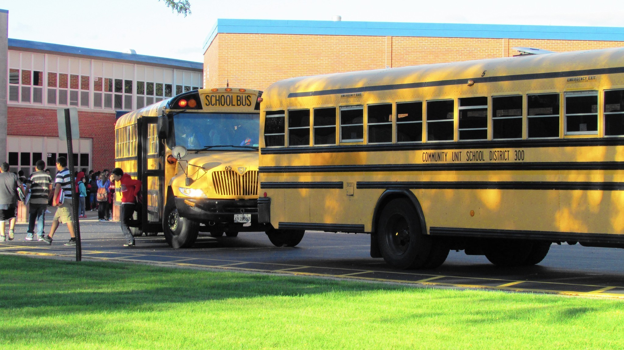
SCHOOL SAFETY - BASIC
Bureau of Workers’ Compensation
PA Training for Health & Safety
(PATHS)
Notes:
There are many hazards within schools that should be addressed whether the school is elementary, middle, high school or a college/university. This presentation is an overview of types of hazards that can exist. Having a good hazard identification/detection program in place will go a long way in preventing incidents.

Slide 2
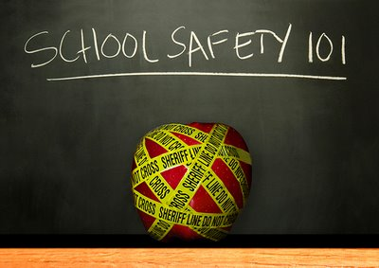
Topics
Hazard Definition
Types of Hazards
Inspections
Recommendations
Follow Up
Notes:
This program will cover:
The definition of a hazard
The types of hazards that can exist in schools
Inspections
Recommendations
Follow Up

Slide 3
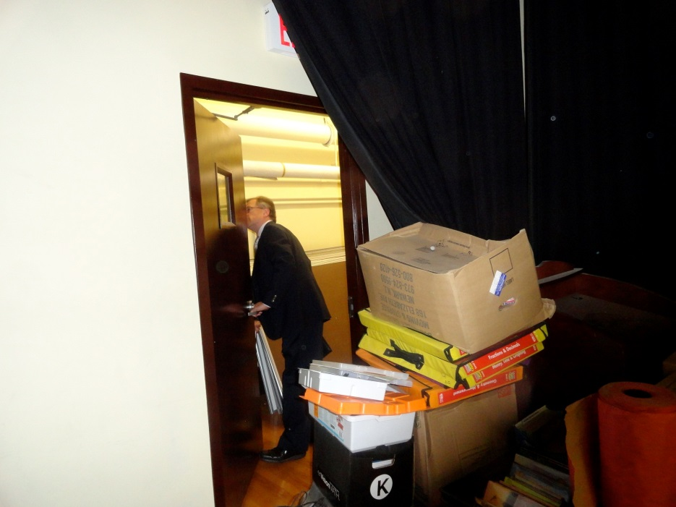
Hazard Definition
A hazard is an unsafe condition or activity that, if left uncontrolled, can contribute to an incident.
National Safety Council
Notes:
The National Safety Council (NSC) defines a hazard as an unsafe condition or activity that, if left uncontrolled, can contribute to an incident.

Slide 4
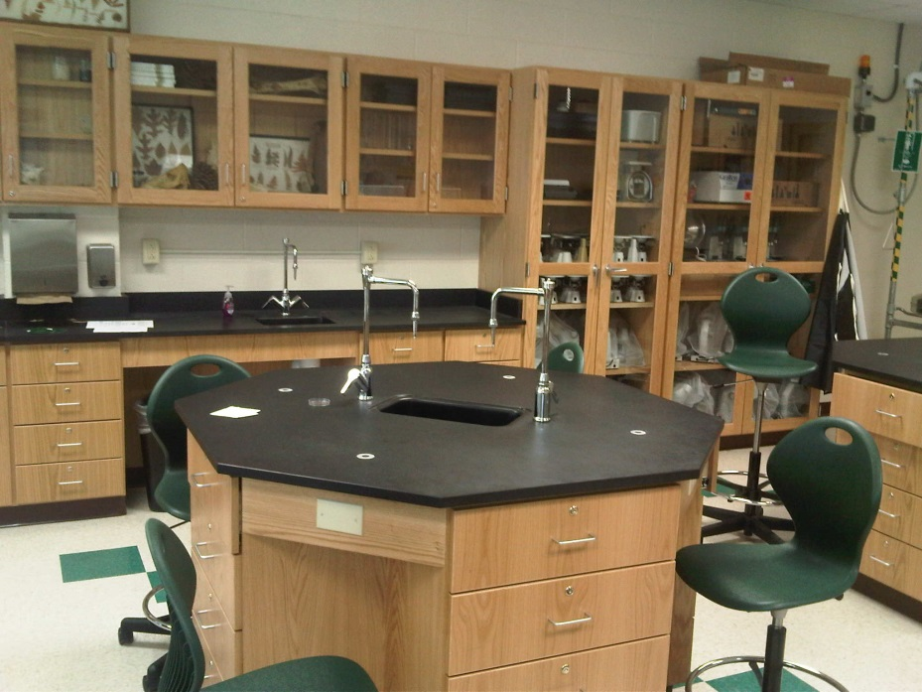
Laboratory Safety
Notes:
Many schools have laboratories in them where students learn the basics of chemistry, biology and other related subjects.
Laboratories can contain many hazards such as chemicals and gasses, natural gas for burners, and sharp instruments used during experiments/learning opportunities.

Slide 5
School Laboratory
A school science lab is an important place for students to learn about biology, chemistry, and physics.
However, many potential hazards lurk in this environment such as fire, chemical contact with skin and eyes, glass breakage and electricity.
Notes:
Hazards within a laboratory setting need to be identified and steps should be put in place to protect students, visitors and employees as well as to correct those hazards.
Employees should remember that a hazard left uncorrected is an injury waiting to happen.

Slide 6
Lab Safety-Responsibilities
School administrators must provide support for laboratory safety programs.
They need to be aware of and appreciate the need for establishing safety and health instruction in the science curriculum.
They need to operate their schools in as safe a manner as possible.
Notes:
All school employees have a responsibility to ensure the safety of students in their environment, however school administrators and management personnel need to understand they have the responsibility to:
Provide support for laboratory safety programs.
Be aware of and appreciate the need for establishing safety and health instruction in the science curriculum.
Operate their schools in as safe a manner as possible.

Slide 7
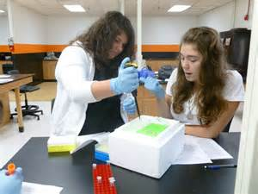
Responsibilities
Teachers play the most important role in ensuring a safe and healthy learning environment for science students.
The best time to impress upon students the need for caution and preparation is before and during working with chemicals in science labs.
Notes:
Because teachers/instructors have a responsibility to ensure a safe and healthy learning environment for students.
The best time to educate students on the need for caution, preparation and safety is before and during the act of working with chemicals.

Slide 8
Responsibilities
Teachers have an obligation to instruct students in basic safety and health practices required in science labs.
One of the most important obligations for teachers is to lead by example.
Provide safety information and training for every stage of experiment planning.
Be there to observe, supervise, instruct, and correct during the experimentation.
Notes:
Teachers/instructors should instruct students in basic safety and health practices necessary within a laboratory.
One of the best ways to do that is to lead by example. Teachers/instructors should always wear the proper Personal Protective Equipment (PPE) and ensure PPE given to students is in a safe condition.
Students should be provided with safety information and training for every stage of experiment planning.
Teachers/instructors should be present to observe, supervise, instruct, and correct during experiments.

Slide 9
Responsibilities
Teachers and teacher’s-aides should lead example:
Wear personal protective equipment (PPE).
Follow and enforce safety rules, procedures, and practices.
Demonstrate safety behavior and promote a culture of safety.
Be proactive in every aspect of laboratory safety, making safety a priority.
Notes:
As part of leading by example, teachers/instructors and teacher’s-aides should:
Wear personal protective equipment (PPE).
Follow and enforce safety rules, procedures, and practices.
Demonstrate safety behavior and promote a culture of safety.
Be proactive in every aspect of laboratory safety, making safety a priority.

Slide 10
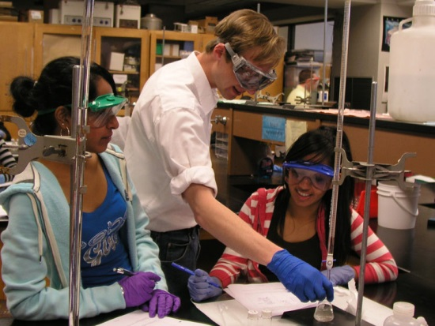
Responsibilities
Students must develop proper attitudes toward safety and acquire good habits of assessing and reporting all hazards and risks.
Notes:
Students also have a responsibility to develop proper attitudes toward safety as well as acquiring good habits of assessing and reporting all hazards and risks.

Slide 11
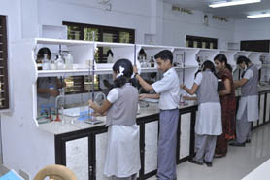
General Lab Safety
Always a key word in safety
No food or drink in the lab
No clothes or bags stored on benches
No clutter
Always wash hands after working with chemicals
Notes:
General Laboratory Safety includes:
Always a key word in safety
No food or drink in the lab
No clothes or bags stored on benches
No clutter
Always wash hands after working with chemicals

Slide 12
General Lab Safety
Do not wear loose/baggy clothing or dangling jewelry.
Make sure long hair is tied back behind the ears.
Never attempt to catch a falling object.
Never leave experiments while in progress.
Never fill a pipette using mouth suction.
Do not leave lit Bunsen burners unattended.
Notes:
In addition, Laboratory Safety also includes:
Do not wear loose/baggy clothing or dangling jewelry.
Make sure long hair is tied back behind the ears.
Never attempt to catch a falling object.
Never leave experiments while in progress.
Never fill a pipette using mouth suction.
Do not leave lit Bunsen burners unattended.

Slide 13
PA Right to Know Law
Signed into Law: October 5, 1984 and requires all School Districts as well as “state affiliated” colleges/universities to comply
All containers and ports of pipelines containing hazardous substances/mixtures must be labeled
A Hazardous Substance Survey Form must be completed and posted by April 1 of each year
Safety Data Sheets for all hazardous substances or mixtures must be in place
Employees must be given annual training
Notes:
As part of maintaining compliance with PA’s Right to Know Act which became law on October 5, 1984, schools that do not fall under OSHA regulations must have:
All containers and ports of pipelines containing hazardous substances/mixtures must be labeled
A Hazardous Substance Survey Form must be completed and posted by April 1 of each year
Safety Data Sheets for all hazardous substances or mixtures must be in place
Provide related training to employees on an annual basis

Slide 14
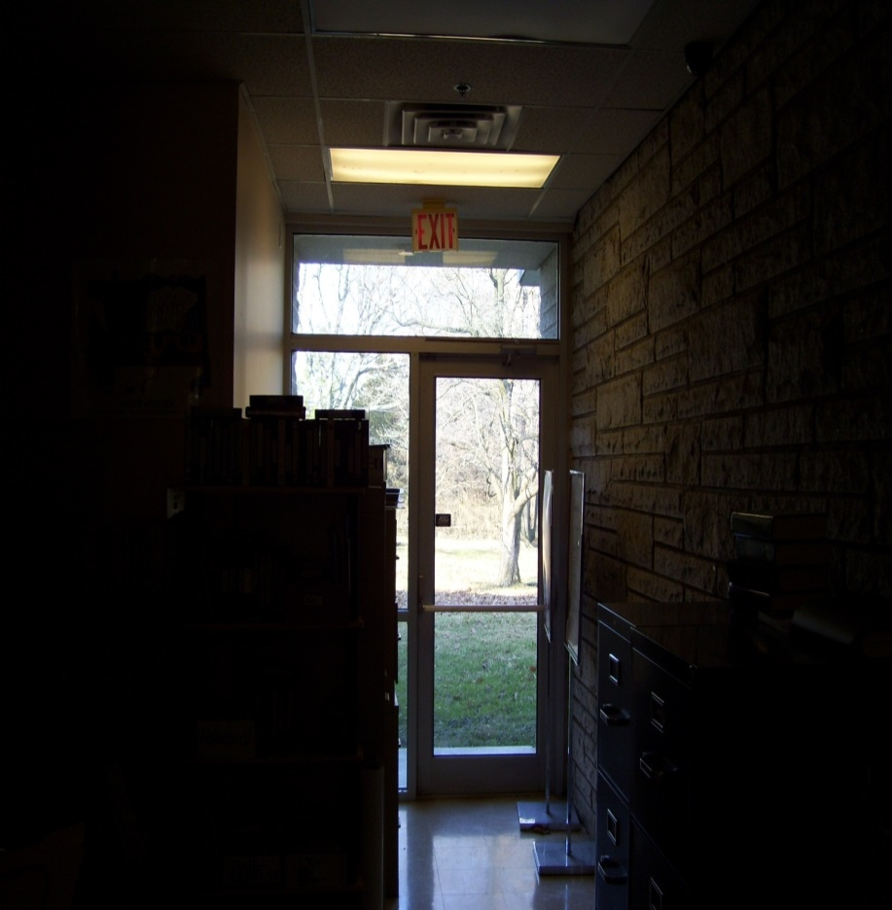
Slips, Trips And Falls
How many problems can you identify in this picture?
Solutions???
Notes:
Problems:
Exit/hallway cluttered
Window area blocked
Insufficient light
Solutions:
Open up hallway
Clear space at windows
Remove clutter
Create better lighting

Slide 15
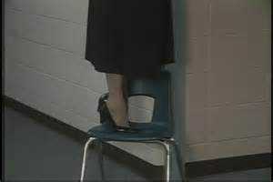
Causes
Over-reaching
Standing on edge of unsecured chair
Climbing ladder alone
Blocked vision around corner
Notes:
Some causes for employee/student injuries include:
Over-reaching
Standing on edge of unsecured chair
Climbing ladder alone
Blocked vision around corner

Slide 16
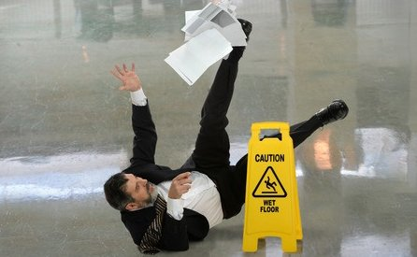
Causes
Not paying attention
Reading and walking
Slippery Floors
Uneven Surfaces
Notes:
Other causes include:
Not paying attention
Reading and walking
Slippery Floors
Uneven Surfaces

Slide 17
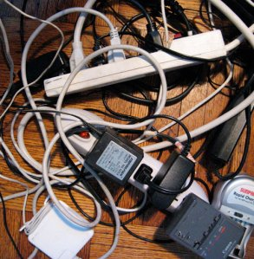
Causes
Insufficient light
Loose, irregular surfaces
Overloaded outlets
Clutter
Notes:
In addition to what was already mentioned, there are other causes attributed to incidents/employee injuries such as:
Insufficient light
Loose, irregular surfaces
Overloaded outlets
Clutter

Slide 18
Hazards
Furniture placement
Rushing in hallways
Poor housekeeping
Notes:
Some hazards that can be identified are as follows:
Furniture placement
Rushing in hallways
Poor housekeeping

Slide 19
Hazards
Open fire doors
Open file cabinet drawers
Wires across walking surfaces
Notes:
This slide shows other hazards that can be found in a school such as:
Open fire doors
Open file cabinet drawers
Wires across walking surfaces

Slide 20
What to do - Prevention
Four Steps:
(1) Find the problem/hazard
(2) Check it out
(3) Fix it
(4) Look at it again
Notes:
Preventing an incident includes four (4) steps:
(1) Find the problem/hazard
(2) Check it out
(3) Fix it
(4) Look at it again

Slide 21
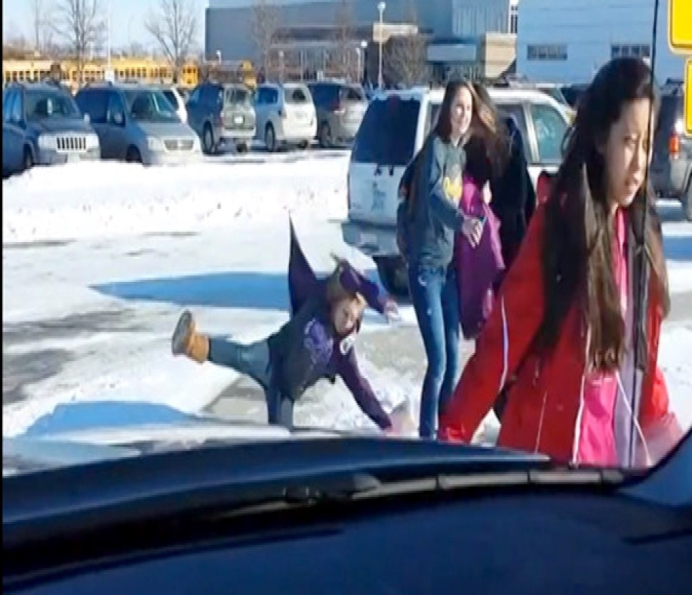
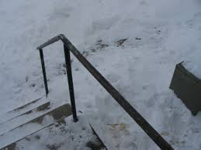
Weather Conditions
Notes:
Weather conditions can also prove to be a hazard, especially for schools that are in a climate where there is snow, freezing rain, ice and cold temperatures.
Schools in an area that is prone to hurricanes, tornados and heavy winds should also plan for the hazards associated with that type of environment.

Slide 22
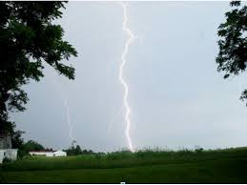
Weather Conditions
Use extreme caution and be alert
Notes:
Using extreme caution and be alert for sudden changes is one method for incident prevention.

Slide 23
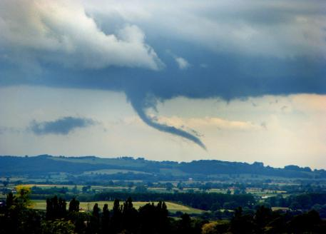
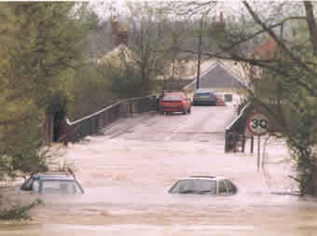
Planning for Weather Issues
Plans should be in place to deal with different severe weather conditions that happen during the school day such as:
Tornados
Floods
Damaging Hail
Snow squalls producing heavy snow
Sudden freezes
Notes:
Schools should be plans in place that address the hazards associated with the different types of weather situations that may occur.

Slide 24
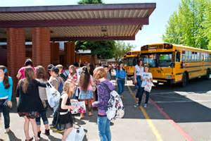
School Traffic
Do you see any safety concerns in this picture?
What steps would you take to remedy the situation?
Notes:
Problems:
Child on other side of yellow “safety line”
Children seem to be inattentive to traffic situation
Correction:
Possibly put physical barriers in place
Provide more adult supervision

Slide 25
School Traffic
Provide Crossing Guards
Notes:
To ensure the safety of students while they’re crossing streets coming to and from school consideration should be given to having dedicated Crossing Guards or law enforcement personnel in place.
Crossing Guards/law enforcement personnel should be wearing a high-visibility appropriate/approved traffic safety vest.

Slide 26
Ergonomics
Ergonomics: The science of fitting jobs to people. Encompasses the body of knowledge about physical abilities and limitations as well as other human characteristics relevant to job design.
Ergonomic design: The application of this body of knowledge to the design of the workplace (tasks, equipment, environment) for safe and efficient worker use.
Good ergonomic design: Makes the most efficient use of worker capabilities while ensuring job demands do not exceed those capabilities.
Notes:
Ergonomics, which is the science of fitting jobs to people, should be taken into account when setting up employee and student workstations as well as purchasing equipment and assigning different job tasks to employees.

Slide 27
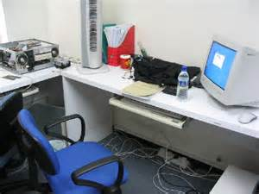
Ergonomic Issues
When setting up a computer “work station” keep in mind the hazards that can occur:
Placement of keyboard vs. computer screen
Desk cluttered, must reach for needed supplies
Wiring setup below desk-possible trip and fall
Any other concerns?
Notes:
Some other ergonomic concerns that are in place with this work station include:
Document placement – no holder, could mean individual continuously looks down and to the right when typing
Ensure chairs are set up so that users forearms are straight and elbows are at a 90 degree angle
Feet should be flat on the floor and legs are at a 90 degree angle
The distance from the user’s eyes to the viewing screen should be between 18-24”

Slide 28
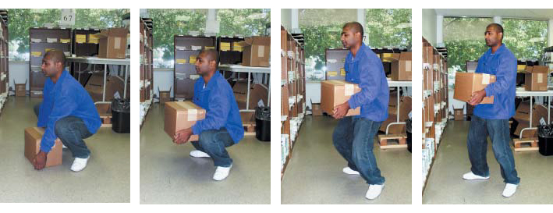
Safe Lifting
Think about the weight, size, and shape of the object and the distance you will be moving it.
Is the object bulky? Will you need help?
Are there any hazards that can be eliminated?
Think about the route you’ll be taking: any stairs, doors, obstacles?
If the object is heavy or awkward use a hand cart or pallet jack.
Notes:
When lifting anything employees should:
Think about the weight, size, and shape of the object and the distance you will be moving it.
Consider if the object is bulky and if help will be needed.
Determine if there are there any hazards that can be eliminated.
Think about the route you’ll be taking: any stairs, doors, or obstacles?
Determine if the object is heavy or awkward use a hand cart or pallet jack.

Slide 29
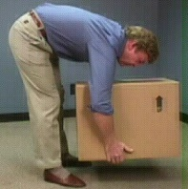
Safe Lifting
When lowering an object remember to bend at the knees not at the waist and avoid twisting motions while putting the load down. (the picture shown demonstrates how NOT to put an object down!).
If you must turn while lowering an object adjust your feet rather than twisting your back.
Not the correct way to lower a box
Notes:
When lifting any objects employees should remember to bend at the knees not at the waist.
If turning while lowering an object employees should adjust their feet rather than twisting their back.

Slide 30
Safety Tips-Standing
If standing for an extended period:
Stand with feet shoulder width apart
Place one foot slightly behind other
Shift weight from foot to foot
Re-position your body if possible
Notes:
Many teachers and other employees have to stand for long periods of time.
Extended standing, especially on hard surfaces, can impact a person’s overall health.
Here are some tips to can make standing more tolerable:
Stand with feet shoulder width apart
Place one foot slightly behind other
Shift weight from foot to foot
Re-position your body if possible

Slide 31
Hazard Inspections
Hazards in the school environment can be reduced or even eliminated by conducting regular “hazard identification” inspections (also called safety inspections).
Inspections should be conducted frequently with hazards noted being documented.
Webster’s II New College Dictionary defines an inspection as an official review or examination.
Notes:
Conducting periodic hazard inspections will aid in preventing incidents for employees, visitors and students.

Slide 32
Inspections
During inspections you are looking for any and all hazards that could lead to an incident.
A hazard may be an unsafe condition or an unsafe act.
All hazards should be recorded and reported to the appropriate authority.
Notes:
When conducting inspections an attempt should be made to identify all hazards which include unsafe acts and unsafe conditions.
Hazards detected should be recorded and reported to ensure they are corrected as soon as possible.

Slide 33
Inspections
The report should include recommendations to eliminate or at least reduce hazards
Emphasis must be placed on awareness
ALWAYS follow up to ensure changes have been implemented and are working
Notes:
A safety/hazard detection report should include recommendations to eliminate or at least reduce hazards discovered.
Employees should be made aware of the importance of reporting hazards a.s.a.p. so that they can be corrected.
Part of the inspection process should be a method of following up to ensure hazards identified have been corrected.

Slide 34
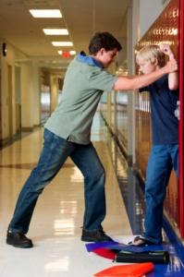
School Violence
No discussion of school safety today is complete without looking at school violence including bullying.
While bullying has been around for many years, violence resulting in serious injuries is becoming more and more prevalent.
Notes:
Unfortunately, workplace violence is on the increase and schools are no exception.
Bullies can exist in any workplace and certainly schools can have their share no matter the age of the students involved.
Bullying and violence must be addressed and policies should be in place to deal with those issues quickly and fairly.

Slide 35
Overview-School Violence
Crime, violence, and disorder in schools have become major national issues, as reported in various national surveys of school order and safety.
These problems not only endanger students and teachers, but they also prevent teachers from concentrating on teaching and students from concentrating on learning.
Developing and Maintaining Safe Schools
Notes:
Violence and even bullying can endanger all employees as well as students and visitors.
Tolerating an environment of bullying and/or violence can lead to a lack of concentration on learning.

Slide 36
School Violence
The diversity of the present school student population, especially in areas of poverty, teenage parents, and lack of respect for all authority has created unique needs and lack of or limited proper resources.
It has become a community dilemma.
Sometimes the lack of discipline or supervision at home contributes to issue arising in school.
Notes:
Schools have become more diverse over the years bringing with many different cultures, attitudes and methods of expression.
As times have changed and different issues have surfaced, more and more there appears to be a lack of respect for all authority whether that authority is a teacher, school administrator, clergy, or law enforcement person.
Many times the lack of discipline, control and supervision in a student’s home life can lead to problems with the student while at school.

Slide 37
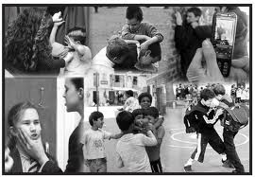
School Violence
To counteract school violence, there must be a plan in place involving input from all sources, including students.
The root cause of violence must be identified and dealt with to significantly change the violent and disruptive school environment.
Notes:
Policies, procedures and plans should be in place that effectively address bullying, violence and improper behavior.
While it may be difficult, the root cause of a violent act should be identified and dealt with to ensure the safety of all concerned.

Slide 38
School Safety Summary
To have a successful school safety program:
Conduct incident investigations
Identify hazards
Find the Root Cause of incidents
Make recommendations to eliminate or at least reduce hazards
Create awareness
Develop plan to reduce school violence involving all aspects of the community
Notes:
For a school to have a successful safety program, the following should be in place:
Conduct incident investigations
Identify hazards
Find the Root Cause of incidents
Make recommendations to eliminate or at least reduce hazards
Create awareness
Develop plan to reduce school violence involving all aspects of the community

Slide 39
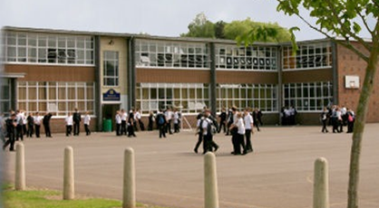
Supporting Resources
Related PowerPoints
Art Safety Elem-Mid-High School
Dealing with Angry People
School Lab Safety
Housekeeping
Incident Investigation
Near Miss
Hazard Identification
Notes:
This slide identifies other PowerPoint presentations within the PA Training for Health and Safety (PATHS) system that may be helpful in developing a school safety program.
The PowerPoint presentations are available free of charge to any employer within the Commonwealth of Pennsylvania.

Slide 40
Contact Information
To contact a Health & Safety Training Specialist:
Bureau of Workers’ Compensation
1171 South Cameron Street Room 324
Harrisburg, PA 17104-2501
717-772-1635
RA-LI-BWC-Safety@pa.gov
Like us on Facebook! https://www.facebook.com/BWCPATHS
PPT-133-01
40
Notes:
To obtain any of the PowerPoint (PPT) presentations listed on the previous slide or to request other PPT’s please use the contact information in this slide to reach us.

Slide 41
Questions

