Slide 1
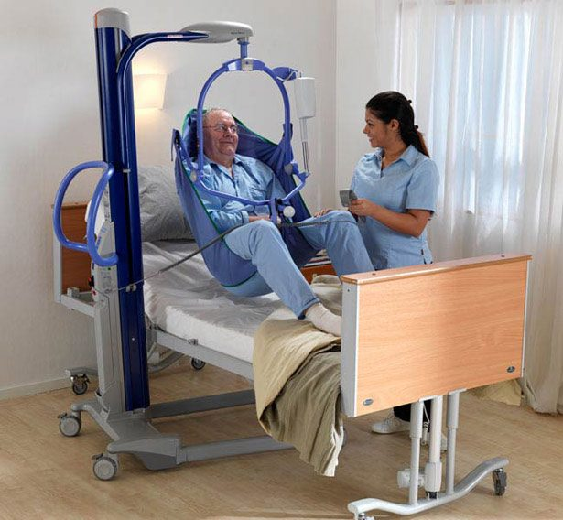
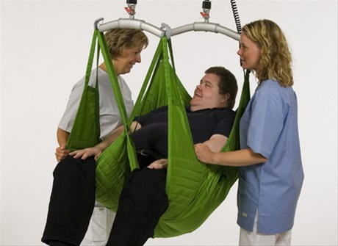
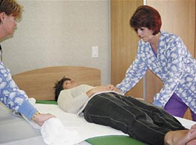
Safe Patient Handling
Bureau of Workers’ Compensation
PA Training for Health & Safety (PATHS)
PPT-075-02
1
Notes:
A big part of patient care is the safe lifting and handling of patients.
Many care givers are injured each year due to patient handling so it is important to understand that when dealing with patients you need to consider proper body mechanics, ergonomics and your and the patient’s safety.

Slide 2
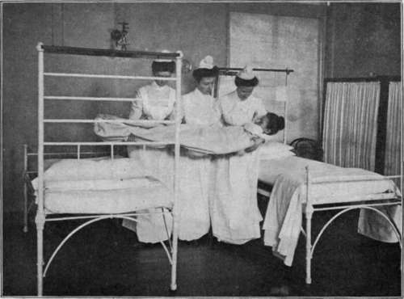
What We’ll Talk About
Injury Risk
Myths vs. Facts
Musculoskeletal Disorders
Body Mechanics/Ergonomics
Using a Patient Lift
Proper Lifting Techniques
PPT-075-02
2
Notes:
To assist you with keeping yourself and your patient safe we will address the following topics:
Injury Risk
Myths vs. Facts
Musculoskeletal Disorders
Body Mechanics/Ergonomics
Using a Patient Lifting Device
Proper Lifting Techniques

Slide 3
Injury Risk
Rates of musculoskeletal (MSD) injuries from overexertion in healthcare occupations are among the highest of all U.S. industries.
Bureau of Labor Statistics (BLS) on average: rate of overexertion injury across all industries is 38 per 10,000 full time workers.
Rate for hospital workers twice the average (76 per 10,000); Nursing home workers 3x the average (132 per 10,000); ambulance workers 6x the average (238 per 10,000)
Single greatest risk factor: manual patient handling
PPT-075-02
3
Notes:
Patient handling accounts for a good deal of injuries to health care workers every year.
The rates of musculoskeletal injuries from overexertion to health care workers are among the highest in the nation.
The Bureau of Labor Statistics has indicated that the rate of injury for hospital workers is twice the average while Nursing Home workers are three times and ambulance personnel are six times above the national average for overexertion injuries.
The single greatest risk factor for sustaining an overexertion injury is manual patient handling.

Slide 4
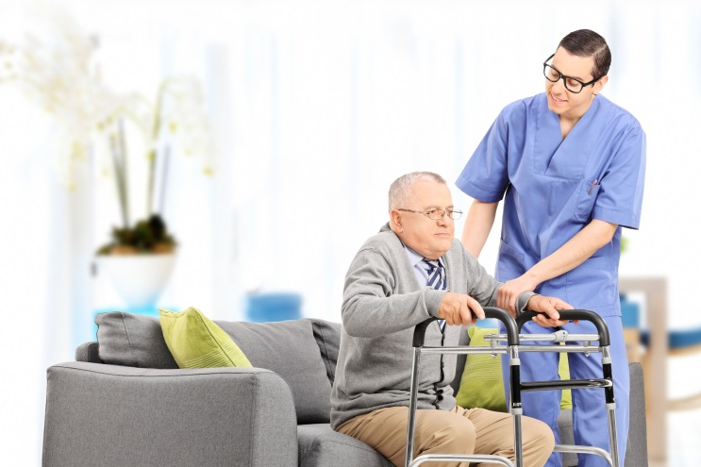
More Risks
Rising obesity rates in the U.S. have increased physical demands on caregivers
Aging workforce: average age of registered nurse in U.S. = 47
Ongoing shortage of nurses/other caregivers
Healthcare organizations cutting workforce
Longer work schedules
PPT-075-02
4
Notes:
Unfortunately, the rate of obese people in the United States is rising and this fact puts more physical demands on caregivers.
In addition, the caregivers themselves are getting older with the average age of a registered nurse in the U.S. being 47 years old.
There is also a shortage of nurses and other caregivers which has actually necessitated some health care organizations bringing in nurses from other countries.
Some health care organizations have been forced to cut their workforce which can add to the work load of those nurses who are still employed.
In addition, many caregivers are now working longer schedules and are required to rotate between different care areas.

Slide 5
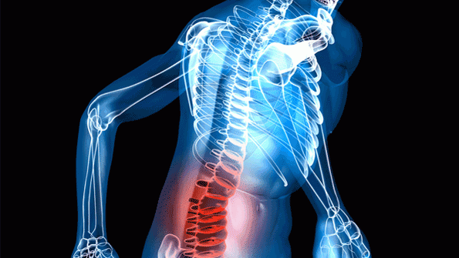
Some Statistics*
52% of Nurses experience chronic back pain
12% leave nursing because of back pain
20% transfer to a different unit due to back pain
Back pain is the leading cause of disability to nurses under 45 years of age
*American Nursing Association, “Handle with Care”
http://www.nursingworld.org/MainMenuCategories/OccupationalandEnvironmental/occupationalhealth/handlewithcare/hwc.aspx
PPT-075-02
5
Notes:
Back pain is a definite problem with health care employees:
52% of nurses experience chronic back pain
12% of nurses leave the profession due to back pain
20% of nurses transfer to a different unit because of back pain
Back pain is the leading cause of disability for nurses under 45 years of age

Slide 6
Moving Patients-Myths vs. Facts
Myth: We can train workers to use proper body mechanics and avoid injuries.
Fact: More than 30 years of research and experience shows relying on proper body mechanics or manual lifting alone is not effective to reduce back/other MSD’s.
Myth: Patients are not as comfortable or safe with mechanical lifting.
Fact: Patient education can reinforce that the lift is for the patient’s safety as well as the caregivers. Patient handling equipment can prevent falls, bruises, and skin tears.
PPT-075-02
6
Notes:
There are some myths about moving patients such as workers can be trained to use proper body mechanics whereas more than 30 years of research and experience shows that relying on proper body mechanics or manual lifting is not effective to reduce injuries.
Another myth is that patients are not as comfortable or safe when mechanical lifting is used, however the fact is that patient education can ensure patients the lift is being used for their safety and can prevent falls, bruises and skin tears.

Slide 7
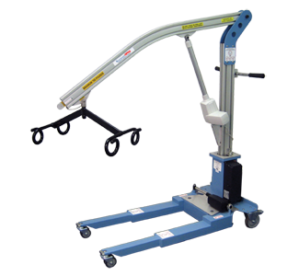
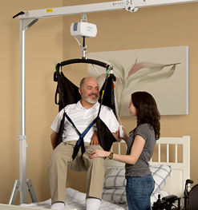
Moving Patients-Myths vs. Facts
Myth: It takes less time to manually move patients than to use lifting equipment.
Fact: It can actually take much longer to get a team of co-workers together to manually lift a patient than to find and use lifting equipment. Attempting to lift a patient by only one person puts that caregiver at risk of injury. Using mechanical devices takes fewer personnel and about 5 minutes less.
PPT-075-02
7
Notes:
One other myth is that it takes less time to manually move patients than to use lifting equipment.
Regarding this myth it can actually take much longer to get a team of co-workers together to manually lift a patient than to find and use lifting equipment.

Slide 8
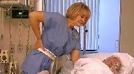
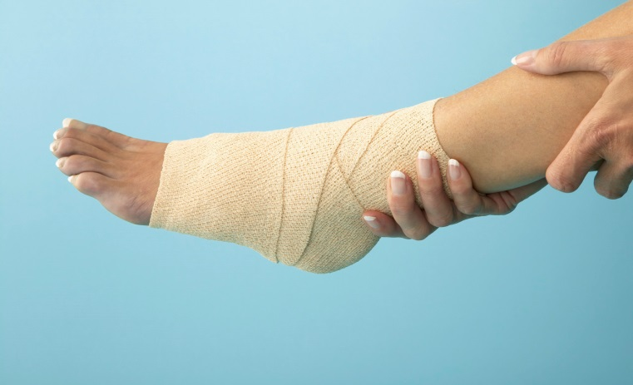
Musculoskeletal Disorders (MSDs)
Injury or disorder of the:
Muscles
Nerves
Tendons
Joints
Cartilage
Spinal Discs
PPT-075-02
8
Notes:
Musculoskeletal Disorders are injuries or disorders of the:
Muscles
Nerves
Tendons
Joints
Cartilage
Spinal Discs

Slide 9
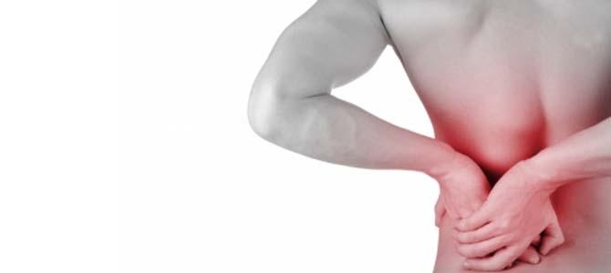
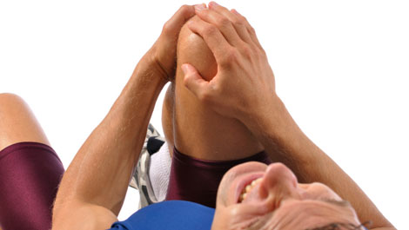
Stages of MSD’s
Early stage – pain may disappear after a rest away from work
Intermediate stage – body part aches and feels weak soon after starting work and lasts until well after finishing work
Advanced stage – body part aches and feels weak even at rest, sleep may be affected, light tasks are difficult on days off
PPT-075-02
9
Notes:
Musculoskeletal disorders have different stages each with a different level of pain:
Early stage – pain may disappear after a rest away from work
Intermediate stage – body part aches and feels weak soon after starting work and lasts until well after finishing work
Advanced stage – body part aches and feels weak even at rest, sleep may be affected, light tasks are difficult on days off

Slide 10
MSD’s-Signs & Symptoms
Do not ignore signs & symptoms!
Aching
Burning
Cramping
Loss of Color
Numbness
Pain
Swelling
Stiffness
Tingling
Weakness
PPT-075-02
10
Notes:
Never ignore any of the following symptoms which could be related to a MSD:
Aching
Burning
Cramping
Loss of Color
Numbness
Pain
Swelling
Stiffness
Tingling
Weakness

Slide 11
Before Patient Handling
• Wear the right clothes: Make sure your clothing and footwear are appropriate – clothes should allow free movement and shoes should be non-slip, supportive and stable.
• Know your limits: Know your own capabilities and don’t exceed them – for instance, if you need training in the technique to be used, tell your Supervisor.
• Do one thing at a time: Don’t try to do two things at once – for instance, don’t try to adjust the patient’s clothing during the transfer.
• Prepare for the task: Make sure everything is ready before you start – for instance, check other care givers are available if needed, equipment is ready and the handling environment is prepared.
• Apply safe principles: Always use safe body mechanics – and use rhythm and timing to aid the task.
PPT-075-02
11
Notes:
Before doing any patient handling tasks such as transfers remember to:
• Wear the right clothes: Make sure your clothing and footwear are appropriate – clothes should allow free movement and shoes should be non-slip, supportive and stable
• Know your limits: Know your own capabilities and don’t exceed them – for instance, if you need training in the technique to be used, tell your Supervisor
• Do one thing at a time: Don’t try to do two things at once – for instance, don’t try to adjust the patient’s clothing during the transfer
• Prepare for the task: Make sure everything is ready before you start – for instance, check other care givers are available if needed, equipment is ready and the handling environment is prepared
• Apply safe principles: Always use safe body mechanics – and use rhythm and timing to aid the task.

Slide 12
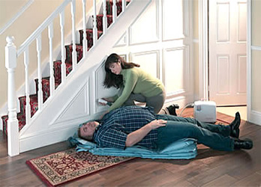
Patient Handling vs. Other Lifting
The load is often unstable
Patients do not have handles
A patient’s weight is distributed unevenly
A patient may be combative
PPT-075-02
12
Notes:
Patient handling can be more hazardous due to the following conditions:
The load is often unstable
Patients don’t have handles
A patient’s weight is distributed unevenly
A patient may be combative

Slide 13
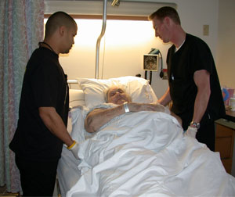
Patient Handling Methods
Most common taught are body mechanics and the principles of ergonomics
PPT-075-02
13
Notes:
The most common methods for safely handling patients are using proper body mechanics and ergonomics. In many health care organizations training is provided to all employees that relates to both of these subjects.

Slide 14
Important Principles-Body Mechanics
Apply safe body mechanics and maintain the natural curve of your spine to minimize the force on your joints and discs. Here’s the safe way to hold your body:
• Stand in a stable position: Your feet should be shoulder width apart
with one leg slightly forward to help you balance – you may need to move your feet to maintain a stable posture.
• Avoid twisting: Make sure your shoulders and pelvis stay in line with
each other.
• Bend your knees: Bend your knees slightly, but maintain your natural
spinal curve – avoid stooping by bending slightly at the hips (buttocks
out).
• Elbows in: Keep your elbows tucked in and avoid reaching – the
further away from the body the load is, the greater the potential for harm.
• Tighten abdominal muscles: Tighten your abdominal muscles to
support your spine.
• Head up: Keep your head raised, with your chin tucked in during the
movement.
• Move smoothly: Move smoothly throughout the technique and avoid
fixed holds.
PPT-075-02
14
Notes:
Apply safe body mechanics and maintain the natural curve of your spine to minimize the force on your joints and discs. Here’s the safe way to hold your body:
• Stand in a stable position: Your feet should be shoulder width apart with one leg slightly forward to help you balance – you may need to move your feet to maintain a stable posture
• Avoid twisting: Make sure your shoulders and pelvis stay in line with each other
• Bend your knees: Bend your knees slightly, but maintain your natural spinal curve – avoid stooping by bending slightly at the hips (buttocks out)
• Elbows in: Keep your elbows tucked in and avoid reaching – the further away from the body the load is, the greater the potential for harm
• Tighten abdominal muscles: Tighten your abdominal muscles to support your spine
• Head up: Keep your head raised, with your chin tucked in during the movement
• Move smoothly: Move smoothly throughout the technique and avoid fixed holds.

Slide 15
Important Principles-Body Mechanics
When handling/moving patients:
Maintain a wide, stable base with your feet
Put the bed at the correct height (waist level when providing care; hip level when moving a patient)
Try to keep the work directly in front of you to avoid rotating the spine
4) Keep the patient as close to your body as possible to minimize reaching
CAUTION: Body mechanics alone is not sufficient!
PPT-075-02
15
Notes:
When handling or moving patients remember the following practices:
Maintain a wide, stable base with your feet
Put the bed at the correct height (waist level when providing care; hip level when moving a patient)
Try to keep the work directly in front of you to avoid rotating the spine
4) Keep the patient as close to your body as possible to minimize reaching

Slide 16
Ergonomics
Ergonomics: The science of fitting jobs to people. Encompasses the body of knowledge about physical abilities and limitations as well as other human characteristics relevant to job design
Ergonomic design: The application of this body of knowledge to the design of the workplace (tasks, equipment, environment) for safe and efficient worker use
Good ergonomic design: Makes the most efficient use of worker capabilities while ensuring job demands do not exceed those capabilities
PPT-075-02
16
Notes:
When working with patients, materials or even entering reports on a computer it’s important to have an understanding of ergonomics.
But what is ergonomics and what does it encompass?
Ergonomics: The science of fitting jobs to people. Encompasses the body of knowledge about physical abilities and limitations as well as other human characteristics relevant to job design
Ergonomic design: The application of this body of knowledge to the design of the workplace (tasks, equipment, environment) for safe and efficient worker use
Good ergonomic design: Makes the most efficient use of worker capabilities while ensuring job demands do not exceed those capabilities

Slide 17
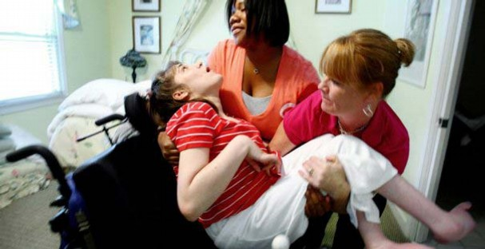
Ergonomic Risk Factors
In patient care occupations:
Forceful and Heavy Exertions
High Frequency/Repetitive Tasks
Awkward Postures
Work Duration
Uneven work floors
Unpredictable patients
Dependence level of patients
PPT-075-02
17
Notes:
In the care of patients there are numerous ergonomic risk factors:
Forceful and Heavy Exertions
High Frequency/Repetitive Tasks
Awkward Postures
Work Duration
Uneven work floors
Unpredictable patients
Dependence level of patients

Slide 18
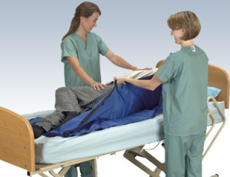
Ergonomic Risk Factors
In patient care occupations:
Lifting heavy loads
Excessive pushing/pulling
Reaching
PPT-075-02
18
Notes:
In addition to the ones already mentioned there are several other ergonomic risk factors involved with patient care:
Lifting heavy loads
Excessive pushing/pulling
Reaching

Slide 19
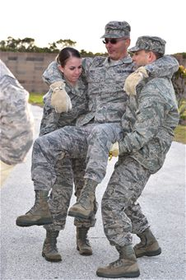
Use Caution
There are lifting tasks that are so stressful to the body even if proper body mechanics and ergonomics are used a person can still suffer an injury!
PPT-075-02
19
Notes:
Always use caution when doing any type of patient handling!
Some lifting tasks are so stressful the a person’s body that even if proper body mechanics and ergonomics are used an injury could still occur.

Slide 20
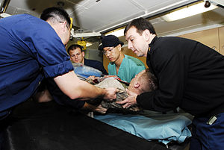
Team Lifting
More than one person required to lift a load: team of folks; one person “calls” directions and lifting steps so everyone will move at the same pace.
Can be used when the patient is very large or overly obese.
Team members must still use caution to ensure proper body mechanics and ergonomic issues are addressed.
PPT-075-02
20
Notes:
Another way to manually lift a patient is through the use of a lifting team.
A lifting team may be required when a patient is very large or overly obese.
With a lifting team one person “calls” directions and lifting steps so everyone will move at the same pace.
Team members must still use caution to ensure proper body mechanics and ergonomic issues are addressed.

Slide 21
Prepare for Safe Patient Handling
Know what equipment is available and how it works
Assess the patient and the environment
Gather appropriate equipment and staff needed
Coach Patient
PPT-075-02
21
Notes:
To prepare for safe patient handling remember the following:
Know what equipment is available and how it works
Assess the patient and the environment
Gather appropriate equipment and staff needed
Coach Patient

Slide 22
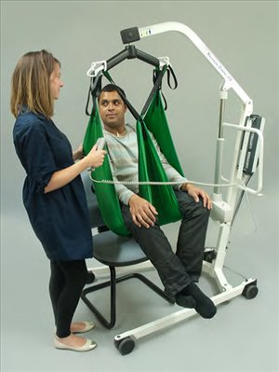
When & Why to Use Lifting Devices
Patient Benefits:
Patient comfort
Respects a patient’s sense of dignity
Promotes patient independence and rehabilitation
PPT-075-02
22
Notes:
There are several benefits to using patient lifting devices such as:
Patient comfort
Respects a patient’s sense of dignity
Promotes patient independence and rehabilitation

Slide 23
Economic Benefits of Lifting Devices
Decreases occupational injuries and indirect costs including:
• Employee replacement
• Additional training
• Loss of productivity
• Liability
PPT-075-02
23
Notes:
Using patient lifting devices can have positive affects for patients and employees alike.
When patient lifting devices are used regularly it can reduce occupational injuries to employees as well as impacting on indirect costs to the organization such as employee replacement and additional training, loss of productivity due to injured employees being off of work, and liability to the organization.

Slide 24
When to Use a Lift
For most patient-lifting tasks – maximum weight limit is 35 pounds.*
Patient characteristics that add risk:
Height
Weight
Body Shape
Dependency
*Waters, Thomas R. PhD. (2007). When Is It Safe to Manually Lift a Patient?. AJN, Vol. 107, No. 8. 53-59.
PPT-075-02
24
Notes:
It’s a good idea to use a patient lift in situations where the task requires any lifting over 35 pounds.
In addition, there are certain characteristics of a patient that also affect a decision to use a patient lifting device such as:
Height and weight of the patient
Body shape and
Patient dependency

Slide 25
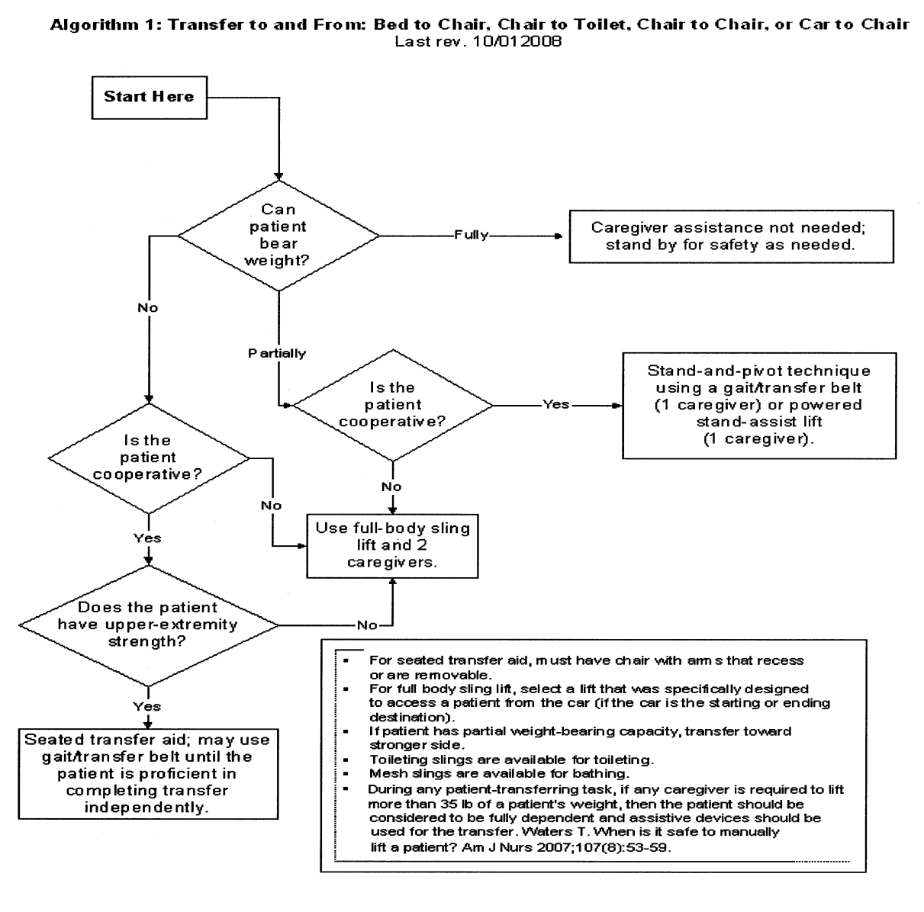
When to Use a Lift
PPT-075-02
25
Notes:
The chart on this slide can be used as a aid for determining when to use a patient lifting device. Some of the issues to be taken into consideration are if the patient can be any weight themselves and if the patient is cooperative.

Slide 26
Employee Responsibility
Know the characteristics of an unsafe lift
Know the help that is available – both coworkers and equipment
Know your employer’s lift policies
If unsure about the safety of a lift, ask your instructor/director
PPT-075-02
26
Notes:
Health care employees have the responsibility for the following when it comes to handling patients:
Know the characteristics of an unsafe lift
Know the help that is available to include co-workers and equipment
Know the employer’s lifting policies
Understand the importance of asking your immediate Supervisor, Manager, Director or a lifting instructor if there is any uncertainty about lifting/handling patients

Slide 27
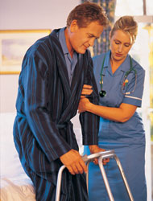
Risk Factors
What do you see?
Patient may have difficulty supporting full weight
Can nurse support full weight of patient by herself?
If patient begins to fall what will the nurse do?
Is the patient wearing non-slip footwear; floor slippery?
PPT-075-02
27
Notes:
When looking at this slide there are several risk factors that are visible.
Take a moment to see what types of issues can be identified.

Slide 28
Sitting a Patient Up in Bed
If the person is not strong enough to push up with his or her hands to a sitting position, place one of your arms under the person's legs and your other arm under his or her back.
Move the person's legs over the edge of the bed while pivoting his or her body so the person ends up sitting on the edge of the bed.
Keep your feet shoulder-width apart, your knees bent and your back in a natural straight position.
PPT-075-02
28
Notes:
To safely sit a patient up in bed you should do the following:
If the person is not strong enough to push up with his or her hands to a sitting position, place one of your arms under the person's legs and your other arm under his or her back.
Move the person's legs over the edge of the bed while pivoting his or her body so the person ends up sitting on the edge of the bed.
Keep your feet shoulder-width apart, your knees bent and your back in a natural straight position.

Slide 29
To Assist with Standing up
Position the person's feet on the floor and slightly apart.
The patient's hands should be on the bed or on your shoulders.
Place your arms around the person's back and clasp your hands together.
If the patient is wearing a lifting belt make sure it is fastened around their waist.
Grasp the belt when lifting the patient.
Hold the person close to you, lean back and shift your weight.
PPT-075-02
29
Notes:
To assist a patient to stand up:
Position the person's feet on the floor and slightly apart.
The patient's hands should be on the bed or on your shoulders.
Place your arms around the person's back and clasp your hands together.
If the patient is wearing a lifting belt which is fastened around their waist.
Grasp the belt when lifting the patient.
Hold the person close to you, lean back and shift your weight.

Slide 30
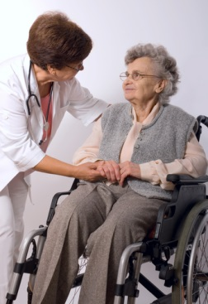
To Assist with Sitting Down
Into a chair, wheelchair, on a bed:
Pivot toward the chair, bend your knees, and lower the person into the chair.
The person should have both hands on the arms of the chair before lowering him/her down.
PPT-075-02
30
Notes:
To assist a patient with sitting down into a chair, wheelchair or on a bed you should pivot toward the chair, bend your knees, and lower the person into the chair. Ensure that the person has both hands on the arms of the chair before lowering him/her down.

Slide 31
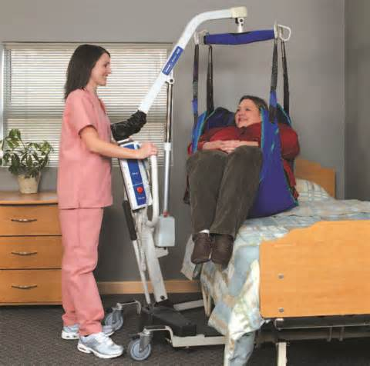
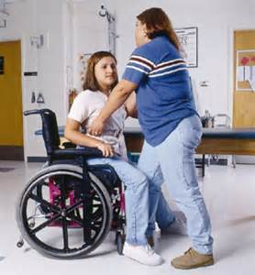
Types of Transfers
Bed
Chair
Commode/toilet
Lateral transfers
Floor
Vehicle
PPT-075-02
31
Notes:
There are several different types of patient transfers that occur to include:
To/from a bed
To/from a chair
To/from a commode/toilet
Lateral transfers
To/from the floor
To/from a vehicle
Consideration and planning should be given to each of these transfers to determine the safest method(s) to accomplish them.

Slide 32
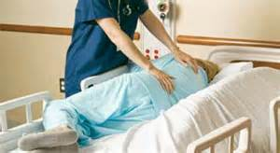
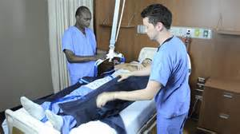
Repositioning
Chair
Bed
Gurney
Diagnostic tables
PPT-075-02
32
Notes:
A patient may need to be repositioned to a chair, bed, gurney, and/or diagnostic table. Always remember the principles of what you’re trying to accomplish and the fact that safety needs to be paramount no matter what you do.

Slide 33
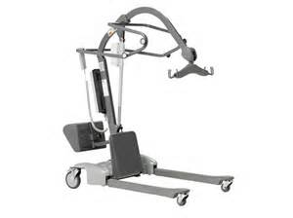
Transfer & Repositioning Factors
Patient
Personnel
Equipment
Environment
PPT-075-02
33
Notes:
When transferring and repositioning a patient you need to keep several factors in mind to include:
The patient themselves (for example how heavy are they, how much mobility do they have, etc.)
The people involved with the transfer/repositioning (what is their size, strength, physical capabilities etc.)
The equipment involved (for example a wheelchair, bed, patient lifting device)
The environment of the room/area (what type of flooring is in the room/area, is it well-lit, etc.)

Slide 34
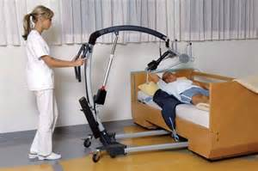
Patient
Medical condition – history
Mental status – cooperative, follows directions etc.
Functional status- strength, balance, coordination & stamina
PPT-075-02
34
Notes:
When involved with patient handling you need to take into account several items such as the medical condition of the patient including his/her history.
You also need to ascertain what the patient’s mental status is, for example are they cooperative, do they follow directions, etc.?
In addition it’s a good idea to find out what the patient’s functional status is. Things like their strength, balance, coordination and stamina.
Base what actions to take when handling the patient on all the factors just covered to ensure the safety of the patient and caregiver alike.

Slide 35
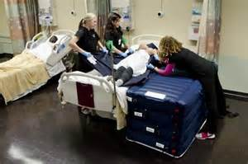
Environment
Design of the room
Furniture
Medical equipment
Lighting
Climate/temperature
Traffic/activity
Is there anything wrong with this?
Posture of care giver could lead to an injury
PPT-075-02
35
Notes:
Remember to think about the environment where the patient handling will take place.
Take into account the design of the room, what type and how much furniture there is in/near the area and what type of medical equipment such as ventilators may be involved.
Also think about the available lighting in the room – is it sufficient to properly see what needs to be done and where the care giver and patient will be walking.
When planning the actual patient handling activity the climate and/or temperature of the area should be taken into account – is the room/area hot or cold which may necessitate the patient needing a blanket or removing a blanket from the patient.
The amount of traffic and/or activity in the area of the patient handling also needs to be evaluated. Will the amount of traffic/activity in the room/area interfere with the patient handling or cause an unsafe situation?

Slide 36
Personnel
Education/Training
Competency
Compliancy
Teamwork
Communication
PPT-075-02
36
Notes:
When handling patients it’s always a good idea to think about those involved in the activity:
What type of training do they have?
Are they competent and capable to safely, properly and efficiently handle the patient?
Will there be more than one care giver involved? If so, can all involved work effectively as a team?
What type of communication is necessary between everyone involved? Does everyone speak and understand the same language?

Slide 37
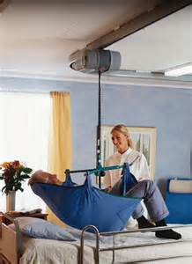
Equipment
Bed
Ceiling lift
Total mechanical lift
Sit to stand lift
Transfer belt
Non-Friction device/Air assistive device
Assistive devices (cane, wheelchair, etc.)
PPT-075-02
37
Notes:
When taking part in patient handling activities the type of equipment involved/to be used should also be taken into account.
Is there a bed involved or is the patient in a wheelchair or other piece of equipment?
What type of lifting device, if any, is involved such as a ceiling lift, total mechanical lift, or sit to stand lift?
Is the patient wearing a “transfer belt” which can assist in the maneuver.
Will a non-friction or air assistive device be used and if so are all trained in the proper use of that device?
What other types of devices are available for patient use: cane, wheelchair, etc.

Slide 38
Before the Task, Remember
Check patient profile: Decide if the task is still necessary and that the handling plan is still appropriate.
Seek advice: Talk to your manager or the patient handling adviser if you need advice on the techniques and equipment you should be using.
Check equipment: Ensure equipment is available in good condition with all
components in place and ready to use. Always follow the manufacturer’s instructions.
Prepare handling environment: Position furniture correctly, check route and access ways are clear, and check the destination is available.
Explain the task: Explain the task to the patient and other care givers who may be helping.
Prepare the patient: Ensure the patient’s clothes and footwear are appropriate for the task, and they have any aids they need. Adjust their clothes, aids and position – for instance, encourage the patient to lean forward.
Give precise instructions: Give clear instructions. This helps the care giver(s) and patient to work together.
PPT-075-02
38
Notes:
Before carrying out any patient handling task remember to:
Check patient profile: Decide if the task is still necessary and that the handling plan is still appropriate.
Seek advice: Talk to your manager or the patient handling adviser if you need advice on the techniques and equipment you should be using.
Check equipment: Ensure equipment is available in good condition with all components in place and ready to use. Always follow the manufacturer’s instructions.
Prepare handling environment: Position furniture correctly, check route and access ways are clear, and check the destination is available.
Explain the task: Explain the task to the patient and other care givers who will be helping.
Prepare the patient: Ensure the patient’s clothes and footwear are appropriate for the task, and they have any aids they need. Adjust their clothes, aids and position – e.g., encourage the patient to lean forward.
Give precise instructions: Give clear instructions. This helps the care giver(s) and patient to work together.

Slide 39
Order of Operation
Ceiling lift/Total mechanical lift
Sit to stand lift
Transfer/gait belt
Non-Friction device/Air assistive device
Independent
Going from the bottom up the patient requires more assistance
PPT-075-02
39
Notes:
The “order of assistance” for a patient depends on their level of activity and what type of device, if any, is necessary.
In order of how much assistance is necessary the care giver much ascertain if the patient is independent or not. If the patient is independent then patient handling should be minimal.
However if a non-friction/air assistive device, transfer gait/belt or lift is necessary then proper preparations should be made before attempting to handle a patient.

Slide 40
Safety Tips
If standing for an extended period:
Stand with feet shoulder width apart
Place one foot slightly behind other
Shift weight from foot to foot
Re-position your body if possible
PPT-075-02
40
Notes:
If standing for an extended period of time, to make things a bit easier as well as utilizing body mechanics remember:
Stand with feet shoulder width apart
Place one foot slightly behind other
Shift weight from foot to foot
Re-position your body if possible

Slide 41
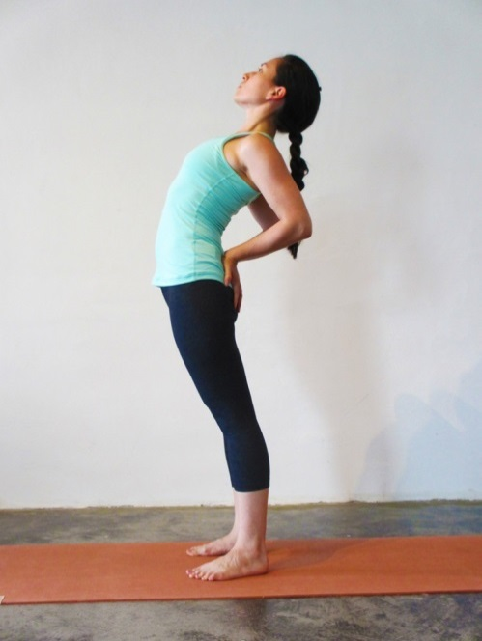
Safety Tips
If bending over for a long period of time:
Stand upright
Place your hands on your lower back
Bend backward slowly
Come back to upright position
PPT-075-02
41
Notes:
If bending over for a long period time:
Stand upright
Place your hands on your lower back
Bend backward slowly
Come back to upright position

Slide 42
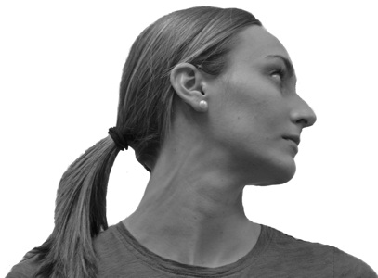
Stretching Exercises
Note: Before doing any exercises check with your physician to ensure you’re able to do them safely!
Sit or stand with arms hanging loosely at your sides
Turn head to one side, then the other
Hold for 5 seconds, each side
Repeat 1 to 3 times
PPT-075-02
42
Notes:
Here are some stretching exercises that can be done to ensure muscles are not tight and easily injured.
To stretch the neck the following can be done:
Sit or stand with arms hanging loosely at your sides
Turn head to one side, then the other
Hold for 5 seconds, each side
Repeat 1 to 3 times

Slide 43
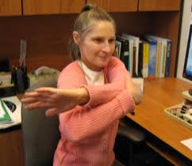
Stretching Exercises
Note: Before doing any exercises check with your physician to ensure you’re able to do them safely!
Stand or sit and place right hand on left elbow
With left hand, pull right elbow across chest toward left shoulder and hold 10 to 15 seconds
Repeat on other side
PPT-075-02
43
Notes:
To stretch the arms:
Stand or sit and place right hand on left shoulder
With left hand, pull right elbow across chest toward left shoulder and hold 10 to 15 seconds
Repeat on other side

Slide 44
Stretching Exercises
Note: Before doing any exercises check with your physician to ensure you’re able to do them safely!
Keep knees slightly flexed
Stand or sit with arms overhead
Hold elbow with hand of opposite arm
Pull elbow behind head gently as you slowly lean to side until mild stretch is felt
Hold 10 to 15 sec
Repeat on other side
PPT-075-02
44
Notes:
A good stretch for the arms, and back can be done as follows:
Keep knees slightly flexed
Stand or sit with arms overhead
Hold elbow with hand of opposite arm
Pull elbow behind head gently as you slowly lean to side until mild stretch is felt
Hold 10 to 15 sec
Repeat on other side

Slide 45
Summary
Health care workers have very high injury rates due to musculoskeletal disorders caused by the overexertion of patient handling.
Always use proper body mechanics if you have to handle a patient and get help if necessary.
Use a patient lifting device where possible/practical.
Use a “lifting team” in the event the patient is very large or overly obese.
Never put yourself in a position where you and your patient could be injured if you move/lift the patient incorrectly.
PPT-075-02
45
Notes:
The bottom line about handling patients is to keep in mind the safety of both the patient and the care giver. Remember that health care workers have very high injury rates due to musculoskeletal disorders caused by the overexertion of patient handling.
Remember to always use proper body mechanics and get help if you need to handle a patient.
Keep in mind that if possible and practical a patient lifting device should be used. Using a lifting device will minimize the possibility of injury to the patient and care giver alike.
If the patient is very large or overly obese then thought should be given to using a “lifting team” concept with one person “controlling when to lift.”
It is important that care givers never put themselves in a position where their patient and themselves can be injured if the move/lift is completed improperly.
Think safety first all the time, every time!

Slide 46
Contact Information
To contact a Health & Safety Training Specialist:
Bureau of Workers’ Compensation
1171 South Cameron Street Room 324
Harrisburg, PA 17104-2501
717-772-1635
RA-LI-BWC-Safety@pa.gov
PPT-075-02
46

Slide 47
Questions
PPT-075-02
47

