Slide 1
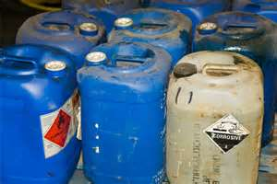
Right To Know
Bureau of Workers’ Comp
PA Training for Health & Safety
(PATHS)
Pennsylvania
Worker & Community
Right to Know Inspections
PPT-090-01
1
Notes:
The Right to Know program is found in PA Act 1984-159 indicates requirements for employers to inform their employees of the hazards of chemicals used in the workplace.
In 2012, the Globally Harmonized System dealing with chemical labelling was adopted from the United Nations which also has a bearing on the PA Right to Know program and the federal Hazard Communication program under 29 CFR 1910.1200. It is the method for identifying product hazards based on proper chemical labeling.
Some agencies, by their nature, may be governed by federal OSHA regulations found in OSHA’s Hazard Communication Standard (29 CFR 1910.1200 often referred to as Haz Comm) while others are governed by PA’s Right to Know.
Private agencies such as manufacturing, colleges and universities not under the state system are governed by OSHA-GHS and portions of the PA Right to Know.
Public entities, municipalities, fire, police, schools and state colleges and universities under the state system are under the PA Right to Know and not OSHA.

Slide 2
Requirements
Written program for each location to cover issues of chemical safety
Labels to identify each chemical
Material Safety Data Sheets (MSDSs) (now SDSs under the Globally Harmonized System: GHS)
Safe work procedures/practices
Employee training on SDS information and safe chemical procedures and practices
PPT-090-01
2
Notes:
PA Right to Know program requirements include:
Written program for each location to cover issues of chemical safety
Labels to identify each chemical
SDSs under the Globally Harmonized System: GHS (which were Material Safety Data Sheets (MSDSs)
Safe work procedures/practices
Employee training on SDS information and safe chemical procedures and practices

Slide 3
Employer Responsibilities
Conduct and document training
Maintain Health and Exposure Records
Complete Hazardous Substance Survey Form annually
Complete Environmental Hazard Survey Form (upon request of L&I)
Maintain SDS file and chemical inventory
Post Workplace Notice
PPT-090-01
3
Notes:
Other employer responsibilities for PA Right to Know:
Conduct and document training
Maintain Health and Exposure Records
Complete Hazardous Substance Survey Form annually
Complete Environmental Hazard Survey Form (upon request of L&I)
Maintain SDS file and chemical inventory
Post Workplace Notice

Slide 4
Employee Responsibilities
Employees cannot be discharged, disciplined or discriminated against for exercising certain rights, including filing a complaint
Burden of proof lies with the employer if it is demonstrated that rights under the Act were exercised within six months of discipline.
PPT-090-01
4
Notes:
Related to the protections of employees,
Employees cannot be discharged, disciplined or discriminated against for exercising certain rights, including filing a complaint.
The burden of proof lies with the employer if it is demonstrated that rights under the Act were exercised within six months of discipline.

Slide 5
Training
Reference PA Code 313
Initial Training within 120 days of hire
Required annually
Can be written or oral
Train employees working with
hazardous chemicals and/or
those who may be potentially
exposed to a hazardous product
PPT-090-01
5
Notes:
Training requirements for the PA Right to Know:
Referenced in PA Code 313
Initial Training within 120 days of being hired
Required annual refresher training
Training can be written or oral
Train employees working with hazardous chemicals and/or those who may be potentially exposed to a hazardous product

Slide 6
Training
Supplemental Training if there is a:
Change in potential for exposure
Reassignment
Receipt of new hazard information
Written documentation of training kept
until next annual session is held.
Customize to meet your workplace needs.
PPT-090-01
6
Notes:
Training requirements also include:
Supplemental Training
When there’s a change in potential for exposure
If the person is reassigned
When new hazard information is received for a chemical
Written documentation of training must be kept until next annual session is held.
Your training should also be customized to meet your workplace needs.

Slide 7
Posting Requirements
PA Code Chapter 311
Employer shall post the following in locations where notices to employees are normally posted:
Lists of hazardous substances
found in the workplace
Lists of special & environmental
hazardous substances found in
the workplace
Notification to employees & their representatives of their rights under the act
PPT-090-01
7
Notes:
Posting requirements for employers can be found in PA Code Chapter 311 dealing with the PA Right to Know.
The employer shall post the following in locations where notices to employees are normally posted:
Lists of hazardous substances found in the workplace
Lists of special & environmental hazardous substances found in the workplace
Notification to employees & their representatives of their rights under the act

Slide 8
Health & Exposure Records
Reference PA Code Chapter 315
Maintain all accident reports, exposure records, air quality monitoring, etc..
Accessible to all employees
Must be maintained for length of
employment plus 30 years (same is required for the SDSs for your facility)
Access provided in reasonable time
frame and manner (within 15 days)
Access to records for exposure of others with similar job function/duties
PPT-090-01
8
Notes:
Health and exposure records for employees can be referenced in PA Code Chapter 315. Requirements for these records include:
Maintain all accident reports, exposure records, air quality monitoring, etc..
Accessible to all employees
Must be maintained for length of employment plus 30 years (same is required for the SDSs for your facility-they could become an exposure document in a court of law).
Access provided in reasonable time frame and manner (within 15 days)
Access to records for exposure of others with similar job function/duties

Slide 9
Hazardous Substance Survey Form
PA Code Chapters 303 & 305
Includes substances on Hazardous Substance List
Must be updated at least annually by
April 1st.
Use of Dept. of L&I form or alternate means that provide at least the minimum required information.
PPT-090-01
9
Notes:
The Hazardous Substance Survey Form in the PA program is delineated in PA Code Chapters 303 and 305. Here you’ll find a compilation of those substances listed as hazardous.
Your compiled in-house list must be updated at least annually by April 1 of each year and includes those substances on the premises during the preceding year.
The employer can use the Department of Labor and Industry form or alternate means that provides at least the minimum required information.

Slide 10
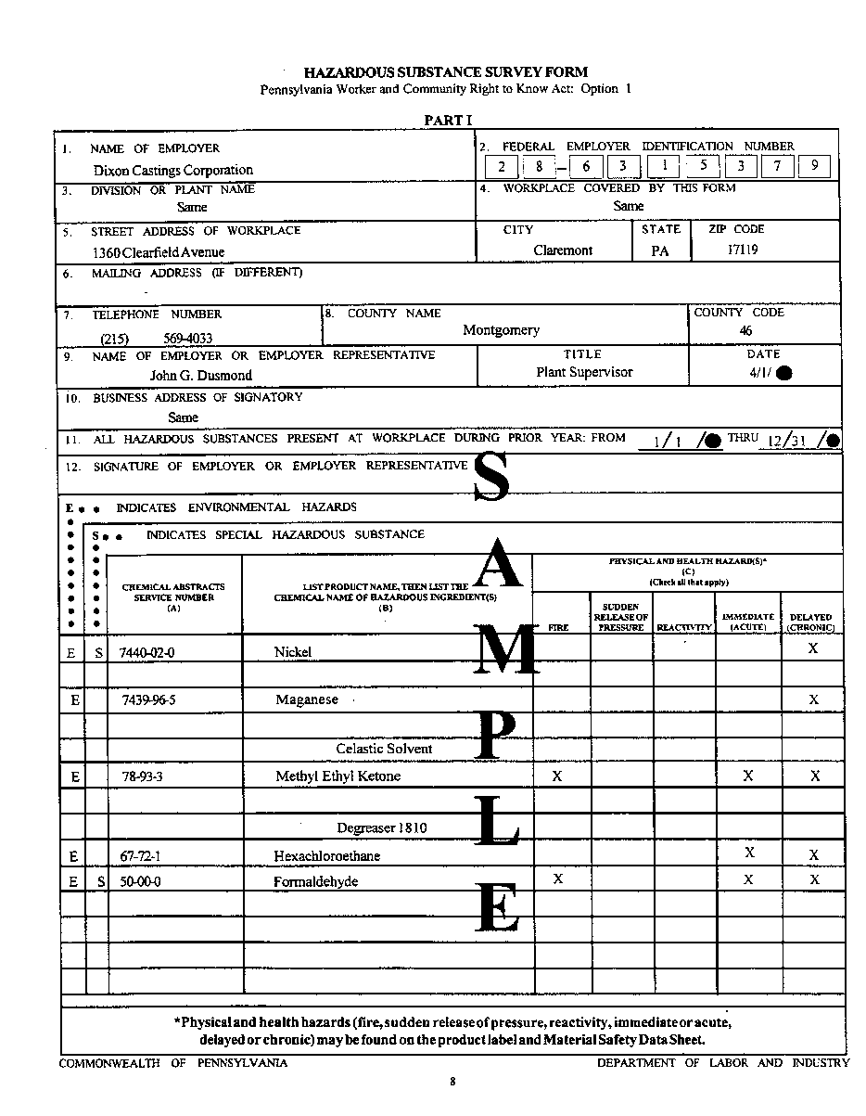
Hazardous Substance Survey Form
PPT-090-01
10
Notes:
Here is a sample of the form.

Slide 11
Hazardous Substance Survey Form
HAZARDOUS SUBSTANCE SURVEY FORM
Pennsylvania Worker & Community Right to Know Act: Option 2
1. NAME OF EMPLOYER
2. FEDERAL EMPLOYER IDENTIFICATION NUMBER
3. DIVISIONS OR PLANT NAME
4. WORKPLACE COVERED BY THIS FORM
5. STREET ADDRESS OF WORKPLACE
CITY
STATE
ZIP CODE
6. MAILING ADDRESS (IF DIFFERENT)
7. TELEPHONE NUMBER
8. COUNTY NAME
COUNTY CODE
9. NAME OF EMPLOYER OR EMPLOYEE REPRESENTATIVE
TITLE
DATE
10. BUSINESS ADDRESS OF SIGNATORY
11. ALL HAZARDOUS SUBSTANCES PRESENT AT WORKPLACE DURING PRIOR YEAR: FROM THRU
12. SIGNATURE OF EMPLOYER OR EMPLOYEE REPRESENTATIVE
PPT-016-03
PPT-090-01
29
11
Notes:
The top of the first page provides for listing information specific to your facility. There’s also a signature block for the employer and representative to attest to the presence of the materials stated.
If you elect to use a different method, this information block should be used for your system since it contains the required information of your facility.

Slide 12
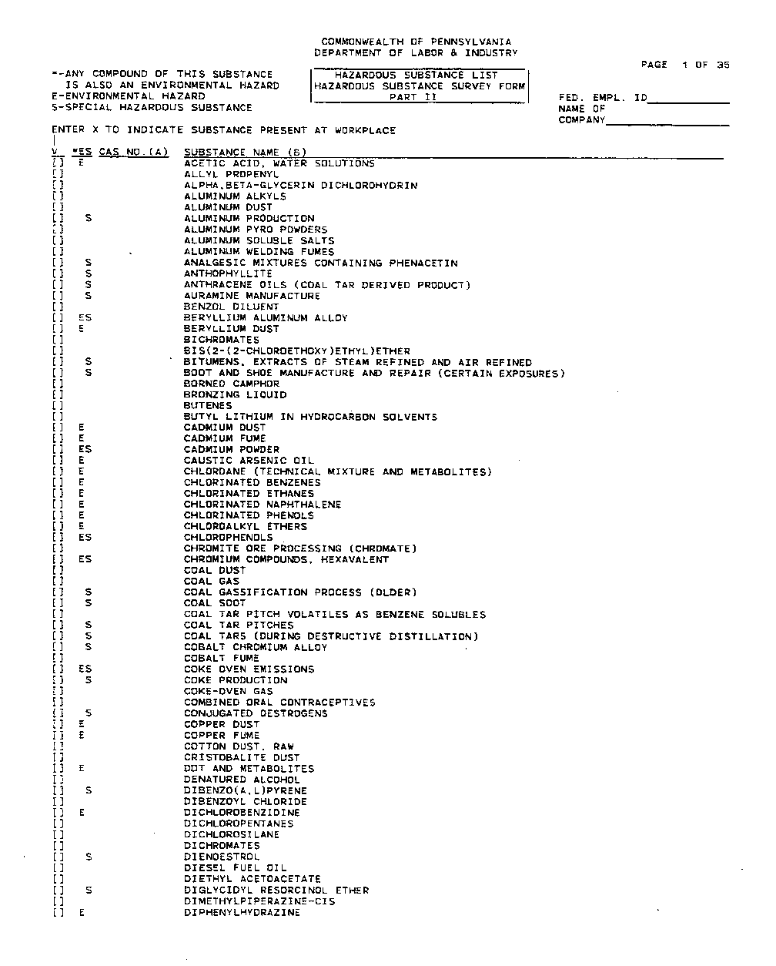
Hazardous Substance Survey Form
PPT-090-01
12
Notes:
This Hazardous Substance Survey Form can be used by putting a checkmark in the left column for each chemical you have on the facility. If you use this form, you still must post all other pages whether they have a check mark or not.
Or, you may devise your own list and post it.

Slide 13
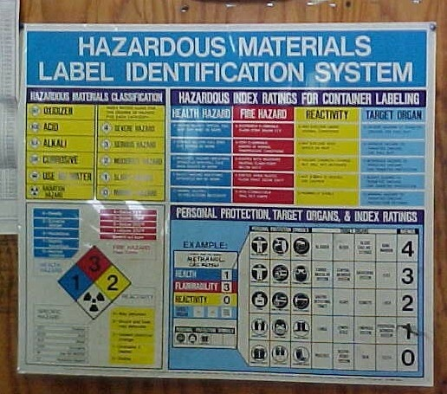
Labeling
Example of the type of labeling systems in use
PPT-090-01
13
Notes:
This is one means of labeling which is posted for better employee understanding.

Slide 14
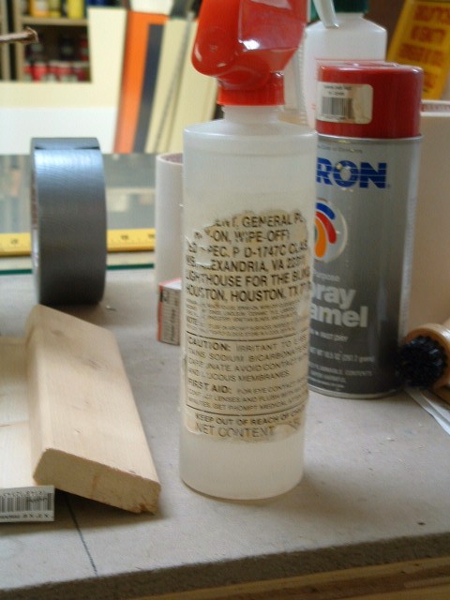
You Be the Inspector
Labels –
Must be able to read
the entire label
or it is NOT labeled
properly!
PPT-090-01
14
Notes:
As indicated, you must be able to read the entire label or its purpose is not served.

Slide 15
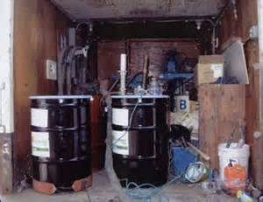
You Be the Inspector
Properly
Labeled?
Storage
around the
drums
Excessive clutter of combustibles in the area
PPT-090-01
15
Notes:
What are the issues noted in this picture?
Drums may not be properly labeled and there is a lot of different storage around and near the drums.
Excessive clutter of combustibles in the area which contributes to the overall fire load.

Slide 16
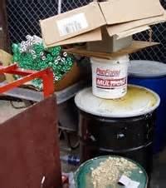
You Be the Inspector
Storage around
the containers
Labeling?
Access to the
chemical containers
obstructed
PPT-090-01
16
Notes:
There are several hazardous situations identified here: the containers may not be labeled, there is storage around them and access to the containers is blocked/obstructed.

Slide 17
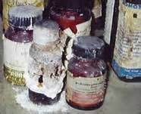
You Be the Inspector
Labels cannot
be read
Chemicals may be expired & need to be disposed of
Chemical spilling
on the ground
PPT-090-01
17
Notes:
In this picture you’ll see that labels on the containers cannot be read, there is substantial leaking of at least one of the chemicals and the chemicals may have reached their expiration date.

Slide 18
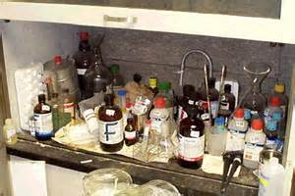
You Be the Inspector
Improper
storage
Combustible
material
around
chemicals
Are all chemicals labeled properly?
PPT-090-01
18
Notes:
This picture shows improper storage of chemicals as well as combustible storage near and around the chemicals.

Slide 19
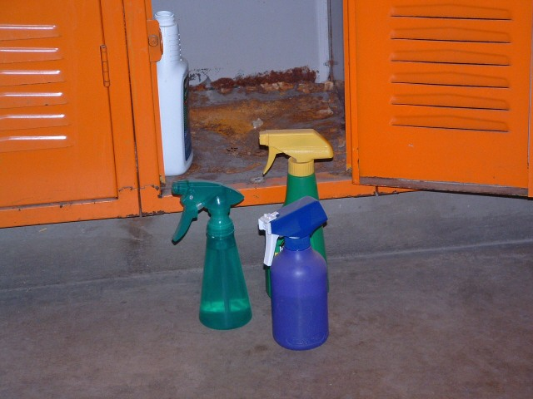
You Be the Inspector
Labels?
PPT-090-01
19
Notes:
Labeling of transport containers is not required if the material will be used by one person on a single shift. Some places, however, label these containers to guard against cross-contamination.

Slide 20
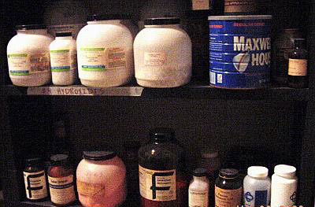
You Be the Inspector
Large containers balanced on edge of shelf- not safe
If chemical, coffee can is not proper type of storage container
Maybe improperly labeled container- what’s in the coffee can? Coffee not allowed with chemicals; if chemical, not labeled properly
PPT-090-01
20
Notes:
How many deficiencies under either PA Right to Know or the GHS program can you find in the slide?

Slide 21
Enforcement & Penalties
PA Code Chapter 321
Public Sector employees can file a complaint
Inspections are conducted only if warranted
PPT-090-01
21
Notes:
Enforcement and Penalties for the PA Right to Know program
PA Code Chapter 321
Public Sector employees can file a complaint
Inspections are conducted only if warranted

Slide 22
Complaint & Investigation Procedure
A person may file a complaint within 180 days of the violation.
Within 30 days after receiving the complaint the Department will notify the respondent in writing and permit them to demonstrate compliance.
If failure to comply within 14 days of the mailing notification the Department will conduct an investigation.
The Department of L&I may obtain a warrant if denied entry.
PPT-090-01
22
Notes:
Complaint and Investigation Procedure
A person may file a complaint within 180 days of the violation.
Within 30 days after receiving the complaint the Department will notify the respondent in writing and permit them to demonstrate compliance.
If failure to comply within 14 days of the mailing notification the Department will conduct an investigation.
The Department of L&I may obtain a warrant if denied entry.

Slide 23
RTK Inspection
A written complaint is received.
- Is it correctly and completely filled out?
- Does it request information we can obtain?
- Pennsylvania resident?
- Commonwealth Employer?
Complaint letter mailed within 30 days of receipt of complaint.
Allegation letter mailed to facility within 30 days of receipt of complaint.
PPT-090-01
23
Notes:
A Right to Know Inspection may be initiated after the following:
A written complaint is received.
- Is it correctly and completely filled out?
- Does it request information we can obtain?
- Pennsylvania resident?
- Commonwealth Employer?
Complaint letter mailed within 30 days of receipt of complaint.
Allegation letter mailed to facility within 30 days of receipt of complaint.

Slide 24
RTK Inspection
Enforcement Inspection warranted only when:
No response received
Information received is not complete
Information received is not correct
PPT-090-01
24
Notes:
An inspection can become a reality only when:
No response received
Information received is not complete
Information received is not correct

Slide 25
RTK Inspection
When the Inspector(s) arrive at the site they will:
Introduce themselves
Show identification/provide a business card
State the reason for inspection
Ask to speak to Superintendent/Principal/Director/Manager etc…
Ask for a pre-conference
PPT-090-01
25
Notes:
When the Inspector(s) arrive at the site they will:
Introduce themselves
Show identification/provide a business card
State the reason for inspection
Ask to speak to Superintendent/Principal/Director/Manager etc…
Ask for a pre-conference

Slide 26
Pre-Conference
During the pre-conference the inspector(s) will:
Introduce themselves
Re-state the reason for the inspection
Discuss the requirements under the Right to Know Law
Discuss any concerns
Identify who will be taking them around the facility
Find out what all areas the facility has
Distribute supplement documents
PPT-090-01
26
Notes:
During the pre-conference the inspector(s) will:
Introduce themselves
Re-state the reason for the inspection
Discuss the requirements under the Right to Know Law.
Discuss any concerns
Identify who will be taking them around the facility
Find out what all areas the facility has
Distribute supplement documents

Slide 27
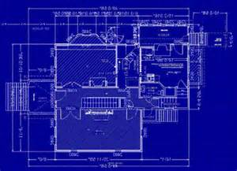
RTK Inspection
Possible Inspection Areas:
Boiler/maintenance rooms
Swimming pool(s)
Kitchen and/or laundry area
Supply storage areas
Janitors’ closets
Science/Technology rooms
Art department and/or dark rooms
*Are any of these services outsourced?
PPT-090-01
27
Notes:
Examples of areas where inspection may occur (are any of these services outsourced?):
Boiler/maintenance rooms
Swimming pool(s)
Kitchen and/or laundry area
Supply storage areas
Janitors’ closets
Science/Technology rooms
Art department and/or dark rooms

Slide 28
RTK Inspection
During the inspection the Inspector will:
Record observations on the inspection form
Make any needed notes
Take photographs
Record names of some chemicals found in the workplace
PPT-090-01
28
Notes:
During the inspection the inspector will:
Record observations on the inspection form
Make any needed notes
Take photographs
Record names of some chemicals found in the workplace

Slide 29
RTK Inspection
Photographs of:
Outside of building with name
Containers without labels
Custodians’ carts/closets
Bulletin Boards – where postings are placed
Storage Areas
Boiler/Maintenance Areas
PPT-090-01
29
Notes:
During the inspection photographs may be taken of:
The outside of building including the building/company name
Containers without labels
Custodians’ carts/closets
Bulletin Boards – where postings are placed
Storage Areas
Boiler/Maintenance Areas

Slide 30
RTK Inspection
Information that will need to be given/verified during the inspection:
Mailing address
Site Coordinator, Director, Principal etc…
Total number of employees at the site
Site of inspection (Middle School, Warehouse etc…)
PPT-090-01
30
Notes:
The following information needs to be given/verified during the inspection:
Mailing address
Site Coordinator, Director, Principal etc…
Total number of employees at the site
Site of inspection (Middle School, Warehouse etc…)

Slide 31
Post Inspection Meeting
Post Inspection Meeting
Review violation(s)
How to interpret inspection sheet(s)
What to expect from L&I – BWC
Certified Mail
Orders to Comply
Preliminary Penalty Assessment
Assistance is Available
Answering Questions
Free Training
PPT-090-01
31
Notes:
A post inspection meeting will be conducted to:
Review violation(s)
Provide information on how to interpret inspection sheet(s)
Give information on what to expect from L&I – BWC
Certified Mail
Orders to Comply
Preliminary Penalty Assessment
Inform organization that assistance is available
Answering Questions
Free Training

Slide 32
After The Inspection
You will receive a Certified Mailing with the Orders to Comply and Preliminary Penalty Assessment.
Within 90 days a follow up inspection will be
conducted to make sure the violations have been corrected.
PPT-090-01
32
Notes:
After the inspection is completed:
You will receive a Certified Mailing with the Orders to Comply and Preliminary Penalty Assessment.
Within 90 days a follow up inspection will be
conducted to make sure the violations have been corrected.

Slide 33
Penalties
The Department has the authority to assess civil penalties from $500 to $10,000 for each violation.
Calculation of Penalties
Four Criteria:
Size of Business
Gravity of Violation
History of Previous Violations
Good Faith of Respondent
PPT-090-01
33
Notes:
Penalties
The Department has the authority to assess civil penalties from $500 to $10,000 for each violation.
Calculation of Penalties will be based on Four Criteria:
Size of Business
Gravity of Violation
History of Previous Violations
Good Faith of Respondent

Slide 34
Summary
All facilities should have a Right to Know program plan and train their employees on that plan.
All hazardous products should be labeled and
all employees should be aware of what and
where they are.
SDSs should be available and accessible for all
hazardous products.
Ensure all containers are properly labeled including secondary containers
PPT-090-01
34
Notes:
In summary,
All facilities should have a Right to Know program plan and train their employees on that plan.
All hazardous products should be labeled and all employees should be aware of what and where they are
SDSs should be available and accessible for all hazardous products
Ensure all containers are properly labeled including secondary containers

Slide 35
Contact Information
Health & Safety Training Specialists
1171 South Cameron Street, Room 324
Harrisburg, PA 17104-2501
(717) 772-1635
RA-LI-BWC-PATHS@pa.gov
Like us on Facebook! - https://www.facebook.com/BWCPATHS
PPT-090-01
35
Notes:
We invite you to contact us for other free PowerPoint programs which you can use for your in-house programs. Also, please feel to contact us to conduct training for your staff at your location. Other downloadable programs can be found at www.dli.state.pa.us/PATHS under training resources.

Slide 36
Questions
PPT-090-01
36

