Slide 1
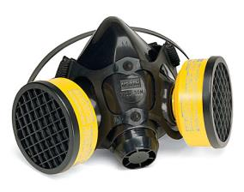
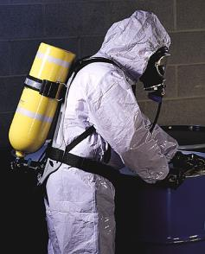
Respiratory Protection
Bureau of Workers’ Compensation
PA Training for Health & Safety (PATHS)
OSHA
29 CFR 1910.134
Notes:
Per 29CFR1910.134(a)
“In the control of those occupational diseases caused by breathing air contaminated with harmful dusts, fogs, fumes, mists, gases, smokes, sprays, or vapors, the primary objective shall be to prevent atmospheric contamination. This shall be accomplished as far as feasible by accepted engineering control measures …When effective engineering controls are not feasible, or while they are being instituted, appropriate respirators shall be used pursuant to this section.”

Slide 2
Respiratory Protection
Respirators shall be provided when necessary to protect the health of employees from breathable hazards (should be used as last choice, not first choice!)
Respirators shall be used in the following circumstances:
  Where exposure levels exceed the permissible exposure limit, or PEL, during time period necessary to install or implement feasible engineering/work practice controls.
  In regulated areas.
  Where employer has implemented all feasible engineering and work practice controls and these are not sufficient to reduce exposures to or below the PEL.
Notes:
Respirators shall be provided when necessary to protect the health of employees from breathable hazards. Respirators should be used as the last choice, not first choice!
Respirators shall be used in the following circumstances:
Where exposure levels exceed the permissible exposure limit, or PEL, during time period necessary to install or implement feasible engineering/work practice controls.
In regulated areas.
Where employer has implemented all feasible engineering and work practice controls and these are not sufficient to reduce exposures to or below the PEL.

Slide 3
Respiratory Hazards
There are two main types of respiratory hazards: oxygen deficiency and airborne contaminants
Airborne contaminants include:
Dusts (e.g. from sawing or grinding)
Mists (e.g. from spray painting)
Vapors (gaseous forms of a liquid)
Fumes (e.g. from welding operations)
Gases (e.g. nitrogen, methane)
Notes:
Two main types of respiratory hazards exist for which protection must be provided: oxygen deficiency and airborne contaminants
Airborne contaminants include:
Dusts (e.g. from sawing or grinding)
Mists (e.g. from spray painting)
Vapors (gaseous forms of a liquid)
Fumes (e.g. from welding operations)
Gases (e.g. nitrogen, methane)

Slide 4
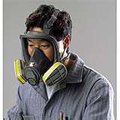
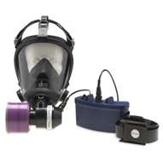
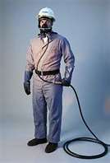
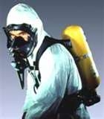
Types of Respirators
Air-Purifying Respirator (APR)
Powered Air-Purifying Respirator (PAPR)
Supplied-Air Respirator (SAR)
Self-Contained Breathing Apparatus (SCBA)
Notes:
There are various respirator types classed according to how they filter the atmosphere or if they provide their own atmosphere. These include:
Air-Purifying Respirator, (APR)
Powered Air-Purifying Respirator, (PAPR)
Supplied-Air Respirator (SAR), and
Self-Contained Breathing Apparatus (SCBA)

Slide 5
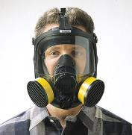
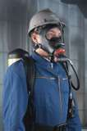
Types of Respiratory PPE
Two general categories:
Air purifying respirators – remove contaminants from air through chemical or mechanical means
Atmosphere supplying respirators – self-contained breathing apparatus (SCBA) and airline equipment
Notes:
These can further be distinguished by 2 general categories:
Air purifying respirators which remove contaminants from the air through chemical or mechanical means
Atmosphere supplying respirators which are self-contained breathing apparatus (SCBA) and airline equipment. They provide the wearer with a breathable quality of air.

Slide 6
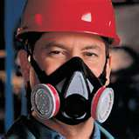
This Program: APRs
Air-Purifying Respirators per 1910.134(b):
“A respirator with an air-purifying filter, cartridge, or canister that removes specific air contaminants by passing ambient air through the air-purifying element”
Notes:
In this program, Air-Purifying Respirators per 1910.134(b) would be:
“A respirator with an air-purifying filter, cartridge or canister that removes specific air contaminants by passing ambient air through the air-purifying element.”

Slide 7
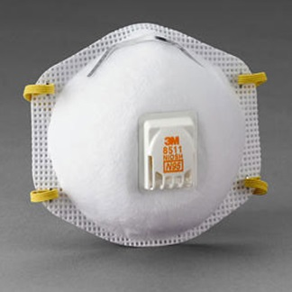
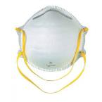
Dust Masks
OSHA refers to Dust Masks as “filtering facepieces” which they define as:
Negative pressure particulate respirators with a filter as an integral part of the facepiece or with the entire facepiece composed of the filtering medium.
All of the requirements of the Respiratory Protection Standard apply to Dust Masks if:
◦ They are required by the employer to protect employees from
any form of dust that exceeds OSHA’s Permissible Exposure
Limits (PEL’s).
The only exception is if the use of Dust Masks is voluntary.
Notes:
Dust masks are usually disposable and can be worn in situations where employees encounter excessive dust or other airborne irritants such as when sanding or leaf/grass blowing.
Dust masks must be included in the employer’s Respiratory Protection Program if they are being required to be worn to protect employees from exposure to any form of dust that exceeds OSHA’s PEL’s.
Since the obligation for determining if the use of Dust Masks will be mandatory or voluntary, it is important that employers give appropriate consideration to what respiratory hazards employees may face and ensure proper and adequate protection is used.

Slide 8
Dust Masks
The employer is responsible for deciding if the use of Dust Masks will be voluntary or required.
If voluntary, the following applies:
Use does not create a hazard in and of itself (e.g. not reusing a contaminated mask, mask used properly).
Users must be provided with Appendix D of Standard (“Information for Employees Using Respirators When Not Required Under the Standard”).
Proper use and maintenance per manufacturer’s instructions must be ensured.
Only NIOSH-certified masks are used with proper design for the tasks being performed.
Notes:
Many times employees will elect to use a Dust Mask due to allergies or possible respiratory problems (asthma, COPD, etc.) even though the employer has determined that the use of such a device is not required. In this case the health of the employee should be taken into consideration with the thought that mandatory use of a dust mask for that particular employee may be to the employers’ benefit to ensure compliance with OSHA’s General Duty Clause.

Slide 9
Dust Masks
If the employer determines the use of Dust Masks is required they must be included as part of the Respiratory Protection Program which includes:
Medical Evaluations for all users.
Fit Testing (either Quantitative or Qualitative).
Training.
Dust Masks should not be used in situations that are Immediately Dangerous to Life & Health (IDLH) including oxygen-deficient atmospheres.
Notes:
If the use of Dust Masks will be required for certain tasks then the employer must ensure that all users receive medical evaluations in addition to fit testing to ensure the user can adequately wear the mask and it will provide the appropriate protection. All users of Dust Masks that have been required for wear should also receive appropriate training which will be described in upcoming slides.

Slide 10
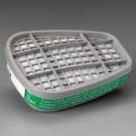
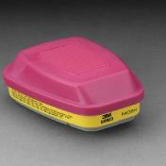
Ratings
N = Not resistant to oil mist
R = Resistant to oil mist
P = Protective against oil mist
Filter efficiency is percentage (%) removed from air stream when tested to 0.3 micron size particles
Notes:
42 CFR 84 (updated July 10, 1995)
Ratings are assigned the various respirators based on oil resistance.
The prefixes will disclose this resistance>
N=Not resistant to oil mists
R=Resistant to oil mist
P=Protective against oil mist
Filter efficiency indicates the percentage removed from the air stream when tested to 0.3 micron size particles.

Slide 11
Air-Purifying Designations
Per 42 CFR Part 84 Approvals:
N
  Tested against sodium chloride
Limited to use in non-oil-based
particulate atmospheres
R & P
Tested against dioctyl phthalate (DOP)
For filtering any solid or liquid particulates
N and R filters may have “use limitations”
P filters do not have “use limitations” assigned
Notes:
N designation is
Tested against sodium chloride
Limited to use in non-oil-based
particulate atmospheres
R & P designation is
Tested against dioctyl phthalate (DOP)
For filtering any solid or liquid particulates
While N and R filters may have “use limitations,” P filters do not have “use limitations” assigned

Slide 12
Use Consideration Chart
Filter Filter Maximum
Series Type Designation Efficiency
“N” N100 99.97%
N 99 99%
N 95 95%
“R” R100 99.97%
R 99 99%
R 95 95%
Notes:
The above use consideration chart will assist in selecting the filter series and type designation for your particular situation.

Slide 13
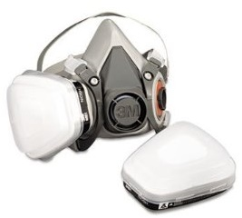
Use Consideration Chart
Filter Filter Maximum
Series Type Designation Efficiency
“P” P100 99.97%
P 99 99%
P 95 95%
Notes:
The “P” designation indicates the maximum efficiency of the filtration means. Check with your respirator supplier. They can help you determine the best match of respirator to your hazards.

Slide 14
Per NIOSH
Filters with “N95, R95 and P95” will be certified as having a minimum efficiency of 95 percent.
Filters with “N99, R99 and P99” will be certified as having a minimum efficiency of 99 percent.
Filters with “N100, R100 and P100” will be certified as having a minimum efficiency of
99.97 percent.
Notes:
Per NIOSH (National Institute of Occupational Safety and Health)
Filters with “N95, R95 and P95” will be certified as having a minimum efficiency of 95 percent.
Filters with “N99, R99 and P99” will be certified as having a minimum efficiency of 99 percent.
Filters with “N100, R100 and P100” will be certified as having a minimum efficiency of 99.97 percent.

Slide 15
Written Respiratory Program
OSHA: Employers must establish a written respiratory program documenting each hazard, site by site, based on work site survey and evaluation.
Written program should spell out site-specific procedures that will be implemented to reduce dangers including:
Medical evaluation of employees required to wear respirators
Procedures for selecting respirators
Fit-testing procedures
Procedures for proper use of respirators in all situations
Procedures and schedules for cleaning, disinfecting, storing, etc.
Training
Program evaluation procedures
Notes:
OSHA requires employers to establish a written respiratory program. This program will document each hazard on a site-by-site basis based on a work survey and evaluation.
This program will be precise in site-specific procedures to be implemented to reduce dangers including:
Medical evaluation of employees required to wear respirators
Procedures for selecting respirators
Fit-testing procedures
Procedures for proper use of respirators in all situations
Procedures and schedules for cleaning, disinfecting, storing, etc.
Training to be provided employees using respirators as well as
Program evaluation procedures

Slide 16
Medical Evaluation
The employee receives a medical evaluation from a physician or other licensed health care professional to determine if they can wear a respirator.
The immediate supervisor must obtain a written recommendation from a health care professional on whether the employee is medically able to use a respirator.
Notes:
Medical evaluations are important to determine if an employee can wear a respirator.
The employee receives a medical evaluation from a physician or other licensed health care professional to determine if they can wear a respirator.
The immediate supervisor must obtain a written recommendation from a health care professional on whether the employee is medically able to use a respirator.

Slide 17
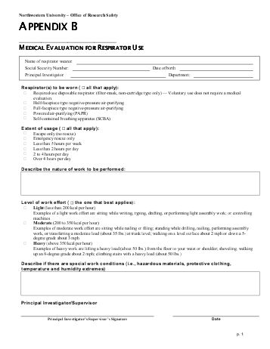
Medical Evaluation
The medical evaluation determines an employee’s fitness to wear a respirator.
It takes into account:
Tobacco use
Pulmonary or lung problems
Cardiovascular or heart problems
Medications
Notes:
This medical evaluation determines the employee’s fitness to wear a respirator.
It takes into account:
Tobacco use
Pulmonary or lung problems
Cardiovascular or heart problems
Medications

Slide 18

Medical Evaluation
It also takes into account:
Vision problems
Hearing
Back problems
Prior chemical exposures
Working conditions with the respirator
Notes:
Also determined during this exam would be other problems which may interfere with use.
Vision problems
Hearing
Back problems
Prior chemical exposures
Working conditions with the respirator

Slide 19

Medical Findings
May indicate the employee can not use a respirator.
May require a specific type of respirator.
May require a follow-up examination.
Notes:
Medical findings may indicate a person can not use a respirator or not use a particular type of respirator.
Follow-up exams may be required to re-evaluate initial findings.

Slide 20
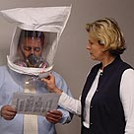
Fitting the Respirator
“Fit” of a respirator face piece to ensure a good seal is extremely important: a secure fit = the difference between life and death!
Most face pieces fit only a certain percentage of people.
It is very important that face pieces are tested for each potential user.
Notes:
For each person using a respirator, a fit test is performed.
The “Fit” of a respirator face piece to ensure a good seal is extremely important: a secure fit = the difference between life and death!
Most face pieces fit only a certain percentage of people. Manufacturers do make various sizes to accommodate the user population.
It is very important that face pieces are tested for each potential user.

Slide 21

Factors Affecting Fit
Facial features such as beards, hollow temples, prominent cheekbones, dentures or missing teeth
Recent jaw surgery
Chewing of gum or tobacco
No, due to excess facial hair.
Under OSHA regs could this guy wear a respirator?
Notes:
Many factors affect the fit of a respirator.
Facial features such as beards, hollow temples, prominent cheekbones, dentures or missing teeth may not permit a good seal. Also, if false dentures are worn for the initial fit
test, they must be worn during use.
Recent jaw surgery
The chewing of gum or tobacco are prohibited when wearing the respirator tending to perhaps flex the face piece to face seal differently then during fit testing.

Slide 22
Initial Fit Testing
Employees must be “fit tested” before initial respirator use and then annually thereafter.
Two types of tests: qualitative and quantitative
Qualitative – user determines if he/she can smell the testing agent being used
Quantitative – instruments detect the agent
Notes:
Requirements exist for Fit Testing.
Employees must be “fit tested” before initial respirator use and then annually thereafter.
Two types of tests exist: either qualitative and quantitative
Qualitative In this test, the user determines if he/she can smell the testing agent being used.
Quantitative This test uses instruments to detect the agent which may have been entrained into the mask.

Slide 23
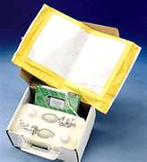
Fit Testing Types
Qualitative (QLFT):
Can the face piece create a seal?
Notes:
During the Qualitative Fit Test (QLFT), a determination is made whether a good seal can be created between the mask and user’s face.

Slide 24
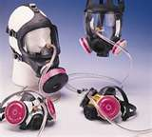
Quantitative Fit Testing
Quantitative (QNFT): Allows sampling inside face piece -- Has hazard intruded and how much?
Tested using the same:
Make
Model
Style
Size of respirator to be used
Notes:
During the Quantitative Fit Test (QNFT), instruments read the internals of the face piece or they may read the exhaled air of the users. A non-offensive aerosol is placed into the test chamber. If the mask seal is not tight, this aerosol may be entrained into the mask. Whether reading the internal mask contents or exhaled air, a reading is obtained of efficiency of the seal.
Information is logged concerning the tests.

Slide 25
Fit Testing Before Each Use
Before using a respirator: user must conduct either a positive or negative pressure test after putting it on.
Positive Pressure Test = User exhales into face piece while exhalation valves are closed off: If face piece bulges slightly and no air leaks out, it’s a good fit.
Negative Pressure Test = User breathes in while inhalation valves are closed off and holds breath for 10 seconds: Face piece should collapse against face and stay collapsed.
Notes:
Before each use there is a further test by the user. This can be either a positive or negative pressure test. For some respirators, both tests are performed to ensure inhalation and exhalation valves function properly.
In the Positive Pressure Test, the user exhales into face piece while exhalation valves are closed off. If the face piece bulges slightly and no air leaks out, it’s a good fit.
During the Negative Pressure Test, the user breathes in while inhalation valves are closed off and holds breath for 10 seconds. The face piece should collapse against face and stay collapsed.
These tests can be performed for all face pieces used on various types.

Slide 26
Fit Test
Before initially using a respirator
When changing to a different respirator
At least annually thereafter
Changes in employee’s physical condition
If one respirator fails test, employee may select and fit test with another
Notes:
The following conditions would require a fit test prior to use:
Before initially using a respirator
When changing to a different respirator
At least annually thereafter
Changes in employee’s physical condition
If one respirator fails test, employee may select and fit test with another

Slide 27
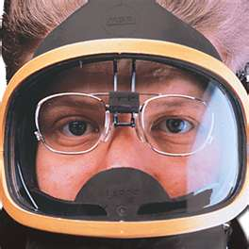
Face Piece Seal Protection
No facial hair that breaks the seal
No condition to interfere with face piece seal or valve function
No glasses (use special inserts)
Perform a seal check before each use
Notes:
To ensure the face to face piece seal, various conditions should be viewed.
No facial hair that breaks the seal is allowed. This includes beards as well as sideburns which may intrude.
No condition to interfere with face piece seal or valve function.
No glasses the posts of which may breech the seal at the temples.
Always perform a seal check before each use!

Slide 28
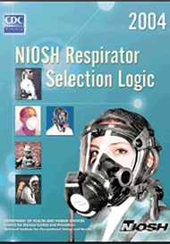
Respirator Selection
Based on respiratory hazards worker will be exposed to
Select a NIOSH-certified respirator
Employer shall select from sufficient number of models and sizes so the respirator is acceptable to, and correctly fits, the user.
Notes:
In selecting the proper respirator, the NIOSH Respirator Selection Logic may be used.
This helps perform the match-up between hazards to which the worker may be exposed and the proper respirator.
This also aids in selecting a NIOSH-certified respirator.
The employer shall select from sufficient number of models and sizes so the respirator is acceptable to, and correctly fits, the user.

Slide 29
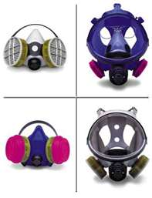
Hazard Compatibility
Respirator shall be appropriate for chemical state and physical form of contaminant
Notes:
When selecting the proper respirator, we seek “hazard compatibility.”
The respirator shall be appropriate for the chemical state and physical form of the contaminant.

Slide 30
Identify/Evaluate Hazards
A reasonable estimate of exposures
An identification of the contaminant’s chemical state and physical form
Where exposure cannot be identified the employer shall consider the atmosphere to be IDLH (Immediately Dangerous to Life or Health)
Notes:
The identification and evaluation of hazards is part of the required written respirator program.
This permits the employer to make a reasonable estimate of exposures.
The chemical state and physical form of the contaminant are identified.
Where the exposure cannot be identified, the employer shall consider the atmosphere to be IDLH (immediately dangerous to life or health).

Slide 31
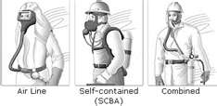
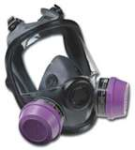
Gas/Vapor Protection
Employer shall provide an atmosphere-supplying respirator, or
Air-purifying with an ESLI (end of service life) indicator certified by NIOSH for the contaminant
Not ESLI appropriate? Change schedule for canister, filter or cartridge required
Notes:
For the protection against gases and vapors:
The employer shall provide an atmosphere-supplying respirator, or
Air-purifying with an ESLI (end of service life) indicator certified by NIOSH for the contaminant.
When no ESLI is provided or appropriate a change schedule for canister, filter or cartridge is required.

Slide 32
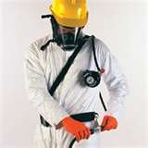
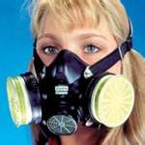
Particulate Protection
An atmosphere-supplying respirator, or
Air-purifying with NIOSH-certified HEPA filter, or
Air-purifying equipped with a filter certified for particulates (42 CFR part 84)
Notes:
For particulate protection, several varieties may be selected.
An atmosphere-supplying respirator, or
Air-purifying with NIOSH-certified HEPA filter, or
Air-purifying equipped with a filter certified for particulates (42 CFR part 84)

Slide 33
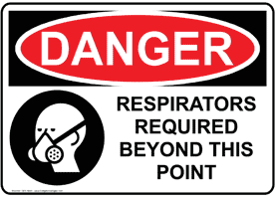
IDLH Atmospheres
”Immediately Dangerous to Life or Health”
An atmosphere that:
Poses an immediate threat to life or
Would cause irreversible adverse health effects or
Would impair an individual’s ability to escape
Notes:
An ”Immediately Dangerous to Life or Health” atmosphere establishes Protective Action Guidelines (PAG’s). These PAG’s establish the protection which must be provided based on the level of contaminant.
An IDLH atmosphere is one that:
Poses an immediate threat to life or
Would cause irreversible adverse health effects or
Would impair an individual’s ability to escape

Slide 34
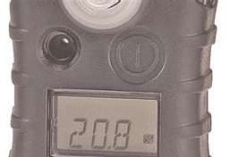
Three IDLH Atmospheres
Oxygen deficient/enriched (below 19.5% or above 23.5%)
Flammable limits achieved
Toxic atmosphere
All oxygen-deficient atmospheres shall be considered IDLH
Notes:
There are three (3) atmospheric conditions which may constitute an IDLH atmosphere:
Oxygen deficient or enriched (below 19.5% or above 23.5%)
Flammable limits achieved
A toxic atmosphere
All oxygen-deficient atmospheres shall be considered IDLH

Slide 35
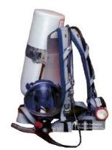
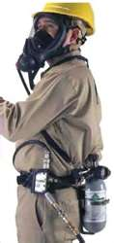
Respirators for IDLH Areas
Full face piece pressure demand SCBA certified by NIOSH (minimum service life 30 minutes), or
Combination full face piece pressure demand supplied air respirator (SAR) with auxiliary self-contained air supply
Notes:
Respirators for IDLH areas must supply air. They will not be filtration types. Those required are:
Full face piece pressure demand SCBA certified by NIOSH (minimum service life 30 minutes), or
Combination full face piece pressure demand supplied air respirator (SAR) with auxiliary self-contained air supply

Slide 36
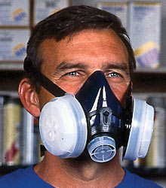
Respirators: Non-IDLH Area
Adequate to protect employee health, and
Ensure compliance with OSHA and regulatory requirements under routine and reasonably foreseeable emergency situations
Notes:
Respirators for non-IDLH atmospheres must
Be adequate to protect employee health, and
Ensure compliance with OSHA and regulatory requirements under routine and reasonably foreseeable emergency situations

Slide 37
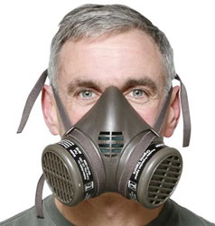
Assigned Protection Factors (APFs)
Defined:
Workplace level of respiratory protection respirators are expected to provide when employer implements a continuing, effective respiratory protection program
Notes:
Each respirator type has an assigned protection factor (APF).
Defined:
Workplace level of respiratory protection respirators are expected to provide when employer implements a continuing, effective respiratory protection program

Slide 38
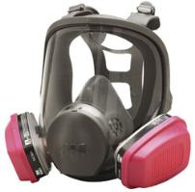
APF Explained
Ratio comparison of the amount of contaminant outside the respirator and amount which may intrude the face piece
APF= Concentration outside respirator
Concentration inside face piece
Notes:
The APF is a ratio comparison of the amount of contaminant outside the respirator and amount which may intrude the face piece.
The higher the number of the APF, the greater the protection.
As shown, this APF is the concentration outside the respirator divided by the concentration found inside the face piece.

Slide 39
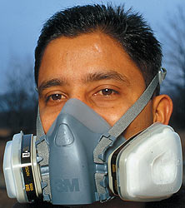
APF
When using a combination respirator, ensure assigned protection factor is appropriate to mode of operation in which respirator is being used (e.g. airline with an air-purifying filter)
Notes:
When using a combination respirator, ensure assigned protection factor is appropriate to mode of operation in which respirator is being used (e.g. airline with an air-purifying filter)

Slide 40
APF Chart
Type Half Face Piece Full Face Piece
APR 10 50
PAPR 50 1,000
SAR (PD) 50 1,000
Demand 10 50
Continuous 50 1,000
SCBA
Demand 10 50
Positive Psi 10,000
*Note: The higher the APF number, the greater
the protection
Notes:
As will be noted by the chart, the assigned protection factor for a full face piece air purifying respirator is 50.
The APF for the positive pressure SCBA is 10,000. Therefore, the SCBA will provide greater protection than the APR.

Slide 41
Maximum Use Concentration (MUC)
Maximum atmospheric concentration of hazardous substance an employee can be expected to be protected from when wearing a respirator
Determined by the assigned protection factor (PF) and exposure limit of the hazardous substance
Highest concentration, not exceeding IDLH concentration, of a specific contaminant in which a respirator can be worn
Notes:
The maximum use concentration (MUC) would be the
Maximum atmospheric concentration of hazardous substance an employee can be expected to be protected from when wearing a respirator.
Determined by the assigned protection factor (PF) and exposure limit of the hazardous substance.
Highest concentration, not exceeding IDLH concentration, of a specific contaminant in which a respirator can be worn.

Slide 42
Determining MUC
The MUC is derived by multiplying the APF by the OSHA permissible exposure limit, or PEL
        MUC = APF x PEL
When no OSHA exposure limit is available, determine the MUC on the basis of relevant available information and professional judgment.
Notes:
The MUC is derived by multiplying the APF by the OSHA permissible exposure limit, or PEL
MUC = APF x PEL
When no OSHA exposure limit is available, determine the MUC on the basis of relevant available information and professional judgment.
When calculating, the MUC can not exceed the IDLH for a material.

Slide 43
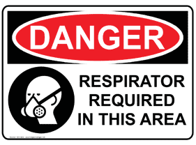
CAUTION
Do NOT apply MUCs to IDLH conditions!
Use respirators approved for IDLH conditions.
When calculated MUC exceeds IDLH level, set maximum MUC at lower limit.
Notes:
As a precaution
Do NOT apply MUCs to IDLH conditions!
Use only those respirators approved for IDLH conditions.
When the calculated MUC exceeds IDLH level, set maximum MUC at lower limit.

Slide 44
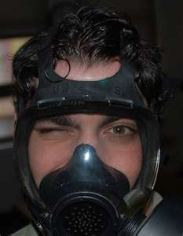
Odor Threshold
Materials which user protects themselves against should have an “odor threshold” below the hazardous concentrations.
This enables the user to know if the hazard has entered the mask via filter or seal.
Notes:
The odor threshold is the percentage or ppm at which the respirator user can detect the intrusion of the material into the face piece.
Materials which the user protects themselves against should have an “odor threshold” below the hazardous concentrations. As an example: Odor threshold of 50ppm; dangerous limit at 100ppm. The user should always have a safety cushion to determine the presence of the material in the mask before it has reached its hazardous level.
This enables the user to know if the hazard has entered the mask via filter or seal.
Some places will not allow the user of filtration respirators if the contaminant does not have an odor threshold.

Slide 45

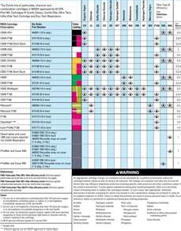
Filter Selection
Base filter selection on identified hazards.
Vendor charts are available to help make this selection.
Notes:
When we discuss respirator compatibility, we also need to make sure the filtration means is to be used against the contaminant otherwise we do not obtain the proper filtration of the hazard.
In one instance a spill team used cartridges meant for chlorine when the material leaking was an organic vapor. Not only did the filter not work but jeopardized the safety of the spill team members.
Base filter selection on identified hazards.
Vendor charts are available to help make this selection. Also, vendors are more than happy to assist you in making the right choice of filters and cartridges.

Slide 46

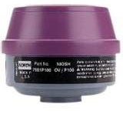
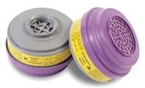

Hazard Compatibility
Filters, cartridges, canisters labeled
Color coded with NIOSH approval label
Label is not removed
Label remains legible
Notes:
Filters, cartridges, and canisters are labeled
They are also color coded with NIOSH approval label
Do not permit labels to be removed
Label should always remain legible
Protect these filters, cartridges and canisters from the elements and temperature extremes.

Slide 47
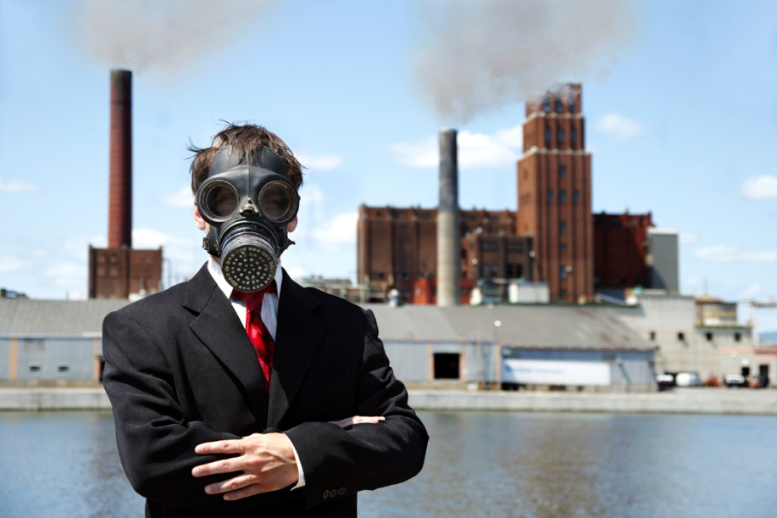
Hazard Compatibility
Be aware of other activities taking place in use area for which filtration may not be compatible.
Notes:
Although you have selected the proper respirator and filtration means based on your in-house hazards (by location), be aware of other activities taking place in the use area for which filtration may not be compatible. Outside activities, vendor operations, material releases which intrude your facility may compromise the protection you’ve selected.

Slide 48
Hazard Warning Properties
Sign filtration is losing its effectiveness
Can be odor, taste or irritation
At first sign, change out old filtration device for a new one
If hazard has no warning properties, respirator efficiency may drop without user’s knowledge: it becomes a health hazard
Notes:
Some of the warning signs that properties in the atmosphere are hazardous when they’ve broken through the face piece seal or to let you know the filtration medium is losing its effectiveness:
It can be an odor, taste or irritation caused by the material.
At the first sign a material may have intruded your face piece, change out old filtration device for a new one in a clean area.
If hazard has no warning properties, respirator efficiency may drop without user’s knowledge making it a health hazard

Slide 49
When to Change Filters
When breathing becomes labored
If feeling nauseous
When odor threshold is detected
If detecting “taste” of intruding material
If irritation occurs on face
When work area or hazard changes
Notes:
Filters are changed when:
When breathing becomes labored
If feeling nauseous
When odor threshold is detected. This is why your hazard evaluation should take into account the odor threshold in ppm.
If detecting “taste” of intruding material
If irritation occurs on face
When work area or hazard changes
Some written programs create a matrix listing the following as headings:
Use Department
Hazards found
Respirator of cartridge type
Cartridge or filter change schedule

Slide 50
Leave Hazard Area . . .
To wash face or face piece
If an odor or gas breakthrough is detected
If there are changes in breathing resistance
If there is a leakage in face piece
To replace respirator or filter means
Notes:
Always leave the hazard area:
To wash face or face piece
If an odor or gas breakthrough is detected
If there are changes in breathing resistance
If there is a leakage in face piece
To replace respirator or filter means

Slide 51
IDLH Area Procedures
One (1) employee (or more, if needed) outside the IDLH atmosphere
Communications between entrants and outside via:
Visual
Voice
Signal line
This parallels the 2-in/2-out rule in 29 CFR 1910.156 by philosophy
Notes:
Safety procedures within an IDLH area must be pre-planned so each person knows their appointed duty if an emergency arises.
These procedures would include:
One (1) employee (or more, if needed) outside the IDLH atmosphere
Establish communications between entrants and outside personnel by way of:
Visual
Voice
Signal line
This parallels the 2-in/2-out rule found in 29 CFR 1910.156 by philosophy.

Slide 52

Outside (Backup)
Outside persons are trained in emergency rescue
Employer (or designee) is notified before outside staff enter IDLH area to rescue
Equipped with Demand or Pressure-Demand SCBA or other positive-pressure respirator
Appropriate retrieval equipment
Notes:
Outside (back-up) personnel should likewise be trained on duties.
Outside persons are trained in emergency rescue
Employer (or designee) is notified before outside staff enter IDLH area to rescue
Outside personnel are equipped with Demand or Pressure-Demand SCBA or other positive-pressure respirator
Appropriate retrieval equipment is available.

Slide 53
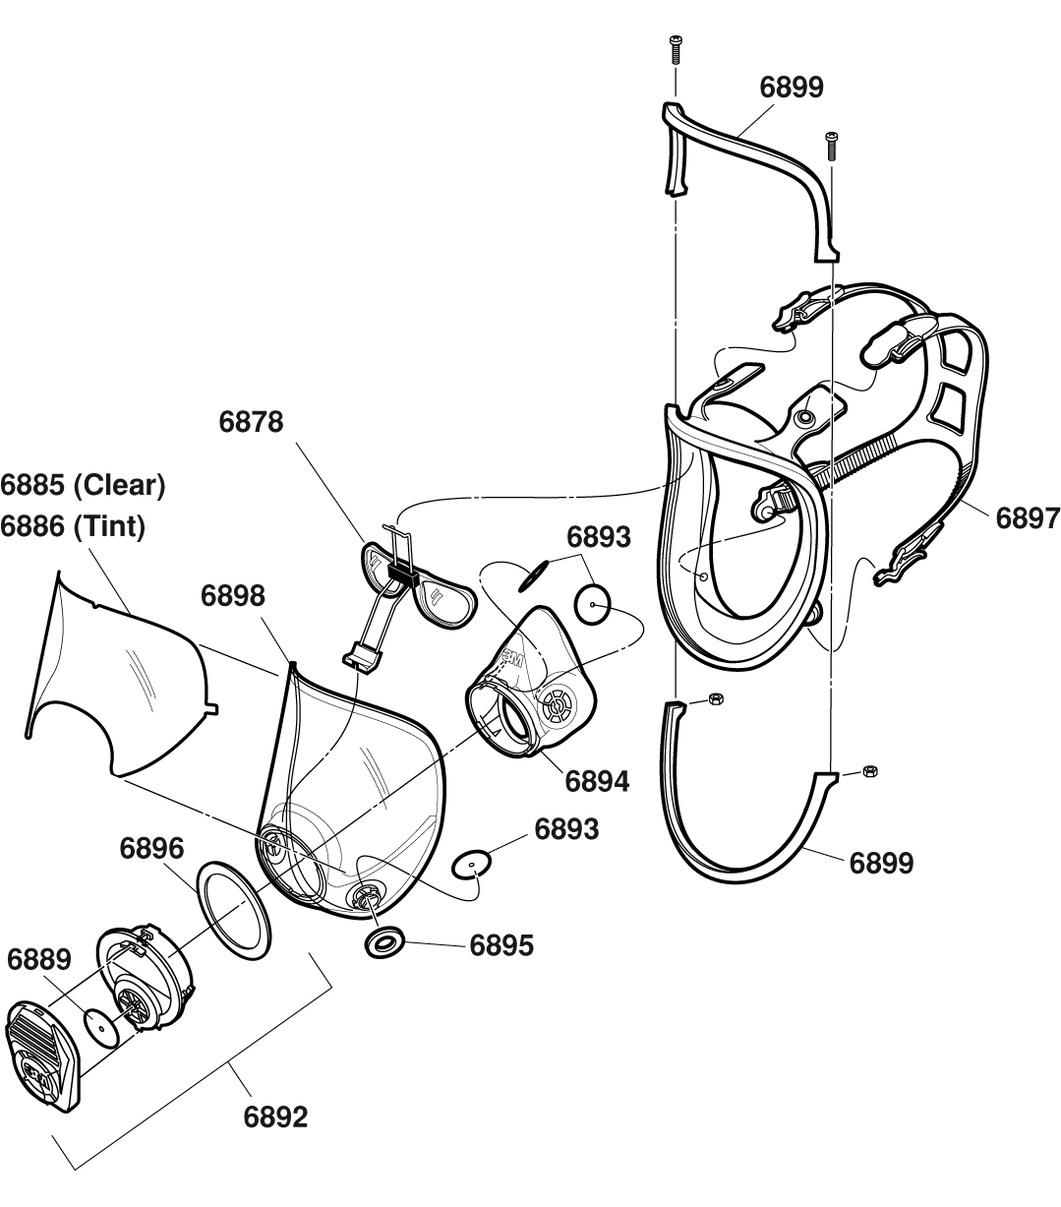
Maintenance and Care
Cleaning and Disinfecting
Storage
Inspection
Maintenance & Repairs
Notes:
Whichever respirator you determine is required for your staff, it must be properly inspected and maintained. The major segments for maintenance and care are:
Cleaning and Disinfecting
Storage
Inspection
Maintenance & Repairs

Slide 54

Cleaning and Disinfecting
For single employee use: as needed
Used by multiple employees: before being worn by another
For emergency use: after each use
For training or fit testing: after each use
Notes:
The cleaning and disinfecting schedules are:
For single employee use: as needed
If used by multiple employees: before being worn by another
For emergency use: after each use
For training or fit testing: after each use

Slide 55

Cleaning Precautions
Various brands of alcohol wipes may be used to clean the respirator.
Use these wipes only on rubber face seal area; never on the clear view plate!
Check manufacturer’s information: most respirators may be cleaned with mild detergent and water.
Notes:
There are precautions during cleaning which will better ensure longevity of the respirator.
Various brands of alcohol wipes may be used to clean the respirator.
Use these wipes only on the rubber face seal area, never on the clear view lens!
Most respirators may be cleaned with mild detergent and water.
Always check the manufacturer’s information.

Slide 56
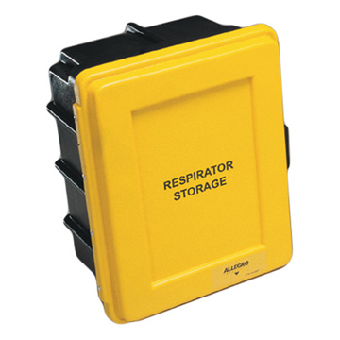
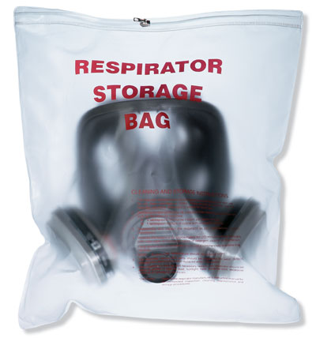
Storage
Protect from adverse effects and damage caused by:
Contamination
Dust
Sunlight
Temperature/moisture extremes
Damaging chemicals (direct contact/vapors)
Pack to prevent deformation of parts
Notes:
When these are stored, make sure they are protection from adverse effects and damage caused by:
Protect from adverse effects and damage caused by:
• Contamination
• Dust
• Sunlight
• Temperature/moisture extremes
• Damaging chemicals (direct contact/vapors)
Store to prevent deformation of parts.

Slide 57
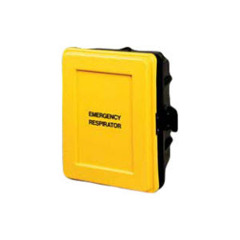
Emergency Response Storage
Accessible to work area
In compartments or covers and clearly marked “For Emergency Use”
Stored in a manner to be donned and used without delay
Notes:
Storage for emergency response means the respirators should:
Be accessible to the work area
Be stored in compartments or covers and clearly marked “For Emergency Use”
Be stored in a manner to be donned and used without delay.
One client had stored their face pieces exposed to the elements unwrapped. When they were needed, the users had to first dump dirt out of them and wash them off. Not conducive to emergency response!

Slide 58
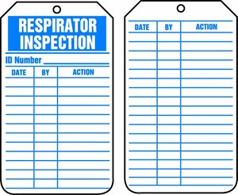
Emergency Respirators
Certify the respirator by
documenting the following
information on a storage
compartment tag or label:
Inspection date
Inspector’s name
Findings
Required remedial action
Serial number or other identifying means for the respirator
Notes:
Certify the respirator by documenting the following information on a storage compartment tag or label:
Inspection date
Inspector’s name
Findings
Required remedial action
Serial number or other identifying means for the respirator

Slide 59
Inspection
Routine use: Before each use and during cleaning
Emergency use: At least monthly & checked for proper function before and after use
Emergency, Before being carried into
escape-only: the workplace for use
Notes:
Inspection intervals can be based on type of use.
Routine use, inspect before each use and during cleaning
Emergency use, inspect at least monthly and check for proper function before and after use
Emergency, escape only can be inspected before taking into the workplace for use.

Slide 60
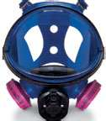
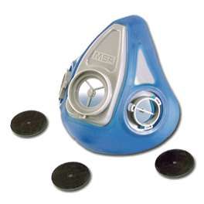
Items Inspected
Check function
Tightness of connections
Condition of:
Face piece
Head straps
Valves
Connecting tube
Filtration means
Check elastomeric parts for pliability/distress
Notes:
The manufacturer and supplier will provide a “turn-over package” when you purchase your respirator. The manual will contain different information concerning the maintenance and use of the unit. This will include inspection schedules as well as things you will not be able to do requiring you send it out or back for various service.
The inspection checklist deals with:
Check function
Tightness of connections
Condition of:
Face piece
Head straps
Valves
Connecting tube
Filtration means
Check elastomeric parts for pliability/distress

Slide 61
Maintenance and Repair
Remove failed or defective units from service
Discard, adjust or repair
Repairs should be completed by appropriately-trained persons using only approved parts
The following repairs should only be completed by the manufacturer or a technician trained by the manufacturer:
◦ Reducing and admission valves
◦ Regulators
◦ Alarms
Notes:
For maintenance and repair,
Remove failed or defective units from service
Discard, adjust or repair
Repairs should be completed by appropriately-trained persons using only approved parts
The following repairs should only be completed by the manufacturer or a technician trained by the manufacturer:
Reducing and admission valves
Regulators
Alarms

Slide 62

Respirator Training Topics
Respiratory hazards that employees are potentially exposed to during routine and emergency situations
Proper use, including putting on (donning) and removing (doffing)
Limitations on use
Maintenance
Procedures for regularly
evaluating the effectiveness
of the program
Notes:
The best way to ensure employee safety is to make sure each has been thoroughly trained on the respirator’s use. Topics in the training should include:
Respiratory hazards that employees are potentially exposed to during routine and emergency situations
Proper use, including putting on (donning) and removing (doffing)
Limitations on use
Maintenance
Procedures for regularly evaluating the effectiveness of the program

Slide 63
Employee Training
Training must be:
Comprehensive
Understandable
Provided prior to respirator usage
Provided annually, and more often if there are:
  Changes in workplace or type of respirator
  Inadequacies in employee’s knowledge
  Other situations in which training appears needed.
Notes:
Its also important the employee training be:
Comprehensive
Understandable
Provided prior to respirator use
Provided annually, and more often if there are:
Changes in the workplace or type of respirator
Inadequacies in the employee’s knowledge
Or if other situations occur in which training appears needed.

Slide 64
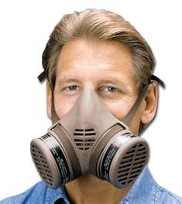
Employee Can Demonstrate
Need for respirator and what can compromise its effectiveness
Unit capabilities and limitations
How to inspect, don, use (also in emergency conditions), doff and check seals
Maintenance and storage
Medical signs and symptoms limiting effectiveness
General requirements of 29 CFR 1910.134
Notes:
The training’s goal is enable the employee to demonstrate
The need for a respirator and what can compromise its effectiveness
The capabilities and limitations of the respirator
How to inspect, don, use (also in emergency conditions), doff and check seals
Maintenance and storage requirements
Medical signs and symptoms limiting effectiveness and
The general requirements of 29 CFR 1910.134

Slide 65
Program Evaluation
Conducted by employer to determine program and use efficiency
Employer seeks employee input concerning respirator use
All problems identified will be corrected
Areas assessed:
  Respirator fit
  Appropriate respirator selection
  Proper use
  Proper maintenance
Notes:
The in-house training program is evaluated by the employees to achieve and maintain effectiveness of understanding.
The program evaluation
Is conducted by the employer to determine program and use efficiency
The employer seeks employee input concerning respirator use
All problems identified will be corrected
Areas assessed to determine user understanding include:
Respirator fit
Appropriate respirator selection
Proper use
Proper maintenance

Slide 66

Recordkeeping
Medical evaluation
Fit testing:
  Name of tested employee
  Type of fit test
Specific make, model, style, size of respirator
tested
Pass/fail results for QLFT and fit factor and strip chart or other recording for QNFTs
RP Program
Records
Notes:
As with other OSHA programs, recordkeeping is vitally important.
Information pertaining to respirator users are also kept. These include:
Medical evaluation
Fit testing:
Name of tested employee
Type of fit test
Specific make, model, style, size of respirator tested
Pass/fail results for QLFT and fit factor and strip chart or other recording for QNFTs

Slide 67
Recordkeeping
Written copy of current respirator program
Written materials required to be retained shall be made available upon request to:
Affected employees
Assistant secretary of labor (federal) or designee
Notes:
Also a part of the employer’s records would be:
A written copy of current respirator program.
Written materials required to be retained shall be made available upon request to:
Affected employees
Assistant secretary of labor (federal) or designee

Slide 68
Respirators - Remember
Should not be the first choice
Use engineering and/or administrative controls before using respirators
Should be selected based on need and task (e.g. full face, half face, supplied air)
All users should have a medical evaluation and fit testing before use
Notes:
In summary, remember:
Respirators should not be the first choice
Use engineering and/or administrative controls before using respirators
Respirators should be selected based on need and task (e.g. full face, half face, supplied air)
All respirator users should have a medical evaluation and fit testing before use

Slide 69
Mandatory Compliance
Appendix A – Fit Test Procedures
Appendix B-1 – User Seal Check Procedures
Appendix B-2 – Respirator Cleaning Procedures
Appendix C – OSHA Respirator Medical Evaluation Questionnaire
Notes:
To comply with OSHA requirements, the Appendices shown would be adopted as part of your written program.

Slide 70
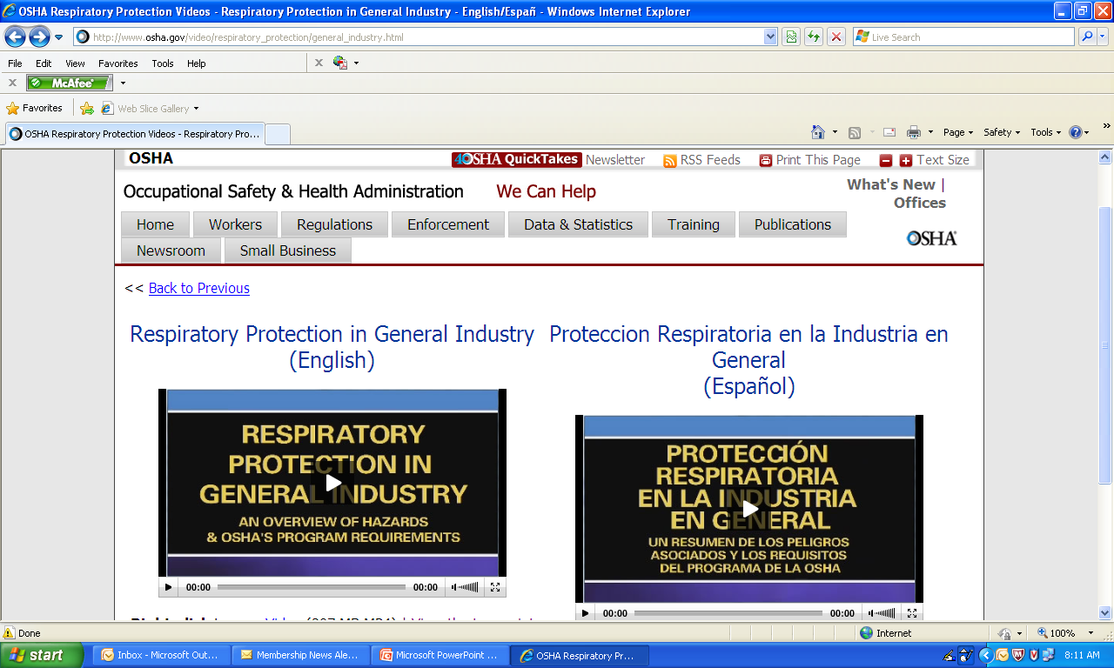
Free Training Videos
From OSHA:
http://www.osha.gov/video/respiratory_protection/general_industry.html
Notes:
To assist your training program, videos may be obtained from OSHA like the one displayed.

Slide 71


Contact Information
Health & Safety Training Specialists
1171 South Cameron Street, Room 324
Harrisburg, PA 17104-2501
(717) 772-1635
RA-LI-BWC-PATHS@pa.gov
Like us on Facebook! - https://www.facebook.com/BWCPATHS
Notes:
For more information on webinars and free training at your location, we invite you to contact us.

Slide 72
Questions

