Slide 1
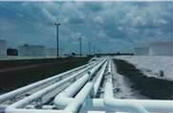
Process Safety Management
Bureau of Workers’ Comp
PA Training for Health & Safety (PATHS)
Process Safety Management
(PSM)
29 CFR 1910.119
PPT-055-01
1
Notes:
29 CFR 1910.119, Process safety management of highly hazardous chemicals, herein referred to as Process Safety Management or PSM.
The intent of this standard is to prevent or minimize the consequences of catastrophic releases of toxic, reactive, flammable, or explosive chemicals.
These releases may result in toxic, fire or explosion hazards.

Slide 2
Topics
Terms
Applicability & Exceptions
Process Hazard Analysis
Data & Evaluation
Methods to Describe Systems
PPT-055-01
2
Notes:
Topics discussed include those shown;
Terms
Applicability and Exceptions
Process Hazard Analysis
Data and Evaluation
Methods to Describe Systems.

Slide 3
Topics
Steps for Each Operating Procedure
Pre-Startup Review
Incident Investigation
Appendix A & B Contents
Bibliography
PPT-055-01
3
Notes:
Also discussed:
Steps for Each Operating Procedure
Pre-Startup Review
Incident Investigation
Appendix A & B Contents
Bibliography

Slide 4
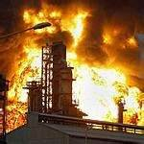
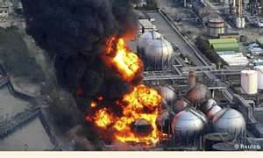
Terms
Catastrophic release:
Major uncontrolled
emission, fire, or
explosion
Involves one or more
highly hazardous
chemicals
Presents serious
danger to employees
in the workplace
PPT-055-01
4
Notes:
A Catastrophic release:
Major uncontrolled emission, fire, or explosion
Involves one or more highly hazardous chemicals
Presents serious danger to employees in the workplace

Slide 5
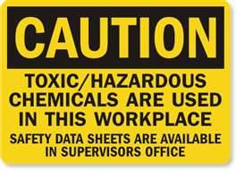
Terms
Highly hazardous chemical: a substance possessing toxic, reactive, flammable, or explosive properties and specified by section 1910.119(a)(1)
PPT-055-01
5
Notes:
A Highly hazardous chemical is defined by the standard as a substance possessing toxic, reactive, flammable, or explosive properties and specified by section 1910.119(a)(1)

Slide 6
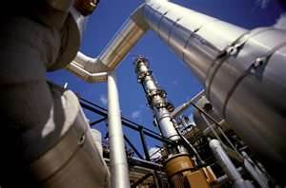
Process Safety Management
Process:
Any activity involving a highly hazardous chemical including use, storage, manufacturing, handling, or the on-site movement of such chemicals, or combination of these activities
Any group of vessels that are interconnected, &
Separate vessels which are located such that a highly hazardous chemical could be involved in a potential release
All considered a single process
PPT-055-01
6
Notes:
Process:
Any activity involving a highly hazardous chemical including use, storage, manufacturing, handling, or the on-site movement of such chemicals, or combination of these activities,
Any group of vessels that are interconnected, and
Separate vessels which are located such that a highly hazardous chemical could be involved in a potential release are considered a single process.

Slide 7
29 CFR 1910.119 Applies To
Chemicals addressed in 1910.119, Appendix A at their Threshold Quantities (TQs)
Chemical Name CAS TQ
Acetaldehyde 75-07-0 2500
Acrolein (2-Propenal) 107-02-8 150
(View complete list of chemicals in Appendix A)
Process involving a chemical at or above the specified threshold quantities (TQs)
PPT-055-01
7
Notes:
Chemicals addressed in 1910.119, Appendix A at their Threshold Quantities (TQs)
Chemical Name CAS TQ
Acetaldehyde 75-07-0 2500
Acrolein (2-Propenal) 107-02-8 150
(View complete list of chemicals in Appendix A)
Process involving a chemical at or above the specified threshold quantities (TQs)

Slide 8
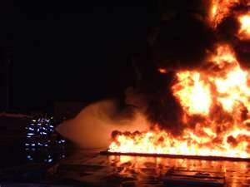
29 CFR 1910.119 Applies To
Category 1 Flammable Liquid (per 1910.1200) or
Flammable Liquid with flashpoint below 100⁰F on site at one location in a quantity of 10,000 lbs or more
PPT-055-01
8
Notes:
Category 1 Flammable Liquid (per 1910.1200) or
Flammable Liquid with flashpoint below 100⁰F on site at one location in a quantity of 10,000 lbs or more
To determine total weight in containment, multiply the liquid’s specific gravity time the number of gallons. This will provide you with the weight of the liquid.
Example: Chemical has a specific gravity of .8 and 100 gallons are stored. By multiplying .8 x 100 gallons we have 80 pounds.
Note: The specific gravity of a liquid determines if is heavier than water or lighter. Water is assigned a specific gravity of 1.0, therefore a liquid having a specific gravity less than 1.0 is lighter than water and will float. Liquids having a number greater than 1.0 would be that many times heavier then water and will sink in a water medium.

Slide 9
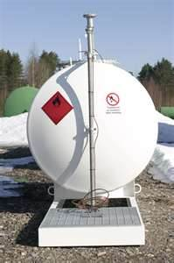
29 CFR 1910.119 Exceptions
29 CFR 1910.119 does NOT apply to:
Hydrocarbon fuels used solely for workplace consumption as a fuel not as part of a process containing another highly hazardous chemical
Flammable liquids with a flashpoint below 100⁰F stored in atmospheric tanks or transferred kept below their normal boiling point without benefit of chilling or refrigeration
PPT-055-01
9
Notes:
The standard provides for exceptions.
29 CFR 1910.119 does NOT apply to:
Hydrocarbon fuels used solely for workplace consumption as a fuel not as part of a process containing another highly hazardous chemical
Flammable liquids with a flashpoint below 100⁰F stored in atmospheric tanks or transferred kept below their normal boiling point without benefit of chilling or refrigeration

Slide 10
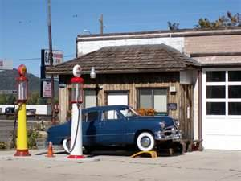
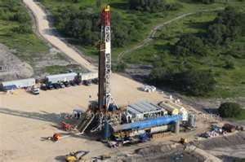
29 CFR 1910.119 Exceptions
Also does NOT apply to:
Retail facilities
Oil/gas well drilling or servicing operations
Normally unoccupied remote facilities
PPT-055-01
10
Notes:
Also the standard does NOT apply to:
Retail facilities
Oil/gas well drilling or servicing operations
Normally unoccupied remote facilities

Slide 11
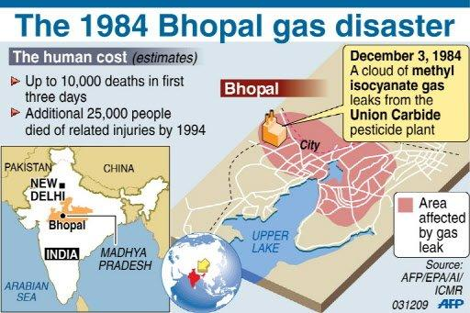
Purpose of Process Hazard Analysis
To plan against events
which will disrupt or
shutdown a process or
to allow a chemical to
escape its containment
and impact the plant, personnel and
community at large
PPT-055-01
11
Notes:
One of the main purposes for Process Hazard Analysis (PHA) is due to historical events and their impact.
To plan against events which will disrupt or shutdown a process or to allow a chemical to
escape its containment and impact the plant, personnel and community at large.

Slide 12
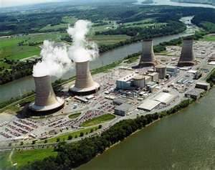
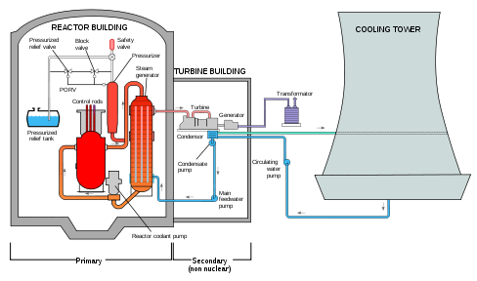
Planning
Through Anticipation or Historic Occurrence:
March 28, 1979, Middletown, Pennsylvania: Although a horrendous event, lessons were learned which benefitted the entire nuclear generating community
Three Mile Island Nuclear Power Station (TMI)
PPT-055-01
12
Notes:
Planning can result through Anticipation or Historic Occurrence:
March 28, 1979, Middletown, Pennsylvania: Although a horrendous event, lessons were learned which benefitted the entire nuclear generating community.

Slide 13
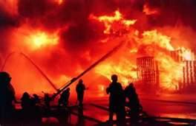
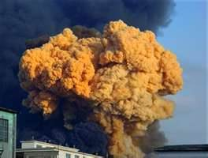
Process Hazard Analysis
Anticipates events based on the chemicals used in storage and processes
To preclude uncontrolled releases or to minimize their severity if released
PPT-055-01
13
Notes:
The process hazard analysis anticipates events based on the chemicals used in storage and processes.
To preclude uncontrolled releases or to minimize their severity if released.

Slide 14
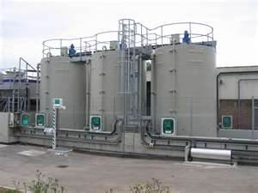
Process Hazard Analysis (PHA)
A method to determine plant or process chemical hazards and develop policies, procedures and safeguards against emergencies which may occur
PPT-055-01
14
Notes:
A method to determine plant or process chemical hazards and develop policies, procedures and safeguards against emergencies which may occur.

Slide 15
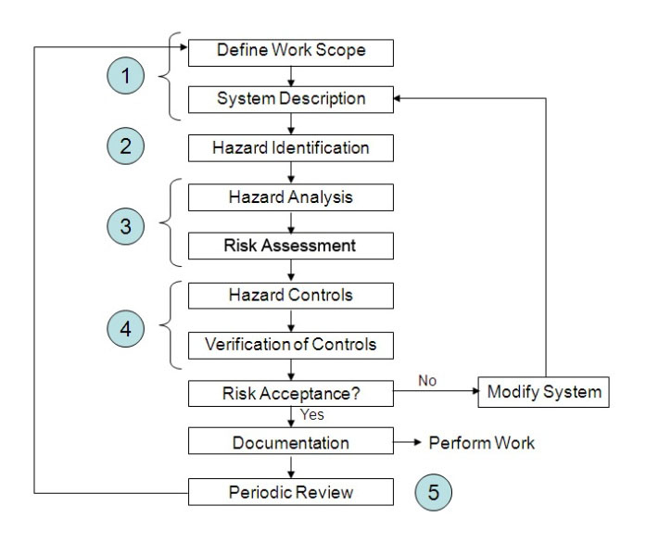
PHA Concept
PPT-055-01
15
Notes:
The PHA Concept views the complete scope of a process.
1.The System and its description
2.Hazards identified with the process or system
3.An analysis and risk assessment
4.Methods to control the identified hazards as well as a means to verify the adopted controls
5.A review process to maintain the enacted controls.

Slide 16
PHA: Employee Participation
Employers shall develop a written plan of action for implementation of the employee participation required by 1910.119(c)
Employers consult with employees/their representatives on conduct and development of process hazards analyses (PHA)
PPT-055-01
16
Notes:
The PHA is not exclusively for management. Employee participation is a must.
Employers shall develop a written plan of action for implementation of the employee participation required by 1910.119(c)
Employers consult with employees/their representatives on conduct and development of process hazards analyses (PHA)

Slide 17
PHA: Employee Participation
Provide employees and their representatives access to PHA and all other information required to be developed under this standard
PPT-055-01
17
Notes:
Provide employees and their representatives access to PHA and all other information required to be developed under this standard.

Slide 18
Process Safety Information
Employer:
Complete written process safety information before conducting any PHA
To identify/understand hazards posed by those processes
Include information concerning hazards of the highly hazardous chemicals used or produced by the process
Information of the technology of the process
Information of the equipment in the process
PPT-055-01
18
Notes:
Process safety information.
The Employer will:
Complete written process safety information before conducting any PHA
To identify/understand hazards posed by those processes
Include information concerning hazards of the highly hazardous chemicals used or produced by the process
Information of the technology of the process
Information of the equipment in the process

Slide 19
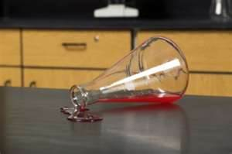
Data Evaluated for PHA
Highly Hazardous
Chemical Process
Information
Toxicity
Permissible exposure limits
Physical data
Reactivity data
Corrosivity data
PPT-055-01
19
Notes:
Data evaluation.
Highly Hazardous Chemical Process Information will be evaluated to include:
Toxicity
Permissible exposure limits
Physical data
Reactivity data
Corrosivity data

Slide 20
Data Evaluated for PHA
Thermal and chemical stability data
Hazardous effects of inadvertent mixing of materials
Safety Data Sheets (SDS) per 29 CFR 1910.1200(g) may be used to comply
PPT-055-01
20
Notes:
Data evaluated includes,
Thermal and chemical stability data
Hazardous effects of inadvertent mixing of materials
Safety Data Sheets (SDS) per 29 CFR 1910.1200(g) may be used to comply.

Slide 21
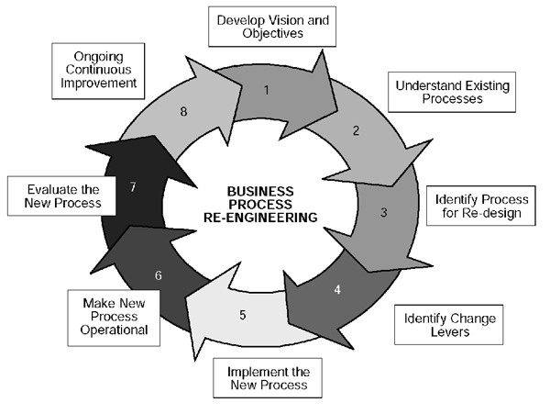
Technology Process Information
Graphic means which describe the workings of a process for purposes of emergency shutdown, maintenance and system restoration
PPT-055-01
21
Notes:
There will also be technology process information which is a graphic means which describe the workings of a process for purposes of emergency shutdown, maintenance and system restoration

Slide 22
Methods to Describe Systems
Block flow diagram
Process flow diagram
Piping and instrument diagrams (P&IDs)
(Block & process diagrams
available in 29 CFR 1910.119,
Appendix B)
PPT-055-01
22
Notes:
Several acceptable methods exist by which systems can be described:
Block flow diagram
Process flow diagram
Piping and instrument diagrams (P&IDs)
(Block & process diagrams are available in 29 CFR 1910.119, Appendix B)

Slide 23
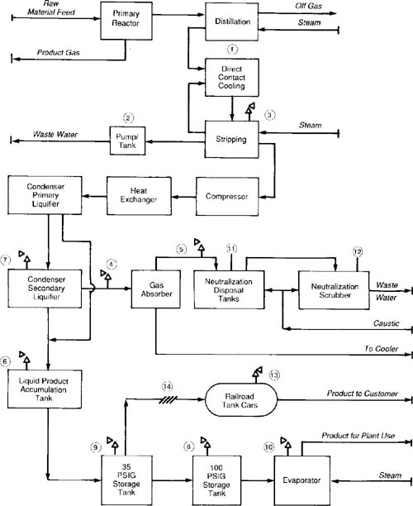
Block Flow Diagram
Elements:
Simplified
Major process equipment
Interconnecting flow lines
Flow rates
Stream composition
Temperatures and pressures
PPT-055-01
23
Notes:
The elements of a Block Flow Diagram would be,
Major process equipment
Interconnecting flow lines
Flow rates
Stream composition
Temperatures and pressures

Slide 24
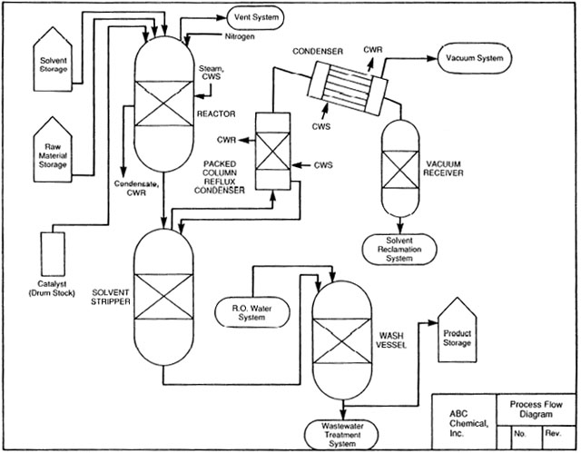
Process Flow Diagram
More complex:
Main flow streams, valves
Temperatures and pressures
Feed and product lines
Materials of construction
Pump capacities & pressure heads
Major control loop components
PPT-055-01
24
Notes:
A more complex Process Flow Diagram would include:
Main flow streams, valves
Temperatures and pressures
Feed and product lines
Materials of construction
Pump capacities & pressure heads
Major control loop components

Slide 25
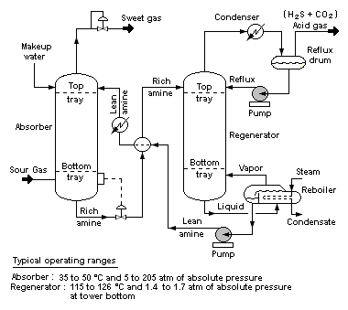
Piping & Instrument Diagrams
Also known as (P&IDs)
Describe relationships between equipment and instrumentation
Computer software may be used
PPT-055-01
25
Notes:
Piping and instrument diagrams, also known as (P&IDs)
Describe relationships between equipment and instrumentation. Computer software may be used for this aspect.

Slide 26
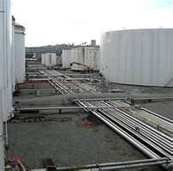
Information Technology
Viewed:
Process chemistry
Maximum intended inventory
Safe upper and lower limits
Temperatures
Pressures
Flows
Compositions
Deviation consequences affecting employee safety and health
PPT-055-01
26
Notes:
Aspects of information technology which will be viewed encompass:
Process chemistry
Maximum intended inventory
Safe upper and lower limits
Temperatures
Pressures
Flows
Compositions
Deviation consequences affecting employee safety and health

Slide 27
Information Technology
Where original technical information no longer exists
Information may be developed in conjunction with the PHA in sufficient detail to support the analysis
PPT-055-01
27
Notes:
Where original technical information no longer exists, information may be developed in conjunction with the PHA in sufficient detail to support the analysis.

Slide 28
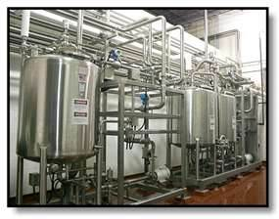
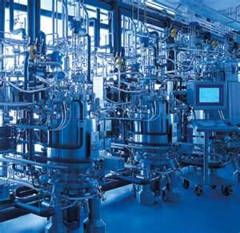
Equipment in the Process
Include:
Materials of construction
Piping and instrument diagrams (P&IDs)
Electrical classification
Relief system design and design basis
PPT-055-01
28
Notes:
Part of the analysis looks at:
Materials of construction
Piping and instrument diagrams (P&IDs)
Electrical classification
Relief system design and design basis

Slide 29
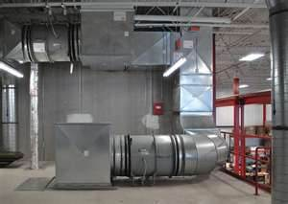
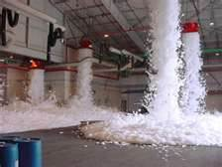
Equipment in the Process
Ventilation system design
Design codes and standards employed
Material and energy balances for processes built after May 26, 1992
Safety systems (interlocks, detection or suppression systems)
PPT-055-01
29
Notes:
Also viewed:
Ventilation system design
Design codes and standards employed
Material and energy balances for processes built after May 26, 1992
Safety systems (interlocks, detection or suppression systems)

Slide 30
Employer Shall Document
Equipment complies with recognized and generally accepted good engineering practices
For existing equipment designed and constructed per codes, standards, or practices no longer in general use, determine and document it is:
Designed,
Maintained,
Inspected,
Tested, and
Operating in a safe manner
PPT-055-01
30
Notes:
Everything viewed will be documented to verify that equipment complies with recognized and generally accepted good engineering practices
For existing equipment designed and constructed per codes, standards, or practices no longer in general use, determine and document it is:
Designed,
Maintained,
Inspected,
Tested, and
Operating in a safe manner

Slide 31
Process Hazard Analysis
PHA on processes covered by this standard
Appropriate to the complexity of the process shall identify, evaluate and control the hazards involved
Determine and document the priority order for conducting PHA based on extent of:
Process hazards
Number of potentially affected employees
Age of process
Operating history of process
PPT-055-01
31
Notes:
The Process Hazard Analysis (PHA) dealing with processes covered by this standard must be appropriate to the complexity of the process shall identify, evaluate and control the hazards involved
Determine and document the priority order for conducting PHA based on extent of:
Process hazards
Number of potentially affected employees
Age of process
Operating history of process

Slide 32
PHA Time Lines
Shall be conducted as soon as possible but no later than (NLT):
NLT Initial Process completed by
25% May 26, 1994
50% May 26, 1995
75% May 26, 1996
Completed by May 26, 1997
After May 26, 1987 - Acceptable if requirements of initial PHA are met
PPT-055-01
32
Notes:
The original standard had phase-in dates established.
Facilities originating after the final phase would have an acceptable program is requirements of the initial PHA are met.
“After May 26, 1987…” intent: If an employer at the time had a relatively recent PHA (no older than May 26, 1987) they could consider that their initial PHA. If they had a PHA that had been completed earlier than May 26, 1987, they would need to start over from scratch with a completely new initial PHA.”

Slide 33
Process Hazard Evaluation
Methods used to determine and evaluate hazards:
What If
Checklist
What If/Checklist
HAZOP (Hazard & Operability Study)
FMEA (Failure Mode & Effects Analysis)
Fault Tree Analysis
An Appropriate Equivalent Methodology
PPT-055-01
33
Notes:
A Process Hazard Evaluation may be implemented using a variety of methods. Some include:
What If
Checklist
What If/Checklist
HAZOP (Hazard & Operability Study)
FMEA (Failure Mode & Effects Analysis)
Fault Tree Analysis
An Appropriate Equivalent Methodology

Slide 34
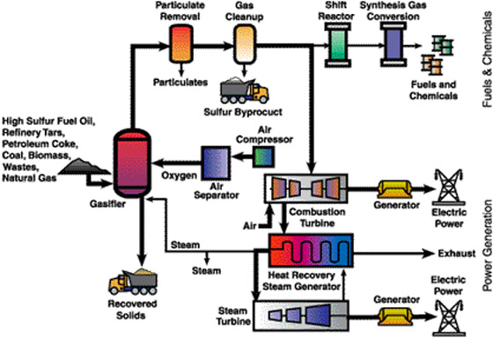
What If
Through developed questions and answers, the effects of component failures or process errors are evaluated
PPT-055-01
34
Notes:
The “What If” method.
Through developed questions and answers, the effects of component failures or process errors are evaluated.

Slide 35
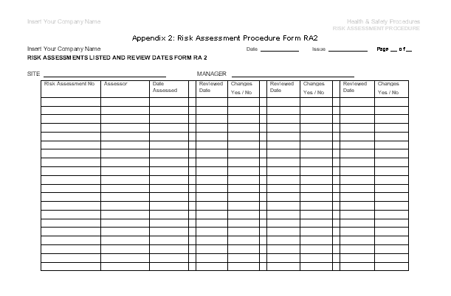
Checklist
As the term implies, checklists are used for various aspects of the process
Audit of operators
Equipment and construction issues
Maintenance records
Others as determined
PPT-055-01
35
Notes:
A checklist, as the term implies, is used for various aspects of the process under view. Checklists can be used for:
Audit of operators
Equipment and construction issues
Maintenance records
Others as determined

Slide 36
What If/Checklist
Team members evaluate the overall operation by topic area
Individuals then specifically study such areas as:
Material hazards
Process hazards
Policies and procedures
Equipment/instrument design
Generating the “what if” questions in a checklist fashion
PPT-055-01
36
Notes:
The “What If/Checklist” has the team members of the evaluation group look at the overall operation by topic area.
Individuals then specifically study such areas as:
Material hazards
Process hazards
Policies and procedures
Equipment/instrument design
Generating the “what if” questions in a checklist fashion

Slide 37
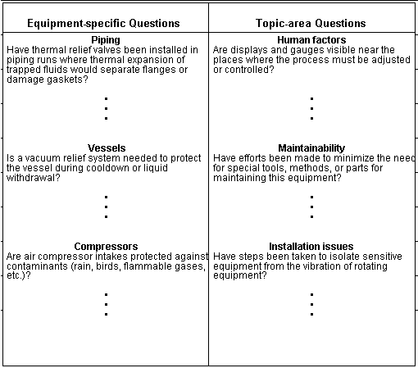
What if Checklist
PPT-055-01
37
Notes:
The above slide shows an example of a “What if Checklist.”

Slide 38
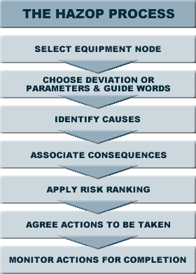
Hazard & Operability Study
Also called HAZOP
Determination of deviation from their design basis
Diagrams of the facility’s piping, electrical system and instrumentation can be used
PPT-055-01
38
Notes:
The Hazard and Operability Study, also called HAZOP,
Makes a determination of deviation from their design basis.
Diagrams of the facility’s piping, electrical system and instrumentation can be used.

Slide 39
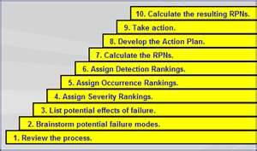
Failure Mode & Effects Analysis (FMEA)
Component failure study
Analyzed would be:
Mode of failure
Consequences
Designation of classification of failure
Likely failure probability
How a failure would be detected
How such a failure could be compensated
Single as well as multiple failures could also be considered in planning
*RPN=Risk Priority Number
PPT-055-01
39
Notes:
The Failure Mode and Effects Analysis (FMEA),
Is a component failure study.
Analyzed would be:
Mode of failure
Consequences
Designation of classification of failure
Likely failure probability
How a failure would be detected
How such a failure could be compensated.
Single as well as multiple failures could also be considered in planning.

Slide 40
FMEA Risk Priority Number (RPN)
Risk Priority Number assigned to assist in prioritizing failure modes in a process
Assigned by the PHA team during planning
RPNs range from 1 (best) to 1,000 (worst)
Formula used:
(S x O x D) = RPN
www.fmea-fmeca.com/fmea-rpn.html
PPT-055-01
40
Notes:
A FMEA Risk Priority Number (RPN) can be assigned to assist in prioritizing failure modes in a process.
This number can be assigned by the PHA team during planning to prioritize their planning.
RPNs range from 1 (best) to 1,000 (worst).
The formula used is:
(S x O x D) = RPN

Slide 41
FMEA RPN
(S x O x D) = RPN
Where:
S=severity assigned relative to the effect perceived
O=Occurrence of likelihood that the cause will produce the failure mode
D=Detection is effectiveness of controls to prevent/detect the cause of the failure mode before the failure results
PPT-055-01
41
Notes:
(S x O x D) = RPN
Where:
S=severity assigned relative to the effect perceived
O=Occurrence of likelihood that the cause will produce the failure mode
D=Detection is effectiveness of controls to prevent/detect the cause of the failure mode before the failure results

Slide 42
FMEA RPN Example
Examples:
S x O x D = RPN
System #1 5 x 10 x 3 = 150
System #2 3 x 3 x 3 = 27
System #3 2 x 2 x 2 = 8
System #1 has a higher number, but System #3 may be more important to the overall operation
Once RPNs are determined, always address the high severity failure modes no matter their RPNs
This RPN ranking assists in the overall planning process
PPT-055-01
42
Notes:
Examples:
S x O x D = RPN
System #1 5 x 10 x 3 = 150
System #2 3 x 3 x 3 = 27
System #3 2 x 2 x 2 = 8
System #1 has a higher number, but System #3 may be more important to the overall operation.
Once RPNs are determined, always address the high severity failure modes no matter what their RPNs.
This RPN ranking assists in the overall planning process.

Slide 43
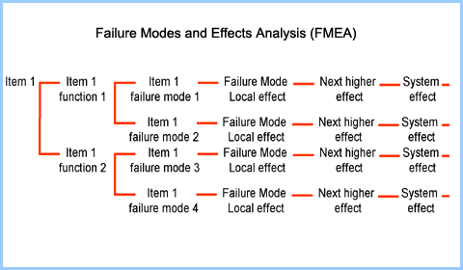
Failure Mode & Effects
PPT-055-01
43
Notes:
This logic diagram shows how the failure mode and effects would be analyzed.

Slide 44
Fault Tree Analysis
Views potential event sequences which may result in an incident
Diagram looks like a tree
Each branch lists sequence of events (failures) for different paths to the end event
Probabilities assigned to each event then used to determine the statistical probability to the end event which is posed
An appropriate equivalent methodology may also be adopted for use
PPT-055-01
44
Notes:
The Fault Tree Analysis views potential event sequences which may result in an incident.
Diagram looks like a tree.
Each branch lists sequence of events (failures) for different paths to the end event.
Probabilities assigned to each event then used to determine the statistical probability to the end event which is posed.
An appropriate equivalent methodology may also be adopted for use.

Slide 45
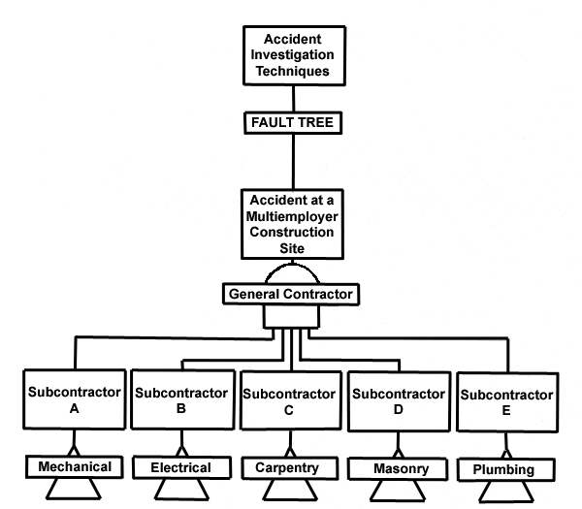
Fault Tree Analysis
PPT-055-01
45
Notes:
The Fault Tree Analysis includes all segments which may cause, contribute to or be effected by an incident.

Slide 46
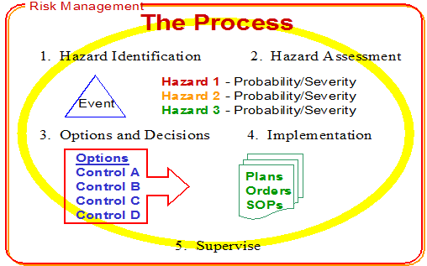
Appropriate Equivalent Methodology
PPT-055-01
46
Notes:
Risk Management provides an appropriate equivalent methodology for analysis.

Slide 47
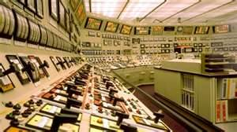
PHA Shall Address
Hazards of the process
Previous incident with likely potential of catastrophic consequences
Engineering & administrative controls applicable to hazards
Consequences of engineering & administrative control failures
PPT-055-01
47
Notes:
Process Hazard Analysis (PHA) addresses:
Hazards of the process.
Previous incident with likely potential of catastrophic consequences.
Engineering & administrative controls applicable to hazards.
Consequences of engineering & administrative control failures.

Slide 48
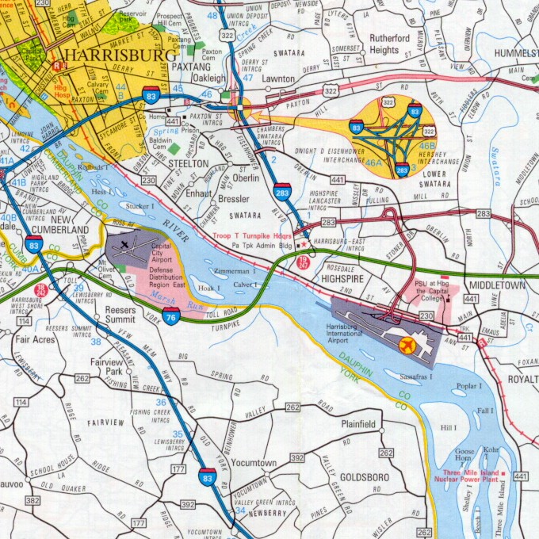
PHA Shall Address
Facility siting
Human factors
Qualitative evaluation of possible safety and health effects of failure of controls on employees
PPT-055-01
48
Notes:
PHA will also address such topics as:
Facility siting.
Human factors.
Qualitative evaluation of possible safety and health effects of failure of controls on employees.

Slide 49
Employer’s System
Address team’s findings and recommendations
Assure team’s recommendations are resolved
Document resolution
Document needed actions
Complete actions as soon as possible
PPT-055-01
49
Notes:
The Employer’s System of analysis and hazard identification,
Address the team’s findings and recommendations,
Assures the team’s recommendations are resolved,
Document resolution,
Document needed actions and
Complete actions as soon as possible.

Slide 50
Employer’s System
Develop a written schedule
Communicate actions to operating, maintenance and other employees in the process and who may be affected by actions
PPT-055-01
50
Notes:
The Employer’s System will require them to;
Develop a written schedule and
Communicate actions to operating, maintenance and other employees in the process and who may be affected by actions.

Slide 51
Process Hazard Analysis
Updated and revalidated by a team meeting at least every 5 years
Update and retain the PHA for each process for the life of the process
Operating Procedures
Written, for safely conducting activities involved in each covered process
PPT-055-01
51
Notes:
The administrative considerations for the PHA provides,
It is updated and revalidated by a team meeting at least every 5 years.
Update and retain the PHA for each process for the life of the process.
Operating Procedures
Written, for safely conducting activities involved in each covered process.

Slide 52
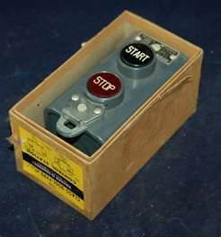
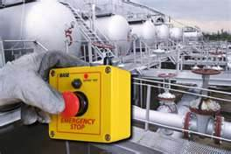
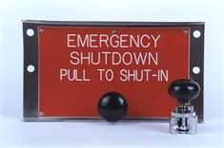
Steps for each Operating Procedure
Addresses at least:
Initial set-up
Normal operations
Temporary operations
Emergency shutdown
Emergency operations
Normal shutdowns
PPT-055-01
52
Notes:
The steps included for each Operating Procedure will address at least:
Initial set-up,
Normal operations,
Temporary operations,
Emergency shutdown,
Emergency operations and
Normal shutdowns.

Slide 53
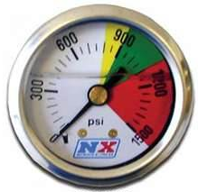
Steps for each Operating Procedure
Startup following turnaround or emergency shutdown
Operating Limits
Consequences of deviation
Steps required to correct or avoid deviation
PPT-055-01
53
Notes:
Operating procedures will also provide for,
Startup following turnaround or emergency shutdown,
Operating Limits,
Consequences of deviation and
Steps required to correct or avoid deviation.

Slide 54
Safety & Health Concerns
Process chemicals
Properties
Hazards
PPT-055-01
54
Notes:
Safety and health concerns must address the process chemicals regarding their properties and hazards.

Slide 55
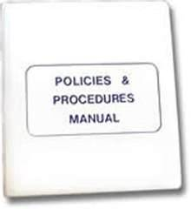
Precautions to Prevent Exposure
Engineering controls
Administrative controls
PPE
PPT-055-01
55
Notes:
Precautions to prevent exposure will include, in the following order:
Engineering controls
Administrative controls
PPE (Personal Protective Equipment). The use of PPE to totally solve a problem is not acceptable. This is the last line of consideration.

Slide 56
Precautions to Prevent Exposure
Control measures against:
Physical contact
Airborne exposure
Quality control for raw materials
Control of hazardous chemical inventory levels
Special/unique hazards
Safety Systems/functions
PPT-055-01
56
Notes:
Determinations must be made to prevent exposure of employees. This would include control measures against:
Physical contact
Airborne exposure
Quality control for raw materials
Control of hazardous chemical inventory levels
Special/unique hazards
Safety Systems/functions

Slide 57
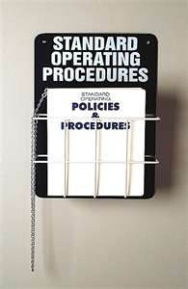
Operating Procedures
Readily accessible to those working in or maintaining a process
Reviewed as necessary
Reflect current operating practice
PPT-055-01
57
Notes:
Operating procedures should,
Be readily accessible to those working in or maintaining a process
Reviewed as necessary
Reflect current operating practice

Slide 58
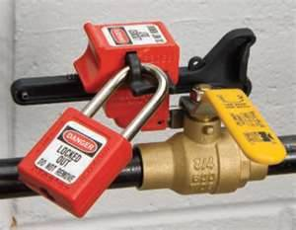
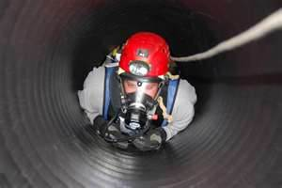
Safe Work Practices
Hazard control during operations
Lock-out/tag-out
Confined space entry
Opening process equipment/piping
Facility entrance control by maintenance, contractor, laboratory, support personnel
PPT-055-01
58
Notes:
Safe work practices equal hazard control during operations.
Lock-out/tag-out
Confined space entry
Opening process equipment/piping
Facility entrance control by maintenance, contractor, laboratory, and support personnel.

Slide 59
Training
Initial: those operating a process
Overview
Procedures
Safety/health hazards
Emergency operations/shutdown
Safe work practices
Train each employee involved in maintaining the on-going integrity of process equipment
PPT-055-01
59
Notes:
Initial and refresher training should be a part of your program. Initial training is provided to those operating a process. Elements of the program should include but not be limited to:
Overview
Procedures
Safety/health hazards
Emergency operations/shutdown
Safe work practices
Train each employee involved in maintaining the on-going integrity of process equipment.

Slide 60
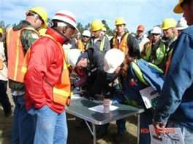
Training: Contractors
Applies to contractors performing:
Maintenance, repair or adjacent to a covered process
Does not apply to: Contractors supplying incidental services
PPT-055-01
60
Notes:
Training for contractors must also be provided. This applies to those contractors performing maintenance, repair or working adjacent to a covered process.
Said training does not apply to contractors supplying incidental services, such as delivering water or dropping off supplies.

Slide 61
Employer’s Responsibilities
Obtain and evaluate contract employer’s safety performance and programs
Inform contract employers of known potential fire, explosion, or toxic release hazards
Explain to contract employers the applicable provisions of emergency action plan
PPT-055-01
61
Notes:
The employer is responsible to,
Obtain and evaluate contract employer’s safety performance and programs
Inform contract employers of known potential fire, explosion, or toxic release hazards
Explain to contract employers the applicable provisions of emergency action plan

Slide 62
Employer’s Responsibilities
Develop, implement safe work practices to control the entrance, presence and exit of contract employers and contract employees in covered process areas
Periodically evaluate performance of contract employers
Maintain a contract employee injury and illness log related to the contractor’s work in process areas
PPT-055-01
62
Notes:
Additionally, the employer must,
Develop and implement safe work practices to control the entrance, presence and exit of contract employers and contract employees in covered process areas,
Periodically evaluate performance of contract employers,
Maintain a contract employee injury and illness log related to the contractor’s work in process areas.

Slide 63
Contractor’s Responsibilities
Assure each employee is trained in work practices necessary
Document each employee has received/understood required training
Keep training record on each employee
Assure each employee follows facility safety rules
Advise employer of unique hazards presented by/found by contract employer
PPT-055-01
63
Notes:
The Contractor is responsible to:
Assure each employee is trained in work practices necessary,
Document each employee has received/understood required training,
Keep training record on each employee,
Assure each employee follows facility safety rules and
Advise employer of unique hazards presented by or found by contract employer.

Slide 64
Pre-Startup Safety Review
Perform for new or modified facilities when modification is significant enough to require a change in process safety information
Shall confirm that prior to introduction of highly hazardous chemicals to a process
Construction and equipment is in accord with design specifications
Safety, operating, maintenance and emergency procedures are in place
PPT-055-01
64
Notes:
Before starting up any process, a pre-startup safety review shall be made.
Perform for new or modified facilities when modification is significant enough to require a change in process safety information
Startup reviews confirm that prior to introduction of highly hazardous chemicals to a process
That construction and equipment is in accord with design specifications and
That safety, operating, maintenance and emergency procedures are in place

Slide 65
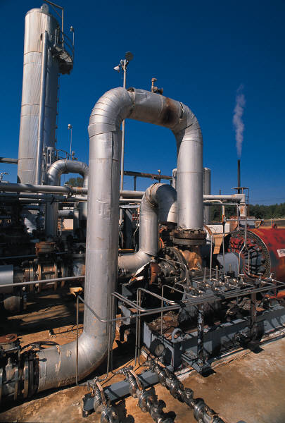
New Facilities
PHA performed and recommendations resolved or implemented before startup
Modified facilities meet requirements contained in management of change section (1910.119(l))
Training of each employee involved in operating a process is completed
PPT-055-01
65
Notes:
For new facilities the PHA is performed and recommendations are resolved or implemented before startup.
Modified facilities must meet the requirements contained in manage of change section 1910.119(l).
Training of each employee involved in operating a process is completed prior to their working on the process.

Slide 66
Mechanical Integrity
Applies to following process equipment:
Pressure vessels and storage tanks
Piping systems
Piping components such as valves
Relief and vent systems and devices
Emergency shutdown systems
Controls
Monitoring devices
Sensors
Alarms
Interlocks
Pumps
PPT-055-01
66
Notes:
Mechanical integrity must be guaranteed for
Pressure vessels and storage tanks
Piping systems
Piping components such as valves
Relief and vent systems and devices
Emergency shutdown systems
Controls
Monitoring devices
Sensors
Alarms
Interlocks
Pumps

Slide 67
Written Procedures
Written to maintain the on-going integrity of process equipment
Specific to the needs and to promote safety
PPT-055-01
67
Notes:
The goal of written procedures is to maintain the on-going integrity of process equipment.
Such procedures are specific to process needs and to promote safety.

Slide 68
Inspection and Testing
On process equipment:
Procedures shall follow recognized and accepted good engineering practices
Frequency consistent with applicable manufacturers’ recommendations
More frequently if determined necessary
Document deficiencies and corrective actions before further use
PPT-055-01
68
Notes:
Consider the following inspection and testing of process equipment.
Procedures shall follow recognized and accepted good engineering practices.
Frequency is consistent with applicable manufacturers’ recommendations.
Inspected and tested more frequently if determined necessary.
Document deficiencies and corrective actions before further use.

Slide 69
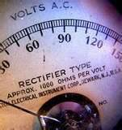
Quality Assurance
New plants: to determine equipment is suitable for process application
Checks & inspections:
Equipment is suitable for process application
Consistent with design specifications
Manufacturer’s instruction
PPT-055-01
69
Notes:
Quality Assurance is a part of each facility’s program. For new plants, it is to determine the suitability of equipment for the designated process application.
Checks and inspections determine;
Equipment is suitable for process application.
Consistent with design specifications.
Manufacturer’s instruction is followed.

Slide 70
Hot Work Permit
For hot work conducted on or near a covered process
Document fire prevention & protection requirements implemented (per 29 CFR 1910.252(a))
Permit kept on file until work operations are completed
PPT-055-01
70
Notes:
To further protect the process, consideration is given to peripheral hazards which may impact on the system. Institute a Hot Work Permit program for hot work conducted on or near a covered process.
Document fire prevention and protection requirements implemented (per 29 CFR 1910.252(a)).
Keep the permit on file until work operations are completed.

Slide 71
Management of Change
Written procedures to manage changes (except for “replacements in kind”)
Prior to any change, address:
Technical basis for
proposed change
Impact on safety and
health
PPT-055-01
71
Notes:
When change occurs within an organization, provisions must exist to sustain safety.
Written procedures must manage changes (except for “replacements in kind”)
Prior to any change, address:
Technical basis for the proposed change and
Impact on safety and health such change may have.

Slide 72
Management of Change
Discuss:
Modifications to operating procedures
Time period for the change
Authorization for the change
Employees and contract employees affected by change are informed and trained in the change prior to process start-up
If change results in change in process safety information, update accordingly
PPT-055-01
72
Notes:
The PHA committee, in managing change, should discuss:
Modifications to operating procedures,
Time period for the change,
Authorization for the change,
Employees and contract employees affected by change are informed and trained in the change prior to process start-up and
If change results in change in process safety information, update accordingly.

Slide 73
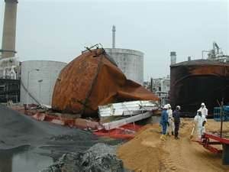
Incident Investigation
Investigate each incident resulting in, or which could have resulted in a catastrophic release of highly hazardous chemical in the workplace
Initiate as soon as possible but not later than 48 hours following the incident
PPT-055-01
73
Notes:
Investigate each incident resulting in, or which could have resulted in, a catastrophic release of highly hazardous chemical in the workplace.
Initiate the investigation as soon as possible but not later than 48 hours following the incident.

Slide 74
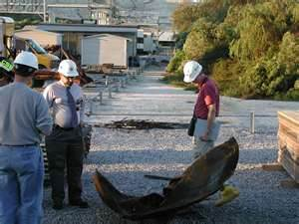
Investigation Team
At least one person knowledgeable in the process
A contract employee if incident involved work of the contractor
Other persons with appropriate knowledge and experience to thoroughly investigate and analyze the incident
PPT-055-01
74
Notes:
Those comprising the investigation team should include:
At least one person knowledgeable in the process
A contract employee if incident involved work of the contractor
Other persons with appropriate knowledge and experience to thoroughly investigate and analyze the incident

Slide 75
Incident Report
At investigation’s conclusion:
Date of incident
Date investigation began
Incident description
Contributing factors
Recommendations resulting
PPT-055-01
75
Notes:
At investigation’s conclusion, include in the report:
Date of incident
Date investigation began
Incident description
Contributing factors
Recommendations resulting

Slide 76
Incident Resolution
Establish a system to address and resolve the incident
Affected personnel review the report
Retain reports for 5 years
PPT-055-01
76
Notes:
Incident resolution establishes a system to address and resolve the incident.
Those personnel affected should review the report.
Retain all such reports for 5 years according to the standard.

Slide 77
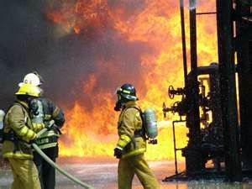
Emergency Planning & Response
Establish an emergency action plan for entire plant (per 29 CFR 1910.38)
Plan will also have procedures for handling small releases (per 29 CFR 1910.120(a)(p)(q))
PPT-055-01
77
Notes:
Establish an emergency action plan for the entire plant in accordance with 29 CFR 1910.38.
The plan will also have procedures for handling small releases per 29 CFR 1910.120(a)(p)(q).

Slide 78
Compliance Audits
Employers certify they have evaluated compliance with provisions of this section at least every 3 years to verify the procedures and practices are adequate and being followed
Audit shall be conducted by at least 1 person knowledgeable in the process
Audit findings shall be developed
Determine and document response to each of the findings
Document deficiencies have been corrected
Retain the 2 most recent compliance audit reports
PPT-055-01
78
Notes:
Compliance audits ensure the program is on-track.
Employers certify they have evaluated compliance with provisions of this section at least every 3 years to verify the procedures and practices are adequate and being followed.
Audit shall be conducted by at least 1 person knowledgeable in the process.
Audit findings shall be developed.
Determine and document response to each of the findings.
Document deficiencies have been corrected.
Retain the 2 most recent compliance audit reports.

Slide 79
Trade Secrets
Employers shall make all information needed to comply available to those:
Compiling the process safety information
Assisting in development of the PHA
Responsible for developing the operating procedures
Involved in:
Incident Investigations
Emergency Planning and Response
Compliance Audits
Nothing in this paragraph shall preclude the employer from requiring the persons receiving the information to enter into confidentiality agreements
PPT-055-01
79
Notes:
Concerning Trade Secrets, employers shall make all information available which is needed to comply. For Example:
Compiling the process safety information
Assisting in development of the PHA
Responsible for developing the operating procedures
Involved in:
Incident Investigations
Emergency Planning and Response
Compliance Audits
Nothing in this paragraph shall preclude the employer from requiring the persons receiving the information to enter into confidentiality agreements

Slide 80
1910.119, Appendix A (Mandatory)
Contains a listing of toxic and reactive highly hazardous chemicals which present a potential for a catastrophic event at or above the threshold quantity
Chemical Name CAS* TQ**
* Chemical Abstract Service Number
** Threshold Quantity in Pounds (Amount necessary to be covered by this standard)
PPT-055-01
80
Notes:
Appendix A is mandatory for those required to institute the Process Safety Management program. This Appendix contains a listing of toxic and reactive highly hazardous chemicals which present a potential for a catastrophic event at or above the Threshold Quantity (TQ).

Slide 81
1910.119, Appendix B (Examples)
Recommended you view Appendix B for legible examples of:
Block Flow Diagram and Process Flow Diagram
PPT-055-01
81
Notes:
It is recommended you review Appendix B which provides examples of;
A Block Flow Diagram and
Process Flow Diagram

Slide 82
1910.119, Appendix C (Nonmandatory)
Provides guidance on following items involved in the Process Safety Management program:
Introduction to Process Safety Management
Employee Involvement
Process Safety Information
Process Hazard Analysis
Operating Procedures and Practices
Employee Training
PPT-055-01
82
Notes:
Although Appendix C is also non-mandatory, it provides guidance on the following items involved in the Process Safety Management program:
Introduction to Process Safety Management
Employee Involvement
Process Safety Information
Process Hazard Analysis
Operating Procedures and Practices
Employee Training

Slide 83
1910.119, Appendix C (Non-mandatory)
Contractors
Pre-Startup Safety
Mechanical Integrity
Non-routine Work Authorizations
Managing Change
Investigation of Incidents
Emergency Preparedness
Compliance Audits
PPT-055-01
83
Notes:
Appendix C also includes information and guidance for:
Contractors
Pre-Startup Safety
Mechanical Integrity
Non-routine Work Authorizations
Managing Change
Investigation of Incidents
Emergency Preparedness
Compliance Audits

Slide 84
Bibliography
29 CFR 1910.38, Emergency Action Plans
29 CFR 1910.119 and Appendices, Process Safety Management of Highly Hazardous Chemicals
29 CFR 1910.252, Subpart Q, Welding, Cutting and Brazing
www.fmea-fmeca.com/fmea-rpn.html
“Process Safety Management: An OSHA Compliance Manual,” J.J. Keller & Associates, Inc., Neenah, WI
PPT-055-01
84
Notes:
The Bibliography above has sources from which additional information may be obtained.

Slide 85
Contact Information
Health & Safety Training Specialists
1171 South Cameron Street, Room 324
Harrisburg, PA 17104-2501
(717) 772-1635
RA-LI-BWC-PATHS@pa.gov
Like us on Facebook! - https://www.facebook.com/BWCPATHS
PPT-055-01
85
Notes:
We invite you to contact us to obtain information on additional free power point programs and other available free training.

Slide 86
Questions
PPT-055-01
86

