Slide 1
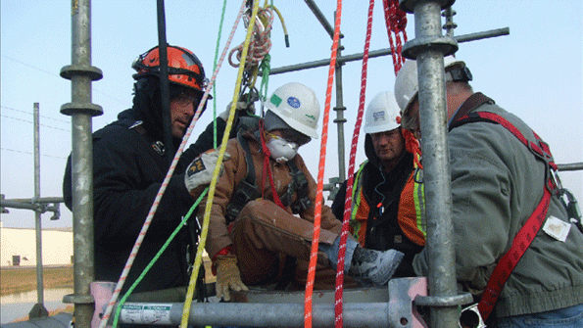
PATHS
Bureau of Workers’ Compensation
PA Training for Health & Safety (PATHS)
PA Training for Health & Safety
PA Bureau of Workers’ Compensation
Health & Safety Division
Notes:
The PATHS program was developed and is administered by the Pennsylvania Department of Labor & Industry, Bureau of Workers’ Comp,
Health & Safety Division.

Slide 2
What PATHS is
A statewide service established by PA Department of Labor & Industry (L&I), Bureau of Workers’ Compensation (BWC), Health & Safety Division
Provides employers and employees with easy access to cost-effective health & safety resources.
Services offered enable WC system participants to achieve greater efficiencies in their WC cost-containment efforts by creating safer workplaces.
Provides employers with a single, comprehensive website to view all health & safety related materials available.
Notes:
PATHS is a “no-fee” service available to all employers and employees within the Commonwealth of Pennsylvania and since its development and launching in 2012 has provided training to approximately 100,000 employees some of whom are not within Pennsylvania but have participated in our programs through webinars.

Slide 3
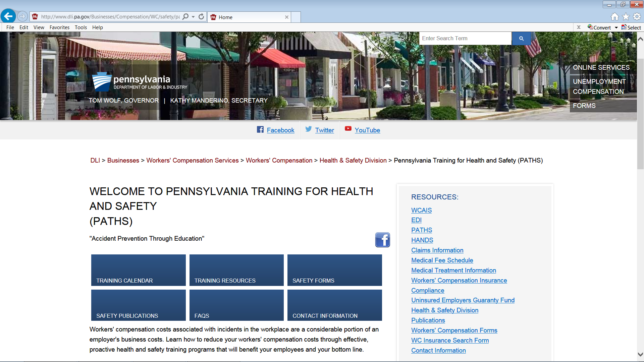
PATHS Website
http://www.dli.pa.gov/PATHS
Notes:
The PATHS website was updated in 2016 to be more “user friendly.” The website has been used by employers both within and outside Pennsylvania to assist in providing education as well as injury prevention within their workplace.

Slide 4
On the PATHS Website
A person can access the following:
Training Calendar
Training Resources including PowerPoints, Posters, Tool Box Talks, Videos, etc.
Safety Forms
Safety Publications
FAQ’s
Contact Information
Notes:
A user of the PATHS website has access to many different types of safety related products such as training, safety forms and publications as well as being able to see what types of training is being offered in the future. In addition, users can register for webinars on-line.

Slide 5
Training Topics
There are currently over 200 different safety and health related topics that can be presented on site or by webinar and this number is constantly growing. Here are some examples of the training that can be provided:
Active Shooter
Bloodborne Pathogens
Confined Space
Distracted Driving
Emergency Action Plans
Fall Protection
Grilling Safety
Near Miss
Opioid Addiction
Poison Ivy
Return to Work
Right to Know
Notes:
Currently there are 216 different safety and health topics that can be presented by one of the trainers either on-site or by webinar. The topics include both on and off the job safety as well as home fire prevention and information on how to deal with angry people, workplace harassment, and difficult co-workers.

Slide 6
Criteria for Training
For on-site training we require at least twenty-five (25) people to attend, whether that’s achieved during one session or several throughout the day
An on-site visit also requires a training location/area that is “conducive to learning” (e.g. climate controlled, adequate space, etc.)
On-site training also requires a requesting employer to complete a “Pre-Training Questionnaire”
To provide training by webinar only ten (10) individuals are required
Webinar training requires the employer to have:
A computer with internet capabilities
Projector if using one computer for all involved
Notes:
While instructors do their best to accommodate a training request, there is certain criteria that needs to be met before training can be scheduled.

Slide 7
No Fees - Exceptions
There is normally no cost associated with the training provided with the exception of the following topics:
CPR/First Aid (Cost of Books and training devices)
OSHA 10 & 30 Hour (Cost of Course Completion Cards)
The National Safety Council’s four-hour Defensive Driving Course (DDC 4) is offered free of charge and includes a Student Guide each attendee is issued as well as a course completion certificate and wallet card.
The National Safety Council’s four-hour “Alive at 25” presentation geared toward teenagers learning to drive and new drivers is also offered free of charge.
Notes:
Most of the training offered is free with the exception of the courses listed due to the cost associated with materials provided.

Slide 8
Forklift Training
The Health & Safety Training Division also offers forklift training to new operators free of charge.
Recertification training for forklift operators is also offered free of charge.
The training for new operators consists of both classroom and “hands-on” operation.
Recertification training can include a classroom portion but usually consists of direct equipment operation only.
Attendees receive a certificate of training completion as well as a wallet sized card.
Notes:
Most of the training offered is free with the exception of the courses listed due to the cost associated with materials provided.

Slide 9
Statistics
Attendees from 47 out of 50 states
Attendees from other locations include: Canada, Puerto Rico, Mexico, Washington D.C, China and Germany
PATHS has over 200 safety related PowerPoints
Notes:
PATHS Webinars have included attendees from 47 out of the 50 states in the United States, Paths has not had attendees from Hawaii, Arkansas, North Dakota and South Dakota. Paths Training Webinars have also reached out to other locations which include Canada, Puerto Rico, Mexico , China and Germany.

Slide 10
Summary
There are very few, if any, states that have a program similar to PATHS.
PATHS is a no-fee program that provides safety and health related training to any and all employers and employees within Pennsylvania.
The PATHS website provides safety and health related training presentations, posters, videos, forms, publications and training schedules and can be accessed at www.dli.pa.gov/PATHS.
Notes:
The BWC is very proud of the PATHS program and the instructors associated with it; with the addition of more competent instructors the program will only continue to grow and provide training and incident prevention services to employers and employees within the state of Pennsylvania.

Slide 11
Questions

Slide 12
Contact Information
Health & Safety Training Specialists
1171 South Cameron Street, Room 324
Harrisburg, PA 17104-2501
(717) 772-1635
RA-LI-BWC-PATHS@pa.gov
PPT-PATHS-02
11

Slide 13
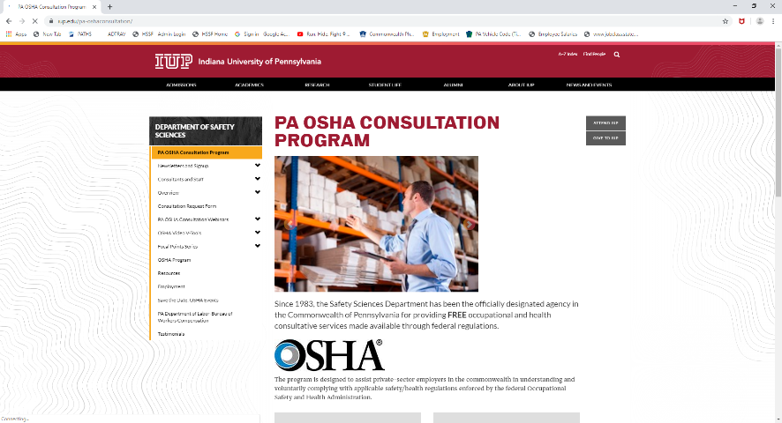
IUP OSHA Consultation Program
Telephone Number 1-800-382-1241
PPT-PATHS-02
12
Notes:
Since 1983, the Safety Sciences Department of Indiana University of Pennsylvania has been the officially designated agency in the Commonwealth of Pennsylvania for providing FREE occupational and health consultative services made available through federal regulations.
The program is designed to assist private-sector employers in the commonwealth in understanding and voluntarily complying with applicable safety/health regulations enforced by the federal Occupational Safety and Health Administration.
This program was designed to assist small business employers with 500 or less employees, however program representatives are able to answer OSHA related questions.

