Slide 1
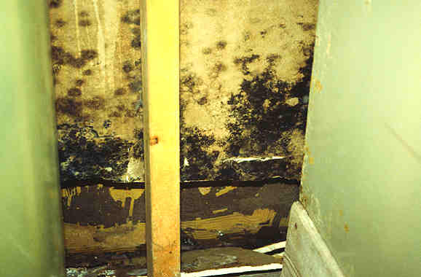
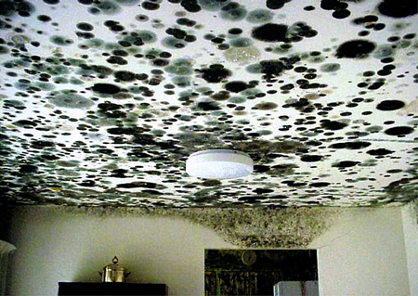
Mold Awareness
Bureau of Workers’ Comp
PA Training for Health & Safety
(PATHS)
PPT-059-01
1

Slide 2
Causes of Mold
Mold spores are always present but require a favorable environment to become active
Humidity or Moisture
If RH (relative humidity) is over 70% for an extended period of time mold growth is almost inevitable.
Temperature
Higher temperatures increase RH: mold growth. Below 70 degrees is best for prevention.
Stagnant Air
Air movement aids in evaporation and decreases moisture. Use to prevent not to cure!
Darkness
UV rays help retard growth.
PPT-059-01
2
Notes:
Mold is alive, but it is neither a plant nor an animal. Mold is a type of fungus. It is part of a group of living organisms that are very common and serve an important role in the environment. Penicillin, an antibiotic that has saved many lives, is a type of mold, as is yeast.
Relative humidity: the ratio of the amount of water vapor actually present in the air to the greatest amount possible at the same temperature. (Webster’s) This is expressed as percent. Not to be confused with specific humidity or absolute humidity.

Slide 3
Mold Needs:
MOISTURE, WARMTH, FOOD
All three conditions necessary for growth.
Most likely growing places: bathroom, basement, kitchen.
Can grow in other rooms if conditions are favorable.
Climate where you live
and living habits can
affect ability to grow.
PPT-059-01
3
Notes:
So, mold is more likely in Florida than in Arizona.
Mold spores can thrive and reproduce in wet or damp parts of a structure: areas that have had flooding or where leakage has occurred in roofs, pipes, or walls, or areas around house plants, especially ones that sometimes are over-watered.
In just 48 hours, a moist environment combined with room-temperature conditions and an organic food source can lead to mold growth.
After it gets the food it needs, mold can move to virtually any kind of surface. Mold prefers temperatures between 40 and 100 degrees Fahrenheit. If a warm enough area in a structure is humid or damp and contains items that mold likes to eat, the structure could develop a mold problem.

Slide 4
Health Effects of Mold
Exposure to mold can occur when airborne mold cells, mostly spores, are inhaled.
We breathe in these cells every day, indoors and out.
Usually these exposures do not present a health risk.
But when exposure is great, some individuals (e.g. those with allergies and asthma) can experience mild to serious illness.
PPT-059-01
4
Notes:
Individuals can be exposed to mold when airborne mold cells, predominantly spores, are inhaled. Inhalation of these spores usually doesn’t present a health issue, however when a person has an existing condition such as asthma or COPD this exposure can greatly affect them.

Slide 5
Health Effects of Mold
The following is a description of the health problems that can be caused by exposure to mold:
Allergic Illness – When mold cells are inhaled and land in the respiratory tract, the body's immune system's response to those invading cells can cause an allergic response (e.g. sneezing, runny nose, etc.).
Infection – Some mold species can cause respiratory infection when the live mold invades the tissues of the lungs or respiratory tract.
Toxic Effects – Very large doses of certain molds, whether inhaled or ingested, can result in poisoning caused by toxins, called mycotoxins, in the mold cells.
PPT-059-01
5
Notes:
When someone tells you they are terribly allergic to mold they are misinformed, what they are is allergic to specific types of mold. Or they are allergic to bread, blue cheese, regular bottled water (distilled or denatured water would be free of mold) and penicillin.
One type of mold, Stachybotrys chartarum, is sometimes called toxic mold. People do show a higher allergic response to it.

Slide 6
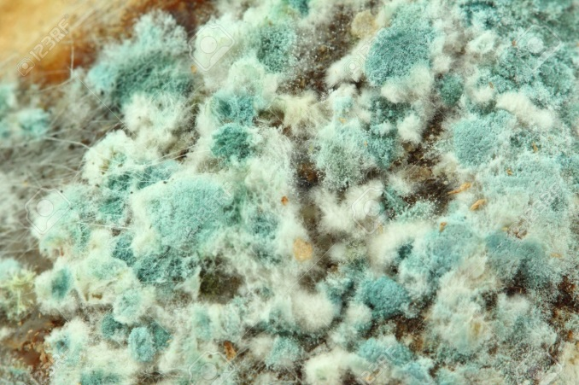
Health Effects of Mold
Exposure to mold is not healthy for anyone, however the following individuals are at a higher health risk:
Infants
Children
Elderly
Immune Comprised Patients
Pregnant Women
People with existing respiratory conditions or allergies
PPT-059-01
6
Notes:
Mold exposure is not healthy for any individual, however there are certain groups of people who exposure can affect more than others:
Infants
Children
Elderly
Immune Comprised Patients
Pregnant Women
People with existing respiratory conditions or allergies

Slide 7
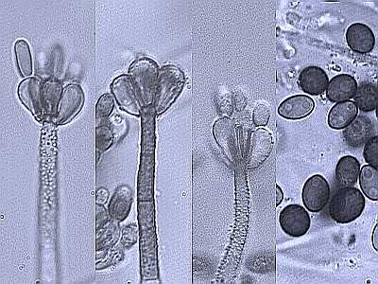
What Does Mold Look Like?
PPT-059-01
7
Notes:
This is an example of what mold can look like when magnified.

Slide 8
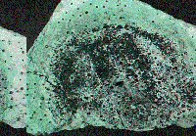
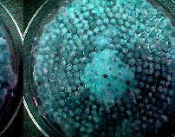
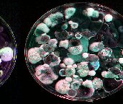
Spore Growth
PPT-059-01
8
Notes:
Here are more pictures of mold which can be unique in size, shape, and color.

Slide 9
Growth Timelines
Effects of Time on Microbial Contamination Level
1 2 3 4 5 6 7 Day
PPT-059-01
9
Notes:
Is time a factor? This is a slightly sticky question. A clean water loss can become a black water loss in seven days. Will it? It depends on other factors. What’s the temperature, was the surface clean? But we know this: Microbial growth or mold can take hold in 48 hours and start to grow in 72 hours.
It’s important that you don’t lose sight of the fact that sooner or later there could be mold growth somewhere, someplace.

Slide 10
“Quick Fixes” Don’t Work
Treating mold outbreaks with Lysol, bleach, fumigants or fungicides will not help.
Only a few of these products will kill mold.
None prevent future outbreaks and many are harmful to contents, documents and people.
Do not introduce airflow. Mold spores are airborne.
Do not wipe off the mold. You are helping it spread.
PPT-059-01
10
Notes:
One of the most common problems seen are situations where people have tried to correct mold problems themselves.
You may have heard, ”Just clean it with bleach, bleach kills mold.” The truth is that bleach does not kill “mold”. It will kill a few species of mold and it will give the appearance of having helped the situation but it is actually just spreading the problem.
When you clean mold with bleach you will kill some of the mold spores and you will wipe away some of the visible mold but you will also be allowing some of the spores that don’t stick to your sponge to become airborne. The mold that remains on the item being cleaned will attach itself to the moisture you left behind and will become airborne as that moisture evaporates. So by cleaning one area of mold with household bleach you have contaminated the entire area.

Slide 11
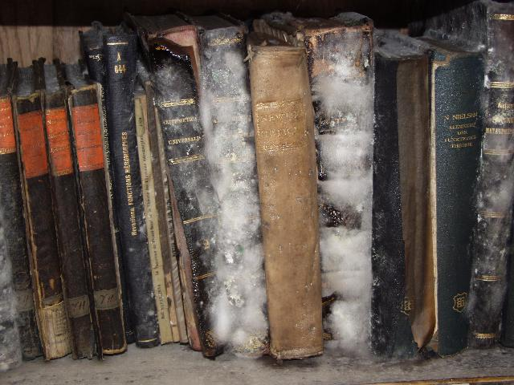
Mold Remediation
Mold testing and remediation requires a professional!
Attempting to identify,
remediate, clean, dry or in any way personally
deal with mold without the appropriate training
is not recommended.
PPT-059-01
11
Notes:
To ensure mold is taken care of properly and safely consideration should be given to having testing and remediation done by a professional who has the necessary training, experience and knowledge.
Untrained individuals can do more harm than good when it comes to dealing with a mold issue.

Slide 12
Find the Cause and Fix It
6 oversimplified steps to mold remediation:
- For mold to grow there must be moisture.
1. Find out what is introducing moisture into your environment and stop it.
2. Remove the excess moisture.
3. Mop, sponge, vacuum and squeegee standing water out of area.
PPT-059-01
12
Notes:
These are six very oversimplified steps for mold remediation. The absolute best way to remediate mold is to hire a professional to do it for you. Unless you have the appropriate training it is not recommended that an attempt to deal with mold yourself in any way is made. Mold remediation requires specialty equipment and training.
Regarding moisture: if you entered a property with a leaking skylight and the moisture from that skylight caused mold to grow your first priority would be the repair or replacement of the skylight. Second would be getting the excess or standing water out of the area.

Slide 13
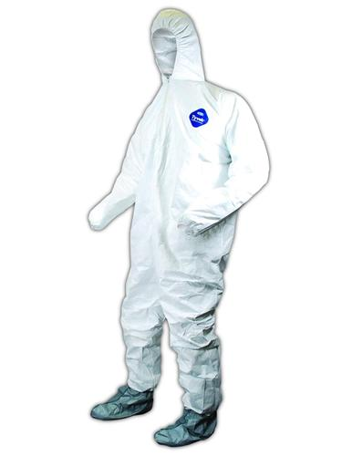
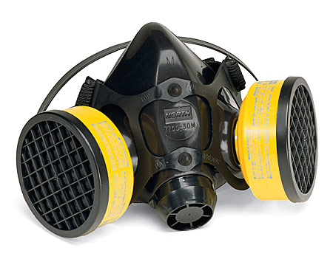
Isolate the Area & Use PPE
4. The affected area must be sealed off from people, objects and areas.
5. The area must not be entered without PPE.
6. If desired, mold can be tested and identified.
PPT-059-01
13
Notes:
Now that you’ve stopped the moisture from entering the structure and have mopped up the excess water, it’s time to turn your attention to mold remediation. You should seal off the area and not remove contents from the area yet.
Your job right now is to keep the mold from spreading any further.
You may have had PPE on while you were mopping, but if you didn’t you should definitely be wearing it at this stage.
If desired, mold can be tested at this time. Why are we saying if desired?
The reason is that you do not want mold of any kind growing in an occupied space.
At this time you may want to test because then you’d have an Industrial Hygienist’s opinion/recommendations which could impact liability on your organization’s part.

Slide 14
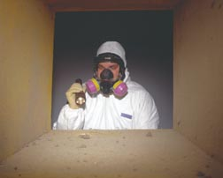
Determine Presence
PPT-059-01
14
Notes:
Personal Protective Equipment (PPE).
Note that this individual has on a respirator, gloves and a Tyvek suit.
Do you know what the Tyvek suit does? How it works?
Tyvek’s claim to fame is that it’s a one-way breathable material so pollutants can’t get in but air can escape.

Slide 15
Begin Drying
Excess moisture removed; now four ingredients of drying used to dry the environment (extraction, humidity control, air movement, temperature).
Contents usually left in the area (this area will be used as a drying chamber).
Once contents are dry mold will go dormant
(must be a negative air environment).
NOTE: If drying cannot be accomplished or will take more then 48 hours to begin, contents can be frozen.
PPT-059-01
15
Notes:
After a determination has been made that mold is in place the area in question should be thoroughly dried.

Slide 16
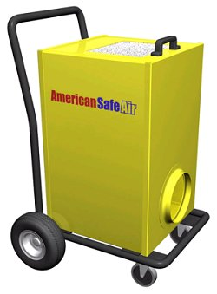
Negative Air?
Negative air refers to the act of scrubbing the air with a HEPA filtering device and discharging it outside of the sealed environment.
(HEPA = High Efficiency Particulate Air)
PPT-059-01
16
Notes:
HEPA stands for High Efficiency Particulate Air. It cleans the air to .3 microns. What does .3 microns mean in real life? Fungal spores range from .6-25 microns, a razor blade is 300 microns thick and a human hair is between around 75 & 125 microns thick. Under 50 microns is invisible to the naked eye.
Positive air rooms use the same equipment but discharge to clean air into the same room they took it from. These are used in many Post offices because of biological scares.

Slide 17
Clean the Contents
Area is dry and mold has gone dormant.
Do not try to clean active mold!
Mold must be cleaned in a negative air environment.
Most solutions require mold to be removed with HEPA filter vacuums.
Use special attachments including screens and brushes attached to suction so surfaces are not damaged.
As contents are cleaned they are isolated from room to prevent further exposure.
PPT-059-01
17
Notes:
Contents within a mold environment should be thoroughly and properly cleaned and then isolated outside the mold affected area to prevent further exposure.

Slide 18
Clean the Area
Area is dry and mold is dormant.
Follow the same procedures used in contents cleaning.
All surfaces in the area must be cleaned.
HVAC components should be cleaned at this time.
After surfaces appear to be free of mold, fungicides can be used.
PPT-059-01
18
Notes:
Once the affected area has been properly dried and the mold is dormant all surfaces and the HVAC components should be properly cleaned using an EPA listed fungicide.

Slide 19
Monitor the Area
Contents have been cleaned and isolated.
Source has been identified and dealt with.
Area has been cleaned.
Area has been re-tested for mold.
Area has been monitored and
corrected environment persists.
Return contents to area.
PPT-059-01
19
Notes:
This is a crucial step that often gets shortchanged. The area must be monitored to prove that a corrected environment exists.

Slide 20
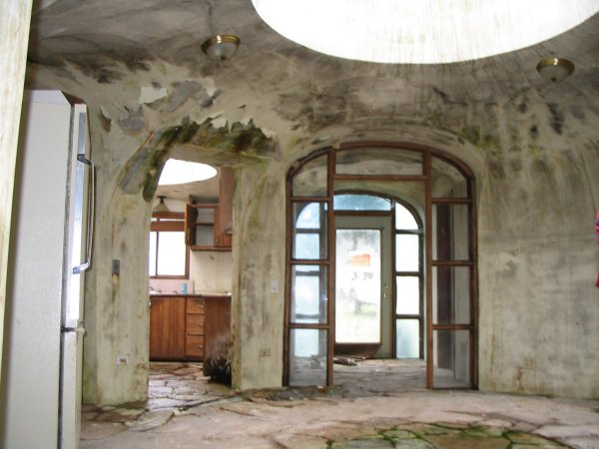
Mold Elimination
Eliminate one of these elements and mold won’t thrive:
Food Source? Expensive & unlikely
Temperature Zone? Bake
the house?
Moisture? All we need to
remove is the excess!
PPT-059-01
20
Notes:
The following elements should be considered when thinking about eliminating mold:
Food Source – Is it be practical to remove anything that could serve as a source for “food” to feed the mold and allow it to grow?
Temperature – Can an area be heated to the point that mold will have difficulty growing?
Moisture – Can excess moisture be removed using something like dehumidifiers to the point that mold would have trouble existing?

Slide 21
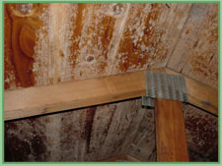
Assessment
Most assessment of microbial is visual
Look for visible growth first.
Consider potential for hidden growth (is there moisture hidden in the walls, HVAC, etc.).
How far has it/will it
spread?
4. Why did the mold start
or how did the moisture
get there?
PPT-059-01
21
Notes:
When looking for mold look for that which is visible and then consider areas that can conceal mold growth such as walls.
Consideration should be given as to how far and where the mold has or will spread.
If mold is observed a determination should be made as to how the mold started and how did any moisture develop which allowed the mold to grow.

Slide 22
Visual
You need to take care of the existing problem: consider the chances of the damage reoccurring.
Is the building envelope the culprit, or possibly the exterior insulated finish systems to blame?
Determine if a moisture
source is a reservoir or
an amplifier.
PPT-059-01
22
Notes:
When assessing mold think about what can happen if the mold reappears.
Determine if the building “envelope” (e.g. the physical separator between the interior and exterior of a building such as walls, floors, roofs, fenestrations and doors. Fenestrations are any opening in the structure: windows, skylights, clerestories, etc.)
Also determine if the source of moisture is a reservoir or an amplifier.

Slide 23
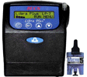
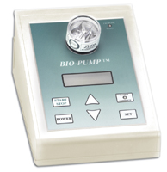
Mold Assessment: Sampling
Assesses occupant exposure – Immune Deficiencies
Determine potential exposures
Possibly help locate hidden contamination – Should not be required in most cases
PPT-059-01
23
Notes:
Sampling is a big part of mold assessment since there are many different types of mold.

Slide 24
More on Sampling
4. Methods (Suggest a Certified Industrial Hygienist)
– Tape Lift
– Bulk Dust
– Swab
– Bulk Material
– Air Sampling
Directory for CIH’s: www.aiha.org or www.abih.org
In most cases of 30 square feet or greater, clearance testing is highly recommended
PPT-059-01
24
Notes:
When determining who will do the sampling and what method to use it may be best to have a certified Industrial Hygienist who has experience in conducting mold sampling accomplish this task.

Slide 25
Remember
Treating mold outbreaks with Lysol, bleach, fumigants or fungicides will not help.
Only a few of these products will kill mold.
None prevent future outbreaks and many are harmful to contents, documents and people.
Do not introduce airflow. Mold spores are airborne.
Do not wipe off the mold. You are helping it spread.
PPT-059-01
25
Notes:
Remember that attempting to treat/eliminate mold by using something like Lysol, bleach or others may not work as only a few of these products will kill mold.
Also remember that using an airflow can allow the spores to become airborne which will spread them around the area or into other areas.
Lastly, remember that wiping mold can help it to spread.

Slide 26
Summary
Causes of Mold:
- Humidity or Moisture
- Temperature
- Stagnant Air
- Darkness
2. Mold needs 3 things to grow:
- Food source
- Temperature zone
- Moisture
PPT-059-01
26
Notes:
Keep in mind that mold needs three things to grow, the proper type of:
Food Source
Temperature
Moisture

Slide 27
Contact Information
Health & Safety Training Specialists
1171 South Cameron Street, Room 324
Harrisburg, PA 17104-2501
(717) 772-1635
RA-LI-BWC-PATHS@pa.gov
Like us on Facebook! - https://www.facebook.com/BWCPATHS
PPT-059-01
27

Slide 28
Questions
PPT-059-01
28

