Slide 1
Laboratory Safety Standard
Bureau of Workers’ Comp
PA Training for Health & Safety (PATHS)
29 CFR 1910.1450
Occupational Exposure to Hazardous
Chemicals in Laboratories
Notes:
This program recognizes the potential injuries which may be suffered through the incorrect understanding and use of various chemicals in the laboratory environment.
Realizing this, the National Research Council’s text, “Prudent Practices for Handling Hazardous Chemicals in Laboratories,” National Academy Press, Washington, D.C., 1981, has been used extensively as the framework for the program as well as the actual Standard.

Slide 2
Topics
Applicability
Permissible exposure limits
Employee exposure determination
Chemical hygiene plan – general
Employee information and training
Notes:
The topics indicated will provide a well-rounded look at those segments to be incorporated into a successful Lab Safety Standard in your facility.
Such facilities would include; R&D labs, educational labs, quality assurance environs and any other chemical or biological lab setting.

Slide 3
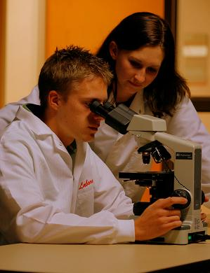
Topics
Medical consultation and medical examination
Hazard identification
Use of respirators
Recordkeeping
Appendices
Notes:
This program will discuss the following topics:
Medical consultation and medical examination
Hazard identification
Use of respirators
Recordkeeping
Appendices

Slide 4
Standard Applies To
All employers engaged in lab use of hazardous chemicals where relatively small quantities of hazardous chemicals are used on a non-production basis.
It supersedes, for labs, requirements of all other OSHA health standards in 29 CFR 1910, subpart Z, except for any OSHA health standard, only the requirement to limit employee exposure to specific PEL shall apply for labs, unless that particular standard states otherwise or unless conditions of paragraph (a) (2) (iii) apply.
Notes:
While OSHA enumerates those employers, employees and labs addressed by this standard, “Best Practices” can be exhibited by other agencies though they may not fall under OSHA jurisdiction through the adoption of the Standard (29 CFR 1910.1450).

Slide 5
Paragraph (a) (2) (iii)
Where action level (or in absence of action level, the PEL) is routinely exceeded for an OSHA regulated substance with exposure monitoring and medical surveillance requirements, paragraphs(d)* and (g)(1)(ii)* of this section shall apply.
Notes:
If an “action level” or the Permissible Exposure Limit (PEL) of an OSHA regulated substance is routinely exceeded with exposure monitoring and medical surveillance requirements than paragraphs (d) employee exposure determination and (g)(1)(ii) medical consultation – signs and symptoms shall apply.
*NOTE: PELs may be derived from various publications recognized in their respective fields.

Slide 6
Standard Does Not Apply To
Uses of hazardous chemicals not meeting the definition of lab use.
In such cases employer shall comply with relevant standard in 29 CR 1910, Subpart Z, even if such use occurs in a lab.
Notes:
The Standard is not applicable to:
Uses of hazardous chemicals not meeting the definition of lab use.
In such cases employer shall comply with relevant standard in 29 CR 1910, Subpart Z, even if such use occurs in a lab.

Slide 7
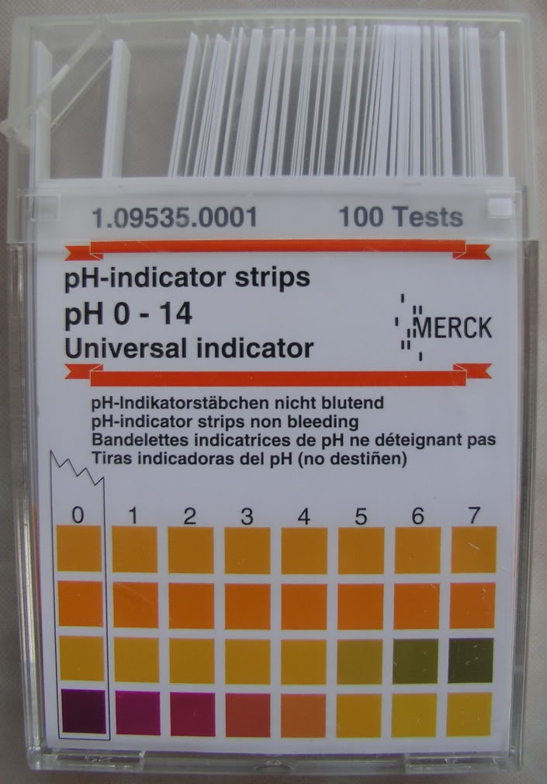
Standard Does NOT Apply To
Lab uses of hazardous chemicals which provide no potential for employee exposure. Examples:
Procedures using chemically-impregnated test media (Dip-and-Read tests);
Commercially prepared kits (pregnancy tests).
Notes:
The Standard does NOT apply to pre-packaged chemicals as below or where the amount of materials (reagents) will pose no harmful effects.
Lab uses of hazardous chemicals which provide no potential for employee exposure. Examples:
Procedures using chemically-impregnated test media (Dip-and-Read tests);
Commercially prepared kits (pregnancy tests).

Slide 8
Hazardous Chemical Defined
A chemical for which there is statistically significant evidence that acute or chronic health effects may occur in an exposed employee
The term “Health Hazard” includes:
Carcinogens;
Toxic or highly toxic agents;
Reproductive toxins;
Notes:
The term “Health Hazard” includes:
Carcinogens;
Toxic or highly toxic agents;
Reproductive toxins;
These have been determined by statistically significant evidence to be acute or chronic health hazards.

Slide 9
Hazardous Chemicals
Health Hazards:
◦ Irritants;
◦ Corrosives;
◦ Sensitizers;
◦ Hepatotoxins (injure the liver);
◦ Nephrotoxins (poison the kidneys);
◦ Neurotoxins (act on nervous
system);
◦ Agents which act on the
hematopoietic systems, (blood);
◦ Agents which damage the lungs,
skin, eyes or mucous membranes.
Notes:
Hazardous chemicals which pose health problems are shown on the slide.

Slide 10
“Select” Carcinogen
Any substance meeting one of the following criteria:
1. Is regulated by OSHA as a carcinogen; or
2. Listed under category “known to be
carcinogens” in National Toxicology Program
(NTP);
3. Listed under Group 1 (“carcinogenic to
humans”) by Agency for Research on Cancer
Monographs (IARC);
Notes:
“Select” Carcinogens would be any substance meeting one of the following criteria:
1. Is regulated by OSHA as a carcinogen; or
2. Listed under category “known to be carcinogens” in National Toxicology Program (NTP);
3. Listed under Group 1 (“carcinogenic to humans”) by Agency for Research on Cancer Monographs (IARC);

Slide 11
“Select” Carcinogen
4. Listed in either Group 2A or 2B by IARC or
under category “reasonably anticipated to be
carcinogens” by NTP and causes statistically
significant tumor incidence in experimental
animals in accordance with any of the following
criteria:
After inhalation exposure of 6-7 hours per day, 5 days per week, for a significant portion of a lifetime to dosages of less than 10mg/m³;
After repeated skin application of less than 300 (mg/kg of body weight) per week; or
After oral dosages of less than 50 mg/kg of body weight per day.
Notes:
Also, “Select” Carcinogens are those,
4. Listed in either Group 2A or 2B by IARC or under category “reasonably anticipated to be carcinogens” by NTP and causes statistically
significant tumor incidence in experimental animals in accordance with any of the following criteria:
-After inhalation exposure of 6-7 hours per day, 5 days per week, for a significant portion of a lifetime to dosages of less than 10mg/m³;
-After repeated skin application of less than 300 (mg/kg of body weight) per week; or
-After oral dosages of less than 50 mg/kg of body weight per day.

Slide 12
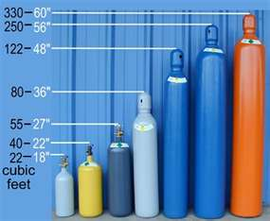
Physical Hazard
A chemical for which there is scientifically valid evidence that it is a:
Combustible Liquid;
Compressed Gas;
Explosive;
Flammable
Aerosol, Flammable
Gas, Flammable
Liquid, flammable
Solid, flammable.
Notes:
Physical Hazards are chemicals for which there is scientifically valid evidence that they are:
Combustible Liquid;
Compressed Gas;
Explosive;
Flammable
Aerosol, Flammable
Gas, Flammable
Liquid, flammable
Solid, flammable.

Slide 13
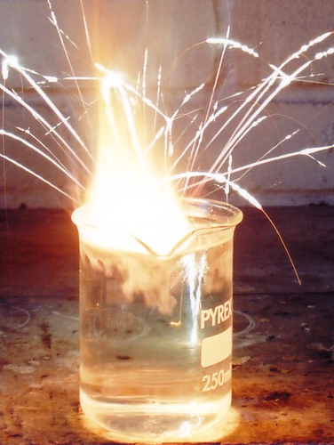
Physical Hazard
Also included as a physical hazard would be:
Organic peroxide;
Oxidizer;
Pyrophoric;
Unstable (reactive), or
Water-reactive
Notes:
Also included as a physical hazard would be:
Organic peroxide which contain both a fuel (the organic) and oxygen (peroxide)
Oxidizer; (contain oxygen in their makeup
Pyrophoric; (these can ignite in dry or moist air at less than 130⁰F
Unstable (reactive), or
Water-reactive

Slide 14
Hazardous Chemical Defined
Additionally:
29 CFR 1910.1200, Hazard Communication Standard, Appendices A & B provide guidance in defining scope of health hazards; and
In determining whether a chemical is to be considered hazardous for purposes of this standard.
Notes:
Additionally:
29 CFR 1910.1200, Hazard Communication Standard, Appendices A & B provide guidance in defining scope of health hazards; and
In determining whether a chemical is to be considered hazardous for purposes of this standard.

Slide 15
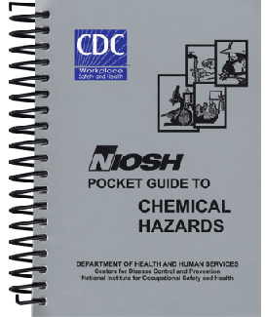
Permissible Exposure Limits
Also known as PELs
For lab use of OSHA regulated substances, the employer shall assure lab employees’ exposure to such substances do not exceed the PELs specified in 29 CFR 1910, subpart Z
Notes:
The NIOSH Pocket Guide to Chemical Hazards has extensive information related to select chemicals.
Exposures are expressed as PELs (Permissible Exposure Limits). If these limits are exceeded or thought to be exceeded, special protective actions are required.
For lab use of OSHA regulated substances, the employer shall assure lab employees’ exposure to such substances do not exceed the PELs specified in 29 CFR 1910, subpart Z.

Slide 16
Employee Exposure
Determined by Initial Monitoring
Employer shall measure employee’s exposure to any substance regulated which requires monitoring if reason to believe exposure levels for substance routinely exceed the action level (or in the absence of an action level, the PEL).
Notes:
The employer shall measure the employee’s exposure to regulated mateials.

Slide 17
Periodic Monitoring
If initial monitoring discloses employee exposure over action level of PEL, employer shall immediately comply with exposure monitoring provisions of relevant standard
Termination of Monitoring:
Monitoring may be terminated in accordance with relevant standard
Notes:
During periodic monitoring, if initial monitoring discloses employee exposure over action level of PEL, employer shall immediately comply with exposure monitoring provisions of relevant standard
Termination of Monitoring:
Monitoring may be terminated in accordance with relevant standard.

Slide 18
Employee Monitoring
Employee Notification:
Employer shall, within 15 days after receipt of monitoring results, notify employee in writing individually or by posting results.
Notes:
Employer shall, within 15 days after receipt of monitoring results, notify the employee in writing individually or by posting results.

Slide 19
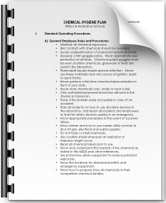
Chemical Hygiene Plan (CHP)
General
Where hazardous chemicals, as defined, are used in the workplace, employer shall develop a written Chemical Hygiene Plan
Capable of protecting employees from
health hazards from the lab chemicals
And keeping exposures below limits
specified in paragraph (c) this section
Notes:
Requirements exist for an in-house Chemical Hygiene Plan (CHP) where hazardous chemicals, as defined, are used in the workplace, the employer shall develop a written
Chemical Hygiene Plan
Capable of protecting employees from health hazards from the lab chemicals,
And keeping exposures below limits specified in paragraph (c) this section.

Slide 20
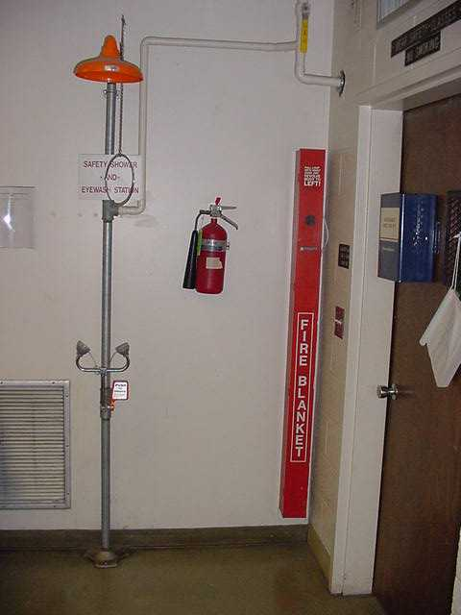
Chemical Hygiene Plan
Plan shall be readily available to employees,
their representatives, and upon request to
the Assistant Secretary.
Plan shall indicate specific
measures to protect lab
Employees.
Employer shall annually
review Plan and update as
needed.
Notes:
The Plan shall:
Be readily available to employees, their representatives, and upon request to the Assistant Secretary.
Plan shall indicate specific measures to protect lab Employees.
Employer shall annually review Plan and update as needed.

Slide 21
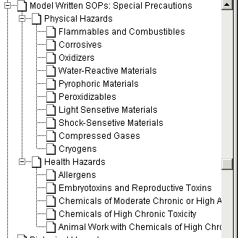
Plan Contents
Standard Operating Procedures
Criteria used to determine and implement control measures to reduce exposures
Notes:
The Plan shall contain:
Standard Operating Procedures for the use, handling and storage of said chemical
The criteria used to determine and implement control measures to reduce exposures. This includes:
Engineering Safeguards,
Administrative Controls, and
PPE

Slide 22
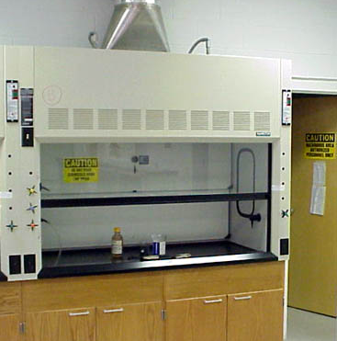
Plan Contents
Requirement that fume hoods
and other protective equipment are functioning properly
Provisions for employee information and training
Notes:
The Plan will also address proper operation and functioning of fume hoods and other protective equipment and provisions for employee information and training on the use of such equipment.

Slide 23
Plan Contents
Circumstances under which a particular lab operation, procedure or activity shall require prior approval from employer or designee before implementation.
Provisions for medical consultation and exams
Notes:
The Plan will contain:
Circumstances under which a particular lab operation, procedure or activity shall require prior approval from employer or designee before implementation.
Provisions for medical consultation and exams.

Slide 24
Plan Contents
Designation of personnel responsible for Plan
implementation including:
Assignment of Chemical Hygiene Officer and, if appropriate;
Establishment of Chemical Hygiene Committee.
Notes:
The Plan will:
Designate personnel responsible for Plan implementation:
Assignment of a Chemical Hygiene Officer and
The establishment of a Chemical Hygiene Committee as appropriate.

Slide 25
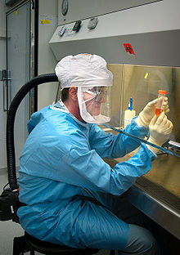
Plan Contents
Provisions for additional employee protection for work with particularly hazardous substances. These include:
- “Select” carcinogens
- Reproductive toxins and
- Substances with a high degree of acute toxicity
Notes:
The Plan will make provisions for:
Additional employee protection for working with particular hazardous substances to include:
“Select” Carcinogens
Reproductive Toxins and
Substances with a high degree of acute toxicity.

Slide 26
Plan Contents
Considerations shall be given the following provisions which shall be included where appropriate:
Establishment of a designated area i.e.:
Area which may be used for work with “select” carcinogens, reproductive toxins, or substances with a high degree of acute toxicity.
This may be the entire lab, an area of a lab or a device such as a lab hood.
Notes:
The Plan will provide
Considerations shall be given the following provisions which shall be included where appropriate:
Establishment of a designated area i.e.
*Note: designated area=An area which may be used for work with “select” carcinogens,” reproductive toxins or substances with a high degree of acute toxicity. This may be the entire lab, an area of a lab or a device such a lab hood.

Slide 27
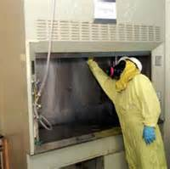
Plan Contents
Use of containment devices, fume hoods or glove boxes;
Procedures for safe removal of contaminated waste; and
Decontamination procedures.
Notes:
Fundamental to such Plan is the inclusion of information detailing the
Use of containment devices, fume hoods or glove boxes;
Procedures for safe removal of contaminated waste; and
Decontamination procedures.

Slide 28
Employee Information/Training
Employer shall provide employees with information and training ensuring they’re apprised of chemical hazards in their work area. It should be
Provided at initial assignment to a work area where such chemicals are present, and
Prior to assignments involving new exposure situations,
Frequency of refresher information and training determined by employer
Notes:
To best ensure employee safety, information and training will be a part of the Plan.
The employer shall provide employees with information and training ensuring they’re apprised of chemical hazards in their work area. It should be:
Provided at initial assignment to a work area where such chemicals are present, and
Prior to assignments involving new exposure situations,
Frequency of refresher information and training determined by employer

Slide 29
Information to Employees
Employees shall be informed of:
Contents of this standard and its appendices;
Location and availability of employer’s Chemical
Hygiene Plan (CHP);
PELs for OSHA regulated substances or recommended exposure limits (RELs) for other hazardous chemicals where there is no applicable OSHA standard.
Notes:
Employees shall be informed of the following to round-out their understanding of hazards and safe use:
Contents of this standard and its appendices;
Location and availability of employer’s Chemical Hygiene Plan (CHP);
PELs for OSHA regulated substances or recommended exposure limits (RELs) for other hazardous chemicals where there is no applicable OSHA standard.

Slide 30
Information to Employees
Signs and symptoms of exposure to hazardous lab chemicals
Location/availability of known reference material on hazards, safe handling, storage and disposal of hazardous chemicals in the lab.
This includes but is not limited to SDSs provided by chemical supplier.
Notes:
Recognition of hazards must include an understanding of:
Signs and symptoms of exposure to hazardous lab chemicals
Location/availability of known reference material on hazards, safe handling, storage and disposal of hazardous chemicals in the lab.
This includes but is not limited to SDSs provided by chemical supplier.

Slide 31
Employee Training
Employee training shall include:
Methods/observations that can be used to detect the presence or release of a hazardous chemical (e.g. such as monitoring, continuous monitoring devices, visual appearance or odor).
Physical and health hazards of chemicals in the work area.
Notes:
Also include in the training program
Methods/observations that can be used to detect the presence or release of a hazardous chemical (e.g. such as monitoring, continuous monitoring devices, visual appearance or odor).
Physical and health hazards of chemicals in the work area.

Slide 32
Employee Training
Measures employees can take to protect themselves from these hazards including:
Specific procedures implemented to reduce exposures
Appropriate work practices
Emergency procedures, and
Personal protective equipment (PPE);
Employees shall be trained on applicable details of written Chemical Hygiene Plan (CHP).
Notes:
Measures employees can take to protect themselves from these hazards including:
Specific procedures implemented to reduce exposures
Appropriate work practices
Emergency procedures, and
Personal protective equipment (PPE);
Employees shall be trained on applicable details of written Chemical Hygiene Plan (CHP).
Note: See Non-Mandatory Appendix A of 1910.1450 for National Research Council Recommendations Concerning Chemical Hygiene in Laboratories. Full outline of program contents available in this Appendix.

Slide 33
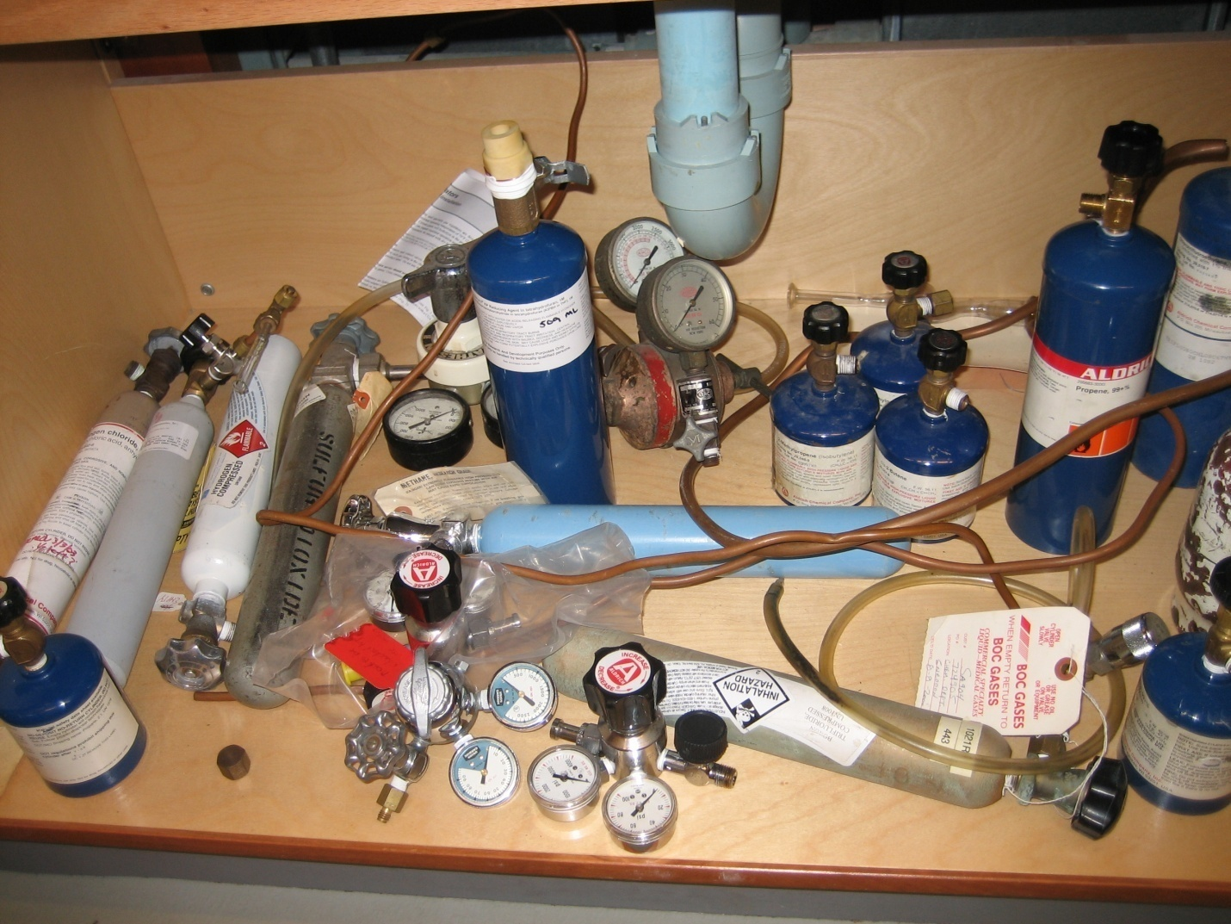
Examples of Lab Hazards
Improper Lecture Bottle Storage
Notes:
Indicate acceptable storage of the various chemicals according to hazard characteristics and physical states, e.g. solid, liquid and gas.

Slide 34
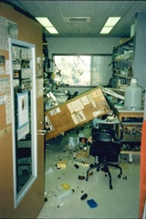
Examples of Lab Hazards
Collapse of Storage
Notes:
Indicate what can result due to improper methods of use and storage.

Slide 35
Examples of Lab Hazards
Lack of PPE
Notes:
Establish firmly enforced policies on PPE as well as enforcement for improper use or non-use.

Slide 36
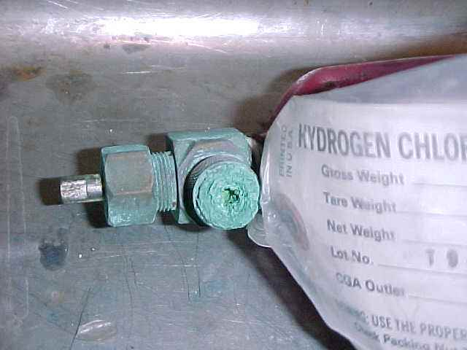
Examples of Lab Hazards
Condition of Cylinders
Notes:
Train on the possible results of out-dated chemicals and the types of distress which may occur to containers or containment.

Slide 37
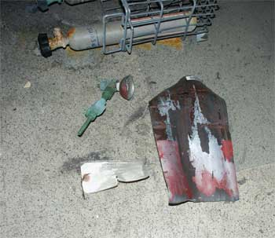
Examples of Lab Hazards
Cylinder Explosions
Notes:
Ensure a thorough understanding of potential catastrophic effects.

Slide 38
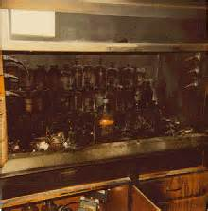
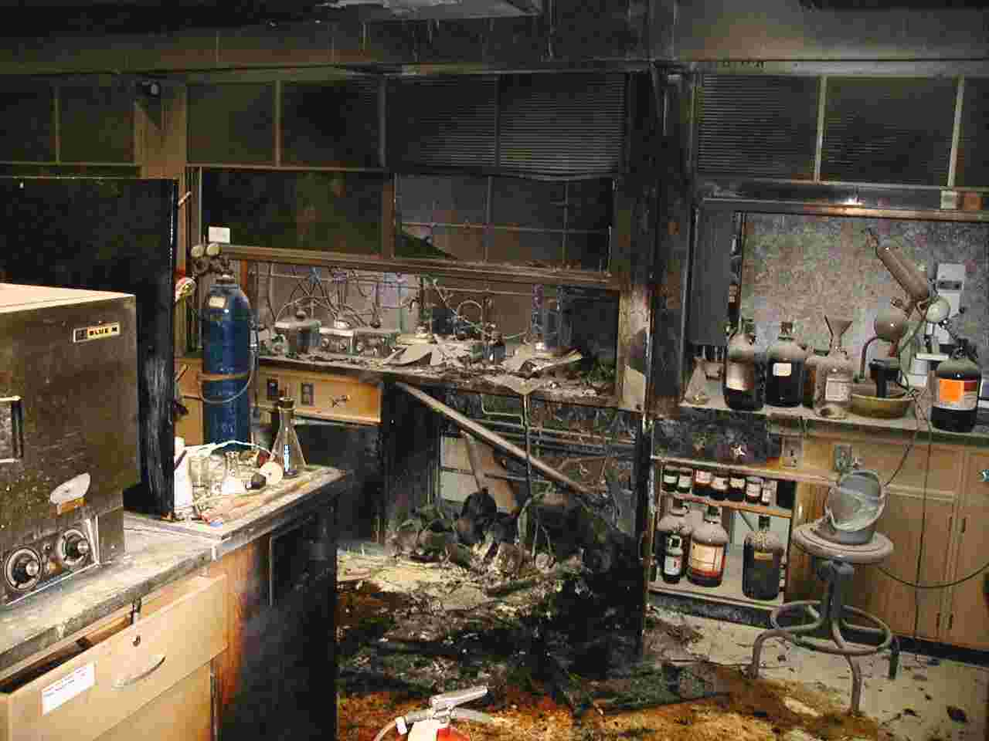
Examples of Lab Hazards
Fume Hood Fires
Notes:
Use manufacturer’s use manuals as part of establishing training and checklists.
These will deal with acceptable and unacceptable actions on your part.

Slide 39
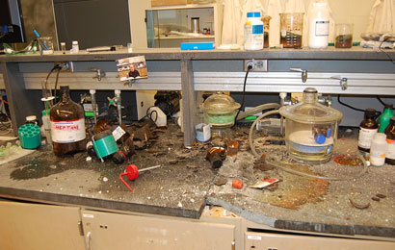
Examples of Lab Hazards
Lab Explosions
Notes:
Cite existing cases of lab accidents and the lessons learned by other agencies upon investigating the causes. Indicate what your facility has instituted to preclude such incidents.

Slide 40
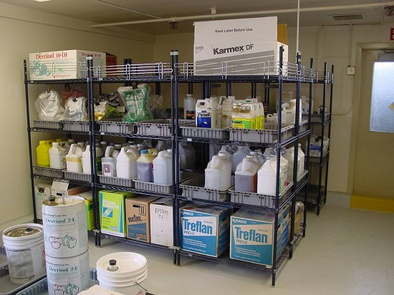
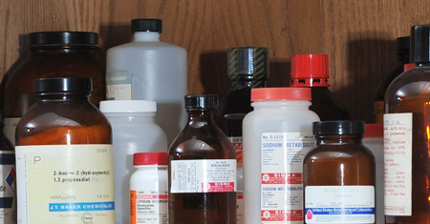
Examples of Lab Hazards
Storage Concerns
Notes:
Do not store strictly in alphabetical order. Storage compatibles together so incidents of chemical reactions do not occur.

Slide 41
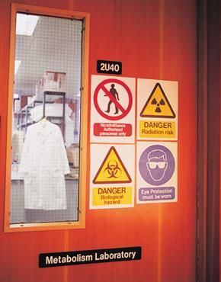
Examples of Lab Hazards
Ensure Proper Signage
Notes:
Where required, or even as a “Best Practice” use signage to inform those in the lab of the hazards and requirements in differing locations.

Slide 42
Medical Consultation/Exams
Employer shall provide employees working with hazardous chemicals an opportunity to receive medical attention, including any follow-up exams physician determines necessary under the following circumstances:
Whenever employee develops signs or symptoms associated with a hazardous chemical to which employee may have been exposed in the lab
Notes:
Regarding medical consultations and exams, let the employee know that
Employer shall provide employees working with hazardous chemicals an opportunity to receive medical attention, including any follow-up exams physician determines necessary under the following circumstances:
Whenever employee develops signs or symptoms associated with a hazardous chemical to which employee may have been exposed in the lab.

Slide 43
Medical Consultation/Exams
2. Where exposure monitoring reveals an exposure level routinely above action level or in its absence above the PEL for an OSHA regulated substance for which there are exposure monitoring and medical surveillance requirements
3. Whenever an occurrence results in the work area where there is a likelihood of a hazardous exposure due to:
Spill
Leak
Explosion or other occurrence
Notes:
2. Where exposure monitoring reveals an exposure
level routinely above action level or in its
absence above the PEL for an OSHA regulated
substance for which there are exposure
monitoring and medical surveillance requirements
3. Whenever an occurrence results in the work area
where there is a likelihood of a hazardous exposure
due to:
Spill
Leak
Explosion or other occurrence

Slide 44
Medical Consultation/Exams
All exams and consultations shall be performed by, or under direct supervision of, a licensed physician.
Shall be provided to employee without cost or loss of pay, and at a reasonable time and place.
Notes:
All exams and consultations shall be performed by, or under direct supervision of, a licensed physician.
Shall be provided to employee without cost or loss of pay, and at a reasonable time and place.

Slide 45
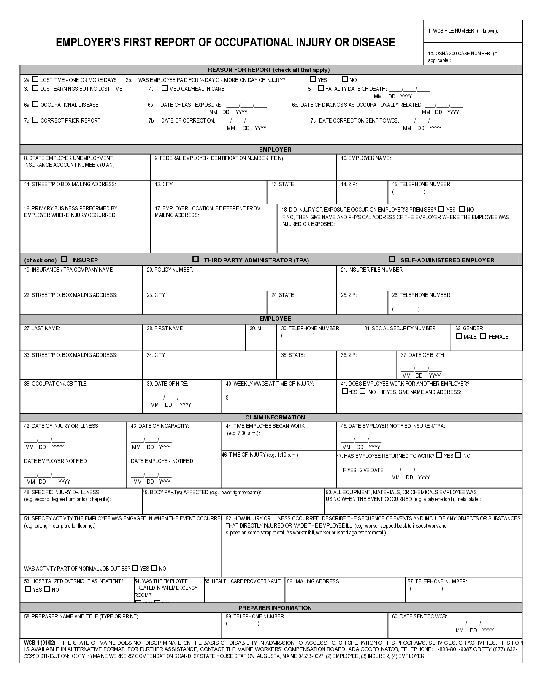
Medical Consultation/Exam
Employer shall provide following
information to physician:
Identity of hazardous chemical(s) to which employee may have been exposed;
A description of conditions under which exposure occurred including quantitative exposure date, if available; and
A description of signs and symptoms of exposure that employee is experiencing, if any
Notes:
Employer shall provide following information to physician:
Identity of hazardous chemical(s) to which employee may have been exposed;
A description of conditions under which exposure occurred including quantitative exposure date, if available; and
A description of signs and symptoms of exposure that employee is experiencing, if any

Slide 46
Physician’s Opinion
Provided to employer in writing including:
Recommendation for further medical follow-up;
Results of medical exam and any associated tests;
Any medical condition revealed in course of exam which might put employee at risk;
Statement that employee has been informed of findings
(Written opinion shall not reveal specific findings unrelated to occupational exposure)
Notes:
Physician’s Opinion:
Provided to employer in writing including:
Recommendation for further medical follow-up;
Results of medical exam and any associated tests;
Any medical condition revealed in course of exam which might put employee at risk;
Statement that employee has been informed of findings
(Written opinion shall not reveal specific findings unrelated to occupational exposure)

Slide 47
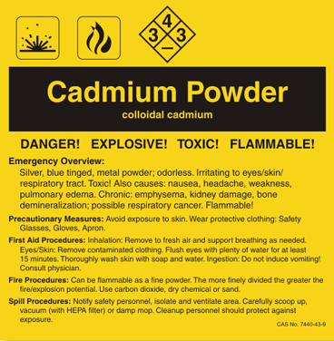
Hazard Identification
Labels and Safety Data Sheets
Employers shall:
Ensure labels on incoming containers are not removed or defaced;
Maintain any SDSs received with incoming shipments of hazardous chemicals and ensure they are readily accessible to lab employees.
Notes:
In identifying hazards, labels and Safety Data Sheets prove a great assist.
Ensure labels on incoming containers are not removed or defaced;
Maintain any SDSs received with incoming shipments of hazardous chemicals and ensure they are readily accessible to lab employees.

Slide 48
Chemical Developed for Lab
If composition produced for lab’s use is known:
1. Determine if it is a hazardous chemical as
defined by standard;
2. If so, provide employees with appropriate
training per this standard (e);
3. If composition is not known, assume it is
hazardous and train per (f) of this standard.
Notes:
If composition produced for lab’s use is known:
1. Determine if it is a hazardous chemical as defined by standard;
2. If so, provide employees with appropriate training per this standard (e);
3. If composition is not known, assume it is hazardous and train per (f) of this standard

Slide 49
Chemical Developed for Others
If chemical is produced for another user outside the lab, employer shall:
Comply with Hazard Communication Standard (29 CFR 1910.1200) including preparation of SDS and labeling.
Notes:
If chemical is produced for another user outside the lab, employer shall:
Comply with Hazard Communication Standard (29 CFR 1910.1200) including preparation of SDS and labeling.

Slide 50
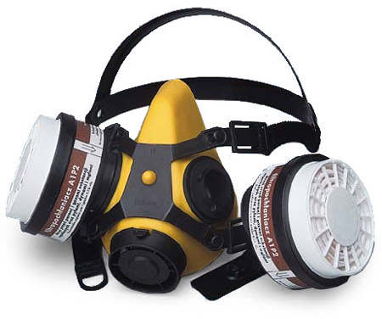
Respirators
Where respirators are necessary to maintain exposure below PELs, employer shall provide, at no cost to employee, the proper respiratory equipment.
Respirators shall be selected and used per 29 CR 1910.134.
Notes:
Where respirators are necessary to maintain exposure below PELs, employer shall provide, at no cost to employee, the proper respiratory equipment.
Respirators shall be selected and used per 29 CR 1910.134.

Slide 51
Recordkeeping
Employer shall
Establish and maintain, for each employee,
An accurate record of any measurements taken to monitor employee exposures, and
2. Any medical consultation and examinations including tests or written opinions required by this standard,
3. Assurance that such records are kept, transferred, and made available per 29 CFR 1910.1020.
Notes:
Recordkeeping is vital to track exposures to staff.
Employer shall establish and maintain, for each employee,
An accurate record of any measurements taken to monitor employee exposures, and
2. Any medical consultation and examinations including tests or written opinions required by this standard,
3. Assurance that such records are kept, transferred, and made available per 29 CFR 1910.1020.

Slide 52
References
A full list of references can be found in 1910.1450 Appendix B to assist in the construction of a Chemical Hygiene Plan
Also the following serve as reference materials:
National Research Council, Prudent Practices for Handling Hazardous Chemicals in Laboratories, National Academy Press, Washington, D.C., 1981
NIOSH/OSHA Pocket Guide to Chemical Hazards, NIOSH Pub. No. 85-114, U.S. Government Printing Office, Washington, DC, (latest edition).
Notes:
Use the above and other references to assist you in the creation of your in-house Plan.
These will also help you develop PPE requirements.

Slide 53
Contact Information
Health & Safety Training Specialists
1171 South Cameron Street, Room 324
Harrisburg, PA 17104-2501
(717) 772-1635
RA-LI-BWC-PATHS@pa.gov
Like us on Facebook! - https://www.facebook.com/BWCPATHS

Slide 54
Questions

