Slide 1
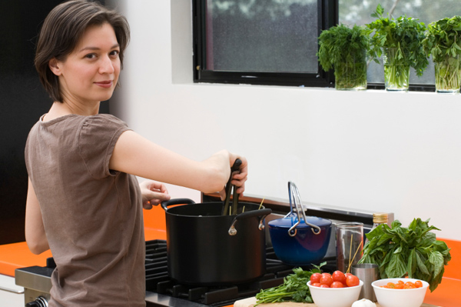
KITCHEN SAFETY
Bureau of Workers’ Compensation
PA Training for Health & Safety (PATHS)
Preventing Burns & Kitchen Fires
Notes:
In the United States approximately 2.4 million burn injuries are reported per year. About 650,000 are treatedby medical professionals; 5,000 are hospitalized; 20,000 have major burns involving at least 25% of their total body surface. Between 8,000 and 12,000 of burn patients will die with about 1 million sustaining substantial or permanent disabilities resulting from their burn injury.

Slide 2
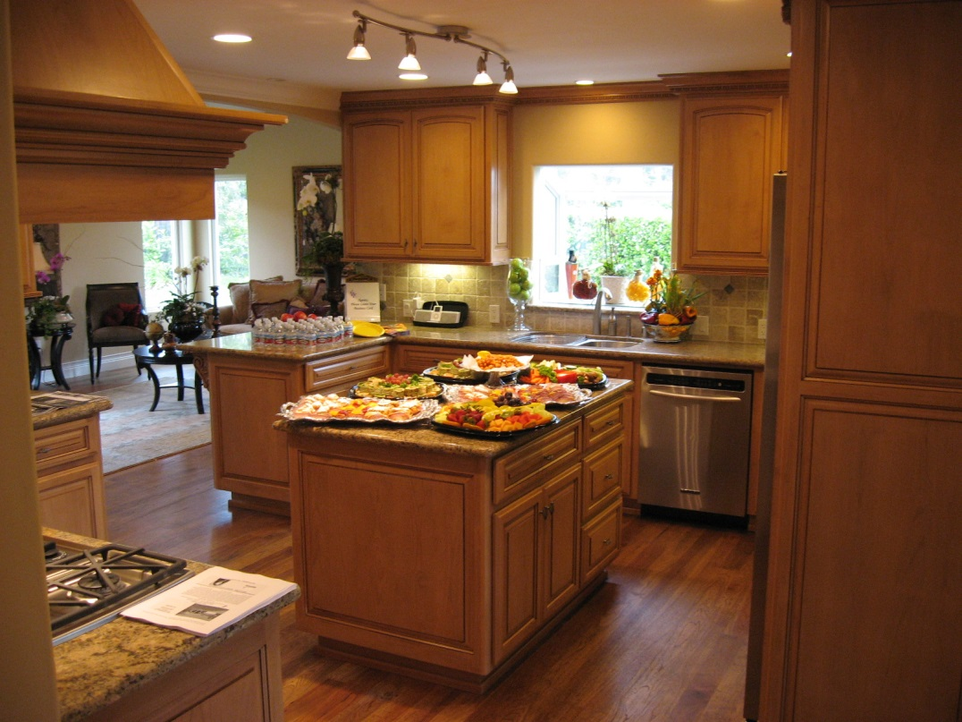
Topics
Degrees of Burns
First Aid for Burns/Scalds
Deep Fat Fryer Safety
Burn Prevention Tips
Kitchen Fires
Fire Extinguishers
Notes:
Topics we’ll discuss include:
Degrees of Burns
First Aid for Burns/Scalds
Deep Fat Fryer Safety
Burn Prevention Tips
Kitchen Fires
Fire Extinguishers

Slide 3
Degrees of Burns
First Degree – minor and heal quickly.
Symptoms = reddened skin, tender, sore
Second Degree – serious and require immediate
first aid & professional medical treatment.
Symptoms = blistered skin, very painful
Third Degree – severe and require immediate
professional medical treatment.
Symptoms = white, brown, or charred tissue, often surrounded by blistered areas; little of no pain at first
Notes:
First Degree – minor and heal quickly.
Symptoms = reddened skin, tender, sore
Second Degree – serious and require immediate first aid & professional medical treatment.
Symptoms = blistered skin, very painful
Third Degree – severe and require immediate professional medical treatment.
Symptoms = white, brown, or charred tissue, often surrounded by blistered areas; little or no pain at first

Slide 4
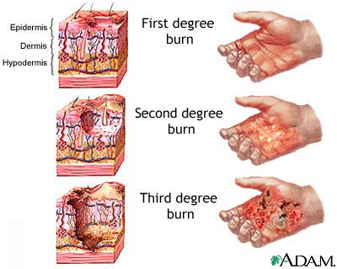
Degrees of Burns
Notes:
You can see the magnitude of physical destruction depending upon the classification of burn type

Slide 5
First Aid for Burns/Scalds
First & Second Degree = Cool the burned area with cool, running water for 10 minutes.
Third Degree = Get medical attention immediately! Cool only with wet, sterile dressings.
After the burned area has been cooled, cover with a clean, dry dressing.
Do NOT put butter or any other grease including medicated ointments on a burn!
Notes:
Some of the first aid for various burn types:
First & Second Degree = Cool the burned area with cool, running water for 10 minutes.
Third Degree = Get medical attention immediately! Cool only with wet, sterile dressings.
After the burned area has been cooled, cover with a clean, dry dressing.
Do NOT put butter or any other grease including medicated ointments on a burn!

Slide 6
First Aid for Burns/Scalds
Do NOT break blisters!
If clothing has been burned, remove that part which isn’t stuck to victim.
If possible, remove jewelry from around burned area before swelling begins.
Treat for shock by keeping the victim’s body temperature normal; cover unburned areas with a dry blanket.
Notes:
Additional first aid for burns;
Do NOT break blisters!
If clothing has been burned, remove that part which isn’t stuck to victim.
If possible, remove jewelry from around burned area before swelling begins.
Treat for shock by keeping the victim’s body temperature normal; cover unburned areas with a dry blanket.

Slide 7
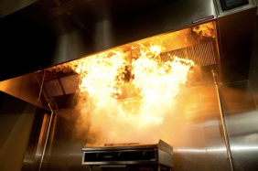
Deep Fat Fryer Safety
Never put water or other liquid
into hot cooking oil – it turns to
steam instantly and can violently
explode hot oil in all directions.
Be careful when adding food to a
deep fat fryer: if the fat is too
hot or there are pockets of liquid
in the prepared food the hot
fat/oil will spray up.
Turn the Fryer off when leaving
for the day.
Notes:
Deep fat fryers are another potential hazard.
Never put water or other liquid into hot cooking oil – it turns to steam instantly and can violently explode hot oil in all directions.
Be careful when adding food to a deep fat fryer: if the fat is too hot or there are pockets of liquid in the prepared food the hot fat/oil will spray up.
Turn the Fryer off when leaving for the day.

Slide 8
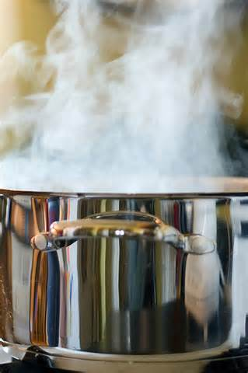
Burn Prevention Tips
Remember that steam will rise from a pot of boiling water when the lid is removed.
Use a pot holder and lift lids so that the end farthest away from you comes up first.
Leave a cloth or oven mitts on a hot lid lying on a counter top to alert others the lid is hot.
Turn pot handles in so that they can’t be bumped or the pots knocked over.
Notes:
Fryer burn prevention includes:
Remember that steam will rise from a pot of boiling water when the lid is removed.
Use a pot holder and lift lids so that the end farthest away from you comes up first.
Leave a cloth or oven mitts on a hot lid lying on a counter top to alert others the lid is hot.
Turn pot handles in so that they can’t be bumped or the pots knocked over.

Slide 9
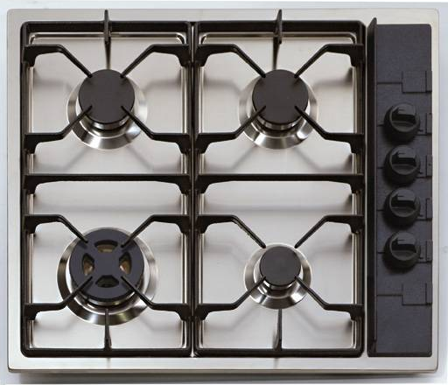
Burn Prevention Tips
Don’t leave spoons or other utensils in pots while cooking.
Don’t leave pots on stove unattended while cooking.
Turn off burners and ovens when they are not in use.
Keep plenty of dry pot holders and oven mitts near your cooking area.
Notes:
General burn prevention tips concerning all cooking appliances require you;
Don’t leave spoons or other utensils in pots while cooking.
Don’t leave pots on stove unattended while cooking.
Turn off burners and ovens when they are not in use.
Keep plenty of dry pot holders and oven mitts near your cooking area

Slide 10
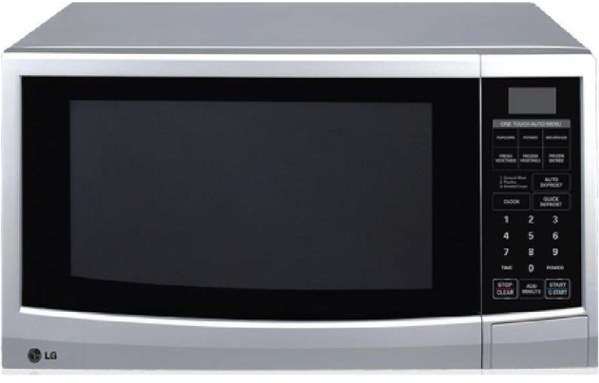
Burn Prevention Tips
When cooking wear clothing with tight fitting sleeves or roll your sleeves up.
When using a microwave, use only containers designed for safe use.
Before carefully removing covers on food cooked in a microwave, ensure the food has cooled down.
Keep things that burn such as dishtowels, paper, etc. at least 3 feet from the range top.
Notes:
Also, as preventive measures:
When cooking wear clothing with tight fitting sleeves or roll your sleeves up.
When using a microwave, use only containers designed for safe use.
Before carefully removing covers on food cooked in a microwave, ensure the food has cooled down.
Keep things that burn such as dishtowels, paper, etc. at least 3 feet from the range top.

Slide 11
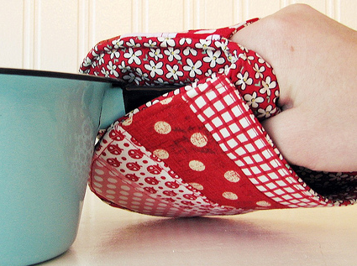
Burn Prevention Tips
Keep grease from building up on range tops, hoods, and appliances.
Keep hot pans, beverages, and trays away from the edge of a counter.
Use pot holders or oven mitts when moving/carrying hot pans, trays, etc.
Use caution when moving about within the kitchen due to hot grills, range tops, ovens.
Notes:
Pay particular attention to the following to prevent burns:
Keep grease from building up on range tops, hoods, and appliances.
Keep hot pans, beverages, and trays away from the edge of a counter.
Use pot holders or oven mitts when moving/carrying hot pans, trays, etc.
Use caution when moving about within the kitchen due to hot grills, range tops, ovens.

Slide 12
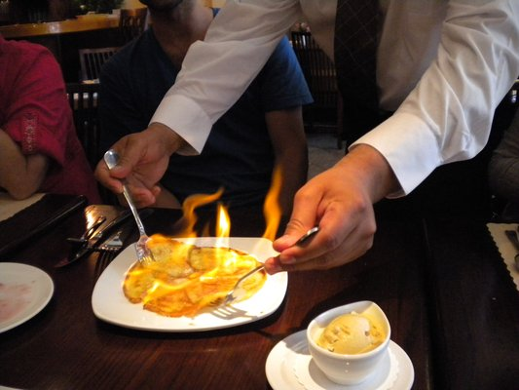
Kitchen Fires
Most kitchen fires start due to the heating of fat or oil.
Unattended cooking can also result in a kitchen fire.
When oil/fat gets hot it smokes a little at first, but if it gets hotter it bursts into flame.
Notes:
When cooking with flaming entrees, remember the importance of safety. With this selection, you’ve already introduced the possibility of harm.
Most kitchen fires start due to the heating of fat or oil.
Unattended cooking can also result in a kitchen fire.
When oil/fat gets hot it smokes a little at first, but if it gets hotter it bursts into flame.

Slide 13
Kitchen Fires
To extinguish a fat/oil fire cover it with a damp cloth, or use a fire extinguisher.
Make sure you turn off the gas or power.
NEVER USE WATER on a fat/oil/grease fire!
Do NOT attempt to carry or move a pan that’s on fire.
Keep the appropriate lid close by while cooking so you can cover a pan that’s on fire.
Notes:
Fire suppression of cooking and kitchen fires have a safety sequence of response.
To extinguish a fat/oil fire cover it with a damp cloth, or use a fire extinguisher.
Make sure you turn off the gas or power.
NEVER USE WATER on a fat/oil/grease fire!
Do NOT attempt to carry or move a pan that’s on fire.
Keep the appropriate lid close by while cooking so you can cover a pan that’s on fire.

Slide 14
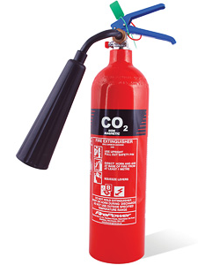
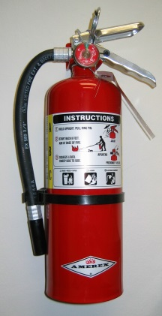
Fire Extinguisher Use
Fire extinguishers are marked to indicate the class of fire they can be used on.
Access to fire extinguishers should not blocked/obstructed.
After a fire extinguisher is used it must be recharged, not put back in place.
Most fire extinguishers will make a mess!
Notes:
Select the proper fire extinguisher to use for cooking fires.
Fire extinguishers are marked to indicate the class of fire they can be used on.
Access to fire extinguishers should not blocked/obstructed.
After a fire extinguisher is used it must be recharged, not put back in place.
Most fire extinguishers will make a mess!
Some people have a container of baking soda for kitchen fires-Remember: It is baking soda NOT baking powder!!

Slide 15
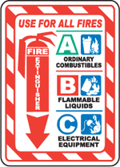
Fire Extinguisher Classifications
Notes:
To help your extinguisher selection, various classifications are used depending upon the fire type.

Slide 16






Class of Fires
Class A= Ordinary Combustibles (.e.g Wood, Paper, Rubber)
Class B = Flamamble Liquids/Gases (e.g. Gasoline, Methane)
Class C = Energized Electrical (e.g. electrical appliance plugged in)
Notes:
Some of the fire classes include:
Class A = Ordinary Combustibles (e.g. Wood, Paper, Rubber)
Class B = Flammable Liquids/Gases (e.g. Gasoline, Methane)
Class C = Energized Electrical (e.g. Electrical appliance plugged in)

Slide 17

Class D Fires
Class D Fires = Combustible metals (e.g. titanium, aluminum)
Extinguishers for these classes of fire:
Often specific for type of metal in question
No picture designator
No rating; also not given multi-purpose rating
Notes:
Class D Fires are combustible metals.
Extinguishers for these classes of fire:
Often specific for type of metal in question
No picture designator
No rating; also not given multi-purpose rating

Slide 18
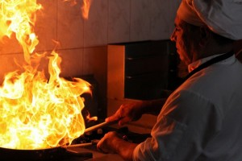
Class K Fires
Class “K” fires occur in cooking grease made from animal fat.
These fires usually burn very hot and can be dangerous to extinguish.
There are special fire extinguishers that are used for these types of fires and are usually in kitchen areas of restaurants/cafeterias.
Notes:
Class “K” fires would involve cooking grease made from animal fat.
These fires usually burn very hot and can be dangerous to extinguish.
There are special fire extinguishers that are used for these types of fires and are usually in kitchen areas of restaurants/cafeterias.

Slide 19
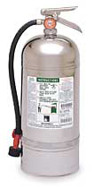
Class K Fire Extinguisher
Looks like a 2 ½ gallon pressurized water extinguisher – don’t get them mixed up!
Use the labels/markings on all extinguishers to ensure you have the correct one!
Notes:
The Class “K” fire extinguisher
Looks like a 2 ½ gallon pressurized water extinguisher – don’t get them mixed up!
Use the labels/markings on all extinguishers to ensure you have the correct one!

Slide 20
To Use: P.A.S.S.
P = Pull the pin on the fire extinguisher handle.
A = Aim the nozzle/horn of the extinguisher at the base/bottom of the fire.
S = Squeeze the fire extinguisher handles together to make the extinguisher work.
S = Sweep the extinguisher from side to side as if you were using a broom.
Notes:
To use a fire extinguisher, remember the acronym P.A.S.S.
P = Pull the pin on the fire extinguisher handle.
A = Aim the nozzle/horn of the extinguisher at the base/bottom of the fire.
S = Squeeze the fire extinguisher handles together to make the extinguisher work.
S = Sweep the extinguisher from side to side as if you were using a broom.

Slide 21
Used Extinguisher
Never put a fire extinguisher that’s been used back in place (even if it still feels heavy).
Even a short burst can cause the extinguisher to leak pressure after use.
Putting a used extinguisher back in place can mean it won’t work in the future.
Have used extinguishers checked and recharged by a reputable dealer.
Notes:
Never put a fire extinguisher that’s been used back in place (even if it still feels heavy).
Even a short burst can cause the extinguisher to leak pressure after use.
Putting a used extinguisher back in place can mean it won’t work in the future.
Have used extinguishers checked and recharged by a reputable dealer.

Slide 22
Think Safety!
Burns can be VERY painful and kitchen fires can be devastating.
The “bottom line” in preventing burns and kitchen fires is to use common sense and safe practices.
Never take anything for granted when working in a kitchen – treat pots, pans, and cooking surfaces as being hot unless YOU know for sure they are not.
Notes:
Think Safety!
Burns can be VERY painful and kitchen fires can be devastating.
The “bottom line” in preventing burns and kitchen fires is to use common sense and safe practices.
Never take anything for granted when working in a kitchen – treat pots, pans, and cooking surfaces as being hot unless YOU know for sure they are not.

Slide 23


Contact Information
Health & Safety Training Specialists
1171 South Cameron Street, Room 324
Harrisburg, PA 17104-2501
(717) 772-1635
RA-LI-BWC-PATHS@pa.gov
Like us on Facebook! - https://www.facebook.com/BWCPATHS

Slide 24
Questions?????

