Slide 1
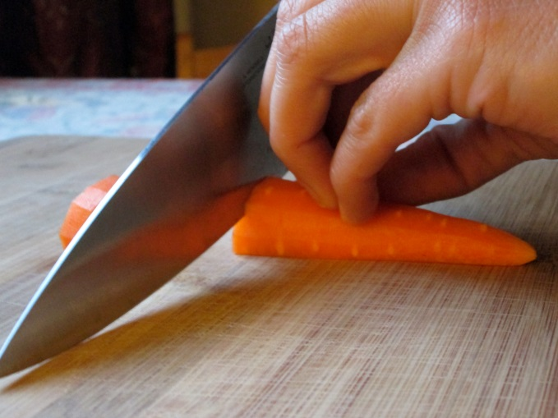
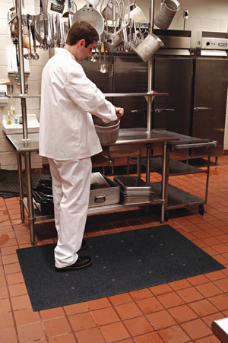
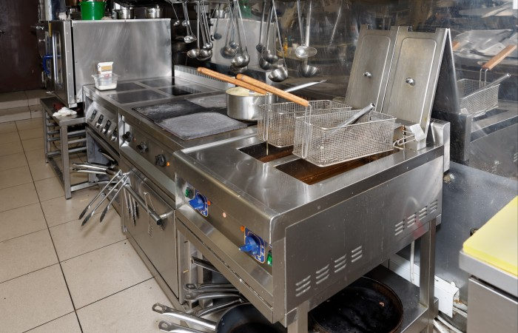
Kitchen Safety Awareness
Bureau of Workers’ Compensation
PA Training for Health & Safety
(PATHS)
PPT-142-01
1
Notes:
“Hand injuries account for nearly 10% of hospital emergency department visits. A series of 1,000 consecutive hand injuries showed the following distribution: 42% lacerations (cuts), 27% contusions (bruises), 17% fractures (broken bones), and 5% infections. Hand injuries account for about 17% all workday loss injuries.
The most common cause of the injuries was blunt trauma (50%) followed by injury from a sharp object (25%).”
Medical Author:
Chad Tarr, MD
Medical Editor:
Charles Patrick Davis, MD, PhD
http://www.emedicinehealth.com/hand_injuries/article_em.htm

Slide 2
Topics
Knife Safety
Safety with Scissors and Sharps
Cuts and Injury Reporting
Degrees of Burns and First Aid
Deep Fat Fryer Safety
Burn Prevention Tips
Kitchen Fires and Fire Extinguishers
Safe Use and Handling of Chemicals
PPT-142-01
2
Notes:
This program will view the following topics:
Knife Safety
Safety with Scissors
Safety with Sharps
Cuts
Injury Reporting

Slide 3
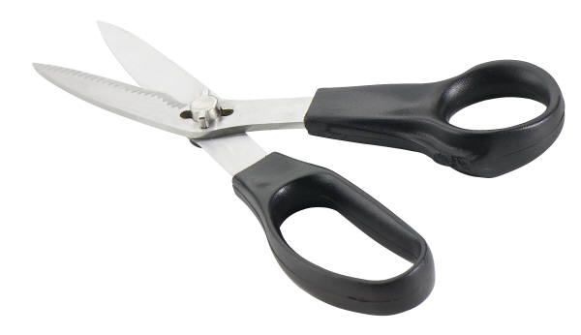
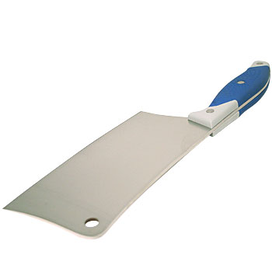
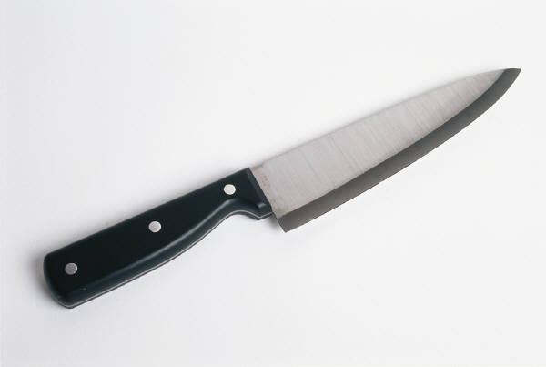
Kitchen Safety Awareness
Bureau of Workers’ Compensation
PA Training for Health & Safety
(PATHS)
SAFETY WITH SHARPS
PPT-142-01
3
Notes:
“Hand injuries account for nearly 10% of hospital emergency department visits. A series of 1,000 consecutive hand injuries showed the following distribution: 42% lacerations (cuts), 27% contusions (bruises), 17% fractures (broken bones), and 5% infections. Hand injuries account for about 17% all workday loss injuries.
The most common cause of the injuries was blunt trauma (50%) followed by injury from a sharp object (25%).”
Medical Author:
Chad Tarr, MD
Medical Editor:
Charles Patrick Davis, MD, PhD
http://www.emedicinehealth.com/hand_injuries/article_em.htm

Slide 4
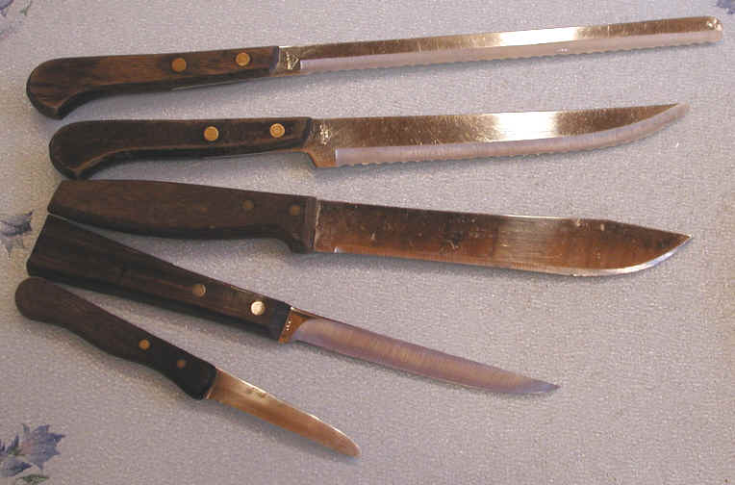
Safety with Knives
Knives are very useful tools when you’re working in the kitchen, but they can also be very dangerous if not handled and cared for properly.
Remember, knives are one of the most dangerous things around a kitchen and should be handled with great caution.
PPT-142-01
4
Notes:
Knives are very useful tools when you’re working in the kitchen, but they can also be very dangerous if not handled and cared for properly.
Remember, knives are one of the most dangerous things around a kitchen and should be handled with great caution.

Slide 5
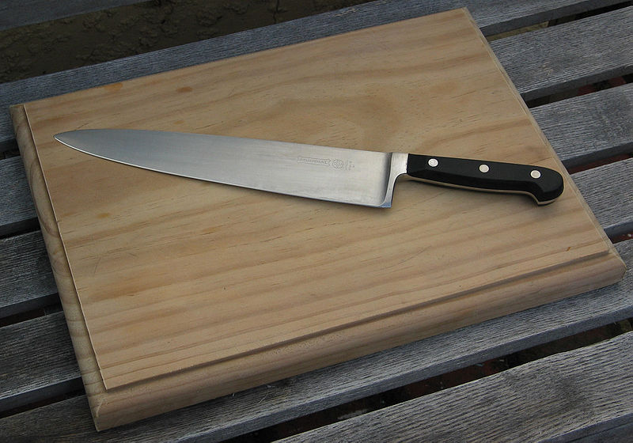
Knife Safety Tips
Use good, sturdy knives that are well balanced
and do not easily bend.
Use a cutting board – do not use kitchen
counters, metal, glass, or steel surfaces when
chopping, slicing, or mincing.
Place a damp cloth under the cutting board to
prevent it from slipping.
PPT-142-01
5
Notes:
Use good, sturdy knives that are well balanced and do not easily bend.
Use a cutting board – do not use kitchen counters, metal, glass, or steel surfaces when
chopping, slicing, or mincing.
Place a damp cloth under the cutting board to prevent it from slipping.

Slide 6
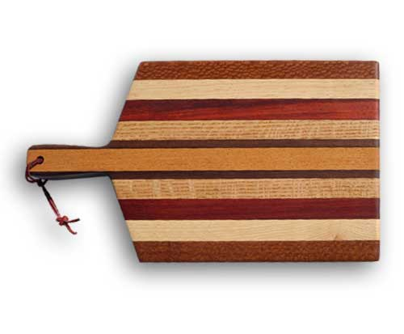
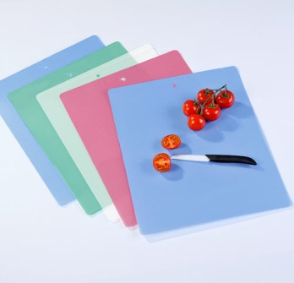
Knife Safety Tips
Use the proper cutting board – plastic boards are dishwasher safe and more sanitary than wooden boards, but they can dull knives quickly.
Wooden boards are ideal but need thorough
cleansing to remain sanitary.
Protect your fingers by curling them under and
positioning them on top of the item to be cut.
PPT-142-01
6
Notes:
Use the proper cutting board – plastic boards are dishwasher safe and more sanitary than wooden
boards, but they can dull knives quickly.
Wooden boards are ideal but need thorough cleansing to remain sanitary.
Protect your fingers by curling them under and positioning them on top of the item to be cut.

Slide 7
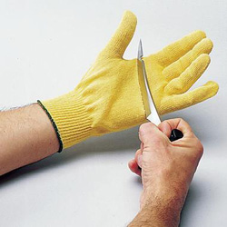
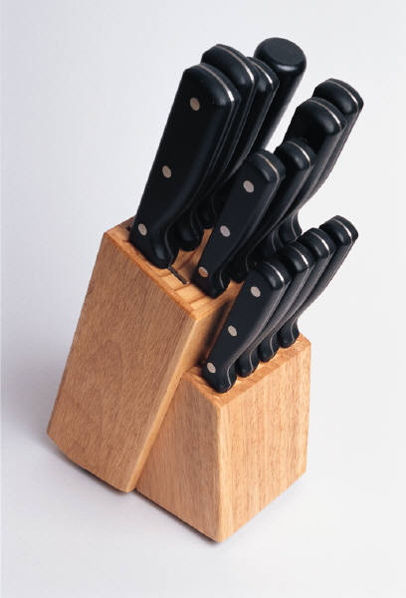
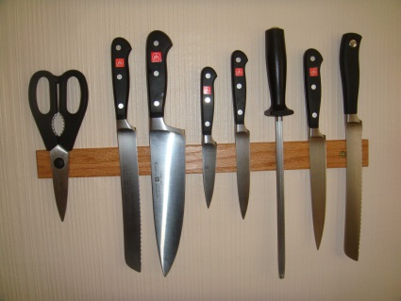
Knife Safety
Keep knives sharpened.
Always store knives in a knife holder or on a
magnetic wall strip.
Store knives from largest to smallest with
blades facing the same direction.
Use Kevlar gloves for added protection.
Never attempt to catch a falling knife!
Never cut anything held in your hand.
Never cut toward yourself.
PPT-142-01
7
Notes:
Keep knives sharpened.
Always store knives in a knife holder or on a magnetic wall strip, never loose in a drawer.
Store knives from largest to smallest with blades facing the same direction.
Use Kevlar gloves for added protection.
Never attempt to catch a falling knife! Remember the old adage, “A falling knife has no handle!”
Never cut anything held in your hand.
Never cut toward yourself always cut away from your body.

Slide 8
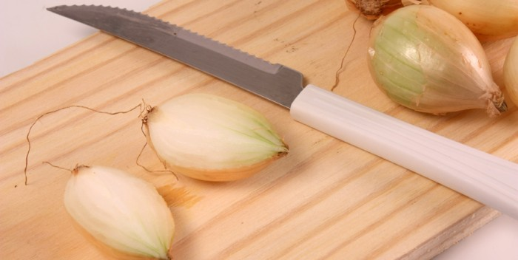
Knife Safety
Use knives for their intended purpose only.
Keep knives clean.
Select the correct knife for the job.
Carry knives down and by your side with the
blade to the back.
Let people know you’re walking with a knife
by saying something like “knife walking.”
Put knives down safely.
PPT-142-01
8
Notes:
Use knives for their intended purpose only.
Keep knives clean.
Select the correct knife for the job.
Carry knives down and by your side with the blade to the back.
Let people know you’re walking with a knife by saying something like “knife walking.”
Put knives down safely.

Slide 9
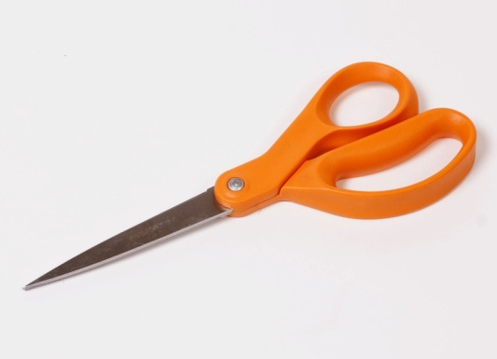
Safety with Scissors
Keep scissors sharpened.
Use proper scissors for the job being done.
Do not try to catch falling scissors.
Carry scissors with the blades closed.
Hand scissors to someone with the handle
facing them.
PPT-142-01
9
Notes:
Keep scissors sharpened.
Use proper scissors for the job being done.
Do not try and catch falling scissors.
Carry scissors with the blades closed.
Hand scissors to someone with the handle facing them.

Slide 10
Sharps Safety
When using a box cutter, cut away from
yourself.
Keep box cutters closed when not in use.
Put broken glass in a safe container & mark it.
Do not pick up broken glass with your bare
hands.
Always turn a slicer off and dial the blade to
“0” before moving product or cleaning.
Always wear the correct PPE when cleaning a
slicer.
When using a potato peeler, peel away from
yourself.
PPT-142-01
10
Notes:
When using a box cutter, cut away from yourself.
Keep box cutters closed when not in use.
Put broken glass in a safe container & mark it.
Do not pick up broken glass with your bare hands.
Always turn a slicer off and dial the blade to “0” before moving product or cleaning.
Always wear the correct PPE when cleaning a slicer.
When using a potato peeler, peel away from yourself.

Slide 11
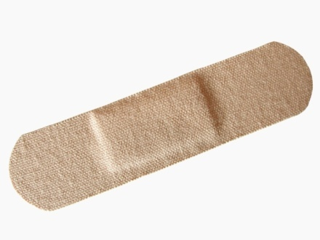
Cuts
If you cut yourself, wash the wound thoroughly
under cold water.
If the wound is shallow and the bleeding stops,
dry the skin around it with paper or a clean cloth.
If available, put an “infection prevention”
cream/spray on the wound.
Cover the wound with a sterile bandage to keep
the wound shielded and clean.
PPT-142-01
11
Notes:
If you cut yourself, wash the wound thoroughly under cold water.
If the wound is shallow and the bleeding stops, dry the skin around it with paper or a clean cloth.
If available, put an “infection prevention” cream/spray on the wound.
Cover the wound with a sterile bandage to keep the wound shielded and clean.

Slide 12
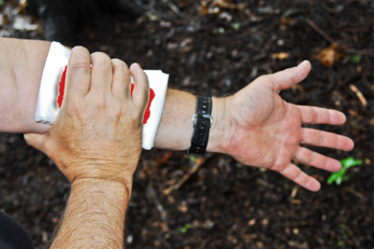
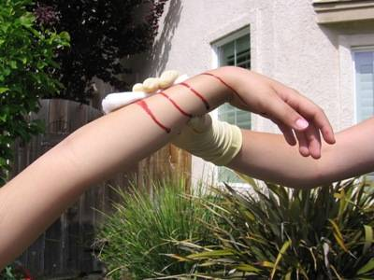
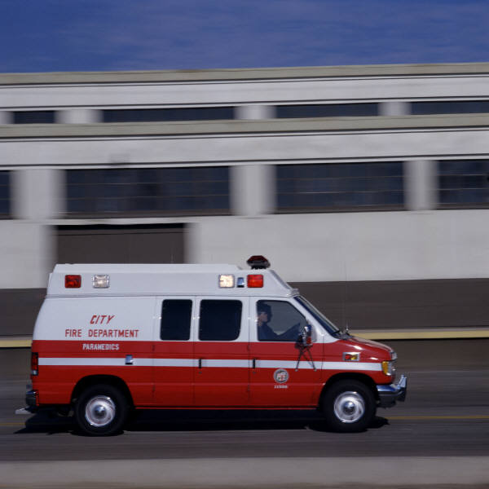
Cuts
To stop bleeding if the wound is deep:
→ Apply pressure
→ Raise the wound site above the heart
→ Seek medical attention a.s.a.p.
PPT-142-01
12
Notes:
To stop bleeding if the wound is deep:
→ Apply pressure
→ Raise the wound site above the heart
→ Seek medical attention a.s.a.p.

Slide 13
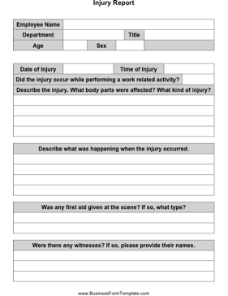

Report On-The-Job Injuries
Report any on-the-job injuries to your Supervisor as soon as possible, and make sure an injury report is completed a.s.a.p.
PPT-142-01
13
Notes:
Report any on-the-job injuries to your Supervisor as soon as possible, and make sure an injury report is completed a.s.a.p.

Slide 14
Summary
Knives, scissors and other cutting objects should be kept sharpened.
Never try to catch a falling knife/sharp object.
Carry knives and sharp objects in a safe
position.
Hand knives and scissors to someone with the
handle facing the person.
Never carry knives or scissors in your pocket.
If you receive a cut stop the bleeding using
direct pressure and/or wound elevation.
Report on-the-job injuries to your Supervisor a.s.a.p.
PPT-142-01
14
Notes:
In summary,
Knives, scissors and other cutting objects should be kept sharpened.
Never try to catch a falling knife/sharp object.
Carry knives and sharp objects in a safe position.
Hand knives and scissors to someone with the handle facing the person.
Never carry knives or scissors in your pocket.
If you receive a cut stop the bleeding using direct pressure and/or wound elevation.
Report on-the-job injuries to your Supervisor a.s.a.p.

Slide 15
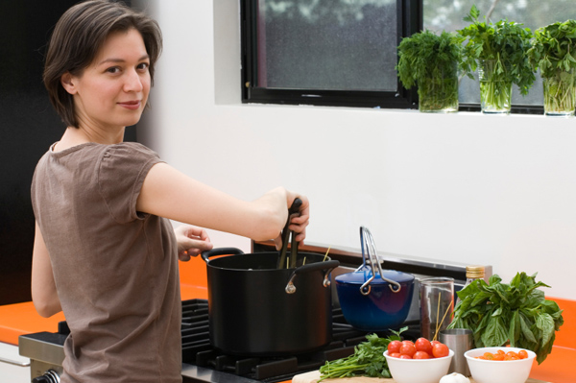
Kitchen Safety Awareness
Bureau of Workers’ Compensation
PA Training for Health & Safety (PATHS)
Preventing Burns & Kitchen Fires
Notes:
In the United States approximately 2.4 million burn injuries are reported per year. About 650,000 are treated by medical professionals; 5,000 are hospitalized; 20,000 have major burns involving at least 25% of their total body surface. Between 8,000 and 12,000 of burn patients will die with about 1 million sustaining substantial or permanent disabilities resulting from their burn injury.

Slide 16
Degrees of Burns
First Degree – minor and heal quickly.
Symptoms = reddened skin, tender, sore
Second Degree – serious and require immediate
first aid & professional medical treatment.
Symptoms = blistered skin, very painful
Third Degree – severe and require immediate
professional medical treatment.
Symptoms = white, brown, or charred tissue, often surrounded by blistered areas; little of no pain at first
Notes:
First Degree – minor and heal quickly.
Symptoms = reddened skin, tender, sore
Second Degree – serious and require immediate first aid & professional medical treatment.
Symptoms = blistered skin, very painful
Third Degree – severe and require immediate professional medical treatment.
Symptoms = white, brown, or charred tissue, often surrounded by blistered areas; little or no pain at first

Slide 17
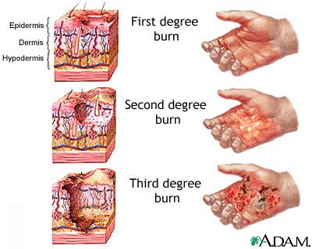
Degrees of Burns
Notes:
You can see the magnitude of physical destruction depending upon the classification of burn type

Slide 18
First Aid for Burns/Scalds
First & Second Degree = Cool the burned area with cool, running water for 10 minutes.
Third Degree = Get medical attention immediately! Cool only with wet, sterile dressings.
After the burned area has been cooled, cover with a clean, dry dressing.
Do NOT put butter or any other grease including medicated ointments on a burn!
Notes:
Some of the first aid for various burn types:
First & Second Degree = Cool the burned area with cool, running water for 10 minutes.
Third Degree = Get medical attention immediately! Cool only with wet, sterile dressings.
After the burned area has been cooled, cover with a clean, dry dressing.
Do NOT put butter or any other grease including medicated ointments on a burn!

Slide 19
First Aid for Burns/Scalds
Do NOT break blisters!
If clothing has been burned, remove that part which isn’t stuck to victim.
If possible, remove jewelry from around burned area before swelling begins.
Treat for shock by keeping the victim’s body temperature normal; cover unburned areas with a dry blanket.
Notes:
Additional first aid for burns;
Do NOT break blisters!
If clothing has been burned, remove that part which isn’t stuck to victim.
If possible, remove jewelry from around burned area before swelling begins.
Treat for shock by keeping the victim’s body temperature normal; cover unburned areas with a dry blanket.

Slide 20
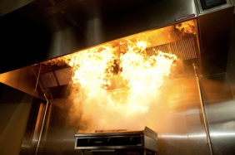
Deep Fat Fryer Safety
Never put water or other liquid
into hot cooking oil – it turns to
steam instantly and can violently
explode hot oil in all directions.
Be careful when adding food to a
deep fat fryer: if the fat is too
hot or there are pockets of liquid
in the prepared food the hot
fat/oil will spray up.
Turn the Fryer off when leaving
for the day.
Notes:
Deep fat fryers are another potential hazard.
Never put water or other liquid into hot cooking oil – it turns to steam instantly and can violently explode hot oil in all directions.
Be careful when adding food to a deep fat fryer: if the fat is too hot or there are pockets of liquid in the prepared food the hot fat/oil will spray up.
Turn the Fryer off when leaving for the day.

Slide 21
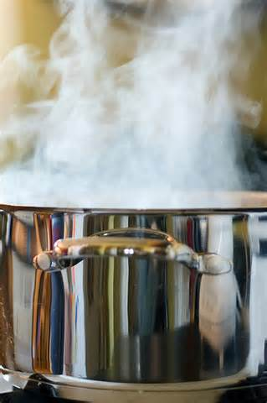
Burn Prevention Tips
Remember that steam will rise from a pot of boiling water when the lid is removed.
Use a pot holder and lift lids so that the end farthest away from you comes up first.
Leave a cloth or oven mitts on a hot lid lying on a counter top to alert others the lid is hot.
Turn pot handles in so that they can’t be bumped or the pots knocked over.
Notes:
Fryer burn prevention includes:
Remember that steam will rise from a pot of boiling water when the lid is removed.
Use a pot holder and lift lids so that the end farthest away from you comes up first.
Leave a cloth or oven mitts on a hot lid lying on a counter top to alert others the lid is hot.
Turn pot handles in so that they can’t be bumped or the pots knocked over.

Slide 22
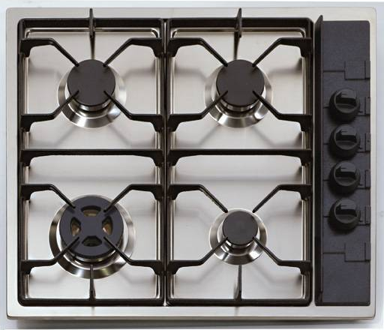
Burn Prevention Tips
Don’t leave spoons or other utensils in pots while cooking.
Don’t leave pots on stove unattended while cooking.
Turn off burners and ovens when they are not in use.
Keep plenty of dry pot holders and oven mitts near your cooking area.
Notes:
General burn prevention tips concerning all cooking appliances require you;
Don’t leave spoons or other utensils in pots while cooking.
Don’t leave pots on stove unattended while cooking.
Turn off burners and ovens when they are not in use.
Keep plenty of dry pot holders and oven mitts near your cooking area

Slide 23
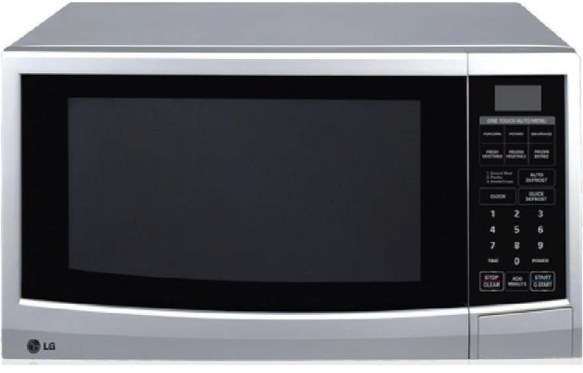
Burn Prevention Tips
When cooking wear clothing with tight fitting sleeves or roll your sleeves up.
When using a microwave, use only containers designed for safe use.
Before carefully removing covers on food cooked in a microwave, ensure the food has cooled down.
Keep things that burn such as dishtowels, paper, etc. at least 3 feet from the range top.
Notes:
Also, as preventive measures:
When cooking wear clothing with tight fitting sleeves or roll your sleeves up.
When using a microwave, use only containers designed for safe use.
Before carefully removing covers on food cooked in a microwave, ensure the food has cooled down.
Keep things that burn such as dishtowels, paper, etc. at least 3 feet from the range top.

Slide 24
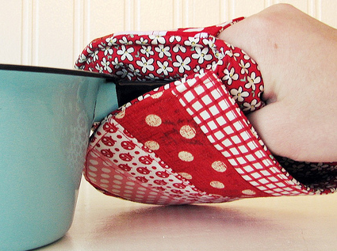
Burn Prevention Tips
Keep grease from building up on range tops, hoods, and appliances.
Keep hot pans, beverages, and trays away from the edge of a counter.
Use pot holders or oven mitts when moving/carrying hot pans, trays, etc.
Use caution when moving about within the kitchen due to hot grills, range tops, ovens.
Notes:
Pay particular attention to the following to prevent burns:
Keep grease from building up on range tops, hoods, and appliances.
Keep hot pans, beverages, and trays away from the edge of a counter.
Use pot holders or oven mitts when moving/carrying hot pans, trays, etc.
Use caution when moving about within the kitchen due to hot grills, range tops, ovens.

Slide 25
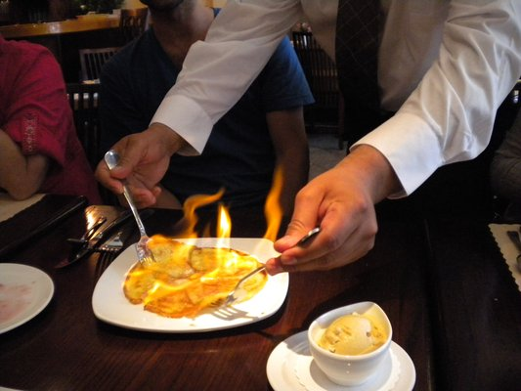
Kitchen Fires
Most kitchen fires start due to the heating of fat or oil.
Unattended cooking can also result in a kitchen fire.
When oil/fat gets hot it smokes a little at first, but if it gets hotter it bursts into flame.
Notes:
When cooking with flaming entrees, remember the importance of safety. With this selection, you’ve already introduced the possibility of harm.
Most kitchen fires start due to the heating of fat or oil.
Unattended cooking can also result in a kitchen fire.
When oil/fat gets hot it smokes a little at first, but if it gets hotter it bursts into flame.

Slide 26
Kitchen Fires
To extinguish a fat/oil fire cover it with a damp cloth, or use a fire extinguisher.
Make sure you turn off the gas or power.
NEVER USE WATER on a fat/oil/grease fire!
Do NOT attempt to carry or move a pan that’s on fire.
Keep the appropriate lid close by while cooking so you can cover a pan that’s on fire.
Notes:
Fire suppression of cooking and kitchen fires have a safety sequence of response.
To extinguish a fat/oil fire cover it with a damp cloth, or use a fire extinguisher.
Make sure you turn off the gas or power.
NEVER USE WATER on a fat/oil/grease fire!
Do NOT attempt to carry or move a pan that’s on fire.
Keep the appropriate lid close by while cooking so you can cover a pan that’s on fire.

Slide 27
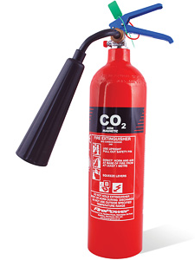
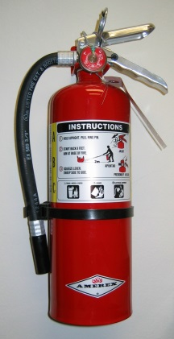
Fire Extinguisher Use
Fire extinguishers are marked to indicate the class of fire they can be used on.
Access to fire extinguishers should not blocked/obstructed.
After a fire extinguisher is used it must be recharged, not put back in place.
Most fire extinguishers will make a mess!
Notes:
Select the proper fire extinguisher to use for cooking fires.
Fire extinguishers are marked to indicate the class of fire they can be used on.
Access to fire extinguishers should not blocked/obstructed.
After a fire extinguisher is used it must be recharged, not put back in place.
Most fire extinguishers will make a mess!
Some people have a container of baking soda for kitchen fires-Remember: It is baking soda NOT baking powder!!

Slide 28
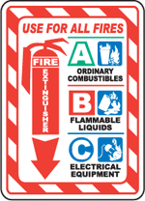
Fire Extinguisher Classifications
Notes:
To help your extinguisher selection, various classifications are used depending upon the fire type.

Slide 29






Class of Fires
Class A= Ordinary Combustibles (.e.g Wood, Paper, Rubber)
Class B = Flamamble Liquids/Gases (e.g. Gasoline, Methane)
Class C = Energized Electrical (e.g. electrical appliance plugged in)
Notes:
Some of the fire classes include:
Class A = Ordinary Combustibles (e.g. Wood, Paper, Rubber)
Class B = Flammable Liquids/Gases (e.g. Gasoline, Methane)
Class C = Energized Electrical (e.g. Electrical appliance plugged in)

Slide 30

Class D Fires
Class D Fires = Combustible metals (e.g. titanium, aluminum)
Extinguishers for these classes of fire:
Often specific for type of metal in question
No picture designator
No rating; also not given multi-purpose rating
Notes:
Class D Fires are combustible metals.
Extinguishers for these classes of fire:
Often specific for type of metal in question
No picture designator
No rating; also not given multi-purpose rating

Slide 31
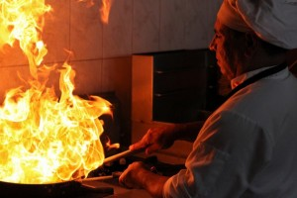
Class K Fires
Class “K” fires occur in cooking grease made from animal fat.
These fires usually burn very hot and can be dangerous to extinguish.
There are special fire extinguishers that are used for these types of fires and are usually in kitchen areas of restaurants/cafeterias.
Notes:
Class “K” fires would involve cooking grease made from animal fat.
These fires usually burn very hot and can be dangerous to extinguish.
There are special fire extinguishers that are used for these types of fires and are usually in kitchen areas of restaurants/cafeterias.

Slide 32
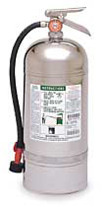
Class K Fire Extinguisher
Looks like a 2 ½ gallon pressurized water extinguisher – don’t get them mixed up!
Use the labels/markings on all extinguishers to ensure you have the correct one!
Notes:
The Class “K” fire extinguisher
Looks like a 2 ½ gallon pressurized water extinguisher – don’t get them mixed up!
Use the labels/markings on all extinguishers to ensure you have the correct one!

Slide 33
To Use: P.A.S.S.
P = Pull the pin on the fire extinguisher handle.
A = Aim the nozzle/horn of the extinguisher at the base/bottom of the fire.
S = Squeeze the fire extinguisher handles together to make the extinguisher work.
S = Sweep the extinguisher from side to side as if you were using a broom.
Notes:
To use a fire extinguisher, remember the acronym P.A.S.S.
P = Pull the pin on the fire extinguisher handle.
A = Aim the nozzle/horn of the extinguisher at the base/bottom of the fire.
S = Squeeze the fire extinguisher handles together to make the extinguisher work.
S = Sweep the extinguisher from side to side as if you were using a broom.

Slide 34
Used Extinguisher
Never put a fire extinguisher that’s been used back in place (even if it still feels heavy).
Even a short burst can cause the extinguisher to leak pressure after use.
Putting a used extinguisher back in place can mean it won’t work in the future.
Have used extinguishers checked and recharged by a reputable dealer.
Notes:
Never put a fire extinguisher that’s been used back in place (even if it still feels heavy).
Even a short burst can cause the extinguisher to leak pressure after use.
Putting a used extinguisher back in place can mean it won’t work in the future.
Have used extinguishers checked and recharged by a reputable dealer.

Slide 35
Think Safety!
Burns can be VERY painful and kitchen fires can be devastating.
The “bottom line” in preventing burns and kitchen fires is to use common sense and safe practices.
Never take anything for granted when working in a kitchen – treat pots, pans, and cooking surfaces as being hot unless YOU know for sure they are not.
Notes:
Think Safety!
Burns can be VERY painful and kitchen fires can be devastating.
The “bottom line” in preventing burns and kitchen fires is to use common sense and safe practices.
Never take anything for granted when working in a kitchen – treat pots, pans, and cooking surfaces as being hot unless YOU know for sure they are not.

Slide 36
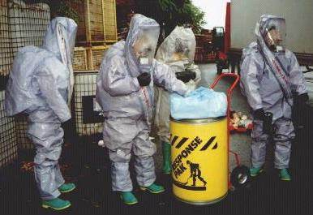
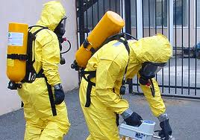
Kitchen Safety Awareness
Bureau of Workers’ Compensation
PA Training for Health & Safety (PATHS)
SAFE USE OF CHEMICALS
Notes:
Chemical burns represent approximately 3 percent of all burn center admissions. Chemical burns occur when certain acids, alkaloids and other caustic chemicals come into contact with the skin.
Possible causes of chemical burns at home or in the workplace include:
Industrial products, tar, gasoline and wet pavement
Household cleaners that contain lye (paint cleaners), sulfuric acid (toilet bowl cleaners), phenol (deodorizers), or sodium hypochlorite (disinfectants and bleaches)
Cosmetic products such as nail polish remover and hair dye
Explosions and spills
http://www.yourlegalguide.com/burn-injury-types/

Slide 37
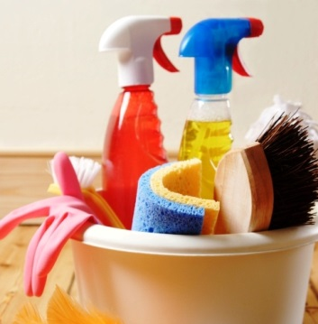
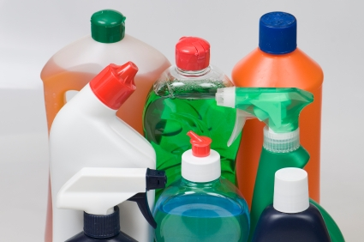
Kitchen Chemicals
There are often many chemicals in a kitchen area
such as:
Drain Cleaners
Bleaches
Surface Cleaners
De-greasers
Floor Cleaners
Chemicals can be harmful to your health and the environment – always use caution when working with any chemical!
Notes:
There are often many chemicals in a kitchen area such as:
Drain Cleaners
Bleaches
Surface Cleaners
De-greasers
Floor Cleaners
• Chemicals can be harmful to your health and the environment – always use caution when working with any chemical!

Slide 38
Chemical Safety
NEVER MIX CHEMICALS TOGETHER! A violent reaction could occur causing injury/damage.
Store flammable chemicals in cabinets designed for safe storage.
If chemicals are stored in the kitchen, store on shelves below foodstuffs so if they leak they will not contaminate food.
Wear appropriate PPE when using chemicals.
Notes:
NEVER MIX CHEMICALS TOGETHER! A violent reaction could occur causing injury/damage.
Store flammable chemicals in cabinets designed for safe storage.
If chemicals are stored in the kitchen, store on shelves below foodstuffs so if they leak they will not contaminate food.
Wear appropriate PPE when using chemicals.
"Working safely with chemicals in the home is really no different than working with them in the workplace," ASSE member Pam Ferrante, CSP, CHMM, of Pittsburgh, said. "Sometimes the chemicals used are more hazardous and we use larger quantities [in the workplace], but the safety principles are the same. We urge everyone to be cautious."
http://ehstoday.com/safety/chemical/ehs_imp_39314

Slide 39
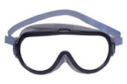
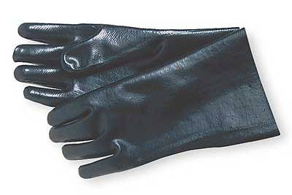
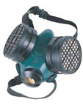
Types of PPE
EYE PROTECTION SUCH AS SAFETY GOGGLES:
HAND PROTECTION SUCH AS RUBBER GLOVES:
RESPIRATORY PROTECTION:
Notes:
EYE PROTECTION SUCH AS SAFETY GOGGLES,
HAND PROTECTION SUCH AS RUBBER GLOVES, which are compatible with the chemical being used.
RESPIRATORY PROTECTION, sufficient to exclude breathing the vapors from the chemical.

Slide 40
Chemical Safety
Make sure chemicals are properly labeled and in proper containers.
Read and follow warning labels.
If available, review corresponding Material Safety Data Sheets (MSDS’s) before working with chemicals.
Follow manufacturer’s recommendations when mixing water with chemicals.
Notes:
Make sure chemicals are properly labeled and in proper containers.
Read and follow warning labels.
If available, review corresponding Safety Data Sheets (SDS’s) before working with chemicals.
Follow manufacturer’s recommendations when mixing water with chemicals.

Slide 41
Chemical Safety
Make sure chemicals are properly labeled and in proper containers.
Read and follow warning labels.
If available, review corresponding Safety Data Sheets (SDS’s) before working with chemicals.
Follow manufacturer’s recommendations when mixing water with chemicals.
Notes:
Make sure chemicals are properly labeled and in proper containers.
Read and follow warning labels.
If available, review corresponding Safety Data Sheets (SDS’s) before working with chemicals.
Follow manufacturer’s recommendations when mixing water with chemicals.

Slide 42
Chemical Safety
Clean up spills immediately and dispose of clean up materials properly.
Ensure areas are well ventilated when using chemicals.
If you feel sick while using a chemical, get to fresh air and have your Supervisor notified as soon as possible.
Report any injuries or physical reactions you may have when using chemicals immediately.
Notes:
Clean up spills immediately and dispose of clean up materials properly.
Ensure areas are well ventilated when using chemicals.
If you feel sick while using a chemical, get to fresh air and have your Supervisor notified as soon as possible.
Report any injuries or physical reactions you may have when using chemicals immediately

Slide 43
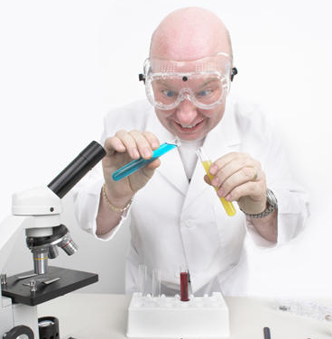
Remember
Never mix chemicals!
Read warning labels and MSDS’s.
Wear appropriate PPE.
Ensure chemicals are properly labeled.
Store chemicals safely.
Clean up spills immediately.
Notify your Supervisor if injured.
Notes:
Remember:
Never mix chemicals!
Read warning labels and SDS’s.
Wear appropriate PPE.
Ensure chemicals are properly labeled.
Store chemicals safely.
Clean up spills immediately.
Notify your Supervisor if injured.

Slide 44


Contact Information
Health & Safety Training Specialists
1171 South Cameron Street, Room 324
Harrisburg, PA 17104-2501
(717) 772-1635
RA-LI-BWC-PATHS@pa.gov
Like us on Facebook! - https://www.facebook.com/BWCPATHS

Slide 45
Questions

