Slide 1
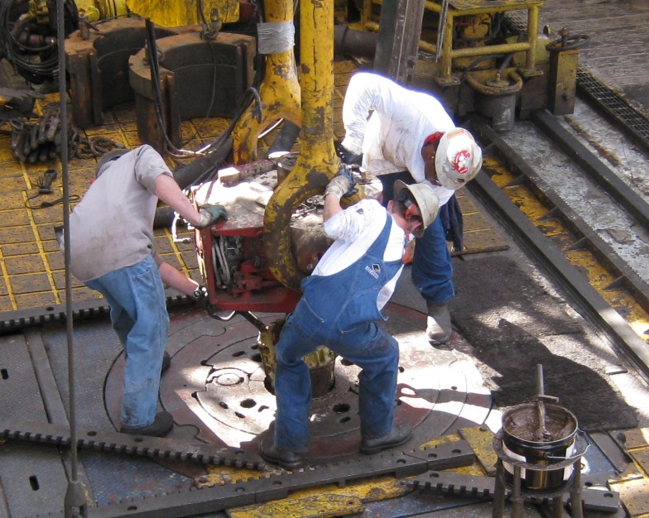

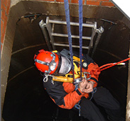
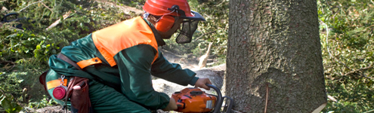
JOB SAFETY ANALYSIS
Bureau of Workers’ Compensation
PA Training for Health & Safety (PATHS)
Notes:
For each job or task there is a method which, when adopted, can best assure the safest means to conduct the work.
To determine this best method, a Job Safety Analysis must be conducted. This JSA will identify hazards at each work stage and design
measures to control or eliminate the hazards.

Slide 2
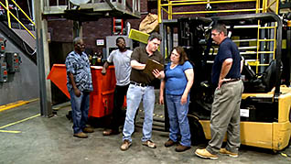
Job Safety Analysis
Also known as “Job Hazard Analysis.”
◦ The breaking down into its component parts of any method or procedure to determine the hazards connected with each key step and the requirements for performing it safely.
Notes:
As shown in the definition, this JSA looks at each component and subcomponent of a task. It determines what, if any, hazards may be connected to each “Key Step” in the task. Once identified the means to remove the hazard are determined, a policy designed and the task performed.

Slide 3
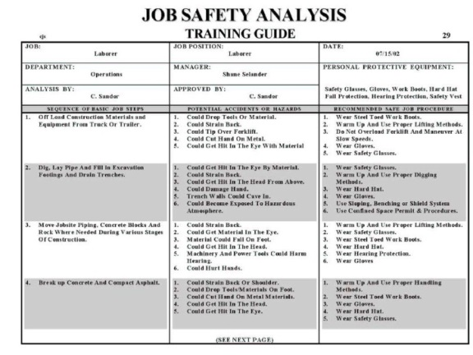
Job Safety Analysis Priorities
New Jobs
Severity Potential
History of Disabling Injuries
Frequency of Accidents
Notes:
We prioritize the JSA’s depending upon several factors.
New jobs which may not have a history within your industry must be evaluated so surprises don’t occur during implementation
Severity potential of a system will demand a JSA be performed due to the magnitude of hazard to personnel and the facility.
The history of disabling injuries or fatalities resulting from a work task can be viewed industry-wide. This record will help to reveal what happened and the corrective actions taken by others.
Frequency of accidents is also reviewed. How often did injuries occur and under what specific conditions of use.

Slide 4
Job Safety Analysis
Job means “task”
e.g. Changing a tire, not being an auto mechanic
“Key” steps
Too detailed becomes cumbersome
Not enough detail becomes useless
Notes:
In the JSA, Job means “task”.
The example of changing a car tire is used when the person is not an auto mechanic.
Remember: “Key” steps may be too detailed thus cumbersome. If not enough detail, the steps become useless.

Slide 5
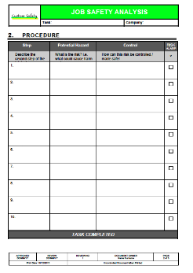
Break Job Down into Key Steps
AVOID:
Making job breakdown so detailed large number of steps results.
Making breakdown so general basic steps are not recorded.
Notes:
Remember to avoid:
Making the job breakdown so detailed large number of steps results.
Making the breakdown so general basic steps are not recorded.

Slide 6

Job Safety Analysis
Example: Changing a Flat Tire on an Automobile
Notes:
Most of us have already gone through this experience in our lives. We either read the owner’s manual beforehand or had to go “through the numbers” when the incident occurred.
There are safety measures included in this tire changing; how to secure the car against rolling, how far to jack the car up before loosening the lug nuts, and a variety of other bits of required information. These can be put into a safety chronology to perform this task.

Slide 7

Key Steps
Changing a Flat Tire (too many steps):
Pull off road
Put car in “park”
Set brake 4. Turn on “four ways” 5. Open door 6. Get out of car 7. Walk to trunk
8. Put key in lock
9. Open trunk
10. Remove Jack
11. Remove Spare
12. Carry Spare
13. Set Jack
14. Remove Flat
Notes:
Key Steps can include too many bits of information many of which can be taken for granted. Example #1, above. This could be expanded to state, “Pull off the road onto right berm in the same direction of travel.” This state information already assumed. While we don’t want to assume information in some instances, some information is already known.
The 11 Key Steps listed in the slide, while they would be included in setting-up a vehicle to change a tire, really lend very little to helping accomplish the task.

Slide 8
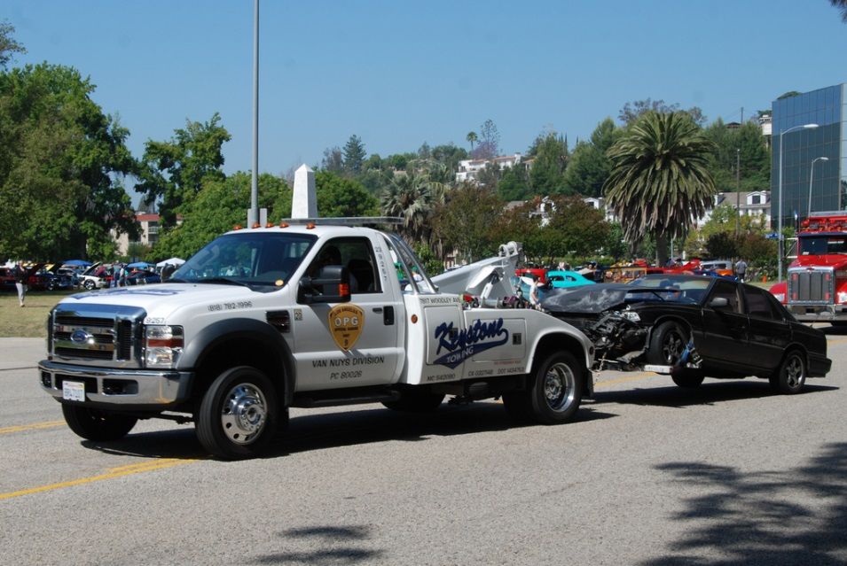
Key Steps
Not Enough Steps:
Park car 3. Put on spare tire
Take off flat tire 4. Drive away
Notes:
Some Key Steps may not be enough to address the task or the hazards and the means to eliminate them.
Not enough steps will also not solve the problem.

Slide 9
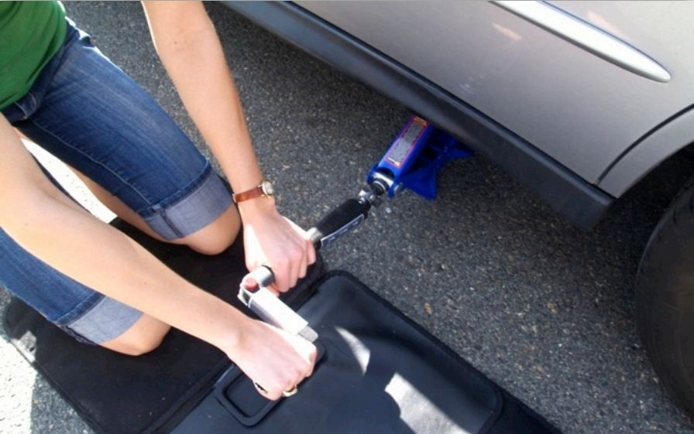
Key Steps
Just Right:
Park car, set brake 8. Tighten lug nuts
Remove jack & tire 9. Store tire & jack
from trunk
3. Loosen lug nuts
4. Jack up car
5. Remove tire
6. Set new tire
7. Jack down car
Notes:
The Key Steps which seem to be just right address the tasks required to get the job accomplished.

Slide 10
Hazards
Parking car
  Struck by traffic
Removing tire & jack
  Back strain
  Strike head on trunk
Loosen lug nuts
  Back/arm strain
  Slip & fall
Jacking up car
  Car could fall off jack
Setting new tire
  Fingers pinched
  Back strain
Tighten nuts
  Back strain
  Slip & fall
Notes:
For the hazards identified at each Key Step, substeps of concerns can be addressed.

Slide 11
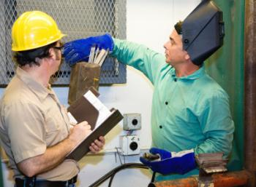
Work Observation
Select experienced worker(s) who will cooperate and participate in the JSA process.
Explain purpose of JSA.
Observe the employee performing the job and write down basic steps.
Completely describe
each step.
Note deviations
(Very Important!).
Notes:
To exercise the JSA to determine suitability to the tasks, workers to observe can form a committee.
The purpose of the JSA is explained to the observers and those who will work within the JSA’s directives.
Allow the employee to perform the basic steps within the job.
Observers should write down these basic steps and completely describe each.
Note any deviations made by the worker from the JSA process.

Slide 12

Hazards
Identify Hazards and Potential Accidents
Search for Hazards
  Produced by work
  Produced by environment
Repeat job observation as many times as necessary to identify all hazards.
Notes:
Identify Hazards and Potential Accidents
Search for Hazards
Produced by work
Produced by environment
Repeat job observation as many times as necessary to identify all hazards.

Slide 13
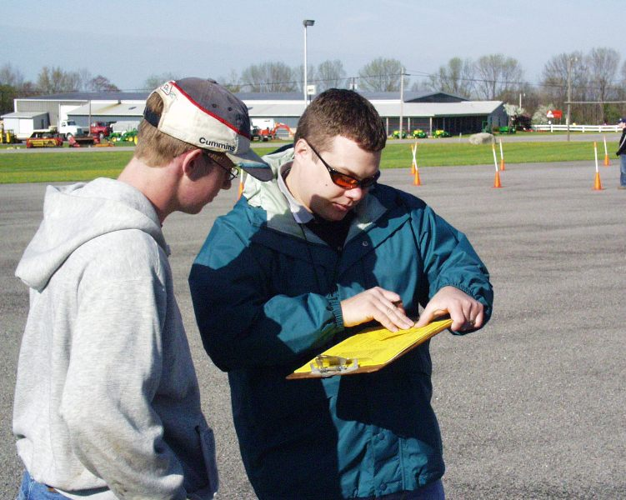
Develop Solutions
Find a new way to do job.
Change physical conditions that create hazards.
Change the work procedure.
Reduce frequency.
Notes:
Developing solutions may entail:
Find a new way to do job. Work smarter-not harder.
Change physical conditions that create hazards. This may require re-engineering the environment and machines.
Change the work procedure to be adaptable to the worker.
Reduce frequency of repetitive tasks where possible.

Slide 14

New Way to do Job
Determine the work goal of the job, and then analyze the various ways of reaching this goal to see which way is safest.
Consider work saving tools and equipment.
Notes:
What is the work goal? What are the various ways to achieve this goal? Which way is the safest?
Consider tools and equipment where dangerous or repetitive motions are required.

Slide 15

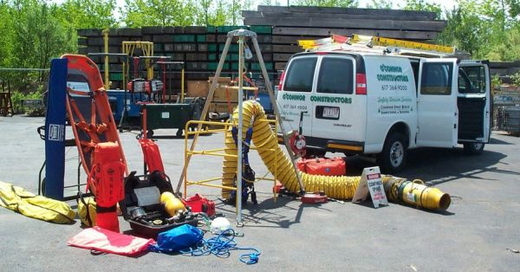

Change in Physical Conditions
Tools, materials, equipment layout or location.
Study change carefully for other benefits (costs, time savings).
Notes:
Physical changes incorporate evaluating the tools, materials and equipment layout or location.
Is each the best for the task? Is the location and layout user-friendly?
What other benefits will change bring in safety, costs and time savings?

Slide 16

Change in Work Procedures
What should the worker do to eliminate the hazard?
How should it be done?
Document changes in detail.
Notes:
Changes in work procedures may assist in creating a safer environment.
What should the worker do to eliminate the hazard?
How should it be done?
Document changes in detail.

Slide 17

Reduce Frequency
What can be done to reduce the frequency of the job?
Identify parts that cause frequent repairs/ change.
Reduce vibration, save machine parts.
Notes:
Frequency reduction concerns include:
What can be done to reduce the frequency of the job??
Identify parts that cause frequent repairs/ change.
Reduce vibration, save machine parts.

Slide 18
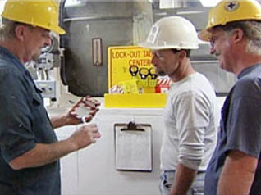
Effects of Changes
A job that has been redesigned may affect other jobs or work processes.
Check or re-observe the new process once it has been redesigned.
Notes:
Always consider the effects changes or modifications.
A job that has been redesigned may affect other jobs or work processes.
Check or re-observe the new process once it has been redesigned.

Slide 19

Summary – JSA/JHA’s
Get assistance from employees who are knowledgeable in and actually do job/task.
Break job/task down into simplified steps.
Too many or not enough steps = not useful.
Look at all hazards/issues and plan for adequate protection.
Goal = protect employees from injuries.
Notes:
In Summary. JSA’s and JHA’s to be successful must be thorough.
Get assistance from employees who are knowledgeable in and actually do job/task.
Break job/task down into simplified steps.
Too many or not enough steps = not useful.
Look at all hazards/issues and plan for adequate protection.
Goal = protect employees from injuries.

Slide 20


Contact Information
Health & Safety Training Specialists
1171 South Cameron Street, Room 324
Harrisburg, PA 17104-2501
(717) 772-1635
RA-LI-BWC-PATHS@pa.gov
Like us on Facebook! - https://www.facebook.com/BWCPATHS

Slide 21
Questions?

