Slide 1
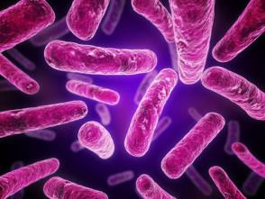
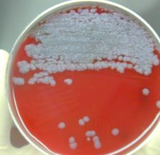
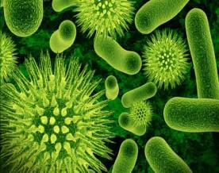
Infectious Diseases
Bureau of Workers’ Compensation
PA Training for Health & Safety (PATHS)
Notes:
Infectious diseases are disorders caused by organisms — such as bacteria, viruses, fungi or parasites. Many organisms live in and on our bodies. They're normally harmless or even helpful, but under certain conditions, some organisms may cause disease.

Slide 2
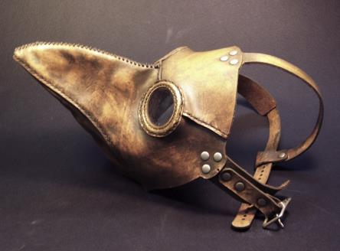
Infectious Diseases
Top 10 Diseases
HIV/AIDS
Ebola
SARs-Severe Acute Respiratory Syndrome
Malaria
Anthrax
Cholera
Bubonic Plague
Influenza
Typhoid fever
Smallpox
Notes:
http://www.sciencechannel.com/life-earth-science/10-infectious-diseases.htm
Measles should also be considered.
This Top Ten List is only one organization’s idea. Other Top Ten Lists exist in other agencies.

Slide 3
Topics
Bureau of Workers’ Compensation
PA Training for Health & Safety (PATHS)
Characteristics of:
Anthrax
Pneumonic Plague
Ebola
Smallpox
- Susceptibility to risk.
- Risk environments and conditions.
- Origins, means of transmission and preventive measures.
- Medical requirements.
Notes:
Our presentation will be discussing:
Characteristics of:
Anthrax,
Pneumonic Plague,
Ebola, and
Smallpox
- Susceptibility to risk.
- Risk environments and conditions.
- Origins, means of transmission and preventive measures.
- Medical requirements.
http://www.sciencechannel.com/life-earth-science/10-infectious-diseases.htm

Slide 4
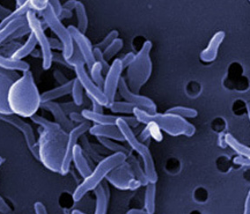
Infectious Disease Defined
Infectious Diseases are defined as:
“Disorders caused by organisms, such as bacteria, viruses, fungi or parasites …which can be passed from person to person. Some are transmitted by insect or animal bites while others are passed by ingesting contaminated food or water or being exposed to organisms in the environment.”
Notes:
Infectious Diseases are defined as:
“Disorders caused by organisms, such as bacteria, viruses, fungi or parasites …which can be passed from person to person. Some are transmitted by insect or animal bites while others are passed by ingesting contaminated food or water or being exposed to organisms in the environment.” Contact with contaminated blood is another source.
http://www.mayoclinic.org/diseases-conditions/infectious-diseases/basics/definition/CON-20033534

Slide 5
Spread of Disease
Endemic: ”Constant presence of a disease or infectious agent within a given geographic area. The usually prevalence of a given disease within such an area.”
Epidemic: “Occurrence in a community or region of cases of an illness or outbreak clearly in excess of expectancy.”
Pandemic: ”Occurring over a wide geographic area and affecting an exceptionally high proportion of the population, i.e. malaria.”
Notes:
The following explanations are how disease spread is listed:
Endemic: ”Constant presence of a disease or infectious agent within a given geographic area. The usually prevalence of a given disease within such an area.”
Epidemic: “Occurrence in a community or region of cases of an illness or outbreak clearly in excess of expectancy.”
Pandemic: ”Occurring over a wide geographic area and affecting an exceptionally high proportion of the population, i.e. malaria.”
Source: Webster’s Dictionary.

Slide 6
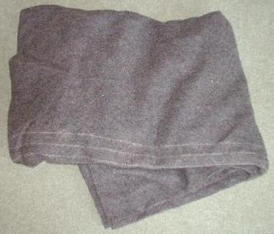
Infectious Diseases in History
1346, during a plague outbreak, Mongols catapulted victims into a city.
1520, Narvaez expedition to Aztec empire spread smallpox.
1763, during French and Indian War (Pontiac’s Rebellion), blankets and handkerchiefs were given to Native Americans.
Notes:
Some infectious diseases were used as biological warfare agents due to their infectivity.
Present use is considered by some due to their inability to be detected by human senses until clinical effects occur.
“Chapter 1, History of Biological Weapons: From Poisoned Darts to Intentional Epidemics,” found at http://www.hsdl.org/?view&did=19931”

Slide 7
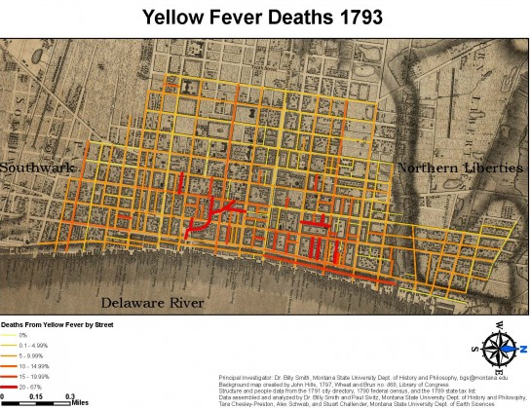
Infectious Diseases in History
1793: Philadelphia yellow fever epidemic.
Nearly 10% of city’s 50,000 population died.
Notes:
In 1793 in Philadelphia there was a yellow fever epidemic which was the cause of death for 10% of the city’s population of 50,000 people.
From “Philadelphia Fever,” by Jeanne Abrams, World War II magazine, February, 2015 issue.

Slide 8
Infectious Diseases in History
20,000 had fled the city to Germantown 6 miles distance upon the encouragement of President George Washington.
Secretary of State, Thomas Jefferson, “left with one clerk,” found his effectiveness impacted.
Notes:
20,000 people fled the city to Germantown 6 miles distance upon the encouragement of President George Washington.
Secretary of State, Thomas Jefferson, “left with one clerk,” found his effectiveness impacted.
From “Philadelphia Fever,” by Jeanne Abrams, World War II magazine, February, 2015 issue.

Slide 9
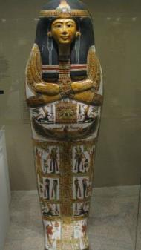
Smallpox in History
“The disease is thought by some scholars to have arisen among settled agricultural populations in Mesopotamia as early as the 5th millennium BC and in the Nile River valley in the 3rd millennium BC.
“The mummified body of the Egyptian pharaoh Ramses V (died c. 1156 BC) bears evidence of pustules characteristic of smallpox.”
Notes:
Some scholars feel that smallpox originated among settled agricultural populations in Mesopotamia as early as the 5th millennium BC and in the Nile River valley in the 3rd millennium BC.
Source: http://www.britannica.com/EBchecked/topic/549405/smallpox, 12/4/2014.

Slide 10
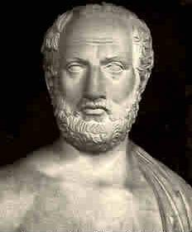
Smallpox in History
“It is possible that smallpox was behind the great plague of Athens in 430 BC, recorded by the Greek historian Thucydides, and a devastating plague carried to Italy by a Roman army returning from Mesopotamia around AD 165.”
“A huge pandemic reached
from Europe to the Middle
East in 1614, and epidemics
arose regularly in Europe
throughout the 17th and
18th centuries.”
Notes:
It is possible that smallpox was behind the great plague of Athens in 430 BC, recorded by the Greek historian Thucydides, and a devastating plague carried to Italy by a Roman army returning from Mesopotamia around AD 165.
A huge pandemic reached from Europe to the Middle East in 1614, and epidemics arose regularly in Europe throughout the 17th and 18th centuries.
Source: http://www.britannica.com/EBchecked/topic/549405/smallpox, 12/4/2014.

Slide 11
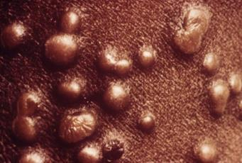
Smallpox in History
“Smallpox was … one of the first diseases to be controlled by a vaccine, due to the experiments of English physician Edward Jenner in 1796.”
1967: World Health Organization (WHO) began a global vaccination program.
1980: the disease was
officially declared eradicated.
Notes:
Smallpox was one of the first diseases to be controlled by a vaccine, due to the experiments of English physician Edward Jenner in 1796.
Source: http://www.britannica.com/EBchecked/topic/549405/smallpox, 12/4/2014
Although the World Health Organization (WHO) declared smallpox eradicated in 1980, two (2) WHO-approved repositories still remain:
a. CDC, Atlanta, GA
b. Russia (Jane’s Chem-Bio Handbook)

Slide 12
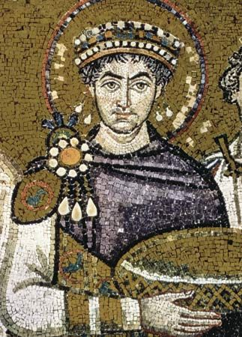
Bubonic Plague in History
“The first recorded bubonic plague epidemic ravaged the Byzantine Empire during the sixth century. It was named the Plague of Justinian after emperor Justinian I, who was infected but survived through extensive treatment.”
Notes:
Bubonic Plague was spread by the bite of the black rat flea which upon feeding on a host, the y. pestis would clog the flea’s mid gut causing it to regurgitate the y. pestis onto the host.
Source: en.wikipedia.org/wiki/Bubonic plague

Slide 13
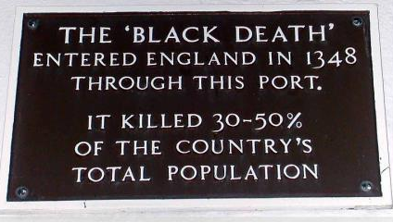
Bubonic Plague in History
“In the late Middle Ages (1340–1400) Europe experienced the most deadly disease outbreak in history when the Black Death, the infamous pandemic of bubonic plague, hit in 1348, killing a third of the human population.”
Notes:
London docks was the point of entry of the plague into England.
Source: en.wikipedia.org/wiki/Bubonic plague

Slide 14
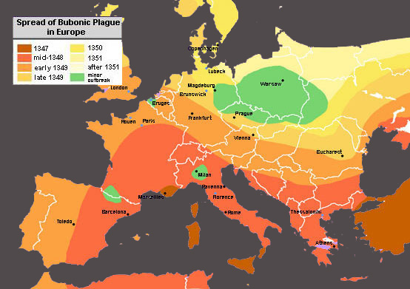
Movement of the Black Plague
Notes:
Take a close look at the gradients for the spread. These indicate not only an expansion over the land mass but also intrusion from maritime ports to landfall.
Source: en.wikipedia.org/wiki/Bubonic plague

Slide 15
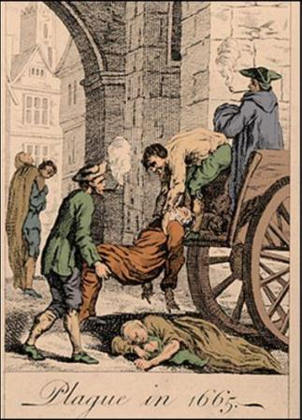
Bubonic Plague in History
In 1665-1666, the Plague hit London killing an estimated 100,000 people; 20% of London's population.
Notes:
In 1665-1666, the Plague hit London killing an estimated 100,000 people; 20% of London's population.
Source: en.wikipedia.org/wiki/Bubonic_plague and www.princeton.edu/~achaney/tmve/wiki100k/docs/Great_Plague_of_London

Slide 16
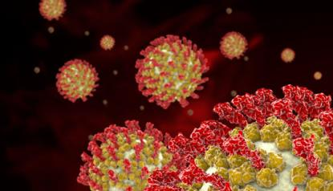
Human Exposure
Four (4) categories of concern related to exposures of humans:
1. BACTERIA
2. RICKETTSIA
3. TOXINS
4. VIRUSES
Notes:
Rickettsia
[riket′sē·ə] pl. rickettsiae
Etymology: Howard T. Ricketts, American pathologist, 1871-1910
a genus of microorganisms that combines aspects of both bacteria and viruses. They can be observed with a light microscope, divide by fission, and may be controlled with antibiotics. They also exist as virus like intracellular parasites, living in the intestinal tracts of insects such as lice. Thus a human infested with lice is also likely to be infected with a form of typhus transmitted by Rickettsia prowazeki. Rickettsial diseases have been responsible for many of history's worst epidemics. The various species are distinguished on the basis of similarities in the diseases they cause. The spotted fever group includes diseases such as Rocky Mountain spotted fever and rickettsialpox; the typhus group includes epidemic typhus and murine typhus; and a miscellaneous group includes Q fever and trench fever. Rickettsial diseases are uncommon in parts of the world where insect and rodent populations are well controlled. rickettsial, adj.
Example of Toxins: botulinal toxin , botulinum toxin, botulinus toxin an exotoxin produced by Clostridium botulinum that produces paralysis by blocking the release of acetylcholine in the central nervous system; there are seven immunologically distinct types (A–G). Type A is used therapeutically to inhibit muscular spasm in the treatment of dystonic disorders such as blepharospasm and strabismus, as well as to treat wrinkles of the upper face; type B is used to treat cervical dystonia.

Slide 17
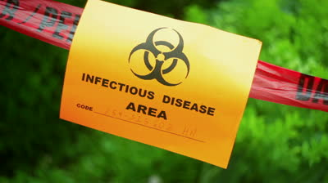
Human Exposure
This program will focus on those infectious diseases caused by:
Bacterial Agents:
Anthrax and
Plague
Viral Agents:
Ebola and
Smallpox
Notes:
This presentation will focus on infectious diseases caused by:
Bacterial Agents:
Anthrax and
Plague
Viral Agents:
Ebola and
Smallpox

Slide 18
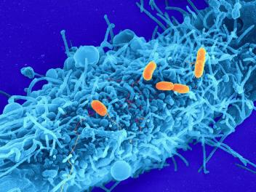
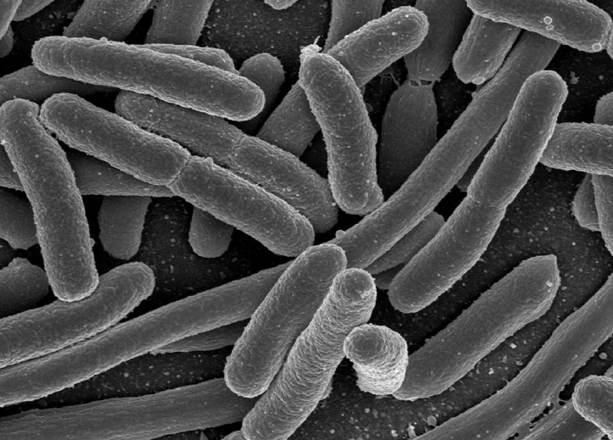
Bacteria
A single-celled organism. “Under certain circumstances some can transform into spores.”
The disease causing method can occur in one of two ways:
1. Invading host tissues, and
2. Producing poisons (toxins)
Certain bacterium, like E. coli, can be present in uncooked foods.
Notes:
Bacteria is a single-celled organism and under certain circumstances it can transform into spores.
Certain bacterium, like E. coli, can be present in uncooked foods.

Slide 19
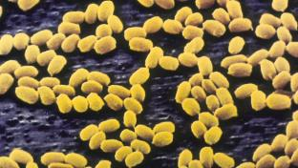
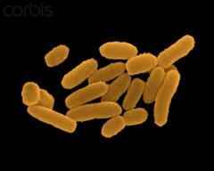
Organism-Disease
Disease-causing organism
Bacillus anthracis
Yersinia pestis
Disease Produced
Anthrax
Plague
Notes:
The disease causing organism produces a specifically designated disease.
USAMRIID, Medical Management of Biological Casualties Handbook, 4th edition, February, 2001, page24

Slide 20
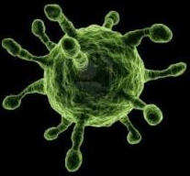
Virus
Smaller than bacteria, a virus is able to cause diseases ranging from the common cold to AIDS.
“Usually consist of a protein coat with genetic material (either RNA or DNA). These are intracellular parasites and lack a system for their own metabolism; they are dependent on the synthetic machinery of their host cells.”
“Every virus requires its own special type of host cell for multiplication.”
Notes:
Smaller than bacteria, a virus is able to cause diseases ranging from the common cold to AIDS.
Usually consist of a protein coat with genetic material (either RNA or DNA).
Every virus requires its own special type of host cell for multiplication.
USAMRIID, Medical Management of Biological Casualties Handbook, 4th edition, February, 2001, page 78

Slide 21
Infection Transmission
Direct Contact
Person-to-Person
Animal to Person
Mother to Unborn Child
Indirect Contact
Touching an infected inanimate object then yourself without thoroughly washing.
Notes:
The importance of good hygiene and isolation can limit the transmission.
This is particularly important for pregnant women due to the unborn being a “captive” of whatever infects the mother-to-be.

Slide 22
Infectivity
Infective doses are cited as required for the condition to affect a person.
Examples:
Disease Infective Dose
Inhalation Anthrax 8,000 to 10,000 spores
Pneumonic Plague <100 organisms
Ebola 1-10 plague forming units
Smallpox Infective dose is assumed low
Notes:
As you will note, amounts of infective material have been determined to be required to launch the on-set of a particular disease.

Slide 23
Emergency Response Guidebook
For those responding to emergencies where infectious materials may be present, the Emergency Response Guidebook recommends:
Guide #158 for Infectious substances, affecting animals only and those affecting humans.
Listed here are precautions for:
Health
Fire or explosion
Public Safety
Protective clothing
Fires
Spill or leak and
First Aid
Notes:
For those responding to emergencies where infectious materials may be present, the Emergency Response Guidebook recommends Guide #158 for Infectious substances, affecting animals only and those affecting humans.

Slide 24
Anthrax
Bacteria: ANTHRAX
Caused by bacterium Bacillus anthracis. Aerobic.
Can be transmitted by direct contact with contaminated wool, hides or tissues or through inhalation.
Anthrax spores occur naturally in soil and may lie dormant for years before ingested by domestic animals; horses, cows and sheep as examples.
Notes:
Those working at places which render hides, wool or may have contact with animal tissues could be susceptible.

Slide 25
Four Types of Anthrax
Cutaneous: through cuts or sores in skin. Those who handle meat or hides and game animals.
Gastrointestinal: eating infected meat.
Inhalation (pulmonary): inhaling spores. Deadliest form and often fatal even with treatment.
Injection: identified in Europe with those injecting illegal drugs from regions where naturally occurring anthrax is common.
Notes:
The means of contracting each type is shown.

Slide 26
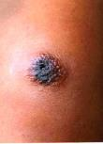
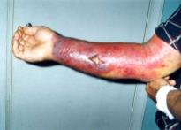
Cutaneous Anthrax Symptoms
Symptoms: Sores or blisters on hands and
forearms. Cutaneous is contagious.
Incubates: 2-7 days in most cases.
Fatal: Within 48 hours if untreated.
Treatment: Penicillin, immunization. Immune
serum helpful in early stages.
Notes:
Learn the symptoms of each infectious disease.
Incubation defined:
In Medicine - The development of an infection from the time the pathogen enters the body until signs or symptoms first appear.
Source: http://www.thefreedictionary.com/incubation

Slide 27
Intestinal Anthrax Symptoms
Symptoms: Intense stomach pain, bowel obstruction, dehydration, diarrhea, fever; blood poisoning, death (rare in humans).
Exposure of the digestive system to anthrax usually by consuming meat products that contain anthrax.
Severe and often fatal form of anthrax. Results in death in 25% to 60% of cases.
Fatal: 1,000 spores required.
Within 24 hours of acute phase if untreated.
Notes:
1. Spores survive sunlight for days and steam or heat up to 319ºF.
2. Spores can contaminate soil or water for years or decades.
.
“Weapons of Mass Destruction Emergency Care,” Robert A. DeLorenzo and Robert S. Porter, Brady, Prentice Hall Health, Upper Saddle River, New Jersey 07458, 2000, page 68.
www.rightdiagnosis.com › Diseases

Slide 28
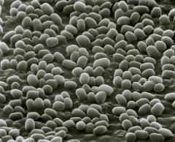
Intestinal Anthrax Symptoms
Incubates: 1-7 days.
Treatment: Doctors can prescribe effective antibiotics.
Bacillus anthracis usually responds effectively to several antibiotics including penicillin, doxycycline, and fluoroquinolones (such as ciprofloxacin).
To be effective, treatment should be initiated early. If left untreated, the disease can be fatal.
Notes:
The treatment for intestinal anthrax symptoms includes effective antibiotics.
“Weapons of Mass Destruction Emergency Care,” Robert A. DeLorenzo and Robert S. Porter, Brady, Prentice Hall Health, Upper Saddle River, New Jersey 07458, 2000 page 68.
www.rightdiagnosis.com › Diseases

Slide 29
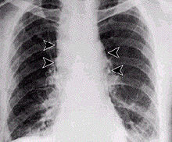
Inhalation Anthrax Symptoms
Also known as Pulmonary Anthrax;
Flu-like symptoms
Mild chest discomfort
Shortness of breath
Nausea
Coughing up blood
Painful swallowing
Progresses to:
High fever
Difficulty breathing
Shock
Meningitis
Notes:
Inhalation Anthrax is also known as Pulmonary Anthrax.
Mayo Clinic Staff
“1970 the World Health Organization (WHO) estimated 100,000 to 150,000 persons could become incapacitated if aerosolized form were delivered over a city of 500,000.”
Jane’s Chem-Bio Handbook, page 128.

Slide 30
Inhalation Anthrax
Symptoms: Initial symptoms may resemble a common cold. After several days, the symptoms may progress to severe breathing problems and shock. Inhalation anthrax is often fatal.
Fatal: Untreated: 90% fatal
8,000 to 10,000 spores required
Incubates: Sick in 1-5 days; sickness lasts 3-5 days (usually fatal)
Treatment: Protective vaccine.
Notes:
“Inhalation Anthrax has a high fatality rate; 90% or more of those who contract it from inhaling will die.”
Much more lethal than common chemical agents.
Source: http://www.thefreedictionary.com/incubation
“Weapons of Mass Destruction Emergency Care,” Robert A. DeLorenzo and Robert S. Porter, Brady, Prentice Hall Health, Upper Saddle River, New Jersey 07458, 2000 page 68.
https://www.osha.gov/SLTC/etools/anthrax/disease_rec.html

Slide 31
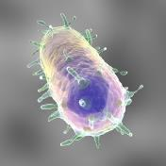
Plague
Bacteria: PLAGUE caused by pasturella pestis or yersinia pestis.
“Black Death” transmittable by bite of an
infected flea or person to person by
respiratory route.
Bubonic: From rats by the bite of an infected fleas.
Septicemic: When plague bacteria multiplies in the blood stream.
Pneumonic: May result from septicemic form or from inhalation of the organism.
Spreads rapidly until Hemorrhagic pneumonia involves entire lung area.
Pneumonic affects the lungs and is spread person to person by way of cough droplets.
Notes:
Human plague in the United States occurs as mostly scattered cases in rural areas effecting 10 to 20 persons each year. Globally, the World Health Organization (WHO) reports 1,000 to 3,000 cases every year.

Slide 32
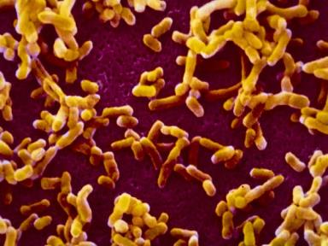
Plague
Type Infection of:
Bubonic: Lymph nodes
Septicemic: The blood
Pneumonic: Lungs
Notes:
Plague types designated according to area infected.

Slide 33
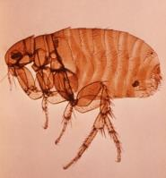
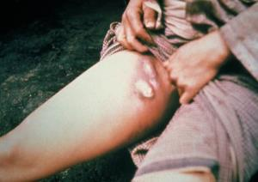
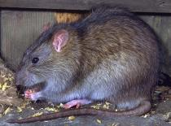
Bubonic Plague
From the bite of the black rat flea.
“Black Death” transmittable by bite of an infected flea or person to person by respiratory route.
This can include domesticated animals, i.e. cats to wild animals, i.e. rabbits, rats, squirrels.
Characterized by buboes which appear.
Notes:
Plague transmitted to persons by fleas from infected animals.
This can include domesticated animals, i.e. cats to include wild animals, i.e. rabbits, rats, squirrels.
Plague can enter through broken skin or flea bites.
Characterized by buboes which appear as shown in the right slide.
Symptoms can appear suddenly-usually within 2 to 5 days of exposure.
“Disease only lasts for 1 to 2 days before death occurs (if untreated).” Jane’s Chem-Bio Handbook, page 132.
Source: http://www.visualdx.com/view/diagnosis/plague_septicemic

Slide 34
Septicemic Plague
This form of the disease occurs when the bacteria multiply in the blood, causing bacteremia and severe sepsis.
Primary septicemic plague results from direct inoculation of the bacteria into the bloodstream, typically via the bite of an infected animal or flea or direct contact with infected tissues.
Secondary septicemic plague occurs when there is progression of disease and dissemination of bacteria following bubonic presentation.
Notes:
Septicemic Plague.
This form of the disease occurs when the bacteria multiply in the blood, causing bacteremia and severe sepsis.
Primary septicemic plague results from direct inoculation of the bacteria into the bloodstream, typically via the bite of an infected animal or flea or direct contact with infected tissues.
Secondary septicemic plague occurs when there is progression of disease and dissemination of bacteria following bubonic presentation.
http://www.visualdx.com/view/diagnosis/plague_septicemic

Slide 35
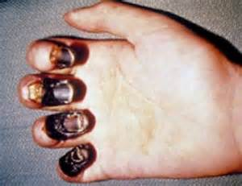
Septicemic Plague
Septicemic plague is rarely transmissible human to human but may become transmissible if the disease reaches the pneumonic stage.
Septicemic plague, either primary or secondary, has approximately 40% mortality when treated, and in untreated cases, the mortality is 100%.
Notes:
Septicemic plague is rarely transmissible human to human but may become transmissible if the disease reaches the pneumonic stage.
Septicemic plague, either primary or secondary, has approximately 40% mortality when treated, and in untreated cases, the mortality is 100%.
http://www.visualdx.com/view/diagnosis/plague_septicemic

Slide 36
Pneumonic Plague Symptoms
Spread person to person by way of cough droplets.
Cough with bloody sputum
Difficulty breathing
High fever
Nausea/vomiting
Weakness
Progresses quickly leading to respiratory failure and shock in 2 days of infection.
Initiate antibiotics within a day of signs and symptoms or it is likely to be fatal. May result from septicemic form or from inhalation of organism.
Notes:
Pneumonic Plague Symptoms
Spread person to person by way of cough droplets.
Cough with bloody sputum
Difficulty breathing
High fever
Nausea/vomiting
Weakness
Progresses quickly leading to respiratory failure and shock in 2 days of infection.
Initiate antibiotics within a day of signs and symptoms or it is likely to be fatal. May result from septicemic form or from inhalation of organism

Slide 37
Plague Symptoms
Symptoms: High fever, headache, general aches, extreme weakness, glandular swelling, pneumonia, hemorrhages in skin and mucous membranes possible, extreme lymph node pain.
Incubates: Bubonic, 2-6 days; unvaccinated: few days longer if vaccinated. Pneumonic: 1 to 6 days.
Fatal: Bubonic if untreated; Pneumonic if untreated.
Treatment: Tetracycline with streptomycin.
Notes:
Symptoms: High fever, headache, general aches, extreme weakness, glandular swelling, pneumonia, hemorrhages in skin and mucous membranes possible, extreme lymph node pain.
Incubates: Bubonic, 2-6 days; unvaccinated: few days longer if vaccinated. Pneumonic: 1 to 6 days; septicemic incubates 1-6 days.
Fatal: Bubonic if untreated; Pneumonic if untreated.
Treatment: Tetracycline with streptomycin.
1. Good BW agent due to being extremely infective, especially in pneumonic form.
2. Disseminating plague in aerosolized liquid droplets from 1 to 5 microns in diameter could be extremely lethal against unprotected, unwarned populace.

Slide 38
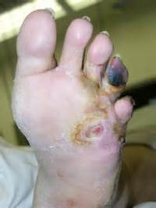
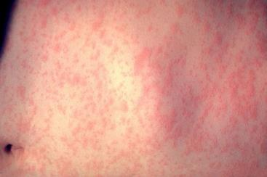
Plague Complications
Death
Gangrene
Meningitis
Notes:
Plague complications can include:
Death
Gangrene or
Meningitis

Slide 39
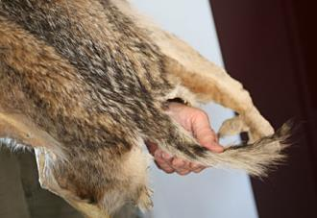
Plague Risk Factors
Where you’re located
Your occupation
Hobbies
Notes:
Risk Factors:
Where you’re located.
Are you located where you could contact animals?
Rural areas but also
Urban areas which are overcrowded, have poor sanitation and a high rat population.
Your occupation.
Do you do anything involving animals; domesticated or wild? Veterinarians? Game Commission picking up “road-kill?” Farming?
Do your hobbies take you into environments possessing the risk factors?
Plague is reportedly found in SW United States: Colorado, New Mexico, Arizona and California
“Greatest number of human plague infections occurs in Africa.” Mayo Clinic Staff.

Slide 40
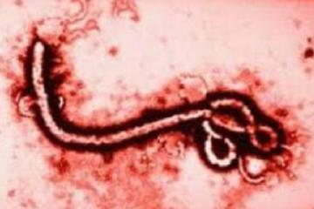
Ebola
Viral: EBOLA Virus caused by Filo virus and other African Hemorrhagic Fevers. These are marked by severe bleeding, organ failure and often death.
**One of the most pathogenic viruses known to science, causing 50-90% fatalities in all clinically ill cases.
Notes:
Viral: EBOLA Virus caused by Filo virus and other African Hemorrhagic Fevers. These are marked by severe bleeding, organ failure and often death.
Ebola is one of the most pathogenic viruses known to science, causing 50-90% fatalities in all clinically ill cases.
Mayo Clinic

Slide 41
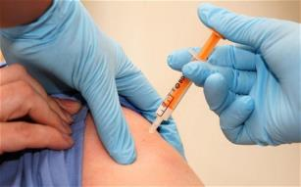
Ebola
This virus lives in animal hosts and can be contracted through contact with blood and waste products.
It is then spread through person
to person contact with body fluids
or contaminated needles of those
infected.
Cases of transmission included direct contact with blood, secretions, organs or semen of infected persons and by handling ill or infected chimps.
Notes:
This virus lives in animal hosts and can be contracted through contact with blood and waste products.
It is then spread through person to person contact with body fluids or contaminated needles of those infected.
Cases of transmission include direct contact with blood, secretions, organs or semen of infected persons and by handling ill or infected chimps.

Slide 42
Ebola
Persons are not contagious until symptoms are developed. Lack of PPE by medical personnel may be the cause of them becoming infected.
This should also be a concern of emergency response personnel when working around accident victims.
Epidemics in Africa are attributed to reusing needles and syringes due to lack of equipment.
Notes:
Persons are not contagious until symptoms are developed. Lack of PPE by medical personnel may be the cause of them becoming infected.
This should also be a concern of emergency response personnel when working around accident victims.
Third world countries, not having finances to purchase new needles or injection equipment, use sterilized equipment. If sterilization fails and old needles are used, the disease may be transmitted to others.
Mayo Clinic

Slide 43
Ebola
Symptoms: Fever, weakness, muscle pain, headache, sore throat. Then vomiting, diarrhea, rash, limited kidney and liver functions & both internal & external bleeding.
Incubation:2-21 days, 5th day: hemorrhagic symptoms
Fatality: 50-90%
Treatment: Supportive care.
Notes:
Symptoms: Fever, weakness, muscle pain, headache, sore throat. Then vomiting, diarrhea, rash, limited kidney and liver functions & both internal & external bleeding.
Incubation: 2-21 days, 5th day: hemorrhagic symptoms
Fatality: 50-90%
Treatment: Supportive care.
Other African hemorrhagic fevers include Lassa Virus and Marburg Virus.
High priority for biological weapons due to being highly infectious by aerosolizing.
This agent was assigned a high priority for Biological Weaponry in the former USSR program. Clandestine stockpiles are not known.

Slide 44
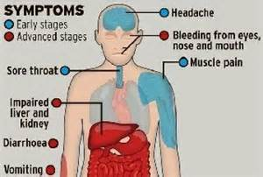
Ebola Symptoms
Within 5 to 10 days, may include:
Chills
Fever
Joint/muscle aches
Weakness
Severe headache
Notes:
Ebola Symptoms
Within 5 to 10 days, may include:
Chills
Fever
Joint/muscle aches
Weakness
Severe headache

Slide 45
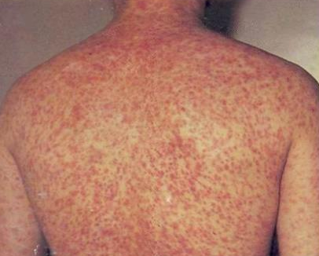
Ebola Symptoms
Symptoms may increase to:
Nausea/vomiting
Diarrhea which may be bloody
Raised rash
Chest and stomach pain
Bleeding: external and internal due to it being a Hemorrhagic agent.
Notes:
Ebola Symptoms may increase to:
Nausea/vomiting
Diarrhea which may be bloody
Raised rash
Chest and stomach pain
Bleeding: external and internal due to it being a Hemorrhagic agent.

Slide 46
Ebola Complications
According to the Mayo Clinic staff, complications for Ebola may include:
Multiple organ failure
Severe bleeding
Jaundice
Delirium
Seizures
Comma shock
Hemorrhagic fevers are lethal for a high percentage of those infected. They interfere with the immune system’s ability to mount a defense.
Notes:
According to the Mayo Clinic staff, complications for Ebola may include:
Multiple organ failure
Severe bleeding
Jaundice
Delirium
Seizures
Comma shock
Hemorrhagic fevers are lethal for a high percentage of those infected. They interfere with the immune system’s ability to mount a defense.

Slide 47
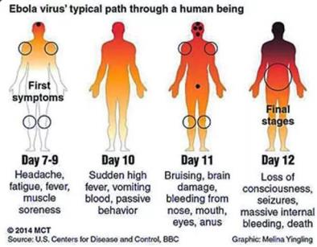
Ebola Recovery
Recovery is slow and may require months.
People may experience:
Sensory changes
Liver inflammation
Weakness
Fatigue
Headaches eye inflammation.
Notes:
Mayo Clinic Staff.
Recovery from Ebola is slow and may require months.
People may experience:
Sensory changes
Liver inflammation
Weakness
Fatigue
Headaches eye inflammation

Slide 48
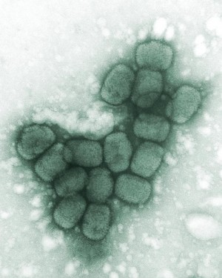
Smallpox
Viral: SMALLPOX
Caused by variola virus.
Highly contagious, disfiguring and often deadly.
No cure or treatment exists. A vaccine exists as a preventative.
Notes:
Viral: SMALLPOX
Caused by Variola virus.
Highly contagious, disfiguring and often deadly.
No cure or treatment exists. A vaccine exists as a preventative.
Side effects are high for the vaccine which did not warrant vaccinations on a large scale.
If you were vaccinated as a child, it may provide partial immunity.
Clandestine stockpiles are not known.

Slide 49
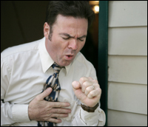
Smallpox Contracted via
Direct contact person to person
Indirectly via an airborne virus
Contaminated items
As a terrorist weapon
Notes:
Smallpox is contracted by way of:
Direct contact person to person
Indirectly via an airborne virus
Contaminated items
As a terrorist weapon

Slide 50
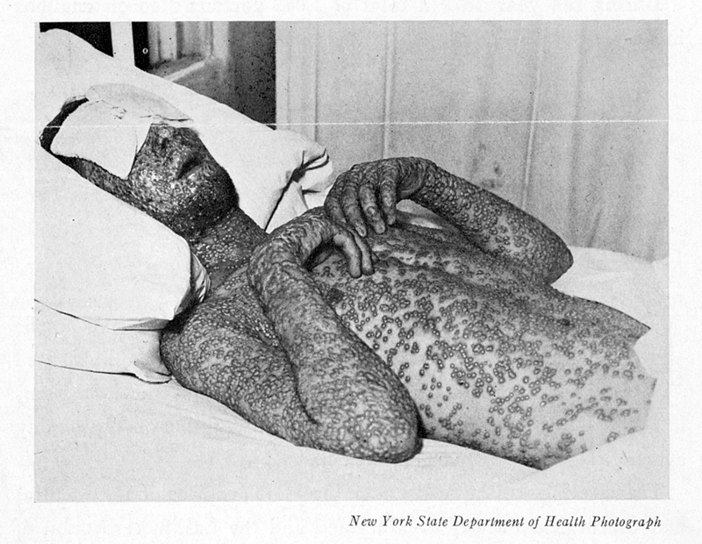
Smallpox Symptoms
Incubation period: 7 to 17 days during which time you can not infect others.
Following incubation:
Fever
Overall discomfort
Headache
Severe back pain and fatigue
Vomiting is possible
Notes:
Smallpox Symptoms
Incubation period: 7 to 17 days during which you can’t infect others.
Following incubation:
Fever
Overall discomfort
Headache
Severe back pain and fatigue
Vomiting is possible

Slide 51
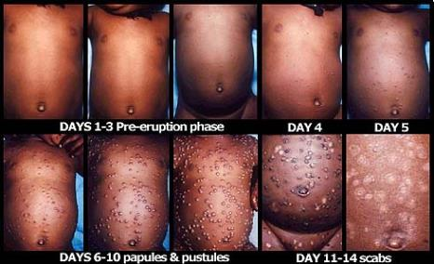
Smallpox Symptoms
A few days later, flat, red spots on your face, hands and forearms which then appear on your trunk.
Lesions may then turn into small blisters with clear fluid
8-9 days later scabs fall off leaving deep, pitted scars.
Notes:
Smallpox Symptoms
A few days later, flat, red spots on your face, hands and forearms which then appear on your trunk.
Lesions may then turn into small blisters with clear fluid
8-9 days later scabs which fall off leaving deep, pitted scars.

Slide 52
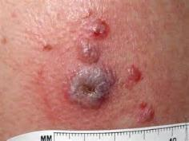
Smallpox Symptoms
Lesions may also form on mucus membranes of nose and mouth.
Most who contract smallpox survive. Blindness may occur in some.
More lethal smallpox affects pregnant women and those with compromised immune systems.
Lethality: High to moderate.
Notes:
Smallpox Symptoms
Lesions may also form on mucus membranes of nose and mouth.
Most who contract smallpox survive. Blindness may occur in some.
More lethal smallpox affects pregnant women and those with compromised immune systems.
Lethality: High to moderate lethality.

Slide 53
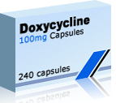
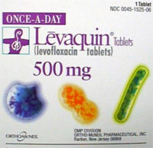
Anthrax Prevention
Antibiotics for those exposed to anthrax spores.
Cipro
Doxycycline
Levaquin
Vaccine for military and those in high risk professions.
Notes:
Anthrax prevention includes antibiotics for those exposed to anthrax spores:
Cipro,
Doxycycline
Levaquin
There is a vaccine for the military and those in high risk professions.

Slide 54
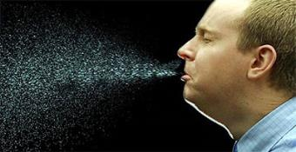
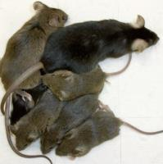
Pneumonic Plague Prevention
Affects lungs, least common form but most deadly.
Spread person to person through cough droplets (aerosolized).
Rodent-proof your home
Use insect repellent to kill fleas
Notes:
Pneumonic plague prevention:
Cover your mouth when you cough or sneeze.
Rid your home of rodents whose fleas may carry the plague.
Use insect repellent to kill fleas.

Slide 55
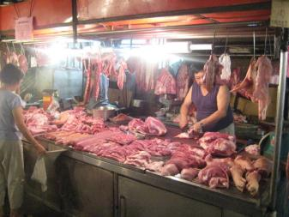
Ebola Prevention
Avoid contact with virus.
Stay away from outbreak areas.
Wash hands frequently
Avoid local meat sold in their markets, if traveling abroad
Do NOT contact infected persons
Follow PPE procedures and requirements
Do NOT handle remains
Notes:
To prevent Ebola,
Avoid contact with virus.
Stay away from outbreak areas.
Wash hands frequently.
Avoid local meat sold in their markets, if traveling abroad.
Do NOT contact infected persons.
Follow PPE procedures and requirements.
Do NOT handle remains of Ebola victims.

Slide 56
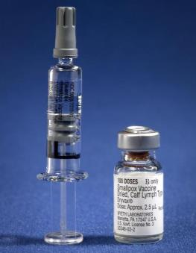
Smallpox Prevention
Vaccine may lessen infection if given within 4 days of exposure.
Childhood vaccination may provide partial immunity
Notes:
Smallpox prevention includes,
Vaccine may lessen infection if given within 4 days of exposure.
Childhood vaccination may provide partial immunity.

Slide 57
Anthrax Treatment
Antibiotic (60 day course); Cipro, doxycycline. The antibiotic depends on how you were infected.
Advanced inhalation anthrax may not respond to antibiotics; the drugs may be over ridden by the amount of toxin produced.
Injection anthrax has been treated by surgically removing infected tissue.
Notes:
Anthrax Treatment.
Antibiotic provided over a 60 day course; Cipro, doxycycline. The antibiotic depends on how you were infected.
Advanced inhalation anthrax may not respond to antibiotics; the antibiotics may be over ridden by the amount of toxin produced.
Injection anthrax has been treated by surgically removing infected tissue.
http://www.nlm.nih.gov/medlineplus/ency/article/000596.htm

Slide 58
Plague Treatment
No vaccine available, antibiotics can prevent infection. Gentamicin, Cipro, doxycycline.
If treatment is not received within 24 hours of when the first symptoms occur, death can result.
Antibiotics: streptomycin, gentamicin, doxycycline, or ciprofloxacin
Oxygen, intravenous fluids, and respiratory support usually are also needed.
Notes:
Plague Treatment.
No vaccine available, antibiotics can prevent infection, such as Gentamicin, Cipro, doxycycline.
If treatment is not received within 24 hours of the first symptoms occurring, death can result.
Antibiotics: streptomycin, gentamicin, doxycycline, or ciprofloxacin.
Oxygen, intravenous fluids and respiratory support usually are also needed.
http://www.nlm.nih.gov/medlineplus/ency/article/000596.htm

Slide 59
Pneumonic Plague Treatment
Pneumonic plague patients should be strictly isolated from caregivers and other patients.
People who have had contact with anyone infected by pneumonic plague should be watched carefully and given antibiotics as a preventive measure.
Without treatment, about 50% of persons with bubonic plague die. Almost everyone with pneumonic plague dies if not treated. Treatment reduces the death rate to 50%.
Notes:
Pneumonic Plague Treatment.
Pneumonic plague patients should be strictly isolated from caregivers and other patients. People who have had contact with anyone infected by pneumonic plague should be watched carefully and given antibiotics as a preventive measure.
Without treatment, about 50% of persons with bubonic plague die. Almost everyone with pneumonic plague dies if not treated. Treatment reduces the death rate to 50%.
http://www.nlm.nih.gov/medlineplus/ency/article/000596.htm

Slide 60
Ebola Treatment
No drug is approved to treat and supportive care is provided:
Rehydrating
Blood pressure maintenance
Oxygen as needed
Lost blood replacement
Treating other infections which may develop due to suppressed immune system.
Notes:
Ebola Treatment.
No drug is approved to treat. Supportive care is provided:
Rehydrating
Blood pressure maintenance
Oxygen as needed
Lost blood replacement
Treating other infections which may develop due to suppressed immune system is included in the overall treatment.
http://www.nlm.nih.gov/medlineplus/ency/article/000596.htm

Slide 61
Smallpox Treatment
No cure - treat symptoms.
Rehydrate.
Antibiotics may be used for those who have a bacterial skin or lung infection.
Treatment
Vaccine exists which is a preventative-not cure.
No specific therapy, supportive care must include prevention of secondary infections.
Notes:
Smallpox Treatment.
No cure - treat symptoms.
Rehydrate.
Antibiotics may be used for those who have a bacterial skin or lung infection.
Treatment
Vaccine exists which is a preventative-not cure.
No specific therapy, supportive care must include prevention of secondary infections.
http://www.nlm.nih.gov/medlineplus/ency/article/000596.htm

Slide 62
Immunization
Agent Immunization Strategy
Anthrax Vaccine or ciprofloxacin or doxycycline prophylaxis
Plague Vaccine or doxycycline prophylaxis
Smallpox Vaccine
(Ebola No vaccine)*
Table 5-8, see notes
Notes:
Table 5-8, “Immunization and prophylaxis strategies for some potential biological agents,” “Weapons of Mass Destruction Emergency Care,” Robert A. DeLorenzo and Robert S. Porter, Brady, Prentice Hall Health, Upper Saddle River, New Jersey 07458, 2000, Page 80.
Ebola – The comment, “No vaccine” is not on this chart but was added for this program. There is no antiviral medication for Ebola. Supportive hospital care is dictated, i.e.;
Providing fluids
Maintaining blood pressure
Providing oxygen as needed
Replacing lost blood
Treating other infections that may develop.

Slide 63
Infectious Disease PPE
Anthrax:
Configure the necessary PPE based on the level of injury and the point at which you make contact.
Excellent resources:
https://www.osha.gov/dts/osta/bestpractices/firstreceivers_hospital.pdf
Also check:
29 CFR 1910.1030-Bloodborne Pathogens,
29 CFR 1910.132-PPE,
29 CFR 1910.134-Respiratory Protection
Notes:
PPE for various infectious diseases:
Anthrax:
Configure the necessary PPE based on the level of injury and the point at which you make contact.
Two (2) excellent sources:
https://www.osha.gov/SLTC/etools/anthrax/ppe.html
https://www.osha.gov/dts/osta/bestpractices/firstreceivers_hospital.pdf
Also check:
29 CFR 1910.1030-Bloodborne Pathogens,
29 CFR 1910.132-PPE,
29 CFR 1910.134-Respiratory Protection

Slide 64
Infectious Disease PPE
Pneumonic Plague:
PPE based on the level of injury and the point at which you make contact:
Emergency Responders
Healthcare Workers, Mortuary
Workers, and Others
Laboratory Workers
Two (2) excellent resources:
https://www.osha.gov/SLTC/plague/controls.html and
https://www.osha.gov/dts/osta/bestpractices/firstreceivers_hospital.pdf
Also check:
29 CFR 1910.1030-Bloodborne Pathogens,
29 CFR 1910.132-PPE,
29 CFR 1910.134-Respiratory Protection
Notes:
Pneumonic Plague:
PPE based on the level of injury and the point at which you make contact:
Emergency Responders
Healthcare Workers, Mortuary Workers, and Others
Laboratory Workers
National infection control guidelines indicate specific precautions when treating patients with pneumonic plague. Such precautions include:
Standard
Droplet
Airborne, and
Contact Precautions
Two (2) excellent sources:
https://www.osha.gov/SLTC/plague/controls.html
https://www.osha.gov/dts/osta/bestpractices/firstreceivers_hospital.pdf
Also check:
29 CFR 1910.1030-Bloodborne Pathogens,
29 CFR 1910.132-PPE,
29 CFR 1910.134-Respiratory Protection

Slide 65
Ebola PPE
Ensure adherence to the proper personal protective equipment requirements. (See selection chart website in note section: OSHA Fact Sheet.)
Also check requirements for other specific infectious diseases in:
29 CFR 1910.1030-Bloodborne Pathogens,
29 CFR 1910.132-PPE,
29 CFR 1910.134-Respiratory Protection
Notes:
Ebola PPE
(Selection chart website in note section: OSHA Fact Sheet.) This PPE selection matrix is specific to anthrax. Similar considerations can be made for other diseases. http://www.dol.gov/osha/pdf/OSHA_FS-3761_PPE_Selection_Matrix_-_Ebola_(11-24-14).pdf
This citation is found on OSHA Fact Sheet “PPE Selection Matrix for Occupational Exposure to Ebola Virus, Guidance for common exposure scenarios.
You will note this chart has 6 distinct levels of response and requisite PPE levels for those providing medical and supportive care.
Those in the area with different duties also have required levels of protection.

Slide 66
Infectious Disease PPE
Smallpox:
National infection control guidelines indicate specific precautions when treating patients with known of suspected smallpox. Such precautions include:
Standard
Droplet
Airborne, and
Contact Precautions
Also check:
29 CFR 1910.1030-Bloodborne Pathogens,
29 CFR 1910.132-PPE,
29 CFR 1910.134-Respiratory Protection
Notes:
Smallpox:
National infection control guidelines indicate specific precautions when treating patients with known of suspected smallpox. Such precautions include:
Standard
Droplet
Airborne, and
Contact Precautions
Also check:
29 CFR 1910.1030-Bloodborne Pathogens,
29 CFR 1910.132-PPE,
29 CFR 1910.134-Respiratory Protection
https://www.osha.gov/dts/osta/bestpractices/firstreceivers_hospital.pdf

Slide 67
Bibliography
http://www.mayoclinic.org/diseases-conditions/infectious-diseases/basics/prevention/con-20033534
http://www.mayoclinic.org/diseases-conditions/anthrax/basics/risk-factors/con-20022705
http://www.mayoclinic.org/diseases-conditions/cholera/basics/treatment/con-20031469
http://www.sciencechannel.com/life-earth-science/10-infectious-diseases.htm
Notes:
It is suggested you explore other information available at the Mayo Clinic.

Slide 68
Bibliography
www.mayoclinic.org/diseases-conditions/ebola-virus/basics/...
www.mayoclinic.org/diseases-conditions/smallpox/basics/definition/...
“Philadelphia Fever,” by Jeanne Abrams, World War II magazine, February, 2015 issue.
www.rightdiagnosis.com › Diseases
http://www.visualdx.com/view/diagnosis/plague_septicemic

Slide 69
Bibliography
http://www.britannica.com/EBchecked/topic/549405/smallpox, 12/4/2014.
Martin, James W., MD, FACP, George W. Christopher, MD, FACP, and Edward M. Eitzen, Jr, MD, MPH, Chapter 1, History of Biological Weapons: From Poisoned Darts to Intentional Epidemics, USAMRIID, Fort Detrick, MD, 21702-5011, 4th edition, February, 2001, found at http://www.hsdl.org/?view&did=19931
https://www.osha.gov/SLTC/plague/index.html

Slide 70
Bibliography
en.wikipedia.org/wiki/Bubonic_plague
https://www.osha.gov/SLTC/etools/anthrax/disease_rec.html
http://www.nlm.nih.gov/medlineplus/ency/article/001363.htm
http://medical-dictionary.thefreedictionary.com/toxins
https://www.osha.gov/SLTC/plague/controls.html

Slide 71
Bibliography
http://www.mayoclinic.org/diseases-conditions/typhoid-fever/basics/treatment/con-20028553
Robert A. DeLorenzo and Robert S. Porter, Weapons of Mass Destruction Emergency Care, Brady, Prentice Hall Health, Upper Saddle River, New Jersey 07458, 2000.
http://medical-dictionary.thefreedictionary.com/Rickettsia

Slide 72
Bibliography
http://www.nlm.nih.gov/medlineplus/ency/article/000596.htm
Williams P, Wallace D. Unit 731: Japan’s Secret Biological Warfare in World War II. New York, NY: Free Press; 1989.
http://www.mayoclinic.org/diseases-conditions/plague/basics/definition/CON-20021610
Army Field Manual, FM 8-284, “Biological Weapons Disease Management,” Department of the Army

Slide 73
Bibliography
USAMRIID’s Medical Management of Biological Casualties Handbook, 4th Edition, Lead Editor, LTC Mark Kortepeter, Operational Medicine Division, U.S. Army Medical Research, Institute of Infectious Diseases (USAMRIID), Fort Detrick, Maryland 21702-5011, (2001,February ) and 7th Edition, (2011, September).
The Medical NBC Battlebook, USACHPPM Tech Guide 244, USACHPPM, Attn: MCHB-TS-OHP, 5158 Blackhawk Road, Aberdeen Proving Ground, MD 21010-5403, August 2002

Slide 74
Bibliography
Alibek K, Handelman K. Biohazard: The Chilling True Story of the Largest Covert Biological Weapons Program in the World Trade From the Inside by the Man Who Ran It. New York, NY: Random House; 1999.
www.princeton.edu/~achaney/tmve/wiki100k/docs/Great_Plague_of_London
https://www.osha.gov/dts/osta/bestpractices/firstreceivers_hospital.pdf

Slide 75
Bibliography
Jane’s Chem-Bio Handbook, Frederick R. Sidell, M.D., Dr. William C. Patrick III, Thomas R. Dashiell, Jane’s Information Group, 1340 Braddock Place, Suite 300, Alexandria, VA 2214-1651, USA, 1998.
http://www.thefreedictionary.com/incubation

Slide 76
Contact Information
Health & Safety Training Specialists
1171 South Cameron Street, Room 324
Harrisburg, PA 17104-2501
(717) 772-1635
RA-LI-BWC-PATHS@pa.gov
Like us on Facebook! - https://www.facebook.com/BWCPATHS
Notes:
For more information on webinars and free training at your location, we invite you to contact us.

Slide 77
Questions

