Slide 1
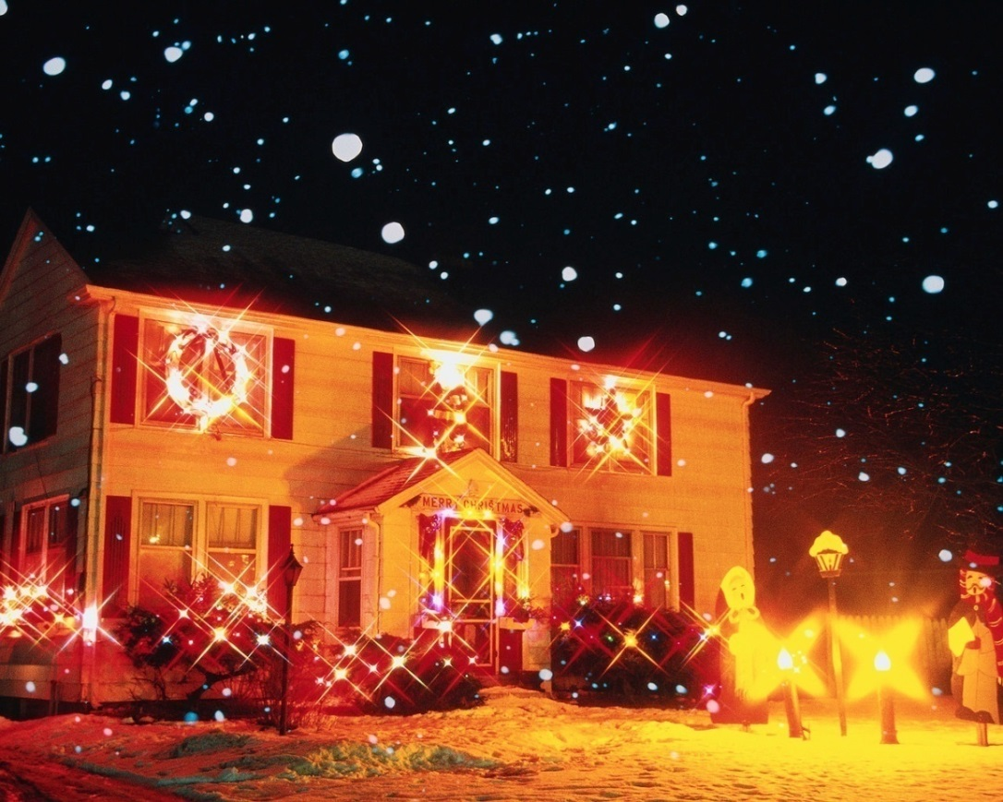
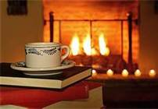
Home Fire Safety
Bureau of Workers’ Compensation
PA Training for Health & Safety (PATHS)
Notes:
Our comfort and security is found in our personal homes. Consider what your life would be without your residence and personal effects. Devastating!
Such concerns are all-seasonal although various holidays may complicate our safety due to the use of non-frequent adjustments in lighting and other
temporary fixtures.

Slide 2
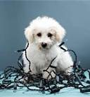
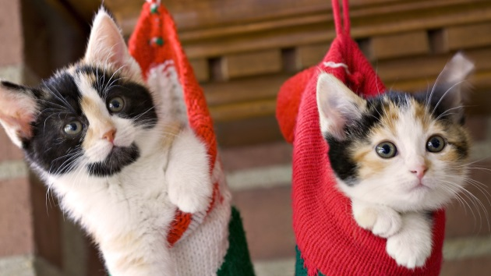
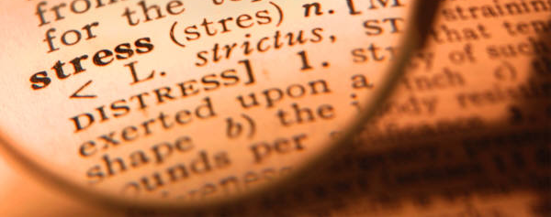
Topics
Potential Hazards
Fireplace Safety
Fire Extinguishers
Smoke Detectors
Escape Planning & Drills
Notes:
This program will look at:
Potential Hazards
Fireplace Safety
Fire Extinguishers
Smoke Detectors
Escape Planning & Drills

Slide 3
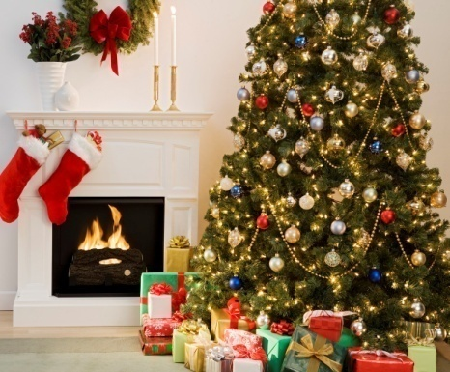
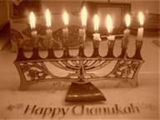
Everyday or Special Occasions
Notes:
Therefore, we’ll view home fire safety concerns during holidays and other special occasions as well as during normal occupancy.

Slide 4
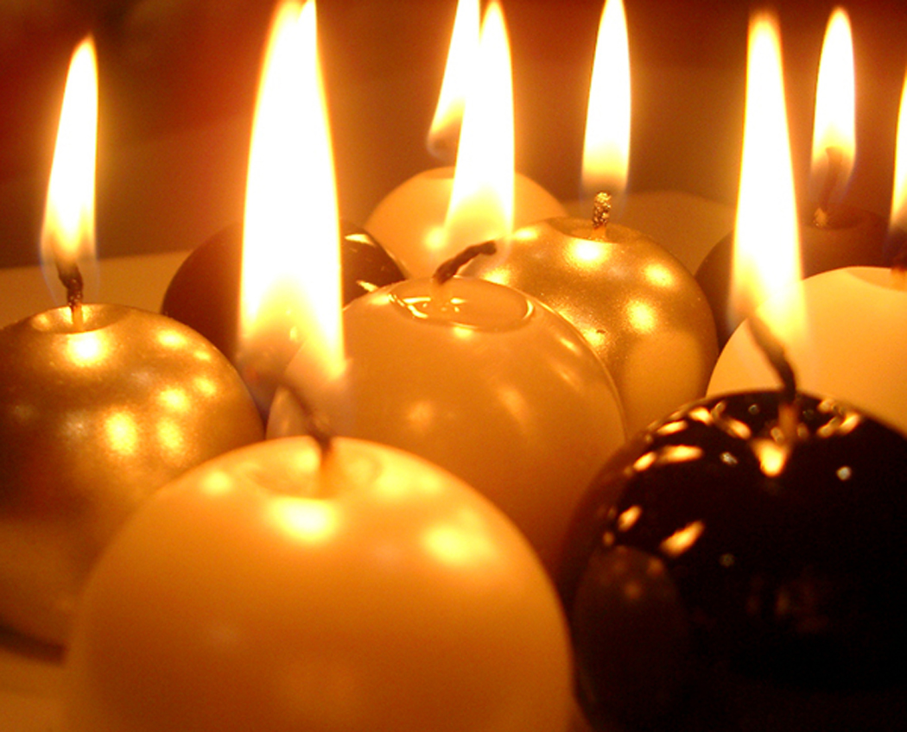
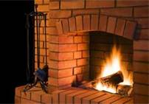
Home Fire Safety
Everyday and Holidays. You change your everyday environment.
Notes:
Through such changes, you introduce possible hazards to your environment.
Temporary lighting sources may run from candles to lighted hangings as well as the use of a hearth.

Slide 5
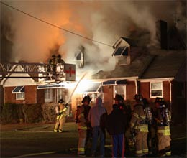
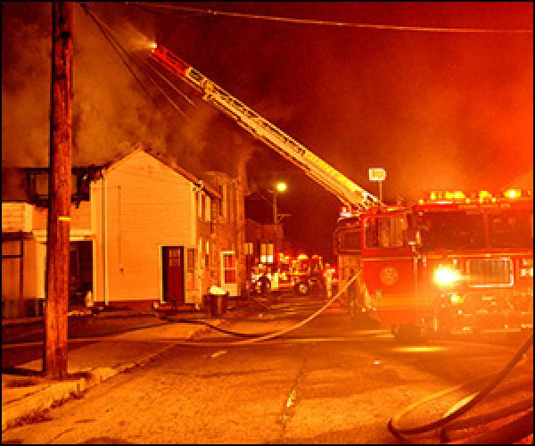
Consequences of Such Changes
Notes:
The potential consequences of such changes may result in a fire, especially if you’re not as familiar with transitory changes as with your normal daily environment.
There have also been reports of persons attempting repairs of fuel sources and electrical systems of which they have little or no full understanding. The results were catastrophic.

Slide 6
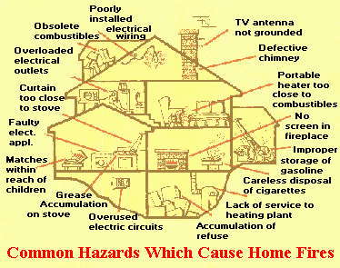
Inspect Home Areas
Notes:
To determine your risk or susceptibility to home fires, you need to inspect various areas of your home. If you’re not knowledgeable about various aspects, i.e. heating systems, fuels or construction features and their likelihood to cause or contribute to a home fire, you may need a professional to inspect.
Look for ignition sources and protection requirements. The National Fire Protection Association (NFPA) is a good place to start for guidance.

Slide 7
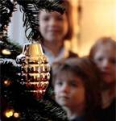
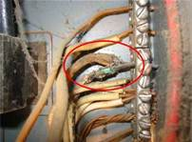
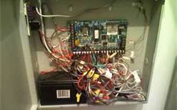
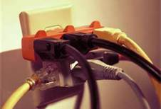
Overloading Systems
Notes:
This is a particularly common practice and may overload circuits thereby causing fires. Electricity is beyond the knowledge base of most of us and would require a professional to inspect.
NFPA 70 (National Electrical Code) can provide guidance regarding electrical safety. However, a better method would be to hire a professional who is updated on the latest NFPA Standards and requirements especially in the National Electrical Code.

Slide 8
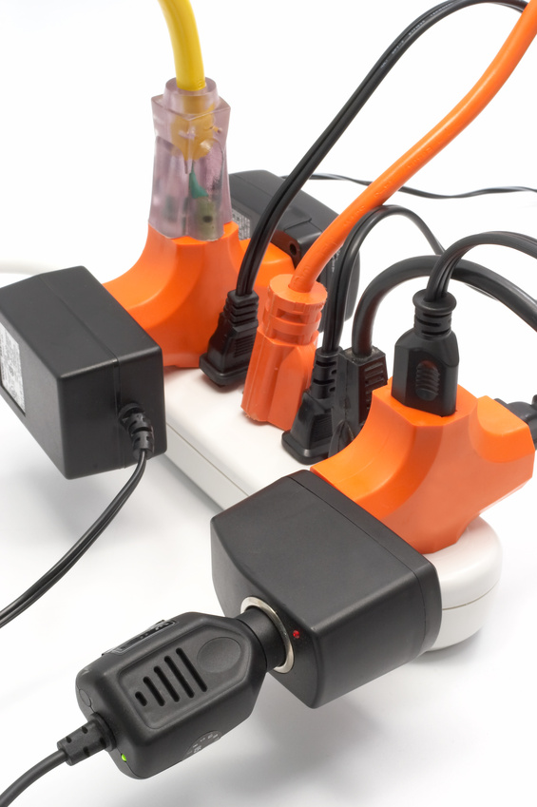
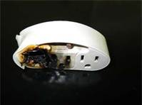
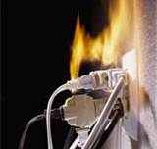
Modification Hazards
Notes:
Too often we take electricity for granted. It has its capabilities but also its limitations.

Slide 9
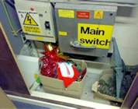
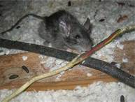
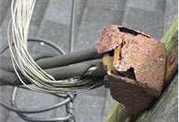
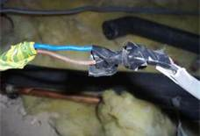
Inspect!
“Not a creature was stirring…”
Notes:
Inspect: but then questionable areas should be left to a professional.
Why? Professionals are up-to-date on approved methods and materials.

Slide 10
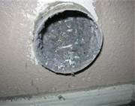
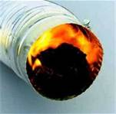
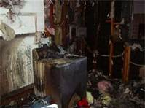
Maintain good housekeeping with these systems
Dryer Fires
Notes:
There are some areas that we can inspect and rectify ourselves. Dryers and ventilation systems can be periodically cleaned to guard against lint build-up and possible fires.

Slide 11
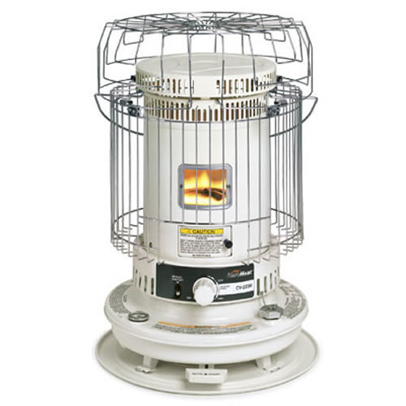
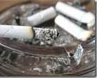
Careless Activities
Proximity of heaters to combustibles or
wrong fuels used,
i.e. gasoline used in kerosene heaters
Smoking materials
and habits
Notes:
Where substitute heating systems will be used, read and be mindful of manufacturers’ prohibitions against use such as the proximity of the element to combustibles. Also, the fuel types to be used.
One purchaser was going to use 87octane gasoline in a kerosene space heater and didn’t see where that was a problem until someone explained the flammability differences between kerosene and gasoline.
It is thought this discussion may have saved the lives of his family and his home!
Also, like any combustion process, what is the byproduct of the machine? Will carbon monoxide be produced? Will this require a window to be opened to relieve the CO2 build-up? It is a good idea to install carbon monoxide detectors in your home (the NFPA and National Safety Council can provide guidance as to where these should be installed).

Slide 12
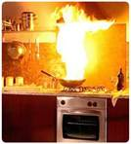
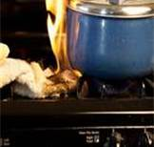
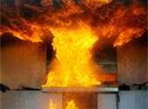
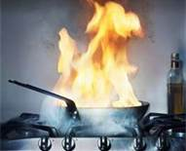
Unattended Cooking Hazards
Notes:
It takes but a moment for unattended cooking to become a runaway fire situation. This is especially true if extinguishing means don’t exist.
Here you see food burning. Persons wearing loose clothing have also had their garments ignited due to being too close to a heat source. Make sure there is a fire extinguisher on each level of your home (Class ABC, Multi-purpose).

Slide 13
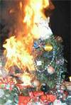
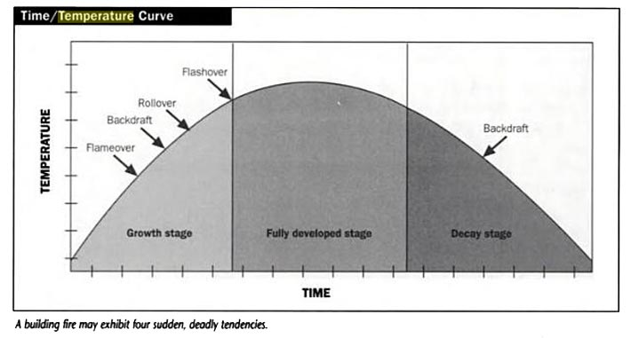
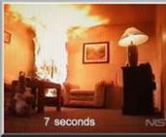
Consider . . .
The speed by which the reaction occurs:
Every 18 seconds the temperature increases 100ºF for Class A fires
Notes:
This is the progress for a Class A “ordinary combustibles” fire.
The corner fire in the lower right slide shows the progress after only 7 seconds. Rapid detection, notification and escape are required to protect your family.
Flammable liquids and gases (Class B fires) burn more rapidly and hotter than Class A fires.

Slide 14
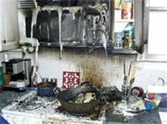
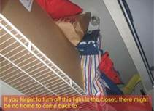
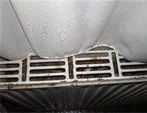
Additional Fire Hazards
Notes:
As you inspect, look for possible exposures to fire situations. From upper left, clockwise:
Overhead cabinet easily ignited by pan fire below
Combustibles in a closet to close to the light (a heat source)
Floor vents with debris too close to curtains.
Keep heating surfaces clear of combustibles and flammables so heat is not insulated into the material thereby causing a heat build-up and possible fire.

Slide 15
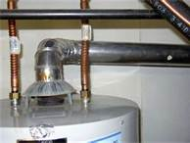
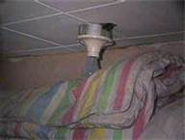
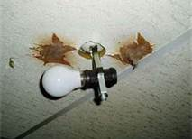
Additional Hazards
Contact Hazards
Notes:
Again from upper left, clockwise:
1.Possibility of carbon monoxide
2 & 3. Contact hazard with light bulbs

Slide 16
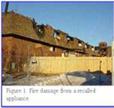
Recall Information
Be mindful of product recall information which informs you of potential problems
Notes:
Be mindful to keep updated on product recall information. You may discover something you thought was a good deal has now been found to be a fire starter.

Slide 17
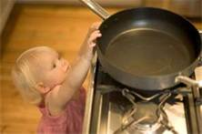
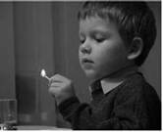
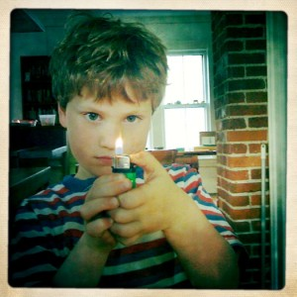
Precautions with Children
Notes:
Children are naturally inquisitive. Don’t leave items accessible where they may be burned or start a fire.

Slide 18
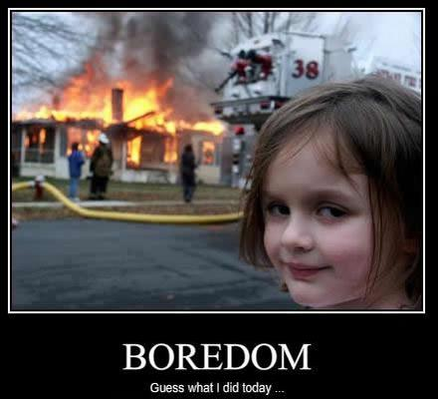
Hmmmmmm?
Notes:
Don’t let this be your homecoming.

Slide 19
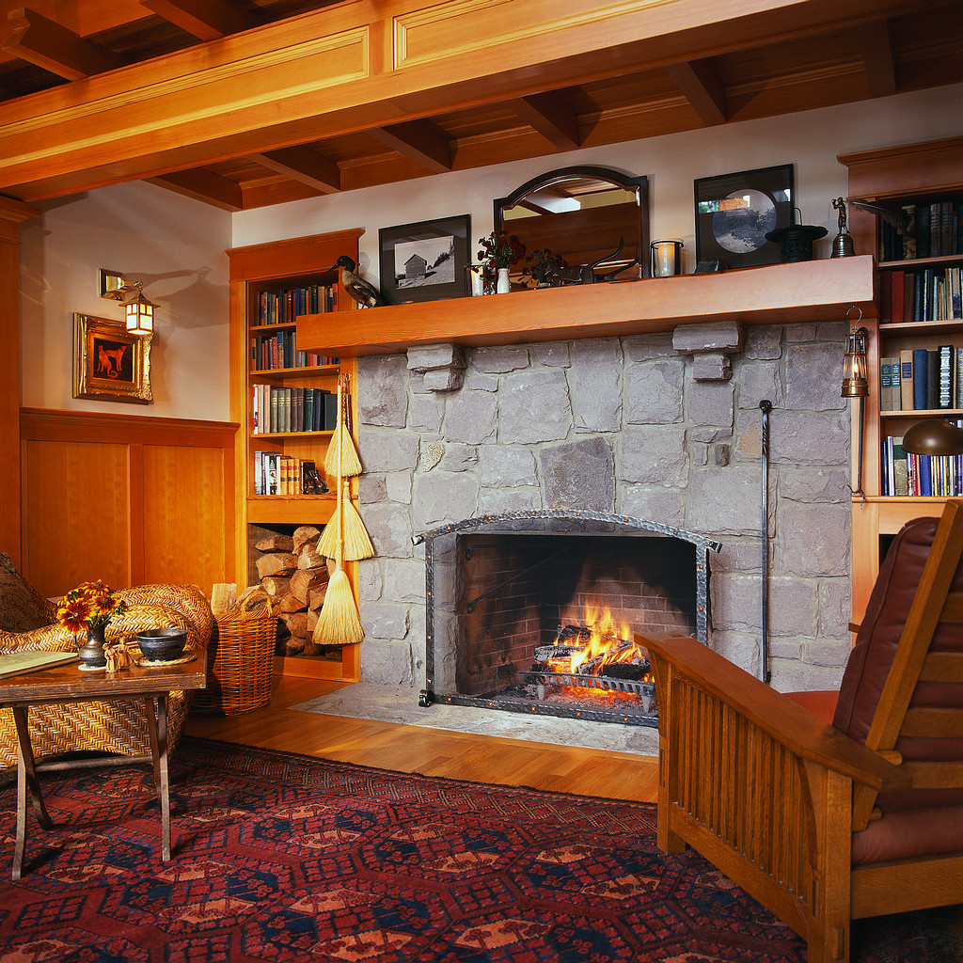
Fire Safety-No Accident
Notes:
Fire Safety can be more precisely planned for. You have the opportunity to plan and create a more risk-free environment.

Slide 20
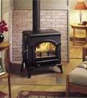
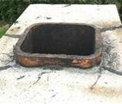
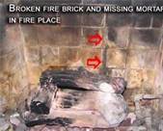
Fireplace Safety
Notes:
Seasonal considerations should be viewed, not just your summer safety concerns. When coming into Fall and Winter, systems which may not have been operational for 6 to 8 months will be re-engaged. Inspect and ensure they are safe to use.
Lower right corner: wood stove in workshop area. Could saw dust ignite? Are flammable solvents or adhesives used? Or, maybe the propane tank is too close to the stove!!!

Slide 21
Fire Extinguishers
Match to type of Hazard
Ensure UL or FM rated
Know how to use
Maintain it.
Notes:
Fire Extinguishers are classified according to the class of fire they will extinguish:
Class A: Ordinary Combustibles (e.g. wood, paper, trash)
Class B: Flammable Liquids and Gases (e.g. gasoline, methane)
Class C: Electrical; Means non-Electrically Conductive (e.g. power going to it)
Class D: Combustible Metals (e.g. Titanium, Magnesium)
Class K: Cooking Fats and Greases
Always check with a vendor who is a member of the NAFED (National Association of Fire Extinguisher Dealers). Box stores will also have listed extinguishers certified by UL (Underwriters Laboratories) or FM (Factory Mutual).
NFPA 10, 12 and 17 can furnish information on specific extinguishing agents.

Slide 22
Smoke Detectors
Determine the type required
Ensure it is FM or UL Listed
Have proper number placed in the proper locations of the home
Notes:
Determine the type required.
Ensure it is listed by FM or UL.
Have proper number placed in the proper locations of your home.
The NFPA and National Safety Council (NSC) have good information and guidance.

Slide 23
Residential Sprinklers
Where residential sprinklers exist, maintain them as recommended
Keep free of obstructions
Notes:
Residential sprinklers are a main line of defense against home fires. Install and maintain them.
View NFPA 13R (Standard for Installation of Sprinkler Systems in Low-Rise Residential Occupancies) for sprinkler types and siting requirements.

Slide 24
Protect Loved Ones
Notes:
Anyone who has a pet understands that “pets are people too.”
Determine how you will provide for their protection should a fire occur and you need to evacuate.

Slide 25
Home Escape Plans/Drills
Make a plan and train on it
Have a designated meeting place outside for all family members
Notes:
Make a plan which will include:
Means of escape
Outside meeting point where family members will be accounted for
How to call the fire department

Slide 26
Home Escape Plans/Drills
Notes:
During your planning, determine special needs of family members to allow their escape.
Train all family members in fire safety and escape techniques.

Slide 27
Have Fire Safe Holidays!
Inspect for hazards
Eliminate hazards found
Take necessary precautions during events
Have a planned response if something happens
Notes:
To have a safe day and safe holiday
Inspect for hazards
Eliminate those that are found
Take necessary precautions during events
Have a planned response if something happens

Slide 28
Contact Information
Health & Safety Training Specialists
1171 South Cameron Street, Room 324
Harrisburg, PA 17104-2501
(717) 772-1635
RA-LI-BWC-PATHS@pa.gov
Like us on Facebook! - https://www.facebook.com/BWCPATHS

Slide 29
Questions

Slide 30
Other Suggested Programs
The following presentations are also available to supplement this program:
Fire Extinguisher Use
Electrical Safety
Emergency Response Planning
Kitchen Safety: Burns & Fire Prevention
Please contact us for a full list of other programs available to you free of charge.

Slide 31
Bibliography
National Fire Protection Association Standards, Batterymarch Park, Quincy, MA,02269:
Standard 10: Standard for Portable Extinguishers
Standard 12: Standard on Carbon Dioxide Extinguishing Systems
Standard 13: Standard for the Installation of Sprinkler Systems
Standard 17: Standard for Dry Chemical Extinguishing Systems
Standard 70: National Electrical Code
Standard 72E: Standard on Automatic Fire Detectors

