Slide 1
HAZARD COMMUNICATION
Bureau of Workers’ Comp
PA Training for Health & Safety (PATHS)
OSHA
29 CFR 1910.1200
(HCS-2012)
&
United Nations Globally Harmonized System of Classification and Labeling of Chemicals (GHS, Rev 3)
PPT-016-06
1
Notes:
In 2012, the Globally Harmonized System dealing with chemical labelling was adopted from the United Nations which has a bearing on the federal Hazard Communication program under 29 CFR 1910.1200. It is the method for identifying product hazards based on proper chemical labeling.
Some agencies, by their nature, may be governed by federal OSHA regulations found in OSHA’s Hazard Communication Standard (29 CFR 1910.1200 often referred to as Haz Comm) while others are governed by PA’s Right to Know.
Private agencies such as manufacturing, colleges and universities not under the state system are governed by OSHA-GHS and portions of the PA Right to Know.
Public entities,i.e. municipalities, fire, police, schools and state colleges and universities under the state system are under the PA Right to Know and not OSHA.

Slide 2
Hazard Communication Standard (1910.1200)
Intent - To provide employees with information to help them make knowledgeable decisions about chemical hazards in their workplace
PPT-016-06
2
Notes:
Intent of each regulation is to provide employees with information to help them make knowledgeable decisions about chemical hazards in their workplace and take the proper precautions.
A public entity under PA Right to Know can still benefit by adopting OSHA regulations as a guideline. This serves as “Best Practices” where “Due Diligence” is enacted when implementing a program.
OSHA anticipates the revised standard (with the adoption of the GHS) will prevent 43 fatalities and 585 injuries annually, with a net annualized saving of over $500 million a year.
The new labeling requirements under GHS will also be found applicable to PA’s Right to Know program.
From Safety+Health Magazine from National Safety Council, Nov 2015
OSHA’s hazcomm standard not ‘direct reflection’ of GHS
The “In the News” item titled” OSHA instructs inspectors on enforcing hazcomm standard” (September 2015, p. 21) links to a compliance directive that has some interesting points that shouldn’t be missed by EHS professionals.
That July 2015 OSHA directive, CPL 02-02-079, specifically states that complying with more recent versions of the Globally Harmonized System of Classification and Labeling (GHS) promulgated by the United Nations (UH) may result in non-compliance with the Hazard Communication Standard (HCS) 2012.
For example, changes in the classification of flammable aerosols under GHS Revision 4 would mean an employer complying with these international standards would be committing a “serious violation” for not meeting OSHA’s HCS 2012 standards, which are based on GHS Revision 3.
Employers and importers should be aware that keeping up with the most current UN GHS standards could cost them when it comes to compliance with OSHA regulations. Despite many similarities, OSHA’s HCS is not a direct reflection of current UN GHS regulations.
Submitted by Carlo Emami, Owner, SAFEWEST, San Diego, Ca.

Slide 3
Standard Requirements
Written program for each location to cover issues of chemical safety and hazard communication (HAZCOMM)
Labels to identify each chemical
Material Safety Data Sheets (MSDSs) (now SDSs under the Globally Harmonized System: GHS)
Safe work procedures/practices
Employee training on SDS information and safe chemical procedures and practices
PPT-016-06
3
Notes:
Standard requirements of the Hazard Communication program include:
Written program for each location to cover issues of chemical safety and hazard communication (HAZCOMM)
Labels to identify each chemical
Material Safety Data Sheets (MSDSs) (now SDSs under the Globally Harmonized System: GHS)
Safe work procedures/practices
Employee training on SDS information and safe chemical procedures and practices

Slide 4
Training
Upon initial employment
When a new hazardous
product/chemical is introduced into the workplace
Change in process
As deemed necessary by
supervision/management
PPT-016-06
4
Notes:
Training for employees is required:
Upon initial employment
When a new hazardous
product/chemical is introduced into the workplace
Change in process
As deemed necessary by
supervision/management

Slide 5
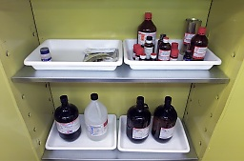
“Right to Know” Law
Ensures all employees’ right to know the hazards
of chemicals they work with at their job
Mandates that employees must be provided with
information about chemicals they work with
through:
Information on chemical labels
Safety Data Sheets (SDSs)
Training on hazard communication
Written HAZCOMM plan
PPT-016-06
5
Notes:
This OSHA “Right to Know” program entitled “The Hazard Communication” standard of “HazComm”
Ensures all employees’ right to know the hazards
of chemicals they work with at their job
Mandates that employees must be provided with
information about chemicals they work with
through:
Information on chemical labels
Safety Data Sheets (SDSs)
Training on hazard communication
Written HAZCOMM plan

Slide 6
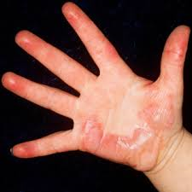
Why is a Standard Necessary?
To evaluate the hazards of all chemicals imported into,
produced, or used in workplaces in the United States
To prevent or minimize employee exposure to chemicals
Because chemical exposure can contribute to serious
health effects:
Heart ailments
Burns/rashes
Kidney/lung damage
Sterility
Cancer
Central nervous system damage
PPT-016-06
6
Notes:
The Haz Comm standard is necessary to:
To evaluate the hazards of all chemicals imported into,
produced, or used in workplaces in the United States
To prevent or minimize employee exposure to chemicals
Because chemical exposure can contribute to serious
health effects:
Heart ailments
Burns/rashes
Kidney/lung damage
Sterility
Cancer
Central nervous system damage

Slide 7
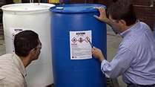
Globally Harmonized System
Labels:
Signal words
(Danger/Warning)
Hazard statements
Precautionary
statements
Pictograms (9)
SDS-16 categories
Training
“Globally Harmonized System” created by the United Nations
Also known as “GHS”
A system for standardizing chemical classification and labeling for world-wide implementation
PPT-016-06
7
Notes:
Identification of chemical hazards utilized by both the federal Haz Comm and PA Right to Know program is found in the Globally Harmonized System. This system, also known as “GHS” created by the UN, was adopted by the federal government (OSHA) in 2012. By inference, the state Right to Know program also uses it.
The GHS is a system for standardizing chemical classification and labeling for world-wide implementation. Requirements on labels include:
Signal words of either Danger or Warning
Hazard statements
Precautionary statements
Pictograms (9 variations)
Safety Data Sheets (SDS) with 16 categories rather than the previous MSDS with only 8 categories
Training required for employees

Slide 8
GHS
Rationale:
“To provide a single, harmonized system to classify chemicals, labels and SDS with the primary benefit of increasing the quality and consistency of information provided to workers, employers and chemical users”*
Effective, in part, on June 26, 2012, with a built-in
transition period and a fully effective date of
June 1,2016
*Ruth Mayo, EHS Today, “GHS: The Power of One,” December 1, 2009
PPT-016-06
8
Notes:
The rationale for GHS is
“To provide a single, harmonized system to classify chemicals, labels and SDS with the primary benefit of increasing the quality and consistency of information provided to workers, employers and chemical users”*
Effective, in part, on June 26, 2012, with a built-in
transition period and a fully effective date of
June 1,2016
*Ruth Mayo, EHS Today, “GHS: The Power of One,” December 1, 2009

Slide 9
Updating GHS/HCS
The adoption of this will affect the OSHA 29 CFR
1910.1200 Hazard Communication Standard with
changes
GHS is updated every two years
Hazard Communication Standard, (HCS), to remain
current, can be updated by:
Technical updates (minor terminology changes),
Direct final rules (for text clarification), and
Notice and comment rulemaking (for more substantive
updates or changes)
PPT-016-06
9
Notes:
Updating GHS and HCS (Haz Comm Standard) is accomplished every two years.

Slide 10
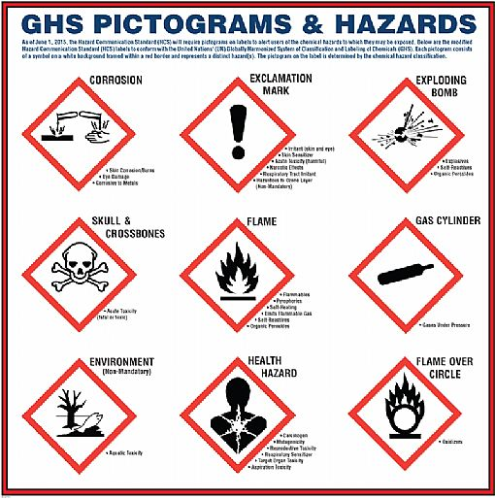
OSHA HazComm Modifications due to GHS
Hazard classification of chemical hazards
Revised labeling provisions that include
requirements for:
Standardized signal words
Pictograms
Hazard statements
Precautionary statements
Specified format for safety data sheets in 16
section format and
Revisions to definitions of terms used in the
standard and requirements for employee training
on labels and Safety Data Sheets (SDS)
PPT-016-06
10
Notes:
Modifications of the OSHA Haz Comm due to the GHS would be:
Hazard classification of chemical hazards
Revised labeling provisions that include
requirements for:
Standardized signal words
Pictograms
Hazard statements
Precautionary statements
Specified format for safety data sheets in 16
section format and
Revisions to definitions of terms used in the
standard and requirements for employee training
on labels and Safety Data Sheets (SDS)

Slide 11
HCS Key Revisions also Include
Disclosure of PELs and voluntary threshold limit values (TLVs)
established by the American Conference of Governmental Industrial
Hygienists (ACGIH)
Disclosure of carcinogen status from nationally and internationally
recognized lists of carcinogens
Inclusion of combustible dust in the definition of “hazardous
chemical” covered on labels and SDS
Workers be re-trained within 2 years of the publication of the final
rule
Mixtures (GHS)
Health hazards can be based on data for mixture
If no data, extrapolate from ingredient data or other similar mixtures to classify
PPT-016-06
11
Notes:
Other key revisions to the OSHA Haz Comm include:
Disclosure of PELs and voluntary threshold limit values (TLVs)
established by the American Conference of Governmental Industrial
Hygienists (ACGIH)
Disclosure of carcinogen status from nationally and internationally
recognized lists of carcinogens
Inclusion of combustible dust in the definition of “hazardous
chemical” covered on labels and SDS
Workers be re-trained within 2 years of the publication of the final
rule
Mixtures (GHS)
Health hazards can be based on data for mixture
If no data, extrapolate from ingredient data or other similar mixtures to classify

Slide 12
HNOC: Hazards Not Otherwise Classified
Creation of a new category of hazards – “Hazards Not Otherwise
Classified” (HNOC)
OSHA originally classified this category
HNOC (HCS) disclosed on SDS in section 2, not label
Under new GHS standard, the following are not classified under
HNOC but addressed individually:
Pyrophoric gases
Simple asphyxiants
Combustible dusts
GHS label elements for combustible dusts:
Signal Word: Warning
Hazard Statement: “May form combustible dust concentrations in the air”
PPT-016-06
12
Notes:
The GHS also created a new category of hazards- “Hazards Not Otherwise Classified” (HNO)
OSHA originally classified this category
HNOC (HCS) is disclosed on the SDS in section 2, but not on the product/chemical label
Under new GHS standard, the following are not classified under HNOC but addressed individually:
Pyrophoric gases
Simple asphyxiants
Combustible dusts

Slide 13
Other Label Elements
OSHA label elements for:
Pyrophoric Gases:
-Signal Word: Danger
-Hazard Statement: “Catches fire spontaneously if exposed to air”
Simple Asphyxiants:
-Signal Word: Warning
-Hazard Statement: “May displace oxygen and cause rapid suffocation”
Combustible Dusts:
-Signal Word: Warning
-Hazard Statement: “May form combustible dust concentrations in the air”
PPT-016-06
13
Notes:
Other OSHA label elements you’ll find deal with a “Signal Word” and “Hazard Statement”
For example:
Pyrophoric Gases:
- Signal Word: Danger (which is more severe than Warning)
- Hazard Statement: “Catches fire spontaneously if exposed to air”

Slide 14
OSHA will Also Revise
Standards dealing with:
Flammable and combustible
liquids
Process safety management
Most substance-specific
health standards
OSHA’s Process Safety Management
PPT-016-06
14
Notes:
To keep updated, OSHA will also revise standards dealing with
Flammable and combustible liquids
Process safety management
Most substance-specific health standards

Slide 15
Effective Dates for GHS
Effective
Completion Date Requirements Who
Dec. 1, 2013 Train employees on the new label Employers
elements and Safety Data Sheet
(SDS) format
June 1, 2015 Compliance with all modified provisions of this final rule (SDS’s) Chemical manufacturers,
Except: importers,
Dec. 1, 2015 The distributor may ship products distributors and
labeled by manufacturers under employers
the old system until December 1,
2015
PPT-016-06
15
Notes:
Dates for implementation of the GHS requirements are also provided.
By checking the slide, it will be found a transition period is been provided before full implementation is required.

Slide 16
Effective Dates
Effective
Completion Date Requirements Who
June 1, 2016 Update alternative workplace labeling Employers
and hazard communication program as
necessary, and provide additional employee
training for newly-identified physical or health
hazards
Transition period May comply with either 29 CFR 1910.1200 Chemical
to the effective Hazard Communication (final standard), manufacturers,
completion dates current standard, or both distributors,
noted above and employers
PPT-016-06
16
Notes:
By June 1, 2016, an updating of alternative workplace labeling and the in-house Haz Comm program must be accomplished. Additional employee training is also required for newly-identified physical or health hazards.
As shown during this transition period, employers may comply with either the federal Haz Comm (29 CR 1910.1200) final standard, current standard, or both.
It has been found that even in 2012, employers were receiving the new 16 part SDS from various vendors. This is to be understood since this program had already been adopted overseas by chemical manufacturers, distributors and importers.

Slide 17
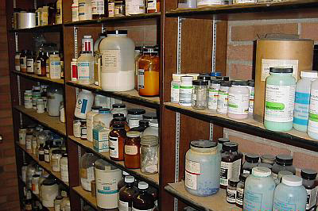
OSHA
OSHA proposed all revisions of the Hazard Communication Standard (HCS) become effective by June 1, 2016
PPT-016-06
17
Notes:
OSHA proposed all revisions of the Hazard Communication Standard (HCS) become effective by June 1, 2016.
Many employers have already instituted a finalized program in conformance with these requirements rather than waiting for the deadline.

Slide 18
Hazard Classification
GHS has specific criteria for each health and
physical hazard
Detailed instructions for hazard evaluation and
determinations whether mixtures of the substance
are covered
A and B (mandatory): Classification guidance for
health hazards and physical hazards
Test-method neutral (person classifying a chemical
or substance should use available data and no
additional testing is required to classify a chemical)
PPT-016-06
18
Notes:
Hazard classification for GHS is according to a specific criteria for both, health and physical hazards.
Detailed instructions for hazard evaluation and determinations whether mixtures of the substance are covered
Appendix A and B (mandatory): Classification guidance for health hazards and physical hazards
Test-method neutral (person classifying a chemical or substance should use available data and no additional testing is required to classify a
chemical)

Slide 19
Hazard Classification
GHS: Only terminology changes
GHS has no provisions regarding Hazard Communication programs
PPT-016-06
19
Notes:
In the hazard classification for GHS, only terminology changes have been made.
GHS has no provisions regarding Hazard Communication programs, it is a chemical classification and labeling provision adopted by OSHA’s Hazard Communication program and PA’s right to Know program.

Slide 20
Hazard Communication & Chemical Safety
Chemicals are all around us every day
Chemicals can be:
Corrosive
Reactive
Flammable
Explosive
Oxidizing
Inert
PPT-016-06
20
Notes:
Chemicals are all around us every day.
Characteristics of some chemicals can be:
Corrosive
Reactive
Flammable
Explosive
Oxidizing
Inert

Slide 21
Chemical Safety
In many cases, the chemicals you may deal with at work are no more dangerous than those you use at home
But in the workplace exposure may be greater, concentrations higher, exposure time longer: potential danger could be greater on the job
PPT-016-06
21
Notes:
Chemical safety is the main intent of either regulation, OSHA’s or the PA Right to Know.
In many cases, the chemicals you may deal with at work are no more dangerous than those you use at home.
However, in the workplace, exposure may be greater, concentrations higher, exposure time longer. The potential danger could be greater on the job.

Slide 22
Routes of Occupational Exposure
Inhalation - nearly all materials that are airborne can be inhaled
Skin Absorption - skin contact with a substance can result in a possible reaction
Ingestion - most workers do not deliberately swallow materials they handle
Injection – normally associated with bloodborne pathogens
Ocular - absorbed through the eyes
PPT-016-06
22
Notes:
Before using chemicals at work (or at home), determine the routes of potential exposure. Then determine and use the proper Personal Protective Clothing to limit exposure.
Various exposure routes include:
Inhalation - nearly all materials that are airborne can be inhaled
Skin Absorption - skin contact with a substance can result in a possible reaction
Ingestion - most workers do not deliberately swallow materials they handle
Injection – normally associated with bloodborne pathogens
Ocular - absorbed through the eyes (around the eyeball and down the optic nerve to the brain)

Slide 23
Hazards
A chemical can pose a “physical hazard” or a “health hazard”
The hazard communication standard applies to both types of hazards
GHS looks at:
Class-nature of hazard
Category-degree of
severity
PPT-016-06
23
Notes:
Chemical hazards may be either 1) physical, or 2) health hazards.
The Hazard Communication Standard applies to both types of hazards (physical and health).
GHS looks at:
Class, is the nature of hazard and the
Category which is the degree of severity

Slide 24
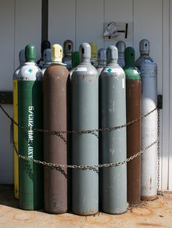
Physical Hazards
Physical hazards are exhibited by certain chemicals because of their physical properties (e.g. flammability, reactivity, etc.)
These chemicals fall into the following classes:
Flammable Liquids or Solids
Compressed Gases
Flammable Gases
Oxidizing Gases
Liquefied Gases
Explosives
Pressurized Gases
Refrigerated Liquefied Gases
Dissolved Gases
PPT-016-06
24
Notes:
Physical hazards are exhibited by certain chemicals because of their physical properties (e.g. flammability, reactivity, etc.)
These chemicals fall into the following classes:
Flammable liquids or solids
Flammable Gases
Compressed gases
Explosives
Oxidizing Gases
Liquefied Gases
Pressurized Gases
Refrigerated Liquefied Gases
Dissolved Gases

Slide 25
Physical Hazards
Organic peroxide: May react explosively to
temperature/pressure changes
Oxidizers: Chemicals that initiate or promote
combustion in other materials
Pyrophoric materials: May ignite
spontaneously in air temperatures of 130ºF
or below
Unstable materials
Water reactive materials
PPT-016-06
25
Notes:
Physical hazards also include such materials and characteristics:
Organic peroxide: May react explosively to temperature/pressure changes
Oxidizers: Chemicals that initiate or promote combustion in other materials
Pyrophoric materials: May ignite spontaneously in air temperatures of 130ºF or below
Unstable materials
Water reactive materials

Slide 26
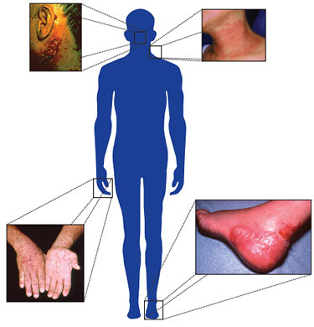
Health Hazard
Health hazard - Occurs when a chemical produces an acute or chronic health effect on exposed employees
PPT-016-06
26
Notes:
Health hazards are those where a chemical produces an acute or chronic health effect to exposed employees.

Slide 27
Acute Health Effects
Happen quickly
High, brief exposure
Examples:
Carbon monoxide
poisoning
Cyanide inhalation
Hydrogen sulfide
inhalation
PPT-016-06
27
Notes:
Acute health hazards are ones which may happen quickly, where there is a high, brief exposure.
Examples:
Carbon monoxide poisoning
Cyanide inhalation
Hydrogen sulfide inhalation

Slide 28
Chronic Health Effects
May be caused by chemical exposures that do not cause immediate, obvious harm or make you feel sick right away
May not see, feel, or smell the danger
Effects are long, continuous and follow repeated long-term exposure; e.g.:
Lung cancer from cigarette smoking
Black lung from coal mine dust
PPT-016-06
28
Notes:
Chronic health effects, however, may be caused by chemical exposures that do not cause immediate, obvious harm or make you feel sick right away.
You may not see, feel, or smell the danger. The exposure effects are long, continuous and follow repeated long-term exposure, such as;
Lung cancer from cigarette smoking
Black lung from coal mine dust

Slide 29
Keeping It Safe
Corrosives, solvents and other chemical substances can be potentially dangerous
Safe handling procedures
Read container labels
Check SDS(s)
Never sniff a chemical for identification
Use appropriate personal protective equipment
PPT-016-06
29
Notes:
Corrosives, solvents and other chemical substances can be potentially dangerous. Such materials can corrode metals and destroy human tissue.
To safely handle such materials:
Read container labels
Check SDS(s)
Never sniff a chemical for identification, and
Use appropriate personal protective equipment.

Slide 30
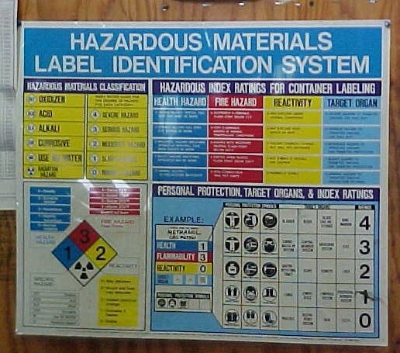
Labeling
Example of one type of labeling system used
PPT-016-06
30
Notes:
This slide shows one means of labeling which is posted for better employee understanding.

Slide 31
Chemical Labels
Each container must be labeled, tagged or marked
“Warning” or “Danger” will be listed on label
Labels must be written in English and prominently displayed
PPT-016-06
31
Notes:
Chemical labeling is addressed in the federal Haz Comm program (GHS applies, adopted by OSHA) and the PA Right to Know.
Products you receive must be properly labelled by the manufacturer of the chemical, distributor or importer of the chemical. There is no requirement to relabel a product or container unless the label is damaged not allowing proper identification.
Each container must be labeled, tagged or marked
Warning or Danger will be listed on label
Labels must be written in English and prominently displayed. If you wish to label with another language for better understanding, you can do this.

Slide 32
Label Information
Chemical manufacturers and importers must provide a label that includes:
Harmonized signal word
Pictogram
Hazard statement for each hazard class
and category
Precautionary statements must also be
provided as well as product identifier and
supplier information
PPT-016-06
32
Notes:
Chemical manufacturers and importers must provide a label that includes:
Harmonized signal word
Pictogram
Hazard statement for each hazard class and category
Precautionary statements must also be provided as well as product identifier and supplier information

Slide 33
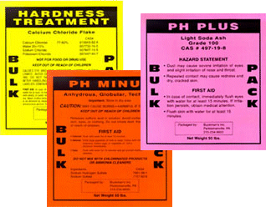
Reading Chemical Labels
Warning labels provide important information about the chemical:
DANGER
WARNING
Always read the label before you begin a job using a potentially hazardous chemical
PPT-016-06
33
Notes:
Warning labels provide important information about the chemical.
Two terms which will be used are:
DANGER (which means this will be hazardous) or
WARNING (which means it may be hazardous under certain circumstances)
Always read the label before you begin a job using a potentially hazardous chemical.

Slide 34
Labels/Other Warnings
Mandatory Appendix C: What specific information is to be provided for each hazard class and category once a chemical is classified
Requirements are significantly different from
existing HCS
GHS uses nine pictograms to convey health,
physical and environmental hazards
Proposed HCS requires eight of these pictograms
(no environmental hazard since environmental is
not within OSHA’s jurisdiction)
PPT-016-06
34
Notes:
The GHS regulations have other elements which are provided as guidance or are mandatory to implement the program.
Mandatory Appendix C: What specific information is to be provided for each hazard class and category once a chemical is classified
Requirements are significantly different from existing HCS
GHS uses nine pictograms to convey health, physical and environmental hazards
Proposed Haz Comm requires eight of these pictograms. (No environmental hazard since environmental is
not within OSHA’s jurisdiction. However, to be GHS compliant, the environmental information will be there.)

Slide 35
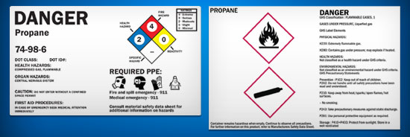
Labeling
Employers who only store chemicals may either use OSHA’s new labeling system or continue using the NFPA 704 rating system or HMIS system
(OSHA plans to change the labeling system June 1, 2016)
PPT-016-06
35
Notes:
Employers who only store chemicals may either use OSHA’s new labeling system or continue using the NFPA 704 rating system or HMIS rating system.
The NFPA 704 system rates Health, Flammability and Reactivity on a number scale of severity;
The HMIS (Hazardous Materials Information System) has a similar numerical hazard rating.
(OSHA plans to change the labeling system June 1, 2016)

Slide 36
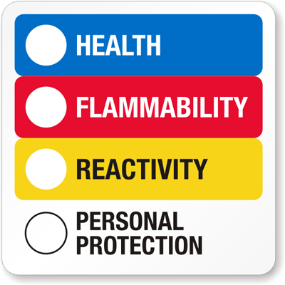
GHS Comparison
GHS classification ratings order of severity differ from NFPA and HMIS:
HMIS/NFPA
0 = Least Hazardous
4 = Most Hazardous
GHS
5 = Least Hazardous
1 = Most Hazardous
PPT-016-06
36
Notes:
On the left is the HMIS system; on the right is the NFPA 704 system. Both of these systems rate each category from 0 to 4 (0,1,2,3,4) with 4 being the most severe rating for a category.
The GHS system reverses this rating. GHS rates each category from 5,4,3,2,1 with 1 being the most hazardous. Make sure your employees understand which rating system you are using.

Slide 37
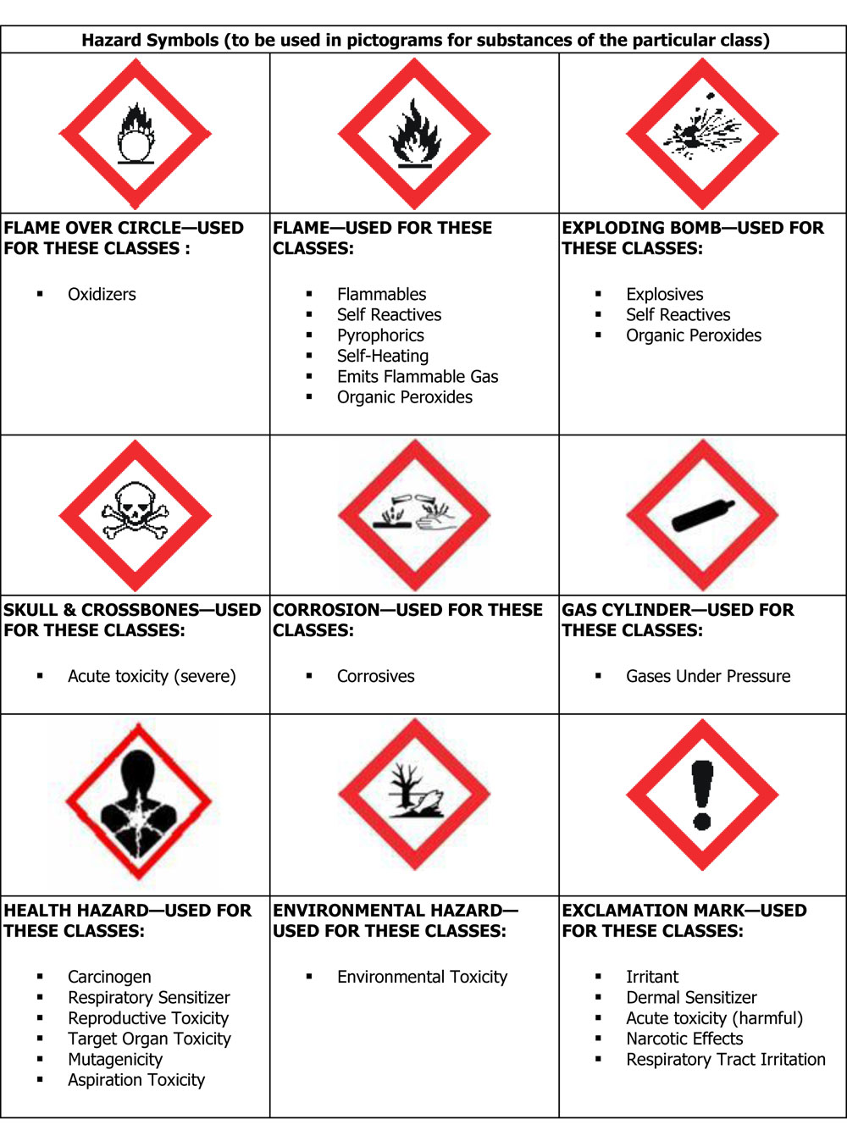
Pictograms
Different symbol on white background with red square frame set on point
Eight pictograms are required by OSHA
The ninth one dealing with the environment is not within OSHA’s
jurisdiction
PPT-016-06
37
Notes:
Pictograms must also be used in the GHS system. Different symbol on white background with red square frame set on point
Eight pictograms are required by OSHA which adopted the GHS program.
The ninth pictogram (Environmental Hazard), is not within OSHA’s jurisdiction.

Slide 38
Health Hazard
Used to describe:
Carcinogen
Mutagenicity
Reproductive toxicity
Respiratory sensitizer
Target organ toxicity
Aspiration toxicity
Germ cell mutagens
PPT-016-06
38
Notes:
The label pictogram will be used to denote health hazards. View the various health hazard categories targeted by the label and understand PPE may be required to safely deal with the hazard.

Slide 39
Flame
Describes:
Flammables
Pyrophorics
Self-heating
Emits flammable gas
Self-reactives
Organic peroxides
PPT-016-06
39
Notes:
Flammability characteristics (ease of vapor production and ignition) are addressed here. The label approximates the labels/placards used by the DOT for shipping flammable materials.

Slide 40
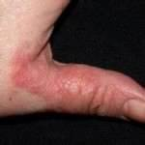
Exclamation Mark
Describes:
Irritant (skin and eye)
Skin sensitizer
Acute toxicity (harmful)
Narcotic effects
Respiratory tract irritant
Hazardous to ozone layer
(non-mandatory)
PPT-016-06
40
Notes:
The Exclamation Mark describes:
Irritant (skin and eye)
Skin sensitizer
Acute toxicity (harmful)
Narcotic effects
Respiratory tract irritant
Hazardous to ozone layer (non-mandatory)

Slide 41
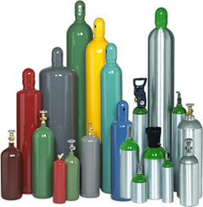
Gas Cylinder
Describes:
Gases under pressure
PPT-016-06
41
Notes:
Gas cylinders possess hazards intrinsic to the materials contained as well as a possibility of a pressure vessel rupture.

Slide 42
Corrosion
Describes:
Skin corrosion/burns
Eye damage
Corrosive to metals
PPT-016-06
42
Notes:
Corrosive materials can cause skin burns, corrode metals as well as cause eye damage if a person is splashed. Remember, however, not all corrosives are in liquid form.

Slide 43
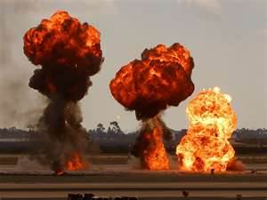
Exploding Bomb
Describes:
Explosives
Self-reactives
Organic peroxide
PPT-016-06
43
Notes:
Explosive hazards include blast over-pressure as well as shrapnel effects.
Some materials not ordinarily thought to be explosive may react under certain conditions such as self-reactives and organic peroxide.

Slide 44
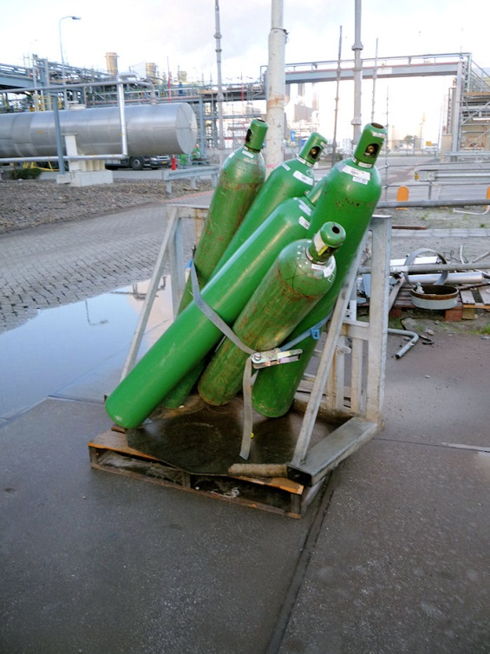
Flame Over Circle
Describes:
Oxidizers
Anything wrong with this picture?
Yes!
Unsafe storage – cylinders falling over!
PPT-016-06
44
Notes:
Oxidizers contain oxygen in their make-up which can fuel a combustion reaction highly accelerating a fire.

Slide 45
Skull and Crossbones
Describes:
Acute toxicity (fatal or toxic)
PPT-016-06
45
Notes:
Acutely toxic materials may be fatal in a variety of ways; skin contact, ingestion or inhalation. Little time after exposure is required before the end result is realized.

Slide 46
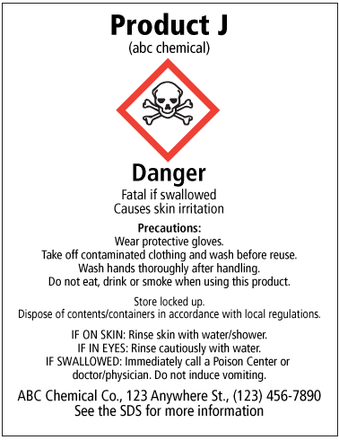
Signal Word
A single word indicating relative hazard severity
“Danger” for more severe hazards,
“Warning” for less severe hazards
PPT-016-06
46
Notes:
Labels must contain a “Signal Word” of either 1) “Danger” for more severe hazards, or 2) “Warning” for less severe hazards. There will also be a written description indicating to what degree and why such a designator has been assigned.

Slide 47
Hazard Statement
Assigned to hazard class and category,
Nature of hazard of a chemical, and
Degree of hazard
“Statements” are alphanumeric codes
Example: H221 (means flammable gas)
H= That this is a hazard statement
2=physical hazard
3=health hazard
4=environmental hazard
“21” in this code is specific to the hazard
PPT-016-06
47
Notes:
The required Hazard Statement is assigned to a hazard class or category for the material.
It will indicate the chemical’s nature of hazard, the degree of hazard (severity)
Then an alphanumeric code is assigned. As an example:
H221 (means flammable gas)
H= That this is a hazard statement
2=physical hazard
3=health hazard
4=environmental hazard
“21” in this code is specific to the hazard

Slide 48
Precautionary Statement
Measures to minimize/prevent adverse effects
from exposure, improper storage, or handling
Also an alphanumeric code
Example: P373
P=that this is a precautionary statement
1=general precaution
2=prevention precaution
3=response precaution
4=storage precaution
5=disposal precaution
P373=“Don’t fight fire when fire reaches explosives”
PPT-016-06
48
Notes:
A Precautionary Statement is provided indicating measures to minimize or prevent adverse effects due to exposure, improper storage, or handling.
This statement is displayed as an alphanumeric code.
Example: P373
P=that this is a precautionary statement
1=general precaution
2=prevention precaution
3=response precaution
4=storage precaution
5=disposal precaution
P373=“Don’t fight fire when fire reaches explosives”

Slide 49
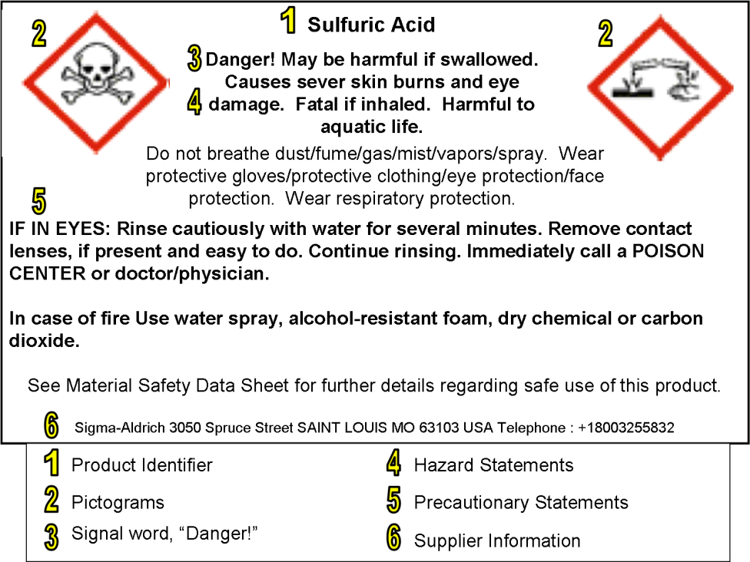
Labels
Information required on a GHS label:
1-Product identifier
2-Pictograms
3-Signal word
4-Hazard statement
5-Precautionary statement
6-Supplier information
PPT-016-06
49
Notes:
Therefore, complete label information required under the new GHS would be:
1-Product identifier
2-Pictograms
3-Signal word
4-Hazard statement
5-Precautionary statement
6-Supplier information

Slide 50
GHS: Annex 2
Classification and Labeling Summary Tables
A2.1 Explosives
Hazard | Criteria | Hazard Communication Elements
Unstable Explosives | According to the results of the test in Part 1 of the Manual of Tests and Criteria … Transport of Dangerous Goods
Symbol
Signal Word
Danger
Hazard Statement
Unstable Explosives
PPT-016-06
50
Notes:
Annex 2 of the GHS contains the Classification and Labeling Summary Tables used to determine the type and extent of hazard. This, then will determine the label, signal word and hazard statement to be applied. This is used by chemical manufacturers, distributors and/or importers to determine the label contents.

Slide 51
GHS: Annex 2
Classification and Labeling Summary Tables
A2.6 Flammable Liquids
Hazard | Criteria | Hazard Communication Elements
1 | Flash point <23ºC and initial boiling point <35ºC
Symbol
Signal Word
Danger
Hazard Statement
Extremely Flammable Liquid & Vapor
PPT-016-06
51
Notes:
This is an example of labeling requirements for a Flammable Liquid with a Flash Point within the given ranges and what would then be put on the label.

Slide 52
Table A3.1.2 Hazard Statement Codes
Hazard Statement Codes for Health Hazards (Examples)
Code Health Hazard Hazard Class Hazard Cat.
H301 Toxic if swallowed Acute Toxicity, oral 3
H331 Toxic if inhaled Acute Toxicity, inhalation 3
H311 Toxic in contact
with skin Acute Toxicity, dermal 3
PPT-016-06
52
Notes:
The slide shows the code for specific health hazards, the hazard class assigned as well as the hazard category.

Slide 53
Table A3.2.3 Precautionary Statements
Codification of Response Precautionary Statements (Examples)
Code Resp. Prec. Hazard Class Hazard Cat.
P301 If swallowed Acute Toxicity, oral 1,2,3,4
Skin corrosion 1A, 1B, 1C
Aspiration hazard 1,2
P330 Rinse mouth Acute Toxicity, oral 1,2,3,4
Skin corrosion 1A, 1B, 1C
P331 Do NOT induce Skin corrosion 1A, 1B, 1C
vomiting Aspiration hazard 1,2
PPT-016-06
53
Notes:
Here are the codified Precautionary Statements as examples.
OSHA adopted all health hazard classes in the GHS program but OSHA did NOT adopt the following categories:
Acute toxicity, Category 5
Corrosion/irritation, Category 3
Aspiration hazards, Category 2
You may still find SDS’s and labels containing these ratings

Slide 54
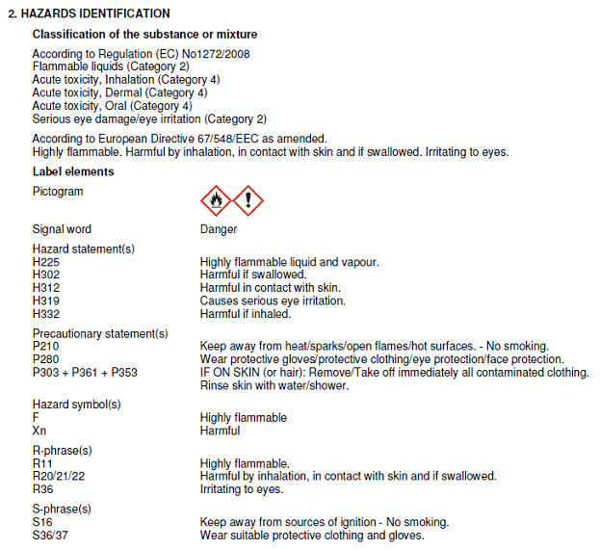
Labels
Chemical manufacturer,
importer or distributor:
ensure each container of hazardous chemicals
leaving workplace is
labeled, tagged or
marked with:
Identity of chemical,
Hazard warnings, and
Name and address of
manufacturer, distributor or importer
PPT-016-06
54
Notes:
Some were worried they would have to memorize a whole new listing of Hazard and Precautionary Statements. As shown on the slide, the alphanumeric code for both the Hazard and Precautionary Statement will be provided along with the written description. Therefore, as shown with this label, the first Hazard Statement is H225 and immediately to the right is the indication, “Highly flammable liquid and vapor.”

Slide 55
Transporting
For transportation:
Use pictograms, referred to as labels in transport regulations, prescribed by UN Model Regulations on the Transport of Dangerous Goods
PPT-016-06
55
Notes:
For transportation:
Use pictograms, referred to as labels in transport regulations, prescribed by UN Model Regulations on the Transport of Dangerous Goods.
The US Department of Transportation (DOT) also has its own requirements which may require DOT Placards fastened to the outside of a vehicle which differ from the UN GHS.
Check DOT regulations is you’re shipping a chemical.

Slide 56
Dangerous Good Label
UN regulations:
This symbol affixed to packaging on a background of contrasting color
Only UN transport markings and labels are required for outer packaging
PPT-016-06
56
Notes:
Dangerous Goods Labels will also be affixed to some shipped materials.
UN regulations:
This symbol affixed to packaging on a background of contrasting color. Only UN transport markings and labels are required for outer packaging
“As part of the rollout of the GHS rule, OSHA explicitly forbids a package from having a GHS pictogram when the package is already required to have a DOT hazmat label.” This is to reduce confusion. (see 29 CFR 1910.1200, Appendix C.2.3.3)

Slide 57
Label Examples
On containers
On shipping boxes
PPT-016-06
57
Notes:
Some of the labels you may expect to find.

Slide 58
Intermodal Container Markings
“Hazard Identification Numbers” may be used with intermodal containers
Top panel: 2 or 3 digits coded to group of hazards;
Bottom panel: these numbers can be searched in the Emergency Response Guidebook
Highly flammable liquid
Gasoline
PPT-016-06
58
Notes:
Intermodal containers have their own placarding and hazard codes. These may be found in the most current edition of the Emergency Response Guidebook.
Top panel: 2 or 3 digits coded to the group of hazards;
Bottom panel: these numbers can be searched in the Emergency Response Guidebook in the Yellow pages to provide product names and emergency actions.

Slide 59
SDS
Under the GHS, MSDSs
(material safety data sheets)
become SDS (safety data sheets)
Categories (16) to be listed in a
specific order
Adheres to ANSI standard Z400.1
GHS requires new SDSs be in
uniform format by June 1, 2015
Information for mixtures not
individual chemicals in a mixture
PPT-016-06
59
Notes:
Under the GHS, MSDSs (material safety data sheets) become SDSs (safety data sheets).
Sixteen (16) categories of product information are listed in a specific order.
The SDS adheres to ANSI standard Z400.1
GHS requires new SDSs be in uniform format by June 1, 2015.
SDS information can be provided for mixtures not individual chemicals in a mixture.

Slide 60
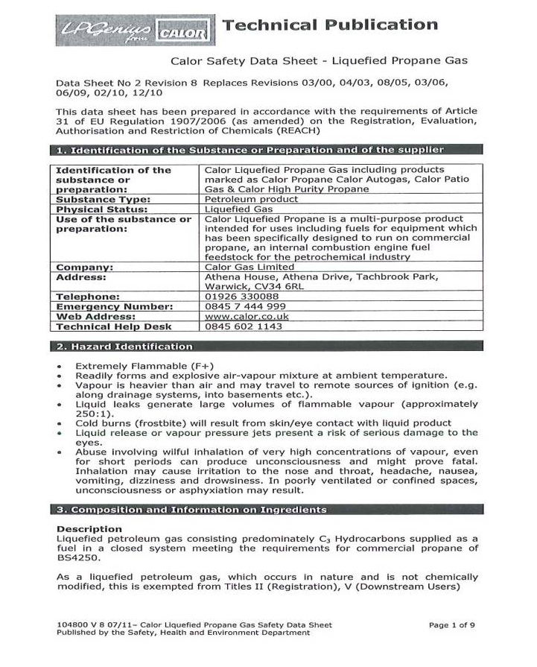
SDS
Safety Data Sheet
Developed by chemical
manufacturers and
importers
An SDS must be on hand
for each hazardous
chemical used
SDS for mixtures not
individual chemicals in the mixtures
PPT-016-06
60
Notes:
A written document prepared by a manufacturer, supplier or importer for the purpose of transmitting information concerning a chemical.
An SDS must be on hand for each hazardous chemical used
SDS for mixtures not individual chemicals in the mixtures

Slide 61
Information on a SDS
Chemical names
Manufacturer info (name,
address and telephone
numbers)
List of chemical ingredients
Permissible exposure limits
(PELs) and threshold limit
values (TLVs)
PPT-016-06
61
Notes:
Information on a SDS:
Chemical names
Manufacturer info (name, address and telephone numbers)
List of chemical ingredients
Permissible exposure limits (PELs) and threshold limit values (TLVs)

Slide 62
Information on a SDS
Any other exposure limit used or recommended by chemical manufacturer, importer or employer preparing the SDSs now are required on the SDS
PPT-016-06
62
Notes:
Any other exposure limit used or recommended by chemical manufacturer, importer or employer preparing the SDSs is now required on the SDS.

Slide 63
Information on a SDS
Reactions with other chemicals
Physical appearance
Date of preparation
Plus:
How to put out a fire caused by a
chemical
How to handle spills
How to prevent dangerous exposures
PPT-016-06
63
Notes:
Information on a SDS
Reactions with other chemicals. This information was/is covered in the NFPA Standard No. 491M Manual of Hazardous Chemical Reactions.
Physical appearance
Date of preparation
Plus:
How to put out a fire caused by a chemical
How to handle spills
How to prevent dangerous exposures
Other information can be found in the NIOSH Pocket Guide to Chemical Hazards.

Slide 64
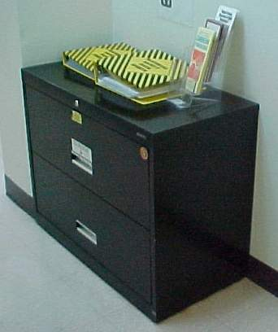
Where are your SDSs?
SDSs:
Must be readily accessible
to employees during their
work shift
Are typically kept in a
centralized location
Must be updated as new
information becomes
available
PPT-016-06
64
Notes:
Questions often arise as to where to locate the facility’s SDS’s (previously MSDS’s). According to the Haz Comm requirements, these should be readily accessible to employees during their work shift, “without direct supervisory intervention.”
The are typically kept in a centralized location.
They must be updated as new information becomes available.
FAQ. Can we keep them on computers? Yes, but you should also have a hard copy backup should the computer crash due to an emergency or incident. That’s the practical and realistic aspect of your program.

Slide 65
SDS Categories
Section 1: Identification
Section 2: Hazard identification
Section 3: Ingredients
Section 4: First-aid measures
Section 5: Fire fighting measures
Section 6: Accidental release measures
Section 7: Handling and storage
PPT-016-06
65
Notes:
SDSs have 16 categories whereas the MSDS system only contained 8. There is also a prescribed sequence of information to standardize the SDSs.
Section 1: Identification
Section 2: Hazard identification
Section 3: Ingredients
Section 4: First-aid measures
Section 5: Fire fighting measure
Section 6: Accidental release measures
Section 7: Handling and storage

Slide 66
SDS Categories
Section 8: Exposure controls and personal protection
Section 9: Physical and chemical properties
Section 10: Stability and reactivity
Section 11: Toxicological information
Section 12: Ecological information*
Section 13: Disposal considerations*
Section 14: Transport information*
Section 15: Regulatory information*
Section 16: Other information
*OSHA indicated that since other agencies regulate sections 12-15, OSHA will
not be enforcing them
PPT-016-06
66
Notes:
SDS Categories
Section 8: Exposure controls and personal protection
Section 9: Physical and chemical properties
Section 10: Stability and reactivity
Section 11: Toxicological information
Section 12: Ecological information*
Section 13: Disposal considerations*
Section 14: Transport information*
Section 15: Regulatory information*
Section 16: Other information
*OSHA indicated that since other agencies regulate sections 12-15, OSHA will not be enforcing them. But to be GHS compliant, they must be on the SDS.

Slide 67
Section 1: Identification
Product identifier used on label
Other means of identification
Recommended use of chemical and
restrictions on use
Name, address, telephone number of
manufacturer, importer or other
responsible party
Emergency phone number
PPT-016-06
67
Notes:
Section 1: Identification. Here you will find:
Product identifier used on label
Other means of identification
Recommended use of chemical and restrictions on use
Name, address, telephone number of manufacturer, importer or other responsible party
Emergency phone number

Slide 68
Section 2: Hazard Identification
Instead of hazard determination, employer must
classify a hazardous chemical according to changed
conditions provided in Appendices A and B
Pictograms are a new requirement
Standardized hazard statements
Signal words
Precautionary statements are now required
SDS required for each mixture rather than one for
each chemical comprising a mixture
If one study in 10 indicates material is carcinogenic,
but others don’t, must list the one carcinogenic study
PPT-016-06
68
Notes:
Section 2: Hazard Identification
Instead of hazard determination, employer must classify a hazardous chemical according to changed conditions provided in Appendices A and B
Pictograms are a new requirement
Standardized hazard statements
Signal words
Precautionary statements are now required
SDS required for each mixture rather than one for each chemical comprising a mixture
If one study in 10 indicates material is carcinogenic, but others don’t, must list the one carcinogenic study

Slide 69
Section 2: Hazard Identification
Classification of chemical
Signal word, hazard statement(s), symbol(s) and
precautionary statement(s) in accordance with
paragraph (f) of this section (hazard symbols may be
provided as graphical reproductions or the name of
the symbol, e.g. flame, skull and crossbones)
Unclassified hazards (e.g., combustible dust or dust
explosion hazard)
Where an ingredient with unknown acute toxicity is
used in a mixture at a concentration > 1 percent, a
statement that x percent of mixture consists of
ingredient(s) of unknown toxicity is required
PPT-016-06
69
Notes:
Section 2: Hazard Identification (cont.)
Classification of chemical
Signal word, hazard statement(s), symbol(s) and precautionary statement(s) in accordance with paragraph (f) of this section (hazard symbols may
be provided as graphical reproductions or the name of the symbol, e.g. flame, skull and crossbones)
Unclassified hazards (e.g., combustible dust or dust explosion hazard)
Where an ingredient with unknown acute toxicity is used in a mixture at a concentration > 1 percent, a statement that x percent of mixture
consists of ingredient(s) of unknown toxicity is required

Slide 70
Section 3: Composition
No new requirements other than:
Format
A separate SDS will be required
for each mixture rather than
one for each chemical
comprising the mixture
SAFETY DATA SHEETS
PPT-016-06
70
Notes:
Section 3: Composition
No new requirements other than:
Format
A separate SDS will be required for each mixture rather than one for each chemical comprising the mixture

Slide 71
Section 3: Composition
Except as provided in (i) this section on trade secrets
For Substances
Chemical name
Common name and synonyms
CAS number and other unique identifiers
Impurities and stabilizing additives which are
themselves classified and which contribute to the
classification of the substance
PPT-016-06
71
Notes:
Section 3: Composition (cont.)
Except as provided in (i) this section on trade secrets
For Substances
Chemical name
Common name and synonyms
CAS number and other unique identifiers
Impurities and stabilizing additives which are themselves classified and which contribute to the classification of the substance

Slide 72
Section 3: Composition
The chemical name and concentration or
concentration ranges of all ingredients, which are
classified as health hazards in accordance with (d)
this section
For all chemicals where a trade secret is claimed
Trade Secret per (i) this section, a statement that
the specific chemical identity and/or percent of
composition has been withheld as a trade secret is
required
PPT-016-06
72
Notes:
Section 3: Composition (cont.)
The chemical name and concentration or concentration ranges of all ingredients, which are classified as health hazards in accordance with (d)
this section
For all chemicals where a trade secret is claimed
Trade Secret per (i) this section, a statement that the specific chemical identity and/or percent of
composition has been withheld as a trade secret is required

Slide 73
Section 4: First Aid
No new requirements other than format
Description of necessary measures, subdivided
according to the different routes of exposure, i.e.
inhalation, skin and eye contact, ingestion
Most important symptoms/effects, acute and delayed
Indication of immediate medical attention and special treatment needed, if necessary
PPT-016-06
73
Notes:
Section 4: First Aid
No new requirements other than format
Description of necessary measures, subdivided according to the different routes of exposure, i.e. inhalation, skin and eye contact, ingestion
Most important symptoms/effects, acute and delayed are provided
Indication of immediate medical attention and special treatment needed, if necessary

Slide 74
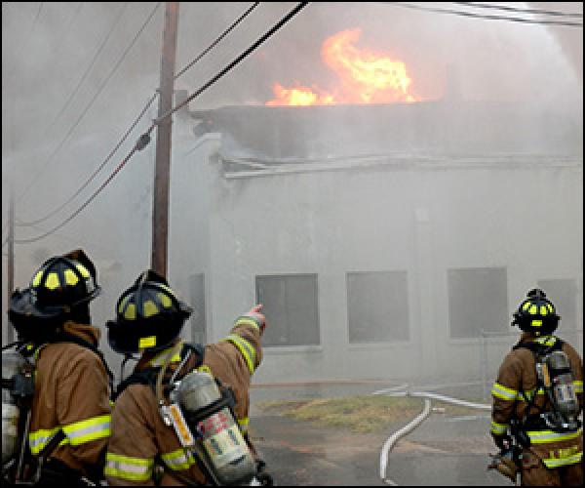
Section 5: Fire-fighting
No new requirements other than format
Suitable (and unsuitable) extinguishing media
Specific hazards arising from the chemical (e.g.
nature of any hazardous combustion products)
Special protective equipment and precautions for
firefighters
PPT-016-06
74
Notes:
Section 5: Fire-fighting
No new requirements other than format
Suitable (and unsuitable) extinguishing media
Specific hazards arising from the chemical (e.g. nature of any hazardous combustion products)
Special protective equipment and precautions for firefighters

Slide 75
Section 6: Accidental Release
No new requirements other than format
Personal precautions, protective equipment,
emergency procedures
Methods and materials for containment and clean up
PPT-016-06
75
Notes:
Section 6: Accidental Release
No new requirements other than format
Personal precautions, protective equipment, emergency procedures
Methods and materials for containment and clean up

Slide 76
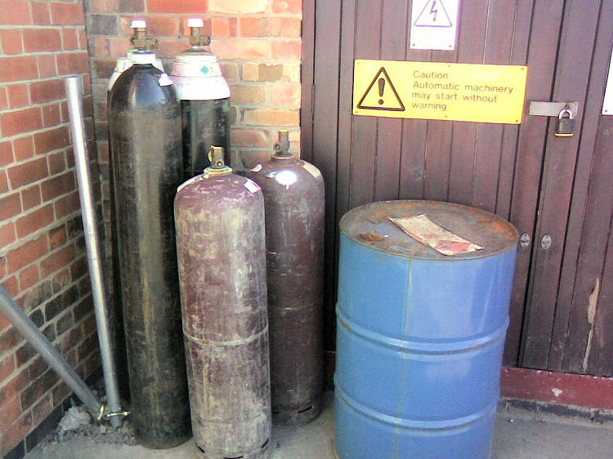
Section 7: Handling & Storage
No new requirements other than format
Precautions for safe handling
Conditions for safe storage, including any
incompatibilities
Cylinders unchained;
Drum not labeled properly;
No spill containment for drum;
Materials may be incompatible
Is this safe storage?
NO!
PPT-016-06
76
Notes:
Section 7: Handling & Storage
No new requirements other than format
Precautions for safe handling
Conditions for safe storage, including any incompatibilities are indicated.

Slide 77
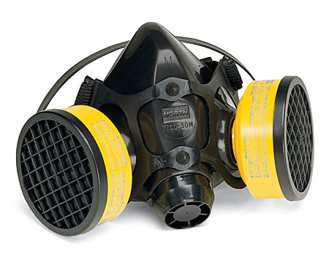
Section 8: Exposure Controls/PPE
No new requirements other than format
OSHA PEL (permissible exposure limit) and any
other exposure limit used or recommended by the
chemical manufacturer, importer or employer
preparing the SDS
Appropriate engineering controls
Individual protection measures, such as PPE
PPT-016-06
77
Notes:
Section 8: Exposure Controls/PPE
No new requirements other than format
OSHA PEL (permissible exposure limit) and any other exposure limit used or recommended by the chemical manufacturer, importer or employer
preparing the SDS
Appropriate engineering controls
Individual protection measures, such as PPE

Slide 78
Section 9: Physical, Chemical Properties
No new requirements other than format:
Appearance (physical
state, color, etc)
Odor
pH
Melting point/freezing
point
Initial boiling point and
boiling range
Flash point
Evaporation rate
Flammability (solid, liquid, gas)
Upper/lower flammability or explosive limits
Vapor pressure
Vapor density
Relative density
Solubility
PPT-016-06
78
Notes:
Section 9: Physical, Chemical Properties
No new requirements other than format:
Appearance (physical state, color, etc.)
Odor (NOT a recommended method to detect the presence of a material)
pH (How acidic or alkaline: A pH of 7 is neutral; a pH between 1 and 6 is acidic; a pH between 8 and 14 is caustic, basic or alkaline)
Melting point/freezing point
Initial boiling point and boiling range
Flash point
Evaporation rate
Flammability (solid, liquid, gas)
Upper/lower flammability or explosive limits
Vapor pressure
Vapor density
Relative density
Solubility

Slide 79
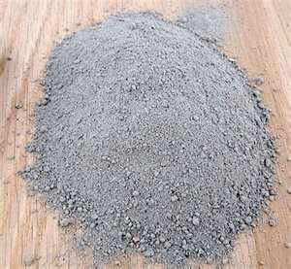
Section 9: Physical, Chemical Properties
Partition coefficient:
n-octanol/water
Auto-ignition
temperature
Decomposition
temperature
Viscosity
PPT-016-06
79
Notes:
Section 9: Physical, Chemical Properties (cont.)
Partition coefficient: n-octanol/water (the ratio of the concentrations of a substance in two heterogenous phases in equilibrium with each other.)
Auto-ignition temperature (also known as autogenious ignition temperature. The ignition temperature required without an outside flaming ignition
source.)
Decomposition temperature
Viscosity (resistance to flow)

Slide 80
Section 10: Stability and Reactivity
Conditions to avoid
New to HCS (as has
been required in ANSI
Z400.1 standard)
Reactivity
Chemical stability
Possibility of hazardous
reactions
Conditions to avoid (static discharge, shock or vibration)
Incompatible materials
Hazardous decomposition products
PPT-016-06
80
Notes:
Section 10: Stability and Reactivity
Hazardous Conditions:
New to HCS (as has been required in ANSI Z400.1 standard)
Reactivity
Chemical stability
Possibility of hazardous reactions
Conditions to avoid (static discharge, shock or vibration)
Incompatible materials
Hazardous decomposition products

Slide 81
Section 11: Toxicological Information
No new requirements other than format:
Description of various toxicological effects and
available data used to identify those effects,
including:
Likely exposure routes (inhalation, ingestion, skin and eye contact)
Symptoms related to the physical, chemical
and toxicological characteristics
Delayed and immediate effects and chronic effects from short and long term exposure
Numerical measures of toxicity (such as acute
toxicity estimates)
PPT-016-06
81
Notes:
Section 11: Toxicological Information
No new requirements other than format:
Description of various toxicological effects and available data used to identify those effects, including:
Likely exposure routes (inhalation, ingestion, skin and eye contact)
Symptoms related to the physical, chemical and toxicological characteristics
Delayed and immediate effects and chronic effects from short and long term exposure
Numerical measures of toxicity (such as acute toxicity estimates)

Slide 82
Section 12: Ecological Information
Non-mandatory
To be GHS-compliant, the requirements for
this section would be:
Ecotoxicity (aquatic and terrestrial,
where available)
Persistence and degradability
Bioaccumulative potential
Mobility in soil
Other adverse effects
PPT-016-06
82
Notes:
Section 12: Ecological Information
Non-mandatory. Although OSHA will not enforce, to be GHS-compliant, the requirements for this section would be:
Ecotoxicity (aquatic and terrestrial, where available)
Persistence and degradability
Bioaccumulative potential
Mobility in soil
Other adverse effects

Slide 83
Section 13: Disposal Considerations
To be GHS compliant, this section is provided, but
compliance is outside OSHA jurisdiction
However, OSHA may enforce provisions associated
with safe handling and use, including appropriate
hygienic practices (see Section 7, above)
Description of waste residues and information on
their safe handling
Methods of disposal
Disposal of any contaminated packaging
PPT-016-06
83
Notes:
Section 13: Disposal Considerations
To be GHS compliant, this section is provided, but compliance is outside OSHA jurisdiction
However, OSHA may enforce provisions associated with safe handling and use, including appropriate hygienic practices (see Section 7, above)
Description of waste residues and information on their safe handling
Methods of disposal
Disposal of any contaminated packaging

Slide 84
Section 14: Transportation Information
To be GHS compliant, this section is provided, but
compliance is outside OSHA jurisdiction.
UN number
UN proper shipping name
Transport hazard classes
Packing group, if applicable
Environmental hazards such as marine pollutant (yes/no)
Transport in bulk (per Annex II of MARPOL 73/78
and IBC Code)
Special precautions which a user needs to be aware of or
needs to comply with, in connection with transport or
conveyance either within or outside their premises
PPT-016-06
84
Notes:
Section 14: Transportation Information
To be GHS compliant, this section is provided, but compliance is outside OSHA jurisdiction.
UN number
UN proper shipping name
Transport hazard classes
Packing group, if applicable
Environmental hazards such as marine pollutant (yes/no)
Transport in bulk (per Annex II of MARPOL 73/78 and IBC Code)
Special precautions which a user needs to be aware of or needs to comply with, in connection with transport or conveyance either within or outside
their premises

Slide 85
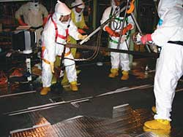
Section 15: Regulatory Information
To be GHS compliant, this section is provided, but compliance is outside OSHA jurisdiction
Safety
Health
Environmental regulations specific to product
PPT-016-06
85
Notes:
Section 15: Regulatory Information
To be GHS compliant, this section is provided, but compliance is outside OSHA jurisdiction
Safety
Health
Environmental regulations specific to product

Slide 86
Section 16: Other Information
No new requirements other than format
Date of preparation of SDS or last revision date
PPT-016-06
86
Notes:
Section 16: Other Information
No new requirements other than format
Date of preparation of SDS or last revision date

Slide 87
Written Hazard Communication Plan
The standard requires industry:
To develop and implement a written hazard
communication program
To provide hazard communication training
for employees:
Initially (to newly hired personnel)
Whenever a new hazard is introduced
into the workplace
PPT-016-06
87
Notes:
The written Hazard Communication Plan.
The standard requires industry:
To develop and implement a written hazard communication program
To provide hazard communication training for employees:
Initially (to newly hired personnel)
Whenever a new hazard is introduced into the workplace

Slide 88
Written HAZCOMM Plan Should Include
How SDS filing requirements are being met
Type of labeling system being used
Detailed information on training and
compliance
Methods to inform you of non-routine tasks
and safe procedures
Methods to inform outside contractors of the
HAZCOMM program
PPT-016-06
88
Notes:
The Plan should include:
How SDS filing requirements are being met
Type of labeling system being used
Detailed information on training and compliance
Methods to inform you of non-routine tasks and safe procedures
Methods to inform outside contractors of the HAZCOMM program

Slide 89
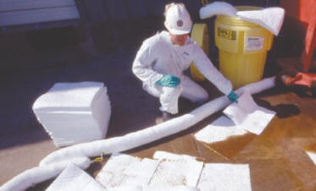
Special Hazards
Management of process spills or leaks:
Implement the facility’s emergency
control program
Secure the area
PPT-016-06
89
Notes:
Special Hazards should also be addressed in the Plan.
How to implement the facility’s emergency control plan
And how to secure the area.

Slide 90
Contractor Requirements
Contractors must abide by the
applicable provisions of federal, state and local hazard communication and right to know laws/regulations
Any contractor found not
meeting the provisions of the
laws or contractor requirements
may be required to cease work until compliance is achieved
PPT-016-06
90
Notes:
Contractor Requirements are also delineated in the standard.
Contractors must abide by the applicable provisions of federal, state and local hazard communication and right to know laws/regulations
Any contractor found not meeting the provisions of the laws or contractor requirements may be required to cease work until compliance is
achieved.

Slide 91
Contractor Requirements
The company will review and provide SDSs
for any hazardous chemicals
The contractor will maintain a copy of the
hazard communication program
The contractor will certify that it has met the
provisions of applicable laws
The contractor will notify the host safety
department
The contractor will state where chemicals will
be used or stored
PPT-016-06
91
Notes:
Contractor Requirements (cont.)
The company will review and provide SDSs for any hazardous chemicals
The contractor will maintain a copy of the hazard communication program
The contractor will certify that it has met the provisions of applicable laws
The contractor will notify the host safety department
The contractor will state where chemicals will be used or stored

Slide 92
GHS- to Comply
Find good source for relevant/compliant SDSs
Ensure accurate inventory of products and find corresponding new SDS
Current classifications, labels, and packaging need to be noted for comparison
Ensure new SDSs are in place and accessible
Ensure all containers properly labeled including secondary containers
Ensure all concerned are appropriately trained
PPT-016-06
92
Notes:
To be compliant with GHS:
Find good source for relevant/compliant SDSs
Ensure accurate inventory of products and find corresponding new SDS
Current classifications, labels, and packaging need to be noted for comparison
Ensure new SDSs are in place and accessible
Ensure all containers properly labeled including secondary containers
Ensure all concerned are appropriately trained

Slide 93
Preparing your Company
Suggestions for making
the transition:
Assemble new GHS
information
2. Check implementation dates for:
Your country, and
Out-of-country clients
3. Plan the transition
4. Inventory in-house chemicals
5. Make a plan to:
Acquire,
Update, and
Manage SDS documents
6. Update workplace labels
7. Schedule/conduct employee training
PPT-016-06
93
Notes:
Prepare your facility for making the transition with the following actions:
1. Assemble new GHS information
2. Check implementation dates for:
Your country, and
Out-of-country clients
3. Plan the transition
4. Inventory in-house chemicals
5. Make a plan to:
Acquire,
Update, and
Manage SDS documents
6. Update workplace labels
7. Schedule/conduct employee training

Slide 94
Summary
All facilities should have a hazard
communication plan in a location that is
accessible to all employees
All hazardous products should be labeled and
all employees should be aware of what and
where they are
SDSs should be available and accessible for all
hazardous products
PPT-016-06
94
Notes:
In summary;
All facilities should have a hazard communication plan in a location that is accessible to all employees
All hazardous products should be labeled and all employees should be aware of what and where they are
SDSs should be available and accessible for all hazardous products

Slide 95
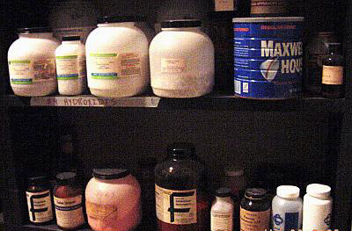
Now that You’ve Been Through the Presentation:
Do you see any problems here?
Large containers balanced on edge of shelf- not safe
If chemical, coffee can is not proper type of storage container
Maybe improperly labeled container- what’s in the coffee can? Coffee not allowed with chemicals; if chemical, not labeled properly
PPT-016-06
95
Notes:
How many deficiencies under the GHS program can you find in the slide?
Large containers balanced on edge of shelf,
Is there a chemical in coffee can?
Improperly labeled containers.

Slide 96
Contact Information
Health & Safety Training Specialists
1171 South Cameron Street, Room 324
Harrisburg, PA 17104-2501
(717) 772-1635
RA-LI-BWC-PATHS@pa.gov
Like us on Facebook! - https://www.facebook.com/BWCPATHS
PPT-016-06
96
Notes:
We invite you to contact us for other free power point programs which you can use for your in-house programs. Also, please feel invited to contact us to conduct training for your staff at your location. Other downloadable programs can be found at www.dli.state.pa.us/PATHS under training resources.

Slide 97
Questions
PPT-016-06
97

