Slide 1
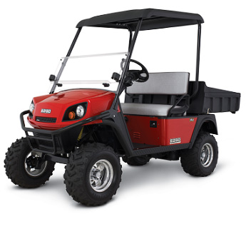
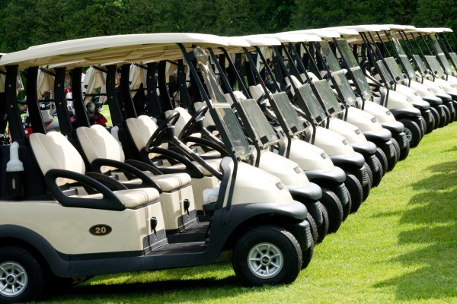
Golf & Utility Cart Safety
Bureau of Workers’ Compensation
PA Training for Health & Safety (PATHS)
Notes:
When you think of golf cart accidents, you probably think they are few and far between; a freak accident occurrence that shouldn’t warrant recognition by reputable legal organizations.
However, the truth is that these accidents are much more common than you are likely to believe. In an analysis of the National Electronic Injury Surveillance System in 2007, it was found that over 147,000 injuries occurred in the U.S. in the sixteen years from 1990 to 2006.
Some examples:
1st year College student died near home – lost control of electric cart. 3 passengers suffered minor injuries
Graduate student working a 4 day freshmen orientation outing died from head trauma suffered when he fell or jumped from back of cart performing night patrols

Slide 2
Statistics
Consumer Products Safety Commission (CPSC)
15,000 related injuries per year
40% of injuries due to passenger ejection
10% of injuries due to rollovers
40% of all injuries involve children < 16 years
www.cpsc.gov/
Notes:
Why do you think children are more likely to be injured riding in a golf cart?
Not holding on
Side rail isn’t designed for children
Lack of seat belts
Horseplay
Going to fast
One University had accident several summers ago; two brothers ran into a campus light pole knocking off the lamp fixture. The cart operator’s abdomen hit the steering wheel and the passenger’s head hit the light pole. Fortunately, neither were seriously injured.
Operating a golf cart in an unsafe manner can and does cause injuries. Driving a golf cart, no matter where, should be treated the same way as if a person is operating a car, truck or other vehicle.

Slide 3
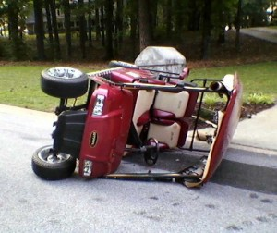
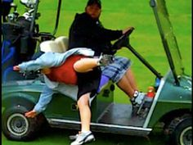
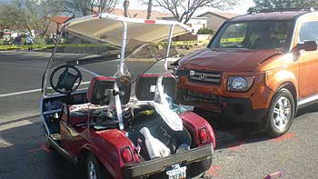
Hazards
Rollover
Improper loading (materials and people)
Passenger ejection
Collisions with people and objects
Notes:
Rollovers occur when
Going too fast
Turning too sharply
Using the cart on too steep of an incline
Load unbalanced
Change in terrain
Improper loading –
Materials not secured
Load not balance
Weight limit exceeded
Too many passengers for the number of seats available
Passenger ejection –
Can occur when making left turns due to centrifugal force; make sure passenger holding on to bar
Most golf carts not equipped with seat belts – designed for use on golf courses where users are frequently stopping and exiting carts
Standards require passive restraints – accessible handholds typically located on each side of the cart’s bench seat. Children are especially vulnerable to left turns and being ejected.
Collisions – avoidable if following the operating procedures put in place and routine maintenance; will review next

Slide 4
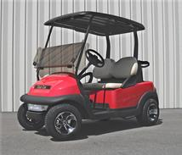
Golf Cart Safety
Operate at safe speed (equivalent to a fast paced walk).
Ensure all occupants keep arms, legs, feet, and hands inside cart.
Give pedestrians the right of way.
Obey traffic signaling devices.
Engage parking brake when cart not in use.
Notes:
Operating a golf safely involves:
Operating at safe speed (equivalent to a fast paced walk).
Ensuring all occupants keep arms, legs, feet, and hands inside cart.
Giving pedestrians the right of way.
Obeying traffic signaling devices.
Engaging the parking brake when the cart not in use.

Slide 5
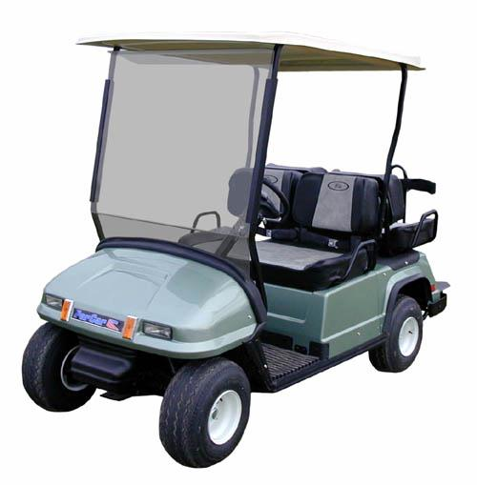
Golf Cart Safety
Check tire inflation before operation.
Check brakes before moving too far.
Check for possible battery leaks.
Never leave keys in unattended cart.
Carry only recommended # of passengers.
How many people should ride in this cart?
No more than two.
Notes:
Safe operation also requires an operator to:
Check tire inflation before operating the vehicle.
Check brakes before moving too far.
Check for possible battery leaks.
Never leave keys in unattended cart (the cart may be “borrowed” by and untrained/unauthorized operator).
Carry only recommended number of passengers.

Slide 6
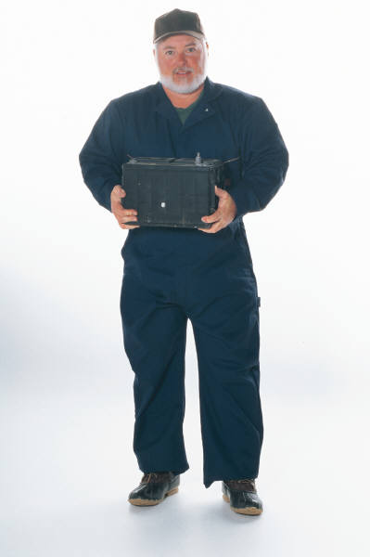
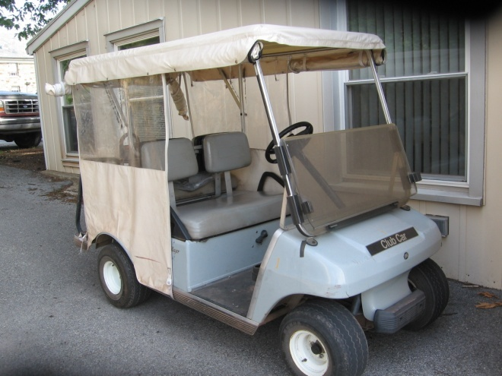
Maintenance
Daily inspection
Tires, brakes, fluid leaks
Battery care
Notes:
Regular maintenance on a golf cart is important and essential and involves inspecting tires, brakes and fluid levels daily.
Regular maintenance also involves ensuring the battery is in good condition, charged regularly and not leaking.

Slide 7
Golf Cart Safety
BATTERY CHARGING
Wear Safety Goggles and appropriate hand protection at all times.
Do not recharge the battery near an open flame or source of ignition.
Do not smoke near the recharge station.
Only an approved battery charger should be used (e.g. those designed to shut off automatically when the batteries are fully charged).
Notes:
Leaking batteries can be a problem and coming into contact with the fluid can cause skin or eye injuries. To safely charge a battery, those involved should keep the following safety precautions in mind:
Wear Safety Goggles and appropriate hand protection at all times.
Do not recharge the battery near an open flame or source of ignition.
Do not smoke near the recharge station.
Only an approved battery charger should be used (e.g. those designed to shut off automatically when the batteries are fully charged).

Slide 8
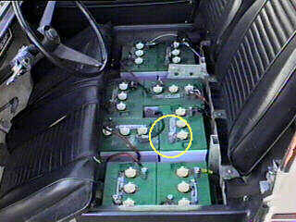
Golf Cart Safety
BATTERY CHARGING (Continued)
Pour baking soda on all spilled battery acid before cleaning up the spill.
Wash skin thoroughly with cold water if you make contact with battery acid.
Disconnect all battery charger cords before using the golf cart.
Notes:
Additionally, to charge a golf cart battery safely anyone charged with that task should also remember to:
Pour baking soda on all spilled battery acid before cleaning up the spill.
Wash skin thoroughly with cold water if you make contact with battery acid.
Disconnect all battery charger cords before using the golf cart.

Slide 9
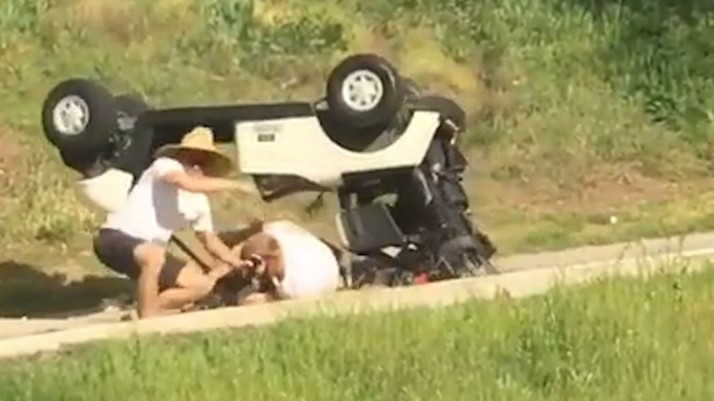
Incident Prevention
Rollovers
Take turns slowly
Distribute load evenly and only as heavy as cart/vehicle rated
Tie loads down
Reduce speed on hills and rough ground
Slow down when backing on wet surfaces
Notes:
To prevent rollovers while operating a golf cart:
Take turns slowly
Distribute load evenly and only as heavy as cart/vehicle rated
Tie loads down
Reduce speed on hills and rough ground
Slow down when backing on wet surfaces

Slide 10
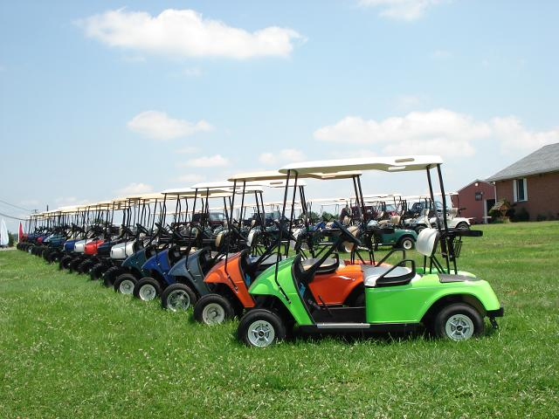
Summary
Follow the do’s and don’ts.
Drive at a speed safe for conditions and the terrain.
Ensure passengers are holding on.
Slow down on curves and blind spots.
Use of cell phones and other electronic devices should not be used while driving.
Avoid overloading the cart.
Notes:
To summarize, remember the following while operating a golf cart or other similar vehicle:
Follow the do’s and don’ts.
Drive at a speed safe for conditions and the terrain.
Ensure passengers are holding on.
Slow down on curves and blind spots.
Use of cell phones and other electronic devices should not be used while driving.
Avoid overloading the cart.

Slide 11
Review
Golf/Utility cart operators have the right-of-way on all pathways on the facility.
False
Never operate carts with more passengers than seating is provided.
True
Golf/Utility carts may be driven across or on a main street.
False
Notes:
The following slides contain some true and false statements that will test an operator’s knowledge.

Slide 12
Review
There’s no problem with using cell phones, pagers, and radios while driving a golf cart.
False
To avoid ejection of passengers when making left turns, use caution and slow down.
True
Keep a safe distance from pedestrians at all times especially those distracted by use of electronic devices.
True

Slide 13
Review
When parking the carts, avoid blocking entrances, exits, stairs, sidewalks, fire hydrants, fire lanes, or handicap ramps.
True
Leave the keys in the ignition when the cart is unattended.
False
Occupants of carts should remain seated, hold on, and keep all body parts inside the frame of the cart while it’s in motion.
True

Slide 14
Contact Information
Health & Safety Training Specialists
1171 South Cameron Street, Room 324
Harrisburg, PA 17104-2501
(717) 772-1635
RA-LI-BWC-PATHS@pa.gov
Like us on Facebook! - https://www.facebook.com/BWCPATHS
PPT-074-02
14
Notes:
We invite you to contact us for other free power point programs which you can use for your in-house programs. Also, please feel invited to contact us to conduct training for your staff at your location. Other downloadable programs can be found at www.dli.state.pa.us/PATHS under training resources.

Slide 15
Questions

