Slide 1
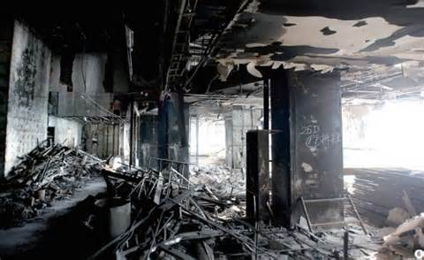
Fire Protection & Prevention
Bureau of Workers’ Compensation
PA Training for Health & Safety (PATHS)
CFR 1926 Subpart F

Slide 2
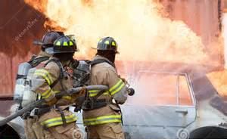
Fire Protection & Prevention
Subpart F - Fire Protection & Prevention
(1926.150 - 159)
2A fire extinguishers - Building area
Flammables/combustibles - Approved containers
Storage of LPG containers
Fire protection program/equipment
10B fire extinguisher within 50 ft. of flammable/combustible liquids

Slide 3
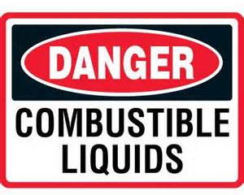
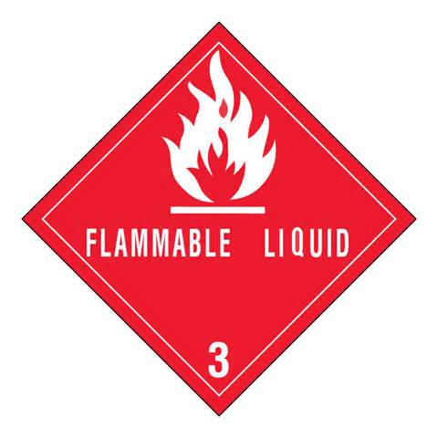
Definitions
"Combustible liquid" means any liquid having a flash point at or above 140 deg. F., and below 200 deg. F
"Flammable liquid" means any liquid having a flash point below 140 deg. F and having a vapor pressure not exceeding 40 pounds per square inch (absolute) at 100 deg. F.

Slide 4
Combustible & Flammable Liquids
200 Fº
III
140 Fº
II
Combustible
Flash point > 100 Fº
100 Fº
Flash Point Fº
IC
Flammable
Flash point < 100 Fº
73 Fº
IA
IB
Boiling Point Fº
Notes:
The afore mentioned definitions for classification of flammable and combustible liquids are quite complex. The diagram above should aid in their understanding.

Slide 5
Definitions
Flash Point
The minimum temperature at which a liquid gives off vapor within a test vessel in sufficient concentration to form an ignitable mixture with air near the surface of the liquid.
The flash point is normally an indication of susceptibility to ignition.
Notes:
Since it is the vapor of the liquid, not the liquid itself, that burns, vapor generation becomes the primary factor in determining the fire hazard.
The expression "low flash - high hazard" applies.
Liquids having flash points below ambient storage temperatures generally display a rapid rate of flame spread over the surface of the liquid, since it is not necessary for the heat of the fire to expend its energy in heating the liquid to generate more vapor.

Slide 6
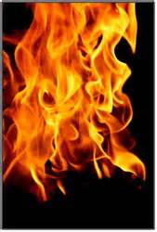
Definitions
Flammable (Explosive) Limits
The flammable range includes all concentrations of flammable vapor or gas in air, in which a flash will occur or a flame will travel if the mixture is ignited.
Notes:
There is a minimum concentration of vapor or gas in air below which propagation of flame does not occur on contact with a source of ignition.
There is also a maximum proportion of vapor in air above which propagation of flame does not occur.

Slide 7
Flammable (Explosive) Limits
Flammable Range
Explosion Pressure
LEL
UEL
Vapor/Gas Concentration in Air (%)
Notes:
These boundary-line mixtures of vapor with air are known as the lower and upper flammable or explosive limits (LEL or UEL) respectively, and they are usually expressed in terms of percentage by volume of vapor in air.

Slide 8
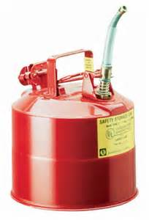
Safety Can
Safety can shall mean an approved container, of not more than 5 gallons capacity, having a spring-closing lid and spout cover and so designed that it will safely relieve internal pressure when subjected to fire exposure.

Slide 9
1926.24 Fire Protection and Prevention
Employer responsibility:
  Development and maintenance of an effective fire protection and prevention program
  At the jobsite
  Throughout all phases of construction
  Comply with provisions of Subpart F
Notes:
The employer shall be responsible for the development and maintenance of an effective fire protection and prevention program at the job site throughout all phases of the construction, repair, alteration, or demolition work. The employer shall ensure the availability of the fire protection and suppression equipment required by Subpart F of this part.

Slide 10
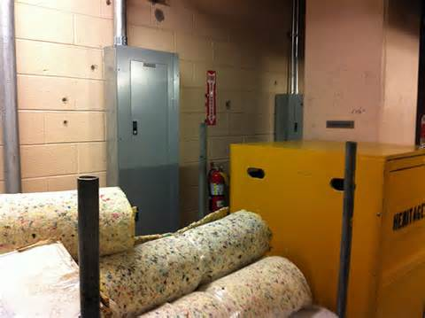
1926.150 General Requirements
Maintain access to fire fighting equipment at all times
Conspicuously located
Periodically inspected
Defective replaced
Notes:
The employer shall be responsible for the development and maintenance of an effective fire protection and prevention program at the job site throughout all phases of the construction, repair, alteration, or demolition work. The employer shall ensure the availability of the fire protection and suppression equipment required by Subpart F of this part.

Slide 11
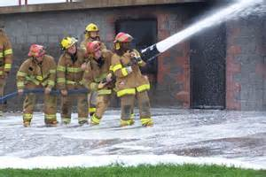
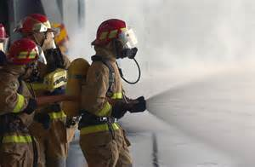
1926.150 General Requirements
Fire brigade provided as warranted
Provide water supply to protect against combustibles
Notes:
A temporary or permanent water supply, of sufficient volume, duration, and pressure, required to properly operate the firefighting equipment shall be made available as soon as combustible materials accumulate.
Where underground water mains are to be provided, they shall be installed, completed, and made available for use as soon as practicable.

Slide 12
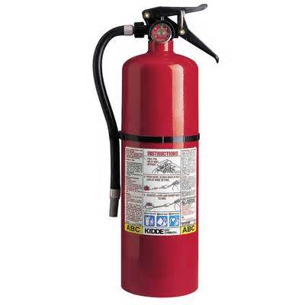
Subpart F - Fire Protection
Know what to look for when inspecting!
  Type of extinguisher
  Labeling
  Pins in place?
  Charged?
  Heft test
  Annual Hydrostatic test

Slide 13
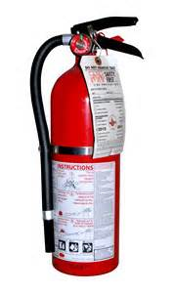
1926.150 General Requirements
Fire extinguishers:
  Fire extinguisher provided every 3000 ft²
  In protected areas travel distance to extinguisher < 100 feet
  Minimum one extinguisher per floor
  Multi-story at least one near stairway
Notes:
A fire extinguisher, rated not less than 2A, shall be provided for each 3,000 square feet of the protected building area, or major fraction thereof. Travel distance from any point of the protected area to the nearest fire extinguisher shall not exceed 100 feet.
One 55-gallon open drum of water with two fire pails may be substituted for a fire extinguisher having a 2A rating.
A 1/2-inch diameter garden-type hose line, not to exceed 100 feet in length and equipped with a nozzle, may be substituted for a 2A-rated fire extinguisher, providing it is capable of discharging a minimum of 5 gallons per minute with a minimum hose stream range of 30 feet horizontally. The garden-type hose lines shall be mounted on conventional racks or reels. The number and location of hose racks or reels shall be such that at least one hose stream can be applied to all points in the area.
One or more fire extinguishers, rated not less than 2A, shall be provided on each floor. In multistory buildings, at least one fire extinguisher shall be located adjacent to stairway.
Extinguishers and water drums, subject to freezing, shall be protected from freezing.

Slide 14
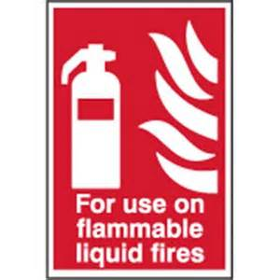
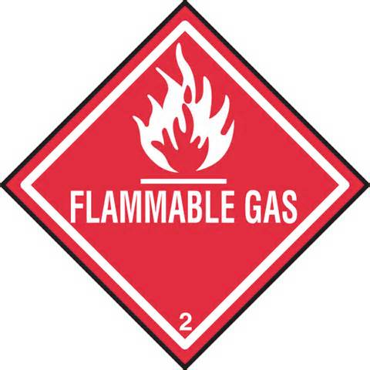
1926.150 General Requirements
Minimum 10B extinguisher within 50 feet of 5 gallons flammable liquid or 5 pounds flammable gas
Extinguishers inspected and maintained in accordance with NFPA No. 10A-1970.
Notes:
A fire extinguisher, rated not less than 10B, shall be provided within 50 feet of wherever more than 5 gallons of flammable or combustible liquids or 5 pounds of flammable gas are being used on the jobsite. This requirement does not apply to the integral fuel tanks of motor vehicles.

Slide 15
Subpart F - Fire Protection
Types of Fires
  Class A - Ordinary materials such as paper, wood, cloth
  Class B - Flammable liquids or Combustible liquids such as gasoline, paint, thinners, propane, kerosene
  Class C - Electrical equipment fires, appliances, switches, panels
  Class D - Certain metals such as magnesium, sodium, that could explode!

Slide 16
Fire Extinguishers

Slide 17
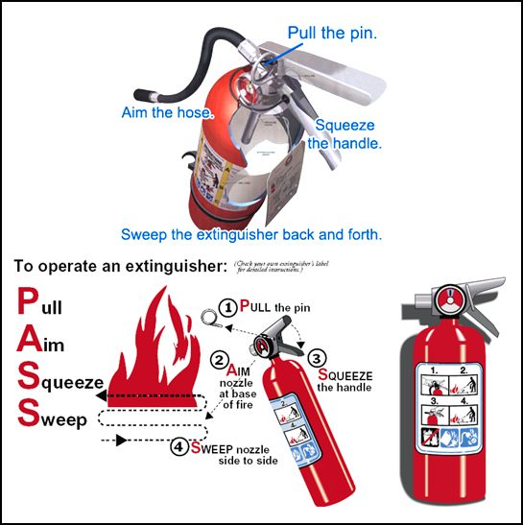
Subpart F - Fire Protection

Slide 18
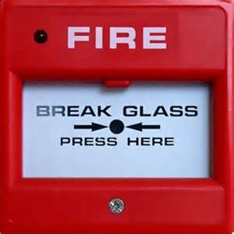
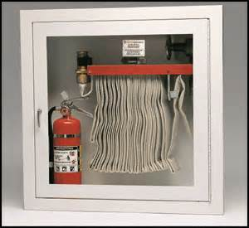
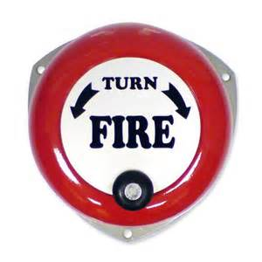
1926.150 General Requirements
Alarm system established for emergencies:
  Alert employees
  Alert fire department
Reporting instructions conspicuously posted by phones and worker entrances
Notes:
An alarm system, e.g., telephone system, siren, etc., shall be established by the employer whereby employees on the site and the local fire department can be alerted for an emergency.
The alarm code and reporting instructions shall be conspicuously posted at phones and at employee entrances.

Slide 19
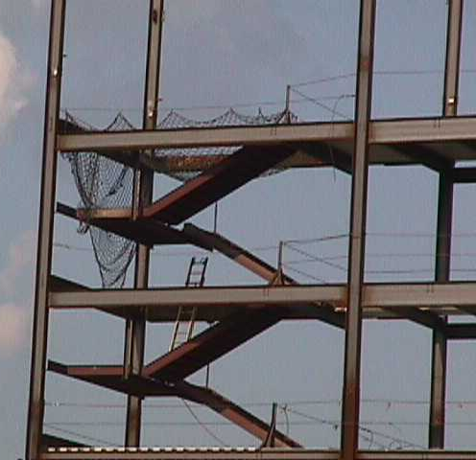
1926.150 General Requirements
Fire Cutoffs:
  Fire walls & exit stairways given construction priority
  For demolition, retain fire walls until removal required

Slide 20
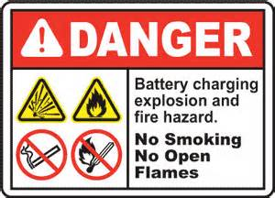
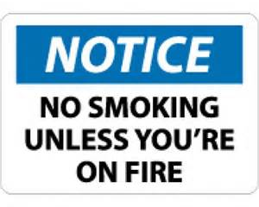
1926.151 Fire Prevention
Electrical for light, heat, and power complies with Subpart K
Engine combustion well away from combustibles
No smoking around fire hazards and signs posted
Notes:
Electrical wiring and equipment for light, heat, or power purposes shall be installed in compliance with the requirements of Subpart K of this part.
Internal combustion engine powered equipment shall be so located that the exhausts are well away from combustible materials. When the exhausts are piped to outside the building under construction, a clearance of at least 6 inches shall be maintained between such piping and combustible material.
Smoking shall be prohibited at or in the vicinity of operations which constitute a fire hazard, and shall be conspicuously posted: "No Smoking or Open Flame.”
Portable battery powered lighting equipment, used in connection with the storage, handling, or use of flammable gases or liquids, shall be of the type approved for the hazardous locations.

Slide 21

1926.151 Fire Prevention
Combustible piles no higher than 20 feet
Driveways around combustible piles minimum 15 feet
wide
Maximum
driveway grid
50' by 150'
50'
20'
150'
15'
Notes:
Combustible materials shall be piled with due regard to the stability of piles and in no case higher than 20 feet.
Driveways between and around combustible storage piles shall be at least 15 feet wide and maintained free from accumulation of rubbish, equipment, or other articles or materials. Driveways shall be so spaced that a maximum grid system unit of 50 feet by 150 feet is produced.
The entire storage site shall be kept free from accumulation of unnecessary combustible materials. Weeds and grass shall be kept down and a regular procedure provided for the periodic cleanup of the entire area.
When there is a danger of an underground fire, that land shall not be used for combustible or flammable storage.

Slide 22
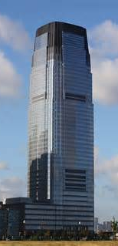
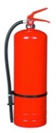
1926.151 Fire Prevention
10'
No piles within ten feet of buildings
Fire extinguisher provided within 100 feet
50'
20'
150'
15'
Notes:
Method of piling shall be solid wherever possible and in orderly and regular piles. No combustible material shall be stored outdoors within 10 feet of a building or structure.
Portable fire extinguishing equipment, suitable for the fire hazard involved, shall be provided at convenient, conspicuously accessible locations in the yard area. Portable fire extinguishers, rated not less than 2A, shall be placed so that maximum travel distance to the nearest unit shall not exceed 100 feet.

Slide 23
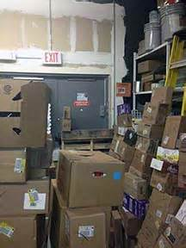
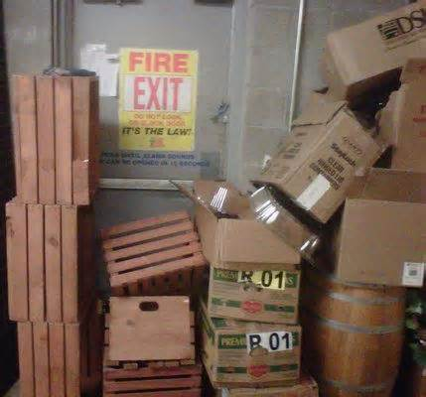
1926.151 Fire Prevention
Indoor Storage:
  No obstruction to exit
  Appropriate management of all fire hazard materials
  Segregate non-compatibles
  Three feet clearance maintained to sprinklers
Notes:
Storage shall not obstruct, or adversely affect, means of exit.
All materials shall be stored, handled, and piled with due regard to their fire characteristics.
Noncompatible materials, which may create a fire hazard, shall be segregated by a barrier having a fire resistance of at least 1 hour.
Material shall be piled to minimize the spread of fire internally and to permit convenient access for firefighting. Stable piling shall be maintained at all times. Aisle space shall be maintained to safely accommodate the widest vehicle that may be used within the building for firefighting purposes.
Clearance of at least 36 inches shall be maintained between the top level of the stored material and the sprinkler deflectors.
Clearance shall be maintained around lights and heating units to prevent ignition of combustible materials.
A clearance of 24 inches shall be maintained around the path of travel of fire doors unless a barricade is provided, in which case no clearance is needed. Material shall not be stored within 36 inches of a fire door opening.

Slide 24
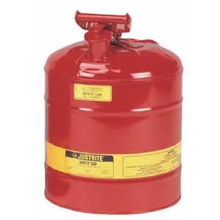
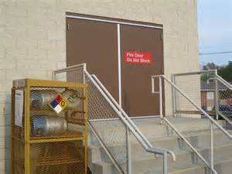
1926.152 Flammable & Combustible Liquids
Flammable liquids > 1 gallon requires safety can
Flammables not stored near exits or stairways
Notes:
Only approved containers and portable tanks shall be used for storage and handling of flammable and combustible liquids. Approved metal safety cans shall be used for the handling and use of flammable liquids in quantities greater than one gallon, except that this shall not apply to those flammable liquid materials which are highly viscid (extremely hard to pour), which may be used and handled in original shipping containers. For quantities of one gallon or less, only the original container or approved metal safety cans shall be used for storage, use, and handling of flammable liquids.
Flammable or combustible liquids shall not be stored in areas used for exits, stairways, or normally used for the safe passage of people.

Slide 25
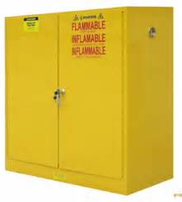
1926.152 Flammable & Combustible Liquids
Inside Storage:
  Max 25 gallons stored outside flammable cabinet
  Cabinets labeled “Flammable - Keep Fire Away”
Notes:
No more than 25 gallons of flammable or combustible liquids shall be stored in a room outside of an approved storage cabinet. For storage of liquefied petroleum gas, see 1926.153.
Quantities of flammable and combustible liquid in excess of 25 gallons shall be stored in an acceptable or approved cabinet meeting the following requirements:
Acceptable wooden storage cabinets shall be constructed in the following manner, or equivalent: The bottom, sides, and top shall be constructed of an exterior grade of plywood at least 1 inch in thickness, which shall not break down or delaminate under standard fire test conditions. All joints shall be rabbeted and shall be fastened in two directions with flathead wood screws. When more than one door is used, there shall be a rabbeted overlap of not less than 1 inch. Steel hinges shall be mounted in such a manner as to not lose their holding capacity due to loosening or burning out of the screws when subjected to fire. Such cabinets shall be painted inside and out with fire retardant paint.
Approved metal storage cabinets will be acceptable.
Cabinets shall be labeled in conspicuous lettering, "Flammable-Keep Fire Away."

Slide 26
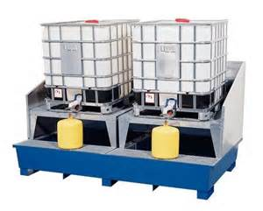
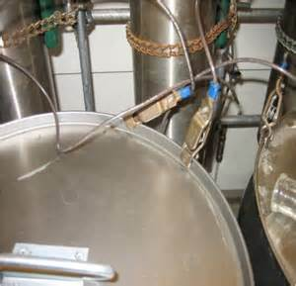
1926.152 Flammable & Combustible Liquids
Dispensing 5 gallons or more, segregate 25 feet from other operations
Bonding required for container transfer
Notes:
Areas in which flammable or combustible liquids are transferred at one time, in quantities greater than 5 gallons from one tank or container to another tank or container, shall be separated from other operations by 25-feet distance or by construction having a fire resistance of at least 1 hour. Drainage or other means shall be provided to control spills. Adequate natural or mechanical ventilation shall be provided to maintain the concentration of flammable vapor at or below 10 percent of the lower flammable limit.
Transfer of flammable liquids from one container to another shall be done only when containers are electrically interconnected (bonded).

Slide 27
1926.152 Flammable & Combustible Liquids
The dispensing units shall be protected against collision damage
Containers closed when not in use
Notes:
The dispensing units shall be protected against collision damage.
Flammable liquids shall be kept in closed containers when not actually in use.
Leakage or spillage of flammable or combustible liquids shall be disposed of promptly and safely.

Slide 28
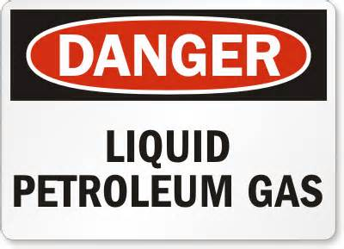
1926.153 Liquefied petroleum gas (LP-Gas)
Systems, valves, connectors of approved type
Welding is prohibited on containers
Storage of LPG within buildings is prohibited
Filling of portable containers or containers mounted on skids from storage containers shall be performed not less than 50 feet from the nearest building.

Slide 29


Contact Information
Health & Safety Training Specialists
1171 South Cameron Street, Room 324
Harrisburg, PA 17104-2501
(717) 772-1635
RA-LI-BWC-PATHS@pa.gov
Like us on Facebook! - https://www.facebook.com/BWCPATHS

Slide 30

Questions

