Slide 1
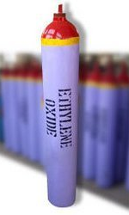
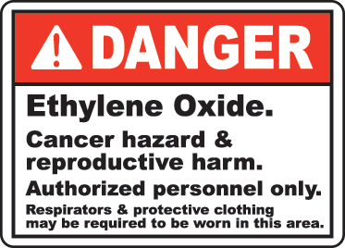
Ethylene Oxide Safety
Bureau of Workers’ Compensation
PA Training for Health & Safety (PATHS)
29 CFR 1910.1047
Subpart Z
Ethylene Oxide(EtO)
PPT-071-01
1
Notes:
This presentation deals with safety issues related to those exposed to Ethylene Oxide (EtO).
Cited are relevant sections of 29 CFR 1910.1047, Subpart Z dealing with Ethylene Oxide exposure.
Uses: EtO is a major industrial chemical and one of the 25 highest production volume chemicals in the United States.
Used as a chemical intermediate for the production of various chemicals with less than 1% used as a sterilant for foods or fumigant.
Used to produce ethylene glycol, non-ionic surfactants, glycol ethers, and ethanolamines. Used in hospitals to sterilize surgical equipment and plastic devices.
Other uses will discussed later in the program.

Slide 2
Program Topics
Glossary
Properties
Uses
Exposures
Monitoring
Compliance with
29 CFR 1910.1047
PPE
Medical Surveillance
Hazard Communication
and Training
Records
Bibliography
PPT-071-01
2
Notes:
The topics for this presentation include:
Glossary
Properties
Uses
Exposures
Monitoring
Compliance with 29 CFR 1910.1047
PPE
Medical Surveillance
Hazard Communication and Training
Records
Bibliography

Slide 3
Glossary of Terms*
Action Level: A concentration of airborne EtO of 0.5 ppm calculated as an 8-hour time-weighted average (which equals 0.9 mg/m³).
Authorized Person: Person specifically authorized by employer to enter a regulated area, or entering into such an area to observe monitoring and measuring procedures, or any other person authorized by the Act or regulations issued under the Act.
Emergency: Any occurrence such as, but not limited to, equipment failure, container rupture or failure of control equipment likely to or does result in an unexpected significant release of EtO.
PPT-071-01
3
Notes:
At the Action Level, certain actions are triggered under the standard, i.e. exposure monitoring and medical surveillance.
Generally the Action Level can be reduced through engineering controls and administrative controls (policies and procedures).
The last resort is the use of PPE.

Slide 4
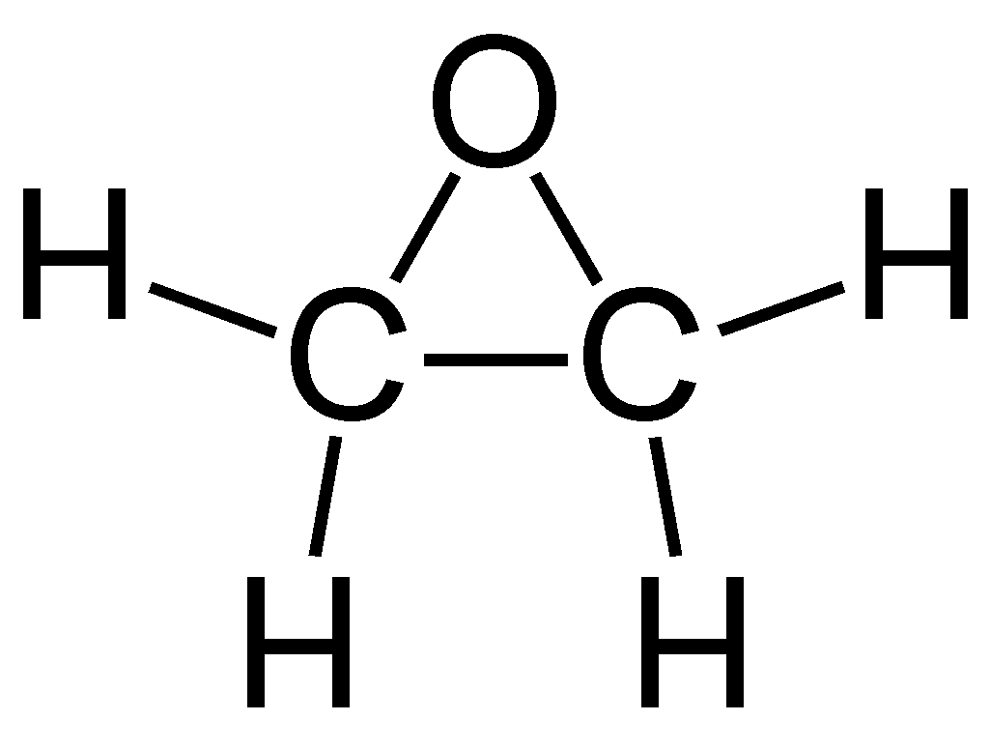
Glossary of Terms*
Employee exposure: Exposure to airborne EtO which would occur if the employee were not using respiratory protective equipment.
Ethylene oxide or EtO: Three-membered ring organic compound with chemical formula C₂H₄O.
PPT-071-01
4
Notes:
EtO is a carcinogen that may cause leukemia and other cancers. It is also linked to spontaneous abortion, genetic damage, nerve damage, peripheral paralysis, muscle weakness, as well as impaired thinking and memory.
OSHA Fact Sheet, US Department of Labor, 2002.

Slide 5
Glossary of Terms*
8 Hour TWA = Threshold Limit Value-Time Weighted
Average. Air concentration under which most people can
work for 8 hours a day. (For EtO =1 ppm which equals
1.8 mg/m³).
PEL = Permissible Exposure Limit. OSHA enforced; 8
hour airborne concentration.
PPM = Parts per million. Method of reading
concentrations.
Excursion Limit = (Short Term Exposure Limit) Amount
to which persons may be exposed for 15 minutes. EtO=
5 ppm equal to 9 mg/m³.
PPT-071-01
5
Notes:
*Terms can also be found in the NIOSH Pocket Guide to Chemical Hazards.

Slide 6
Glossary of Terms*
Excursion Limit:
No employee is to be exposed to an Ethylene Oxide airborne concentration in excess of 5 ppm as averaged over a sampling period of 15 minutes.
Summary:
Action level = 0.5 ppm for 8 hour TWA
Permissible exposure limit = 1 ppm for 8-hour TWA
Excursion limit = 5 ppm for 15 minutes
PPT-071-01
6
Notes:
*Terms can also be found in the NIOSH Pocket Guide to Chemical Hazards

Slide 7
Glossary of Terms*
IDLH = Immediately Dangerous to Life & Health. Conditions which pose an immediate threat to life or health.
UEL = Upper Explosive Limit. Greatest amount of vapor/gas mixed with air where combustion can occur.
LEL = Lower Explosive Limit. Least amount of vapor/gas mixed with air where combustion can occur.
PPT-071-01
7
Notes:
*Terms can also be found in the NIOSH Pocket Guide to Chemical Hazards

Slide 8
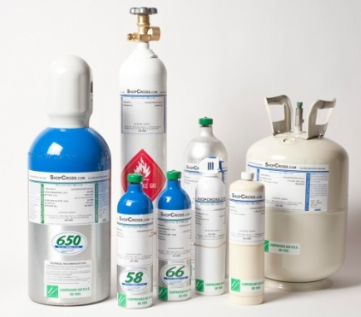
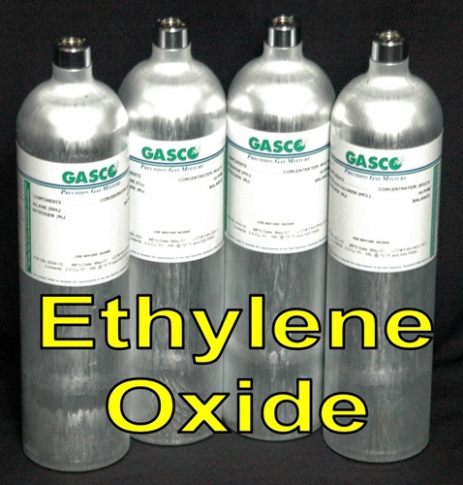
29 CFR 1910.1047, Subpart Z
This Ethylene Oxide standard applies to all occupational exposures:
From liquid, gas,
Materials which release
ethylene oxide
PPT-071-01
8
Notes:
The applicability is stated in 29 CFR 1910.1047(a)(1), also indicating it applies to EtO with the Chemical Abstract Service Registry No. 75-21-8 for specific reference.

Slide 9
29 CFR 1910.1047, Subpart Z
This Ethylene Oxide standard does NOT apply to:
Processing, use or handling of products containing EtO where objective data are reasonably relied on that demonstrate the product is not capable of releasing EtO in airborne concentrations at or above the action level and may not reasonably be foreseen to release EtO in excess of the excursion limit under expected conditions of processing, use, or handling.
PPT-071-01
9
Notes:
If an employer is exempt from the standard, then is exempt from monitoring requirements if objective data demonstrates such exemption. Data might be generated by the employer, obtained from manufacturers, industry studies, or trade associations. Maintain data for as long as employer relies on it for exemption.

Slide 10
29 CFR 1910.1047, Subpart Z
This Ethylene Oxide standard does NOT apply:
Where products containing EtO are exempt.
The employer shall maintain records of data supporting the exemption.
Exemption Data
PPT-071-01
10
Notes:
Maintain data for as long as employer relies on it for exemption. (29 CFR 1910.1047(a)(3).

Slide 11
OSHA General Duty Clause
Section 5(a)(1)of the OSH Act, (the General Duty Clause) where employers must
“…Furnish to each of his employees … a place of employment … free from recognized hazards that are causing or are likely to cause death or serious physical harm to his employees."
Section 5(a)(2) requires employers to "comply with occupational safety and health standards promulgated under this Act."
PPT-071-01
11
Notes:
Some facilities are not under OSHA, however it has been discovered that the adoption of OSHA Standards by Reference are “Best Practices.”
OSHA’s General Duty Clause is shown requiring each employer to provide their employees with a hazard-free environment.
If you have staff working at field locations, such safety would be required at those locations as well.

Slide 12
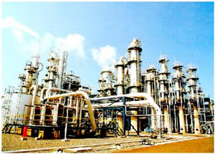
Ethylene Oxide
Also known as:
Dimethylene Oxide
1,2-Epoxyethane
Oxinane
EtO
Global demand for ethylene oxide is forecast to grow at a rate of 5% per year from 2009 to 2014, and around 3% per year from 2014 to 2019*
PPT-071-01
12
Notes:
(SRI Consulting, 2010).

Slide 13
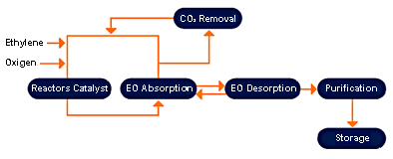
Ethylene Oxide
Initially made using ethylene chlorohydrin as an intermediate
but now by the direct oxidation
of ethylene with air or oxygen in
presence of silver oxide catalyst.
OSHA has concluded that
Ethylene oxide “should
be regarded as a
potential human
carcinogen”
PPT-071-01
13
Notes:
“Ethylene Oxide (EtO) Production and Manufacturing Process,” at http://www.icis.com/v2/chemicals/9075773/ethylene+oxide/process.html

Slide 14
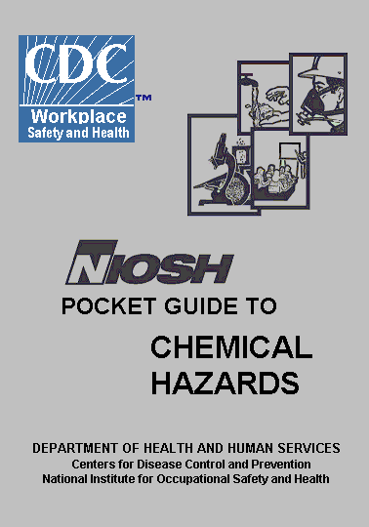
Ethylene Oxide Properties
IDLH: Ca (800ppm) Carcinogen
OSHA PEL: TWA 1.0 PPM
STEL: 5 PPM as a 15-minute Excursion
Colorless, odorless gas or liquid.
CAS Number: 75-21-8
MW: 44.1
Boiling Point: 51ºF
Sol: Miscible with water, ether, alcohol
and most organic solvents
IP: 10.56 eV
RGasD: 1.49 (vapors are minimally
heavier than air)
Sp.Gr: 0.82 (liquid at 50ºF)
UEL: 100%
LEL: 3.0%
Flammable Gas and highly reactive
Ignition temperature: 804ºF
PPT-071-01
14
Notes:
NIOSH: DHHS (NIOSH) Publication No. 2005-149, September 2007
Email: cdcinfo@cdc.gov
Website: www.cdc.gov/niosh

Slide 15
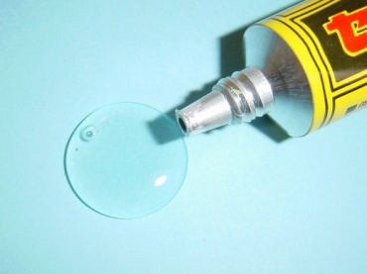
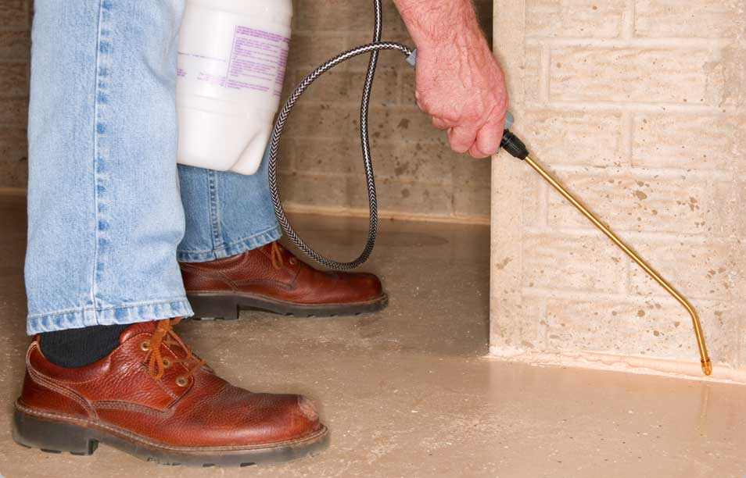
Forms/Derivatives
Ethylene oxide is used to manufacture:
Textiles,
Detergents,
Polyurethane foam
Antifreeze,
Solvents
Medicines
Adhesives,
Sterilant for food and cosmetics
Sterilization of surgical equipment
and plastic devices otherwise
damaged by steam
PPT-071-01
15
Notes:
EtO is used to manufacture many items such as those listed.

Slide 16
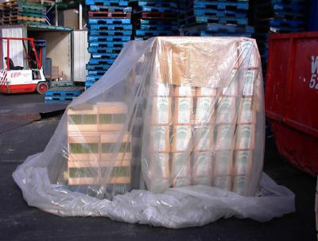
Forms/Derivatives
Also used to produce:
Ethylene glycol
Non-ionic surfactants
Glycol ethers
Ethanolamines
Miscellaneous chemicals
Fumigants
Cosmetics
Sterilant for food
PPT-071-01
16
Notes:
EtO is also used to produce those products listed.

Slide 17
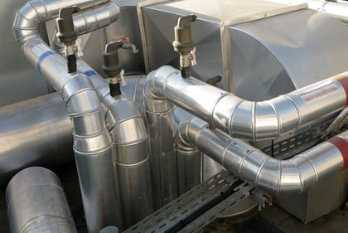
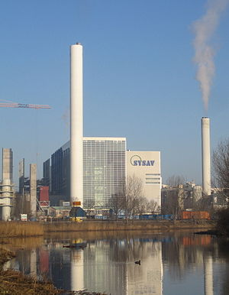
Waste Materials
Scrubbers can be used to remove waste gases
Other waste containing EtO may be incinerated by:
-Rotary kiln, or
-Fluidized bed incineration
PPT-071-01
17
Notes:
Waste materials:
Scrubbers can be used to remove waste gases
Other waste containing EtO may be incinerated by:
-Rotary kiln, or
-Fluidized bed incineration

Slide 18
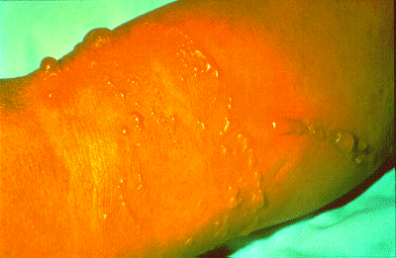
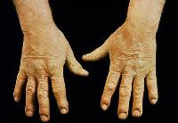
Signs/Symptoms of Exposure
Injury to eyes and skin or if inhaled
Liquid:
Eye irritation and skin blistering
Ingestion:
Gastric irritation and liver damage
Inhaled:
Lung injury, headache, nausea,
vomiting, diarrhea, shortness of
breath and cyanosis.
Cancer, reproductive effects,
neurotoxicity and other effects
PPT-071-01
18
Notes:
1910.1047, Appendix A
During training, apprise each staff member of the signs and symptoms of exposure as well as immediate actions to take.

Slide 19
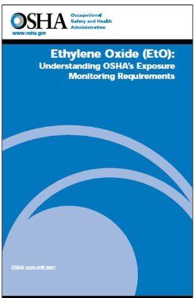
Exposure Monitoring
Types of Monitoring in Standard:
Area Monitoring: Of the workplace at
large and in different locations
Personal Monitoring: short-term
testing of the employee’s breathing
zone
Leak Detection: periodic testing of
potential point sources
Area Monitoring does not take the place of personal monitoring
PPT-071-01
19
Notes:
“Monitoring” in the context of the OSHA publication does NOT refer to the sort of 24/7 continuous area monitoring for EtO, most often performed in hospital SPDs (Sterile Processing Departments). Rather, it refers to relatively short-term testing of either the employee’s breathing zone (personal monitoring), the workplace at large and in different locations (area monitoring), or periodic testing of potential point sources (leak detection). ( From “Our commentary on OSHA’s Small Business Guide for Ethylene Oxide” from authors of the “Guide” cited.)
The OSHA “Small Business Guide for Ethylene Oxide,” has a decision matrix, Table 3, on page 15, indicating Actions Triggered by Air Sampling Results.
“Small Business Guide for Ethylene Oxide,” OSHA 33-59-04-2009, www.osha.gov.

Slide 20
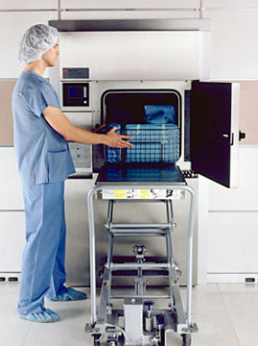
Exposure (Personal) Monitoring
Determinations of exposure shall be made from breathing zone air samples representative of both, the 8-hour TWA and 15-minute STEL of each employee.
Representative 8-hour TWA employee exposure.
Determine on basis of 1 or more samples representing full-shift exposure for each shift for each job classicization in each work area.
PPT-071-01
20
Notes:
29 CFR 1910.1047(d)(1)(ii)
Conventionally, the "breathing zone" is defined as the zone within a 0.3 m (or 10 inches) radius of a worker's nose and mouth, and it has been generally assumed that a contaminant in the breathing zone is homogeneous and its concentration is equivalent to the concentration inhaled by the worker.

Slide 21
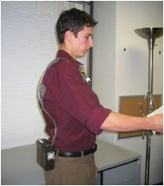
Exposure Monitoring
Representative 15-minute short -term exposure shall be on basis of 1 or more samples representing 15-minute exposures
Associated with operations most likely to produce exposures above excursion limit.
For each shift
For each job classification
In each work area
Air sampling pump
and sorbent tube.
PPT-071-01
21
Notes:
Collect a 15 minute air sample during portion of work shift when you think employee’s EtO exposure will be the highest.
(“Ethylene Oxide (EtO): Understanding OSHA’s Exposure Monitoring Requirements,” OSHA 3325-01N, page 12, 2007, www.osha.gov.)

Slide 22
Exposure Monitoring
Importance of 15 minute sample:
“Research shows exposures above 15-minute OSHA PEL continue to occur in workplaces involved in processing, using, or handling products containing EtO.
Monitoring often fails to detect accidental exposures during EtO leaks and spills. Look at your activities when possible releases may occur:
▫ Changing EtO supply cylinders,
▫ Working with sterilizers where doors are opened at the end of a cycle or when EtO is being pumped into/out of equipment.”
PPT-071-01
22
Notes:
(“Ethylene Oxide (EtO): Understanding OSHA’s Exposure Monitoring Requirements,” OSHA 3325-01N, page 12-13, 2007, www.osha.gov.)

Slide 23
Exposure Monitoring
Should you monitor every employee?
No, but you need to determine the exposure level of every employee.
Only 1 employee or a few doing different jobs, collect samples for each.
Two or more employees at same job, collect from one and use results as representative sample.
PPT-071-01
23
Notes:
Not every employee needs to be monitored, however the exposure level for each employee must be determined.

Slide 24
Exposure Monitoring
If you answer “no” to any of following, compare a similar group or do individual monitoring:
Employees do same job?
Similar working conditions (equipment/tasks)?
Similar work practices?
Same area or similar air patterns?
Use same EtO product, same amount of time?
Work same distances from possible EtO sources?*
*“Ethylene Oxide (EtO): Understanding OSHA’s Exposure Monitoring Requirements,” OSHA 3325-01N, page 11, 2007, www.osha.gov.
PPT-071-01
24
Notes:
*“Ethylene Oxide (EtO): Understanding OSHA’s Exposure Monitoring Requirements,” OSHA 3325-01N, page 11, 2007, www.osha.gov.

Slide 25
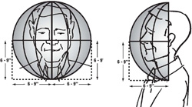
Exposure Monitoring
Where employer can document exposure levels are equivalent for similar operations in different work shifts, employer need only determine representative employee exposure for that operation during one shift.
Monitor within breathing zone.
PPT-071-01
25
Notes:
Upper right side: passive diffusion monitor.
Lower right: Indicates the area within the breathing zone that would be monitored.

Slide 26
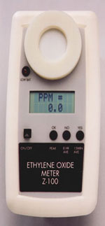
Initial Monitoring
Employer covered by this standard, unless exempted, shall perform initial monitoring to determine accurately the airborne concentration of EtO to which employees may be exposed.
Monitored after June 15, 1983, employer may rely on earlier results to satisfy standard.
This includes excursion results which are relied on.
PPT-071-01
26
Notes:
Initial Monitoring is addressed in 29 CFR 1910.1047(d)(2)

Slide 27
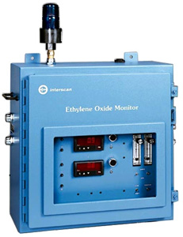
Frequency: Periodic Monitoring
If exposure is at or above action level but at or below the 8-hour TWA employer shall repeat monitoring for each employee at least every 6 months.
If exposure is above the 8-hour TWA-repeat monitoring for each such employee at least every 3 months.
PPT-071-01
27
Notes:
“Action Level” means a concentration of airborne EtO of 0.5 ppm calculated as an eight (8)-hour time-weighted average. (29 CFR 1910.1047(b))

Slide 28
Frequency: Periodic Monitoring
May alter schedule from quarterly to semiannually for any employee for whom 2 consecutive measurements taken at least 7 days apart indicate employee’s exposure has decreased to or below the 8-hour TWA.
If monitoring reveals employee exposure above 15 minute excursion limit, repeat such monitoring for each such employee at least every 3 months and more often as necessary to evaluate employees short-term exposures.
PPT-071-01
28
Notes:
29 CFR 1910.1047(d)(3)

Slide 29
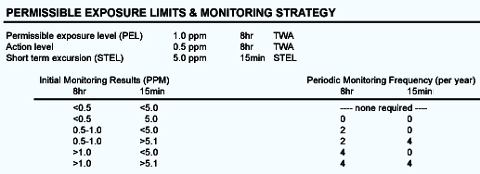
Frequency: Periodic Monitoring
Actions Triggered by Monitoring Results: Summary
PPT-071-01
29
Notes:
“Ethylene Oxide (EtO): Understanding OSHA’s Exposure Monitoring Requirements,” OSHA 3325-01N, pages 15-17, Tables 3-4, 2007, www.osha.gov.

Slide 30
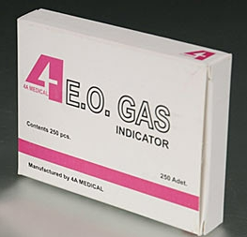
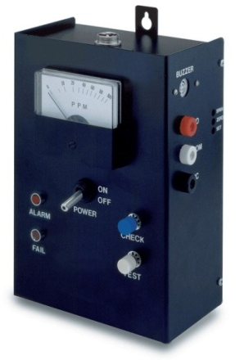
Termination of Monitoring
Initial Monitoring
If it is revealed exposure is below the action level, employer may discontinue TWA monitoring for those employees whose exposures are represented by the initial monitoring.
If exposure is at or below excursion limit.
PPT-071-01
30
Notes:
“Action Level” means a concentration of airborne EtO of 0.5 ppm calculated as an eight (8)-hour time-weighted average.

Slide 31
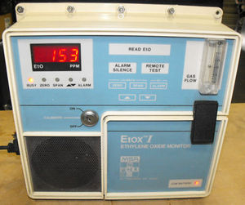
Termination of Monitoring
Periodic Monitoring
If employee exposure, as indicated by at least 2 consecutive measurements taken at least 7 days apart are below action level-TWA monitoring may be discontinued.
At or below excursion limit-employer may discontinue monitoring.
PPT-071-01
31
Notes:
“Action Level” means a concentration of airborne EtO of 0.5 ppm calculated as an eight (8)-hour time-weighted average.
“Excursion Limit” means the maximum exposure a person may have to a chemical over a short period (usually 30 minutes).

Slide 32
Additional Monitoring
Institute monitoring if a change in:
Production
Process
Control equipment
Personnel or
Work practices
Which may result in new or
additional exposures to EtO
Or when employer has reason to
suspect a change may
result in new or additional
exposures.
PPT-071-01
32
Notes:
Remember the intent of OSHA regulations is to promote the safety of the worker in the workplace!

Slide 33
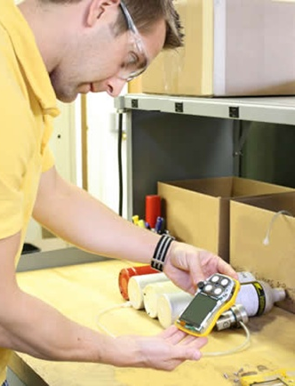
Monitoring Accuracy
To a confidence level of 95%, to within plus or minus 25% for airborne concentrations at the 1 ppm TWA and to within plus or minus 35% for airborne concentrations at the action level of 0.5 ppm.
Airborne Concentration
Monitoring shall be accurate to a confidence level of 95%, to within plus or minus 35% for airborne concentrations of EtO at the excursion limit.
PPT-071-01
33
Notes:
Monitoring accuracy.
To a confidence level of 95%, to within plus or minus 25% for airborne concentrations at the 1 ppm TWA and to within plus or minus 35% for airborne concentrations at the action level of 0.5 ppm.
Airborne Concentration
Monitoring shall be accurate to a confidence level of 95%, to within plus or minus 35% for airborne concentrations of EtO at the excursion limit.

Slide 34
Monitoring Accuracy
Each affected employee must be notified individually in writing or by posting within 15 working days of results after employer receives them
Corrective actions will also be indicated.
PPT-071-01
34
Notes:
Each affected employee must be notified individually in writing or by posting within 15 working days of results after employer receives them.
Corrective actions will also be indicated.

Slide 35
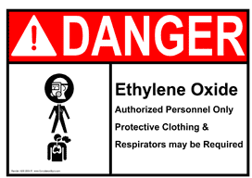
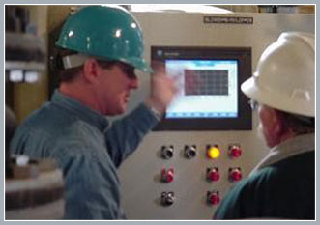
Monitoring Accuracy
Affected employees or representatives shall be given opportunity to observe monitoring.
If affected area requires PPE to view monitoring, employer will provide the PPE and ensure observer complies with all safety and health procedures.
PPT-071-01
35
Notes:
Affected employees or representatives shall be given opportunity to observe monitoring.
If affected area requires PPE to view monitoring, employer will provide the PPE and ensure observer complies with all safety and health procedures.

Slide 36
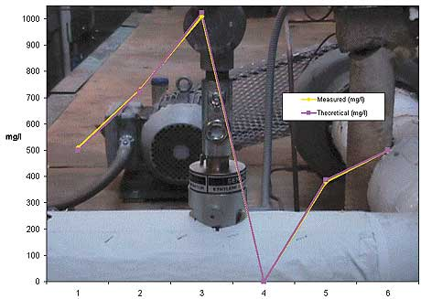
Regulated Areas
Created when airborne limits may exceed TWA or when concentrations exceed or can reasonably be expected to exceed excursion limit.
Access limited to authorized persons.
Area demarcated to minimize persons within regulated area.
PPT-071-01
36
Notes:
Regulated Areas
Created when:
airborne limits may exceed TWA or
when concentrations exceed or can reasonably be expected to exceed excursion limit.
Access limited to authorized persons.
Area demarcated to minimize persons within regulated area.

Slide 37
Area Monitoring
Area Monitoring
Detect EtO levels throughout the general work area
Area samples taken close to emission source or
Collected at various locations throughout the
work area
Detectors may be wall-mounted or placed
directly on equipment
May be similar to personal monitoring or
Direct-reading type
“Area monitoring complements personal monitoring, but can never be used instead of it.”
PPT-071-01
37
Notes:
“Our commentary on OSHA’s Small Business Guide for Ethylene Oxide,” www.osha.gov.

Slide 38
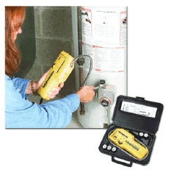
Leak Detection
Leak Detection
If required to have a written compliance program due to exposures over the PEL, a schedule for routine leak detection surveys must be produced.
PPT-071-01
38
Notes:
“Small Business Guide for Ethylene Oxide,” OSHA 33-59-04-2009, page 6, www.osha.gov.

Slide 39
Communication of EtO Hazards
SIGNS
Post and maintain signs demarcating regulated areas and entrance or access ways to regulated areas bearing the following legend:
DANGER
ETHYLENE OXIDE
CANCER HAZARD AND REPRODUCTIVE HAZARD
AUTHORIZED PERSONNEL ONLY
RESPIRATORS AND PROTECTIVE CLOTHING MAY BE
REQUIRED
TO WORK IN THIS AREA
PPT-071-01
39
Notes:
Signage is important to your overall program.
29 CFR 1910.1047(j)(1)(i).

Slide 40
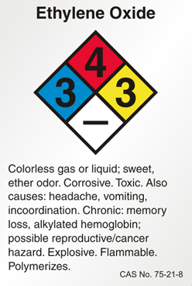
Precautionary Labels
Affixed to containers of EtO whose contents are capable of causing exposure at or above action level, or
Whose contents may reasonably be foreseen to cause employee exposure above excursion limit
Not considered containers:
Reaction vessels
Storage tanks
Pipes or piping systems
PPT-071-01
40
Notes:
CAS no. 75-21-8.
CAS no. is the Chemical Abstract Service number assigned specifically to the chemical noted.
The labels will comply with 29 CFR 1910.1200(f) of OSHA’s Hazard Communication Standard. (29CFR 1910.1047(j)(1)(ii))

Slide 41
Precautionary Labels
Labels Comply With
29 CFR 1910.1200(f) of OSHA’s Hazard Communication standard and include:
DANGER CONTAINS ETHYLENE OXIDE
CANCER HAZARD AND REPRODUCTIVE HAZARD
And warning statement against breathing airborne concentrations of EtO
PPT-071-01
41
Notes:
Precautionary labels need to comply with OSHA’s Hazard Communication Standard and include the following:
DANGER CONTAINS ETHYLENE OXIDE
CANCER HAZARD AND REPRODUCTIVE HAZARD
In addition precautionary labels should also include a warning statement against breathing airborne concentrations of EtO

Slide 42
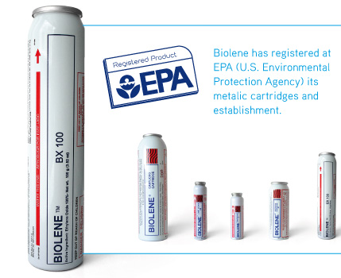
Labeling Does NOT Apply
● Where EtO is used as a pesticide as defined in Federal Insecticide, Fungicide and Rodenticide Act ● When labeled pursuant to that Act and regulations issued under EPA
PPT-071-01
42
Notes:
It’s important to understand those conditions for which labeling is not required.

Slide 43
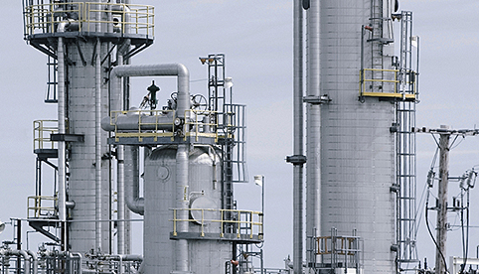
Safety Data Sheets (SDSs)
Manufacturers or importers of EtO shall comply as specified in 29 CFR 1910.1200(g) of OSHA’s Hazard Communication standard
PPT-071-01
43
Notes:
EtO as well as other chemicals should have a corresponding Safety Data Sheet (SDS) in place and accessible to employees.

Slide 44
Methods of Compliance
1. Engineering controls and work practices and
2. Compliance program
1. Engineering controls and work practices
Instituted to reduce and maintain exposure to or below TWA and excursion limit (except to extent such controls are not feasible).
If such controls/practices not sufficient, use them to reduce exposure to lowest levels achievable and supplement them by using respiratory protection.
PPT-071-01
44
Notes:
To comply with the OSHA Standard the following should be used:
1. Engineering controls and work practices and
2. Compliance program

Slide 45
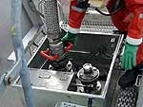
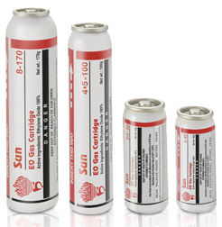
Methods of Compliance
Engineering controls generally not feasible for:
Collection of quality assurance sampling from sterilized materials;
Removal of biological indicators from
sterilized materials;
Loading/unloading tank cars;
Changing ethylene oxide tanks on
sterilizers;
Vessel cleaning
PPT-071-01
45
Notes:
Engineering controls generally not feasible for:
Collection of quality assurance sampling from sterilized materials;
Removal of biological indicators from sterilized materials;
Loading/unloading tank cars;
Changing ethylene oxide tanks on sterilizers;
Vessel cleaning

Slide 46
Methods of Compliance
2. Compliance Program:
Where TWA and Excursion limits are exceeded
A written program to reduce exposures to or below TWA and to or below Excursion Limit via engineering and work practice controls.
A schedule of periodic leak detection surveys and written plan for emergency situations.
PPT-071-01
46
Notes:
OSHA PEL (Permissible Exposure Limit), 1.0 ppm 8-hour TWA (Time Weighted Average); Excursion Level: 5 ppm for 15 mins.

Slide 47
Methods of Compliance
2. Compliance Program (cont.)
Written plans reviewed at least every 12 months and updated as necessary to reflect changes
Employer shall not implement a schedule of employee rotation as a means of compliance with TWA or excursion limits
PPT-071-01
47
Notes:
Ensure Plans are reviewed at least every 12 months; more frequently if conditions change.
Also important for the employer to realize they shall not implement a schedule of employee rotation as a means of compliance with TWA or excursion limits.

Slide 48
Respiratory Protection
Employer provides each employee with approved respirator that complies with requirements. Must be used during:
- Periods necessary to install or implement feasible
engineering and work-practice controls
- Work operations (i.e. maintenance/repair activities)
- Vessel cleaning for which engineering and work- practice controls are not feasible
- Work operations for which feasible engineering and work practice controls are not yet sufficient to reduce exposure to or below the TWA
- Emergencies
PPT-071-01
48
Notes:
Respiratory Protection
The employer provides each employee with an approved respirator that complies with requirements. The respirator must be used during:
Periods necessary to install or implement feasible engineering and work-practice controls
Work operations (i.e. maintenance/repair activities)
Vessel cleaning for which engineering and work-practice controls are not feasible
Work operations for which feasible engineering and work practice controls are not yet sufficient to reduce exposure to or below the TWA
Emergencies.

Slide 49
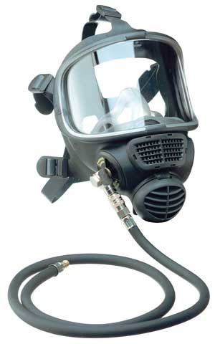
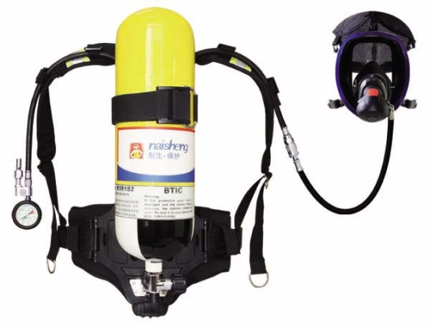
Respirator Program
Present standard states: “As of the date of this standard, only air-supplied, positive-pressure, full facepiece respirators are approved for protection against EtO.”
Future use of air-purifying respirators must have a NIOSH label per 42 CFR 84 approving such use.
PPT-071-01
49
Notes:
Respirator Program can adhere to either:
42 CFR 84 and/or
29 CFR 1910.134
Present standard states: “As of the date of this standard, only air-supplied, positive-pressure, full facepiece respirators are approved for protection against EtO.”
Future use of air-purifying respirators must have a NIOSH label per 42 CFR 84 approving such use.

Slide 50
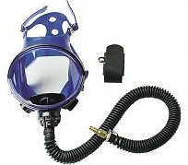
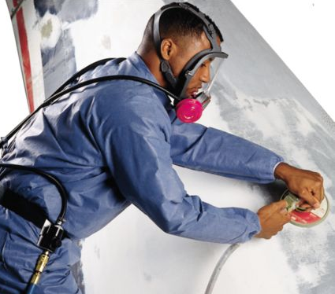
Respirator Program/Selection
Implemented per 1910.134 (b) through (d) (except (d) (i) (iii), and (f) through (m)
Respirator Selection
Employer-supplied per 29 CFR 1910.134
(d) (3) (i) (A) NO use of half masks of any
type due to EtO causing eye injury or
irritation
No air-purifying masks-EtO has no detectable odor except at levels well above the permissible exposure limits
PPT-071-01
50
Notes:
Respirator Program and Selection
Implemented per 1910.134 (b) through (d) (except (d) (i) (iii), and (f) through (m)
Respirator Selection
Employer-supplied per 29 CFR 1910.134 (d) (3) (i) (A) NO use of half masks of any
type due to EtO causing eye injury or irritation.
No air-purifying masks-EtO has no detectable odor except at levels well above the permissible exposure limits.

Slide 51
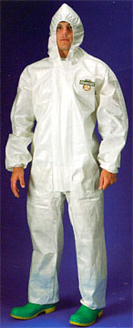
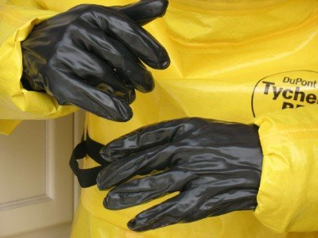
Protective Clothing/Equipment
Used when eye or skin contact is possible.
Employer selects and provides per:
- 29 CFR 1910.132 or
- 29CFR 1910.133
Must ensure employee wears the PPE
Clothing should be impermeable to EtO
PPT-071-01
51
Notes:
Wear goggles and skin protection at all times in areas where there is a risk of splashes from liquid EtO.
Wear proper PPE as required when working with EtO
Discard clothing degraded by EtO
See a Dr. if exposed to EtO
Do not eat, drink or smoke while working with EtO

Slide 52
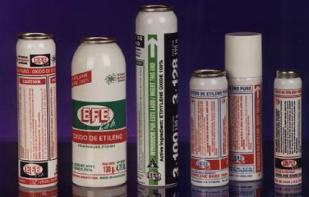
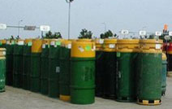
Safe Use, Handling, Storage
EtO is flammable; vapors can form explosive mixtures
Store:
Tight containers in well-ventilated area away from heat and sparks
Remove all ignition sources and use non-sparking tools
Wear impermeable clothing
PPT-071-01
52
Notes:
1910.1047, Appendix A, V (A) through (I)
Appendix B (Non-Mandatory)
Physical data:
Boils at 51.3⁰F
Vapor density 1.49 (heavier than air)
Solubility in water: complete
Appearance and odor: colorless liquid; gas at temperature above 10.7⁰F with either-like odor above 700 ppm.
Fire, Explosion, Reactivity
Flash point: less than 0⁰F
Stability: decomposes violently above 800⁰F
Flammable Limits in air: Lower: 3%, Upper, 100%
Will polymerize violently if contaminated with aqueous alkalies, amines, mineral acids, metal chlorides or metal oxides.

Slide 53
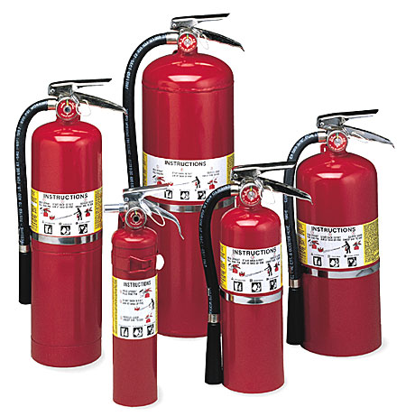
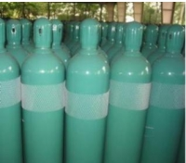
Safe Use, Handling, Storage
Store:
No food, drink or smoking
materials in regulated
areas
Fire extinguishers and
emergency deluge showers
should be available
Know all storage locations
and safety procedures
PPT-071-01
53
Notes:
1910.1047, Appendix A, V (A) through (I)

Slide 54
Emergency Situations
Written Plan and Alerting
Written Plan
Developed for each workplace where there is a possibility of an emergency
Stipulates those employees engaged in emergencies shall be equipped with respiratory protection until emergency is abated.
Plan will include elements prescribed in
-29 CR 1910.38-Emergency Action Plans and
-29 CFR 1910.39-Fire Prevention Plans
PPT-071-01
54
Notes:
A written plan:
Should be developed for each workplace where there is a possibility of an emergency.
Stipulates those employees engaged in emergencies shall be equipped with respiratory protection until emergency is abated.
Plan will include elements prescribed in
-29 CR 1910.38-Emergency Action Plans and
-29 CFR 1910.39-Fire Prevention Plans

Slide 55
Emergency Situations
Written Plan
For employers with more than 10 employees-plan MUST be in writing.
Ten (10) or fewer, plan may be communicated verbally.
PPT-071-01
55
Notes:
“Ethylene Oxide (EtO): Understanding OSHA’s Exposure Monitoring Requirements,” OSHA 3325-01N, page 17, 2007, www.osha.gov.

Slide 56
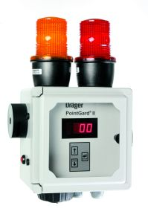
Emergency Situations
Alerting
Prompt alerting devised when there is a possibility of employee exposure to EtO
Affected employees shall be immediately evacuated from emergency area
“Choose an alert trigger level appropriate to your workplace!”
PPT-071-01
56
Notes:
Bell, voice-activated or voice communications for 10 or fewer employees. More than 10 employees-simple voice communication is not acceptable.
It’s not necessary to base alarm trigger on the OSHA action level (0.5ppm) or PEL for 8 hours (1 ppm) for 15 mins (5 ppm).
Some systems alert at levels greater than 20 ppm while other systems can trigger at 1 ppm or lower (NIOSH, 1989).
Information from “Ethylene Oxide (EtO): Understanding OSHA’s Exposure Monitoring Requirements,” OSHA 3325-01N, page 19, 2007, www.osha.gov.

Slide 57
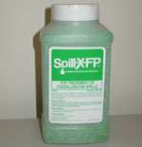
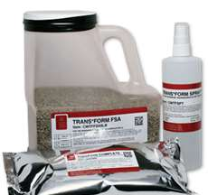
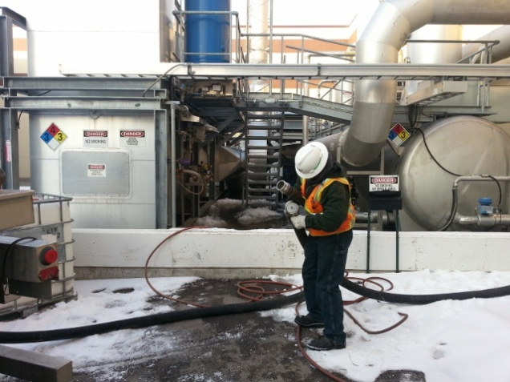
Emergency Situations
Provide for spill control
Decontamination and
Waste disposal
Repair leaks
Clean-up spills by
properly trained
employees
With proper PPE
PPT-071-01
57
Notes:
Spill Control
Determine if your staff will respond alone or with off-site assistance or have off-site responders solely perform control measures.

Slide 58
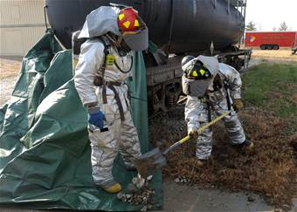
Emergency Situations
Spill control considerations:
Ethylene Oxide is miscible in all proportions with:
Water
Alcohol
Ether
Most organic solvents
PPT-071-01
58
Notes:
Spill control considerations:
Ethylene Oxide is miscible (can be mixed together) in all proportions with:
Water
Alcohol
Ether
Most organic solvents
Will you attempt to dilute a spill or use solid absorbent materials?

Slide 59
Emergency Situations
Response Considerations
PPT-071-01
59
Notes:
Preplan your types of responses and the needs of responders to do a safe and thorough job.

Slide 60
Medical Surveillance
Employees covered:
Those who are or may be exposed to EtO at or above action level without regard to the use of respirators, for at least 30 days a year.
Medical exams and consultations made available to all employees who have been exposed to EtO in an emergency situation.
PPT-071-01
60
Notes:
Medical Surveillance
Employees covered:
Those who are or may be exposed to EtO at or above action level without regard to the use of respirators, for at least 30 days a year.
Medical exams and consultations made available to all employees who have been exposed to EtO in an emergency situation.

Slide 61
Exam by Physician
All medical exams and procedures are performed by or under supervision of a licensed physician and
Are provided without cost, without loss of pay and at a reasonable time and place.
PPT-071-01
61
Notes:
Exam by a Physician
All medical exams and procedures are performed by or under supervision of a licensed physician and
Are provided without cost, without loss of pay and at a reasonable time and place.

Slide 62
Medical Exams/Consultations
Frequency
- Prior to assignment to an area where exposure maybe at or above action level for at least 30 days a year
- At least annually each employee exposed at or above the action level for at least 30 days in past year
- At employment termination or reassignment to an area where exposure to EtO is not at or above action level for at least 30 days a year
- As medically appropriate for any employee exposed during an emergency
PPT-071-01
62
Notes:
The frequency of medical exams and consultations are indicated in 29 CFR 1910.1047(i)(2)(i)

Slide 63
Medical Exams/Consultations
As soon as possible, upon notification by an employee that either:
Employee has developed signs or symptoms indicating possible overexposure to EtO or
That employee desires medical advice concerning effects of current or past exposure on employee’s ability to produce a healthy child.
If examining physician determines any of the exams should be provided more frequently than specified.
PPT-071-01
63
Notes:
A medical exam/consultation needs to be completed:
As soon as possible, upon notification by an employee that either:
Employee has developed signs or symptoms indicating possible overexposure to EtO or
That employee desires medical advice concerning effects of current or past exposure on employee’s ability to produce a healthy child.
If examining physician determines any of the exams should be provided more frequently than specified.

Slide 64
Medical Exams: Content
Medical and work history
Physical exam
Pulmonary
Hemotologic
Neurologic
Reproductive systems
Eyes and skin
PPT-071-01
64
Notes:
The exam will be thorough, viewing the Medical and work history.
Physical exam
Pulmonary
Hemotologic
Neurologic
Reproductive systems
Eyes and skin

Slide 65
Medical Exams: Content
Complete Blood Count
At least a white cell count including:
Differential cell count
Red cell count
Hematocrit
Hemoglobin
Any lab or other test determined by examining physician
PPT-071-01
65
Notes:
Medical exam content:
Complete Blood Count (CBC)
At least a white cell count including:
Differential cell count
Red cell count
Hematocrit
Hemoglobin
Any lab or other test determined by examining physician.

Slide 66
Medical Exam: Content
Determined by physician
Shall include pregnancy testing or lab evaluation of fertility, if requested and deemed appropriate by physician
PPT-071-01
66
Notes:
Determined by physician
Shall include pregnancy testing or lab evaluation of fertility, if requested and deemed appropriate by physician.

Slide 67
Information to Physician
Copy of this standard and Appendices A,B, and C
Description of affected employee’s duties related to exposure
Employee’s representative exposure level or anticipated exposure level
Description of PPE and respiratory equipment used or to be used
Information from previous employee medical exams not otherwise available to examining physician
PPT-071-01
67
Notes:
Information provided to the physician
Copy of this standard and Appendices A,B, and C
Description of affected employee’s duties related to exposure
Employee’s representative exposure level or anticipated exposure level
Description of PPE and respiratory equipment used or to be used
Information from previous employee medical exams not otherwise available to examining physician

Slide 68
Physician’s Written Opinion
To employer and include:
- Physician’s opinion as to whether employee has any detected medical conditions placing them at increased risk of material health impairment from EtO exposure
- Recommended limitations on employee or on use of PPE (clothing or respirators)
PPT-071-01
68
Notes:
The physician’s written opinion to the employer will include:
Physician’s opinion as to whether employee has any detected medical conditions placing them at increased risk of material health impairment from EtO exposure
Recommended limitations on employee or on use of PPE (clothing or respirators)

Slide 69
Physician’s Written Opinion
- Statement employee has been informed by physician of medical exam results
- Physician shall not reveal in the written opinion given to employer specific findings or diagnoses unrelated to occupational exposure to EtO
- Employer provides copy of physician’s written opinion to affected employee within 15 days from its receipt
PPT-071-01
69
Notes:
There will be a statement the employee has been informed by the physician of medical exam results
The Physician shall not reveal in the written opinion given to the employer specific findings or diagnoses unrelated to occupational exposure to EtO.
The Employer provides a copy of physician’s written opinion to the affected employee within 15 days from its receipt from the Physician.

Slide 70
Information and Training
Inform and train employees potentially exposed at or above action level or above excursion limit at time of initial assignment and at least annually thereafter
Inform of:
Standard requirements; explain contents including Appendices A and B
Operations in areas where EtO is present
Location and availability of written EtO final rule
Medical surveillance programs, Appendix C
PPT-071-01
70
Notes:
One of the best ways to promote safety in dealing with EtO is through information sharing and training of staff.
Inform and train employees potentially exposed at or above action level or above excursion limit at time of initial assignment and at least annually thereafter
Inform of:
Standard requirements; explain contents including Appendices A and B.
Operations in areas where EtO is present.
Location and availability of written EtO final rule.
Medical surveillance programs, Appendix C.

Slide 71
Training
Train on:
Methods of observations used to detect presence or release of EtO such as monitoring conducted by employer and continuous monitoring devices.
Physical and health hazards of EtO
Protection measures from hazards:
- Procedures
- Work practices
- Emergency procedures
- PPE
PPT-071-01
71
Notes:
Train your personnel on:
Methods of observations used to detect presence or release of EtO such as monitoring conducted by employer and continuous monitoring devices.
Physical and health hazards of EtO
Protection measures from hazards:
- Procedures
- Work practices
- Emergency procedures
- PPE

Slide 72
Recordkeeping
Where processing, use or handling of products made from or containing EtO are exempted from requirements,
Where objective data has been relied on in lieu of initial monitoring,
Employer shall establish/maintain accurate record of objective data reasonably relied on in support of exemption.
PPT-071-01
72
Notes:
As you can imagine, when dealing with such chemicals and possible exposures where strict controls are mandated, recordkeeping follows, especially when opting for exemptions to requirements.
Where processing, use or handling of products made from or containing EtO are exempted from requirements,
Where objective data has been relied on in lieu of initial monitoring,
Employer shall establish/maintain accurate record of objective data reasonably relied on in support of exemption.

Slide 73
Recordkeeping
Record shall include at least:
Product qualifying for exemption
Source of objective data
Test protocol, results and/or analysis of material for release of EtO
Description of operation exempted and how data supports exemption
Other data relevant to operation, materials, processing or employee exposures covered in exemption
PPT-071-01
73
Notes:
Record shall include at least:
Product qualifying for exemption
Source of objective data
Test protocol, results and/or analysis of material for release of EtO
Description of operation exempted and how data supports exemption
Other data relevant to operation, materials, processing or employee exposures covered in exemption

Slide 74
Exposure Measurements
Keep accurate records of all measurements taken to monitor employee exposure to EtO:
- Date of measurement
- Operation monitored involving EtO exposure
- Sampling and analytical methods used/evidence of their accuracy
- Number, duration and results of samples
- Type of protective devices worn, if any;
- Name, social security number and exposure of Employees represented.
Records maintained for 30 years per 29 CFR 1910.1020
PPT-071-01
74
Notes:
Exposure Measurements
Keep accurate records of all measurements taken to monitor employee exposure to EtO:
- Date of measurement
- Operation monitored involving EtO exposure
- Sampling and analytical methods used/evidence of their accuracy
- Number, duration and results of samples
- Type of protective devices worn, if any;
- Name, social security number and exposure of Employees represented.
Records are maintained for 30 years per 29 CFR 1910.1020

Slide 75
Medical Surveillance
Maintain record for each employee subject to medical surveillance
Include:
Name and social security number
Physicians’ written opinions
Any employee medical complaints related to EtO
exposure
Copy of information provided to physician as required by this standard
Maintain this record for the duration of employment plus 30 years per 29 CFR 1910.1020
PPT-071-01
75
Notes:
Medical Surveillance Records
Maintain record for each employee subject to medical surveillance.
Include:
Name and social security number
Physicians’ written opinions
Any employee medical complaints related to EtO exposure
Copy of information provided to physician as required by this standard
Maintain this record for the duration of employment plus 30 years per 29 CFR 1910.1020

Slide 76
Record Availability
Employer: Make all records available to
- Assistant Secretary and Director
- Exemption and exposure records to
Affected employees,
Former employees,
Designated representatives and
Assistant Secretary.
- Medical records to
Subject employee,
Anyone having the specific written consent of subject employee and
Assistant Secretary
PPT-071-01
76
Notes:
Employer will make above records available, upon written request.
All records which are required to be maintained.

Slide 77
Transfer of Records
Shall comply with transfer of records per 29 CFR 1910.1020(h)
When employer ceases to do business and there is no successor employer, the employer shall notify the Director at least 90 days prior to disposal and transmit records to the Director.
PPT-071-01
77
Notes:
“Director” means the Director of the National Institute for Occupational Safety and Health, U.S. Department of Health and Human Services, or designee. (1910.1047(b) Definitions)

Slide 78
1910.1047, Appendices
Appendix A: Substance Safety Data Sheet for Ethylene Oxide (Non-Mandatory)
Appendix B: Substance Technical Guidelines for Ethylene Oxide (Non-Mandatory)
Appendix C: Medical Surveillance Guidelines for Ethylene Oxide (Non-Mandatory)
Appendix D: Sampline and Analytical Methods for Ethylene Oxide (Non-Mandatory)
PPT-071-01
78
Notes:
Although Non-Mandatory, the supplemental information in these appendices will aid you in structuring your in-house program.

Slide 79
Summary
Determine if products contain Ethylene oxide or derivatives.
If so, take proper precautions.
If employed in an industry involved in Ethylene oxide
production or the production of any of its “relatives”
recognize the employer must take specific actions to reduce the hazard to employees.
Understand the safety requirements and regulations
governing working around and handling such products.
Adopt and use best practices and proper PPE to limit your exposure thereby reducing your consequences.
PPT-071-01
79
Notes:
Summary
Determine if products contain Ethylene oxide or derivatives.
If so, take proper precautions.
If employed in an industry involved in Ethylene oxide production or the production of any of its “relatives” recognize the employer must take specific actions to reduce the hazard to employees.
Understand the safety requirements and regulations governing working around and handling such products.
Adopt and use best practices and proper PPE to limit your exposure thereby reducing your consequences.

Slide 80
Bibliography
29 CFR 1910.1047, Ethylene oxide, Subpart Z, Toxic and Hazardous Substances.
29 CFR 1910.1200, Hazard Communication, Subpart Z – Toxic and Hazardous Substances.
NIOSH Pocket Guide to Chemical Hazards, DHHS, 2007 or most current edition.
“Ethylene Oxide (EtO): Understanding OSHA’s Exposure Monitoring Requirements,” OSHA 3325-01N 2007, www.osha.gov.
“Small Business Guide for Ethylene Oxide,” OSHA 33-59-04-2009, www.osha.gov.
“Our commentary on OSHA’s Small Business Guide for Ethylene Oxide,” www.osha.gov.
PPT-071-01
80

Slide 81
Bibliography
OSHA Fact Sheet, US Department of Labor, 2002.
SRI Consulting, 2010.
“Ethylene Oxide (EtO) Production and Manufacturing Process,” at http://www.icis.com/v2/chemicals/9075773/ethylene+oxide/process.html
“Handbook of Compressed Gases,” 3rd Edition, Compressed Gas Association, Inc., Chantilly, VA, 1990.
PPT-071-01
81

Slide 82
Additional Resources
The following additional resources may help support or supplement your safety program.
You may find the suggested Power Point Programs and others at our PATHS website. (www.dli.state.pa.us/PATHS).
Suggestions for additional review:
Basic Air Monitoring
Compressed Gas Safety
Flammable/Combustible Liquids
Emergency Response Planning
If you can not find what you’re looking for, you’re invited to contact us at (717) 772-1635.
PPT-071-01
82

Slide 83
Contact Information
Health & Safety Training Specialists
1171 South Cameron Street, Room 324
Harrisburg, PA 17104-2501
(717) 772-1635
RA-LI-BWC-PATHS@pa.gov
Like us on Facebook! - https://www.facebook.com/BWCPATHS
PPT-071-01
83

Slide 84
Questions
PPT-071-01
84

