Slide 1
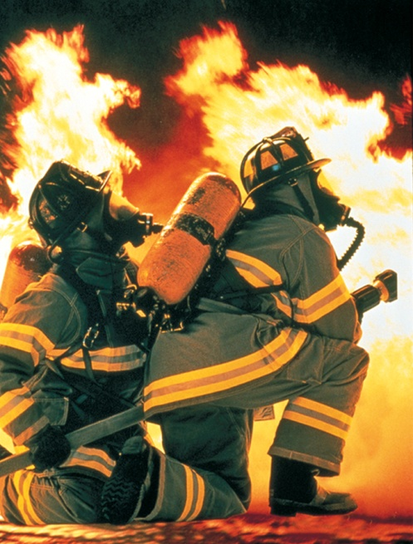
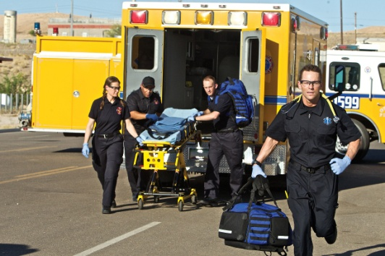
Emergency Response Planning
Bureau of Workers’ Compensation
PA Training for Health & Safety (PATHS)
Emergency Response through Emergency Planning & Management
PPT-100-01
1
Notes:
One of your facility’s main missions is to provide for the protection of your employees as well as to maintain continuity of operations. Depending upon the types of materials with which you deal, the public surrounding your facility may also be impacted during a fire or material release.

Slide 2
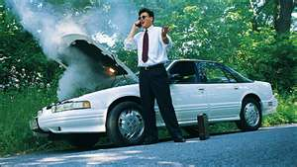
Generic Emergencies
Most of us are used to emergencies. We’ve all suffered:
Car trouble
Electrical outage
Plumbing problems
General repairs
Other types which are
always inconvenient!!
PPT-100-01
2
Notes:
Most of us are used to emergencies which may be generic.
Car trouble
Electrical outage
Plumbing problems
General repairs
Other types which are always inconvenient!!

Slide 3
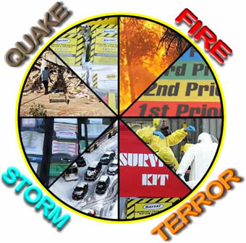
Types of Emergencies
The “Big Ones” fall into 2 general categories:
Natural, or
Man-Made
PS: Even the small incidents can disrupt like large ones!!!
PPT-100-01
3
Notes:
Types of emergencies fall into 2 general categories for planning purposes:
Natural and
Man-made
Even the small incidents can disrupt like the large ones!

Slide 4
Emergency Management
The scope of emergency management in today’s world requires:
Considering possible events
Planning for situations of high probability
as well as unique events
Providing for resources to meet the
event
Recovering and restoring to normal
PPT-100-01
4
Notes:
The scope of emergency management in today’s world requires:
Considering possible events.
Planning for situations of high probability as well as unique events.
Providing for resources to meet the event needs.
Recovering and restoring to normal operations.

Slide 5
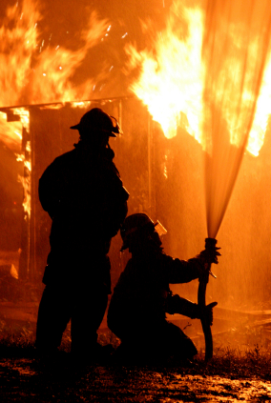
Facility Model
The emergency response
cycle for a facility can include:
Preparation
Warning
Relocation
Mobilization
Monitoring Services
PPT-100-01
5
Notes:
The emergency response cycle for a facility can include:
Preparation
Warning
Relocation
Mobilization
Monitoring Services

Slide 6
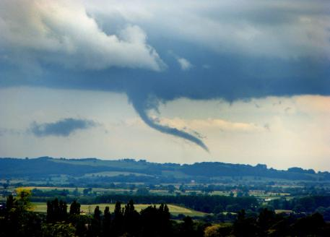
Facility Model
Control/Stabilization
Close-out/Termination
Return to Normal Operations
Damage Assessment &
Recovery
Plan Review & Modification
Let’s simplify this…..
PPT-100-01
6
Notes:
A facility model for planning and response also includes the following considerations.
Control/Stabilization
Close-out/Termination
Return to Normal Operations
Damage Assessment & Recovery
Plan Review & Modification
Let’s simplify this…..

Slide 7
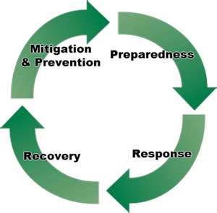
Emergency Management
Cyclic in Nature
Preparedness
Response
Recovery
Mitigation & Prevention
PPT-100-01
7
Notes:
Emergency management, then, is cyclic in nature, encompassing,
Preparedness
Response
Recovery
Mitigation & Prevention

Slide 8
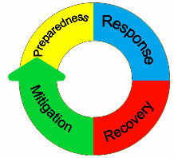
Emergency Management Methods
IEMS (Integrated Emergency Management System)
ICS (Incident Command System)
PPT-100-01
8
Notes:
Other components involved in this management would be:
IEMS (Integrated Emergency Management System) containing standardized methods and terminology for all responders.
ICS (Incident Command System) having a reporting system and hierarchy of action components.
These create a standardized response while using multiple agencies or resources.

Slide 9
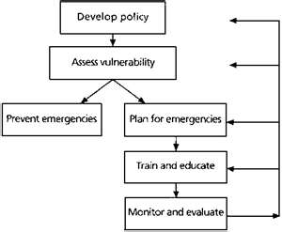
Plan!
PPT-100-01
9
Notes:
You want to plan your response to potential incidents. Allow the written text to evolve into checklists with greater field application.

Slide 10
Aids to Planning
PPT-100-01
10
Notes:
Many aids to planning exist.
The National Incident Management System and
Fire Officer’s Guide to Disaster Control
Being but 2 of them.

Slide 11
Plan Contents
Facility Overview
Hazards and Hazard Control
Safety Systems In-place
Emergency Response
Organization
Levels of Magnitude for Events
Emergency
Plan
Emergency
PPT-100-01
11
Notes:
Your plan should contain, at a minimum:
Facility Overview.
Hazards and Hazard Control. What events or emergencies have you had in the past? How were they handled?
Safety Systems In-place.
Emergency Response Organization.
Levels of Magnitude for Events.

Slide 12
Plan Contents
Communications
Contacts
Procedures/Action Plans
Checklists
Plan Administration
Staff Training
Action Plan
PPT-100-01
12
Notes:
Also include in your plan:
Communications
Contacts
Procedures/Action Plans
Checklists
Plan Administration
Staff Training

Slide 13
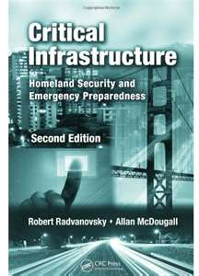
Evaluate Emergency Possibilities
Analyze your area(s) of
responsibility.
Ask questions regarding:
What could happen and
the results?
How do we meet the
needs?
Could your facility exist
absent the infrastructure
which has been damaged?
PPT-100-01
13
Notes:
The first stage in the planning process is to evaluate emergency possibilities.
This could include reviewing your in-house Job Hazard Analysis file to determine events which could impact your normal operations.
You can then use information obtained to plan your response to non-normal expectations, i.e. floods, fires, high winds, etc. Whatever you’re planning for, you should,
Analyze your area(s) of responsibility.
Ask questions regarding:
What could happen and the results?
How do we meet the needs to respond and control?
Could your facility exist absent the infrastructure which has been damaged?

Slide 14
Hazards by Area
Determine hazards for
which procedures should
be created.
Internal events or
intrusive external hazards.
Determine the lead
agency concerned with
response:
→ Fire Brigade
→ Spill Team
→ First Aid Team
→ Security
Or maybe the “A” Team!
PPT-100-01
14
Notes:
Determine hazards for which procedures should be created.
Internal events or intrusive external hazards.
Determine the lead agency concerned with response:
→ Fire Brigade
→ Spill Team
→ First Aid Team
→ Security

Slide 15
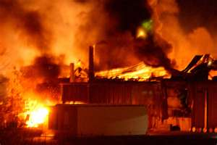
Emergency Types by Agency
Fire Response
Structures
Storage
Processes
Manufacturing
Transport (off-loading
materials)
Labs
Parking lot
Adjacent properties
exposing yours
PPT-100-01
15
Notes:
You can look at emergency types by action agency.
Fire
Hazardous materials response
Security issues
If planning for fire response view possible situations. These would include fire impact on:
Structures
Storage
Processes
Manufacturing
Transport (off-loading materials)
Labs
Parking lot
Adjacent properties
exposing yours

Slide 16
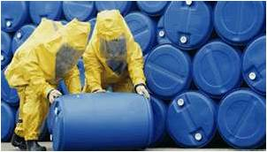
HazMat Response
Labs
Hazardous waste
locations
Manufacturing
Environmental events
Chemical storage
Processes
Shipping/Receiving
Transportation
PPT-100-01
16
Notes:
Hazardous materials spill response may rely on an on-site team, off-site company or combination of both. Where could it happen?
Chemical storage
Processes
Shipping/Receiving
Transportation
Labs
Hazardous waste locations
Manufacturing
Environmental events
Does adequate containment exist as an engineered safeguard?

Slide 17
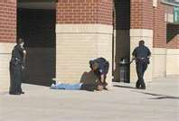
Security
Disgruntled employees
Bomb threats
Full power outage
Control of mass media
Access control for off-
site responders
Demonstrations
Securing vacated
buildings
PPT-100-01
17
Notes:
Security issues may arise due to a variety of reasons. Plan against the occurrence.
Disgruntled employees
Bomb threats
Full power outage
Control of mass media
Access control for off-site responders
Demonstrations
Securing vacated buildings

Slide 18
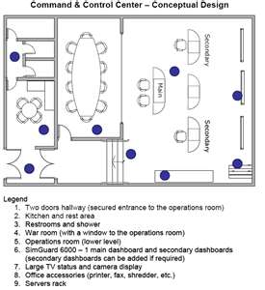
Develop Command & Control
Duty Assignments
Job descriptions
When do they report
Where do they go
To whom do they report
Who reports to them
Radio channels
Adopt terminology common
to those responding
PPT-100-01
18
Notes:
Develop Command and Control for response. Someone needs to lead the response; some need to constitute the action teams. Create,
Duty Assignments
Job descriptions
When do they report
Where do they go
To whom do they report
Who reports to them
Radio channels
Adopt terminology common to those responding.

Slide 19
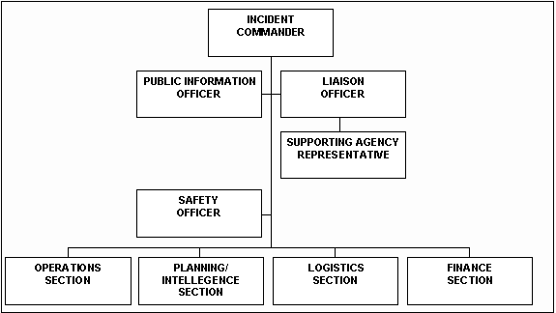
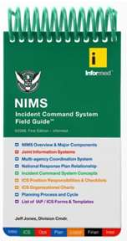
Emergency Titles/Duties
Incident Commander
Safety
Liaison
Public Information (PIO)
Operations
Planning/Intelligence
Logistics
Finance/Administration
PPT-100-01
19
Notes:
Assign emergency titles and requisite duties to each title. Examples include:
Incident Commander (and Command Staff)
Safety
Liaison
Public Information (PIO)
Operations (and the following are General Staff)
Planning/Intelligence
Logistics
Finance/Administration

Slide 20
Facility Emergency Team
A facility’s team may also include the following:
Sr. Rep of Operations
Sr. Manager
Human resources
Public relations
Environmental
Engineering
Legal
PPT-100-01
20
Notes:
The facility, if having an emergency team, will include the action agencies to respond. The team may also include:
Sr. Representative of Operations
Sr. Manager
Human resources
Public relations
Environmental
Engineering
Legal

Slide 21
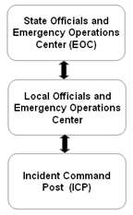
Expanding the ICS
As the incident magnitude
increases, so will the
number and types of
agencies involved.
Provide for such expansion
PPT-100-01
21
Notes:
Your plan should allow for expanding horizontally to include the participation of other agencies.
It should also allow vertical expansion with higher agencies.
As the incident escalates, so will the number and types of agencies involved.
Provide for such expansion.

Slide 22
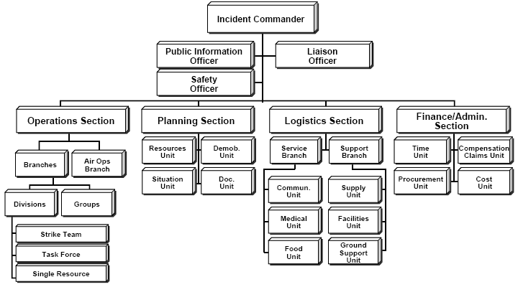
Expanded ICS
The system should be able to expand vertically and horizontally.
PPT-100-01
22
Notes:
The expanded ICS (Incident Command System) allows for such expansion.

Slide 23
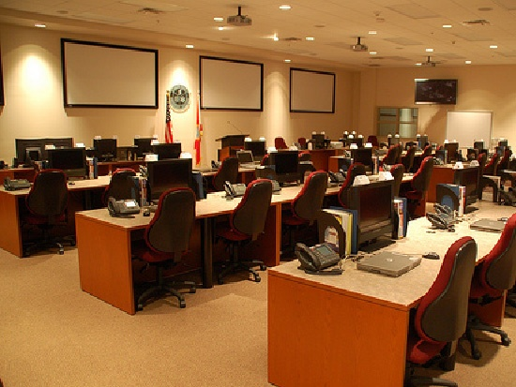
Locate a Facility EOC
Equip with:
Telephones
Radios
Tables/chairs
White boards
Lighting
Backup generator
Locate agencies with similar missions in
close proximity
PPT-100-01
23
Notes:
A dedicated location should serve as the focal point during an incident. This would be the Emergency Operations Center, equipped with:
Telephones
Radios
Tables/chairs
White boards
Lighting
Backup generator
This allows leadership and support to be away from the high-stress areas of the event. Locate agencies with similar missions in close proximity.

Slide 24
Event Classifications
Unusual Event
Alert
Site Emergency
General Emergency
Note: You may also reduce the number of levels to three (3), i.e.
Level I
Level II
Level III
PPT-100-01
24
Notes:
Your plan may wish to assign an initial “start point” regarding its initial magnitude or threat as well as the types and number of agencies required to respond.
The nuclear industry uses the 4 level method:
Unusual Event
Alert
Site Emergency
General Emergency
Note: You may also reduce the number of levels to three (3), i.e.
Level I
Level II
Level III

Slide 25
Event Classification
Base the event classification on:
Severity of event to people.
Severity to facility; physically or operationally.
Potential of condition to spread.
Effort/resources required to control event.
Effect event has on the surrounding community.
Number and type of additional agencies affected by
the event.
PPT-100-01
25
Notes:
Base the event classification on:
Severity of event to people.
Severity to facility; physically or operationally.
Potential of condition to spread.
Effort/resources required to control event.
Effect event has on the surrounding community.
Number and type of additional agencies affected by the event.

Slide 26
Unusual Event
An event has occurred on the facility but does not affect:
-Personnel safety
-Public safety
-The operation of the facility
On-site emergency responders only:
Fire Brigade
First Aid Squad
HazMat Team
PPT-100-01
26
Notes:
An Unusual Event
Conditions or criteria for use might be, “An event has occurred on the facility but does not affect:
Personnel safety
Public safety
The operation of the facility
On-site emergency responders only:
Fire Brigade
First Aid Squad
HazMat Team”

Slide 27
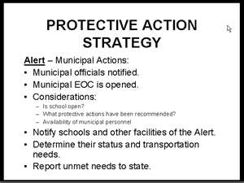
Alert
An event has occurred on the facility minimally affecting:
-Personnel safety
-Public safety
-The operation of the
facility
On-site emergency responders with possibility of off-site responders.
PPT-100-01
27
Notes:
Alert level
Conditions for use may be, “An event has occurred on the facility minimally affecting:
Personnel safety
Public safety
The operation of the facility
On-site emergency responders with possibility of off-site responders.”

Slide 28
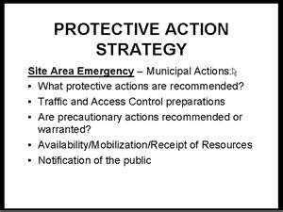
Site Emergency
An event has occurred on the facility which may greatly affect:
-Personnel safety
-Off-site public
-The operation of the facility
On-site emergency responders
along with off-site emergency
responders.
Event may be of long duration.
Evacuation may be required.
PPT-100-01
28
Notes:
Site Emergency
Conditions for use, “An event has occurred on the facility which may greatly affect:
Personnel safety
Off-site public
The operation of the facility
On-site emergency responders along with off-site emergency responders.
Event may be of long duration.
Evacuation may be required.”

Slide 29
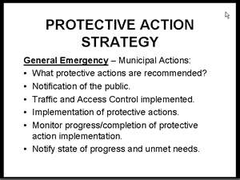
General Emergency
An event has occurred on the facility posing an imminent threat to:
-Site Personnel
-Off-site Public Safety
-The operation of the
facility
• On-site emergency responders along with
off-site emergency responders.
• Event will require extreme actions to stabilize.
PPT-100-01
29
Notes:
A General Emergency is the highest magnitude for an event,
Conditions for use, “An event has occurred on the facility posing an imminent threat to:
Site Personnel
Off-site Public Safety
The operation of the facility
• On-site emergency responders along with off-site emergency responders.
• Event will require extreme actions to stabilize.”

Slide 30
Communications
Complex events require more complex communications than just dialing 911!
PPT-100-01
30
Notes:
Complex events require more complex communications than just dialing 911!

Slide 31
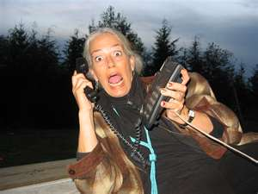
Communications
Provide direct lines.
Alternate means.
“Rumor Hotlines”
Each person’s problem is
the most important
during an emergency.
Create filters and
distribution methods.
Log all messages.
PPT-100-01
31
Notes:
You may want to,
Provide direct lines.
Alternate means.
“Rumor Hotlines”
Each person’s problem is the most important during an emergency.
Create filters and distribution methods to direct calls to the proper action agency.
Log all messages and provide for checking if requested actions were completed.

Slide 32
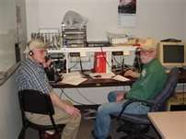
Alternate Communications
CB clubs.
Radio clubs.
Former military staff.
EBS contacts.
Assign a
Communications
Coordinator and
alternate.
PPT-100-01
32
Notes:
Alternate communications might be required from other sources.
CB clubs.
Radio clubs.
Former military staff.
EBS contacts.
Assign a Communications Coordinator and alternate to deal with this in planning and operations phase.

Slide 33
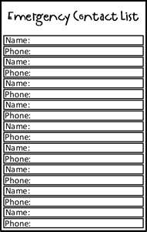
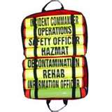
Contact Lists & Alternates
During an emergency is no time to find phone numbers or identify responsible persons.
Establish these lists during planning.
Update lists when persons vacate their assignment.
PPT-100-01
33
Notes:
During an emergency is no time to find phone numbers or identify responsible persons.
Establish these lists during planning, mindful to designate alternates should the primary be absent during an event.
Update lists when persons vacate their assignment.

Slide 34
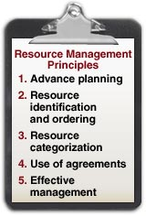
Resource Lists
Determine resource requirements depending on type of event.
Obtain the needed resources and make agreements to use during an event.
PPT-100-01
34
Notes:
Determine resource requirements depending on type of event and create a list or index.
Obtain the needed resources and make agreements to use them during an event.
Do not wait for an event before you make these response arrangements.

Slide 35
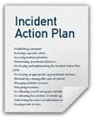
Action Plans
Assign an AP Number.
Assign an initial event magnitude.
Criteria for Implementing.
Checklist, by action agency, of
those tasks to be implemented.
Initial call-outs
Procedures to be reviewed
Technical information reviewed
Support procedures
Restoration procedures
PPT-100-01
35
Notes:
Action Plans encapsulate response requirements for a particular incident. They detail who will respond and control efforts required.
Assign an AP Number.
Assign an initial event magnitude.
Criteria for Implementing.
Checklist, by action agency, of those tasks to be implemented.
Initial call-outs
Procedures to be reviewed
Technical information reviewed
Support procedures
Restoration procedures

Slide 36
Action Plan Index (Examples)
Event Level
300 Explosions
301 Structures Alert
302 Bulk Product:
Liquid or Gas Site Emergency
400 Transportation Accidents
406 Aircraft Accident General Emergency
PPT-100-01
36
Notes:
For the Action Plans developed, create an index where they can be found during the determined event.

Slide 37
Basic Emergency Action Plans
Address need for immediate action to protect employees due to the occurrence of life-threatening or endangering exposure.
Examples:
Building & Site Evacuation
Hazardous Materials Spill
Urgent Employee Medical Treatment
Workplace Violence
PPT-100-01
37
Notes:
Basic Emergency Action Plans address the need for immediate action to protect employees.
Examples:
Building & Site Evacuation
Hazardous Materials Spill
Urgent Employee Medical Treatment
Workplace Violence

Slide 38
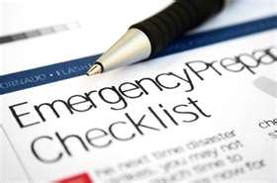
Checklists
Design checklists to cut down on written instructions.
It is easier to view a graphic than decipher long paragraphs of instructions.
PPT-100-01
38
Notes:
After the written plan is developed, condense its contents into checklists which can be used during the event.
Checklists cut down on having to read written instructions.
It is easier to view a graphic than decipher long paragraphs of instructions.

Slide 39
Continuing Operations
Backup operating records/documents.
Locate secondary/tertiary records to restart
operations.
Does your facility have another location to
continue operations?
Is there rental property you can obtain?
How do you minimize your down time?
PPT-100-01
39
Notes:
To ensure continued operations of your facility,
Backup operating records/documents.
Locate secondary/tertiary records to restart operations.
Does your facility have another location to continue operations?
Is there rental property you can obtain?
How do you minimize your down time?

Slide 40
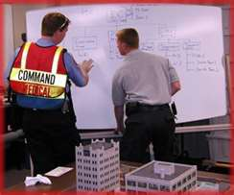
Command & Control
Conduct briefings with
agency leaders.
Conduct combined (all
agency) briefings.
Brief each on event
developments and
determine each agency’s
required actions.
PPT-100-01
40
Notes:
When the actions are determined during planning or the event, brief agency leaders.
This will lead to combined (all agency) briefings during training and response.
Brief each on event developments and each agency’s required actions.

Slide 41
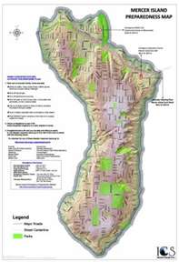
Mapping
Develop mapping strategies:
Populated areas
Evacuation routes/alternates
Congregate Care Centers
Road link capabilities
Determine security measures for:
Populations
Infrastructure locations
PPT-100-01
41
Notes:
Develop mapping strategies:
Populated areas
Evacuation routes/alternates
Congregate Care Centers
Road link capabilities
Determine security measures for:
Populations
Infrastructure locations

Slide 42
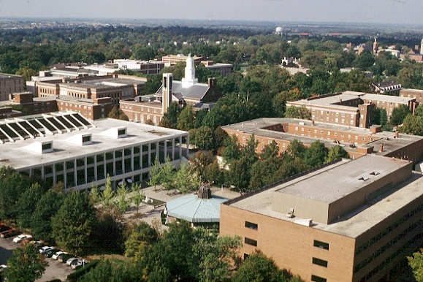
Mapping
Facility Target hazards:
-Life
-Property:
High value materials
Safety related equipment
Bulk/hazardous storage
-Important to Plant Operations
Fire pumps
Emergency generators
-Utilities
PPT-100-01
42
Notes:
In your Mapping, determine,
Facility Target hazards:
-Life
-Property:
High value materials
Safety related equipment
Bulk/hazardous storage
-Important to Plant Operations
Fire pumps
Emergency generators
-Utilities

Slide 43
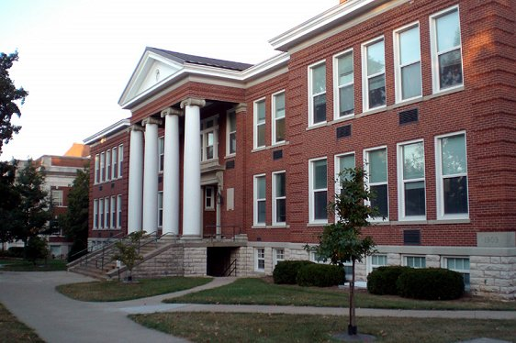
Mapping
Individual buildings
Life hazards/evacuation
routes.
Assembly points for
emergency teams.
Access points for off-site
agencies.
Shutdown logics for
equipment/processes.
Emergency equipment
locations.
PPT-100-01
43
Notes:
Mapping should also include individual buildings and processes. Determine,
Life hazards/evacuation routes.
Assembly points for emergency teams.
Access points for off-site agencies.
Shutdown logics for equipment/processes.
Emergency equipment locations

Slide 44
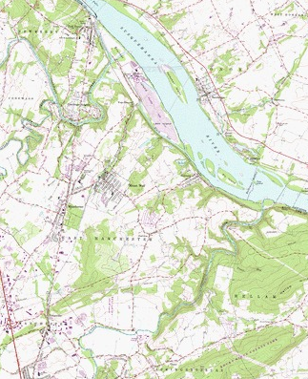
Mapping
Use Topographic maps to determine potentially threatened areas.
Also determine areas subject to flooding.
Plot downwind drift for released gases or vapors.
PPT-100-01
44
Notes:
Use Topographic maps to determine potentially threatened areas from explosions or hazardous materials releases.
Also determine areas subject to flooding.
Plot downwind drift for released gases or vapors.

Slide 45
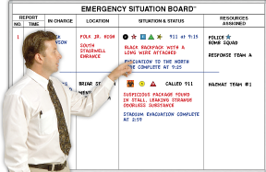
Information Logs
Adopt a means to Log Information:
Situation status
Resource status
PPT-100-01
45
Notes:
Adopt a means to Log Information.
Situation status
Resource status
This permits you to check on the status of various teams and groups; their placement and if they’ve fulfilled their duties for rest or reassignment.

Slide 46
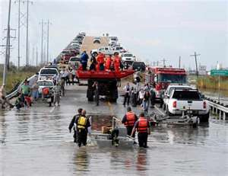
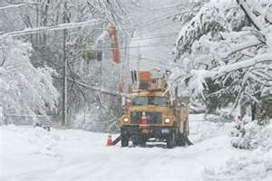
Disruptions
How would this affect
access to your facility?
Or evacuation from?
What’s required to
over-ride the problem?
PPT-100-01
46
Notes:
During planning and training, determine likely disruptions and how you would respond to them.
Do you have in-house teams or must you rely on off-site emergency responders?
Will your staff evacuate?
If you are determined to respond with an on-site team, what’s required to over-ride the emergency?
Can you match resources to the needs you determined?

Slide 47
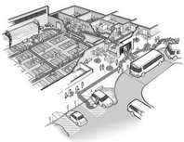
Protective Actions: Evacuation
To where?
By what means?
By what routes? Alternates?
Who sets-up the CCC
(congregate care center)?
Who provides services?
Will they take pets??
PPT-100-01
47
Notes:
Protective actions will be required based on type of event. You can either evacuate your staff or shelter in-place. If you evacuate,
To where?
By what means?
By what routes? Alternates?
Who sets-up the congregate care center (CCC)?
Who provides services?
Will they take pets?? (some staff may have assist dogs)

Slide 48
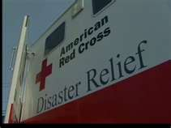
Protective Actions: Sheltering
American Red Cross is structured to set-up these shelters.
Staff trained to the needs of the population received.
You might also implement a combination of evacuating & sheltering.
PPT-100-01
48
Notes:
If you elect to shelter in-place or evacuate to a sheltering location,
The American Red Cross is structured to set-up these shelters.
Staff is trained to the needs of the population received.
You might also implement a combination of evacuating & sheltering.

Slide 49
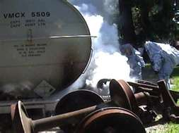
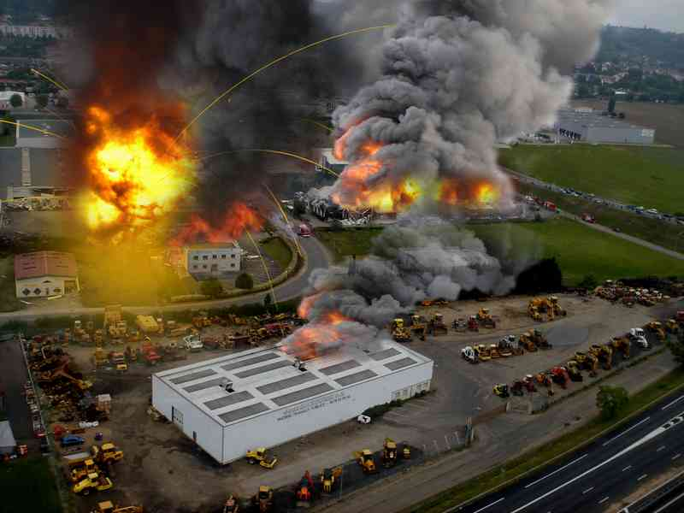
Impacting Off-Site Locations
A release at your facility may directly impact off-site communities.
This impact may directly affect you if your neighborhood is involved.
Consider the needs the following may trigger:
PPT-100-01
49
Notes:
Also consider what impact to off-site locations you facility’s incident may cause.
A release at your facility may directly impact off-site communities.
This impact may directly affect you if your neighborhood is involved.
Consider the needs the following may trigger:

Slide 50
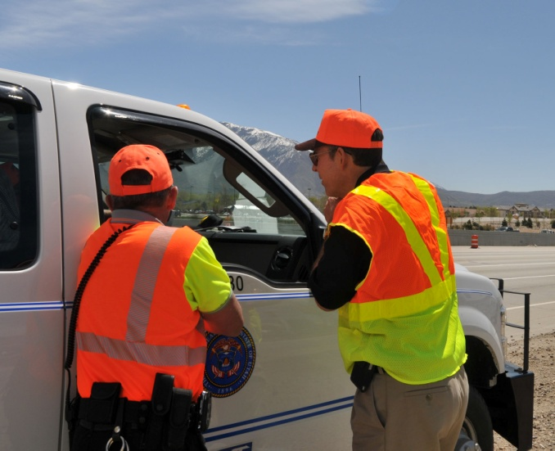
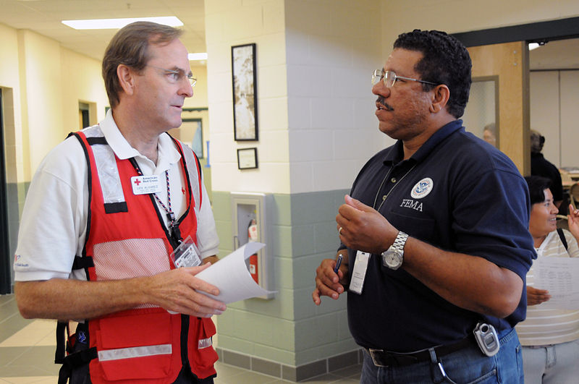
Special Considerations
Transportation Coordinator
-Provides transport for
various groups.
Sheltering Coordinator
-Sets-up lodging and
registration for moved
groups.
-Establishes services.
PPT-100-01
50
Notes:
Other special considerations to include in your plan.
A Transportation Coordinator
-Provides transport for various groups.
A Sheltering Coordinator
-Sets-up lodging and registration for relocated groups (accountability).
-Establishes services.

Slide 51
Where Does A School Go?
School concerns:
Evacuate or Shelter In-Place?
Some schools own their
buses and have paid
drivers.
Accessibility to transport
is provided.
Schools “evacuate” their students each day at a given time.
Time of occurrence will determine their destination
PPT-100-01
51
Notes:
Where will school students go?
Evacuate or Shelter In-Place?
Some schools own their buses and have paid drivers.
Accessibility to transport is provided.
Schools “evacuate” their students each day at a given time.
The time of occurrence will determine the students’ destination.

Slide 52
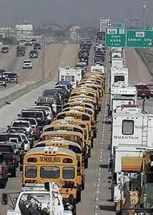
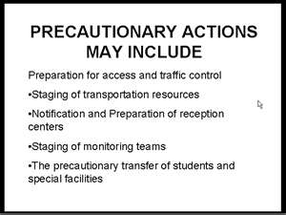
Student Transport
Special security & safety
issues.
Concerned parents may
create traffic problems
during an evacuation by
going to the school.
PPT-100-01
52
Notes:
Whether student transport or for your employees are there special security and safety issues?
If a school, concerned parents may create traffic problems during an evacuation by going to the school.
Let your plans and announcements to parents indicate the actions you’ll take to limit this traffic problem.

Slide 53
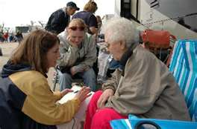
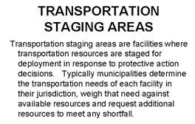
Elderly/Infirm
Special requirements:
Transport.
Medical Needs.
Contacting family.
The patience to explain
the situation.
PPT-100-01
53
Notes:
With elderly and inform, special requirements involve,
Transport.
Medical Needs.
Contacting family.
The patience to explain the situation to affected persons.

Slide 54
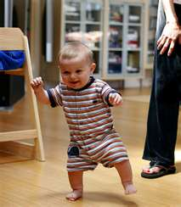
Toddlers and Infants
Some facilities have Day Care. This presents its own special concerns for evacuation or sheltering.
Feeding
Clothing
Medication
Attention spans
PPT-100-01
54
Notes:
Some facilities have a Day Care. This presents its own special concerns for evacuation or sheltering.
Feeding
Clothing
Medication
Attention spans of parents you’re briefing.

Slide 55
Special Friends
Some shelters do not take pets.
Determine what arrangements have been made for receiving pets.
Some owners are adamant: “If you won’t take my pet, I won’t go!”
PPT-100-01
55
Notes:
If you’re planning to move your group to a shelter, some shelters do not take pets.
This impacts guide dogs or civilians in the threatened area off-site.
Determine what arrangements have been made for receiving pets.
Some owners are adamant: “If you won’t take my pet, I won’t go!”

Slide 56
Special Needs
Remember, pets are people, too.
Some of your employees may also have assist dogs.
PPT-100-01
56
Notes:
Remember, pets are people, too.
Some of your employees may also have assist dogs.

Slide 57
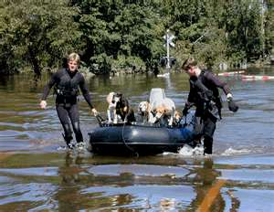
Rescue
Group rescue for pets.
Evaluate the resources
required for this rescue.
List them.
Could your agency provide
them in a timely fashion.
How do demands change if
this is a water rescue of
people?
PPT-100-01
57
Notes:
Some locales have special pet or animal rescue concerns.
Evaluate the resources required for this rescue.
List them.
Could your agency provide them in a timely fashion.
How do demands change if this is a water rescue of people?

Slide 58
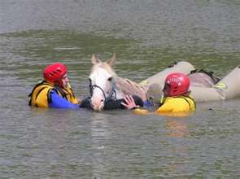
Livestock
Animal rescue training available (e.g. Penn State Agricultural Extension).
PPT-100-01
58
Notes:
For livestock, animal rescue training is available (e.g. Penn State Agricultural Extension).

Slide 59
Community Volunteers
Consider:
Varying Talents
Availability
Training needs
Equipment needs
Transport needs
PPT-100-01
59
Notes:
You may not have the numbers of staff available in-house to satisfy response needs.
This may require that you rely on community volunteers. Consider,
Varying Talents required by actions determined.
Availability of a volunteer staff.
Training needs.
Equipment needs.
Transport needs to get them to your location.

Slide 60
Community Emergency Response Team
Guidance Exists for
Training
Assigning
Equipping
Communicating
PPT-100-01
60
Notes:
Some community emergency response teams have been created and guidance exists for,
Training
Assigning
Equipping
Communicating

Slide 61
Existing Agencies
Include:
Fire Service
EMS Service
Police Service
HazMat Teams
Magnitude of your event may stress these agencies.
PPT-100-01
61
Notes:
Some existing agencies on which you may rely include:
Fire Service
EMS Service
Police Service
Hazardous Materials Teams
The magnitude of your event may stress these agencies especially if others need the same assistance for the same event.

Slide 62
Train Your Staff
On their duties.
Policies.
Reporting methods.
Communications.
Documentation.
Authority assigned.
Emergency actions
allowed.
Conduct multi-agency
drills to perfect
response capabilities.
Critique drills and
modify plans.
PPT-100-01
62
Notes:
Once your plan is developed and assignments made, train your staff on their duties and policies.
Stress the communication process and documentation required.
Apprise each member of their authority, actions and to whom they each report.
Conduct drills to perfect capabilities and critique actions to modify your plans.

Slide 63
Train Your Staff
Conduct multi-agency
drills to perfect
response capabilities.
Critique drills and
modify plans.
PPT-100-01
63
Notes:
Where reliance is placed on working with contractors or off-site agencies, conduct multi-agency drills.
Critique these drills to also modify your plans.

Slide 64
Kits
Specialty response kits can be constructed for individuals as well as action teams.
When the emergency begins is no time to determine and gather the needed supplies.
PPT-100-01
64
Notes:
Specialty response kits can be constructed for individuals as well as action teams.
When the emergency begins is no time to determine and gather the needed supplies.

Slide 65
Response
Consider the various emergency types and
magnitudes.
Match resources which may be required for
each type.
Allow for rotation of responders and the need
for additional resources.
Also consider:
“What if you have an emergency and nobody shows up to help?”
PPT-100-01
65
Notes:
Consider the various emergency types and magnitudes.
Match resources which may be required for each type.
Allow for rotation of responders and the need for additional resources.
Also consider:
“What if you have an emergency and nobody shows up to help?”
The emergency may engulf a geographic area which will erode response capabilities of many agencies. Others will have needs, not just your location.

Slide 66
Fire Emergencies
Processes,
Single buildings,
Industrial complexes,
Unique facilities.
Evacuation?
In-place sheltering?
Combination?
PPT-100-01
66
Notes:
Fire emergency planning. Look at,
Processes,
Single buildings,
Industrial complexes,
Unique facilities.
Evacuation?
In-place sheltering?
Combination?

Slide 67
Industrial Losses
Will it rebuild?
If it rebuilds, what’s the life expectancy?
Is it a major employer for the area?
Short-term effects.
Long-term effects.
PPT-100-01
67
Notes:
If you have an industrial facility, consider,
Will it rebuild?
If it rebuilds, what’s the life expectancy?
Is it a major employer for the area?
Short-term effects.
Long-term effects.

Slide 68
Handle Alone or Mutual Aid?
What fixed systems
exist?
What systems will be
stressed?
Your Fire Brigade?
With off-site help?
Access available?
Support requirements?
PPT-100-01
68
Notes:
How will you handle the event? Yourself or with help?
What fixed systems exist in-house?
What systems will be stressed?
Your Fire Brigade?
With off-site help?
Access available?
Support requirements?

Slide 69
Medical Emergencies
What unique
requirements?
Will the numbers
involved stress the
support services?
Will they inundate the
medical facilities and
staff?
PPT-100-01
69
Notes:
For medical emergencies,
What unique requirements may result?
Will the numbers involved stress the support services due to mass casualties resulting?
Will they inundate the medical facilities and staff? Would an in-house medical response team for triage aid in reducing this overwhelming situation?

Slide 70
Incident Command System: EMS
PPT-100-01
70
Notes:
The Incident Command System provides for “locking-in” individual agencies which may respond.

Slide 71
Special Support
Can you obtain?
Will other agencies need to support?
What if the special units suffer an incident?
PPT-100-01
71
Notes:
If special support is determined,
Can you obtain them in a timely fashion?
Will other agencies need to provide support?
What if the special units suffer an incident? Do you have backup?

Slide 72
Water Emergencies
If you’re near water, you’ll need:
Rescue means
Personal protection (PFDs)
Alerting means
Transport means
Medical treatment
Relocation center
If you’re near water, you’ll need “Water Stuff”
PPT-100-01
72
Notes:
For water emergencies, if you’re near water, you’ll need:
Rescue means
Personal protection (PFDs)
Alerting means
Transport means
Medical treatment
Relocation center
If you’re near water, you’ll need “Water Stuff.”

Slide 73
The Watch
Review plans while anticipating a weather event.
Determine methods to “secure” the facility against impact.
How will other seasonal weather conditions impact your plan?
PPT-100-01
73
Notes:
The Watch. Nothing has happened yet, but a weather situation may unfold which stands alone as the emergency event. Or, during another type of incident, weather may further impact your response.
Plan for various weather emergencies.
Review plans while anticipating a weather event.
Determine methods to “secure” the facility against impact.
How will other seasonal weather conditions impact your plan?

Slide 74
The Warning
Xenia, Ohio, April 3-4, 1974
The Impact Results
PPT-100-01
74
Notes:
The Warning. The next stage after The Watch. Something is imminent.
Review the impact and needs determined by past emergencies to include in your own response.

Slide 75
Disruption
What needs to be restored?
Is this a short-term or long-term event?
Can alternate means be implemented while restoration is being achieved?
PPT-100-01
75
Notes:
During an event there will be system disruption. Restoration on your part may have to wait until the weather event has passed. Utility companies have their own response teams to restore services during bad weather. They’re trained in safety if they have to operate in such conditions. Your safest restoration may be after the passing of the threat.
Ask,
What needs to be restored?
Is this a short-term or long-term event?
Can alternate means be implemented while restoration is being achieved?

Slide 76
Save or Relocate?
What event level?
Long-term?
Effects on persons and the economy?
Recovery?
How long?
PPT-100-01
76
Notes:
When planning for various events, ask,
What event level is anticipated?
Long-term?
Effects on persons and the economy?
Recovery?
How long?

Slide 77
Infrastructure?
What’s Plan B?
Plan C?
If you have an active plant, how can you maintain operation?
What’s Plan Z?
PPT-100-01
77
Notes:
What infrastructure will be damaged or rendered useless? Infrastructure is a term for societal components without which society can’t long function.
Examples would be clean water and water treatment to cite but two (2).
What’s Plan B?
What’s Plan C?
If you have an active plant, how can you maintain operation?
What’s Plan Z?

Slide 78
Infrastructure?
Consider the Katrina flooding:
Roads gone!
Businesses gone!
Work force gone!
What external impacts do you need to guard against?
Can you?!
PPT-100-01
78
Notes:
Consider the Katrina flooding:
Roads gone!
Businesses gone!
Work force gone!
What external impacts do you need to guard against?
Can you?!

Slide 79
Borrowing from History
What emergency response needs were determined due to this event?
Can your facility “buy into” procedures developed by this agency?
PPT-100-01
79
Notes:
In planning and response, borrow from history.
What emergency response needs were determined due to this event?
Can your facility “buy into” procedures developed by this agency?

Slide 80
Downed Aircraft Incidents
“This can never happen here!”
Beware of emphatic statements like this.
Somebody also said the Titanic couldn’t sink!!
PPT-100-01
80
Notes:
Downed aircraft incidents can involve a wide expanse of property.
“This can never happen here!”
Beware of emphatic statements like this.
Somebody also said the Titanic couldn’t sink!!

Slide 81
Possibilities
Aircraft flight paths over the United States.
The volume of flights indicates the possibility of a downed aircraft incident just about anywhere.
PPT-100-01
81
Notes:
Think of possibilities and probabilities. Some things may always be possible; fewer may be statistically probable. View the slide. It shows aircraft flight paths over the United States.
The volume of flights indicates the possibility of a downed aircraft incident just about anywhere in the nation.

Slide 82
Escalating Events
Could this…
Become this?
PPT-100-01
82
Notes:
Provide for events which may escalate to the next higher level. This would equate to more responders needed and more agencies involved.
If you are a facility, you may obtain off-site emergency assistance.
If a municipality is involved, they may obtain help from the county level.
Counties can gain assistance from the federal government.
This is why you provide for a vertical expansion in your Incident Command System.

Slide 83
Unique Concerns
What would be their impact on your planning needs?
PPT-100-01
83
Notes:
Do you have unique concerns in your facility or the neighborhood potentially impacted?
How do these impact on your planning and response needs?

Slide 84
Anti-Terrorism Planning
Is your industry or locale
a potential target?
Is such a target close-by?
What unique planning is
required to preclude or
minimize such a threat?
PPT-100-01
84
Notes:
Anti-Terrorism planning is not a fad but a reality which needs your attention.
Is your industry or locale a potential target?
Is such a target close-by?
What unique planning is required to preclude or minimize such a threat?
Can we gain assistance in planning or do plans already exist which we can adopt?

Slide 85
Lessons Learned
PPT-100-01
85
Notes:
Review lessons learned by others during their emergencies.
Final reports and findings can be obtained and reviewed. Were their requirements similar to yours?
What did they do which you may have to do under the same circumstances?

Slide 86
Mass Casualty Events
These can result from:
Terroristic events
Process releases
Transportation accidents
Storage failures
Agricultural incidents
PPT-100-01
86
Notes:
Mass casualty events can result from:
Terroristic events
Process releases
Transportation accidents
Storage failures
Agricultural incidents

Slide 87
Who Responds?
Dictated by the event
Numbers impacted
Nature of impacting material
PPT-100-01
87
Notes:
Who will respond will be,
Dictated by the event.
Determined by the numbers of persons impacted.
Based on the nature of the impacting material.

Slide 88
Recovery
Sorting it all out.
Prioritize what must be
restored first.
Determine the resources
required for restoration.
Schedule & implement.
Monitor progress.
Keep staff advised.
PPT-100-01
88
Notes:
After the passage of the event, recovery occurs. This is the point where requirements for restoration are sorted-out and prioritized.
What must be restored first? And, possibly, what must be secured first? Electricity? Gas supplying the facility?
Determine the resources required for restoration.
Schedule & implement.
Monitor progress.
Keep your staff advised.

Slide 89
Recovery & Planning
When in doubt…
PPT-100-01
89
Notes:
Check with professional organizations to which you belong for planning aids.
Also, reach-out to other agencies for assistance.
If you are a facility or municipality, you may gain aid from your County Emergency Management Agency. The County has plans and Annexes should your event escalate requiring them to phase-in assistance and coordinate.
Review County plans to determine your possibility to adopt-with-modification.
The Pennsylvania Emergency Management Agency (PEMA) can also provide assistance.

Slide 90
Recovery & Planning
PPT-100-01
90
Notes:
Depending upon your affiliation, standards may already exist to aid not only your planning but also your response.

Slide 91
Mitigation/Prevention
Make the most of lessons learned.
Critique response for fact-finding NOT fault-finding.
Determine plan changes and implement.
Train staff on changes.
PPT-100-01
91
Notes:
After the event, mitigation and prevention make the most of lessons learned.
Critique the response for fact-finding NOT fault-finding.
Determine plan changes.
Implement changes.
Train staff on changes.

Slide 92
Continue to Train
Train on:
Probable events
Possible events
Unique and severe
events
PPT-100-01
92
Notes:
Continue to train your staff on,
Probably events,
Possible events and
Unique and severe events.

Slide 93
PATHS
PA Training for Health and Safety
PATHS is a “no fee” state-wide service providing Pennsylvania employers and employees with coordinated Health and Safety resources through easy access and affordability
PPT-100-01
93
Notes:
Additional free training is available on our website at PATHS. PATHS stands for PA Training for Health and Safety.
PATHS is a “no fee” state-wide service providing Pennsylvania employers and employees with coordinated Health and Safety resources through easy access and affordability

Slide 94
PATHS
At the PATHS Website you can:
View . . . Health & Safety Training PowerPoint briefings
Access “Safety Talks” (Toolbox Talks)
Review . . . Course descriptions, objectives, and schedules
Employers can register online to participate in webinars and training sessions. Most sessions are free and are open to everyone
PPT-100-01
94
Notes:
At the PATHS Website you can:
View . . . Health & Safety Training PowerPoint briefings.
Access “Safety Talks” (Toolbox Talks).
Review . . . Course descriptions, objectives, and schedules.
Employers can register online to participate in webinars and training sessions. Most sessions are free and are open to everyone.

Slide 95
PATHS
To Access PATHS
www.dli.state.pa.us/PATHS
or
www.dli.state.pa.us
“Workers Compensation” icon
Health & Safety Division
PATHS
PPT-100-01
95
Notes:
You can access PATHS via:
www.dli.state.pa.us/PATHS
or
www.dli.state.pa.us
“Workers Compensation” icon
Health & Safety Division
PATHS

Slide 96
Contact Information
To contact a Health & Safety Training Specialist:
Bureau of Workers’ Compensation
1171 South Cameron Street Room 324
Harrisburg, PA 17104-2501
717-772-1635
RA-LI-BWC-PATHS@pa.gov
Like us on Facebook! - https://www.facebook.com/BWCPATHS
PPT-100-01
96
Notes:
We invite you to contact us concerning other free training materials and opportunities.

Slide 97
Questions
PPT-100-01
97

