Slide 1
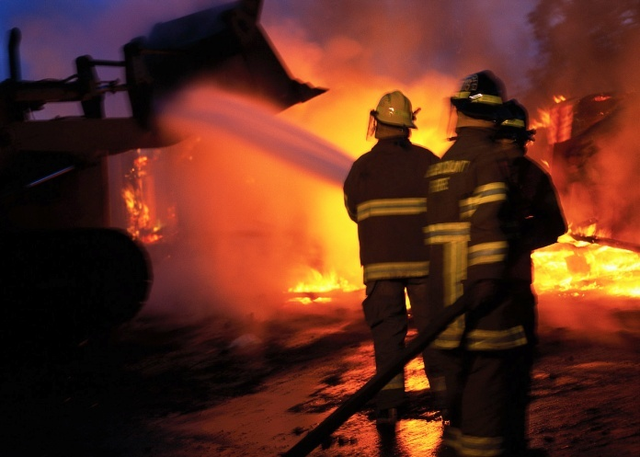
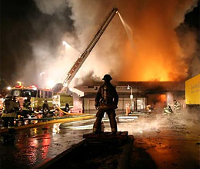
OSHA 29 CFR 1910 Subparts E & L
Bureau of Workers’ Compensation
PA Training for Health & Safety (PATHS)
EGRESS,
FIRE PREVENTION &
FIRE PROTECTION
Notes:
The safety of building occupants from fire is dependent upon preventive measures, the ability to evacuate threatened persons and fire protection measures to mitigate and suppress the fire. Fire protection may exist in the form of alarm systems, fixed suppression systems or manually applied measures by trained personnel, fire brigades or fire companies or departments.

Slide 2
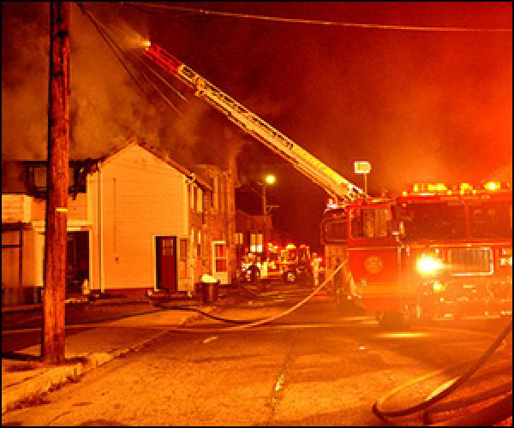
What We’ll Talk About
Escape Routes/Exits
Emergency Action Plan
Fire Prevention Plan
Fires
Fire Extinguishers
Workplace Fire Prevention Tips
Notes:
Topics addressed by this program include:
Escape Routes/Exits
Emergency Action Plan
Fire Prevention Plan
Fires
Fire Extinguishers
Workplace Fire Prevention Tips

Slide 3
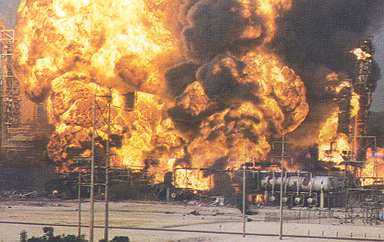
Destruction!
Workplace fires are still occurring despite advances in detection and suppression technology.
Notes:
Depending upon the industry type, commodities and chemicals required in the process and storage, fires will always be a possibility.
However, instituting protective measures both administratively and operationally while creating and adhering to safety policies can also minimize or preclude such an occurrence.

Slide 4
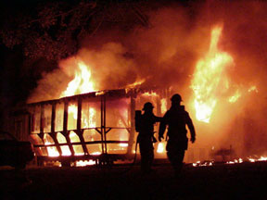
Workplace Fires
On average kill more than 100 and injure more than 1,600 workers each year.
There is a long and tragic history of workplace fires in this country caused by problems with fire exits and extinguishing systems.
OSHA requires employers to provide proper exits, fire fighting equipment, and employee training to prevent fire deaths and injuries in the workplace.
Notes:
In 1995, more than 75,000 workplace fires cost businesses more than $2.3 billion
Means of Egress: 29 CFR 1910 Subpart E
Fire Protection: 29 CFR 1910 Subpart L
More complete information on means of egress can be found in the National Fire Protection Association document:
NFPA 101: Life Safety Code

Slide 5
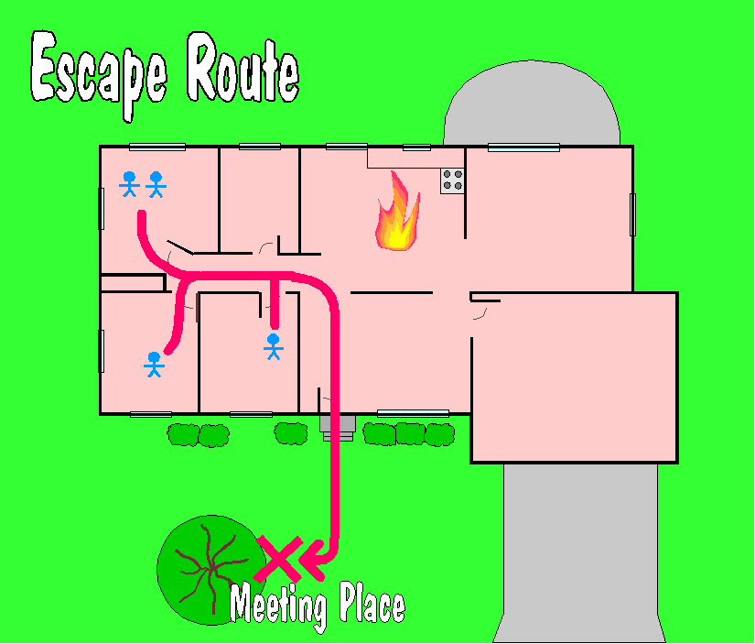
Escape Route
“A continuous and unobstructed way of exit travel from any point in a building or structure to a public way (a street, yard, court or other open space leading to the street)”
Three parts to an escape route:
the way of exit access;
the exit; and
the way of exit discharge.
Notes:
1910.35(a)
Another term for “means of egress” is “escape route.”
Emphasis is on escaping from fires, however some additional hazards include:
Explosion
Earthquake
Bomb threat
Toxic vapors
Storms (tornadoes, hurricanes, etc.) Compounding factors that may interfere with safe escape include:
Panic and confusion,
Poor visibility,
Lack of information, and
Misinformation.
These factors frequently cause more injuries and fatalities than the hazard itself.

Slide 6
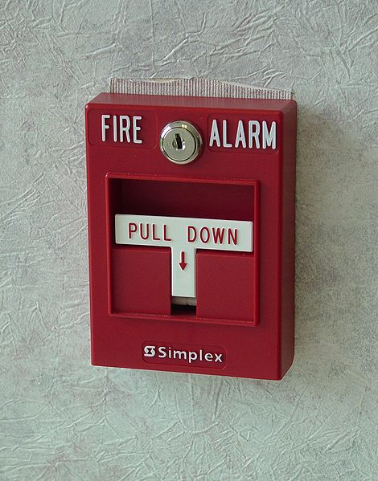
Escape Routes: General Requirements
Fire alarms = required if a fire could start without providing adequate warning to occupants.
Must be enough exits in proper arrangement for quick escape.
Adequate and reliable illumination
must be provided for all exit facilities.
Escape Routes:
Minimum width = 28”
Minimum ceiling height = 7-½’
Notes:
1910.37(f)(6)
1910.37(i)
Fire alarms also facilitate the orderly conduct of fire exit drills.

Slide 7
Locking Exits
Must not install any lock or fastening device that impedes/prevents escape from the inside of any building.
Locked and blocked exit
Notes:
1910.36(b)(4)
Locking Exits:
You must not install any lock or fastening device that impedes/prevents escape from the inside of any building.
There is an exception for mental, penal, or corrective institutions where there is constant supervision.

Slide 8
Access to Exits
Exits must be readily accessible at all times.
When room occupied by more than 50 people or contains high hazard contents, door from room:
To exit or escape route must be side-hinged swinging type
Swing in the direction of exit travel
Notes:
1910.37(f)(1) & (2)
Access to Exits:
Exits must be readily accessible at all times.
When a room is occupied by more than 50 people or contains high hazard contents, door from room:
▫ To exit or escape route must be side-hinged swinging type
▫ Swing in the direction of exit travel
High hazard contents are those which are liable to burn with extreme rapidity or which may produce poisonous fumes or explosions in a fire. Examples include flammable chemicals and grain.

Slide 9
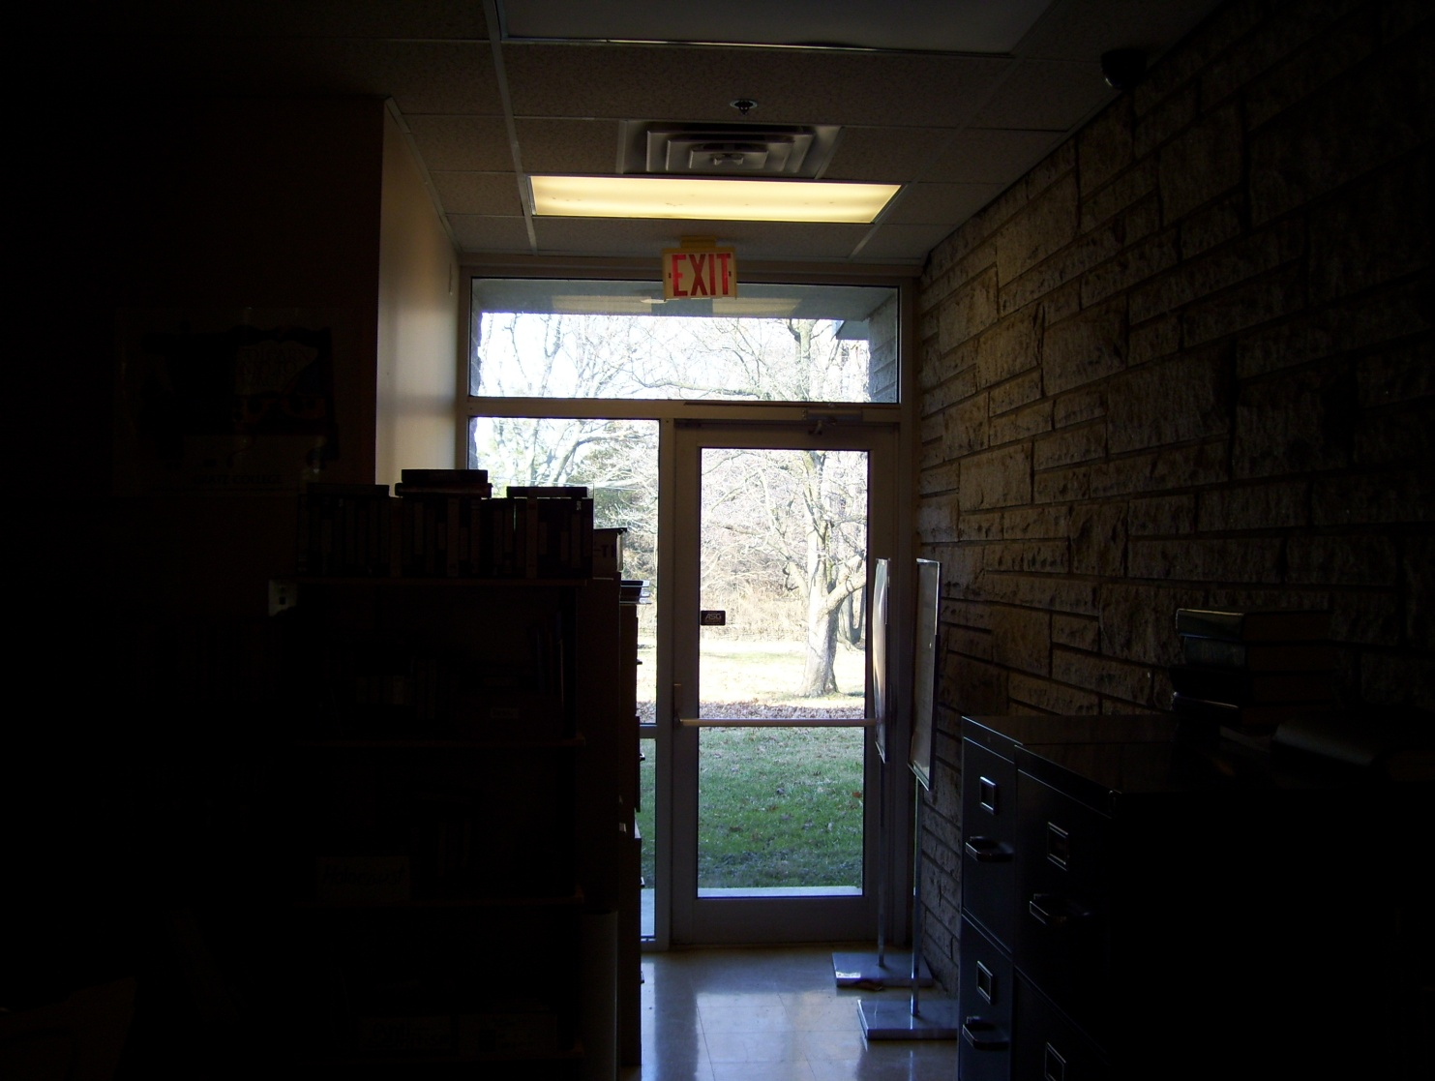
Is This Okay?
No – clutter in exit, exit access poorly lit
Notes:
No!
Clutter in exit
Exit access is poorly lit

Slide 10
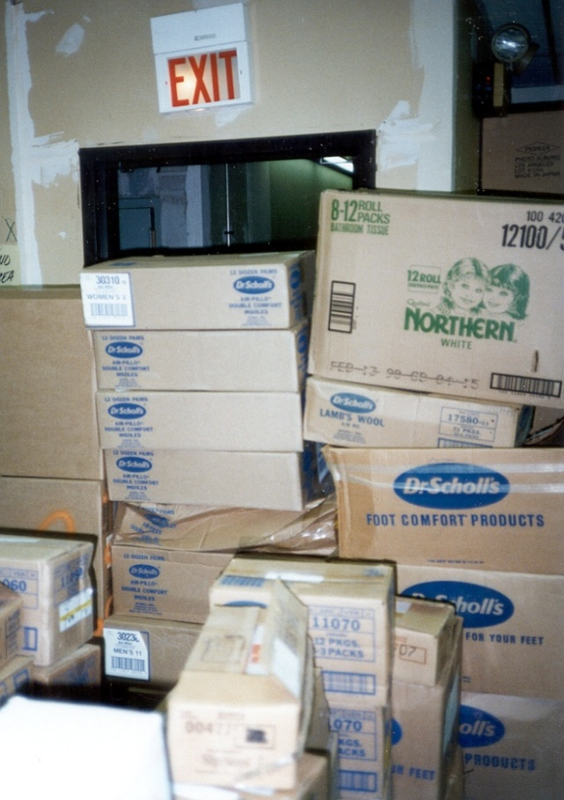
Maintaining Escape Routes
Escape routes from all parts of a building must be continuously maintained free of all obstructions in case of emergency.
Blocked & Obstructed exit
Notes:
1910.37(k)(2)
In maintaining escape routes such escape routes from all parts of a building must be continuously maintained free of all obstructions in case of emergency.
This exit is blocked and obstructed.

Slide 11
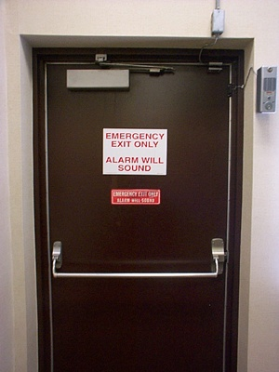
Exit Marking
Exits must be marked by a readily visible sign when the exit or way to reach it is not immediately visible to occupants.
Notes:
1910.37(q)(1)
Exit Marking:
Exits must be marked by a readily visible sign when the exit or way to reach it is not immediately visible to occupants.

Slide 12
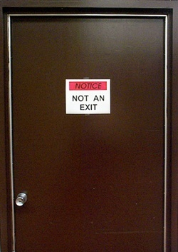
Exit Marking
If a door, passage, or stairway is not an exit or way of exit access, but may be mistaken for one, it must be identified by a sign reading “Not an Exit”, “Storeroom”, “To Basement”, etc.
Notes:
1910.37(q)(2)
Exit Marking:
If a door, passage, or stairway is not an exit or way of exit access, but may be mistaken for one, it must be identified by a sign reading “Not an Exit”, “Storeroom”, “To Basement”, etc.

Slide 13
Exit Marking
Sign reading “Exit” with arrow indicating direction must be placed in every location where direction of travel to nearest exit is not immediately apparent.
Notes:
1910.37(q)(5)
Exit Marking:
Sign reading “Exit” with arrow indicating direction must be placed in every location where direction of travel to nearest exit is not immediately apparent.
Also, some facilities are putting illuminated Exit signs at floor level rather than up high. Their feeling is that if smoke rises during a fire and people are crawling below it to find the exit, they’ll be able to see the lower Exit sign.

Slide 14
Emergency Action Plan
Describes actions that must be taken to ensure employee safety in emergencies.
→ Includes floor plans or maps which show emergency escape routes.
→ Tells employees what actions to take in emergency situations.
→ Covers emergencies the employer may reasonably expect such as:
▪ Fires ▪ Explosions ▪ Floods ▪ Tornadoes ▪ Hurricanes ▪ Toxic chemical releases ▪ Power Failure
Notes:
1910.38(a) applies to all emergency action plans required by a particular OSHA standard, such as the Fire Brigades or Permit-Required Confined Spaces standard. The emergency action plan must be in writing, except for firms with 10 or fewer employees. These businesses can communicate the plan orally to employees.
Emergency plans include, as a minimum:
- Escape procedures and escape route assignments
- Critical plant operations shutdown procedure
- Procedure to account for all personnel
- Assignment of rescue and medical duties
- Means for reporting emergencies
- Identification of responsible persons to contact for further information
Employee training is necessary and an alarm system must be in place which has a distinctive signal.
See OSHA Publication 3088, “How to Prepare for Workplace Emergencies”, available at www.osha.gov for more information.

Slide 15
Fire Prevention Plan
The plan must include:
-A list of the major fire hazards and handling, storage, and control procedures.
-Names/job titles of persons responsible for maintenance of equipment and systems to prevent or control ignitions or fires.
-Names or job titles of persons responsible for control of fuel source hazards.
-Training for all employees who have responsibilities in the plan.
Fire Prev. Plan
Notes:
1910.38(b) applies to all fire prevention plans required by a particular OSHA standard.
The fire prevention plan must be in writing, except for firms with 10 or fewer employees. Those businesses can communicate the plan orally to employees.

Slide 16
Ingredients of a Fire
There are three fundamental and essential “ingredients” necessary to produce the chemical reaction that is called fire:
Oxygen - the catalyst
Heat - the ignition source
Fuel - solid, liquid, or gas that burns
You remove one of these ingredients, you can extinguish the fire.
Notes:
Three (3) necessary components required for combustion are:
1.Fuel
2.Oxygen, and
3.Heat
The removal of one of these ingredients will extinguish a fire.

Slide 17
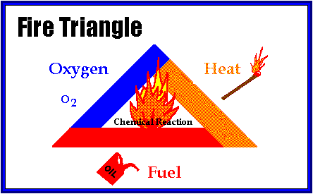
Fire Triangle/Tetrahedron
Fire Triangle = Oxygen, heat, and fuel
Fire Tetrahedron = Add chemical reaction
Remove any of these items = No fire (fire goes out)
Basic Fire safety/prevention = Keep fuel & ignition sources separate
Notes:
The fourth component for combustion would be an uninhibited chemical chain reaction. This aspect guarantees heat gain during the combustion process when supportive molecules such as oxygen collide in the combustion zone with flammable or combustible molecules, such as carbon and hydrogen.
Fire suppression materials seek to eliminate these chemical chain reactions, thereby removing heat gain and then leading to suppression.

Slide 18
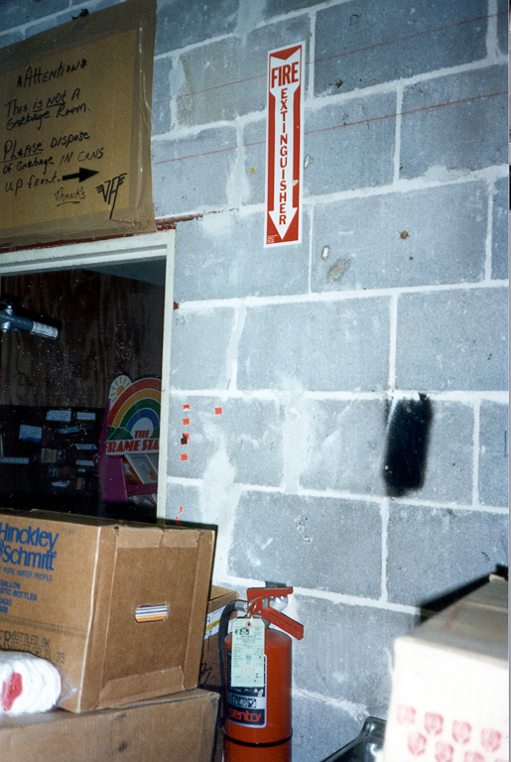
Portable Fire Extinguishers
If portable fire extinguishers are provided for employee use, employer must mount, locate, and identify them so workers can access without being injured.
Blocked extinguisher
Notes:
1910.157(c)(1)
Employers can choose whether to train their workers to fight fires or to rely on outside services.

Slide 19
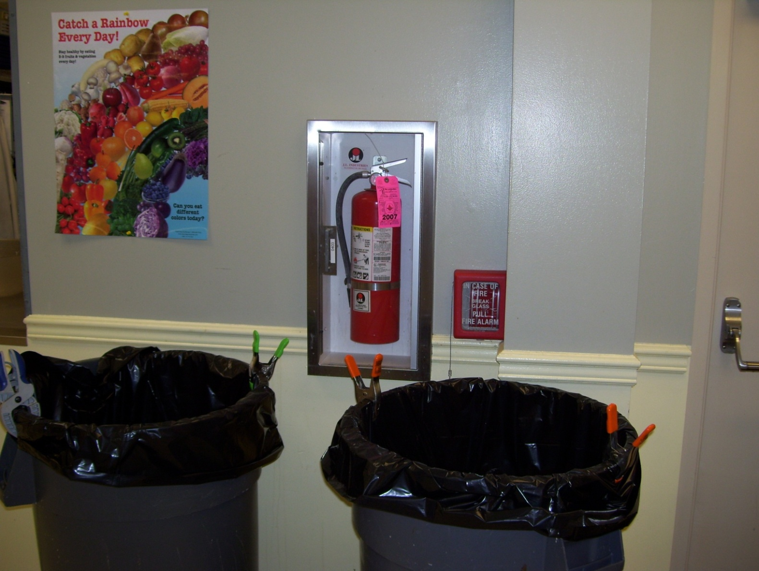
Do You See a Problem Here?
Access to fire extinguisher obstructed
Notes:
Yes, access to fire extinguisher is blocked as is the fire alarm pull station.

Slide 20
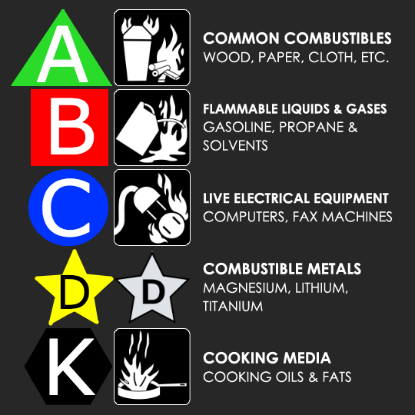
Letter classification on extinguisher designates class or classes of fire for which it will be effective.
Notes:
The class of extinguisher should be on the extinguisher shell. The picture-symbol labeling system now in use is designed to make the operation of fire extinguishers more effective and safe to use through the use of less confusing pictorial labels. The system also emphasizes when not to use an extinguisher on certain types of fires.
Because of recent information outlining the difficulties inherent in the extinguishment of fires in cooking appliances that involve combustible cooking media (vegetable or animal oils and fats), a new classification (Class K) has been established. This classification is not listed in OSHA standards. NFPA 10 specifies that listed and labeled Class K fire extinguishers are to be provided in these cases.
Class A (Ordinary Combustibles)
Class B (Flammable Liquids & Gases)
Class C (Energized Electrical = means object on fire has power going to it)
Class D (Combustible Metals)
Class K (Cooking oils & fats)

Slide 21
Extinguisher Classfication
Class “K” Fires
Cooking grease made from animal fat.
▪ These fires usually burn
very hot.
▪ Dangerous to extinguish.
▪ Special fire extinguishers
used for these classes of
fires.
▪ Usually in kitchen areas of
restaurants/cafeterias.
Notes:
So, Class “K” Fires are those involving cooking grease made from animal fat.
▪ These fires usually burn very hot.
▪ Dangerous to extinguish.
▪ Special fire extinguishers used for these classes of fires.
▪ Usually in kitchen areas of restaurants/cafeterias.

Slide 22
Maintaining Portable Fire Extinguishers
Must maintain in fully charged and operable condition.
Must keep in their designated locations at all times except during use.
Must conduct an annual maintenance check.
Must do “visual inspection” monthly (i.e. ensure extinguisher in place, not damaged, and properly charged).
Notes:
1910.157(c)(4)
1910.157(e)(3)
Maintaining Portable Fire Extinguishers
Must maintain in fully charged and operable condition.
Must keep in their designated locations at all times except during use.
Must conduct an annual maintenance check.
Must do “visual inspection” monthly (i.e. ensure extinguisher in place, not damaged, and properly charged).

Slide 23
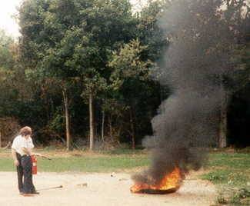
Extinguisher Training and Education
If portable fire extinguishers are provided for employee use, employees must be given training on the:
General principles of fire extinguisher use
Hazards of incipient (beginning) stage fire fighting
Employees designated to use extinguishers must receive instruction and hands-on practice in the operation of equipment
Notes:
1910.157(g)
If portable fire extinguishers are provided for employee use, employees must be given training in:
1.General principles of fire extinguisher use and
2.Hazards of incipient fire.
Training and education is required upon initial employment/assignment and at least annually thereafter.
“Incipient Stage Fire” means a fire which is in the initial or beginning stage and which can be controlled or extinguished by portable fire extinguishers, Class II standpipe or small hose systems without the need for protective clothing or breathing apparatus. [1910.155(c)(26)]

Slide 24
Remember the Word P.A.S.S.
P = Pull the pin on the fire extinguisher handle.
A = Aim the nozzle/horn of the extinguisher
at the base/bottom of the fire.
S = Squeeze the handles together to make
the extinguisher work.
S = Sweep the extinguisher from side to
side (as if using a broom).
Notes:
To properly use a fire extinguisher, the acronym PASS should be remembered.
P=Pull the pin to activate the extinguisher,
A=Aim the nozzle or horn at the base of the fire,
S=Squeeze the handles together to expel the agent, and
S=Sweep the extinguisher from side to side to distribute the agent.

Slide 25
Workplace Fire Prevention Tips
Eliminate Fire Hazards: Keeping workspaces free of waste paper and other combustibles, replacing damaged electrical cords and avoiding overloaded circuits.
Prepare for Emergencies: Making sure all smoke detectors work, knowing who to call in an emergency and participating in fire drills.
Report Fires and Emergencies Promptly: Sounding the fire alarm and calling the fire department.
Evacuate Safely: Leaving the area quickly in an emergency, using stairs instead of the elevator, and helping your coworkers.
Notes:
Prevention to eliminate the possibility of a fire benefits everyone. No down time due to damage, no personnel injured or temporarily out of work during facility restoration, and no loss of clients which your services or products support. A few tips for prevention include:
1. Eliminate fire hazards
2. Prepare for emergencies
3. Report fires and emergencies promptly
4. Evacuate your personnel safely

Slide 26
Workplace Fire Prevention Tips
Use and maintain wiring, tools, and equipment correctly. Keep everything oil and dust free.
Uncoil an extension cord fully before use (use for temporary wiring ONLY). Be sure the amperage of the cord is appropriate for the job you are doing.
Do not use equipment that delivers mild electrical shocks, gives off unusual heat or smells odd. If in doubt have it checked and repaired or replaced.
Sweep up scraps of paper or material and dust as soon as possible.
Notes:
Other prevention tips.
Use and maintain wiring, tools, and equipment correctly. Keep everything oil and dust free.
Uncoil an extension cord fully to use.
Use extension cords for temporary wiring ONLY.
Ensure cord amperage is appropriate for the job.
Do not use equipment that delivers mild electrical shocks, gives off unusual heat or smells odd. If in doubt have it checked and repaired or replaced.
Sweep up scraps of paper or material and dust as soon as possible.

Slide 27
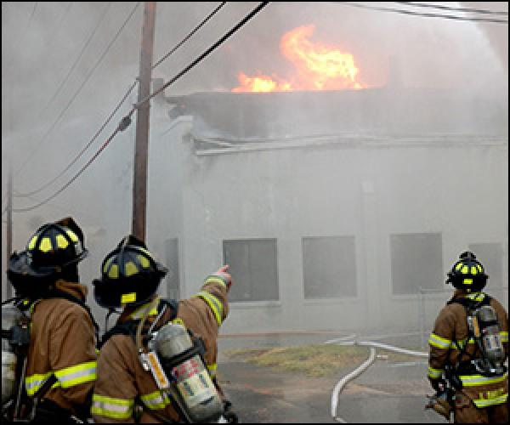
Workplace Fire Prevention Tips
Store flammable liquids in approved containers and locations.
Do not use electrical equipment when flammable gases, vapors, liquids, dusts, or fibers are present.
Insure trash is emptied frequently enough to prohibit a build up of combustibles in an area.
Notes:
Workplace fire prevention tips:
1.Store flammable liquids in approved containers and locations
2.Do NOT use electrical equipment in atmospheres of flammable gases, vapors, liquids, dusts or fibers.
3.Prohibit build-up of combustibles by emptying trash frequently in work areas.

Slide 28
Summary
There must be enough exits in the building arrangement for quick escape.
→ Escape routes must be marked, lighted, free of obstructions, and locks must not be used to impede or prevent escape.
→ An emergency action plan and a fire prevention plan must be in place.
→ Fire extinguisher classes and numerical ratings help a user understand its capabilities.
→ Fire extinguishers must be inspected, maintained and employees must be trained in how to use them.
Notes:
In summary:
There must be enough exits in a facility in the proper arrangement for quick escape.
Escape routes must be marked, lighted, free of obstructions.
An emergency action plan as well as a fire prevention plan must be in place.
Fire extinguisher classes and numerical ratings help users understand the capabilities of extinguishers.
Fire extinguishers must be inspected and maintained and employees must be trained in how to use them.

Slide 29
Contact Information
Health & Safety Training Specialists
1171 South Cameron Street, Room 324
Harrisburg, PA 17104-2501
(717) 772-1635
RA-LI-BWC-PATHS@pa.gov
Like us on Facebook! - https://www.facebook.com/BWCPATHS
Notes:
If you would like to know more about our other training programs, PowerPoint presentations, webinars or our monthly schedule, please feel invited to contact us on the website or phone above.

Slide 30
Questions?

