Slide 1
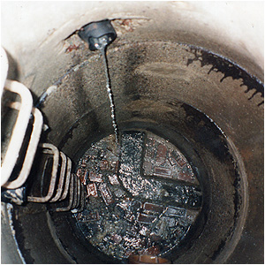
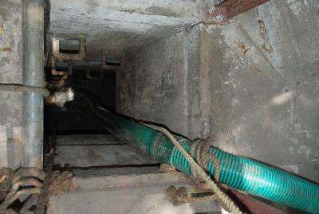
Confined Space Safety
Bureau of Workers’ Comp
PA Training for Health & Safety
(PATHS)
29 CFR 1926.1200
For Construction
PPT-136-01
1
Notes:
The Scope of this standard, found in 29 CFR 1926.1200, is to protect employees engaged in construction activities at a worksite with one or more confined spaces. Its intent parallels 29 CFR 1910.146 Permit-Required Confined Spaces for General Industry.
There were 431 confined space incidents with 530 fatalities in the US due to oxygen deficient and/or toxic atmospheres from 1992-2005.
From 08/18/2009 to 12/31/2009, there were 36 worker fatalities and 6 worker hospitalizations related to confined spaces.
In 2010, there were 63 worker fatalities and 28 hospitalizations related to confined spaces.
From 01/01/2011 to 08/01/2011, there were 22 worker fatalities and 3 worker hospitalizations related to confined spaces.
Repair & Maintenance and cleaning & inspection activities account for almost one-quarter of confined space-related fatalities.
Construction and manufacturing industries experience the most fatalities.

Slide 2
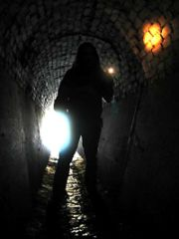
Reason for the Standard
Why did OSHA develop a Confined Space standard?
122 confined space accidents each year led to 173 fatalities.
60% of the fatalities occurred during rescue attempts.
PPT-136-01
2
Notes:
The reason for the standard is to protect those entering confined spaces or permit-required confined spaces (as defined by the standard).
For an early understanding of the problem, the 1973 Michigan Study should be read dealing with the numbers of fatalities of those entering permit-required confined spaces.
This study determined that in one (1) year, 123 persons died by making such an entry. In one case, 4 rescuers died trying to rescue a co-worker.
The main problem with each of the cases? Improper air to breathe.
During a study done in 2006 by a California company, it was found that approximately one-fifth of the confined space incidents result in multiple fatalities. Data also indicated that for every fatality due to oxygen-deficient and/or toxic atmosphere, 2 non-fatal injuries occur, one of which requires hospitalization. More often than not, those additional injuries are to rescuers.

Slide 3
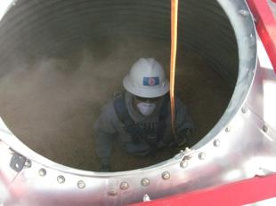
The Standard
Intended to protect workers from toxic, flammable, explosive, or asphyxiating atmospheres.
Possible engulfment.
Any other recognized serious hazard (example: hazardous energy).
The standard focuses on areas with immediate health or safety risks, denoting them as “Permit Required Confined Space” (PRCS).
PPT-136-01
3
Notes:
Therefore, understanding past incidents, the standard was created to protect workers from:
Toxic, flammable, explosive, or asphyxiating atmospheres.
Possible engulfment.
Any other recognized serious hazard (example: hazardous energy).
The standard focuses on areas with immediate health or safety risks, denoting them as “Permit Required Confined Space” (PRCS).

Slide 4
Industry Standard
All employees required to enter into confined or enclosed spaces shall be instructed as to:
- Nature of the hazards involved. - Necessary precautions to be taken. - Use of protective emergency equipment.
The employer shall comply with any specific regulations that apply to work in dangerous or potentially dangerous areas.
PPT-136-01
4
Notes:
This industry standard requires all employees required to enter into confined or enclosed spaces shall be instructed as to:
Nature of the hazards involved.
Necessary precautions to be taken.
Use of protective emergency equipment.
The employer shall comply with any specific regulations that apply to work in dangerous or potentially dangerous areas.

Slide 5
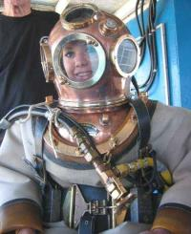
Exceptions to the Standard
This standard does not apply to Construction work regulated by 1926 addressing the following areas:
Subpart P – Excavations
Subpart S – Underground Construction, Caissons, Cofferdams and Compressed Air
Subpart Y - Diving
PPT-136-01
5
Notes:
Where this standard applies and there is a provision addressing a confined space hazard in another OSHA standard, the employer must comply with BOTH requirements and applicable provisions of this standard. (29 CFR 1926.1200 parallels 1910.146, Confined Spaces for General Industry. Therefore, since portions of 1910.146 would also be complied with, this program includes those different or additional requirements found in 1926.1200, Confined Space for Construction.)

Slide 6
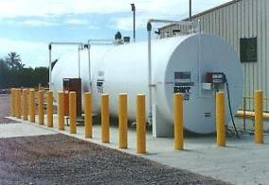
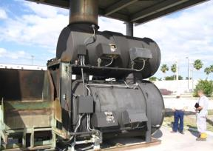
Typical Confined Spaces
Tanks, incinerators, scrubbers
Concrete pier columns, transformer vaults, HVAC ducting
Drilling shafts, enclosed beams, vessels
Digesters, lift stations, step up transformers, turbines
Chillers, bag houses and mixers/reactors
PPT-136-01
6
Notes:
Typical examples of confined spaces would include:
Tanks, incinerators, scrubbers
Concrete pier columns, transformer vaults, HVAC ducting
Drilling shafts, enclosed beams, vessels
Digesters, lift stations, step up transformers, turbines
Chillers, bag houses and mixers/reactors

Slide 7
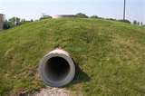
How to Identify Confined Spaces
Large enough/so configured for worker to enter.
Limited Openings for Entry and Exit.
Not Designed for Continuous Worker Occupancy.
PPT-136-01
7
Notes:
There are 2 designations concerning these hazards: confined space and a permit-required confined space (PRCS).
Non-permit confined space meets the definition of a confined space but does not meet the requirements for a permit-required confined space.
A confined space can be identified if it meets any of the following conditions:
Large enough/so configured for worker to enter.
Limited Openings for Entry and Exit.
Not Designed for Continuous Worker Occupancy.

Slide 8
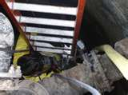
Limited Openings for Entry/Exit
Openings as small as 18 inches in diameter.
Difficult to enter with SCBA or other life-saving equipment.
Difficult to remove downed worker in folded up or bent over position.
Exit from large openings may be difficult due to presence of ladders, hoists, etc.
PPT-136-01
8
Notes:
Additional characteristics of a confined space:
Openings as small as 18 inches in diameter.
Difficult to enter with SCBA or other life-saving equipment.
Difficult to remove downed worker in folded up or bent over position.
Exit from large openings may be difficult due to presence of ladders, hoists, etc.

Slide 9
Unfavorable Natural Ventilation
Lack of air movement in and out of the space can create an atmosphere much different than the outside atmosphere.
Deadly gases can be trapped inside.
Organic materials can decompose.
May not be enough oxygen due to presence of
other gases or chemical reactions such as rusting.
PPT-136-01
9
Notes:
Ventilation also figures in to a confined space.
Lack of air movement in and out of the space can create an atmosphere much different than the outside atmosphere.
Deadly gases can be trapped inside.
Organic materials can decompose.
May not be enough oxygen due to presence of other gases or chemical reactions such as rusting.

Slide 10
Characteristics Include
Not Designed for Continuous Worker Occupancy:
Most confined spaces are not designed to enter and work in on a regular basis.
Designed to store a product.
Enclose materials or processes.
Transport products or substances.
Occasional worker entry for inspection, repair, cleanup, maintenance, etc.
PPT-136-01
10
Notes:
Further occupancy concerns,
Not Designed for Continuous Worker Occupancy:
Most confined spaces are not designed to enter and work in on a regular basis.
Designed to store a product.
Enclose materials or processes.
Transport products or substances.
Occasional worker entry for inspection, repair, cleanup, maintenance, etc.

Slide 11
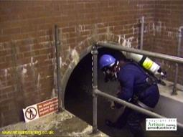
Hazards
Physical hazard: an existing or potential hazard that can cause death or serious physical damage.
Limited or restricted means for entry or exit: a condition that has a potential to impede an employee’s movement into or out of a confined space (e.g. trip hazards, slippery floors, poor illumination, etc.).
PPT-136-01
11
Notes:
Per 1926.1200,
Physical hazard is an existing or potential hazard that can cause death or serious physical damage. Examples (not exhaustive) explosives (as defined in 1926.914(n)) and: mechanical, electrical, hydraulic and pneumatic energy; radiation; temperature extremes; engulfment; noise; and inwardly converging surfaces. Physical hazard also includes chemicals that can cause death or serious physical damage through skin or eye contact (rather than through inhalation).
Limited or restricted means for entry or exit means a condition that has a potential to impede an employee’s movement into or out of a confined space. Such conditions include, but are not limited to, trip hazards, poor illumination, slippery floors, inclining surfaces and ladders.

Slide 12
Dangerous Combinations
Presence of all three confined space characteristics can complicate the situation.
Working in and around the space.
Rescue operations during emergencies.
Worsened conditions due to work activities:
Welding and cutting, use of bonding agents.
Cleaning with solvents, use of other chemicals.
Use of gas-powered equipment.
PPT-136-01
12
Notes:
Dangerous combinations of hazards may occur in confined spaces. The presence of all three confined space characteristics can complicate the situation and can affect those:
Working in and around the space.
Rescue operations during emergencies.
Worsened conditions due to work activities:
Welding and cutting, use of bonding agents.
Cleaning with solvents, use of other chemicals.
Use of gas-powered equipment.

Slide 13
PRCS
Permit-Required Confined Space
Contains or has a potential to contain a hazardous atmosphere.
Contains a material that has the potential for engulfing an entrant.
3. Has an internal configuration such that an entrant could be trapped or asphyxiated by inwardly converging walls or by a floor which slopes downward and tapers to a smaller cross-section.
4. Contains any other recognized serious safety or health hazard.
PPT-136-01
13
Notes:
The Permit-Required Confined Space characteristics build on the definition of the confined space. Additional concerns for a PRCS would be:
Contains or has a potential to contain a hazardous atmosphere.
Contains a material that has the potential for engulfing an entrant.
3. Has an internal configuration such that an entrant could be trapped or asphyxiated by inwardly converging walls or by a floor which slopes downward and tapers
to a smaller cross-section.
4. Contains any other recognized serious safety or health hazard.

Slide 14
Categorizing Work Space
* Space large enough to enter &;
* Limited or Restricted entry or exit &;
* Not designed for continuous worker
occupancy.
NO
Not a confined Space
YES
Confined Space
Hazardous Atmosphere
Non-
Permit
Required
Space
Permit-
Required
Confined
Space
Or
YES
Engulfment Hazard
NO
Or
Configuration Hazard
Or
Any other recognized
serious hazard
PPT-
14
Notes:
This Decision Logic will aid you in determining if spaces on your facility conform to the definition of either a confined space or permit-required confined space.
Those who work at remote work sites (e.g. in the field or in valve pits) should use this decision logic to determine operational needs. I can be used as a pre-planning tool.
Always decide on the side of safety in making a determination.

Slide 15
Evaluation
Employers are required to evaluate workplaces for permit required confined spaces.
Employees must be informed of the existence of confined spaces through the use of signs, etc.
UNAUTHORIZED ENTRY
MUST BE PREVENTED
PPT-136-01
15
Notes:
Evaluate and map locations within the facility/on the worksite. Some facilities have created maps that indicate the category of hazard (i.e. confined space or permit-required confined space).
Employers are required to evaluate workplaces for permit required confined spaces (PRCS).
Employees must be informed of the existence of confined spaces through the use of signs, etc.
UNAUTHORIZED ENTRY MUST BE PREVENTED!

Slide 16
Signs
A sign reading:
- DANGER -
PERMIT REQUIRED CONFINED SPACE
DO NOT ENTER
or other similar language would satisfy the requirement for a sign.
PPT-136-01
16
Notes:
Or a sign reading:
- DANGER -
PERMIT REQUIRED CONFINED SPACE
DO NOT ENTER
or other similar language would satisfy the requirement for a sign

Slide 17
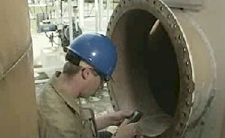
Responsible Personnel
Competent Person must identify and predict hazards in surroundings or in the space.
Qualified persons will resolve problems found.
PPT-136-01
17
Notes:
Competent Person: is one capable of identifying existing and predictable hazards in the surroundings or working conditions which are unsanitary, hazardous, or dangerous to employees, and who has the authorization to take prompt corrective measures to eliminate them.
Qualified Person: means one who, by possession of a recognized degree, certificate, or professional standing, or who by extensive knowledge, training, and experience, has successfully demonstrated his ability to solve or resolve problems relating to the subject matter, the work, or the project.

Slide 18
Responsible Personnel
Controlling contractor is the employer with overall responsibility for construction at the worksite.
Entry Employer is any employer who decides an employee it directs will enter a permit space.
Host employer is the employer that owns or manages the property where the construction work is taking place.
PPT-136-01
18
Notes:
Controlling contractor is the employer with overall responsibility for construction at the worksite.
Entry Employer: An employer cannot void the duties of the standard merely by refusing to decide whether its employees will enter a permit space, and OSHA will consider the failure to so decide to be an implicit decision to allow employees to enter those spaces if they are working in the proximity of the space.
Host Employer: If the owner of the property on which the construction activity occurs has contracted with an entity for the general management of that property, and has transferred to that entity the information specified in 1203(h)(1) (dealing locations, hazards and precautions), will treat the contracted management entity as the host employer for as long as that entity manages the property. Otherwise, OSHA will treat the owner of the property as the host employer. In no case will there be more than one host employer.
Note. If the owner of the property on which the construction activity occurs has contracted with an entity for the general management of that property, and has transferred to that entity the information specified in 1203(h)(1) (dealing with locations, hazards and precautions), the contracted management entity will be treated as the host employer for as long as that entity manages the property. Otherwise, OSHA will treat the owner of the property as the host employer. In no case will there be more than one host employer.

Slide 19
Hazard Control
Control is the action taken to reduce the level of any hazard inside a confined space using engineering methods (example, by ventilation), and then using these methods to maintain the reduced hazard level.
Control also refers to the engineering methods used for this purpose. PPE is not a control.
Control ensures persons do not enter Immediately Dangerous to Life or Health (IDLH) atmospheres.
PPT-136-01
19
Notes:
Immediately dangerous to life or health (IDLH) means any condition that would interfere with an individual’s ability to escape unaided from a permit required confined space and which poses a threat to life or that would cause irreversible adverse health effects.
Note: Some materials, such as hydrogen fluoride gas and cadmium vapor, may produce immediate transient effects that, even if severe, may pass without medical attention, but are followed by sudden, possible fatal collapse 12-72 hours after exposure. The victim “feels normal” after recovery from transient effects until collapse. Such materials in hazardous quantities are considered to be “immediately” dangerous to life or health.

Slide 20
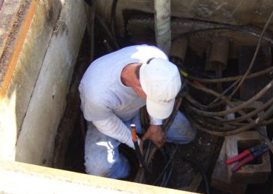
Hazard Control
Isolate or isolation: the process by which a permit space is removed from service and completely protected against the release of energy and material into the space; in 1926.1200 also includes “placement of barriers to eliminate the potential for employee contact with a physical hazard.”
◦ Line breaking
◦ Lockout
◦ Tagout
◦ Monitoring
PPT-136-01
20
Notes:
Isolate or isolation means the same as in 1910.146 but also includes “placement of barriers to eliminate the potential for employee contact with a physical hazard.”
Monitor or monitoring is the process used to identify and evaluate the hazards after an authorized entrant enters the space. This is a process of checking for changes that is performed in a periodic or continuous manner after the completion of the initial testing or evaluation of that space.
Line breaking is the intentional opening of a pipe, line, or duct that is or has been carrying flammable, corrosive, or toxic material, an inert gas, or any fluid at a volume, pressure, or temperature capable of causing injury.
Lockout is the placement of a lockout device on any energy isolating device, in accordance with an established procedure, ensuring the energy isolating device and the equipment being controlled cannot be operated until the lockout device is removed.
Tagout means:
Placement of a tagout device on a circuit or equipment that has been de-energized, in accordance with an established procedure, to indicate that the circuit or equipment being controlled may not be operated until the tagout device is removed; and the employer ensures that:
(i) tagout provides equivalent protection to lockout, or
(ii) that lockout is infeasible and the employer has relieved, disconnected, restrained and otherwise rendered safe stored (residual) energy.

Slide 21
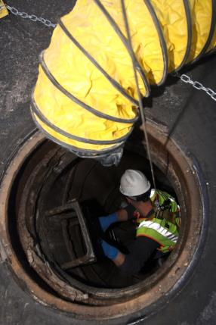
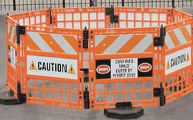
Hazard Control
Protection against serious physical damage
Ventilation may also be used
PPE
Lighting
Barriers
PPT-136-01
21
Notes:
Serious physical damage means an impairment or illness in which a body part is made functionally useless or is substantially reduced in efficiency. Such impairment or illness may be permanent or temporary and includes, but is not limited to, loss of consciousness, disorientation, or other immediate and substantial reduction in mental efficiency. Injuries involving such impairment would usually require treatment by a physician or other licensed health-care professional.
Ventilate or ventilation means controlling a hazardous atmosphere using continuous forced-air mechanical systems that meet the requirements of §1926.57—Ventilation.
*(4) Personal protective equipment insofar as feasible engineering and work-practice controls do not adequately protect employees;
*Note to paragraph §1926.1204(d)(4). The requirements of Subpart E of this part and other PPE requirements continue to apply to the use of PPE in a permit space. For example, if employees use respirators, then the respirator requirements in §1926.103 (Respiratory protection) must be met.
(5) Lighting equipment that meets the minimum illumination requirements in §1926.56, that is approved for the ignitable or combustible properties of the specific gas, vapor, dust, or fiber that will be present, and that is sufficient to enable employees to see well enough to work safely and to exit the space quickly in an emergency.

Slide 22
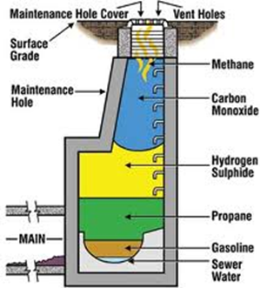
Hazards of Confined Spaces
Oxygen Deficient Atmospheres.
Oxygen Enriched Atmospheres.
Flammable Atmospheres.
Toxic Atmospheres.
Temperature Extremes.
Engulfment Hazards.
Noise, Slick/Wet Surfaces.
Falling Objects.
PPT-136-01
22
Notes:
Oxygen content should be between 19.5% and 23.5%
Flammable atmospheres should be below the LEL. Detectors will register a reading of 10% LEL, to determine if the area should be purged with ventilation or enough time to evacuate the location.
Toxic atmospheres will depend upon the material flowing into the location or created by the process of the area.
Engulfment, noise, slick surfaces or falling objects should be evaluated to determine safety efforts to exclude them.
Hazardous atmosphere. Note: An atmospheric concentration of any substance that is not capable of causing death, incapacitation, impairment of ability to self-rescue, injury, or acute illness due to its health effects is not covered by this definition.
Inerting is the displacing of the atmosphere in a permit space by a noncombustible gas (such as nitrogen or argon) to such an extent the resulting atmosphere is noncombustible.
Note: This procedure produces an IDLH oxygen-deficient atmosphere due to diluting the breathable oxygen in the space.

Slide 23
Oxygen Deficient Atmospheres
19.5 % Minimum acceptable oxygen level. 15 - 19% Early symptoms: Decreased ability
to work strenuously. Impaired
coordination.
12-14% Respiration increases. Poor judgment.
10-12% Respiration increases. Lips blue.
8-10% Mental failure. Fainting. Nausea. Unconsciousness. Vomiting.
6-8% 8 minutes=fatal, 6 minutes=50% fatal
4-5 minutes=possible recovery.
4-6% Coma in 40 seconds. Death.
PPT-136-01
23
Notes:
The percentage of oxygen by volume in the slide show the symptoms which can occur. The entrant and attendant should be familiar with symptoms resulting from oxygen depletion.

Slide 24
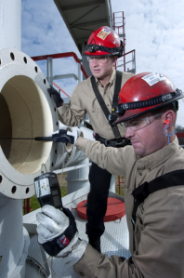
Oxygen Enriched Atmospheres
Oxygen level above 23.5%.
Causes flammable and combustible materials to
burn violently when ignited.
Hair, clothing, materials, etc.
Oil soaked clothing and
materials.
Never use pure oxygen
to ventilate.
Never store or place
compressed tanks in a
confined space.
PPT-136-01
24
Notes:
Oxygen enriched atmospheres have an oxygen level above 23.5%.
Oxygen is not flammable but would require less input heat to allow ignition. Enriched atmospheres cause flammable and combustible materials to burn violently
when ignited.
Hair, clothing, materials, etc.
Oil soaked clothing and materials.
Never use pure oxygen to ventilate.
Never store or place compressed tanks in a confined space.

Slide 25
Flammable Atmospheres
3 Critical Factors:
Presence of a flammable gas or vapor
Presence of Oxygen content in the air
Presence of dust (visibility of 5’ or less)
Proper air/gas mixture can lead to explosion
Typical Ignition Sources:
Sparking or electric tool
Welding/cutting operations
Smoking
PPT-136-01
25
Notes:
Flammable atmospheres may be considered.
3 Critical Factors:
￫ Presence of a flammable gas or vapor
￫ Presence Oxygen content in the air
￫ Presence of dust (visibility of 5’ or less)
Proper air/gas mixture can lead to explosion
Typical Ignition Sources:
￫ Sparking or electric tool
￫ Welding/cutting operations
￫ Smoking

Slide 26
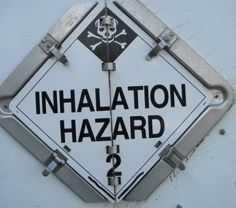
Toxic Atmospheres
Product stored in a confined space:
Gases released when cleaning
Materials absorbed into walls of confined space
Decomposition of materials in
the confined space
Work performed in a confined space:
Welding, cutting, brazing,
soldering
Painting, scraping, sanding,
Degreasing
Sealing, bonding, melting
Areas adjacent to a confined space.
PPT-136-01
26
Notes:
Toxic atmospheres can be created by:
Product stored in a confined space:
￫ Gases released when cleaning
￫ Materials absorbed into walls of confined space
￫ Decomposition of materials in the confined space
Work performed in a confined space:
￫ Welding, cutting, brazing, soldering
￫ Painting, scraping, sanding, degreasing
￫ Sealing, bonding, melting
Areas adjacent to a confined space.
Such atmospheres can be created by work conducted in the space.
Hot work means operations capable of providing a source of ignition (for example, riveting, welding, cutting, burning, and heating).

Slide 27
Hydrogen Sulfide
Decomposition of materials; human waste.
Rotten egg odor at low concentrations.
Possibly no warning at high concentrations.
PPM Effect Time
10 Permissible Exposure Level 8 Hours
50 - 100 Mild Irritation - eyes, throat 1 Hour
200 - 300 Significant Irritation 1 Hour
500 - 700 Unconsciousness, Death 1/2-1 Hour
>1000 Unconsciousness, Death Minutes
PPT-136-01
27
Notes:
Hydrogen sulfide, as an example, has PPM levels which an unprotected person should not exceed.
Hydrogen sulfide is the result of:
Decomposition of materials; human waste.
Rotten egg odor at low concentrations.
Possibly no warning at high concentrations. May deaden the sense of smell falsely leading one to think it’s no longer present.

Slide 28
Carbon Monoxide
Odorless, Colorless Gas.
Combustion By-Product.
Quickly collapse at high concentrations.
PPM Effect Time
50 Permissible Exposure Level 8 Hours
200 Slight headache, discomfort 3 Hours
600 Headache, discomfort 1 Hour
1000-2000 Confusion, nausea, headache 2 Hours
1000-2000 Tendency to stagger 1 1/2 Hours
1000-2000 Slight heart palpitation 30 Min.
2000-2500 Unconsciousness 30 Min.
PPT-136-01
28
Notes:
Carbon monoxide.
Odorless, Colorless Gas.
Combustion By-Product.
Quickly collapse at high concentrations.
The chart reveals the effects of exposure for various PPM (parts per million in air).

Slide 29
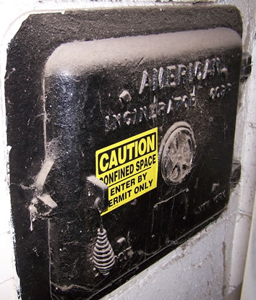
Temperature Extremes
Extremely hot or cold temperatures.
Steam cleaning of confined spaces.
Humidity factors.
Extremely cold liquids.
Work processes inside the confined
space can increase temperature
extremes.
Personal protective equipment.
PPT-136-01
29
Notes:
Temperature extremes affect the welfare of workers.
Extremely hot or cold temperatures.
Steam cleaning of confined spaces.
Humidity factors.
Extremely cold liquids.
Work processes inside the confined space can increase temperature extremes.
Personal protective equipment.

Slide 30
Engulfment Hazards
Loose, granular materials stored in bins and
hoppers - grain, sand, coal, etc.
Crusting and bridging below a worker.
Flooding of confined space.
Water or sewage flow.
PPT-136-01
30
Notes:
Engulfment can occur with the following materials, usually kept in silos although underground storage is also an option used. These include:
Loose, granular materials stored in bins and hoppers - grain, sand, coal, etc.
Crusting and bridging below a worker.
Flooding of confined space.
Water or sewage flow.

Slide 31
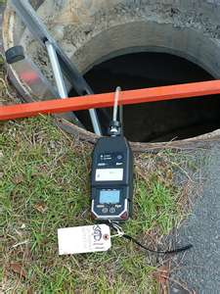
Testing the Atmosphere
Verify presence of safe work atmosphere.
Test in this order: oxygen, combustible gases
and vapors, toxic gases and vapors
Test all areas of a confined space.
Top, Middle, Bottom
Methane is lighter than air.
Carbon Monoxide is the same as air.
Hydrogen Sulfide is heavier than air.
Oxygen Deficiency.
PPT-136-01
31
Notes:
Test the atmosphere before permitting entry.
Verify presence of safe work atmosphere.
Test in this order: oxygen, combustible gases and vapors, toxic gases and vapors
Test all areas of a confined space.
-Top, Middle, Bottom
Methane is lighter than air.
Carbon Monoxide is the same as air.
Hydrogen Sulfide is heavier than air.
Oxygen Deficiency.

Slide 32
Entry Requirements
Continuously monitor entry conditions unless the employer can demonstrate that the equipment for continuously monitoring a hazard is not commercially available or that periodic monitoring is of sufficient frequency to ensure that the atmospheric hazard is being controlled at safe levels.
Provide an early-warning system that continuously monitors for non-isolated engulfment hazards.
PPT-136-01
32
Notes:
(ii) If entry is authorized, continuously monitor entry conditions in the areas where authorized entrants are working, except that employers may use
periodic monitoring in accordance with paragraph §1926.1204(e)(2) for monitoring an atmospheric hazard if they can demonstrate that equipment for continuously monitoring that hazard is not commercially available;
(iii) Provide an early-warning system that continuously monitors for non-isolated engulfment hazards. The system must alert authorized entrants and attendants in sufficient time for the authorized entrants to safely exit the space.
(2) Continuously monitor atmospheric hazards unless the employer can demonstrate that the equipment for continuously monitoring a hazard is not commercially available or that periodic monitoring is of sufficient frequency to ensure that the atmospheric hazard is being controlled at safe levels. If continuous monitoring is not used, periodic monitoring is required with sufficient frequency to ensure that acceptable entry conditions are being maintained during the course of entry operations.
Early warning system is the method used to alert authorized entrants and attendants that an engulfment hazard may be developing. Examples of early-warning systems include, but are not limited to: alarms activated by remote sensors; and lookouts with equipment for immediately communicating with the authorized entrants and attendants.

Slide 33
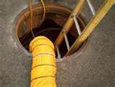
Ventilation
First option to correct problems.
Must be aware of hazards you are trying to
correct in the confined space.
Air intake in a safe location to draw fresh air
only.
Continuous ventilation whenever possible.
Retest the confined space before entry.
PPT-136-01
33
Notes:
Ventilation is the first option to correct atmospheric problems in a confined space.
Must be aware of hazards you are trying to correct in the confined space.
Air intake in a safe location to draw fresh air only.
Continuous ventilation whenever possible.
Retest the confined space before entry.

Slide 34
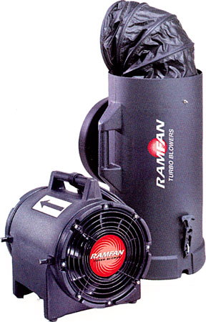
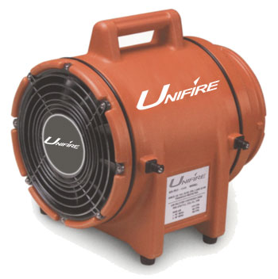
Alternative Protection Procedures
OSHA has specified alternative protection procedures that may be used for permit spaces where the only hazard is atmospheric and ventilation alone will control the hazard.
PPT-136-01
34
Notes:
OSHA has specified alternative protection procedures that may be used for permit spaces where the only hazard is atmospheric and ventilation alone will control the hazard.

Slide 35
Determination of Purge Time
Purge times can be estimated by the following:
T = 7.5 V/C
T = purge time in minutes
V = the volume of the space in ft³
C = effective blower capacity CFM
PPT-136-01
35
Notes:
The slide shows the formulas for determining the purge time, in minutes, for a confined space.
Other methods can be used, such as determining the cubic volume of the space, determining the number of full air exchanges you need per minute. This will allow you to determine the rating of the fan (in cubic feet per minute) to use for ventilation.

Slide 36
Purging Time Example
Situation:
An estimation of purging time is needed for a 800 ft³ deep neck manhole. The effective blower capacity is 250 CFM.
800/250 x 7.5 = 24 minutes
PPT-136-01
36
Notes:
This compartment would require 24 minutes to purge (cleanse) the atmosphere.

Slide 37
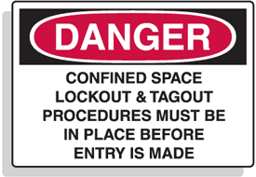
Isolation
Locking and tagging out electrical
sources.
Blanking and bleeding pneumatic and hydraulic lines.
Disconnecting mechanical drives and
shafts.
Securing mechanical parts.
Blanking sewer and water flow.
Locking and tagging out shutoff
valves.
PPT-136-01
37
Notes:
To further ensure entrant’s safety, isolation of hazards intruding the space must be controlled.
This is where the Lock-out/Tag-out standard 29 CFR 1910.147 now intervenes. This may require,
Locking and tagging out electrical and other energy sources.
Blanking and bleeding pneumatic and hydraulic lines.
Disconnecting mechanical drives and shafts.
Securing mechanical parts.
Blanking sewer and water flow.
Locking and tagging out shutoff valves.

Slide 38
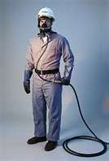
Respirators
Air-Purifying Respirators
- Filter dangerous substances from the air.
- Must know the type and amount of hazardous
substance present in the confined space.
- NEVER use where oxygen is deficient!
Air-Supplying Respirators
- Deliver a safe supply of breathing air from
a cylinder or an uncontaminated area nearby.
- Must be adequately monitored.
PPT-136-01
38
Notes:
In some instances, respirators may be required for a confined space job. This may require a filtration-type respirator or an air-supplied respirator.
Air-Purifying Respirators
- Filter dangerous substances from the air.
- Must know the type and amount of hazardous substance present in the confined space.
- NEVER use with oxygen deficiency! Minimum oxygen content must be 19.5%!
Air-Supplying Respirators
- Deliver a safe supply of breathing air from a cylinder or an uncontaminated area nearby.
- Must be adequately monitored.

Slide 39
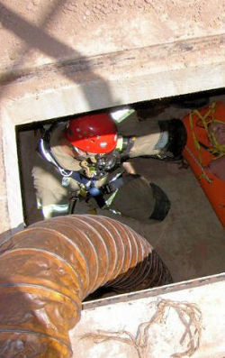
Authorized Entrants
Entrants must:
Know the hazards they are facing.
Be able to recognize signs and symptoms
of exposure.
Understand the consequences of exposure to hazards.
Communicate with
attendants as necessary.
Alert attendants to warning
signs or existence of a
hazardous condition.
Exit when ordered or
alerted.
PPT-136-01
39
Notes:
The 4 persons addressed in the Permit-Required Confined Space standard, 29 CFR 1910.146 are:
Entrant
Attendant
Supervisor, and
Rescue Team
Authorized entrants must
Know the hazards they are facing.
Be able to recognize signs and symptoms of exposure.
Understand the consequences of exposure to hazards.
Communicate with attendants as necessary.
Alert attendants to warning signs or existence of a hazardous condition.
Exit when ordered or alerted.

Slide 40
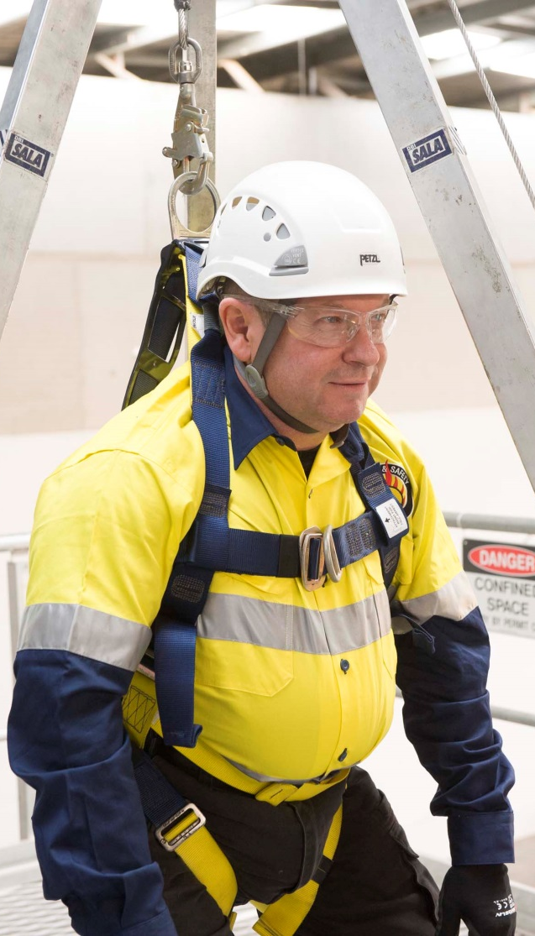
Authorized Entrants
Chest or full body harness with a retrieval line attached at the center of entrant’s back near shoulder level, above the entrant’s head.
Wristlets or anklets may be used in lieu of chest or full body harness is employer can demonstrate the use of chest or full body harness is infeasible or creates a greater hazards.
PPT-136-01
40
Notes:
Authorized entrants must use a chest or full body harness with a retrieval line attached at the center of entrant’s back near shoulder level, above the entrant’s head. Wristlets or anklets may be used in lieu of chest or full body harness if the employer can demonstrate the use of chest or full body harness is infeasible or creates a greater hazards.
The other end of the retrieval line must be attached to a mechanical device or fixed point outside the permit space in such a manner that rescue can begin as soon as the rescuer becomes aware a rescue is necessary. A mechanical device must be available to retrieve personnel from vertical type permit spaces more than 5 feet deep.
Equipment that is unsuitable for retrieval must not be used, including, but not limited to, retrieval lines that have a reasonable probability of becoming
entangled with the retrieval lines used by other authorized entrants, or retrieval lines that will not work due to the internal configuration of the permit space.

Slide 41
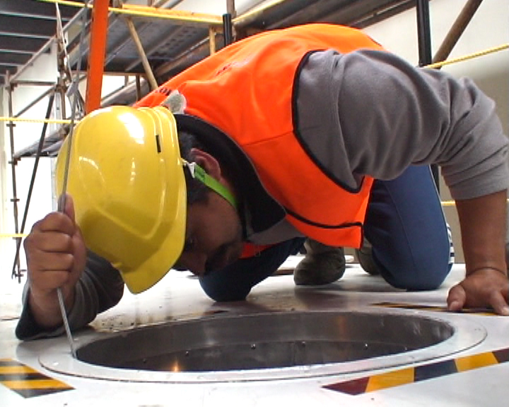
Attendants
Attendants must:
Be aware of behavioral effects
of potential exposures.
Maintain count and identity of entrants.
Remain outside the space until
relieved.
Communicate with entrants.
Monitor activities inside and
outside the space and order
exit if required.
Could this be a safety issue for the attendant?
Yes, if a hazardous atmosphere is present.
PPT-136-01
41
Notes:
Attendants must:
→ Be aware of behavioral effects of potential exposures.
→ Maintain count and identity of entrants.
→ Remain outside the space until relieved.
→ Communicate with entrants.
→ Monitor activities inside and outside the space and order exit if required.

Slide 42
Attendants
Summon rescuers if necessary.
Prevent unauthorized entry.
Perform non-entry rescue.
Attendants may NOT perform other duties that interfere with their primary duty to monitor and protect!
PPT-136-01
42
Notes:
Attendants must also
▪ Summon rescuers if necessary.
▪ Prevent unauthorized entry.
▪ Perform non-entry rescue.
Attendants may NOT perform other duties that interfere with their primary duty to monitor and protect!

Slide 43
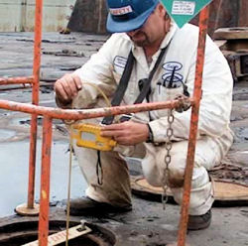
Entry Supervisors
Entry Supervisors must:
Issue confined space permits.
Know hazards.
Verify that all tests have been
conducted.
Verify that all procedures and
equipment are in place before
signing a permit.
Terminate entry if necessary and
cancel permits.
PPT-136-01
43
Notes:
Entry Supervisors must:
• Issue confined space permits.
• Know hazards.
• Verify that all tests have been conducted.
• Verify that all procedures and equipment are in place before signing a permit.
• Terminate entry if necessary and cancel permits.

Slide 44
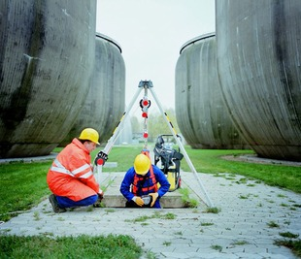
Entry Supervisors
Verify availability of rescue
services & means for
summoning.
Remove unauthorized
individuals.
Terminate entry if
necessary.
Cancel permits.
Coordinate shift
change.
PPT-136-01
44
Notes:
Entry supervisors also
– Verify availability of rescue services & means for summoning.
– Remove unauthorized individuals.
– Terminate entry if necessary.
– Cancel permits.
– Coordinate shift change

Slide 45
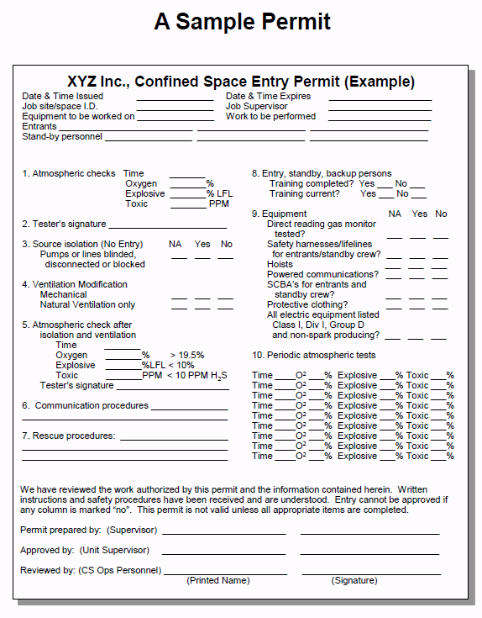
Entry Permit Systems
Written permit signed by entry supervisor.
Verifies pre-entry precautions have
been taken and the space is safe to enter.
Posted at entry to confined space.
Specifies apparent hazards and
corrective actions taken prior to entry.
Requires termination of permit when task is completed or when new conditions exist.
PPT-136-01
45
Notes:
The entry permit system contains safety information.
Written permit signed by entry supervisor.
Verifies pre-entry precautions have been taken and the space is safe to enter.
Posted at entry to confined space.
Specifies apparent hazards and corrective actions taken prior to entry.
Requires termination of permit when task is completed or when new conditions exist.

Slide 46
Entry Permit Requirements
Date, location, and name of confined space.
Purpose of entry and known hazards.
Duration of entry permit time.
Authorized entrants, attendants, supervisors.
Air testing results - signature of tester.
Protective measures to be taken.
Ventilation, Isolation, Flushing
Lockout/Tagout, Purging
PPT-136-01
46
Notes:
Additional permit requirements.
Date, location, and name of confined space.
Purpose of entry and known hazards.
Duration of entry permit time.
Authorized entrants, attendants, supervisors.
Air testing results - signature of tester.
Protective measures to be taken.
Ventilation, Isolation, Flushing
Lockout/Tagout and Purging
1926.1206 Entry Permit
(e) Means of detecting an increase in atmospheric hazard levels in the event the ventilation system stops working.

Slide 47
More Entry Permit Requirements
Name and phone numbers of rescue and emergency services.
Communication procedures.
Special equipment and procedures.
Personal protective equipment (PPE)
Alarm procedures
Rescue equipment
Respirators
PPT-136-01
47
Notes:
Permits must also contain:
Name and phone numbers of rescue and emergency services.
Communication procedures.
Special equipment and procedures.
Personal protective equipment (PPE)
Alarm procedures
Rescue equipment
Respirators

Slide 48
Entry without Permit
When a confined space is opened:
The opening must be promptly guarded by a
rail or temporary cover.
The atmosphere must be tested before
entering using only direct reading instruments.
The atmosphere must be tested (in this order)
for oxygen content, flammable gases/vapors,
and toxic air contaminants.
Continuous forced air ventilation must be used.
PPT-136-01
48
Notes:
Entry without a permit can be made if the following conditions are met.
When a confined space is opened:
The opening must be promptly guarded by a rail or temporary cover.
The atmosphere must be tested before entering using only direct reading instruments.
The atmosphere must be tested (in this order) for oxygen content, flammable gases/vapors, and toxic air contaminants.
Continuous forced air ventilation must be used.
(2) The following requirements apply to entry into permit spaces that meet the conditions set forth in paragraph §1926.1203(e)(1):
(i) Any conditions making it unsafe to remove an entrance cover must be eliminated before the cover is removed.
(ii) When entrance covers are removed, the opening must be immediately guarded by a railing, temporary cover, or other temporary barrier that will prevent an accidental fall through the opening and that will protect each employee working in the space from foreign objects entering the space.
(iii) Before an employee enters the space, the internal atmosphere must be tested, with a calibrated direct-reading instrument, for oxygen content, for flammable gases and vapors, and for potential toxic air contaminants, in that order. Any employee who enters the space, or that employee’s authorized representative, must be provided an opportunity to observe the pre-entry testing required by this paragraph.
(iv) No hazardous atmosphere is permitted within the space whenever any employee is inside the space.

Slide 49
Entry without Permit
When a confined space is opened:
The atmosphere must be tested
periodically during work.
The employer must verify
alternative procedure applicability
and safe entry conditions by a
written certification (not a permit)
with the following information:
● Date
● Location
● Signature
NOTE: The above certificate must be made available to entrant to review
PPT-136-01
49
Notes:
When a confined space is opened:
The atmosphere must be tested periodically during work.
The employer must verify alternative procedure applicability and safe entry conditions by a written certification (not a permit) with the following information:
● Date
● Location
● Signature
NOTE: The above certificate must be made available to entrant to review

Slide 50
Entry without Permit
If you meet the conditions stated in Section (C)(5)(i) of the OSHA standard 1910.146
Employer can prove only hazard is actual or potential hazardous atmosphere
Continuous forced air or ventilation alone sufficient for entry
Employer develops monitoring and inspection data
You may use the procedures specified in Section (C)(5)(ii) of the standard. This allows you to OMIT Paragraphs (d) through (f) and (h) through (k) of the standard.
NOTE: Paragraph (g) Training still applies to all confined
space activities
PPT-136-01
50
Notes:
Entry can also be made without a permit if you meet the conditions stated in Section (C)(5)(i) of the OSHA 1910.146 standard:
￫ Employer can prove only hazard is actual or potential hazardous atmosphere
￫ Continuous forced air or ventilation alone is sufficient for entry
￫ Employer develops monitoring and inspection data
You may use the procedures specified in Section (C)(5)(ii) of the 1910.146 standard. This allows you to OMIT Paragraphs (d) through (f) and (h) through (k) of the 1910.146 standard.
(Remember, you need to comply with other standards besides the 1926.1200 if they apply to Confined Spaces. This is why 1910.146 is also cited.)

Slide 51
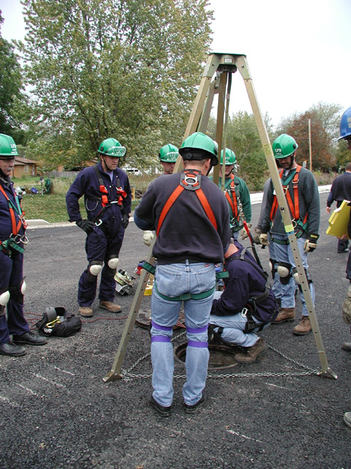
Training and Education
All workers who must enter confined spaces.
All attendants and rescue
team members.
Prior to initial work assignment.
Retraining when:
Job duties change
Change in permit-space
program
New hazards are present
Job performance indicates
deficiencies
PPT-136-01
51
Notes:
Training and education pertains to
All workers who must enter confined spaces.
All attendants and rescue team members.
Prior to initial work assignment.
Retraining when:
Job duties change
Change in permit-space program
New hazards are present
Job performance indicates deficiencies
1926.1207 Training
The employer must provide training to each employee whose work is regulated by this standard, at no cost to the employee, and ensure that the employee possesses the understanding, knowledge, and skills necessary for the safe performance of the duties assigned under this standard. This training must result in an understanding of the hazards in the permit space and the methods used to isolate, control or in other ways protect employees from these hazards, and for those employees not authorized to perform entry rescues, in the dangers of attempting such rescues.
Training required by this section must be provided to each affected employee:
In both a language and vocabulary that the employee can understand

Slide 52
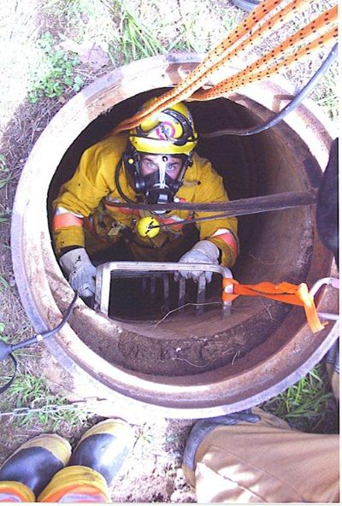
Training and Education
Training and emergency drills should be conducted once a year or whenever the procedure or process changes.
Records for training must include:
￫ Name of employee(s)
￫ Signature of trainer(s)
￫ Date(s) of training and
￫ Must be retained for 3 years
PPT-136-01
52
Notes:
Training and emergency drills should be conducted once a year or whenever the procedure or process changes.
Records for training must include:
￫ Name of employee(s)
￫ Signature of trainer(s)
￫ Date(s) of training and
￫ Must be retained for 3 years
Representative permit space means a mock-up of a confined space that has entrance openings that are similar to, and is of similar size, configuration, and accessibility to, the permit space that authorized entrants enter.

Slide 53
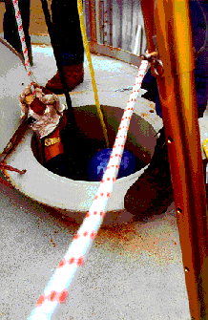
Rescue Services
May be provided by:
On-site employees
or
“Off-site services”
PPT-136-01
53
Notes:
Rescue services may be provided by
On-site employees or
Off-site services, such as fire companies/departments or rescue squads. Contractors also exist to provide these services.
A timely arrival and on-set of rescue is required by the standard.
1926.1211 Rescue and emergency services
(3) Select a rescue team or service from those evaluated that:
(i) Has the capability to reach the victim(s) within a time frame that is appropriate for the permit space hazard(s) identified;
(ii) Is equipped for, and proficient in, performing the needed rescue services;
(iii) Agrees to notify the employer immediately in the event that the rescue service becomes unavailable;
(3) Equipment that is unsuitable for retrieval must not be used, including, but not limited to, retrieval lines that have a reasonable probability of becoming entangled with the retrieval lines used by other authorized entrants, or retrieval lines that will not work due to the internal configuration of the permit space.
Non-entry rescue is required unless the retrieval equipment would increase the overall risk of entry or would not contribute to the rescue of the entrant.

Slide 54
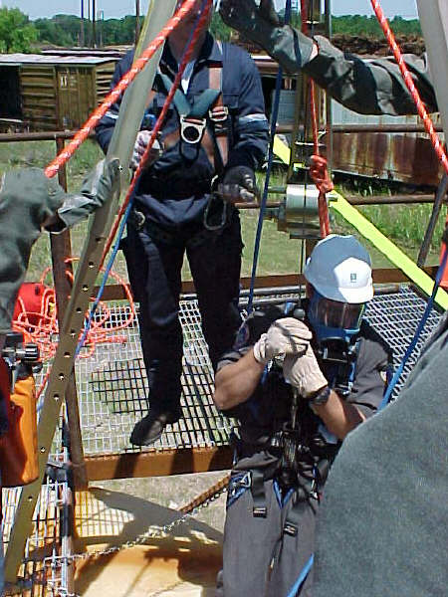
On-site Teams
On-site teams must:
Be properly equipped.
Receive the same training as entrants.
Receive additional training in the use of PPE, rescue
equipment, first aid and CPR.
Practice simulated rescues
once each year.
PPT-136-01
54
Notes:
If you elect to go with on-site teams, it must:
Be properly equipped.
Receive the same training as entrants.
Receive additional training in the use of PPE, rescue equipment, first aid and CPR.
Practice simulated rescues once each year.

Slide 55
Off-site Teams
Off-site teams must:
Be aware of confined space hazards.
Practice similar rescues in similar spaces.
PPT-136-01
55
Notes:
Off-site teams must:
Be aware of confined space hazards.
Practice similar rescues in similar spaces.
Non-entry rescue occurs when a rescue service, usually the attendant, retrieves employees in a permit space without entering the permit space.

Slide 56
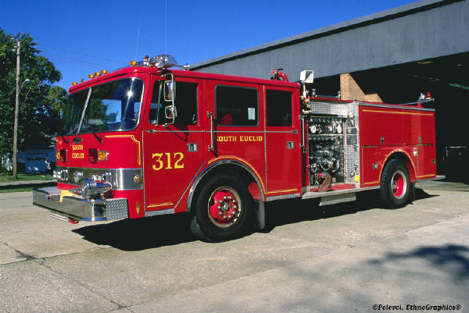
Local Fire/Rescue Service
Are all fire companies/departments in your county equipped and trained to handle Confined Space rescue?
Is your local fire company/department trained, equipped, and are they available every time you enter a PRCS?
Is your local fire company/department aware of the
locations of your Confined Spaces?
These are questions that need to be answered before allowing entry into a Permit Required Confined Space!
PPT-136-01
56
Notes:
Questions to ask if you opt to go with off-site volunteer fire companies to respond.
Are all fire companies/departments in your county equipped and trained to handle Confined Space rescue?
Is your local fire company/department trained, equipped, and are they available every time you enter a PRCS?
Is your local fire company/department aware of the locations of your Confined Spaces?

Slide 57
1926 General Requirements
Before work, each employer must ensure a competent person:
Identifies all confined spaces in which one or more of the employees it directs may work, and
Identifies each space that is a permit space, through consideration and evaluation of the elements of that space, including testing as necessary.
PPT-136-01
57
Notes:
1926.1203
(a) Before beginning work, each employer must ensure a competent person identifies all confined spaces in which one or more of the employees it directs may work, and identifies each space that is a permit space, through consideration and evaluation of the elements of that space, including testing as necessary.

Slide 58
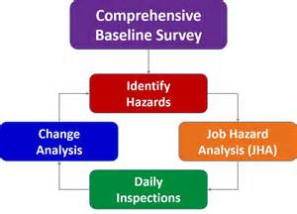
1926 General Requirements
1203(b) If the workplace contains one or more permit spaces, employer who identifies, or who receives notice of, a permit space must:
(1) Inform exposed employees by posting danger signs or by any other equally effective means, of the existence and location of, and the danger posed by, each permit space;
PPT-136-01
58
Notes:
Note to paragraph §1926.1203(b)(1). A sign reading “DANGER – PERMIT REQUIRED CONFINED SPACE, DO NOT ENTER” or using other similar
language would satisfy the requirement for a sign.

Slide 59
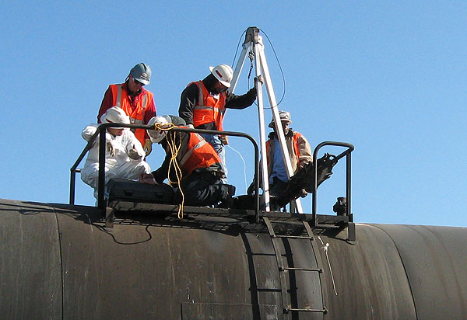
1926 General Requirements
(2) Inform employees’ representatives and controlling contractor of the existence and location of, and the danger of each permit space.
(c) Each employer who has not authorized employees entry must prevent those employees from entering that permit space.
PPT-136-01
59
Notes:
(2) Inform, in a timely manner and in a manner other than posting, its employees’ authorized representatives and the controlling contractor of the existence and
location of, and the danger posed by, each permit space.
(c) Each employer who identifies, or receives notice of, a permit space and has not authorized employees it directs to work in that space must take effective measures to prevent those employees from entering that permit space, in addition to complying with all other applicable requirements of this standard.

Slide 60
1926 General Requirements
(d) Any employer deciding employees will enter a permit space, must have a written permit space program complying with §1926.1204 implemented at the construction site. Written program made available prior to and during entry for inspection.
(e) An employer may use the alternate procedures specified in paragraph §1926.1203(e)(2) for entering a permit space only under the conditions set forth in paragraph §1926.1203(e)(1).
PPT-136-01
60
Notes:
(d) If any employer decides that employees it directs will enter a permit space, that employer must have a written permit space program that complies with §1926.1204 implemented at the construction site. The written program must be made available prior to and during entry operations for inspection by employees and their authorized representatives.
(e) An employer may use the alternate procedures specified in paragraph §1926.1203(e)(2) for entering a permit space only under the conditions set forth in paragraph §1926.1203(e)(1).

Slide 61
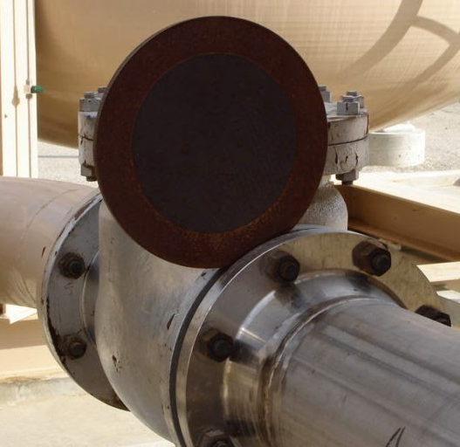
1926 General Requirements
An employer whose employees enter a permit space need not comply with §1926.1204 through 1206 and §1926.1208 through 1211, provided
all the following are met:
(i) The employer can demonstrate that all physical hazards in the space are eliminated or isolated through engineering controls so that the only hazard posed by the permit space is an actual or potential hazardous atmosphere;
PPT-136-01
61
Notes:
(1) Note to paragraph §1926.1203(e)(1). See paragraph §1926.1203(g) for reclassification of a permit space after all hazards within the space have been eliminated.

Slide 62
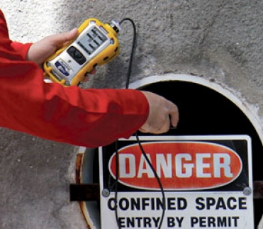
1926 General Requirements
(ii) Employer can demonstrate continuous forced air ventilation alone is sufficient to maintain safe for entry, and that, in the event the ventilation system stops working, entrants can exit the space safely;
(iii) Employer develops monitoring
and inspection data supporting
demonstrations required by
paragraphs §1926.1203 (e)(1)(i) and §1926.1203 (e)(1)(ii);
PPT-136-01
62
Notes:
(ii) The employer can demonstrate that continuous forced air ventilation alone is sufficient to maintain that permit space safe for entry, and that, in the
event the ventilation system stops working, entrants can exit the space safely;
(iii) The employer develops monitoring and inspection data that supports the demonstrations required by paragraphs §1926.1203(e)(1)(i) and §1926.1203(e)(1)(ii);

Slide 63
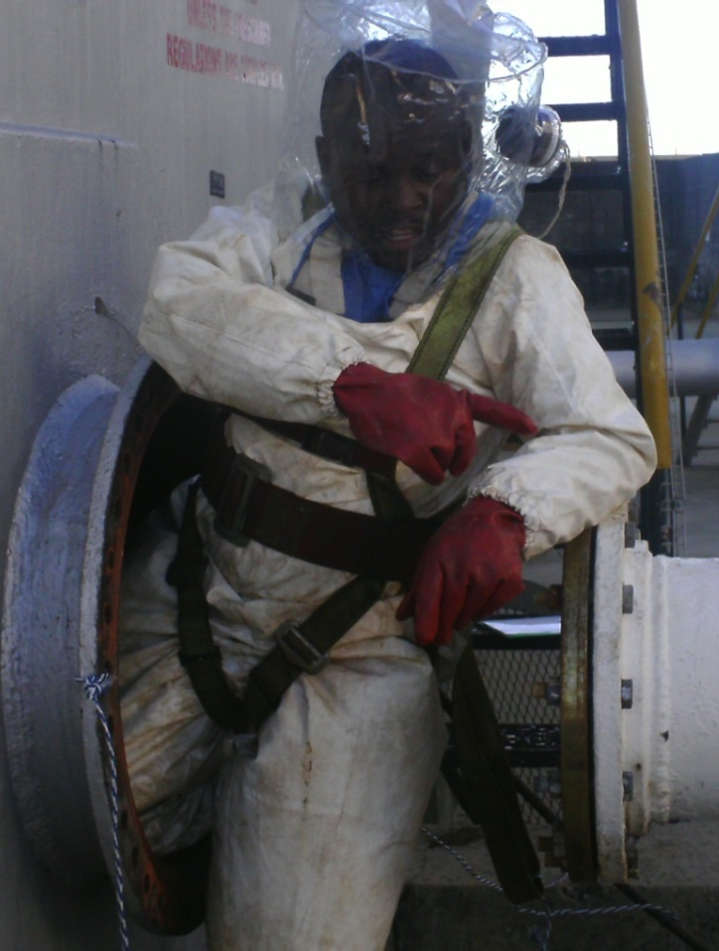
1926 General Requirements
(iv) If initial entry is necessary to obtain the data per §1926.1203(e)(1)(iii), entry is performed compliant with §1926.1204 through 1211 of this standard
(v) The determinations and supporting data required by paragraphs§1926.1203(e)(1)(i), (e)(1)(ii), and (e)(1)(iii) are documented by the employer
PPT-136-01
63
Notes:
(iv) If an initial entry of the permit space is necessary to obtain the data required by paragraph §1926.1203(e)(1)(iii), the entry is performed in compliance with §§1926.1204 through 1211 of this standard;
(v) The determinations and supporting data required by paragraphs §1926.1203(e)(1)(i), (e)(1)(ii), and (e)(1)(iii) are documented by the employer and are made available to each employee who enters the permit space under the terms of paragraph §1926.1203(e) or to that employee’s authorized representative; and

Slide 64
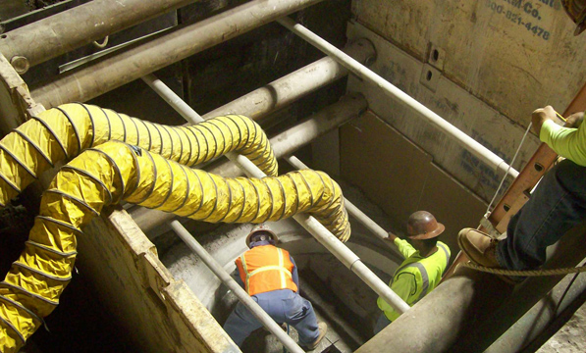
1926 General Requirements
1203. Continuous forced air ventilation must be used, as follows:
To eliminate the hazard
Ventilate immediate areas occupied by employees
Air source must be clean
Space continuously monitored
*(see notes for more detailed information)
PPT-136-01
64
Notes:
(A) An employee must not enter the space until the forced air ventilation has eliminated any hazardous atmosphere;
(B) The forced air ventilation must be so directed as to ventilate the immediate areas where an employee is or will be present within the space and must continue until all employees have left the space;
(C) The air supply for the forced air ventilation must be from a clean source and must not increase the hazards in the space.
*(vi) The atmosphere within the space must be continuously monitored unless the entry employer can demonstrate that equipment for continuous monitoring is not commercially available or periodic monitoring is sufficient. If continuous monitoring is used, the employer must ensure that the monitoring equipment has an alarm that will notify all entrants if a specified atmospheric threshold is achieved, or that an employee will check the monitor with sufficient frequency to ensure that entrants have adequate time to escape. If continuous monitoring is not used, periodic monitoring is required. All monitoring must ensure that the continuous forced air ventilation is preventing the accumulation of a hazardous atmosphere. Any employee who enters the space, or that employee’s authorized representative, must be provided with an opportunity to observe the testing required by this paragraph.

Slide 65
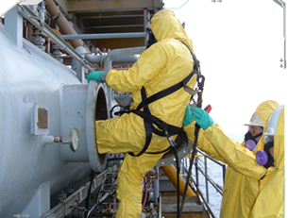
1926 General Requirements
(vii) If a hazard is detected during entry:
Each employee must leave the
space immediately;
(B) The space must be evaluated to determine how the hazard
developed; and
(C) The employer must implement
measures to protect employees
from the hazard before any
subsequent entry takes place.
PPT-136-01
65
Notes:
(vii) If a hazard is detected during entry:
(A) Each employee must leave the space immediately;
(B) The space must be evaluated to determine how the hazard developed; and
(C) The employer must implement measures to protect employees from the hazard before any subsequent entry takes place.

Slide 66
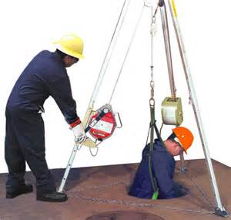
1926 General Requirements
(viii) The employer must ensure a safe method of entering and exiting the space:
If hoisting system used, must be designed and manufactured for personnel hoisting;
A job-made hoisting system is permissible if approved for personnel hoisting by a registered professional engineer, in writing, prior to use.
PPT-136-01
66
Notes:
(viii) The employer must ensure a safe method of entering and exiting the space. If a hoisting system is used, it must be designed and manufactured for personnel hoisting; however, a job-made hoisting system is permissible if it is approved for personnel hoisting by a registered professional engineer, in writing, prior to use.

Slide 67
1926 General Requirements
(ix) The employer verifies the space is safe for entry and that the pre-entry measures per §1926.1203(e)(2) have been taken, through a written certification that contains the date, location of the space, and the signature of the person providing the certification.
The certification must be made before entry and must be made available to each employee entering the space or to that employee’s authorized representative.
PPT-136-01
67
Notes:
(ix) The employer must verify that the space is safe for entry and that the pre-entry measures required by paragraph §1926.1203(e)(2) have been taken, through a written certification that contains the date, the location of the space, and the signature of the person providing the certification. The certification must be made before entry and must be made available to each employee entering the space or to that employee’s authorized representative.

Slide 68
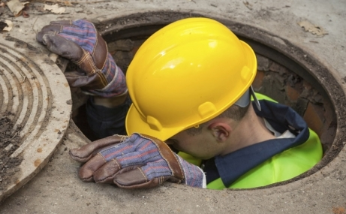
1926 General Requirements
(f) When changes occur in the use or configuration of a non-permit confined space possibly increasing the hazards to entrants, or some indication the initial evaluation of the space may not have been adequate:
Each entry employer must have a competent person reevaluate that space and, if necessary, reclassify it as a permit required confined space.
PPT-136-01
68
Notes:
(f) When there are changes in the use or configuration of a non-permit confined space that might increase the hazards to entrants, or some indication that the initial evaluation of the space may not have been adequate, each entry employer must have a competent person reevaluate that space and, if necessary, reclassify it as a permit required confined space.

Slide 69
1926 General Requirements
(g) Spaces classified by an employer as a PRCS may only be reclassified as a non-permit confined space when a competent person determines that all of the applicable requirements in paragraphs §1926.1203(g)(1) through (g)(4) have been met:
(h) Prior to entry, host employer provides
Locations
Hazards or potential hazards of each space
Precautions implemented by previous:
• Controlling contractor
• Entry contractor
PPT-136-01
69
Notes:
(g) A space classified by an employer as a permit-required confined space may only be reclassified as a non-permit confined space when a competent person determines that all of the applicable requirements in paragraphs §1926.1203(g)(1) through (g)(4) have been met.
(h) Permit Space Entry Communication and Coordination:
(1) Before entry operations begin, the host employer must provide the following information, if it has it, to the controlling contractor:
The location of each known permit space;
(ii) The hazards or potential hazards in each space or the reason it is a permit space; and
(iii) Any precautions that the host employer or any previous controlling contractor or entry employer implemented for the protection of employees in the permit space.
Note to paragraph §1926.1203(h). Unless a host employer or controlling contractor has or will have employees in a confined space, it is not required to enter any confined space to collect the information specified in this paragraph (h).

Slide 70
1926 General Requirements
Before entry the controlling contractor must:
Obtain the host employer’s information
Provide information to entrants:
• Host information
• Additional information from controlling contractor
• Precautions which both have implemented
PPT-136-01
70
Notes:
(2) Before entry operations begin, the controlling contractor must:
(i) Obtain the host employer’s information about the permit space hazards and previous entry operations; and
(ii) Provide the following information to each entity entering a permit space and any other entity at the worksite whose activities could foreseeably result in a hazard in the permit space:
The information received from the host employer;
Any additional information the controlling contractor has about the subjects listed in paragraph (h)(1) of this section; and
The precautions that the host employer, controlling contractor, or other entry employers implemented for the protection of employees in the permit spaces.

Slide 71
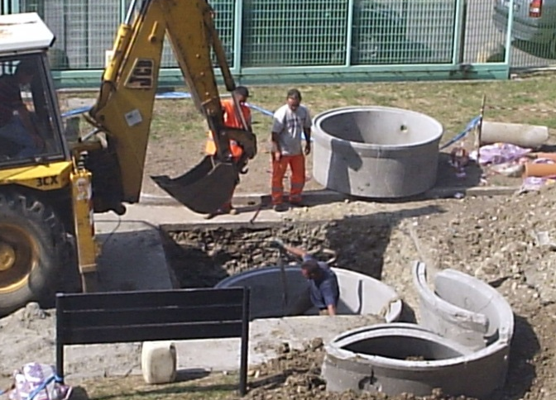
1926 General Requirements
Before entry each entry employer must:
Obtain all of the controlling contractor’s information
Inform the controlling contractor of the permit space program that the entry employer will follow
Include any hazards likely to be found or created in each space
PPT-136-01
71
Notes:
Before entry operations begin, each entry employer must:
Obtain all of the controlling contractor’s information regarding permit space hazards and entry operations; and
Inform the controlling contractor of the permit space program that the entry employer will follow, including any hazards likely to be confronted or created in each permit space.

Slide 72
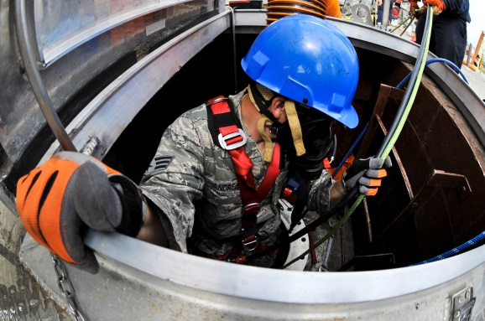
1926 General Requirements
(4) Controlling contractor and entry employer(s) must coordinate entry operations when:
More than one entity performs permit space
entry at the same time; or
(ii) Permit space entry is performed at the same
time that any activities that could foreseeably
result in a hazard in the permit space are
performed.
PPT-136-01
72
Notes:
(4) The controlling contractor and entry employer(s) must coordinate entry operations when:
(i) More than one entity performs permit space entry at the same time; or
(ii) Permit space entry is performed at the same time that any activities that could foreseeably result in a hazard in the permit space are performed.

Slide 73
1926 General Requirements
1203(5) After entry operations, controlling contractor:
Debriefs each entrant
Informed by entry employer of any hazards found
Apprises host employer of information exchanged with entrants per this subparagraph.
PPT-136-01
73
Notes:
1203(5) After entry operations:
(i) The controlling contractor must debrief each entity that entered a permit space regarding the permit space program followed and any hazards confronted or created in the permit space(s) during entry operations;
(ii) The entry employer must inform the controlling contractor in a timely manner of the permit space program followed and of any hazards confronted or created in the permit space(s) during entry operations; and
(iii) The controlling contractor must apprise the host employer of the information exchanged with the entry entities pursuant to this subparagraph.
(iv) If there is no controlling contractor present at the worksite, the requirements for, and role of, controlling contactors in §1926.1203 must be fulfilled by the host employer or other employer who arranges to have employees of another employer perform work that involves permit space entry.

Slide 74
1926.1204: PRCS Program
(a) Prevent unauthorized entry;
(b) Identify/evaluate hazards of permit spaces
before entry
(c) Develop/implement means, procedures, and
practices for safe entry operations, including,
(1) Acceptable entry conditions;
(2) Allow entrants to observe any monitoring or
testing
(3) Isolate physical hazard(s) within the space;
(4) Purging, inerting, flushing, or ventilating to
eliminate or control atmospheric hazards; *(see notes for detailed information)
PPT-136-01
74
Notes:
* (4) Note to paragraph §1204(c)(4). When an employer is unable to reduce the atmosphere below 10 percent LFL, the employer may only enter if the employer inerts the space so as to render the entire atmosphere in the space noncombustible, and the employees use PPE to address any other atmospheric hazards (such as oxygen deficiency), and the employer eliminates or isolates all physical hazards in the space.

Slide 75
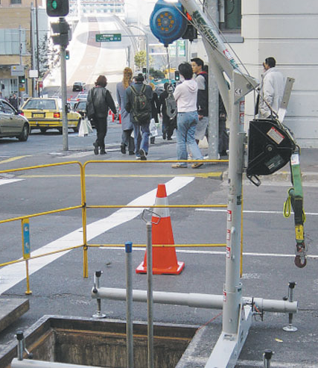
1926.1204: PRCS Program
(5) Determining that, in the event the ventilation system stops working, the monitoring procedures will detect an increase in atmospheric hazard levels in sufficient time for the entrants to safely exit the permit space;
(6) Providing pedestrian, vehicle, or other barriers as necessary to protect entrants from external hazards;
PPT-136-01
75
Notes:
(5) Determining that, in the event the ventilation system stops working, the monitoring procedures will detect an increase in atmospheric hazard levels in
sufficient time for the entrants to safely exit the permit space;
(6) Providing pedestrian, vehicle, or other barriers as necessary to protect entrants from external hazards;

Slide 76
1926.1204: PRCS Program
(7) * Verifying that conditions in the permit space are acceptable for entry throughout the duration of an authorized entry, and ensuring that employees are not allowed to enter into, or remain in, a permit space with a hazardous atmosphere unless the employer can demonstrate that personal protective equipment (PPE) will provide effective protection for each employee in the permit space and provides the appropriate PPE to each employee; and
(8) Eliminating any conditions (for example, high pressure) that could make it unsafe to remove an entrance cover.
* See notes for additional information
PPT-136-01
76
Notes:
(7) *Verifying that conditions in the permit space are acceptable for entry throughout the duration of an authorized entry, and ensuring that employees are not allowed to enter into, or remain in, a permit space with a hazardous atmosphere unless the employer can demonstrate that personal protective equipment (PPE) will provide effective protection for each employee in the permit space and provides the appropriate PPE to each employee; and
(8) Eliminating any conditions (for example, high pressure) that could make it unsafe to remove an entrance cover.

Slide 77
1926.1212: Employee Participation
(a) Employers must consult with affected employees and their authorized representatives on the development and implementation of all aspects of the permit space program required by §1926.1203 of this standard.
(b) Employers must make available to each affected employee and his/her authorized
representatives all information
required to be developed
by this standard.
PPT-136-01
77
Notes:
(a) Employers must consult with affected employees and their authorized representatives on the development and implementation of all aspects of the permit space program required by §1926.1203 of this standard.
(b) Employers must make available to each affected employee and his/her authorized representatives all information required to be developed by this standard.

Slide 78
Bottom Line
Be aware of the location of all Confined Spaces in your facility.
Ensure you’re familiar with the hazards of these Confined Spaces.
Don’t enter a Permit Required Confined Space until all the safety conditions have been met and you’re wearing the proper PPE.
Before entering a PRCS, ensure reliable and trained personnel are available to perform rescue if the need arises.
PPT-136-01
78
Notes:
To ensure the safety of all concerned:
Be aware of the location of all Confined Spaces in your facility.
Ensure you’re familiar with the hazards of these Confined Spaces.
Don’t enter a Permit Required Confined Space until all the safety conditions have been met and you’re wearing the proper PPE.
Before entering a PRCS, ensure reliable and trained personnel are available to perform rescue if the need arises.

Slide 79
Contact Information
Health & Safety Training Specialists
1171 South Cameron Street, Room 324
Harrisburg, PA 17104-2501
(717) 772-1635
RA-LI-BWC-PATHS@pa.gov
Like us on Facebook! - https://www.facebook.com/BWCPATHS
PPT-136-01
79

Slide 80
Questions
PPT-136-01
80

Slide 81
Bibliography
29 CFR 1910.146 Permit-Required Confined Spaces for General Industry.
29 CFR 1926.1200 Confined Spaces for Construction.
29 CFR 1926.57-Ventilation.
29 CFR 1926.103-Respiratory protection.
29 CFR 1910.147-Lockout/Tagout
PPT-136-01
81

Slide 82
Other Suggested Programs
The following presentations are also available to supplement your in-house program:
Basic Air Monitoring
Excavation & Trenching
Lock-out/Tag-out
Ventilation-Basic
Work Zone Safety
Please contact us for a full list of other programs available to you free of charge.
PPT-136-01
82

