Slide 1
Building a Business Case for Safety
Bureau of Workers’ Comp
PA Training for Health & Safety (PATHS)
Notes:
Safety is not only about complying with miscellaneous regulations and laws, it’s also about doing the right thing to prevent incidents and injuries so employees can go home in one piece.
Having and using appropriate safety practices and procedures can also amount to a cost savings to the organization whether that comes from not paying high Workers’ Comp insurance premiums, fines or replacing costs due to damage.
Having a good, active Safety Committee can contribute to saving money which affects “the bottom line” for any company.

Slide 2
Safety
Why is safety important to you?
Notes:
Companies in the Commonwealth of Pennsylvania who’ve won the Governor’s Award for Safety Excellence have safety as one of their “core values” and put a definite emphasis on making safety a priority on all jobs and tasks.
Using proper safety practices and procedures allows us, as employees, to not have injuries both on and off the job.

Slide 3
What is a “Hazard”?
A hazard is an unsafe condition or
activity that, if left uncontrolled, can
contribute to an incident.*
* National Safety Council
People do not always share the same view on “what” defines a hazard.
Notes:
The National Safety Council (NSC) defines a hazard as an unsafe condition or activity that, if left uncontrolled, can contribute to an incident. Leaving hazards uncorrected can lead to serious injuries or even death.
Having a good, comprehensive hazard detection/safety inspection program can directly contribute to having little or no on the job incidents.

Slide 4
Hazards
The next several slides depict some hazards that have been found in different environments
Finding and correcting hazards should be given a priority within any workplace
Notes:
Identifying and correcting hazards is a very important process and should not be taken lightly.
A good, active Workplace Safety Committee can assist in hazard detection, however all employees should be encouraged to find and report hazards within their work areas.
Once hazards are identified, there should be a process in place to get them corrected as soon as possible.

Slide 5
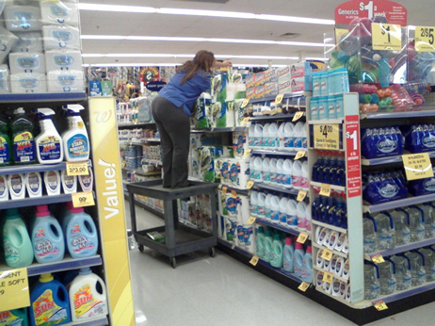
Spill in Aisle 4 !
Notes:
Obviously this is not a very safe situation, however could this situation be attributed to the employee not being given the proper “tools” to do her job?
Maybe there are no step stools/ladders in place so in the process of trying to be a “good employee” she decided she would adapt, improvise and overcome to complete the task given.
It is the employers responsibility to provide employees with proper safety related equipment be that an appropriate step ladder or Personal Protective Equipment (PPE).
Having good, accurate, up to date JSA’s (Job Safety Analysis)/JHA’s (Job Hazard Assessment) in place for every task should be a priority.

Slide 6
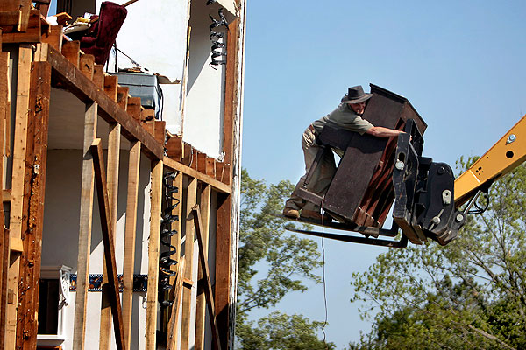
Just Tie it Down!
Notes:
Here is possibly another case where an employee has decided to use what is in place to accomplish the task they were given.
Employees may know they’re not doing things safely, but many times they’re given tasks and not provided with instruction on the safe methods or given appropriate training to accomplish their task.
Of course there are employees who choose to take shortcuts and those situations need to be addressed as quickly as possible.

Slide 7
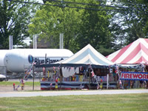
Location, Location, Location
Notes:
While we may not know the exact distance the fireworks stand is from the large compressed gas cylinders which appear to be propane, giving some forethought while setting up could have lead to coming up with a much safer location for the stands.
Employees should take safety into consideration when preparing or setting up for any job.
They need to ensure the proper safety procedures are in place as well as having appropriate safety equipment such as correct and safe tools as well as PPE.

Slide 8
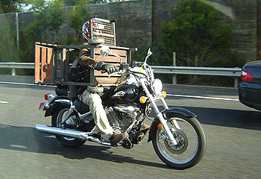
Bird Strike Avoidance
Notes:
This may well have been the only method of transportation the individual had to move the equipment from one place to another; this could be another example of a person adapting, improvising and overcoming obstacles to get the task accomplished.

Slide 9
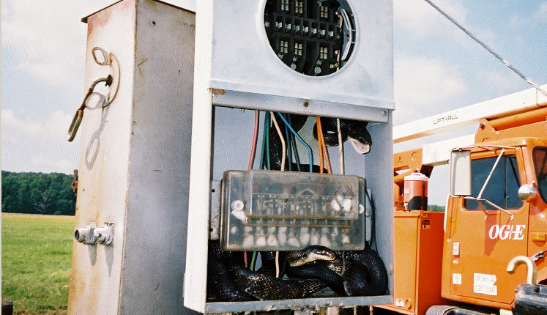
Open with Caution !
Notes:
Employees need to understand they should expect the unexpected at all times while completing a task.
Employees who work in outdoor environments can encounter numerous hazards that they may not see within a “closed” workplace.
Being alert can mean the difference from being injured or coming home safe and sound!

Slide 10
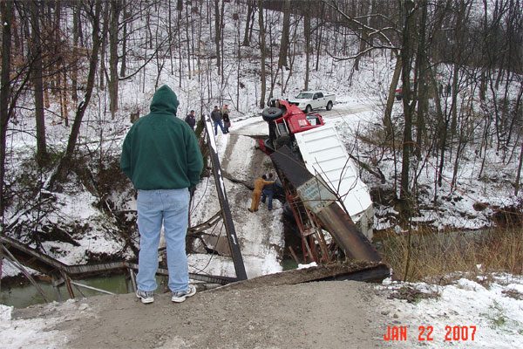
10 Ton Truck … 5 Ton Bridge
Notes:
If the driver of this truck had known the weight of their vehicle this incident may not have happened.
Drivers of heavier vehicles need to be aware of the size and weight of their vehicles in addition to the approximate weight of what they may be transporting.

Slide 11
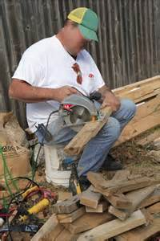
Hold it steady!
Notes:
This employee may have done it this way for many years without having an injury, however one little “slip” can drastically change his life.
Another issue with this picture is the employee not wearing appropriate PPE – safety glasses and ear protection.

Slide 12
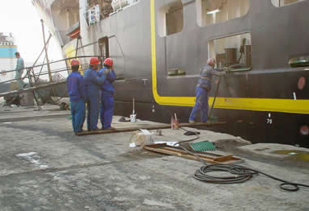
Counterweights
Notes:
This may be the remaking of a Three Stooges film!

Slide 13
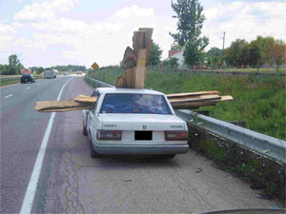
Should have Bought a Truck !
Notes:
Again, this could be a case of “adapt, improvise, overcome!”
Allowing employees to use their own imagination and resources when it comes to safety could contribute to numerous workplace incidents.
Employees should be provided with appropriate training, policies/procedures and guidance when it comes to safely accomplishing the tasks there are given.

Slide 14
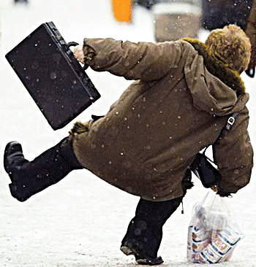
Why is Safety Important?
Head 19,600 11.1%
Eyes 6,524
Upper Extremities 66,532 37.5%
Fingers 21,667
Shoulders 12,144
Arms 11,934
Trunk 33,045 18.6%
Back 22,797
Lower Extremities 38,034 21.4%
Knees 14,269
Ankles 7,800
Feet 6,015
2014 Total Cases = 177,316
Fatal = 75
Notes:
This is a summation of the body parts that can be injured while on the job for a recent year within Pennsylvania workplaces.
The remaining percentage of injuries to total 100% were classified as miscellaneous and involved several body parts combined.

Slide 15
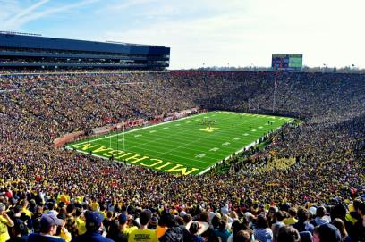
110,000 +
Notes:
Adding up the number of injuries from the previous slide will give a total of over 100,000 which means that over 100,000 employees within PA may be injured annually!

Slide 16
Types of Injuries
0.3% (486)
2.0% (3,500)
2.0% (3,536)
2.8% (4,933)
4.1% (7,357)
15.6% (27,623)
17.8% (31,552)
16.3% (28,910)
39.1% (69.418)
Notes:
This slide shows the types of injuries that have occurred within workplaces in PA during an average year.

Slide 17
Cause of Injury
2.1% (3,636)
4.1% (7,249)
3.0% (5,305)
4.1% (7,324)
2.8% (4,973)
5.8% (10,218)
10.9% (19,261)
9.5% (16,819)
12.4% (22,073)
18.9% (33,520)
26.3% (46,703)
Notes:
This slide depicts the causes of those injuries.

Slide 18
Iceberg of Workplace Injury Costs
(Insured)
(Uninsured)
Like an iceberg, the hidden costs of accidents are not visible on the surface but are there just the same.
Notes:
To determine the total cost of workplace injuries, employers should take into account both direct and indirect costs associated with those injuries.
Adding those costs together will give an accurate amount of money spent on each injury. Sometimes these overall costs can be very expensive!

Slide 19
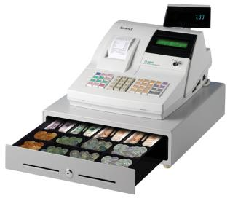
Indirect Costs
Covering the Indirect Costs
Calculating the additional required sales revenue
Notes:
Indirect costs can add up very quickly. In most instances employers do not plan for indirect costs within their budget.
For example, not very many employers plan for a forklift to run into the side of their building or for an employee falling off a chair with wheels while reaching for something on a chair thereby seriously injuring their back.

Slide 20
A-Z Inc. Income Statement
Gross Revenues (GR) $1,000,000.00
*Cost of Goods Sold ($400,000.00)
$600,000.00 Gross Profit (GP)
Less Operating Expenses
*Depreciation ($150,000.00)
*SG&A (Selling,
General, and
Administrative Exp ($200,000.00)
$250,000.00 Operating Income
Less Interest Expense
Loans, equipment,
Mortgage, etc. ($10,000.00)
$240,000.00 NIBT (Net Income Before taxes)
Tax Expense 40% ($96,000.00)
$144,000.00 NIAT (Net Income After Taxes)
14.40% Net Profit Margin = NIAT / GR $144,000.00 / $1,000,000.00
Notes:
This slide gives an example of a non-existent company’s income statement for an average year.

Slide 21
Determine Addition Sales Volume
A-Z, Inc. incurred $25,000.00 in uninsured, indirect cost for an accident.
The most widely accepted cost accounting method to estimate the amount of additional sales volume in dollars per year required to offset the expenditure, is to divide the cost of the incident by the company’s year end net profit margin.
Notes:
Just one incident can substantially affect a company’s overall profit.

Slide 22
Calculation for A-Z, Inc
Divide the costs by the company’s
year end net profit margin
Estimated sales volume required = $25,000.00
14.40%
Estimated sales volume required/yr = $173,611.11
Notes:
This slide shows just how much more product will have to be sold to recoup the cost of one incident.

Slide 23
Additional Sales Volume
Annual Indirect Net Profit Margin
Cost
3% 8% 14.4%
_______________________________________
$25,000 $833,000 $312,500 $173,611
Notes:
The amount of additional sales volume depends on the amount of net profit margin a company expects to yield.

Slide 24
Workers’ Comp Premiums
WC Premium costs are driven by three primary factors:
Type of Industry
Annual payroll
Claims costs
Notes:
Workers’ Compensation premium costs are based on three different primary factors:
The type of industry
Annual payroll
Claims costs

Slide 25
Experience Modification Rating (EMR)
How the Experience Modification Rating (EMR)
Affects What You Pay
EMR averages claims costs over a 3 year period.
The EMR factor is multiplied by the manual premium to obtain the actual premium due.
Notes:
A company’s Experience Modification Rating (EMR) directly affects the cost of their Workers’ Comp premium.
The formula for Manual Premium is: Manual Rate x Estimated Annual Payroll or Remuneration.
The Manual Rate is the specific rate per $100 of payroll or remuneration for any individual workers compensation classification code while the Estimate Annual Payroll is the projected annual payroll for any individual workers compensation classification code.

Slide 26
EMR Factor
Your EMR can be found on the Declarations Page of Your WC Policy
Average claim history EMR 1.00
Better than average claim history EMR below 1.00
Worse than average claim history EMR above 1.00
Notes:
To find their EMR the employer should examine the Declarations Page for their WC Policy.
The Declarations Page is the front page (or pages) of a policy that specifies the named insured, address, policy period, location of premises, policy limits, and other key information that varies from insured to insured. The Declarations Page is also known as the Information Page and is often informally referred to as the "dec" or "dec page."

Slide 27
EMR Example
Manual Premium EMR Actual Premium
$85,000.00 1.00 $ 85,000.00
$85,000.00 .75 $ 63,750.00
$85,000.00 1.50 $127,500.00
Notes:
This slide shows an example of how WC premium is calculated when taking into account the company’s EMR.

Slide 28
Calculate Your Potential Savings
Manual Actual Year Premium EMR Premium 5% Credit Savings 1 $85,000 1.50 $127,500 $6,375 = $ 6,375
$121,125 (5% credit deducted)
Total Savings = $6,375
Notes:
An employer in the Commonwealth of PA can obtain a 5% savings on their WC premium if they have a “State Certified” Workplace Safety Committee (WSC).
In order to become certified the Committee has to meet certain criteria as defined in Pennsylvania Code Title 34, Labor & Industry.

Slide 29
Calculate Your Potential Savings
Manual Actual
Year Premium EMR Premium EMR 5% Credit Savings
1 $85,000 1.50 $127,500 $ 00 $6,375 = $6,375
$121,125 (5% credit deducted)
2 $85,000 1.25 $106,250 $21,250 + $5,312 = $26,562
$100,938 (5% credit deducted)
Total Savings = $ 32,937
Notes:
Having a 5% discount for WC premium can prove to be a substantial savings for an employer.

Slide 30
Calculate Your Potential Savings
Manual Actual
Year Premium EMR Premium EMR 5% Credit Savings
1 $85,000 1.50 $127,500 $ 00 $6,375 = $6,375
2 $85,000 1.25 $106,250 $21,250 + $5,312 = $26,562
3 $85,000 1.00 $85,000 $21,250 + $4,250 = $25,500
4 $85,000 .90 $76,500 $8,500 + $3,825 = $12,325
5 $85,000 .75 $63,750 $12,750 + $3,188 = $15,938
$60,562 (5% credit deducted)
Total Savings = $86,700
Notes:
As this slide shows, a 5% savings can add up over time.

Slide 31
PA Certified Safety Committee Program
1993 Workers’ Compensation Act Amended Established a 5% Policy Premium Discount for creating and Certifying a Workplace Safety Committee
1996 Amended to provide 5 premium discount periods
2002 Amended to allow unlimited discount periods*
*Assuming that all mandated compliance requirements have been maintained
Notes:
This is an overview of when Pennsylvania’s “Certified Workplace Safety Committee” legislation was established along with key dates that affected the Act.

Slide 32
PA Certified Safety Committee Program
How BIG is the Pennsylvania Workplace Safety Committee Program?
Notes:
Earlier in this presentation there was a slide giving information on how many Certified Workplace Safety Committees there are in the Commonwealth of Pennsylvania.
Pennsylvania is currently the only State in the United States to offer a 5% discount on Workers’ Comp premiums to employers who’ve made the effort to establish and recertify their Workplace Safety Committee.
The number of Certified Committees in the State grow each year along with the amount of money saved in WC premiums.

Slide 33
PA Certified Safety Committee Program
Average of over 11,000 initially certified Workplace Safety Committees
Covering over 1,100,000 Pennsylvania employees
Notes:
There are on average over 11,000 WSC’s within PA that have been certified which cover over 1 million employees.
Those numbers continue to grow and it is anticipated within the next few years the number will grow to over 12,000 Committees covering almost 2 million employees!

Slide 34
PA Certified Safety Committee Program
Employer cumulative total premium savings Average of over $600,000,000
Reflects 5% premium savings
Notes:
An average of over 600 million dollars is saved annually on Workers’ Comp premiums due to employers having Certified Committees.
The total number of dollars saved per employer varies from as little as $6,000 to as much as $30,000, however in today’s times of profit and saving money any money saved is certainly worthwhile.

Slide 35
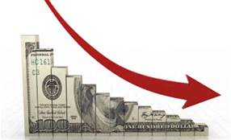
Program Benefits
24% – 28% average reductions in claims cost for employers participating in the program*
Reduction in the hidden (indirect) cost associated with workplace injuries and illnesses
*PCRB (PA Compensation Rating Bureau)
Notes:
Since the Certified WSC program came into existence on average there as been between a 24-26% reduction in claims cost for employers simply because they have an active Committee that is participating in hazard identification/detection, incident investigating and reporting, and monitoring an employer’s overall safety program.

Slide 36
Building a Business Case for Safety
Establish safety as the broad foundation of your organization
A strong safety culture supports and increases efficiency, productivity and profit
Profit
Productivity
Efficiency
Safety
Notes:
A strong “safety culture” is one way to ensure the safety of workers and visitors. When safety is a core value and given the necessary priority an employer can save money due to incident prevention.

Slide 37
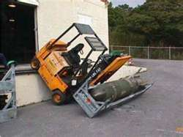
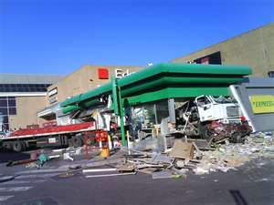
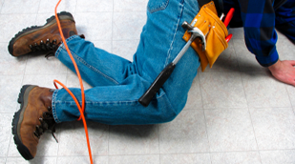
Safety First
It’s difficult to prevent all incidents, but all incidents are preventable!
Notes:
While it is very difficult to prevent ALL incidents, an effort should still be made. If management and employees have an attitude of “it’s an incident and incident’s just happen,” then incidents will continue to occur.

Slide 38
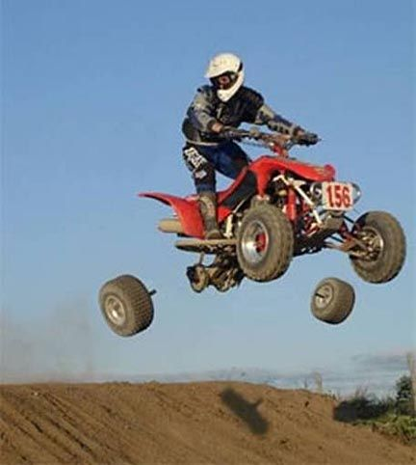
Preventable?
Notes:
Incidents are preventable!
This situation could possibly have been prevented through proper maintenance or by using a simple checklist to ensure all bolts are tightened and equipment is safe to use.

Slide 39
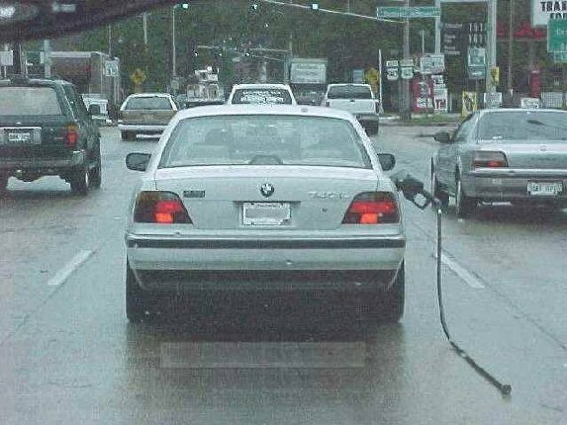
Preventable?
Notes:
Many times incidents occur due to a lack of concentration or attempting to complete the task too quickly.
Employees should be instructed to take the time to check and double-check their work before proceeding on to some other task.

Slide 40
Other Benefits
Benefits beyond the 5% Premium reduction:
Organization
Fewer injuries and lost work time
Promotes involvement
Accomplish more related safety projects
Increased productivity
Saves $$$$$
Employees
Safer work environment
Better communication
Increases safety awareness at work and at home
Enhanced employee morale
Notes:
There are many benefits for employers who have a Certified WSC in place beyond the 5% savings on WC premium.

Slide 41
Safety is Important Because
It’s the right thing to do!
Basic fundamental – provide a safe work environment so employees can return home in the same condition as when they arrived at work. (Think 24/7)
Notes:
Employers have both a legal and moral obligation to ensure their employees have a safe workplace.

Slide 42
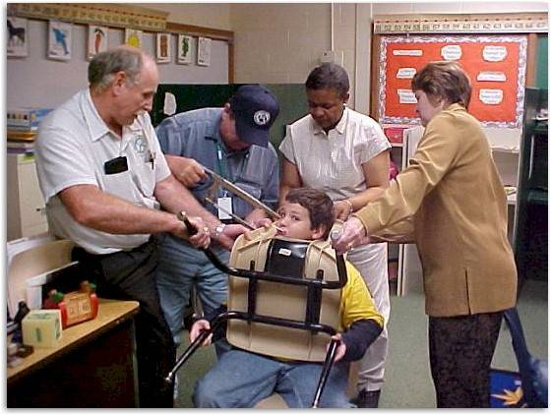
Train Early, Train Often
Notes:
Training is something that needs to be relative, updated, on-going and worthwhile.
Training for any type of incident that may occur as well as having contingency plans in place can prove extremely useful if an incident occurs.

Slide 43
Training - Sample Safety Topics
Blood borne pathogens
Back Safety
Ergonomics
Forklift safety
Lab safety
Ladder safety
Fire Safety
Tool Safety
Incident investigation
Employee suggestions review
Incentive program
Wellness programs
Workplace violence
Personal protection
Defensive driving
Slips, Trips, Falls
Notes:
Training is important, however boring, non-relative or “lack luster” training can be ineffective when it comes to incident prevention.
This slide lists some sample training topics that can be used to enhance employee education/information efforts.

Slide 44
Sample Safety Topics
Workplace / Home Safety
Blood borne pathogens
Back Safety
Ergonomics
Forklift safety
Lab safety
Ladder safety
Fire Safety
Tool Safety
Incident investigation
Employee suggestions review
Incentive program
Wellness programs
Workplace violence
Personal protection
Defensive driving
Slips, Trips, Falls
Notes:
Many topics that are used in the workplace can also apply to enhancing employees off-the-job safety as well.

Slide 45
Safety First
Safe and Healthy Employees are Productive Employees…….. Productive Employees Increase Productivity….. Increased Productivity Increases Profits
Notes:
Companies that have what is considered as a “World Class Safety Program” have safety as their number one priority.
In these companies safety is given top consideration no matter what the task or activity is.

Slide 46
Workplace Safety Committee Tips
Keep Your Program Exciting!!!
Catch people doing something right !!
Create safety recognition programs
Find new issues to address
Find new safety topics to discuss!!
Mix it Up!!!!
Notes:
Here are some tips for employers who already have a Certified Committee or are thinking about establishing one.

Slide 47
Quote
“Insanity: doing the same thing over and over again and expecting different results.” Albert Einstein
Notes:
Albert Einstein was a brilliant scientist and human being; this is one of his most famous quotes.

Slide 48
Workplace Safety
Repeat the process because everything changes! Safety is a Continuous Improvement Process
Notes:
Safety should be a process of continuous improvement.
Hazard detection/identification, incident investigation, near miss reporting and investigation, and completing Job Hazard/Job Safety Assessments should be on-going.
The overall Safety Program should be reviewed and updated as necessary on at least an annual basis to ensure it is applicable and appropriate.

Slide 49
Workplace Safety Committee
A Workplace Safety Committee, just makes good business sense!
Notes:
The process of establishing and maintaining an active Workplace Safety Committee is proven to be a decision that just makes good business sense as well as cents!

Slide 50
Contact Information
Health & Safety Training Specialists
1171 South Cameron Street, Room 324
Harrisburg, PA 17104-2501
(717) 772-1635
RA-LI-BWC-PATHS@pa.gov
Like us on Facebook! - https://www.facebook.com/BWCPATHS

Slide 51
Questions

