Slide 1
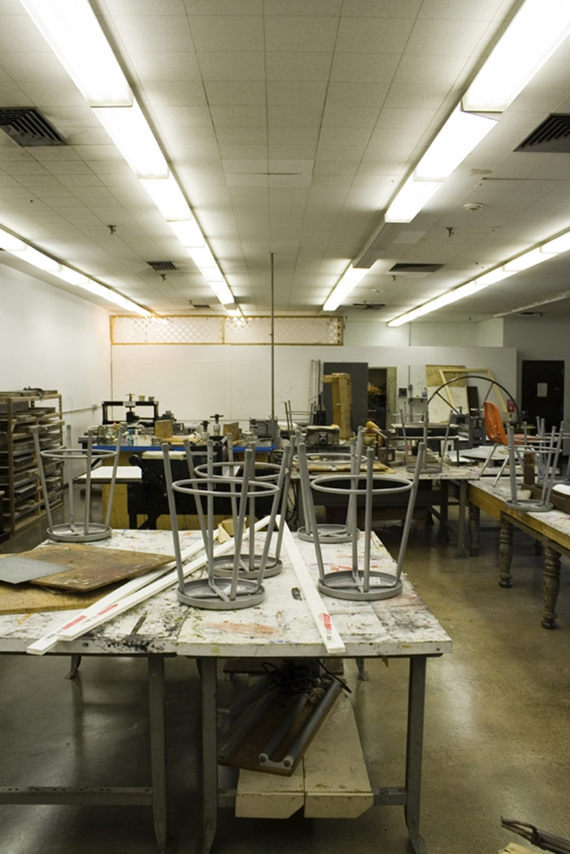
Art Safety 101
Elementary
Middle/Junior High
High Schools
PPT-049-01AP
1
Notes:
Materials used in art classes in Elementary, Middle, Junior and High Schools present exposures of contact, inhalation and possibly ingestion.

Slide 2

What We’ll Talk About
Hazards of different materials/operations
Precautions to keep you safe
Flammable and combustible liquids
Personal protective equipment (PPE)
Safe storage practices
Ergonomic considerations
PPT-049-01AP
2
Notes:
We’ll view not only the potential hazards but preventive measures and protective clothing considerations which might be required to eliminate exposures.

Slide 3
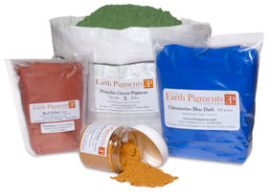
Painting – Pigments
Pigments are used in oil paints,
acrylics, watercolor paints,
gouache, encaustic, poster
paints, casein paints and tempera
Paints are pigments mixed with
a vehicle or binder
Both inorganic and organic
pigments are used as colorants
Dry pigments are especially
hazardous because they are
easily inhaled and ingested
PPT-049-01AP
3
Notes:
Gouache: (gwash)
Pigments and paints both organic and inorganic can be hazardous especially in the dry form due to being easily inhaled or ingested.

Slide 4
Hazards - Paints
Poisoning can occur if toxic pigments are inhaled
or ingested
Main hazard in standard painting: accidental
ingestion of pigments due to eating or drinking
while working, inadvertent hand to mouth
contact, or pointing paint brush with lips
If spraying, heating or sanding are used then
opportunity for inhalation exists
Classic example of toxic inorganic pigment is
white lead or flake white (basic lead carbonate)
PPT-049-01AP
4
Notes:
Paint hazards can also include poisoning if toxic pigments are present.
Spraying, heating or sanding provides the greatest opportunity for inhalation hazards.
A classic example of toxic inorganic pigment is white lead or flake white (basic lead carbonate).

Slide 5
Precautions - Paints
Obtain Safety Data Sheets (SDSs) on all your
paints and paint products; learn to read and
understand them
Use the least toxic pigments possible (don’t use
lead/carcinogenic pigments)
Avoid mixing dry pigments
Wet mop and wipe all surfaces when using dry
pigments
PPT-049-01AP
5
Notes:
Precautions you can exercise when dealing with paints is to obtain the Safety Data Sheet (SDS) for the material.
Use the least toxic pigments possible (don’t use lead/carcinogenic pigments)
Avoid mixing dry pigments
Wet mop and wipe all surfaces when using dry pigments

Slide 6
Hazards - Solvents
All solvents cause defatting of skin and
dermatitis from prolonged/repeated exposures
Turpentine can also cause skin allergies and be
absorbed through skin
Acute inhalation of high concentrations of
mineral spirits, turpentine vapors, and other
solvents can cause:
▪ dizziness ▪ headaches ▪ drowsiness
▪ nausea ▪ fatigue ▪ respiratory irritation
▪ coma ▪ loss of coordination
Chronic inhalation of large amounts of solvents
can cause decreased coordination, behavioral
changes, brain damage
PPT-049-01AP
6
Notes:
Solvents can cause:
Dermatitis
Skin allergies
Acute inhalation of high concentrations can cause dizziness all the way to coma.
Chronic inhalation of large amounts of solves can decrease coordination, create behavioral changes and may result in brain damage.

Slide 7
Precautions - Solvents
Whenever possible, replace turpentine or ordinary
mineral spirits with less toxic, less flammable,
odorless mineral spirits
Ensure adequate ventilation when using solvents of
any kind
When working with solvents wear appropriate PPE
such as neoprene gloves and chemical splash
goggles (includes cleaning brushes/equipment)
Use baby oil then soap and water to remove paint
from hands
PPT-049-01AP
7
Notes:
Precautions with Solvents:
Use substitute materials that are less toxic and flammable.
Ensure adequate ventilation.
Proper PPE is required from gloves to possibly respiratory protection.
Remove paint with baby oil then soap and water.

Slide 8
Hazards – Airbrush, Spray Cans, Spray Guns
Spray mists are particularly hazardous because
they are easily inhaled
Besides pigments and solvents, aerosol spray
paints have propellants that are extremely
flammable
Airbrushing produces a fine mist that is a
serious inhalation hazard
Spray guns are less common but usually
involve spraying larger quantities of paint
(inhalation and fire hazard)
PPT-049-01AP
8
Notes:
Airbrushing, spray cans and spray guns:
Create mists which can be easily inhaled.
The propellants used can be flammable.
Spray guns, though less common, can cause inhalation and fire hazards.
Any material which can go airborne has a greatly likelihood of exposure since each of us must breathe so many times each minute.

Slide 9
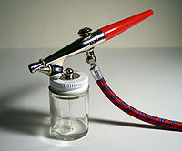
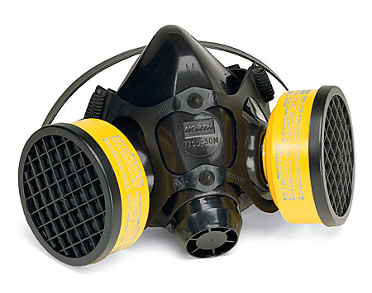
Precautions – Airbrush, Spray Cans, Spray Guns
Try to brush items rather than spraying
Use water-based airbrushing paints and inks
rather than solvent-based ones
If ventilation is not adequate then use
appropriate respiratory protection while
airbrushing or spraying
PPT-049-01AP
9
Notes:
Precautions which can be taken when airbrushing, using spray cans or spray guns:
Try to brush items rather than spraying, thereby reducing the amount of airborne material created.
Use water-based airbrushing paints and inks rather than solvent-based ones.
If ventilation is not adequate then use appropriate respiratory protection while airbrushing or spraying.

Slide 10
Hazards – Dry Drawing Media
Pencils are made with graphite and are not
considered hazardous
Colored pencils have pigments added to the
graphite but amounts are small
Inhaling large amounts of charcoal dust can
create chronic lung problems
Chalk dust can be a hazard to those who have
respiratory conditions/problems
Inhalation of pastel stick/pencil dust can be a
major hazard due to pigments involved
PPT-049-01AP
10
Notes:
Regular pencils are not considered hazardous. However, colored pencils have pigments added which may be:
Charcoal dust can create chronic lung problems.
Chalk dust can create respiratory problems.
Inhalation of pastel stick or pencil dust can be a major hazard due to pigments used.

Slide 11
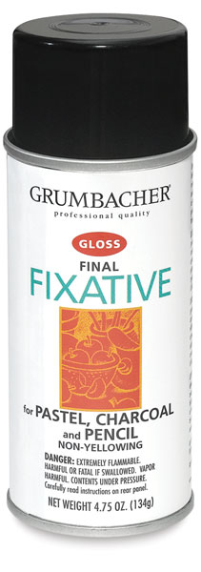
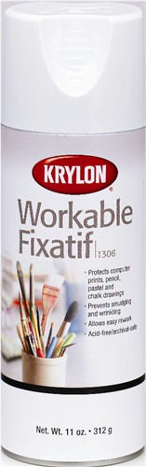
Hazards – Dry Drawing Media
Permanent and workable spray fixatives used
to fix drawings contain toxic solvents –
inhalation hazard
Accidental ingestion if trying to spray fixative
by blowing air from your mouth through a tube
PPT-049-01AP
11
Notes:
Dry Drawing Media
Permanent and workable spray fixatives used to fix drawings contain toxic solvents – inhalation hazard.
Accidental ingestion if trying to spray fixative by blowing air from your mouth through a tube.
It can be seen that susceptibility may be age-dependent requiring greater supervision for younger users.
Always consider the age group using the materials. This will dictate closer supervision rather than simply instructing.

Slide 12
Precautions – Dry Drawing Media
Use the least dusty types of pastels, chalks, etc.
Don’t blow off excess pastel or charcoal dust with
your mouth – tap off excess dust to floor/paper
Wet mop and wipe all surfaces clean of dusts
Use spray fixatives in a spray booth that exhausts
to outside (best situation)
If spray fixatives used only occasionally, should use
outside while wearing NIOSH-approved respirator
PPT-049-01AP
12
Notes:
Precautions-Dry Drawing Media
Use the least dusty types of pastels, chalks, etc.
Tap off excess dust to floor/paper, don’t blow off excess.
Wet mop and wipe all surfaces clean of dusts.
Use spray fixatives in a spray booth that exhausts to outside (best situation).
If spray fixatives used only occasionally, should use outside while wearing NIOSH-approved respirator.

Slide 13
Hazards – Liquid Drawing Media
Drawing inks are usually water based but some
are solvent-based (can contain toxic solvents
such as xylene)
Permanent felt tip markers contain solvents
Hazardous when using numerous markers at
same time in close proximity (due to irritation
of eye, nose, throat)
PPT-049-01AP
13
Notes:
Hazards – Liquid Drawing Media
Drawing inks are usually water based but some are solvent-based (can contain toxic solvents such as xylene).
Permanent felt tip markers contain solvents.
Hazardous when using numerous markers at same time in close proximity (due to irritation of eye, nose, throat).
Determine safest media for classroom use.

Slide 14
Precautions – Liquid Media
Use water-based markers and drawing inks if
possible
Alcohol-based markers are less toxic than
aromatic solvent-based markers
Solvent-based drawing inks and permanent
markers should be used with good dilution
ventilation (e.g. window exhaust fan)
Never paint on the body with markers or
drawing inks (should use cosmetic colors)
PPT-049-01AP
14
Notes:
Precautions – Liquid Media
Use water-based markers and drawing inks if possible.
Alcohol-based markers are less toxic than aromatic solvent-based markers.
Solvent-based drawing inks and permanent markers should be used with good dilution ventilation (e.g. window exhaust fan).
Never paint on the body with markers or drawing inks (should use cosmetic colors).

Slide 15

Cosmetic Colors?
PPT-049-01AP
15
Notes:
Decorating a person’s face with face paint or other makeup lets them see better than if they're wearing a mask. A mask can make it hard to see where a person is going as well as being able to watch out for cars or other movable objects. But in using any type of face paint the user needs to make sure that painted-on designs don't cause problems of their own.

Slide 16


Flammable & Combustible Liquids
Should be stored only in certain types of
approved containers (e.g. manufacturers’
containers)
Type of container needed depends on quantity
and class of liquid
– Class IA, B, C = Flammable Liquid
– Class II, IIIA, B = Combustible Liquid
PPT-049-01AP
16
Notes:
Flammable and Combustible Liquids
These should be stored only in approved containers (e.g. manufacturers’ containers)
Type of container depends on quantity and class of liquid
Class IA, B, C = Flammable Liquid
Class II, IIIA, B = Combustible Liquid

Slide 17
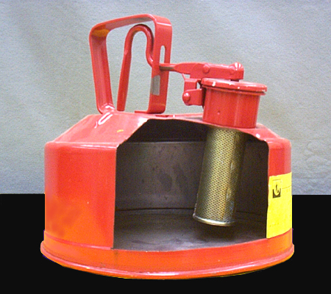
Flammable & Combustible Liquids
Safety can: approved container of not more
than 5 gallons capacity with a spring closing lid
and spout cover
Safety cans are designed to safely relieve
internal pressure when exposed to fire
conditions
PPT-049-01AP
17
Notes:
Flammable and Combustible Liquids
A Safety can is a container of not more than 5 gallons capacity with a spring closing lid and spout cover designed to relieve internal pressure when exposed to fire conditions
thereby preventing catastrophic rupture.

Slide 18
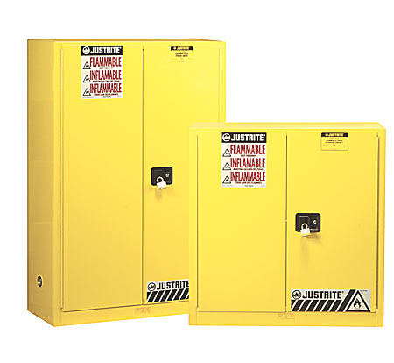
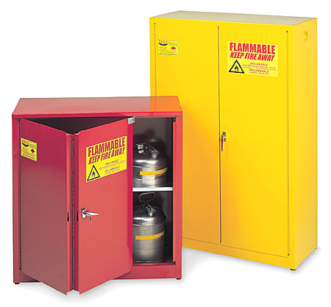
Flammable Liquids Storage Closet
Approved cabinet designed and constructed to
protect contents from external fires
PPT-049-01AP
18
Notes:
A Flammable Liquids Storage Closet is an approved cabinet designed and constructed to protect contents from external fires.

Slide 19
Flammable & Combustible Liquids Storage
Quantities should be limited to the amount
necessary for the work in progress
No more than 10 gallons combined should be
stored outside a flammable liquids storage
cabinet (unless safety cans used)
Storage must not obstruct/block exits
Flammable liquids should be stored separately
from strong oxidizers, shielded from direct
sunlight, and kept away from heat sources
Containers must be sealed when not in use
PPT-049-01AP
19
Notes:
Flammable and Combustible Liquids Storage
Limit Quantities to the amount necessary for the work in progress.
No more than 10 gallons combined should be stored outside a flammable liquids storage cabinet (unless safety cans used).
Storage must not obstruct/block exits.
Flammable liquids should be stored separately from strong oxidizers, shielded from direct sunlight, and kept away from heat sources.
Containers must be sealed when not in use.

Slide 20
Precautions - Flammable & Combustible Liquids
Control all ignition sources in areas where
flammable and combustible liquids are
used/stored
Smoking, open flames, spark producing
equipment should not be used in area
Pressurized containers of flammable aerosols
may explode when exposed to fire
Pressurized containers of flammable aerosols
should be stored in flammable liquids cabinets
PPT-049-01AP
20
Notes:
Precautions – Flammable and Combustible Liquids
Control all ignition sources in areas where flammable and combustible liquids are used/stored
Prevent smoking, open flames, spark producing equipment.
Pressurized containers of flammable aerosols may explode when exposed to fire; store in flammable liquids cabinets.

Slide 21
Clay
  Clays: Minerals composed of hydrated aluminum
  silicates, often containing large amounts of
  crystalline silica
  Other impurities may include organic matter or
  sulfur compounds
  Sometimes ground firebrick, sand, talc,
  vermiculite, perlite and small amounts of
  minerals such as barium carbonate and metal
  oxides are added to modify clay properties
PPT-049-01AP
21
Notes:
Clay
Clay is composed of hydrated aluminum silicates, often containing large amounts of crystalline silica.
Other impurities may include organic matter or sulfur compounds.
Sometimes ground firebrick, sand, talc, vermiculite, perlite and small amounts of minerals such as barium carbonate and metal oxides are added to modify clay
properties.

Slide 22
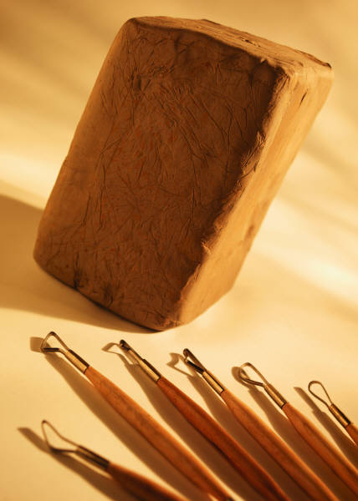
Clay
Contains kaolinite sold as “kaolin”
Made by mixing dry clay with
water in clay mixer
Clay slip is made by adding talcs
which can be contaminated with
fibrous asbestos or asbestos-like
materials
  Clays can be worked by hand or
  on a potter’s wheel, or cast in a
  clay slurry into molds
PPT-049-01AP
22
Notes:
Clay
Contains kaolinite sold as “kaolin.”
Made by mixing dry clay with water in clay mixer.
Clay slip is made by adding talcs which can be contaminated with fibrous asbestos or asbestos-like materials.
Clays can be worked by hand or on a potter’s wheel, or cast in a clay slurry into molds.

Slide 23
Hazards - Clay
Known causes of silicosis or “potter’s rot” from
chronic inhalation of large amounts of free
silica during clay mixing
Symptoms of silicosis include: shortness of
breath, dry cough, emphysema, and high
susceptibility to lung infections such as
tuberculosis
Silicosis may take years to develop
Silica dust not hazardous by skin contact or
ingestion
PPT-049-01AP
23
Notes:
Hazards – Clay
Clay is a known cause of silicosis or “potter’s rot” from chronic inhalation of large amounts of free silica during clay mixing.
Silicosis symptoms include: shortness of breath, dry cough, emphysema, and high susceptibility to lung infections such as tuberculosis.
Silicosis may take years to develop.
Silica dust not hazardous by skin contact or ingestion.

Slide 24
Hazards - Clay
Chronic inhalation of kaolin moderately
hazardous and can result in kaolinosis –
disease in which lungs become mechanically
clogged
Asbestos extremely toxic by inhalation and
possibly ingestion; inhalation may cause
asbestosis, lung, stomach and intestinal cancer
as well as mesothelioma
Sand, perlite, ground firebrick, vermiculite
contains free silica – highly toxic by inhalation
PPT-049-01AP
24
Notes:
Hazards – Clay
Chronic inhalation of kaolin is moderately hazardous and can result in kaolinosis – disease in which lungs become mechanically clogged.
Asbestos is extremely toxic by inhalation and possibly ingestion; inhalation may cause asbestosis, lung, stomach and intestinal cancer as well as mesothelioma.
Sand, perlite, ground firebrick, vermiculite contains free silica – highly toxic by inhalation.
Determine respiratory protection needs or ventilation requirements which may exceed other occupied areas within your facility.

Slide 25

Hazards - Clay
Bags of clay and glaze materials are
heavy, incorrect lifting can cause
back problems
Exposure to molds in wet clay being
soured/aged in a damp place can
cause respiratory problems such as
asthma
“Throwing” of a potter’s wheel for
long time periods can result in
carpel tunnel syndrome or back
problems from bending over wheel
PPT-049-01AP
25
Notes:
Hazards - Clay
Bags of clay and glaze materials are heavy; incorrect lifting can cause back problems.
Exposure to molds in wet clay being soured/aged in a damp place can cause respiratory problems such as asthma.
“Throwing” of a potter’s wheel for long periods can result in carpel tunnel syndrome or back problems from bending over wheel

Slide 26
Hazards - Clay
Hand contact with wet clay can result in
abrasion and dryness of fingertips and hands
Moving parts of kickwheels can cause cuts and
abrasions
Clay scraps on floor, bench, other surfaces can
dry and pulverize producing an inhalation
hazard of free silica
Reconditioning clay by pulverization and
sanding finished greenware can create very
high concentrations of hazardous silica dust
PPT-049-01AP
26
Notes:
Hazards – Clay
Hand contact with wet clay can result in abrasion and dryness of fingertips and hands.
Moving kickwheels can cause cuts and abrasions.
Clay scraps on floor, bench, other surfaces can dry and pulverize producing an inhalation hazard of free silica.
Reconditioning clay by pulverization and sanding finished greenware can create very high concentrations of hazardous silica dust.

Slide 27
Precautions - Clay
Use pre-mixed clay to avoid exposure to large
quantities of clay dust
Clay storage/mixing should take place in a
separate room
Bags of clay and other pottery materials should
be stored off the floor on palettes or grids for
easier clean-up
Clay mixers should be equipped with local
exhaust ventilation to remove fine silica dust
PPT-049-01AP
27
Notes:
Precautions – Clay
Use pre-mixed clay to avoid exposure to large quantities of clay dust.
Clay storage/mixing should take place in a separate room.
Bags of clay and other pottery materials should be stored off the floor on palettes or grids for easier clean-up.
Clay mixers should be equipped with local exhaust ventilation to remove fine silica dust.

Slide 28
Precautions - Clay
Proper guards should be installed on clay mixers
to prevent opening to add clay/water
Wear separate work clothes of material and
design that won’t trap dust; wash separately
each week
Avoid contact with broken skin (use skin
moisturizer)
To prevent back problems always lift with knees
bent; avoid bending at waist
PPT-049-01AP
28
Notes:
Precautions - Clay
Install proper guards on clay mixers to prevent opening to add clay/water.
Wear separate work clothes of material and design that won’t trap dust; wash separately each week.
Avoid contact between clay and broken skin (use skin moisturizer).
To prevent back problems always lift with knees bent; avoid bending at waist.

Slide 29
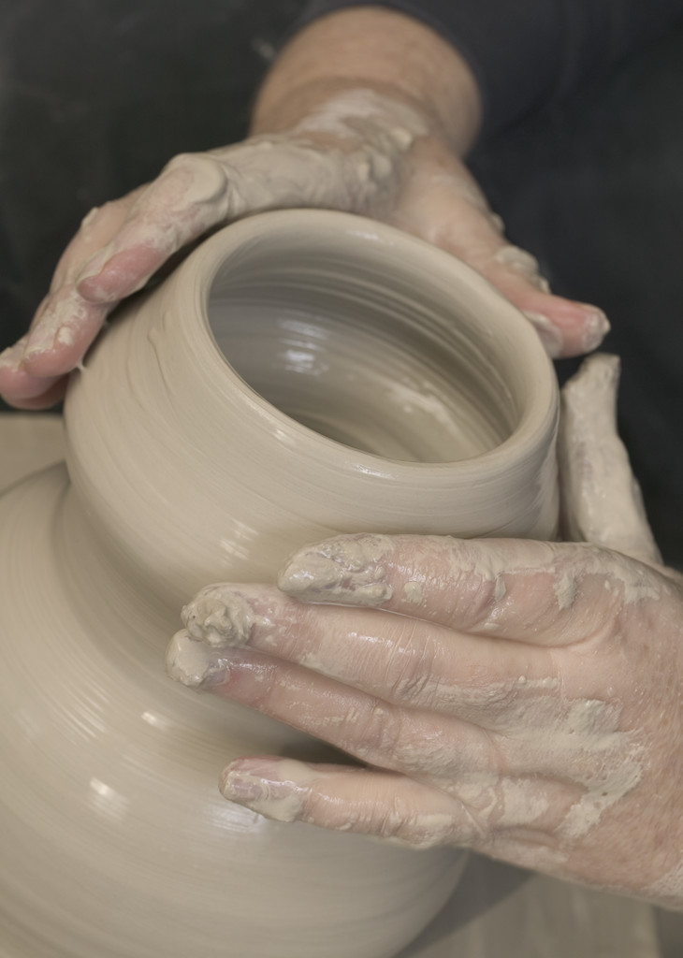
Precautions - Clay
Use a standup wheel or
elevate electric wheels to a
height that doesn’t require
bending over
Keep wrists in non-flexed
position as much as possible
Take frequent work breaks
Be careful with moving
parts on kickwheel
PPT-049-01AP
29
Notes:
Precautions - Clay
Use a standup wheel or elevate electric wheels to a height that doesn’t require bending over.
Keep wrists in non-flexed position as much as possible.
Take frequent work breaks.
Be careful with moving parts on kickwheel.

Slide 30
Precautions - Clay
Recondition clay by cutting still wet clay into
small pieces and letting them air dry then soak in
water
Finish greenware while still wet or damp with a
fine sponge instead of sanding when dry
Do not sand greenware containing fibrous talc
Wet mop floors and work surfaces daily to
minimize dust levels and prevent dry scraps from
becoming pulverized
PPT-049-01AP
30
Notes:
Precautions – Clay
Recondition clay by cutting still wet clay into small pieces and letting them air dry then soak in water.
Finish greenware while still wet or damp with a fine sponge instead of sanding when dry.
Do not sand greenware containing fibrous talc.
Wet mop floors and work surfaces daily to minimize dust levels and prevent dry scraps from becoming pulverized.

Slide 31
Control of Clay Dust Exposure
Dusts are most likely generated when mixing
clay, cleaning up dry clay or sanding/polishing
clay items
Use only wet mopping or hosing methods or a
special vacuum cleaner
Ordinary household/industrial vacuums will
collect only large dust particles and will release
finer particles into air
Vacuums used should have HEPA (high
efficiency particulate air) filter
PPT-049-01AP
31
Notes:
Control of Clay Dust
Dusts are most likely generated when mixing clay, cleaning up dry clay or sanding/polishing clay items.
Use only wet mopping or hosing methods or a special vacuum cleaner.
Ordinary household/industrial vacuums will collect only large dust particles and will release finer particles into air.
Vacuums used should have HEPA (high efficiency particulate air) filter.

Slide 32
Control of Clay Dust Exposure
Daily wet mopping or hosing down to a floor
drain
Wheel area can be hosed down at end of every
work session
Large wet sponges are essential to clean work
tables, counters, wheels, small floor areas
Use repeated sponging with washed out
sponges to remove clay haze
Two clean sponges good idea – first gets mess,
second removes residue
PPT-049-01
32
Notes:
Control of Clay Dust
Daily wet mopping or hosing down to a floor drain.
Wheel area can be hosed down at end of every work session.
Large wet sponges are essential to clean work tables, counters, wheels, small floor areas.
Use repeated sponging with washed out sponges to remove clay haze.
Two clean sponges good idea – first gets mess, second removes residue.

Slide 33
Glazes
Glazes used to color or finish clay pieces are a
mixture of silica, fluxes and colorants
Common fluxes include lead, barium, lithium,
calcium and sodium – used to lower melting
point of silica
Actual colorants: assortment of metal oxides
(< 5 percent of glaze by weight)
Luster or metallic glazes fired in reduction
atmosphere and can contain mercury, arsenic,
highly toxic solvents, also oils
Some under/over glazes use mineral spirits as
the vehicle instead of water
PPT-049-01AP
33
Notes:
Glazes
Glazes used to color or finish clay pieces are a mixture of silica, fluxes and colorants.
Common fluxes include lead, barium, lithium, calcium and sodium – used to lower melting point of silica.
Actual colorants: assortment of metal oxides (< 5 percent of glaze by weight).
Luster or metallic glazes fired in reduction atmosphere and can contain mercury, arsenic, highly toxic solvents, also oils.
Some under/over glazes use mineral spirits as the vehicle instead of water.

Slide 34
Hazards - Glazes
Lead compounds are highly toxic by
inhalation/ingestion
Symptoms of lead poisoning: damage to
peripheral nervous system, brain, kidney or
gastrointestinal system, anemia, chromosomal
damage, birth defects, miscarriages
Other fluxes such as barium and lithium are
highly toxic by inhalation (but less than lead)
Certain colorant compounds of particular
metals are known or probable carcinogens (i.e.
arsenic, beryllium, cadmium, nickel)
PPT-049-01AP
34
Notes:
Hazards – Glazes
Lead compounds are highly toxic by inhalation/ingestion.
Symptoms of lead poisoning include:
Damage to peripheral nervous system,
Damage to brain, kidney or gastrointestinal system, anemia,
Chromosomal damage, birth defects, miscarriages
Other fluxes such as barium and lithium are highly toxic by inhalation (but less than lead).
Certain colorant compounds of particular metals are “known carcinogens” or “probable carcinogens” (i.e. arsenic, beryllium, cadmium, nickel).

Slide 35
Hazards - Glazes
Weighing and mixing of glazes: could have
inhalation of toxic materials such as plant ash,
flint, talcs, silica, quartz feldspars
Soda ash, potassium carbonate, alkaline
feldspars and fluorspar used in glazes are skin
irritants
Spray application of glazes very hazardous due
to potential inhalation of glaze mists
Glazes containing solvents are flammable and
hazardous
PPT-049-01AP
35
Notes:
Hazards – Glazes
Weighing and mixing of glazes could expose to toxic materials through inhalation such as plant ash, flint, talcs, silica, quartz feldspars.
Soda ash, potassium carbonate, alkaline feldspars and fluorspar used in glazes are skin irritants.
Spray application of glazes is very hazardous due to the potential inhalation of glaze mists.
Glazes containing solvents are flammable and hazardous.

Slide 36
Precautions - Glazes
Use lead-free glazes and pre-mixed glazes
If possible, use colorants that are not known
carcinogens
If weighing/mixing powdered material wear
appropriate respiratory protection
Wet mop spilled powders
Wear appropriate gloves when handling wet or
dry glazes
Use dilution ventilation or local exhaust when
applying glazes containing solvents
PPT-049-01AP
36
Notes:
Precautions – Glazes
Use lead-free glazes and pre-mixed glazes.
If possible, use colorants that are not known carcinogens.
If weighing/mixing powdered material wear appropriate respiratory protection.
Wet mop spilled powders.
Wear appropriate gloves when handling wet or dry glazes.
Use dilution ventilation or local exhaust when applying glazes containing solvents.

Slide 37

Glazed?
Is this hazardous?
PPT-049-01AP
37
Notes:
Obviously the glazing used on a donut does not have the same hazards as does glazing used in the art world, unless a person is concerned about their waistline!

Slide 38
Kilns
Electric and fuel-fired kilns are used to heat
pottery to desired firing temperature
Electric kiln most common type: heating
elements heat kiln as electric current passes
through coils
Fuel-fired kiln heated by burning natural or LP
gas, oil, wood, coke, charcoal, other materials
Fuels produce carbon monoxide and other
combustion gases
Kiln firing temperatures can vary from 1,382 °F
(degrees Fahrenheit) to 2,642°F depending
upon materials being fired
PPT-049-01AP
38
Notes:
Kilns:
Electric and fuel-fired kilns are used to heat pottery to desired firing temperature.
Electric kiln most common type: heating elements heat kiln as electric current passes through coils.
Fuel-fired kiln heated by burning natural or LP gas, oil, wood, coke, charcoal, other materials.
Fuels produce carbon monoxide and other combustion gases.
Kiln firing temperatures can vary from 1,382 °F (degrees Fahrenheit) to 2,642°F, depending on materials being fired.

Slide 39
Hazards - Kilns
Chlorine, fluorine, sulfur dioxide, nitrogen
dioxide, and ozone can be produced and are
highly toxic by inhalation
Bisque firings of high-sulfur clay have caused
production of large amounts of sulfur dioxide
Long term inhalation of low levels of gases
produced can cause chronic bronchitis and
emphysema
Fluorine gas can also cause bone and teeth
problems
Metal fumes generated at high temperatures
are highly toxic by inhalation
PPT-049-01AP
39
Notes:
Hazards – Kilns
Chlorine, fluorine, sulfur dioxide, nitrogen dioxide, and ozone can be produced and are highly toxic by inhalation.
Bisque firings of high-sulfur clay have caused production of large amounts of sulfur dioxide.
Long term inhalation of low levels of gases produced can cause chronic bronchitis and emphysema.
Fluorine gas can also cause bone and teeth problems.
Metal fumes generated at high temperatures are highly toxic by inhalation.
Consider the need for local ventilation and/or respiratory protection during such operations.

Slide 40
Hazards- Kilns
Carbon monoxide from fuel-fired kilns is highly
toxic by inhalation and can disrupt O₂ level
Hot kilns produce infrared radiation that is
hazardous to the eyes
Heat generated can cause thermal burns (1 foot
from peephole - temperature 156°F)
If electric kiln fails to shut off, heating elements
melt and cause fires
Gas kilns generate a lot of heat and can heat
room to over 100°F
Top loading kiln lid latch could fail – lid falls on
loader’s head
PPT-049-01AP
40
Notes:
Hazards – Kilns
Carbon monoxide from fuel-fired kilns is highly toxic by inhalation and can disrupt O₂ level.
Hot kilns produce infrared radiation that is hazardous to the eyes.
Heat generated can cause thermal burns (1 foot from peephole - temperature 156°F).
If electric kiln fails to shut off, heating elements melt and cause fires.
Gas kilns generate a lot of heat and can heat room to over 100°F .
Top loading kiln lid latch could fail allowing lid to fall on loader’s head.

Slide 41
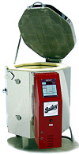
Precautions - Kilns
Use infrared goggles or hand-held welding shields
when looking into operating kiln
Do not use lead compounds at stoneware
temperatures (lead will vaporize)
Do not store lumber, paper, solvents, or other
combustible/flammable materials near kilns
PPT-049-01AP
41
Notes:
Precautions – Kilns
Use infrared goggles or hand-held welding shields when looking into operating kiln.
Do not use lead compounds at stoneware temperatures (lead will vaporize).
Do not store lumber, paper, solvents, or other combustible/flammable materials near kilns.

Slide 42
Precautions - Kilns
Separate room from classroom
Chain on top-loading kiln lid
Comply with fire regulations and electrical codes
Fire extinguishers and first aid/burn kits nearby
Wear appropriate protective clothing (PPE)
Post: operating instructions, warning signs,
emergency procedures
PPT-049-01AP
42
Notes:
Precautions – Kilns
Should be in a room separate from classroom. With necessary fire-ratings on separating walls.
Chain on top-loading kiln lid to prevent lid from falling.
Comply with fire regulations and electrical codes.
Fire extinguishers and first aid/burn kits nearby.
Wear appropriate protective clothing (PPE).
Post operating instructions, warning signs, emergency procedures.

Slide 43





Pay Attention to Warning Signs
PPT-049-01AP
43
Notes:
Warning signs should be posted corresponding with the hazard to be encountered.

Slide 44

Photography- Black & White Processing
Wide variety of chemicals
used in black and white
photographic processing
Print processing uses tray
processing with successive
developing baths, fixing baths
and rinse steps
Other treatments include use
of hardeners, intensifiers,
reducers, toners and hypo-
eliminators
PPT-049-01AP
44
Notes:
Photography – Black & White Processing
Each stage presents its own unique safety consideration regarding potential exposure.

Slide 45
Hazards- Mixing Photochemicals
Developer solutions and powders are often highly
alkaline
Glacial acetic acid used in making stop bath is
corrosive by skin contact, inhalation, ingestion
Developer powders are highly toxic by inhalation,
and moderately toxic by skin contact (due to alkali
and developers themselves)
PPT-049-01AP
45
Notes:
Hazards – Mixing Photochemicals
Acidic and alkaline situations exist corrosive by skin contact, inhalation and ingestion.
Developer powders are highly toxic by inhalation, and moderately toxic by skin contact (due to alkali and developers themselves).

Slide 46
Precautions- Mixing Photochemicals
Use liquid chemistry rather than mixing
developing powders whenever possible (pregnant
women should not be exposed to powdered
developer)
When mixing powdered chemicals use a glove box
(cardboard box with glass or plexiglass top and
two holes in sides for hands and arms) and local
exhaust ventilation or wear NIOSH-approved toxic
dust respirator
Wear gloves, goggles and protective apron when
mixing concentrated photochemicals
PPT-049-01AP
46
Notes:
Precautions - Mixing Photochemicals
Use liquid chemistry rather than mixing developing powders whenever possible (pregnant women should not be exposed to powdered developer).
When mixing powdered chemicals use a glove box (cardboard box with glass or plexiglass top and two holes in sides for hands and arms) and local
exhaust ventilation or wear NIOSH-approved toxic dust respirator.
Wear gloves, goggles and protective apron when mixing concentrated photochemicals.

Slide 47
Precautions- Mixing Photochemicals
In case of skin contact, rinse with large quantities
of water
In case of eye contact rinse for 15-20 minutes
and seek medical attention as soon as possible
Store concentrated acids and other corrosive
chemicals on low shelves
Do not store photographic solutions in glass
containers
PPT-049-01AP
47
Notes:
Precautions - Mixing Photochemicals
In case of skin contact, rinse with large quantities of water ensuring water supply is handy within close proximity to possible need.
Eye contact: rinse eyes for 15-20 minutes and seek medical attention as soon as possible.
Store concentrated acids and other corrosive chemicals on low shelves segregated from incompatible chemicals.
Do not store photographic solutions in glass containers.

Slide 48
Developing Baths
Most commonly used developers are
hydroquinone, monomethyl para-amino phenol
sulfate and phenidone
Several other developers used for special
purposes
Other common components include an accelerator
(often sodium carbonate or borax), sodium sulfite
as a preservative, and potassium bromide as a
restrainer or anti-fogging agent
PPT-049-01AP
48
Notes:
Developing Baths
Most commonly used developers are hydroquinone, monomethyl para-amino phenol sulfate and phenidone.
Several other developers are used for special purposes.
Other common components include an accelerator (often sodium carbonate or borax), sodium sulfite as a preservative, and potassium bromide as a
restrainer or anti-fogging agent.
Check chemical hazards using the corresponding SDS.

Slide 49
Hazards – Developing Baths
Developers are skin and eye irritants; in many
cases strong sensitizers
Most developers are moderately to highly toxic by
ingestion
Sodium hydroxide, sodium carbonate and other
alkalis used as accelerators are highly corrosive
by skin contact or ingestion
PPT-049-01AP
49
Notes:
Hazards – Developing Baths
Skin and eye irritants; in many cases strong sensitizers.
Most developers are moderately to highly toxic by ingestion.
Sodium hydroxide, sodium carbonate and other alkalis used as accelerators are highly corrosive by skin contact or ingestion.

Slide 50
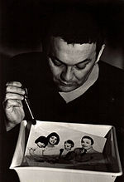
Precautions – Developing Baths
Do not put bare hands in developer baths, use
tongs instead
Do not use para-phenylene diamine or any
derivatives if possible
PPT-049-01AP
50
Notes:
Precautions – Developing Baths
Do not put bare hands in developer baths, use tongs instead.
Do not use para-phenylene diamine or any derivatives if possible.

Slide 51
Stop Baths & Fixers
Stop baths are usually weak solutions of acetic
acid
Acetic acid commonly available as pure glacial
acetic acid or 28 percent acetic acid
Some stop baths contain potassium chrome alum
as a hardener
Fixing baths contain sodium thiosulfate as the
fixing agent and sodium sulfite and sodium
bisulfite as a preservative
Fixing baths may also contain alum as a hardener
and boric acid as a buffer
PPT-049-01AP
51
Notes:
Stop Baths and Fixers
Stop baths are usually weak solutions of acetic acid.
Acetic acid commonly available as pure glacial acetic acid or 28 percent acetic acid.
Some stop baths contain potassium chrome alum as a hardener.
Fixing baths contain sodium thiosulfate as the fixing agent and sodium sulfite and sodium bisulfite as a preservative.
Fixing baths may also contain alum as a hardener and boric acid as a buffer.

Slide 52
Hazards - Stop Baths & Fixers
Acetic acid in concentrated solutions is highly
toxic by inhalation, skin contact and ingestion
Acetic acid can cause dermatitis/ulcers, and can
be strong irritant to mucous membranes
Final stop bath only slightly hazardous by skin
contact
Continual inhalation of acetic acid vapors, even
from stop bath, can cause chronic bronchitis
Boric acid is moderately toxic by ingestion or
inhalation and slightly toxic by skin contact
PPT-049-01AP
52
Notes:
Hazards – Stop Baths and Fixers
Acetic acid in concentrated solutions is highly toxic by inhalation, skin contact and ingestion.
Acetic acid can cause dermatitis/ulcers, and can be strong irritant to mucous membranes.
Final stop bath only slightly hazardous by skin contact.
Continual inhalation of acetic acid vapors, even from stop bath, can cause chronic bronchitis.
Boric acid is moderately toxic by ingestion or inhalation and slightly toxic by skin contact.

Slide 53
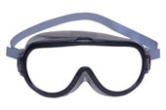

Precautions - Stop Baths & Fixers
All darkrooms require good ventilation to
control level of acetic acid vapors and sulfur
dioxide gas produced
Cover all baths when not in use to prevent
evaporation or release of toxic vapors/gases
Wear gloves and goggles
PPT-049-01AP
53
Notes:
Precautions - Stop Baths and Fixers:
Prevent evaporation or release of toxic vapors/gases by properly covering baths.
Wear gloves and goggles to guard against splash exposures.

Slide 54
Disposal of Photochemicals
Check with your local municipality regarding type
and quantity of materials that can be disposed of
“down the drain”
Old or unused concentrated photographic
solutions containing high concentrations of
solvents as well as non-silver solutions should be
treated as hazardous waste and disposed of as
such
Alkaline developer solutions should be neutralized
first before being poured down the drain (if
allowed)
PPT-049-01AP
54
Notes:
Disposal of Photochemicals:
Check local municipality regulations regarding type and quantity of materials that can be disposed of “down the drain” or other disposal requirements (keep in mind that
currently there are very few chemicals a municipality will allow to be dumped down a drain for disposal and consequently into their overall “system;” in many municipalities NO
chemicals are allowed to be disposed of by dumping down a drain, into a toilet or into a stream).
Old or unused concentrated photographic solutions containing high concentrations of solvents as well as non-silver solutions should be treated as hazardous waste and disposed
of as such.
Neutralize alkaline developer solutions before being poured down the drain (if allowed). Be mindful of dilution ratios.

Slide 55
Disposal of Photochemicals
Stop bath left over from neutralization of
developer can be poured down drain once mixed
with wash water (if allowed)
Fixing baths should never be treated with acid
(e.g. mixing with stop bath) since they usually
contain sulfites and bisulfites which produces
sulfur dioxide
Fixing baths contain large concentrations of silver
thiocyanate – should be collected and poured into
silver recovery unit or disposed of as hazardous
waste
PPT-049-01AP
55
Notes:
Disposal of Photochemicals
Stop bath left over from neutralization of developer can be poured down drain once mixed with wash water (if allowed).
Fixing baths should never be treated with acid (e.g. mixing with stop bath) since they usually contain sulfites and bisulfites which produces sulfur dioxide. Chemical reactions
can be exothermic and produce high levels of vapors.
Fixing baths contain large concentrations of silver thiocyanates. These should be collected and poured into a silver recovery unit or disposed of as hazardous waste.

Slide 56
Personal Protective Equipment
PPE: special gear used to protect the wearer from
specific hazards of a substance/task
PPE: includes hand, respiratory, eye, hearing, and
foot protection, also protective clothing
Need for PPE depends upon type of operations
and nature and quantity of materials used/task
being done
Workers using PPE must understand function,
proper use, limitations
PPT-049-01AP
56
Notes:
Personal Protective Equipment (PPE):
Provide as appropriate to the task.
This may involve hand, respiratory, eye, hearing and foot protection.
Ensure those using PPE are properly trained in its use. This includes capabilities and limitations of the PPE chosen.

Slide 57
PPE - Gloves
Gloves should be worn whenever possibility of
skin contact with hazardous materials exist or cut
hazards are present
Hazardous materials – review Safety Data Sheets
(SDS) for PPE considerations
Leather gloves not designed for chemical use,
chemical gloves not designed for cut protection
Latex surgical gloves may be appropriate if using
small amounts of most chemicals for short
periods of time.
PPT-049-01AP
57
Notes:
PPE – Gloves
Wear gloves when skin contact is possible.
Review Safety Data Sheets (SDS) for PPE considerations as a job planning tool.
Leather gloves not designed for chemical use, chemical gloves not designed for cut protection.
Latex surgical gloves may be appropriate if using small amounts of most chemicals for short periods of time. Check chemical compatibility charts provided by the
manufacturer.

Slide 58
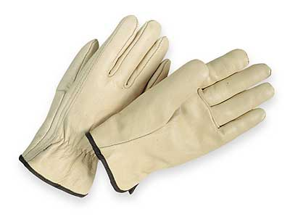
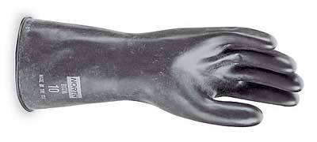
PPE - Gloves
Determine physical resistance properties required
of glove: heat, cut, puncture resistance
Determine size and dexterity requirements
Inspect gloves for pinholes, cuts, tears, etc.
PPT-049-01AP
58
Notes:
PPE – Gloves
Determine physical resistance properties for the glove as well as other characteristics.
Create a procedure for inspecting prior to use and whether gloves are maintained or disposed.
Compatibility charts exist by manufacturers which will furnish chemical resistance information.

Slide 59
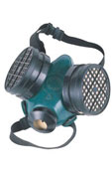
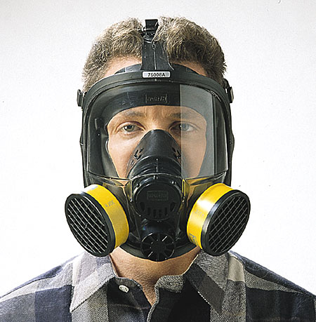
PPE – Respiratory Protection
Respirators may be required if
general ventilation or a fume hood
are not feasible or provide adequate
removal of vapors/fumes
Before wearing must be determined
“medically qualified,” fit-tested, and
appropriately trained
No excessive facial hair to interfere
with seal of facemask
Respirators must be inspected before
each use to ensure in good
condition/safe to use
PPT-049-01AP
59
Notes:
PPE – Respiratory Protection
Respirators may be required if general ventilation or a fume hood are not feasible or provide inadequate vapor/fume removal.
Before wearing must be determined as “medically qualified.” Fit-test and train users.
No excessive facial hair to interfere with seal of facemask. See relevant regulations (29 CFR 1910.134).
Respirators must be inspected before each use to ensure usability.

Slide 60

PPE – Eye Protection
Safety glasses should be worn for protection
against impact of particles
Standard eyeglasses with side shields are usually
not sufficient
Chemical goggles should be worn if potential of
chemical splash exists (may be worn over
prescription glasses)
Contact lenses do not offer protection from
chemical contact
PPT-049-01AP
60
Notes:
PPE – Eye Protection
Safety glasses should be worn for protection against impact of particles. Glasses should have wraparound side shields.
Standard eyeglasses with side shields are usually not sufficient and may require goggles.
Chemical goggles should be worn if potential of chemical splash exists (may be worn over prescription glasses).
Contact lenses do not offer protection from chemical contact.
Always be mindful of use prohibitions.

Slide 61
PPE – Protective Clothing
Where the possibility of contamination exists,
protective clothing that resists physical and
chemical hazards should be worn over street
clothes
Smocks are appropriate for minor chemical
splashes and spills
Plastic or rubber aprons are best for protection
from corrosive or irritating liquids
Hazards: loose clothing such as overlarge smocks
and ties, skimpy clothing such as shorts, torn
clothing or clothing with holes
PPT-049-01AP
61
Notes:
PPE – Protective Clothing
Protective clothing that resists physical and chemical hazards should be worn over street clothes.
Smocks are appropriate for minor chemical splashes and spills.
Plastic or rubber aprons are best for protection from corrosive or irritating liquids.
Loose clothing such as overlarge smocks and ties, skimpy clothing such as shorts, torn clothing or clothing with holes will not serve as a protective ensemble.

Slide 62

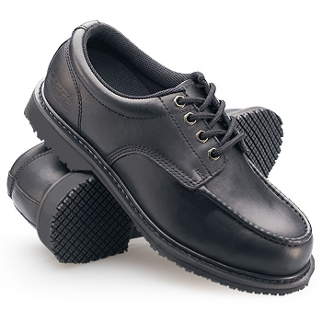

PPE – Additional Considerations
Unrestrained hair can be a hazard depending on
the task being done and equipment used
Perforated shoes, sandals or cloth sneakers
should not be worn when using chemicals or
doing mechanical or cutting work
Which shoe is safer for work?
PPT-049-01AP
62
Notes:
PPE – Additional Considerations
Unrestrained hair can be a hazard depending on the task being done and equipment used. Wear hair restrained or protective hood.
Perforated shoes, sandals or cloth sneakers should not be worn when using chemicals or doing mechanical or cutting work. They provide insufficient protection against
chemical spills or materials which may be dropped.

Slide 63
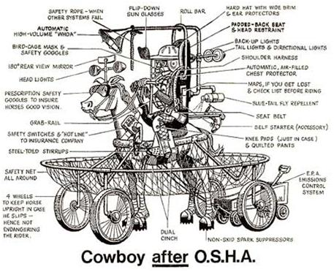
How Some View PPE and Safety!
PPT-049-01AP
63
Notes:
While viewed in the extreme, areas of concern may be singled-out for safety considerations.

Slide 64
Storage Room Safety
Shelving should be anchored to the wall to
prevent it from tipping over
Do not overload shelves
Store heavier items on lower shelves (between
knee and shoulder height)
Do not climb on shelves; use a step ladder or
step stool
Keep aisles clear when people are placing items
on or taking items off of shelves
Don’t stand directly behind someone who is
taking something off of a shelf
PPT-049-01AP
64
Notes:
Storage Room Safety
Anchor shelving to the wall to prevent tipping over.
Do not overload shelves.
Store heavier items on lower shelves (between knee and shoulder height).
Do not climb on shelves; use a step ladder or step stool.
Keep aisles clear when people are placing items on or taking items off of shelves.
Don’t stand directly behind someone who is taking something off of a shelf.
Some storage rooms require a pre-ventilation fan to evacuate vapor/fume build-up. Once ventilated, safe to enter.

Slide 65
Storage Room Safety
Do not store items within 18 inches of sprinkler
heads or smoke and heat detectors
Do not suspend anything from sprinkler heads or
smoke and heat detectors
Do not block or obstruct fire extinguishers, fire
hoses, fire alarm pull boxes or electrical panels
Do not store flammable and combustible liquids
with paper or other combustibles
Do not store supplies on or near heat registers
Do not allow access to storage rooms except by
authorized personnel only
PPT-049-01AP
65
Notes:
Storage Room Safety
Do not store items within 18 inches of sprinkler heads or smoke and heat detectors.
Do not suspend anything from sprinkler heads or smoke and heat detectors.
Do not block or obstruct fire extinguishers, fire hoses, fire alarm pull boxes or electrical panels.
Do not store flammable and combustible liquids near other combustibles.
Do not store supplies on or near heat registers.
Permit access to storage rooms by authorized personnel only.

Slide 66
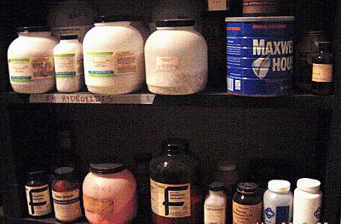
Any Safety Issues?
Coffee can – what’s in it?
No lip on shelf
Incompatible storage?
PPT-049-01AP
66
Notes:
This picture shows some safety issues/concerns regarding chemical storage. Any chemicals should be used and stored appropriately!

Slide 67
Prevention of Carpal Tunnel Syndrome
If you do the same tasks with your hands over
and over, try not to bend, extend or twist your
hands for long periods
Don’t work with your arms too close or too far
from your body
Don’t rest your wrists on hard surfaces for long
periods
Switch hands during work tasks if possible
PPT-049-01AP
67
Notes:
Prevention of Carpal Tunnel Syndrome
If you perform repetitive tasks with your hands, try not to bend, extend or twist your hands for long periods.
Don’t work with your arms too close or too far from your body.
Don’t rest your wrists on hard surfaces for long periods which may restrict circulation.
Switch hands during work tasks if possible.

Slide 68
Prevention of CTS
Take regular breaks from repeated hand
movements to give your hands and wrists time
to rest
Don’t sit or stand in the same position all day
Ensure your chair is adjusted so that your
forearms are level with your keyboard and you
don’t have to flex your wrists to type
PPT-049-01AP
68
Notes:
Prevention of CTS:
Take regular breaks from repeated hand movements to give your hands and wrists time to rest.
Don’t sit or stand in the same position all day.
Ensure your chair is adjusted so that your forearms are level with your keyboard and you don’t have to flex your wrists to type.

Slide 69
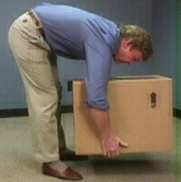
Common Causes of Back Injuries
Heavy lifting from above the
shoulders
Heavy lifting from below the
knees
Twisting while lifting/carrying
Bending over at the waist
Carrying objects to one side
PPT-049-01AP
69
Notes:
Common Causes of Back Injuries:
Heavy lifting from above the shoulders.
Heavy lifting from below the knees.
Twisting while lifting or carrying.
Bending over at the waist.
Carrying objects to one side which impacts the symmetry of your body.

Slide 70
Protecting Your Back
Lifting
Avoid bending at the waist
Squat down with your back
straight and knees bent
Grasp the object
Bring it close to your body
Slowly rise
Let your thigh muscles do the
lifting
PPT-049-01AP
70
Notes:
Protecting Your Back: Lifting
Avoid bending at the waist .
Squat down with your back straight and knees bent.
Grasp the object.
Bring it close to your body.
Slowly rise.
Let your thigh muscles do the lifting.

Slide 71
Protecting your Back
Standing
Shift your weight slightly
Use proper footwear with cushioned insoles
Avoid high heels
Proper posture when standing:
  ▪ Shoulders not rolled forward, stomach area
  pulled in, small of the back straight, hips not
  tilted
PPT-049-01AP
71
Notes:
Protecting Your Back: Standing
Shift your weight slightly
Use proper footwear with cushioned insoles
Avoid high heels
4. Proper posture when standing:
▪ Shoulders not rolled forward, stomach area
pulled in, small of the back straight, hips not
tilted

Slide 72

Protecting your Back
Sitting
Use an adjustable chair
with lower back support
Keep knees in line with the
hip joints or slightly lower
Sit with the lower back
firmly against the chair
back support
Shift elevation of the legs
during prolonged sitting
Avoid crossing your legs
Any ergonomic issues?
If prolonged sitting, back will hurt due to no support.
PPT-049-01AP
72
Notes:
Protecting Your Back: Sitting
Use an adjustable chair with lower back support.
Keep knees in line with the hip joints or slightly lower.
Sit with the lower back firmly against the chair back support.
Shift elevation of the legs during prolonged sitting.
Avoid crossing your legs.

Slide 73

Bottom Line
Follow safety related policies and procedures
Pay attention
Think safety, act safely
Make safety your
number one priority!
PPT-049-01AP
73
Notes:
In summary:
Follow safety related policies and procedures.
Pay attention.
Think safety, act safely.
Make safety your number one priority!
Perform pre-task Job Safety Analysis to determine PPE and other safety needs by area and task.

Slide 74


Contact Information
Health & Safety Training Specialists
1171 South Cameron Street, Room 324
Harrisburg, PA 17104-2501
(717) 772-1635
RA-LI-BWC-PATHS@pa.gov
Like us on Facebook! - https://www.facebook.com/BWCPATHS
PPT-049-01AP
74
Notes:
We invite you to contact us to obtain information on other free training available to your organization.

Slide 75

Questions
PPT-049-01AP
75

