Slide 1
Bureau of Workers’ Compensation
Welcome to Pennsylvania’s
EDI Web-Portal
Training

Slide 2
Bureau of Workers’ Compensation
The Bureau of Workers’ Compensation (BWC) implemented the IAIABC EDI Release 3 Claims Standard for Subsequent Report of Injury (SROI) claim filings on Sept. 9, 2013.

Slide 3
Bureau of Workers’ Compensation
Trading partners have the option of three different methods to submit transactions:
Utilize a Transaction Partner who will send files to the BWC on their behalf
Send files in IAIABC EDI Release 3 format directly to the BWC
Utilize the WCAIS EDI claims Web Portal

Slide 4
Bureau of Workers’ Compensation
The Web Portal has data entry screens to allow trading partners to enter information.
The Data Elements captured through the Web Portal screens correspond to IAIABC EDI Release 3 claims data elements.

Slide 5
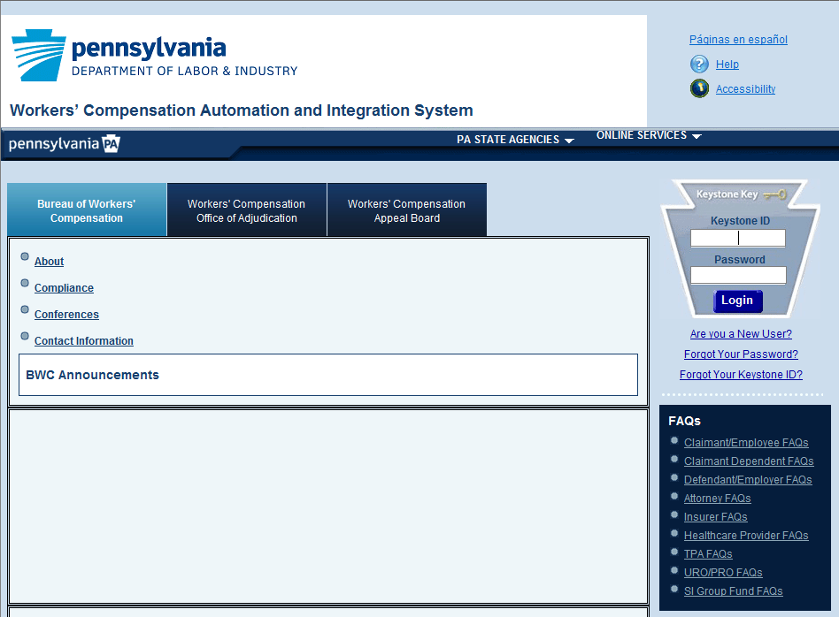
Bureau of Workers’ Compensation
To access the WCAIS web portal
log in using your Keystone ID and password

Slide 6
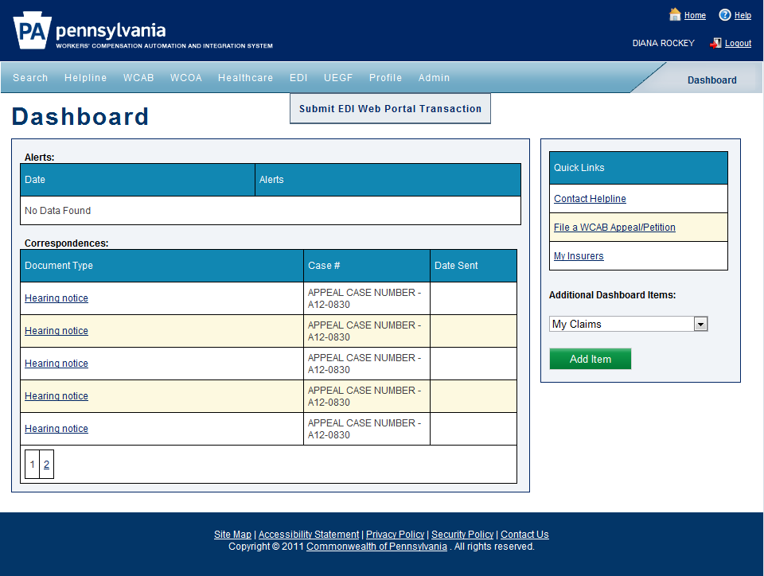
Bureau of Workers’ Compensation
select ‘EDI’ then ‘Submit EDI Web Portal Transaction’

Slide 7
Select a Transaction Type
Select the ‘Maintenance Type Code’
Select the ‘Transaction Type’
Select to ‘Continue’

Slide 8
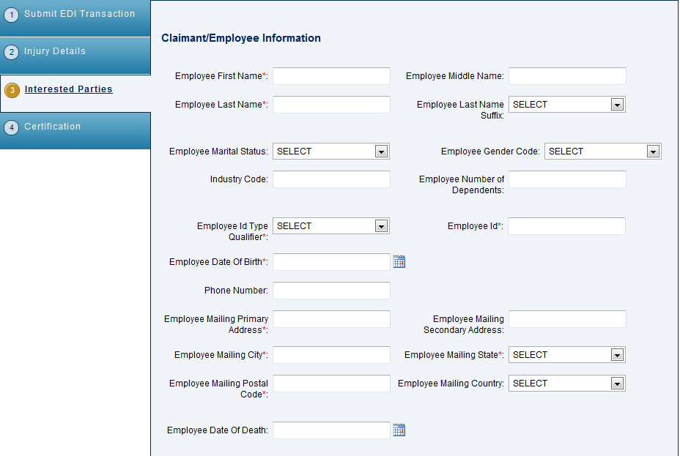
Enter Interested Parties Information
Enter the interested parties information, starting with the claimant/employee information

Slide 9
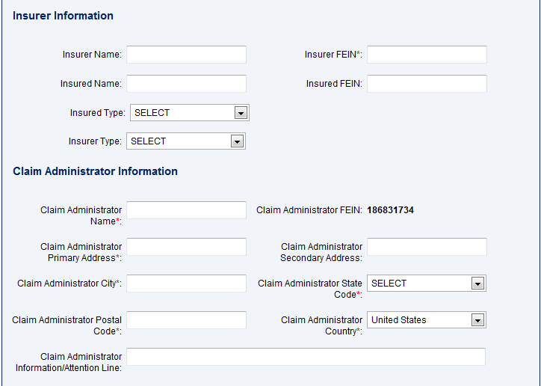
Enter Interested Parties Information
Enter the insurer and claim administrator information

Slide 10
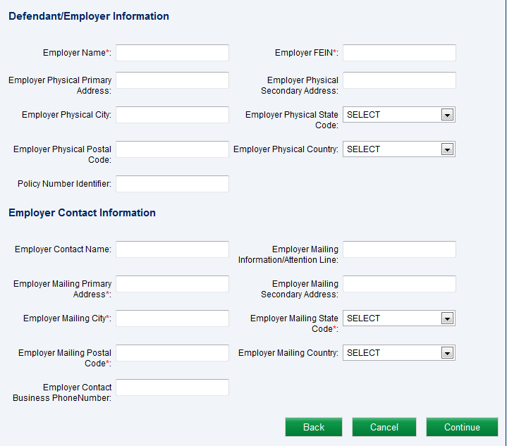
Enter Interested Parties Information
Enter the defendant/employer information
Select the ‘Continue’ button to go on to the next screen

Slide 11
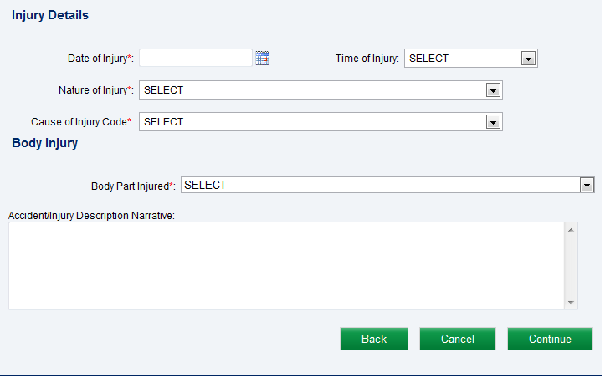
Enter Injury Details Information
Enter injury details
Select ‘Continue’ to go to the next screen

Slide 12
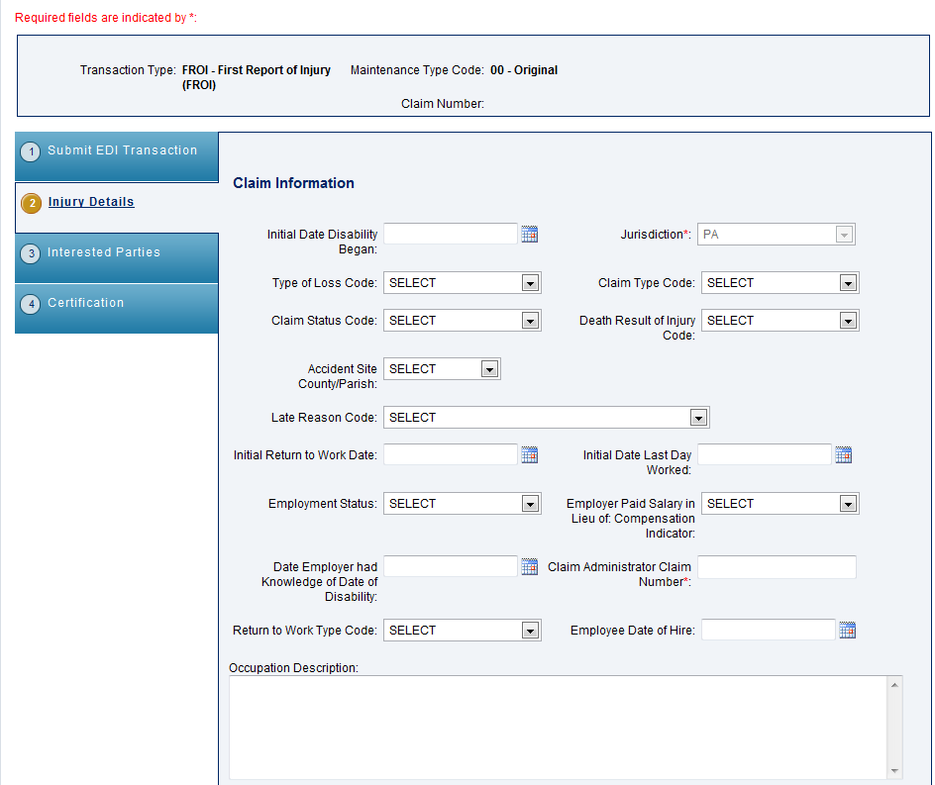
Enter Claim Information
The tabs correspond to the type of information collected on each screen
Data is grouped by category on each screen
Claim Information
For the FROI 00, enter the claim information
Required fields are indicated by a red asterisk

Slide 13
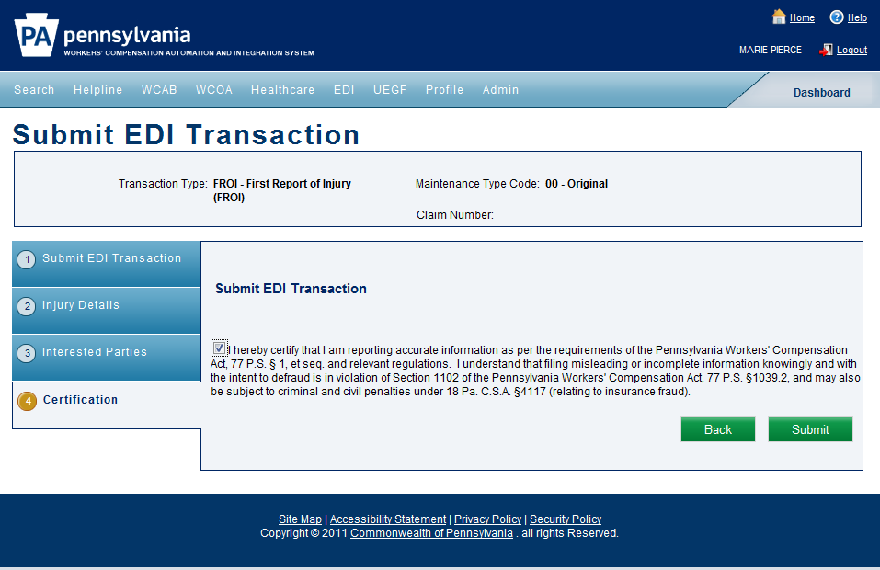
Certification
Certification is confirmed by selecting the checkbox
And selecting the ‘Submit’ button

Slide 14
Confirmation
A confirmation message will confirm your submission and let you know if the transaction was accepted or rejected

Slide 15
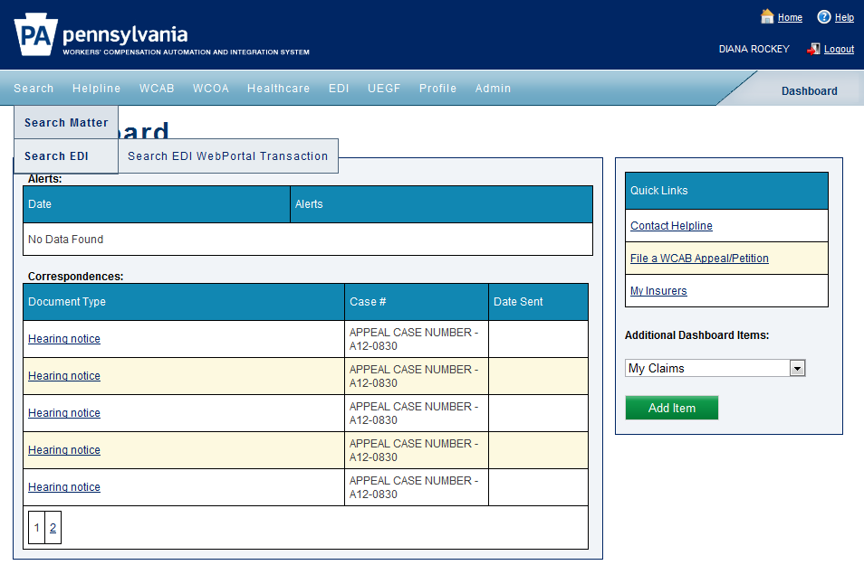
Check EDI Transactions
To check all transactions submitted on the claim, go to your dashboard, select ‘Search’, ‘Search EDI’ then ‘Search EDI Web Portal Transaction’

Slide 16
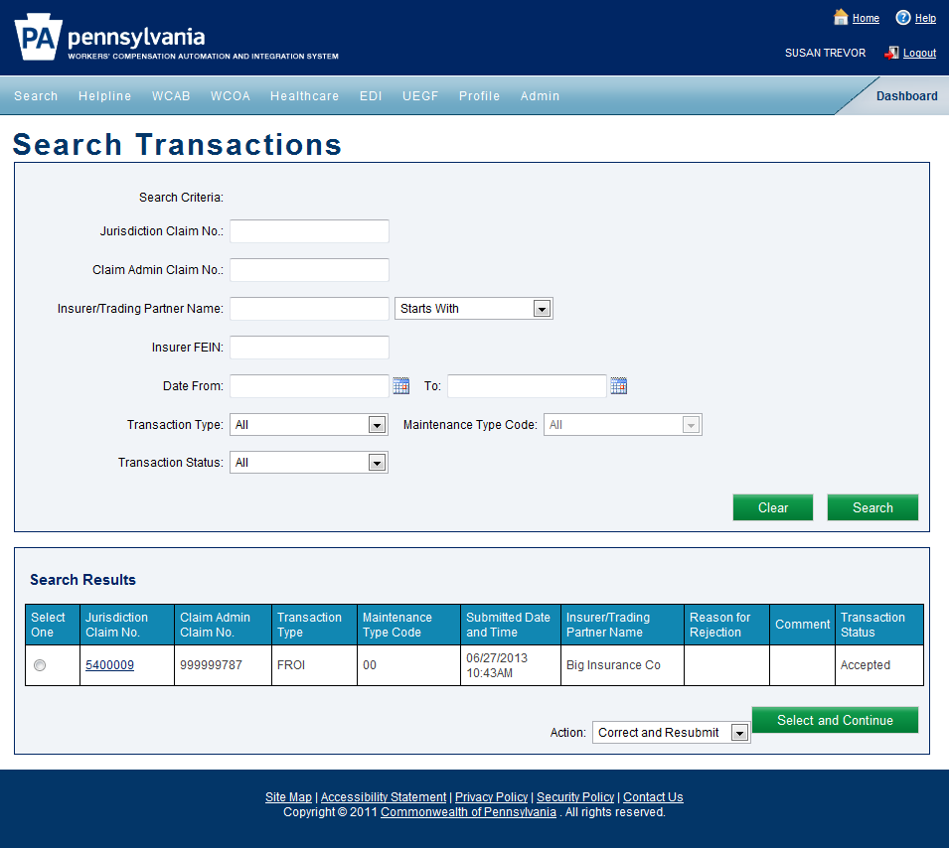
Check EDI Transactions
Transactions can be searched by different criteria
Transaction status is displayed
A subsequent transaction can be initiated from this screen by selecting the claim in the results grid, selecting the ‘Submit Transaction’ from the Action dropdown and by selecting the ‘Select and Continue’ button
Search results will appear in a grid
Jurisdiction claim number is displayed

Slide 17
Obtaining the Jurisdiction Claim Number
All FROI and SROI transactions, excluding the FROI 00 and FROI 04 require the jurisdiction claim number.
This number is provided in the confirmation screen.

Slide 18
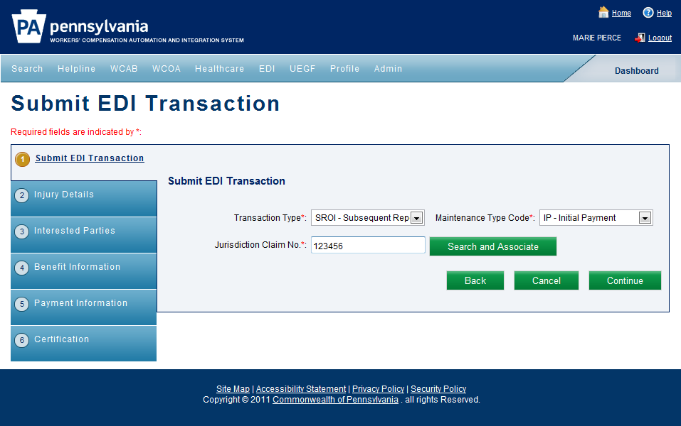
Entering a SROI Transaction
To enter a SROI IP, select SROI from the ‘Transaction Type’ dropdown
Select ‘IP-Initial Payment’
from the maintenance type code
The jurisdiction claim number is now populated or can be typed in
The jurisdiction claim number can also be obtained by selecting the ‘Search and Associate’ button which will take the user to another screen to search for it
Select ‘Continue’ to go to the next screen

Slide 19
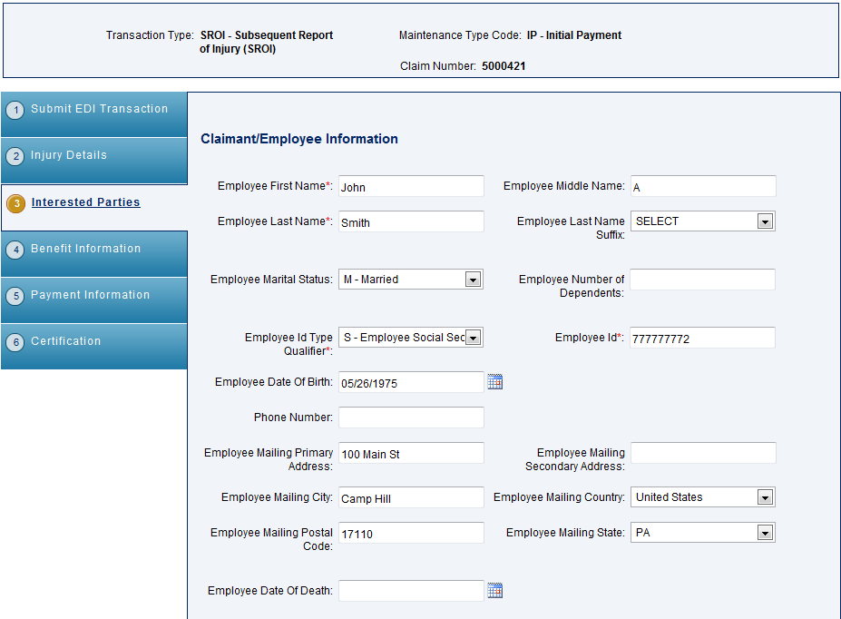
Entering Interested Parties
Interested parties information is pre-populated from previous transactions. Additional fields can be filled in as available.

Slide 20
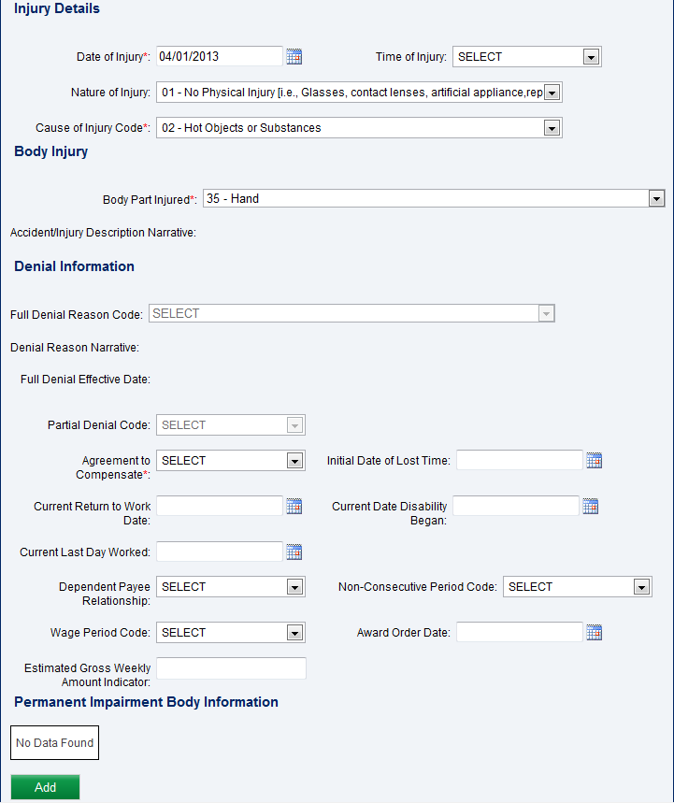
Entering Injury Details
The permanent impairment body information can be entered by selecting the ‘Add’ button

Slide 21
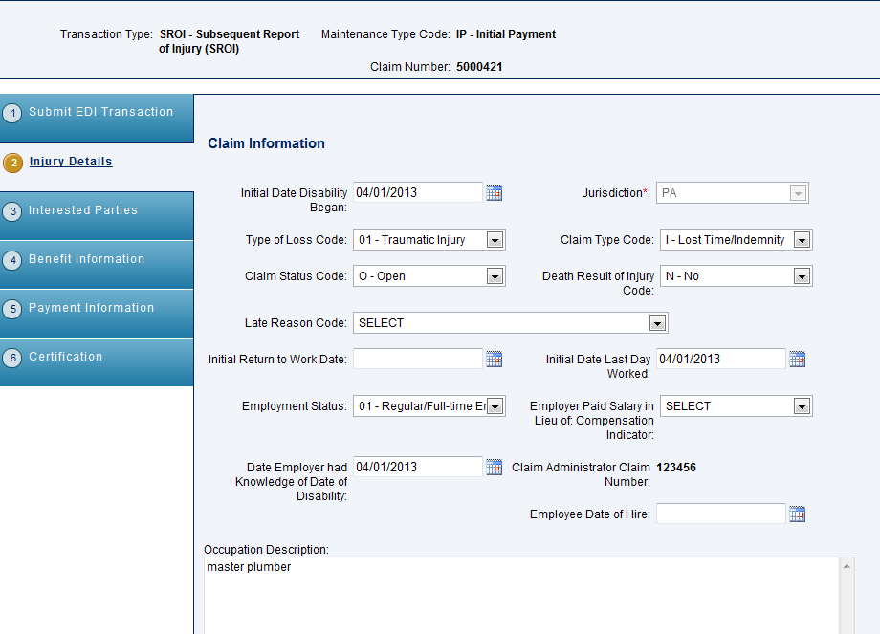
Entering Claim Information
The screen fields will be pre-populated with the information that was made available from the FROI transaction
Claim Information

Slide 22
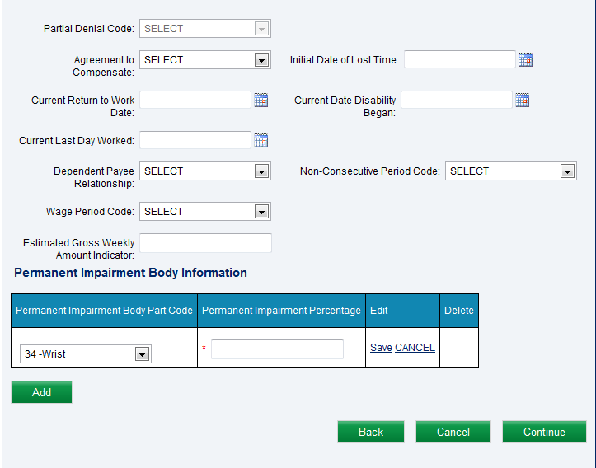
Entering Claim Information Con’t
Selection of the permanent Impairment body part code is made from the dropdowns. The permanent impairment percentage is added as a mandatory field
Selection should be saved by selecting ‘Save’
Select ‘Continue’ to go to the next screen
Additional codes can be added by selecting the ‘Add’ button

Slide 23
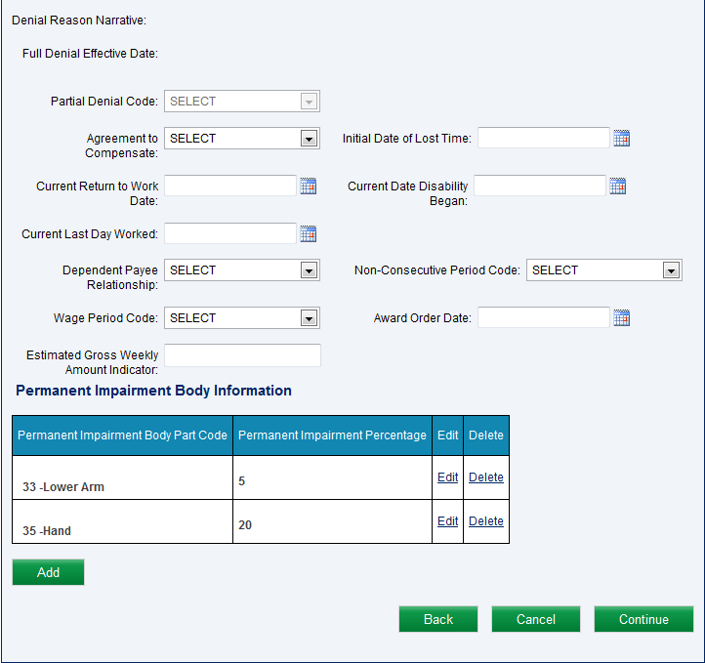
Entering Claim Information Con’t
Selections can be deleted or edited from the grid
Select ‘Continue’ to go to the next screen

Slide 24
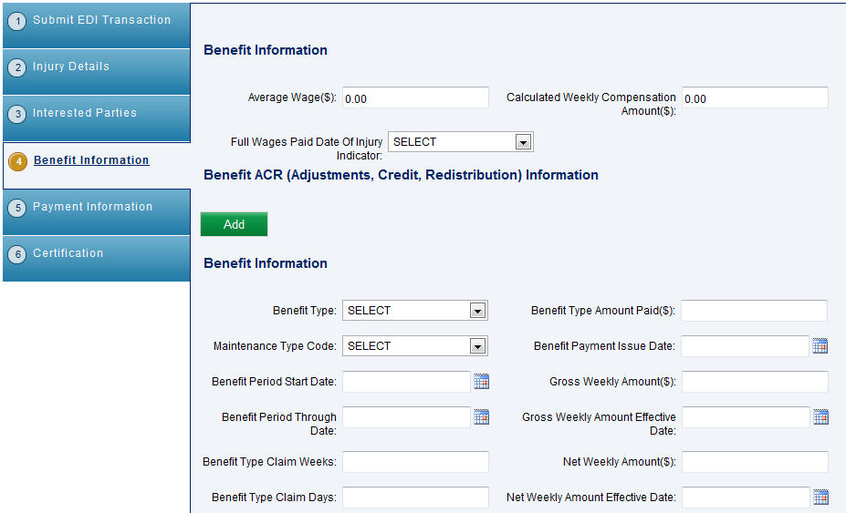
Entering Benefit Information
Benefit information can be entered on the benefit information tab
To add benefit ACR information, select the ‘Add’ button

Slide 25
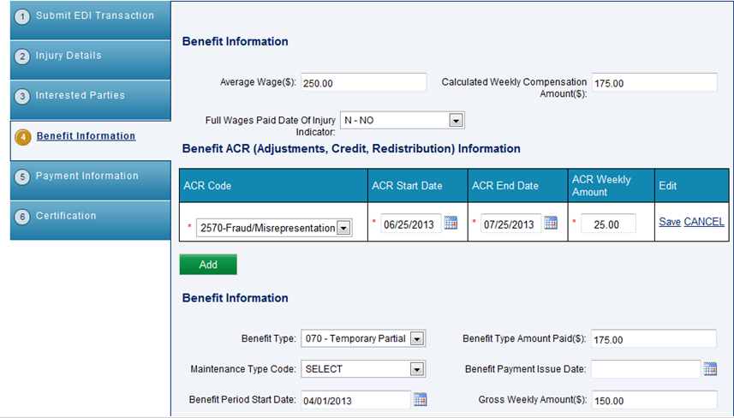
Entering Benefit Information Con’t
This will display a grid where the ACR code information can be entered

Slide 26
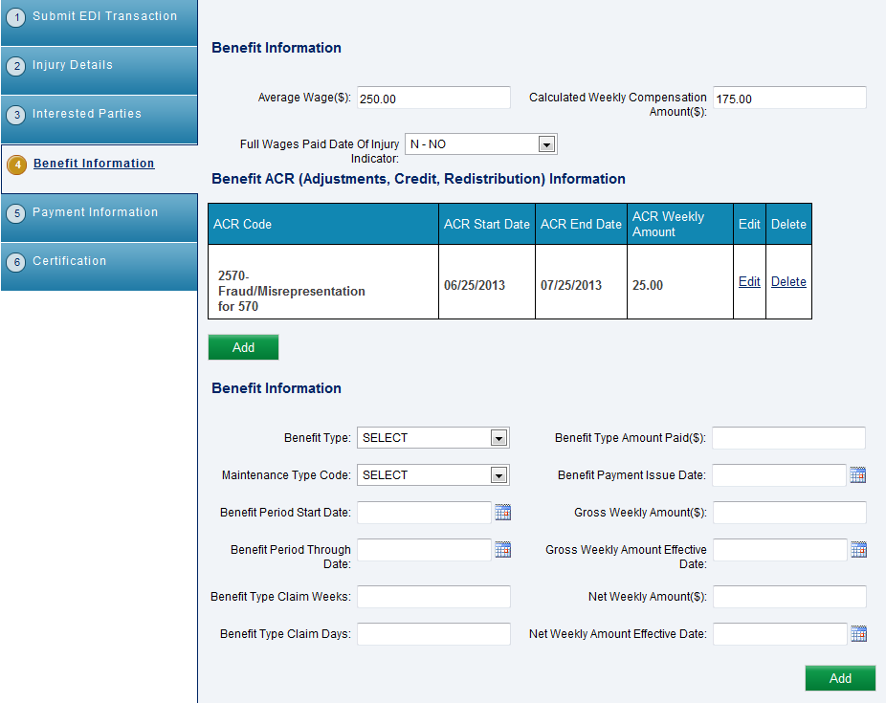
Entering Benefit Information Con’t
Additional benefit information can be entered here
And will be added to a grid by selecting the ‘Add’ button

Slide 27
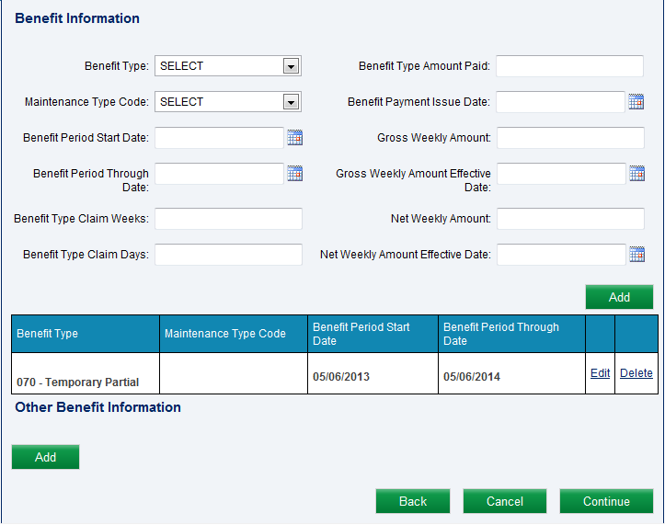
Entering Benefit Information Con’t
To add additional benefit information, select the ‘Add’ button
Benefit information will then appear on a grid
To add other benefit information, select the ‘Add’ button

Slide 28
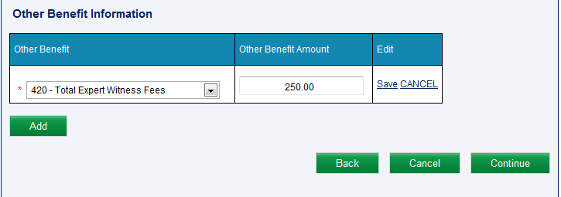
Entering Benefit Information Con’t
Select the other benefit type from the dropdown and enter the other benefit amount
Select ‘Save’ to save your selection in the grid
Select ‘Continue’ to go to the next screen

Slide 29
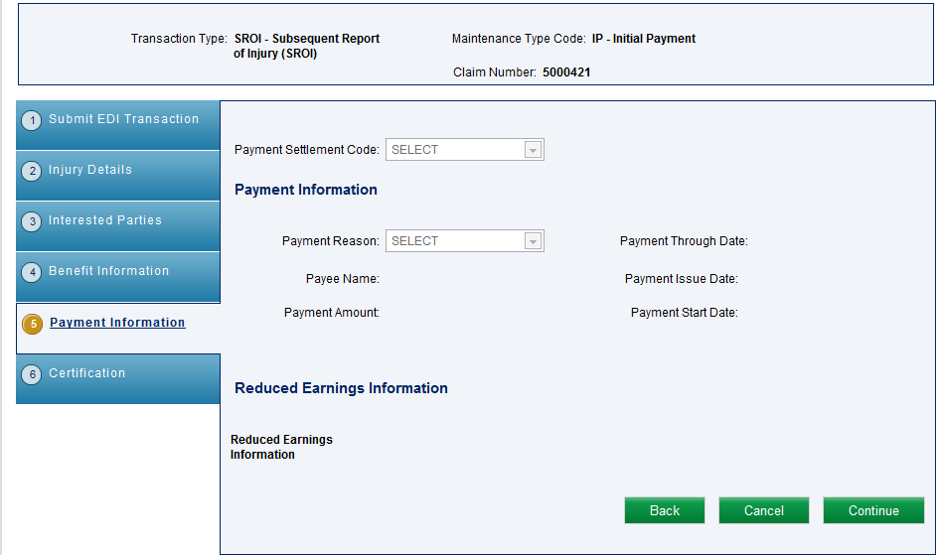
Entering Payment Information
Payment information is available for editing on the payments tab, if applicable to the transaction type. Otherwise, payment information is displayed, if available
Select ‘Continue’ to go to the next screen

Slide 30
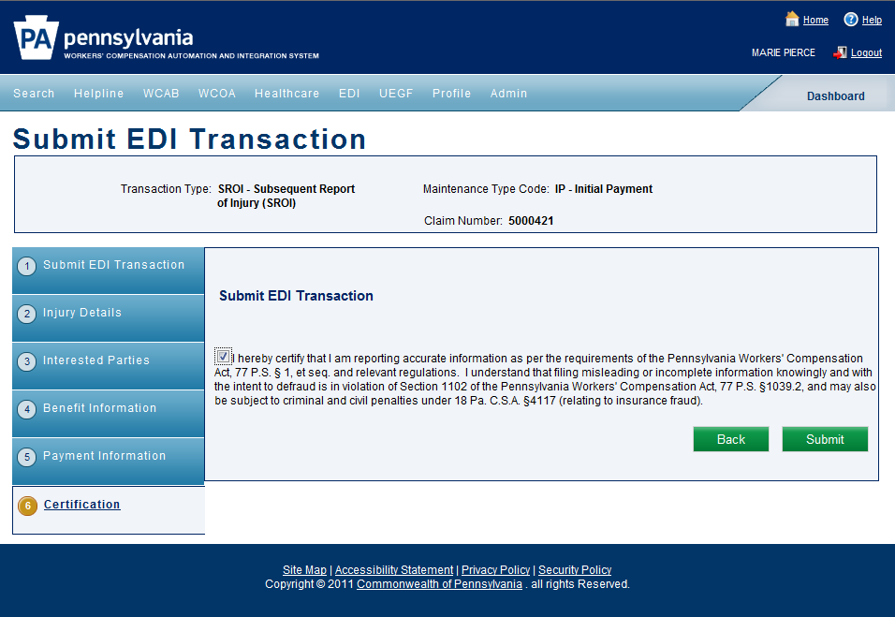
Certification
Certification is confirmed by selecting the checkbox
And selecting the ‘Submit’ button

Slide 31
Questions/Comments
Contact us using the WCAIS Customer Service Center “Submit a Question” feature (category= EDI).

