Slide 1
WSC Regulatory Requirements
Bureau of Workers’ Compensation
PA Training for Health & Safety (PATHS)
PA Workplace Safety Committee Certification Program
Health and Safety Division
PA Bureau of Workers’ Compensation

Slide 2
Agenda
PA WSC Program & Certification Requirements
Review/Audit Process
Provider Qualifications
HandS – Electronic Filing
Resources
Agenda

Slide 3
PA Certified Safety Committee Program
1993 Workers’ Compensation Act Amended Established a 5% Policy Premium Discount for creating and Certifying a Workplace Safety Committee
1996 Amended to provide 5 premium discount periods
2002 Amended to allow unlimited discount periods*
* Assuming that all mandated compliance requirements have been maintained

Slide 4
What are the benefits?
Reduction in the number of incidents
PCRB - 24% – 28% lower claims cost
Improve employee moral
Reduce EMR - Reduce direct cost
Reduce indirect (hidden) cost
Retain experienced/skilled employees

Slide 5
PA Certified Safety Committee Program
How BIG is the Pennsylvania Workplace Safety Committee Program?
Over 11,000 initially certified Workplace Safety Committees
Covers over 1,442,900 Pennsylvania employees

Slide 6
PA Certified Safety Committee Program
Employer cumulative total premium savings Over $578,899,250
Reflects 5% premium savings

Slide 7
PA Certified Safety Committee Program
PA Workers’ Comp Act
Article X
Health and Safety Regulation Mandates

Slide 8
Chapter 129 Subchapter F
§ 129.1001 Purpose
§ 129.1002 Application for initial certification
§ 129.1003 Minimum eligibility requirements
§ 129.1004 Committee formation and membership
§ 129.1005 Committee responsibilities
§ 129.1006 Committee member training
§ 129.1007 Certification
§ 129.1008 Committee renewal
§ 129.1009 Information verification
§ 129.1010 Record keeping requirements
§ 129.1011 Contesting final determinations

Slide 9
§ 129.1001 - Purpose
Subchapter F sets forth the certification criteria for operation of workplace safety committees (WSC) established for the purpose of accident and illness prevention
An applicant employer shall meet the criteria in this subchapter to obtain certification or certification renewal of its WSC’s for its workplaces within this Commonwealth

Slide 10
§ 129.1002 - Application for Initial Certification
An application shall be filed for each legal entity of the applicant-employer
Each application shall incorporate all of the applicable applicant workplaces within this Commonwealth
Initial applications shall be submitted to the Bureau between 90 and 30 calendar days prior to the renewal of a WC policy, self-insurance renewal year or a group self-insurance fund year

Slide 11
§ 129.1003 – Minimum Eligibility Requirements
Applicant-employer’s committees shall be located within this Commonwealth
Pre-Certification Period
Be in existence and operating according
to the regulatory requirements for six (6)
full consecutive months prior to signing,
dating, and submitting application
All committee mandates apply during the 6 month
pre-certification period

Slide 12
§ 129.1003 – Minimum Eligibility Requirements
Reasonably represent all primary operations of the workplace
Minimum committee membership:
Two (2) employer-representatives
Two (2) employee-representatives
In no case will the number of employer representatives exceed the number of employee representatives

Slide 13
§ 129.1003 – Minimum Eligibility Requirements
Employer – Authority to do one or more of the following:
Select or hire an employee
Remove or terminate an employee
Direct the manner of employee performance
Control the employee
Employee – Does not possess any authority or responsibility described for the Employer
A person cannot function as both

Slide 14
§ 129.1004 – Committee Formation & Membership
(b) Committee Formation
Single - One workplace, one committee
Centralized – More than one workplace
One “Centralized” committee with representation for each outlying workplace location
Multiple - More than one workplace
The number of committees is exactly equal to the number of PA workplaces

Slide 15
§ 129.1004 – Committee Formation & Membership
Committee shall be composed of at least an equal number of employee and employer representatives unless mutually agreed upon by both parties.
The number of employer representatives will not exceed the number of employee representatives.
When a majority of employer representatives exist;
Provide written explanation to the Bureau
Explanation signed by one employee and one employer representative

Slide 16
§ 129.1004 – Committee Formation & Membership
Establish procedures that retain a core group of experienced members at all times
Employee reps shall:
Be permitted to take reasonable time from work to perform committee duties without loss of pay or benefits
2. Join the committee for a continuous term of 1 year. Records of committee rotation shall be maintained by the applicant–employer for 5 years from date of Bureau’s receipt of application

Slide 17
§ 129.1005 – Committee Responsibilities
Responsibilities include:
Represent accident and illness prevention concerns of employees at every applicant-employer workplace
Definitions
Workplace – A permanent location in this Commonwealth of the applicant employer at which full-time or permanent part-time workers perform their job duties or from which job assignments are made and administrative controls are exercised
Worksite - A temporary location at which full-time or permanent part-time workers perform their job duties for a limited period of time

Slide 18
§ 129.1005 – Committee Responsibilities
Responsibilities (continued):
Review employers hazard detection and accident & illness prevention programs and formulate written proposals
Establish procedures for periodic workplace inspections *Document inspections in writing with locations and identity of hazards
*Make proposals for corrective action
Conduct reviews of work related incidents resulting in deaths, injuries and illnesses, and health and safety concerns from committee members and employees

Slide 19
§ 129.1005 – Committee Responsibilities
Responsibilities (continued):
Conduct follow-up evaluations of newly implemented health and safety equipment or health and safety procedures to assess their effectiveness
Establish a system to allow the committee members to obtain safety related proposals, reports of hazards, or other information directly from persons involved in the operation of the workplace
Suggestion Box
Email
A quorum of committee member shall meet a least monthly

Slide 20
§ 129.1005 – Committee Responsibilities
(c) The committee shall additionally:
(1) Develop operating procedures (rules, by-laws)
(2) Develop and maintain membership lists
(3) Develop an agenda for each meeting
(4) Maintain meeting attendance lists
(5) Take and maintain minutes for each meeting
Post or make minutes available for all employees
Send to each committee member

Slide 21
§ 129.1005 – Committee Responsibilities
The committee shall additionally: (cont’d)
Ensure that the reports, evaluations, and proposals of the committees become part of the minutes of the meeting and shall include:
(i) Inspection reports
(ii) Reports on specific hazards and corrective measures taken
(iii) Reports on workplace injuries or illnesses
(iv) Management responses to committee reports
Make decisions by majority vote

Slide 22
§ 129.1006 – Committee Member Training
The employer shall, through itself or through its insurer, provide adequate, annual training programs for each committee member listed in the application.
Annually required committee member training shall at a minimum address:
Hazard detection and inspection
Accident and illness prevention and investigation
(includes substance abuse awareness and prevention training)
Safety committee structure and operation
Other health and concerns specific to the business of the employer

Slide 23
§ 129.1006 – Committee Member Training
All committee members shall receive training in topics listed in subsection (b) prior to submitting an application and annually thereafter.
Committee members shall be trained by individuals who:
Meet Bureau accident and illness prevention service provider qualifications or..
Who have been recognized by the Bureau as qualified trainers
Employers are responsible for providing verification of trainer qualifications to the Bureau and if necessary, supporting documentation

Slide 24
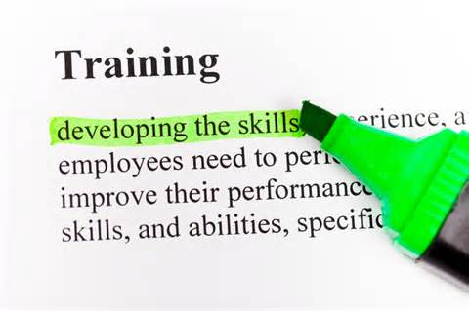
§ 129.1006 – Committee Member Training
Employer shall maintain written records of safety committee training including:
Names of committee members trained
Dates of training
Training time period
Training methodology
Names & credentials of personnel conducting the training
Names of training organizations sponsoring training, if applicable
Training location
Training topics

Slide 25
§ 129.1007 – Certification
If all requirements have been met, a certification approval letter will be sent to the employer.
By signing acknowledgements and agreements page of application, employer agrees to operate safety committee according to initial certification requirements
Employer may not disband committee except for valid business reasons

Slide 26
§ 129.1007 – Certification
The insured applicant employer submits a copy of the letter of certification to its insurer to receive the 5% reduction of its WC premium
Reduction effective upon the commencement of the policy renewal period following the date of the Bureau certification
The Bureau notifies the PCRB of all approved insured applicant-employers

Slide 27
§ 129.1007 – Certification
If application is disapproved, employer will receive written notification listing the specific disapproval reasons.
Employer may resubmit a corrected application for reconsideration prior to the renewal of its WC policy
The employer may challenge the disapproval determination under Subchapter G relating to hearings

Slide 28
§ 129.1008 – Certification Renewal
Note: The renewal affidavit is no longer in use
Electronic and hard copy renewals shall be submitted between 90 and 15 calendar days prior to the annual renewal of the WC policy
If applicant-employer has established additional safety committees not previously certified, application shall be completed before certification renewal may be granted.
Note: applies to multiple committee structure only!

Slide 29
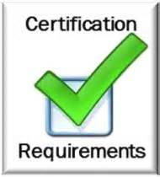
§ 129.1008 – Certification Renewal
If Bureau determines employer has met certification requirements, a letter of certification renewal will be sent to the employer.
The insured applicant employer submits a copy of the letter of certification to its insurer to receive the 5% reduction of its WC premium
The Bureau notifies the PCRB of all approved insured applicant-employers

Slide 30
§ 129.1008 – Certification Renewal
If renewal application is disapproved, employer will receive written notification listing the specific disapproval reasons.
Employer may resubmit a corrected application for reconsideration prior to the renewal of its WC policy
The employer may challenge the disapproval determination under Subchapter G relating to hearings

Slide 31
§ 129.1011 – Contesting Final Determinations
An applicant-employer may contest a final
application determination under Subchapter G
(relating to hearings)

Slide 32
Subchapter G. Hearings
§ 129.1302 Request for a hearing
Written request to BWC Director within 30 days of the date of determination
§ 129.1303 Hearing process

Slide 33
Frequently Asked Questions
“Is there a filing deadline grace period ? “
NO!!
Recommend reminders
such as:
MS Outlook
Tickler File
Calendar

Slide 34
Frequently Asked Questions
“ Can the required annual training count as a monthly meeting?”
YES!!
As long as you provide:
An agenda
Document attendance
Training is documented in the meeting minutes

Slide 35
Additional FAQ’s
www.dli.state.pa.us
At the center of the Page click “Workers’ Compensation”
On the left hand blue bar click “Health & Safety Division”
On the left hand blue bar click “HandS System”
At the center of the page click “Workplace Safety Committee Certification Program FAQs”

Slide 36
Audit Overview
Purpose: To ensure committees receiving the 5% safety credit from their insurers are meeting all compliance requirements
Random / Target Audits
30 day notification
Opening conference
Table top “On-site” audit
Information verification
Closing conference
Issue Compliance / Non-compliance Rating
Non-Compliance issues explained

Slide 37
Audit & Recordkeeping
§ 129.1009 - Information Verification (audit)
Bureau may verify information submitted by the applicant including pertinent supporting information
§ 129.1010 - Recordkeeping requirements
Copies of required documents relating to committee member responsibilities
and committee member training shall be retained for 5 years

Slide 38
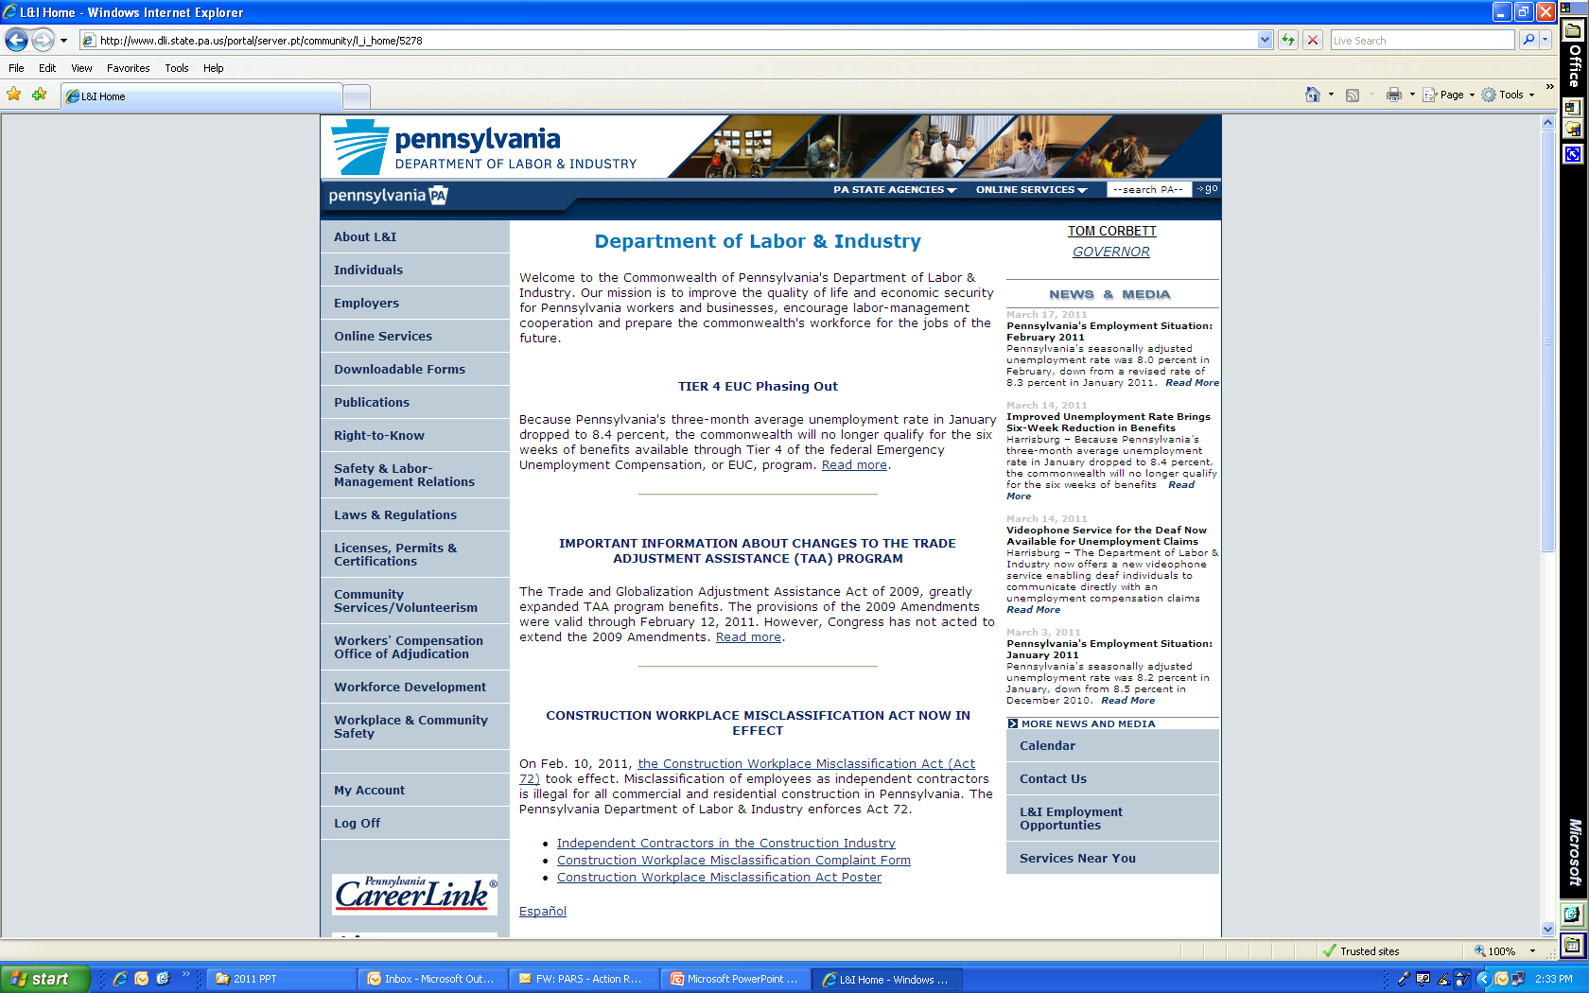
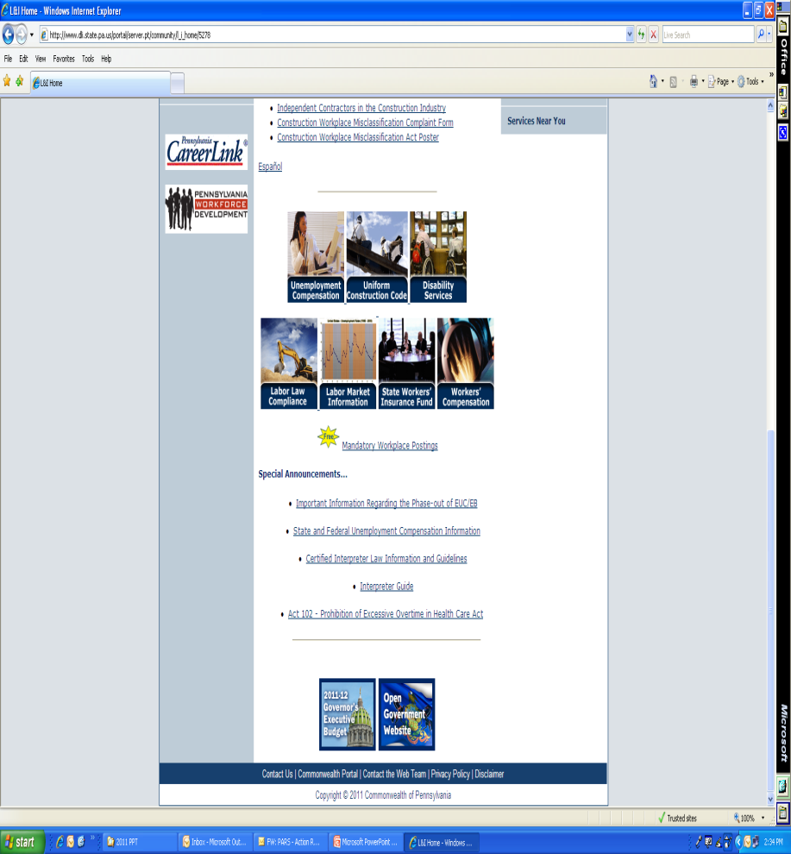
Provider Qualifications
www.dli.state.pa.us
WC icon

Slide 39
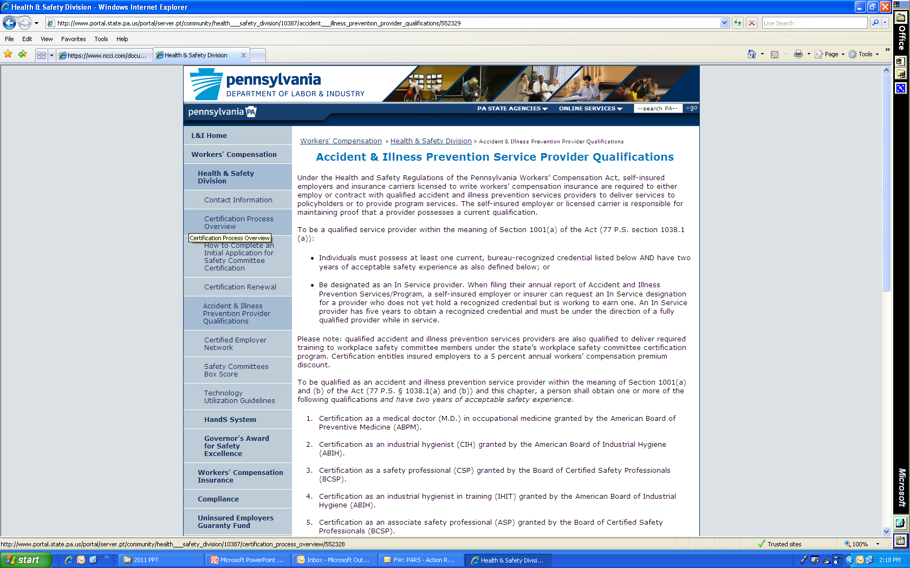
Provider Qualifications
* Click on “Health & Safety Division”
* Click on “Accident & Illness Provider Qualifications”

Slide 40
Provider Qualifications
Subchapter B
Insurer’s Accident & Illness Prevention Services
129.102 (ii) (D) Service Requirements
Accident and illness prevention training programs which may include training for safety committee members as outlined under Subchapter F (relating to workplace safety committees)

Slide 41
Provider Qualifications
Subchapter B
Insurer’s Accident & Illness Prevention Services
129.104 Insurers accident and illness prevention services providers requirements
Accident and illness prevention services providers employed by or contracted with an insurer to perform accident and illness prevention services shall meet the requirements specified in Subchapter E (relating to accident and illness prevention services providers requirements)
The Bureau may require that the insurer provide documentation or evidence to support that the requirements for accident and illness prevention services providers have been met by each individual providing services

Slide 42
Provider Qualifications
Subchapter E
Accident & Illness Prevention Services Providers Requirements
129.702 (a) Requirement to employ or contract individuals who meet the requirements to provide accident and illness prevention services
(b) Requirement to supply annual proof of credential

Slide 43
Provider Qualifications
129.1006 Committee member training
The applicant employer shall maintain written records of safety committee training including:
The names and credentials of personnel conduction the training

Slide 44
HandS
Health and Safety Division’s
online processing system

Slide 45
How will I benefit by using HandS?
Convenient and user friendly
Eliminates mailing delays associated with paper forms
Enables employers to file initial and renewal Certification forms electronically
Allows for the electronic exchange of information which results in:
Quicker determinations
Higher approval rates

Slide 46
HandS
How do I get started?

Slide 47
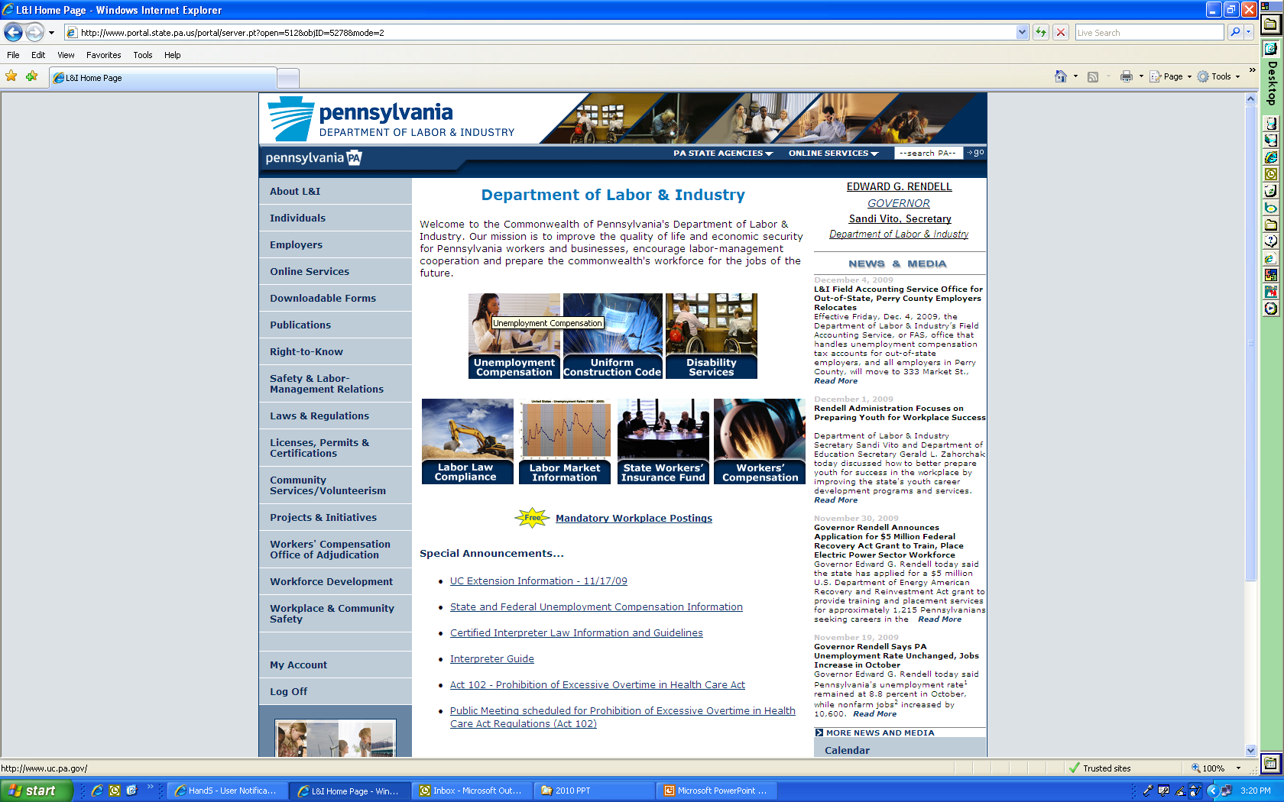
HandS
Go to directly there
www.dli.state.pa.us/hands
or
www.dli.state.pa.us &
Click “Workers’ Compensation”

Slide 48
HandS
Click
“Health & Safety
Division”
Then
Click on “HandS
System”

Slide 49
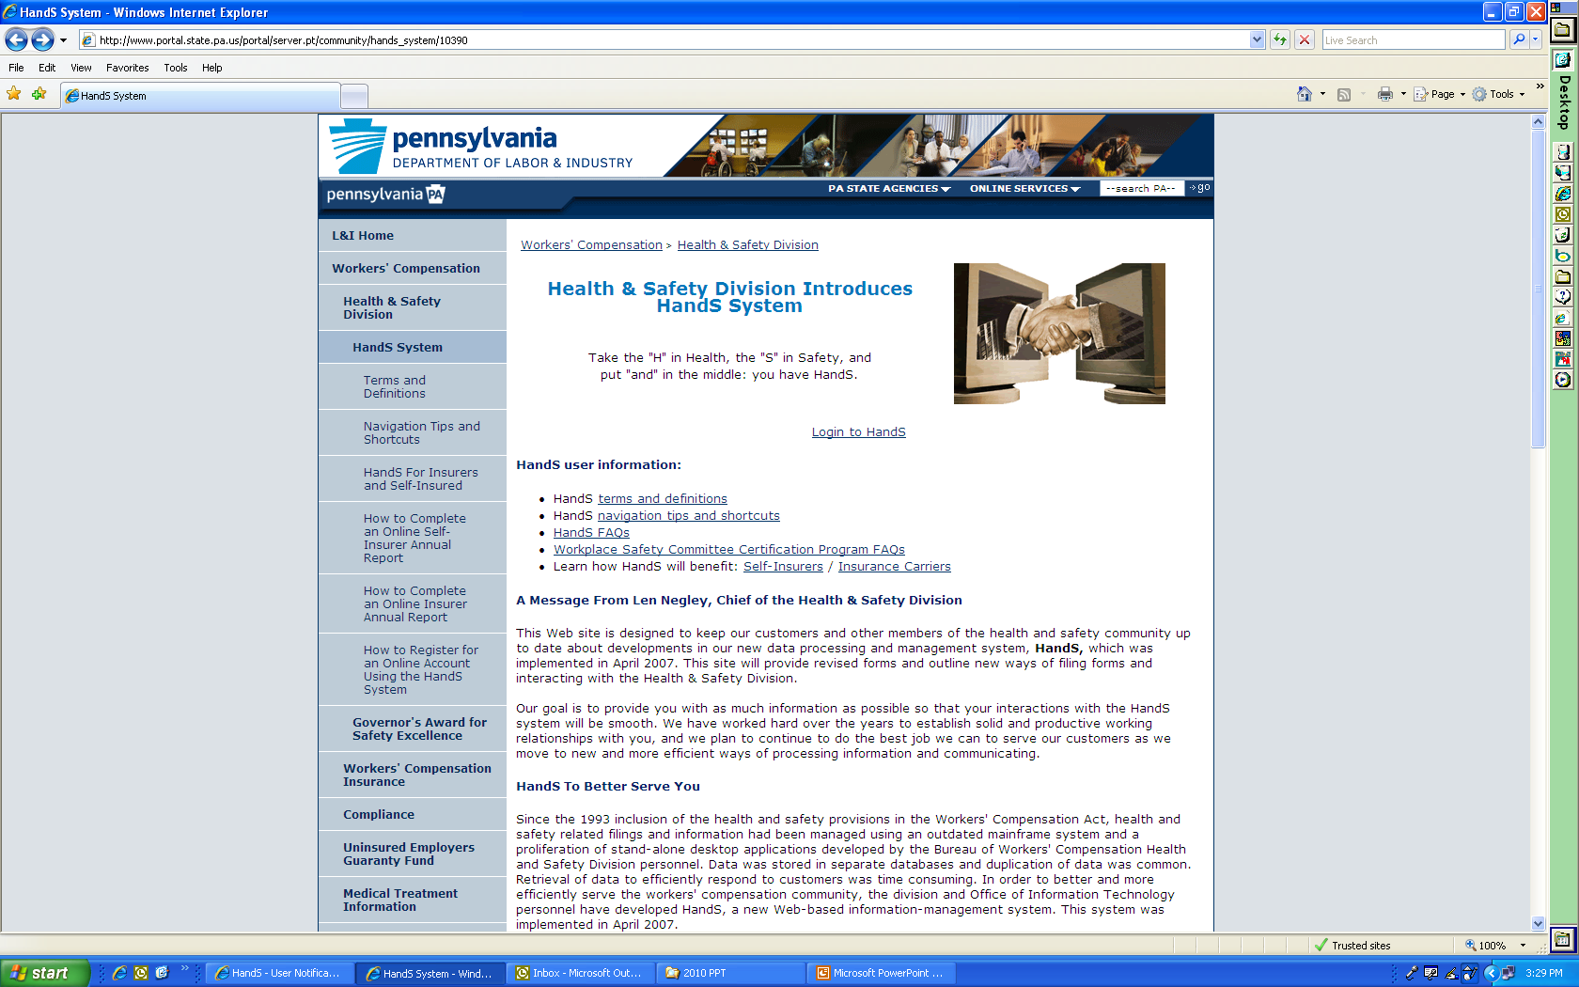
HandS
Click “Login to HandS”
Direct link to this page is:
www.dli.state.pa.us/hands

Slide 50
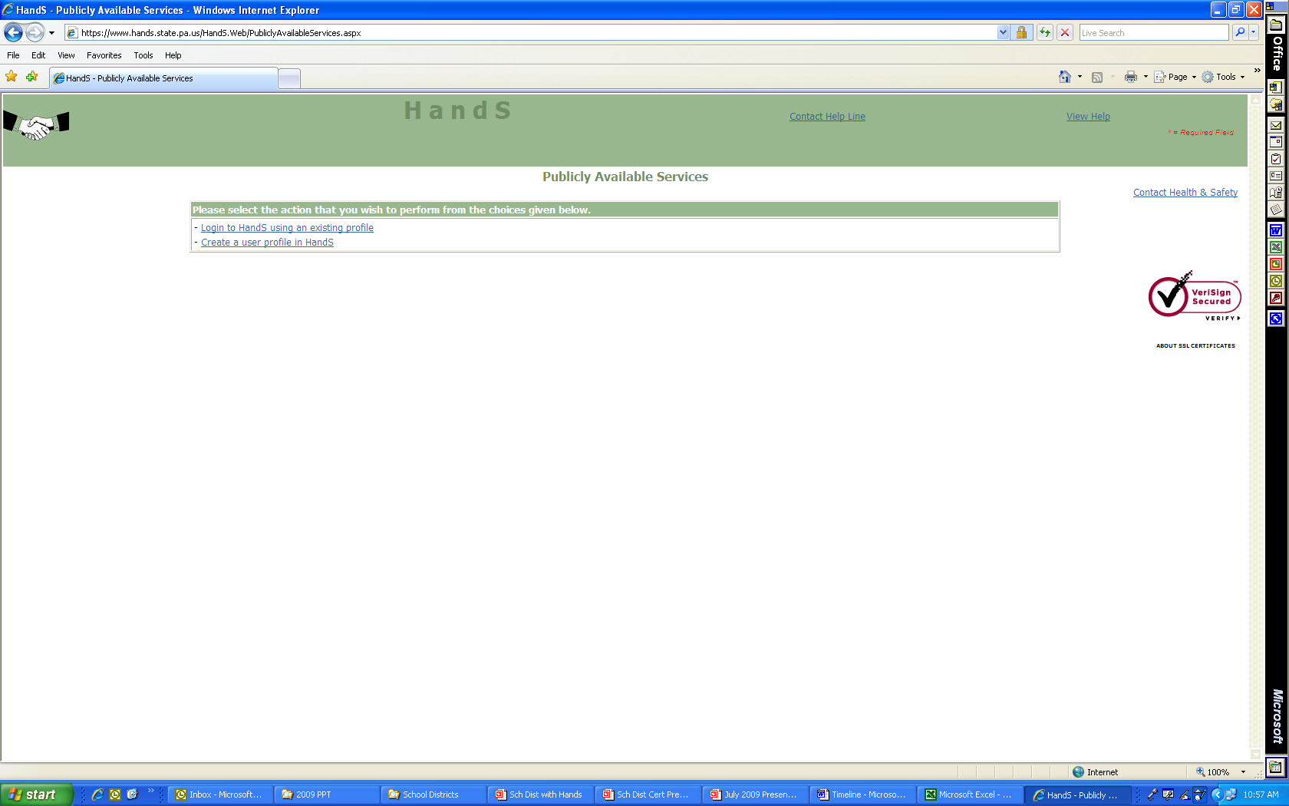
Log in or Create a User Profile
Login with an existing
Profile
OR
Click “Create a user profile in HandS”

Slide 51
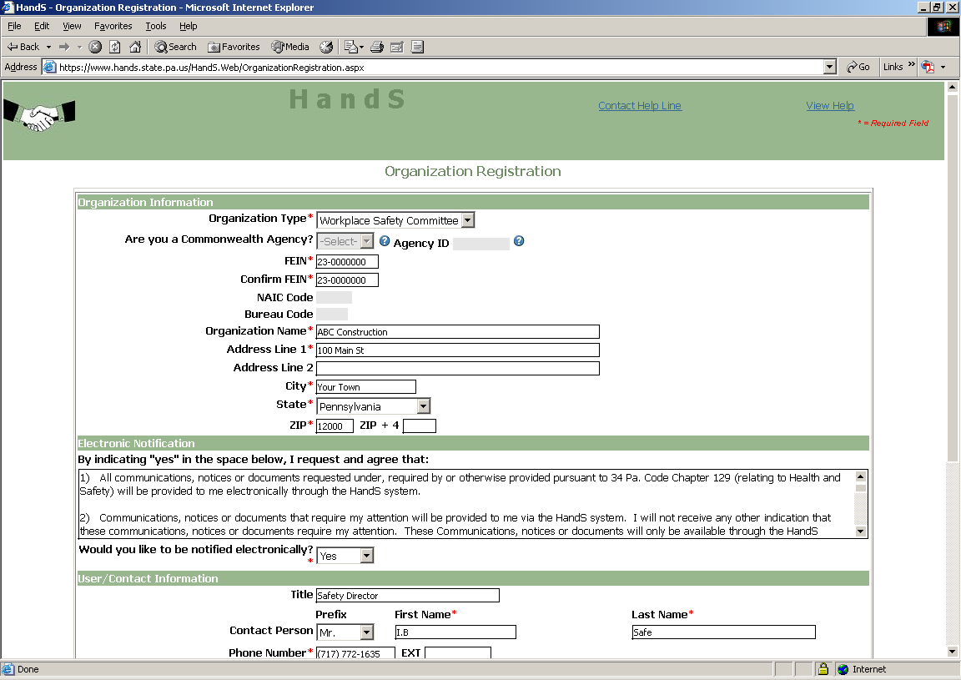
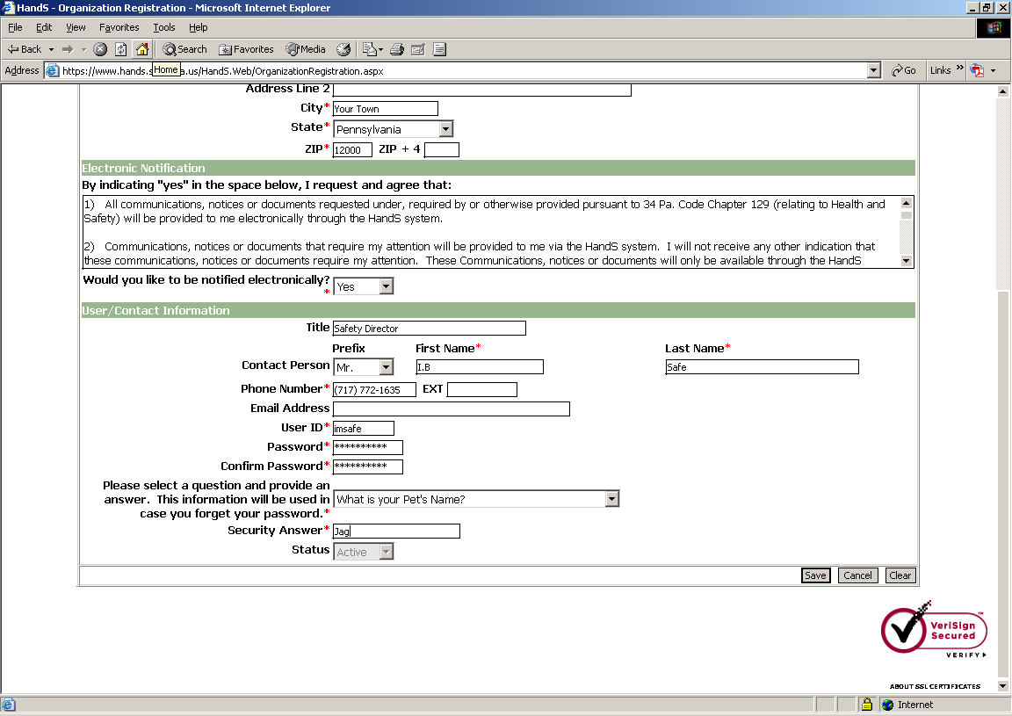
HandS
Click “save”

Slide 52
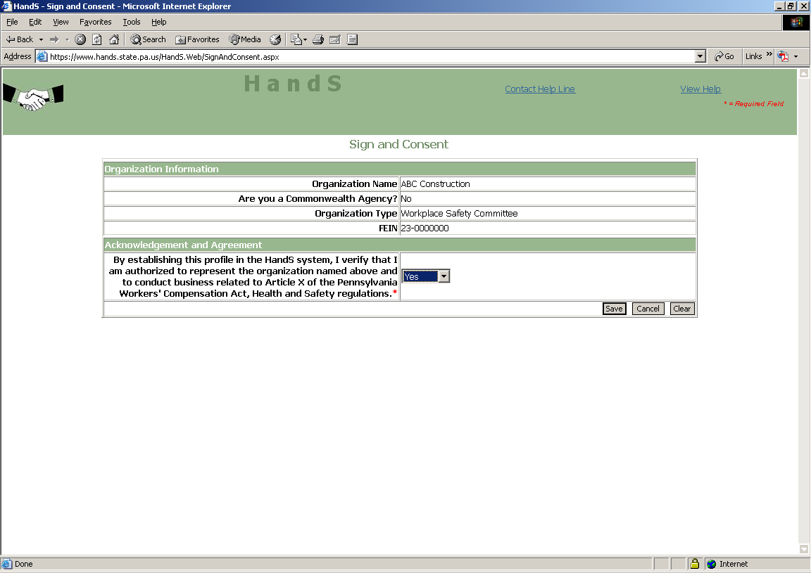
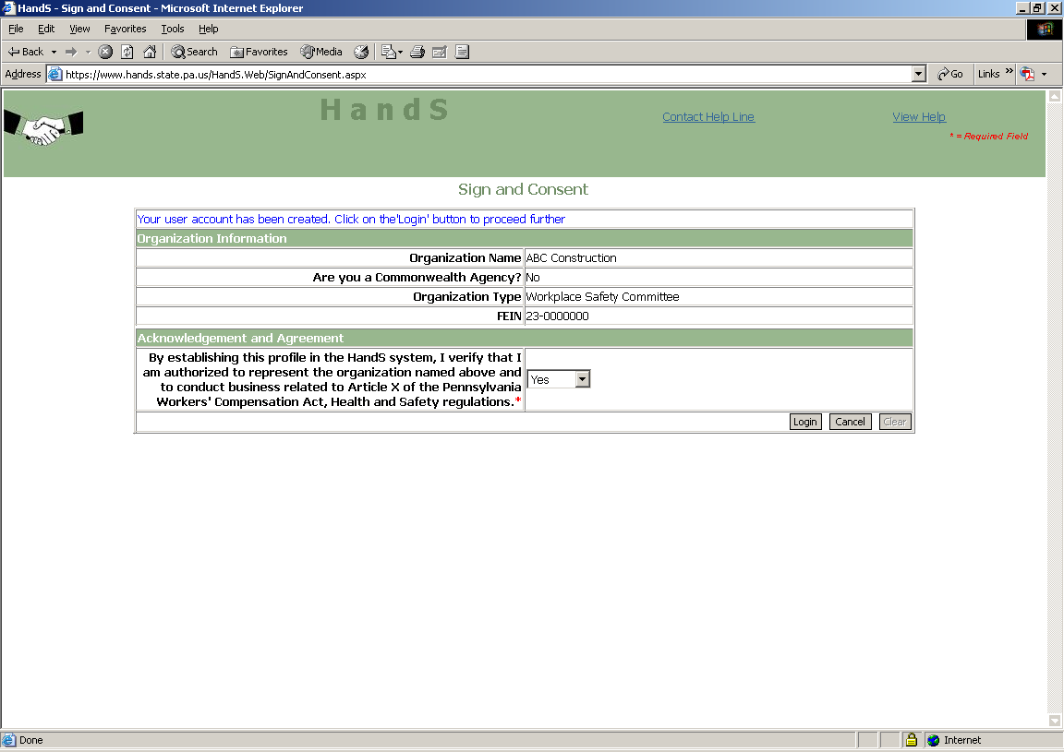
HandS
Select “Yes”
Acknowledgement that account has been created.
Click “save”
Click “Login”

Slide 53
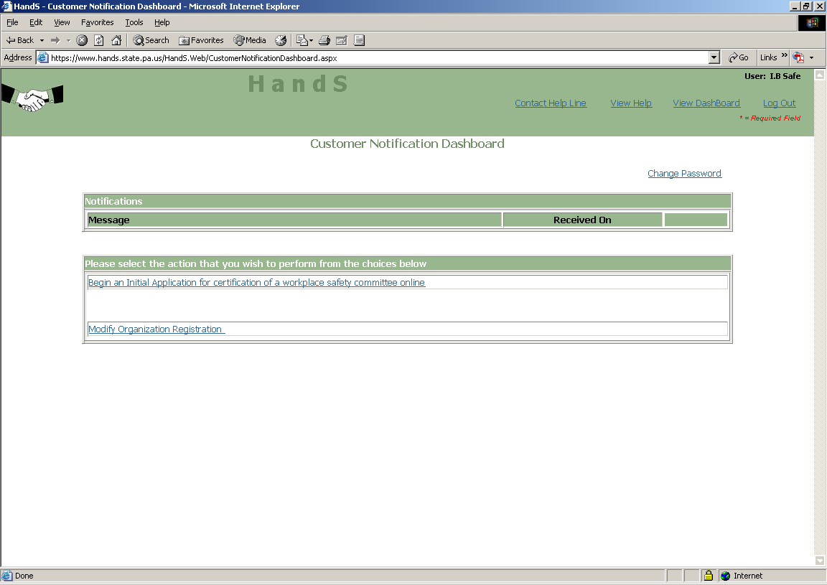
Initial Application
You have two choices.
Log out now and log on later to continue
or
2. Continue now, and Select
“Begin an initial
application”

Slide 54
Notification
Log onto your account periodically if you selected to be notified electronically.
Once your application is approved, your letter to present to your insurance carrier will be mailed along with your certificate.
Notification !!

Slide 55
Technical Assistance Manual
www.dli.state.pa.us
Click on “Workers’ Compensation” icon
Click on “Health & Safety Division
Click on “HandS” System
Click on “Workplace Safety Committee Technical Assistance Manual”

Slide 56
Technical Assistance Manual
Section 1
Overview of WSC
Section 2
How to Develop a WSC
Section 3
How to apply using HandS
Section 4
Reference Materials / Templates

Slide 57
PATHS
To Access PATHS
www.dli.state.pa.us/PATHS
or
www.dli.state.pa.us
“Workers Compensation” icon
Health & Safety Division
PATHS

Slide 58
PATHS
At the PATHS Website you can:
View Health & Safety Training PowerPoint briefings.
Access Safety Talks (Toolbox Talks)
Access Safety Posters
Access Safety Videos
Access Safety Forms
Register to participate in webinars and training sessions
View 15-20 minute recorded webinars

Slide 59
Resources
Go to:
www.dli.state.pa.us
At center of Page click “Workers’ Compensation”
On left hand blue bar click “Health & Safety Division”
Health & Safety contact information
Certification process overview
“HandS” online filing information
Safety Committee Technical Assistance Manual
FAQs
Training Calendar

Slide 60
Contact Information
Health & Safety Training Specialists
1171 South Cameron Street, Room 324
Harrisburg, PA 17104-2501
(717) 772-1635
RA-LI-BWC-PATHS@pa.gov
Like us on Facebook! - https://www.facebook.com/BWCPATHS

Slide 61
Questions?

