Slide 1
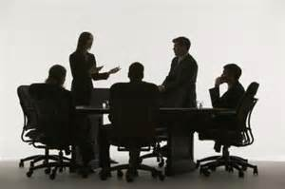
Workplace Safety Committee Leadership
Bureau of Workers’ Compensation
PA Training for Health & Safety (PATHS)
Notes:
Safety leadership entails how to get things done and influence people.

Slide 2
Objectives
Recognize and resolve potential areas of conflict
Assume a leadership role in Committee Activities
Delegation and coaching of Committee Members
Understand People, Process and Problems
Understand the role of the Committee Chairperson
Notes:
This program will address each of the topics listed.

Slide 3
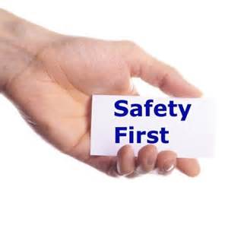
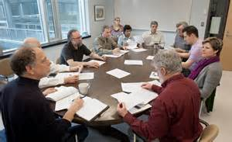
Safety Committees
Foundation for a functioning Safety Program
Provides a non-adversarial forum for discussing Safety & Health issues
Notes:
Safety committees focus everyone’s attention on safety and provide a key channel for communication about safety issues between employees and management.

Slide 4
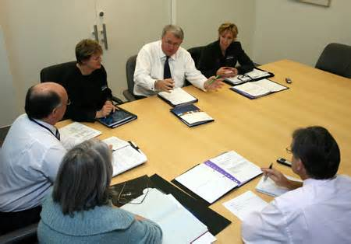
Question
What do you feel is the primary purpose of your safety committee?
Notes:
The main objective of a workplace safety committee is to create a communication process to change behavior.
Effective communication can create an environment where employees have an emotional commitment to the organization and its goals.
Typically, the objective of safety communication/message is to get employees to stop something (unsafe acts) and start something (following policies and procedures).

Slide 5
Leadership Qualities
Empathy – trying to understand other people’s perspectives but decide for the common good of all involved.
Passion for Work – looking for ways to improve yourself, the Committee or the situation.
Optimism/Enthusiasm – remaining positive and persistent in the face of setbacks and failures.
Notes:
Qualities found in safety leaders that keep members committed to them and the mission of the organization’s safety initiatives:
Empathy – trying to understand other people’s perspectives but decide for the common good of all involved.
Passion for Work – looking for ways to improve yourself, the Committee or the situation.
Optimism/Enthusiasm – remaining positive and persistent in the face of setbacks and failures.

Slide 6
Leadership Qualities
Integrity – doing the right thing even if it’s not the popular thing.
Comfort with Uncertainty – demonstrating openness to change and challenges.
Self Confidence – a feeling of knowing who you are and what you stand for.
Notes:
Additional qualities found in safety leaders are:
Integrity – doing the right thing even if it’s not the popular thing.
Comfort with Uncertainty – demonstrating openness to change and challenges.
Self Confidence – a feeling of knowing who you are and what you stand for.
When people trust both the intentions and ability of their leaders, they are more likely to contribute willingly to whatever process improvements are called for.

Slide 7
Leader Traits
Dedication to the mission
Enthusiasm towards safety
Knowledge of injury prevention
Willing to learn
Notes:
While there certainly is no substitute for the premium that can be placed on knowledge of injury prevention for safety, it is not the sole factor that should be considered.

Slide 8
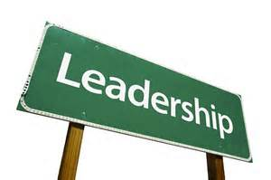
Leader Traits
Good communication skills
Established working relationships
Well organized
Ability to generate action and bring closure to action items
Notes:
Leading a safety committee goes beyond good planning and organizing. It encompasses providing direction and ensuring that all members are on board and support the safety program’s overall mission.

Slide 9
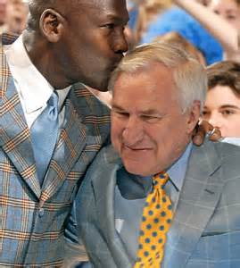
Quote
“The most important thing in good
leadership is truly caring.”
- Dean Smith
Notes:
Actions speak louder than words. People don’t care what you say unless your actions demonstrate what you say.

Slide 10
Safety Committee Leader
Duties
Set ground rules
Define roles
Stays neutral
Is positive, has a win/win attitude
Suggests process when needed
Notes:
Duties of the Safety Committee leader include:
Set ground rules
Define roles
Stays neutral
Is positive, has a win/win attitude
Suggests process when needed

Slide 11
Safety Committee Leader
Duties
Identify processes and procedures
Enforces process agreements
Ensures the group takes responsibilities for its actions
Builds the agenda
Notes:
Other leader duties are:
Identify processes and procedures
Enforces process agreements
Ensures the group takes responsibilities for its actions
Builds the agenda

Slide 12
Safety Committee Leader
Duties
Facilitates
Generating ideas/Data analysis
Selecting Alternatives
Stimulating Discussion
Closure
Notes:
The facilitation skills necessary to bring focus to committee member ideas and guide a safety meeting include:
Generating ideas/Data analysis
Selecting Alternatives
Stimulating Discussion
Closure

Slide 13
Recipe for Success
Correct mix of members
Representation from all departments
Equal employee & employers or
More employees than employers
Understanding of all services & departments
Access to agency’s upper management
Ability to delegate
Notes:
The recipe for a successful safety committee requires understanding and analyzing the support structure in place for initiatives leading to success.

Slide 14
Recipe for Success
Understanding of data, budgets and processes
Prioritizing and timing of projects
Development of the committee
Keeping track of activities
Keeping motivated people motivated
Coaching unproductive members
Notes:
A finely tuned committee will operate at peek performance when attention to details are not ignored or left to chance.

Slide 15
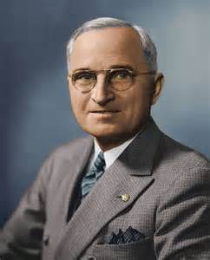
Quote
“It is amazing what you can accomplish
if you do not care who gets the credit.”
- President Harry S. Truman
Notes:
Don’t allow egos and personal agendas to stand in the way of organization goals and mission.

Slide 16
Motivators
Achievement
Recognition
Responsibility
Advancement
Belonging
Growth & development
Job enjoyment
Making a difference
* Adopted from Frederick Herzberg
Notes:
These are essential factors that inspire committee members and create within them a desire to become fully engaged in the activities of the safety committee. They influence people’s perception of empowerment and willingness to help others. This motivation comes from inside people and is commonly referred to as internal or self-directed motivation.

Slide 17
De-Motivators
Undesirable Policies
Poor working conditions
Unhelpful fellow employees
Bad working relationships
Micro Management
Low Status
Job Security
Poor Communication
* Adopted from Frederick Herzberg
Notes:
There are many things which serve as de-motivators that can actually sabotage a Workplace Safety Committee.
“Attitude reflects leadership” is a quote taken from the movie “Remember the Titans.” In workplaces where low employee morale exist you will find these traits. To create a positive safety culture listen to employee input and make safety a focal point of employee activity. The de-motivators are “other directed” rather than “self-directed.”

Slide 18
Leading the Committee
Select participants
Develop agendas
Open meetings
Establish ground rules for meetings
Manage time
Evaluate the meeting
Close meetings
Notes:
There is a lot of work that goes into conducting effective meetings. The responsibility should not be left to one person. Participation and leadership must be distributed among members. As leaderships needs arise, members should all feel responsibility for meeting them.

Slide 19
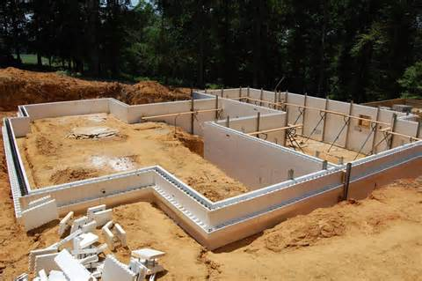
Committee Foundation
Mission and function
“SMART” objectives
Effective communication
Mutual support, trust and respect
Joint commitment to incident prevention
Notes:
When constructing a building, a good foundation is essential for a safe and solid structure. It’s the same with workplace safety. Building a successful committee and program requires a solid foundation.

Slide 20
Committee Foundation
Effective problem solving
Non-adversarial conflict resolution
Identification of all member resources
Utilization of all member resources
Notes:
Leadership growth is accomplished by forging a new path today using the foundation from the lessons learned yesterday.

Slide 21
Committee Membership
Ensure all work areas are represented by employees knowledgeable in the tasks and risks of their areas.
Managers should be recruited based on agency job knowledge and ability to assist in the resolution or implementation of safety and health items.
Notes:
Getting the right people on the committee from the start cannot be emphasized enough. Power and influence need to be approximately equal throughout the committee. Committee membership should be based on expertise, ability and access to information, not on authority.

Slide 22
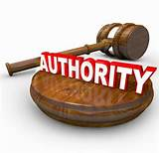
Committee Authority
Act as a recommending body
Evaluates processes, procedures and equipment
Advises on best safety alternatives
Warns of potential dangers
Influences work practices
Notes:
Allow the committee to take responsibility for the administration, evaluation and planning of the safety management process. A properly run committee should be responsible for the safety program and authorized by senior management.

Slide 23
Committee Chairperson
Accountable to management
Selects members
Sets/follows agenda
Coordinates meeting logistics
Facilitates meetings
Uses committee resources/talents and makes sure everyone is heard
Notes:
Putting on an effective meeting and facilitating discussion around safety topics is a real skill set.
The committee chairperson should not do all the work.
The Committee Chairperson is responsible for the meeting’s content (the agenda) and process (ensures agenda is followed and everyone is heard).

Slide 24
Committee Chairperson
Assists/follow-up with member assignments
Encourages/assists sub-committees
Ensures committee documentation
Follows-up with committee recommendations
Determines/schedules safety training and development activities.
Notes:
A committee chairperson’s responsibilities don’t stop when meetings end. The real work happens in between meetings.

Slide 25
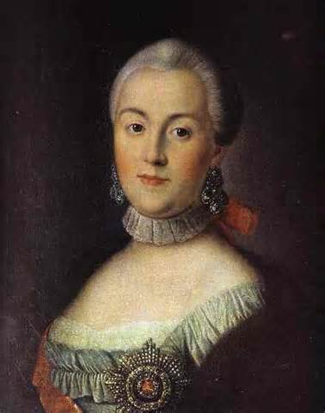
Quote
“I praise loudly. I blame softly.”
- Catherine the Great, 1729-1796
Notes:
When giving feedback be more positive than negative; this is exactly what is necessary for improvement suggestions to be appreciated, accepted and followed.
Remember: Only with positive consequences can improvement to both behavior and attitude at the same time be achieved.

Slide 26
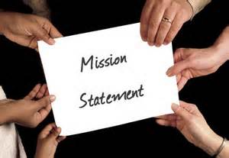
Committee Mission
Sets the groundwork for the agency’s safety & health program
Endorsed by all within the organization
Signed by management
Parallels the agency’s mission
Communicated to everyone
Understood by everyone
Notes:
When developing a safety mission, involve the people expected to carry out the mission.

Slide 27
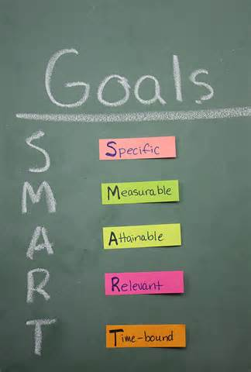
“SMART” Goals
Identify and prioritize
Develop action plans
Recommend improvements
Monitor progress, keep records
Establish responsibilities and accountability
Continuously follow-up
Revise as necessary
Notes:
Involvement in process activities for safety improvement can be increased dramatically through goal setting. Those responsible for reaching a particular goal need to know exactly what to do for goal achievement. Progress toward goal attainment needs to be measured and charted in order to maintain interest and motivation in the process. The work doesn’t stop there - follow-up with revisions when necessary.

Slide 28
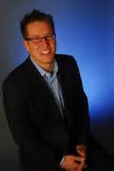
Quote
“In life, as in football, you won’t go far
unless you know where the goalposts are.”
- Arnold H. Glasgow
Notes:
In football, goalposts establish recognized marks of success. We need to know what direction we need to go to succeed.

Slide 29
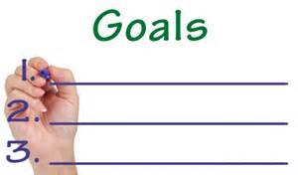
Question
The committee cannot agree on which
goals are the most important.
How would you bring the group
to a consensus?
Notes:
In the example provided think of the types of actions or processes that can be taken to get Committee members to agree.
Maybe if the goals involve injury prevention have Committee members review the amount of injuries and see first-hand which ones occur the most and then concentrate on those areas.
Or perhaps reviewing the costs associated with injuries, property damage, etc. may provide a direction as to what areas are best focused on relating to certain goals.
The amount of methods to achieve consensus are definitely not limited!

Slide 30
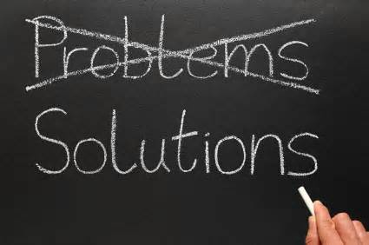
Committee Problems
Lack of purpose
Insufficient resources
Ineffective training
Absence of leadership
Lack of communication and follow-up
Sporadic member participation
Special interest domination
Notes:
Pitfalls to avoid when creating a safety committee:
Lack of purpose
Insufficient resources
Ineffective training
Absence of leadership
Lack of communication and follow-up
Sporadic member participation
Special interest domination

Slide 31
Question
What is a “Meeting Negative” that you
have experienced?
Notes:
When attending meetings there are times that situations arise which make the meeting non-productive such as a conflict, loud “discussion” or possibly side conversations that are distracting; these types of things can serve as a negative experience.

Slide 32
Negative People
Blocker – interferes with progress
Non Participant – indifferent and passive
Fighter – aggression, blame, hostility
Dominator – my way is the right way
Clown – jokes, inappropriate laughter
Politician – changes sides, lacks a position
Stickler – interrupts
Whisperer – has private talks with others
Notes:
Effective meeting leadership addresses actions and attitudes of negative people.

Slide 33
Intervention Techniques
Boomerang the question back to the group when they should answer it: “How does the rest of the group feel about this?”
Maintain/regain focus: “What’s the real issue here?”
Say what’s going on when destructive behavior occurs.
Encourage all members to participate
Don’t be defensive; let the group decide what’s correct or not.
Use positive body language.
Notes:
Safety leaders use intervention techniques that inspire people to feel personally responsible for the success of a safety process, as opposed to safety managers who may hold people accountable for their participation.

Slide 34
Successful Safety Meetings
Schedule in advance
Attend all meetings
Adhere to time frames
Avoid side-bars, non-essential talks
Listen to your members
Encourage participation
Meet on ideas not people
Notes:
Successful safety committees evaluate their meetings for effectiveness. The indicators for successful safety meetings include:
Schedule in advance
Attend all meetings
Adhere to time frames
Avoid side-bars, non-essential talks
Listen to your members
Encourage participation
Meet on ideas not people

Slide 35
The Agenda
Send a copy to all members and invitees in advance
Date, time, specific location
Topic/action/time allocation
Data analysis/inspection results
New and old business
Action items status
Roundtable of issues
Adjournment time
Agenda
Notes:
Regular monthly meetings with minutes of the meeting as well as a planned, outlined agenda is essential to the success of a safety committee but the follow-through is just as important.
Use agendas to make the committee and it’s meetings more efficient.
Agendas should be more than a standardized template.
They should be delivered to committee members at least a week before the monthly meeting and indicate who is responsible for what topic/assignment at the meeting.
In the monthly minutes, each incident should include a case number, cause and recommendation that the safety committee discussed for each incident.

Slide 36
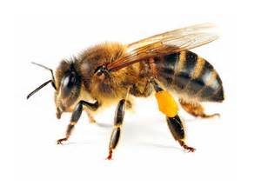
Decision Making Style
Buzzing Bee
Buzzes around trying to get consensus.
Includes others in decision making to learn their viewpoints and gain their commitment.
Sometimes drags out decision making until decision is reached through consensus building when consensus wasn’t required or perhaps appropriate.
Notes:
Leaders can use different styles when it comes to making decisions. The leader who could be considered a “buzzing bee:”
Goes from person to person trying to get consensus.
Includes others in decision making to learn their viewpoints and gain their commitment.
Sometimes drags out decision making until decision is reached through consensus building when consensus wasn’t required or perhaps appropriate.

Slide 37
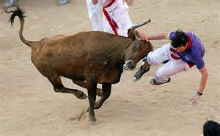
Decision Making Style
Charging Bull
Relentlessly attacks a decision that needs to be made.
Helps move decision making along so that decision is made in a timely manner and issues are resolved.
May sometimes stampede others into decisions.
Notes:
Those leaders who can be considered “charging bulls” exhibit the following characteristics:
Relentlessly attacks a decision that needs to be made.
Helps move decision making along so that decision is made in a timely manner and issues are resolved.
May sometimes stampede others into decisions.

Slide 38
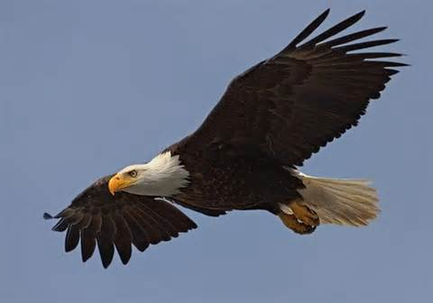
Decision Making Style
Soaring Eagle
Prefers to view issues from 10,000 feet.
Sees the big picture and helps others understand the issue, needs, and impacts.
Sometimes doesn’t demonstrate enough interest in the details of a decision.
Notes:
A person serving in a leadership capacity who may be labeled a “soaring eagle:”
Prefers to view issues from 10,000 feet.
Sees the big picture and helps others understand the issue, needs, and impacts.
Sometimes doesn’t demonstrate enough interest in the details of a decision.

Slide 39
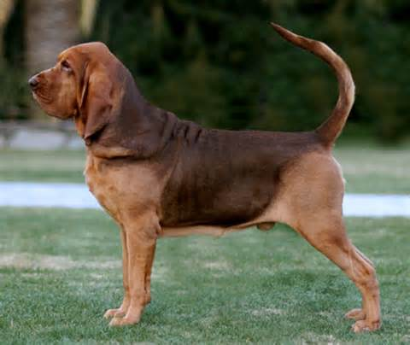
Decision Making Style
Dogged Bloodhound
Noses around to uncover data needed for good decision making.
Provides the facts needed to make good decisions.
Sometimes ties up decision making because still more facts are needed.
Notes:
Those leaders who some may call “dogged bloodhounds” will:
Nose around to uncover data needed for good decision making.
Provide the facts needed to make good decisions.
Sometimes tie up decision making because still more facts are needed.

Slide 40
When to Use Group Decision Making
Highly technical decisions where you are not the expert.
When success will depend on the support of the team.
When the result of the decision is critical.
When you have a highly-competent, motivated team.
Notes:
Some committees need direction to perform their role. However there are instances when allowing the committee to take the lead is a better option.

Slide 41
Leading By Example
This leadership style requires that employees treat one another with trust and respect.
Leaders increase effectiveness by modeling the organization’s expectations:
Attendance
Punctuality
Breaks
Speaking negatively about other employees
Commitment
Notes:
When people trust both the intentions and ability of their leaders and co-workers they are more likely to contribute willingly to whatever process improvements are called
for.
“Most people see leadership as the act of leading others. What if it is really the act of leading ourselves?” Peter Urs Bender

Slide 42
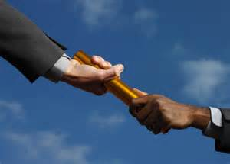
When to Delegate
You trust others to make the correct decision.
Your time and expertise could be better focused elsewhere.
Team involvement is not critical for success.
There is unlikely to be controversy about the decision.
Notes:
As a safety leader knowing when to delegate may be hard to tell.

Slide 43
Summary
Chairpersons have:
to be a leader, coach and instructor
to bring issues to closure
to select and use member’s talent
Good safety meetings are the result of organization, preparation and viewing issues as opportunities.
Notes:
Being the Chairperson of a Workplace Safety Committee is not the easiest task in the world! There are many times when the Chairperson has to be a leader, coach and instructor and there are others when they have to bring an issue to a closure and select and use a particular member’s talent.
An effective Safety Committee includes conducting good meetings that involve organization, preparation and viewing issues as opportunities.

Slide 44
Contact Information
Health & Safety Training Specialists
1171 South Cameron Street, Room 324
Harrisburg, PA 17104-2501
(717) 772-1635
RA-LI-BWC-PATHS@pa.gov
Like us on Facebook! - https://www.facebook.com/BWCPATHS

Slide 45
Questions

