Slide 1
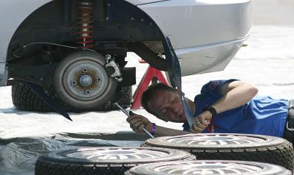
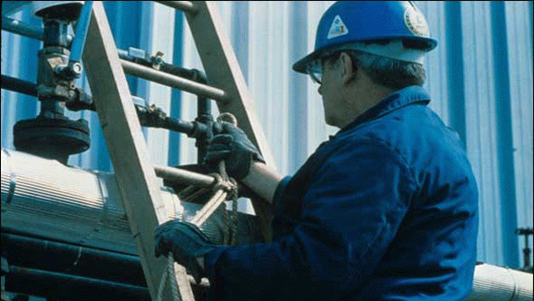
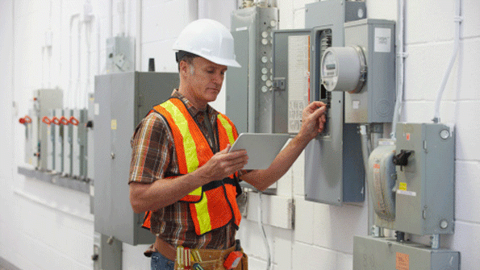
Safety When Working Alone
Bureau of Workers’ Compensation
PA Training for Health & Safety (PATHS)
Notes:
'Working alone' is working anywhere a person is unable to get immediate assistance from colleagues or other people. In some cases other people may be close by, such as a cleaner working by themselves in a city office building. In other cases the employee could be in a remote location, such as a researcher undertaking field work in a park.

Slide 2
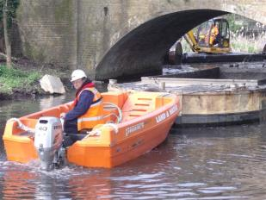
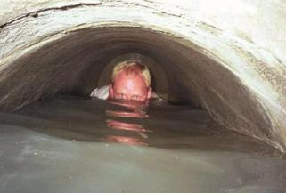
Employees Who Work Alone
Bureau of Workers’ Compensation
PA Training for Health & Safety (PATHS)
Each year individuals who work alone are injured or become fatalities; this could have been prevented had plans and policies existed
Notes:
There are many scenarios in many occupations where these circumstances could apply, for example:
Sales representatives, including real estate agents
All-night convenience store and service station attendants
Transport freight and public transport drivers
Doctors, health and community workers
Rural and agricultural workers
Scientists, park rangers or others undertaking field work.
www.worksafe.vic.gov.au

Slide 3
Employees Who Work Alone
While OSHA does not require a special plan for those working alone, OSHA’s General Duty Clause requires the employer to provide a safe workplace for employees.
Notes:
Always decide on the side of Safety for you or your staff when evaluating potential issues which may affect their safety.

Slide 4
Employees Who Work Alone
Adopting the General Duty clause becomes a “best practice” using such plans and procedures to promote safety.
Notes:
While there is no specific legislation, rules or regulations from OSHA governing those who work alone, the General Duty clause is often invoked.
This states the employer is responsible for the creation of a safe work area for their employees.
Even if not obliged to comply with OSHA, the adoption of their recommendations is working toward achieving Best Practices as it regards safety.

Slide 5
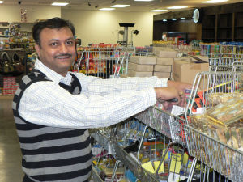
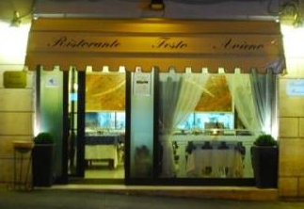
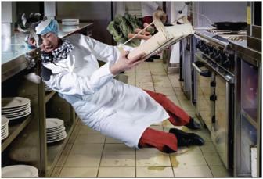
Potential Work Alone Situations
Service stations and all-night establishments
Mini Marts
Diners/Restaurants: Shut-
down person
Accidents,
Invasive actions
Notes:
Possible situations which may impact on employees who work alone could include the environment itself, or how it might be changed. Example above is a worker slipping on a wet floor.
After hours situations can occur that involve lighting, persons or the environment.

Slide 6
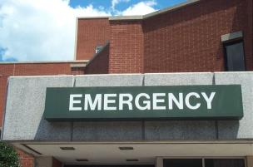
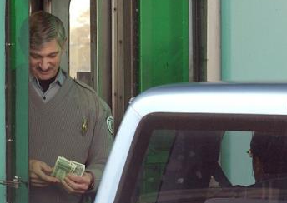
Potential Work Alone Situations
Hospital Emergency Rooms:
Irate family members or
injured persons
Toll Takers: Booth crashers,
medical incidents, lost or
frustrated motorists
Notes:
Hospital Emergency Rooms can become hazardous. Irate family members who feel a loved one is not getting fast enough service; multiple victims from traffic accidents can inundate the staff and capacity of the ER. Gang-related incidents where victims are brought together in the same area as well as victims from tavern or bar altercations who want to continue the “battle” even in the ER.
Toll Takers can have problems with booth crashers who don’t want to pay the toll. Medical incidents can occur as well as lost or frustrated motorists.
Other types of Booth Crashers include traffic incidents where a motorist may lose control of the vehicle and impact the booth or another vehicle.

Slide 7
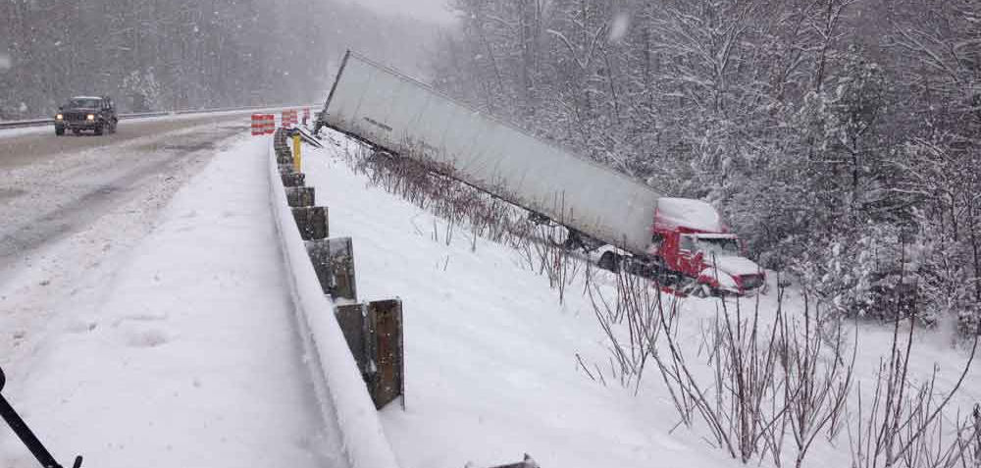
Potential Work Alone Situations
Transportation Industry: Hijackings and
seasonal concerns as well as hours of
operation leading to accidents
Notes:
The Transportation Industry for trucking is subjected to seasonal concerns which could lead to accidents. Hijackings, as in the past, may yet continue.
Problems between trucks and motorists may happen to cause tempers to flare resulting in altercations.

Slide 8
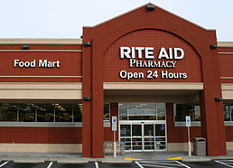
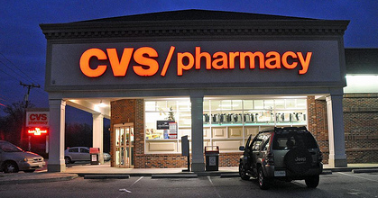
Potential Work Alone Situations
24-hour Pharmacies: Robberies, anxious patrons
Notes:
Any facility open round-the-clock (24 hours) may be subject to various types of incidents:
Robberies, theft, vandalism, people in a rush. The problem is increased for those working alone due to being responsible to attend to the problem and possibly need to call for help.
Multiple duties may distract the worker and make the facility and themselves vulnerable.

Slide 9
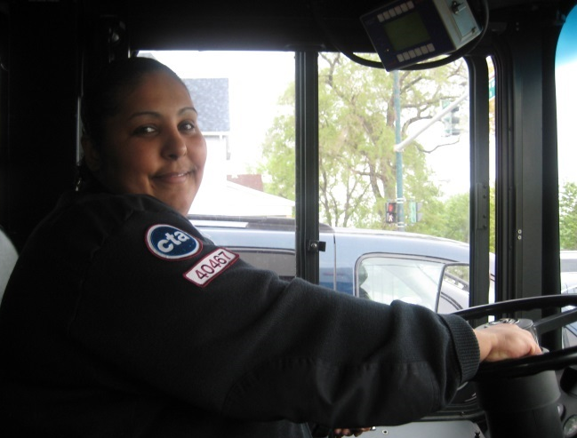
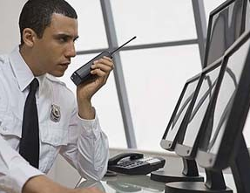
Potential Work Alone Situations
Taxi and Bus Drivers
Security staff
Any location open 24
hours or after hours
and dealing with public
Notes:
Taxi Drivers don’t know who their fare might be. As vast as are the types of personalities, so might be the types of incidents to impact them.
Bus Drivers may have a normal route, but may not have routine, familiar clientele.
Security Staff, by the very nature of their duties, may be targeted by those who want to compromise the security system and commit offenses.

Slide 10
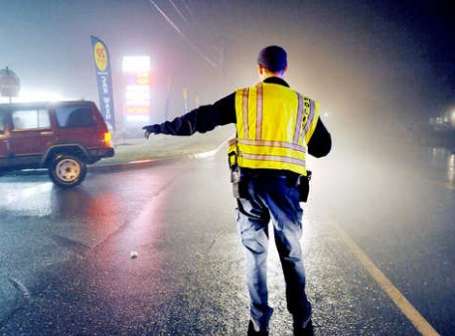
Potential Work Alone Situations
Law Enforcement (Special
Assignments): vehicle
incidents, drive-by
shootings, medical
problems.
Any location in isolation
dealing with public,
equipment, or an actual
or potential hazardous situation
Notes:
Law Enforcement (Special Assignments) such as traffic control for road impediments or closings, vehicle accidents or securing a location may meet with the public who refuse to be convinced that they can’t go through because they “live just down the road.” Some, when informed they’ll have to take an alternate route will state they don’t know any other way to get home. When asked how long they’ve lived at that location, some have indicated 42 years.

Slide 11
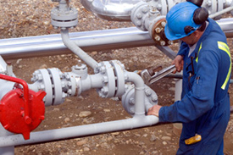
Potential Work Alone Situations
Night shift workers or
after-hours jobs:
Domestic incidents
Robberies/theft
Vandalism
Specialty Service Work
Sites: Uncontrolled energy or material releases, personal injuries
Notes:
Night shift or during hours of darkness pose their own possible hazards. This includes distance from building to parking lot, availability to summon help due to a person-to-person incident and traffic problems. Often dark areas are possible ambush points.
Specialty Service Work Sites: systems under pressure or problems with valves may allow uncontrolled material or energy releases.

Slide 12
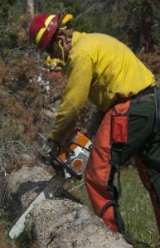
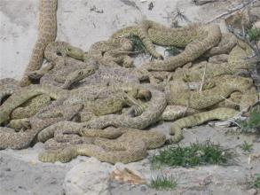
Potential Work Alone Situations
Forestry Service activities:
Absence of phone relay towers, equipment injuries, wildlife hazards
Game Commission
Officers: Armed poachers, wildlife hazards
Notes:
Forestry: work alone in parks and woodlands and possibly cut-off from communications in some areas.
They may confront armed persons hunting or fishing illegally who will challenge the officer’s authority.
Crews clearing deadfall using power tools may be subject to accidents requiring immediate medical attention.
Areas may be inaccessible to vehicular traffic.
Wildlife hazards include rabid animal bites and snake bites as well as encounters with bears.

Slide 13
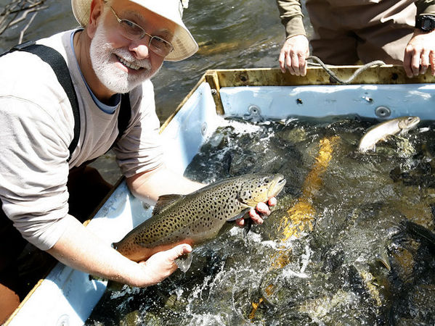
Potential Work Alone Situations
Fish & Boat Commission Officers
Notes:
Fish and Boat Commission Officers may not work completely alone, but might be subject to the same limitations as others in the wild. This would include water accidents, strains, sprains and falls coupled with environmental hazards.
Water always presents a chance for accidental drowning. Cuts, insect bites, and back injuries may also occur. Also, if on duty during the first day of Trout Season, dealings with irate persons may occur.

Slide 14
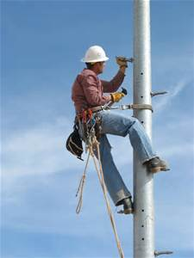
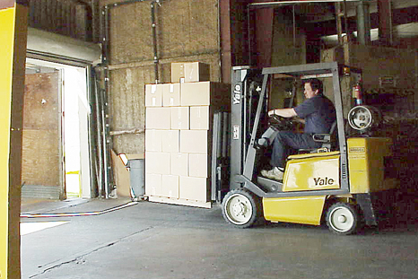
Potential Work Alone Situations
Utility Linemen: shock or
electrocution, falls from heights
Shipping/Receiving:
falling stock, vehicle
overturns
Notes:
Utility Line Workers can be subjected to electrical hazards during all types of weather. Since downed lines and disruptions may be caused by bad weather, restoration may also have to be performed during the same conditions. Vehicular incidents may also occur if the line truck needs to park on the berm or close to intersections.
Shipping and Receiving incidents may include driving forklifts off edges or on uneven terrain. Struck-by situations may also occur due to visibility problems.
Since shipping concerns moving a product “out,” cuts may occur during packaging or opening, lifting strains may also happen.
Forklifts improperly powered for an environment may be a hazard, e.g. propane powered or gasoline powered inside an enclosed area (carbon monoxide build-up).

Slide 15
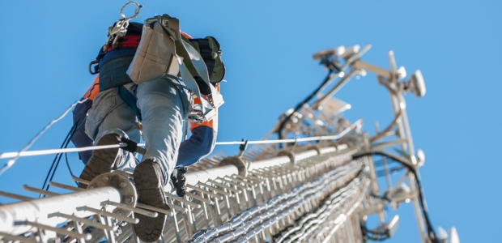
Assess Job for Safety
Assess your facility to determine who may work alone and their activities
What special considerations they might need
What types of incidents may occur
Notes:
Some situations may be found to be unsafe for an individual to work alone.

Slide 16
Assess Job for Safety
This includes being geographically distant within a building or separation from work crew due to task (only one person will fit in a vault)
At out-buildings separated from coworkers and communications
Time of day or night concerns
Field Operations
Notes:
Working alone may involve geographic distance as well as building separations. They include time of day or night concerns and field operations.

Slide 17
Assess the Job for Safety
Determine hazards or circumstances for each condition, i.e.
Tasks + Tools = Accidents(?)
Tasks – PPE = Accidents(?)
Identify dangerous conditions
Develop procedures
Ensure employee monitoring
Guarantee immediate assistance if needed
Notes:
Remember: Those who work alone work by themselves without direct supervision. They may be mobile, going to field locations. They may also work outside normal daytime hours.

Slide 18
Assess the Job for Safety
Determine fitness of individual to safely perform duties.
How is it determined that a lone person can do the job
Are there medical restrictions to the work
Is any type of supervision required
Types of emergencies which may arise and means to respond
First Aid training and equipment provided to lone worker
Establish limits to work activities
Notes:
Assess the job for safety.
Can the lone person do the job
Are there medical restrictions
What supervision may be required
Types of emergencies which may arise and how to respond
First Aid training and equipment required
Work limits established for activities?

Slide 19
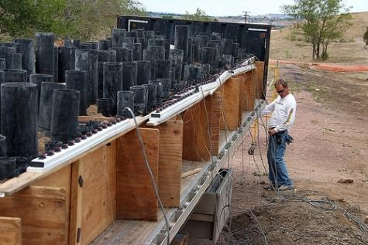
Assess the Job for Safety
Provide required tools and equipment
Provide information concerning potential hazards
Assure ability to contact assistance
Notes:
Pyro technician doing a set-up. This requires a specific sequence of actions to guard against pre-ignition and explosive tragedy.

Slide 20
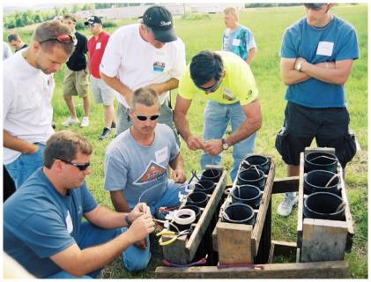
Assess the Job for Safety
Train to familiarize workers, supervisors and foremen of hazards and response
Train regarding equipment to ensure safety
Brief on Policies and Procedures in effect
Notes:
Pyro technician training. Do they understand what you said; for example, how to do it; when to do it; and what not to do?

Slide 21
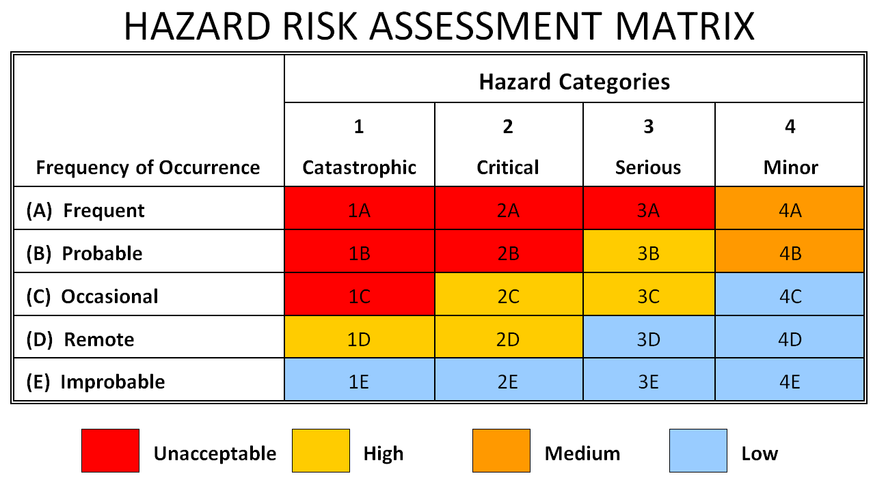
Categorize the Jobs
Assign a High Risk or Low Risk (or combination) to hazard
Notes:
Categorize the hazards of the job. The hazard categories may be trimmed to just 3 levels. Modify according to your needs ensuring all needs are met.

Slide 22
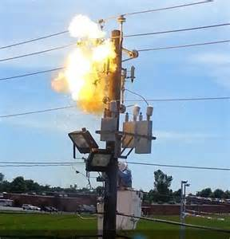
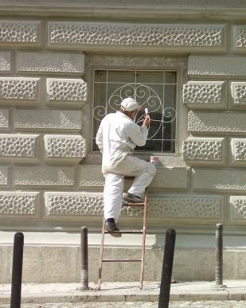
Categorize the Jobs
Design control measures regardless of risk level
Notes:
Magnitude of risk level will dictate your risk assignment. Even seemingly small jobs may breed injury. Think through the process taking into account the possibilities and probabilities of risk.

Slide 23
Control Measures
Are based on the hazard assessment and targeted toward obtaining emergency help when needed.
Some control measures include:
Buddy System
Personal Check
Periodic Telephone Contact
Electronic Communication/Surveillance
Central Monitoring
Shutdown and Isolation Measures
“What To Do If…” Situations
Notes:
Other control measures may also be included depending upon the uniqueness of the task. Seasonal and climatic conditions should always be viewed. Some set-ups, such as erecting scaffolding or ladders, will be effected by inclement weather reducing sound footing.

Slide 24
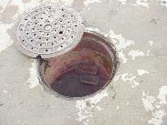
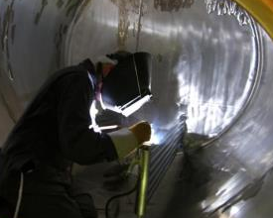
Buddy System
One worker may be separated from other workers in the work environment by distance or barrier between task and other employee
Examples of work alone locations:
Confined spaces
Manholes
Pits
Tanks
Notes:
When team members are separated physically or by distance, the physical separation must be taken into account, especially if the need for immediate aid or assistance occurs.

Slide 25
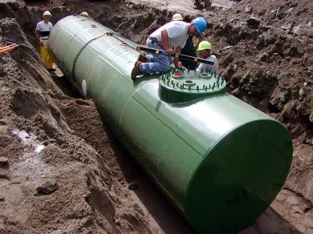
Buddy System
Locations which may be oxygen-deficient or contain harmful vapors may exist
These locations should not be a work-alone situation. Another person should be in close proximity
Develop work and rescue procedures to best guarantee
safety
Notes:
Regulations already exist requiring a Buddy System where this separation by physical barriers may occur. They include permit-required confined space jobs, trenching and excavating and working at elevated heights.

Slide 26
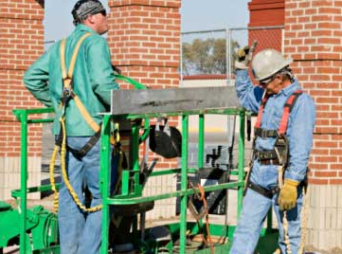
Buddy System
The Work Alone aspect is affected when a space may only permit a single person to enter
This system relies on a proper understanding of hazards and requisite PPE and implementation of emergency rescue
Notes:
Therefore, the Work Alone concept also must view distance of one worker from others. This is especially important when working confined space or elevated height situations.
For those working alone in the field, aid may not be as immediately available as it would were coworkers nearby to begin first aid and call for assistance.

Slide 27
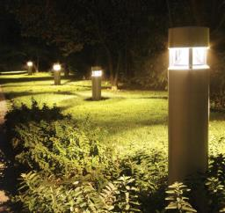
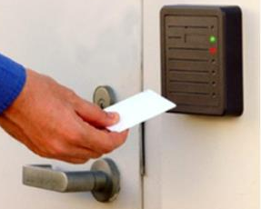
Job Site Security
Security may consist of physical or administrative barriers
Lighting
Locking systems/keycard access
Notes:
Physical barriers to limit entry may also hinder rapid response.

Slide 28
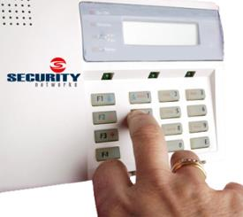
Job Site Security
Alarms: automatic, remote dialers, panic buttons
Create environment of physical barriers
Notes:
Alarms against intrusion serve to exclude non-authorized entry. How would these devices also delay emergency response to provide assistance?
Emergency Buttons or “Panic Buttons” for lone workers should be made available where the threats warrant.

Slide 29
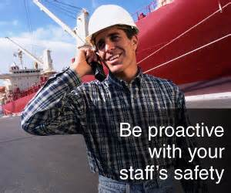
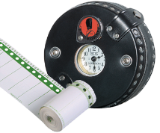
Personal Check
Periodic visits on a timed interval
Various staff may do this but must be trained, assigned and briefed
Time intervals are based on job hazards
Notes:
Periodic checks of your staff working alone will allow you not only to promote their safety but also to do quality checks on their tasks.
In high security environments do not perform these checks on a standard interval such as every hour on the hour; break them up in case someone be watching in an attempt to compromise your security.

Slide 30
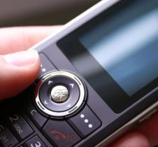
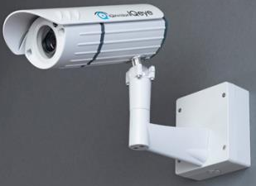
Periodic Checks
At scheduled intervals, periodic checks should be made.
Accomplished by:
Telephone,
Electronic surveillance
Work-Alone persons informed of procedures to use
Notes:
Some periodic checks may be made by telephone or via electronic surveillance. Inform your people if they are “under view” by camera and areas which are viewed by the camera. Should something happen, they will know where to stand to get the attention of the monitoring team.

Slide 31
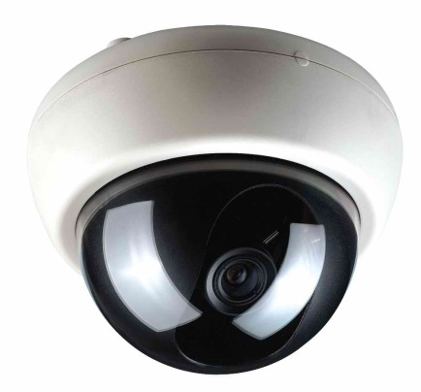
Other Means of Contact
Cell phones
Pagers
Radios
Cameras
Motion detection systems
Notes:
Additional means of contact may be selected. However, ensure each person has a thorough knowledge of their use. Once arriving on location where they will work alone, perform a communications check to determine adequacy of the communications means. This would include the individual performing the check throughout the area or facility where they’ll be working.
Determine “voids” where receipt and transmit may be weak or non-existent. In such cases, devise alternate communication means.

Slide 32
Central Monitoring
By internal staff or external contractors
Alarms relayed to central station
Emergency alarms/automatic dialers
Notes:
Whether a “Central Station” concept or other central monitoring means, have the ability to save and retrieve audio and visual data. This may be needed for investigative purposes in the future.
Ensure all monitors in the central monitoring are trained on normal (routine) operations and emergency actions.

Slide 33
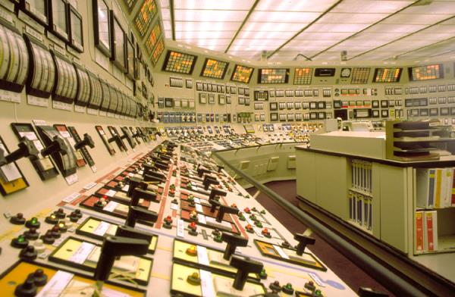
Identify . . .
Locations and identification of shutdown and isolation switches so machinery can be secured
Notes:
How are systems shut down during an emergency? If the facility is governed by PSM (Process Safety Management per 29 CFR 1910.119) there may be Decision Logics to use.
There may also be prohibitions on performing such shut-downs without Management authorization. (Some systems also may not shut down completely and require a deceleration time).
Some systems have a re-route capability whereby system power is routed around a primary path to a secondary to maintain operability of the process.
Fully understand this aspect for locating shutdown and isolation sequences for emergency response.

Slide 34
“What to do if…” Situations
Policies to implement for events:
Accident or medical incidents such as heart attack, diabetic reaction, breathing difficulties
Accidents could include:
Falls, electric shock, cut, struck-by events
Individual(s) attempting to rob the business or steal materials from storage areas (inside and outside). Attempts to force entry onto/into premises
Notes:
Risks should view those potentials outside the realm of normal expectations (those possible hazards targeted at the job).
Consider the full area of the job, task or operation. Example: a spinning lathe has it’s own mechanical hazards, but also includes a hazard zone wherein parts of jobs and pieces may be flung or ejected.
Crimes against persons will require special procedures as well as special barriers to provide personal protection to those working alone.

Slide 35
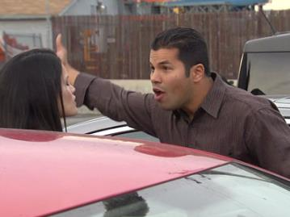
“What to do if…” Situations
Person reporting a problem to you, e.g. vehicle breakdown or injury, which may require placing yourself in a vulnerable position.
Someone threatening your safety, with or without a weapon.
Notes:
The area to secure includes from the parking lot through the corridor to the work station as well as the work assignment.
Safety may be threatened throughout this corridor. Make special provisions to maximize safety for work alone staff for arriving, reporting, working and leaving at the end of their job.

Slide 36
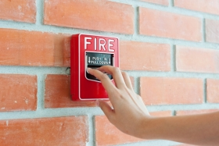
“What to do if…” Situations
Fire alarm or sprinkler system activation.
Your staff will provide excellent service if you take nothing for granted and thoroughly brief them on all required policies and contact information.
Notes:
Whether pulling a fire alarm box or the operation of a sprinkler system-an audible alarm will sound in-house. By its very nature, such an alarm creates a chaotic situation to have persons evacuate.
Do your people know what to do if they are working alone?
Will they check the hallway for smoke and seeing none, continue to work until conditions deteriorate?
If you have an in-house fire brigade, a better awareness may exist as to proper actions due to parallel training.

Slide 37
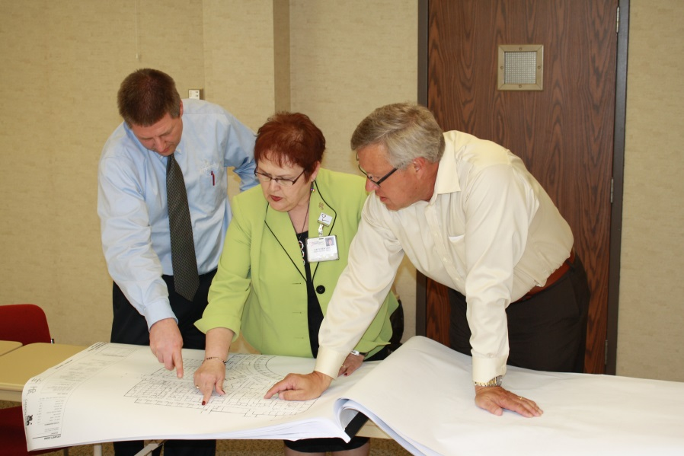
Fit Program to Staff’s Needs
Perform a job assessment
Group determines hazards, monitoring and policies
Create the plan and policies
Determine the intervals for monitoring
Notes:
Adopt or create a checklist accounting for the variety of potential hazards during your risk assessment. If equipment is involved, very often the manufacturer’s “turn-over package” for the equipment may contain checklists for maintenance as well as activation/shutdown procedures.
Have a team of multi-versed persons aid in determining hazards. Have them create a plan and policies
Determine the monitoring intervals for the lone worker
If systems change; change the policies, also updating when needed
Administer the Program and monitor its effectiveness.

Slide 38
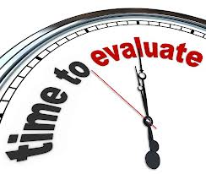
Fit Program to Staff’s Needs
At established time, review and update plan
Update plan when systems change to remain current
Administer the Program
Monitor Program’s Effectiveness
Notes:
At established time, review and update plan
Update plan when systems change to remain current
Administer the Program
Monitor Program’s Effectiveness

Slide 39
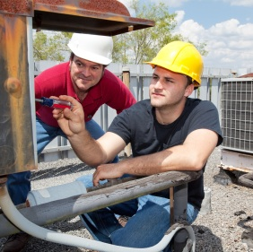
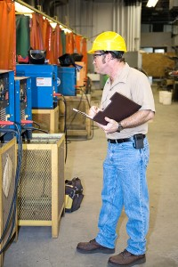
Perform Job Assessment
To determine:
PPE needs
Special circumstances
that may occur
Notes:
The Job Assessment will aid in determining not only the type of PPE but the level of safety to be provided by same.
An example would be: different layering is required under Arc Flash jobs.

Slide 40
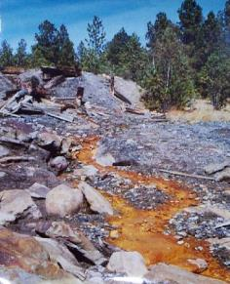
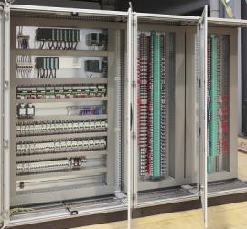
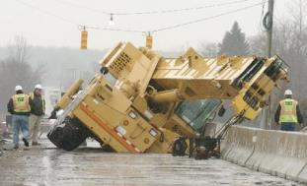
Perform Job Assessment
Risk Assessment Factors
Environment
Engineering Controls
Administrative/Work Practice Controls
Notes:
Assess the environment where the lone worker will function.
Not only chemical hazards but terrain features.
Proximate hazards or harm which may intrude into their work area.
Is wildlife active in this area which will pose a hazard?
What engineered controls are required and have they been adequately provided? Will existing roads and bridges take the strain of equipment required to do the job?
Have administrative and work practice controls accounted for foreseeable hazards created by the operation or intruding into the work area?

Slide 41
Perform Job Assessment
Determine:
Conditions
Circumstances
Interactions
People
Equipment
Environment
Possible Emergency
Situations
(Documents that can be adapted to aid you)
Notes:
So, when performing the job assessment, search-out existing documents which you may modify and add to that aiding your determination.
The Physical Security manual, although for the Army, can be a great aid due to covering personnel and physical security aspects.

Slide 42
Determine Policies
Determine hazards, monitoring and policies
Notes:
Are hard hats required in both instances?
Is fall arrest equipment required? If not required, would it be a good idea?
Does policy indicate, “No walking on top shelf to pick an order?” What other limitations are stressed to preclude an accident?

Slide 43
Create Plan/Policies
Several good sources for building your program:
Notes:
Plan and Policy creation is assisted by OSHA manuals. And, although your agency/industry may not be governed by OSHA, the adoption of OSHA recommendations is considered “Best Policy.”

Slide 44
Determine Monitoring Intervals
Determine method of monitoring.
Visual verification may be better than voice communication.
Notes:
Visual verification may be better than solely voice communication. You are not performing a security check on your lone worker. You are guaranteeing your lone worker has provisions for assist or backup. The Lone Worker wants to know they are in view should a situation arise.

Slide 45
Plan Review and Update
Establish a plan/policy and review
Update as necessary
Train all personnel who will function within the plan
Notes:
Brief all of those who will work alone on the plan and policies in effect.
Update these as needed.
Ensure each person fully understands the Plan/Policies.

Slide 46
Administer the Program
Risk Management Model
Notes:
During Program Administration, use a Risk Management Model as shown or devise your own.

Slide 47
Monitor Program Effectiveness
Notes:
After determining the effectiveness of the Program, constantly monitor/audit.
Keep the Plan and Policies current to meet changing needs.

Slide 48
Your Thoughts . . .
What potential safety hazards do you see?
How would you make the situation safer?
Notes:
Some answers:
What hazards exist due to working at elevated heights?
Is fall arrest equipment required?
What are the assigned duties of the lone worker?
Were others required to set-up scaffolding?
Is the safety of scaffolding checked by supervision before turn-over to lone worker?

Slide 49
Your Thoughts . . .
What potential safety hazards do you see?
How would you make the situation safer?
Notes:
Some answers:
Fall arrest equipment required?
Face masks to protect against overspray?
Although unsupervised, will periodic checks be required to determine quality of work?
Is the lone worker able to set-up and remove ladders?

Slide 50
Your Thoughts . . .
What potential safety hazards do you see?
How would you make the situation safer?
Notes:
Some answers:
Is lifting a hazard?
Could lifting slings make job easier?
What PPE is required?

Slide 51
Your Thoughts . . .
What potential safety hazards do you see?
How would you make the situation safer?
Notes:
Some answers:
Does the job have a need for additional persons for lifting or is there equipment to assist?
What is the possibility of this or other duties resulting in injury?
Can medical assist arrive in a timely manner?
Does lone worker possess necessary PPE? Hard hat-yes. Are safety shoes needed? Eye protection?

Slide 52
Your Thoughts . . .
What potential safety hazards do you see?
How would you make the situation safer?
Notes:
Some answers:
Unarmed patrol should have armed backup response.
Determine strenuous activities required and limitations of those doing the job; not only medical but check-in on periodic basis and when stopping vehicle and getting out to interact with public.

Slide 53
Your Thoughts . . .
What potential safety hazards do you see?
How would you make the situation safer?
Notes:
Some answers:
Repaint directional lines
Reinforce with direction signage
Facility map to indicate relationship of parking lot to main buildings
Security patrol daytime and evenings
Seasonal considerations: snow and ice removal

Slide 54
Your Thoughts . . .
What potential safety hazards do you see?
How would you make the situation safer?
Notes:
Some answers:
Briefing on route concerning existing hazards now snow-covered
Radio contact; frequencies
Passenger to observe
Rest period requirements
Rehydration ability

Slide 55
Your Thoughts . . .
What potential safety hazards do you see?
How would you make the situation safer?
Notes:
Some answers:
Knowing where their Mother is and if she’s coming after you!
PPE
Rabies may be a possibility as well as ticks which may be on Raccoons
Cuts, scrapes, scratches and spread of infection
Do you really want to bring your work home with you?

Slide 56
Summary
Control measures are based on the hazard assessment and targeted toward obtaining emergency help when needed.
Some control measures include:
Buddy System
Personal Check
Periodic Telephone Contact
Electronic Communication/Surveillance
Central Monitoring
Shutdown and Isolation Measures
“What To Do If…” Situations
Notes:
In summary:
Determine the hazards then craft the control measures to take into account those variables which may effect the safety of the lone worker.

Slide 57
Bibliography
“Recommendations for Workplace Violence Prevention Programs in Late Night Retail Establishments,” OSHA, OSHA 3153-12R, 2009
“Guidelines for Preventing Workplace Violence for Health Care and Social Service Workers,” OSHA, OSHA 3148-01R, 2004
FM3-19.30 Physical Security, Headquarters, Department of the Army, Washington, DC, January 2001. (Supersedes FM 19-30, 1 March 1979)

Slide 58
Bibliography (Con’t.)
www.worksafe.vic.gov.au Article, May, 2014
www.hsa.ie/eng/Topics/Hazards/Lone_Workers
Article, May 2014

Slide 59
Contact Information
To contact a Health & Safety Training Specialist:
Bureau of Workers’ Compensation
1171 South Cameron Street Room 324
Harrisburg, PA 17104-2501
717-772-1635
RA-LI-BWC-Safety@pa.gov
Like us on Facebook! - https://www.facebook.com/BWCPATHS
PPT-079-01
58

Slide 60
Questions

