Slide 1
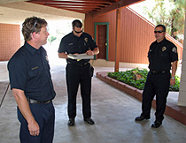
Walk Through Survey
Bureau of Workers’ Comp
PA Training for Health & Safety (PATHS)
1
Notes:
One way to ensure safety within a workplace is to conduct periodic walk through surveys. These surveys are a way to observe processes, procedures and actions on a more regular and informal basis with the overall goal being injury prevention.

Slide 2
Topics
What is a walk through survey?
How does it differ from an inspection?
Why should you conduct one?
When should you conduct one?
2
Notes:
This training program will discuss:
What is a walk through survey?
How does it differ from an inspection?
Why should you conduct one?
When should you conduct one?

Slide 3
Survey Purpose
What a walk through survey involves:
A formal inspection has been conducted for the month.
Everyone knew when the inspection was taking place and things went smoothly.
3
Notes:
A walk through survey can be completed after a more formal “safety inspection” has been conducted for the month.
In most cases workers, and in particular management, knew the inspection was coming and in many instances things went smoothly.

Slide 4
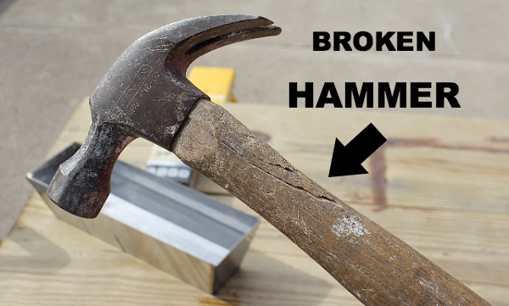
Survey Purpose
Hazards/deficiencies were noted.
Recommendations were made.
Observations were made to ensure everyone was performing his/her job safely and with proper Personal Protective Equipment (PPE).
4
Notes:
The purpose of a walk through survey is to:
Note hazards/deficiencies with recommendations for correction being made.
Observations are made to ensure all employees are performing their jobs safely and using the correct Personal Protective Equipment (PPE).

Slide 5
Survey Purpose
• Why should walk through surveys be conducted?
• What it is a walk through survey?
• What should be observed during the survey?
5
Notes:
When doing a walk through inspection the overall purpose should be taken into consideration.
• Why should walk through surveys be conducted?
• What it is a walk through survey?
• What should be observed during the survey?

Slide 6
Definition
Webster’s II New College Dictionary says to survey means to “look over”.
A survey gathers information.
6
Notes:
Webster’s II New College Dictionary says to survey means to “look over”.
A survey gathers information.

Slide 7
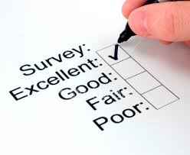
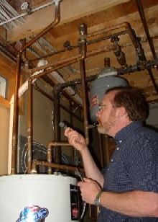
Walk Through Survey
What does the word survey imply?
Is it just a follow up after the inspection?
7
Notes:
What does the word survey imply?
Is it just a follow up after the inspection? In some cases it could be while in others it’s a matter of ensuring what was identified has been corrected and is still correct as well as determining if employees are using safe work practices.

Slide 8
Survey Purpose
A walk through survey answers:
What’s happening when no one is looking
What’s happening when no one is expected
What’s happening daily in the real world
8
Notes:
A walk through survey can determine the following:
What’s happening when no one is looking
What’s happening when no one is expected to be looking
What’s happening daily in the real world

Slide 9
Follow Up Observation
Were safety recommendations implemented?
Are they working?
Did they generate feedback?
Are work areas still free of obstacles?
9
Notes:
A walk through survey can be used as a follow up to the formal inspection to ensure:
That safety recommendations were implemented.
That these suggestions/recommendations are working.
To ascertain if feedback has been generated.
That work areas are still free from obstacles/hazards.

Slide 10
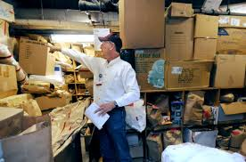
Ensure Compliance
How did this happen again?
10
Notes:
Walk through surveys can prevent improper storage practices or similar occurrences which may cause an incident or injury.

Slide 11
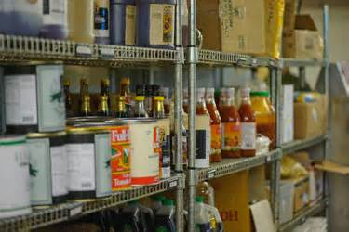
Observe
Good food storage – how it looked.
How does it look now?
11
Notes:
Proper food and other storage is very important. Walk through surveys can identify if proper storage methods are still in place.

Slide 12
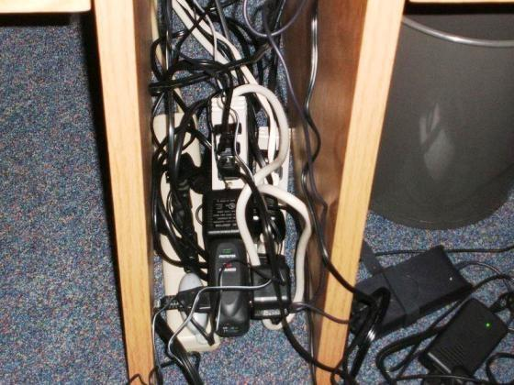
Observe
This situation needs immediate
attention:
Has a work order been initiated?
Do you have a time frame?
12
Notes:
Observing is a big part of a walk through survey. In this instance which needs immediate attention:
Has a work order been initiated?
Do you have a time frame?

Slide 13
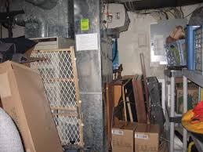
Follow Up
This is a “before” picture from the inspection.
A walk through will follow up on what changes were made.
13
Notes:
This is a “before” picture from the inspection.
A walk through will follow up on what changes (if any) were made.

Slide 14
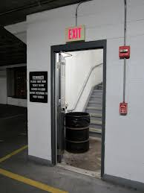
Ensure Compliance
Are all fire doors closed at all times?
Are employees vigilant about such safety measures?
Does attitude play a part?
14
Notes:
Walk through surveys can ensure that compliance with the myriad of safety regulations is being maintained.

Slide 15
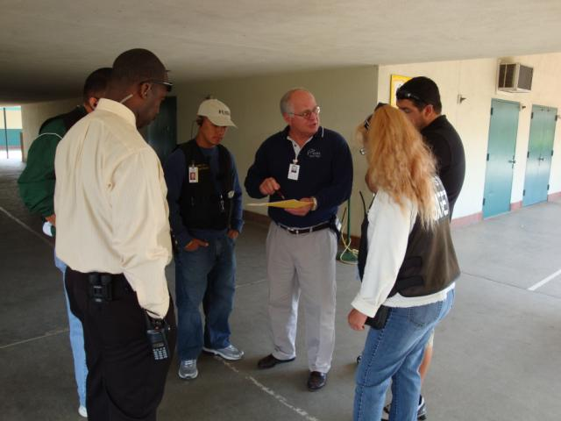
Observe and Listen
A walk through survey is a good time to generate a thought process and employee dialogue regarding safety attitudes.
15
Notes:
A walk through survey is a good time to generate a thought process and employee dialogue regarding safety attitudes.

Slide 16
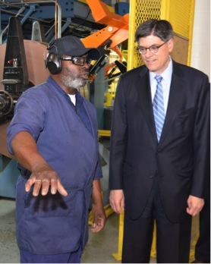
Follow Up and Listen
Seek employee input:
How do you feel about safety at our company?
Do you feel you are heard regarding safety issues?
Would you like to become involved in the safety program?
16
Notes:
During a walk though inspection it’s good to seek employee input asking questions such as:
How do you feel about safety at our company?
Do you feel you are heard regarding safety issues?
Would you like to become involved in the safety program?

Slide 17
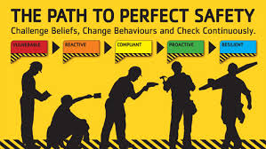
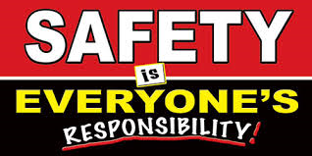
Safety Perception
What is the general attitude toward safety?
Maybe the safety representatives need to look at involvement and awareness publicity that will motivate positive attitudes.
17
Notes:
During a walk through inspection employees’ general perception of safety can be determined.

Slide 18
Inspection vs. Survey
Now let’s look at the difference between an inspection and a walk through survey.
A walk through survey is a “look over” and is used to gather information.
How is an inspection defined?
18
Notes:
There is a difference between a formal safety inspection and a walk through survey:
A walk through survey is a “look over” and is used to gather information.
A safety inspection is a more formal process going into detail as to whether compliance is in effect as well as thoroughly observing processes, procedures and actions regarding overall safety within the workplace.

Slide 19
Inspection vs. Survey
Webster’s II New College Dictionary defines
an inspection as an “official review or
examination”.
What hazards were found?
Were there any safety rule violations?
19
Notes:
An inspection is defined as an “official review or examination.”
What hazards were found during the inspection?
Were there any safety rule violations?

Slide 20
Another Definition
We could define a walk through as a less formal “How’s it going?/ How are we doing?” survey.
20
Notes:
We could define walk through as a less formal “How’s it going?/How are we doing?” survey.

Slide 21
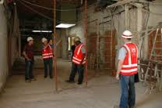
Useful or Not
Is a walk through survey really necessary?
Is it just a “look over your shoulder” check up?
What do we learn from it?
Is it really a necessity?
21
Notes:
Here are some questions that can be asked to determine if a walk through survey is useful or not:
Is a walk through survey really necessary?
Is it just a “look over your shoulder” check up?
What do we learn from it?
Is it really a necessity?

Slide 22
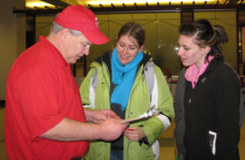
Overall Purpose
Let’s go back to the purpose of the survey.
You wanted a general overview:
22
Notes:
Remember the overall purpose of a walk through survey – to get a general overview of the area being inspected.

Slide 23
Survey Results
How did the walk through survey go?
What information was gathered?
What was the purpose of the survey?
What actions did it generate?
23
Notes:
After the survey is over, a determination needs to be made in order to answer the following questions:
How did the walk through survey go?
What information was gathered?
What was the purpose of the survey?
What actions did it generate?

Slide 24
Value of the Survey
The answers to these questions will show the value of the walk through survey and help determine how often one should be conducted.
It is “good practice” to conduct a survey 2-3 weeks after an inspection and use the information gathered to decide on the necessary survey frequency.
24
Notes:
The answers to the questions asked will show the value of the walk through survey and help determine how often one should be conducted.
It is “good practice” to conduct a survey 2-3 weeks after an inspection and use the information gathered to decide on the necessary survey frequency.

Slide 25
Real Time Information
Walk through surveys yield valuable information to safety committees and safety representatives in determining their goals and how best to carry them out.
Because it is less formal and more in the realm of identifying ways of working together to stay safe, the information is more realistic.
25
Notes:
Walk through surveys yield valuable information to safety committees and safety representatives in determining their goals and how best to carry them out.
Because it is less formal and more in the realm of identifying ways of working together to stay safe, the information is more realistic.

Slide 26
Useful Purpose
Good workplace safety committees and safety representatives are always looking for ways to create greater awareness and involvement on the part and for the good of all employees.
When a walk through survey says “How are we doing?” it also says “How can we help?”
26
Notes:
Good workplace safety committees and safety representatives are always looking for ways to create greater awareness and involvement on the part and for the good of all employees.
When a walk through survey says “How are we doing?” it also says “How can we help?”

Slide 27
Bottom Line
Walk through surveys gather information.
They should also share that information, thereby generating a team effort mentality that says:
We can do better together!
27
Notes:
Walk through surveys gather information.
The information should be shared that information thereby generating a team effort mentality that says:
We can do better together!

Slide 28
Contact Information
Health & Safety Training Specialists
1171 South Cameron Street, Room 324
Harrisburg, PA 17104-2501
(717) 772-1635
RA-LI-BWC-PATHS@pa.gov
Like us on Facebook! - https://www.facebook.com/BWCPATHS
28
Notes:
We invite you to contact us for other free PowerPoint programs which you can use for your in-house programs. Also, please feel to contact us to conduct training for your staff at your location. Other downloadable programs can be found at www.dli.state.pa.us/PATHS under training resources.

Slide 29
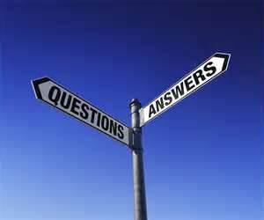
Questions
?????
Questions
& Answers
29

