Slide 1
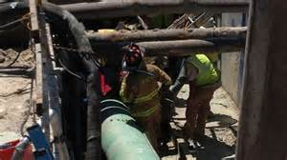
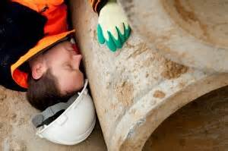
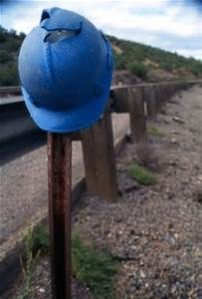
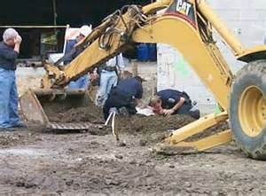
Struck-By Hazards: Construction
Bureau of Workers’ Compensation
PA Training for Health & Safety (PATHS)
Notes:
Struck-by hazards are one of the four most deadly hazards found on a construction site (the other three being falls, electrical and caught-in). Struck-by issues can come from falling, flying and swinging/slipping objects as well as from objects on the ground.

Slide 2
Main Topics
Hazard Recognition
1. Struck-by Falling Objects
2. Struck-by Flying Objects
3. Struck-by Swinging/Slipping Objects
4. Struck-by Objects on Ground Level
B. Accident Prevention
1. Personal Protective Equipment
2. Material Storage
3. Proper Materials Handling
4. Work Zone Safety
Notes:
This presentation will deal with the topics listed.

Slide 3
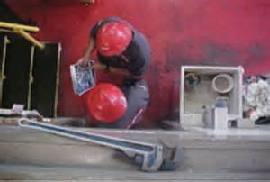
Struck-By Definition
A struck-by hazard refers to an accident in which a worker is hit and injured by an object, tool or equipment. Struck-by hazards are mostly related to improper material and equipment handling and poor housekeeping.
Notes:
A struck-by hazard refers to an accident/incident in which a worker is hit and injured by an object, tool or piece of equipment. Struck-by hazards are mostly related to improper material and equipment handling as well as poor housekeeping.

Slide 4
Struck-By Hazards
Struck-by hazards originate from many sources. The most common include:
Accidental hits by cranes, heavy equipment and loader trucks etc.
Falling, flying, slipping, rolling and swinging equipment and materials
Poorly stacked heavy materials that may fall, slip and slide
Concrete constructions while being constructed
Notes:
There is a myriad of sources that can create a struck-by hazard/incident to include:
Accidental hits by cranes, heavy equipment and loader trucks etc.
Falling, flying, slipping, rolling and swinging equipment and materials
Poorly stacked heavy materials that may fall, slip and slide
Concrete constructions while being constructed

Slide 5
Struck-By Hazards (cont’d)
Poor housekeeping, such as a tools or equipment left on edges or shelves
Objects leaning against walls or posts
Unmarked low beams or pipes at site
No screen guard at site for objects flying off
Unusual work such as demolition of buildings, tree trimming, pruning and felling etc.
Notes:
In addition to the ones already listed, the following situations can also lead to struck-by incidents:
Poor housekeeping, such as a tools or equipment left on edges or shelves
Objects leaning against walls or posts
Unmarked low beams or pipes at site
No screen guard at site for objects flying off
Unusual work such as demolition of buildings, tree trimming, pruning and felling etc.

Slide 6
Struck-By Hazards
Struck-by hazards are one of the four most deadly hazards found at construction sites.
This program will help you recognize common struck-by hazards.
The symbol will tell you if the situation in the picture is either safe or not safe.
Safe
Not safe
Notes:
This module will focus on the hazard of being “struck-by” something. On a construction site, that “something” could be almost anything. You may be struck by materials as they are being moved about the construction site. The bucket of a backhoe may hit you while you are in a trench. If you work near traffic, you may be hit by a motor vehicle. These are only a few examples of how you may be struck by something that can cause great pain or even death.
This program will help you recognize common struck-by hazards and show you ways to decrease those hazards at your job site. By the end of this program, you will be able to recognize and avoid these hazards.
Throughout the program, you will be shown examples of safe and unsafe conditions. Two different symbols will be used to represent safe and unsafe conditions. The red “No” symbol is used to denote unsafe conditions, and the green “Yes” checkmark will be used to show safe conditions.

Slide 7
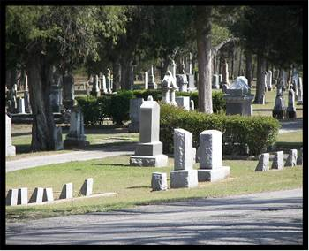
Struck-By Statistics
Each year workers die from ‘struck-by’ accidents. On average:
Deaths from struck-by cases: 583
Deaths in construction: 119
Approximately 10% of deaths in construction are from ‘struck-by’ accidents
Approximately 10% of all occupational deaths are from ‘struck-by’ accidents
Notes:
Each year a surprising number of workers die from being struck-by falling, flying, slipping or swinging objects. These seemingly simple accidents were responsible for 583 deaths in the year 2006. Nearly 10%, or 119, of those fatalities happened in the construction industry. According to the latest Bureau of Labor Statistics, during one year alone there were 5,703 occupational fatalities. This means that approximately 10% of all occupational deaths are a result of being struck-by falling, flying, slipping or swinging objects. In addition, 20.4% of all struck-by deaths in that one year occurred in construction.

Slide 8
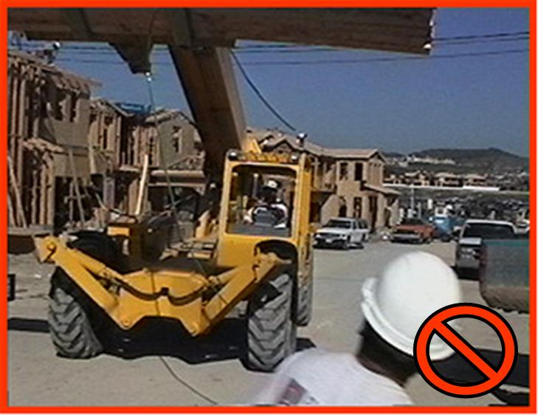
Hazard Recognition
Struck-by hazards exist any time a worker could be struck or hit by an object.
Notes:
A struck-by hazard exists anytime a worker has the potential to be struck or hit by an object. A hammer that falls from a roof, a metal chip “flying” from a grinder, materials that slip out of a choker when being moved, or steel swinging while being moved are all examples of struck-by hazards. Each can cause minor injuries or even death.
As seen on the previous slide, workers die from struck-by injuries each year. For example, a worker is struck by a piece of steel as it is being hoisted into place. The worker is hit in the head and dies from his injuries as a result.
This presentation will cover struck-by hazards that are commonly found on construction sites to include:
Stuck-by falling objects
Struck-by flying objects
Struck-by swinging/slipping objects
Struck-by objects on ground level

Slide 9
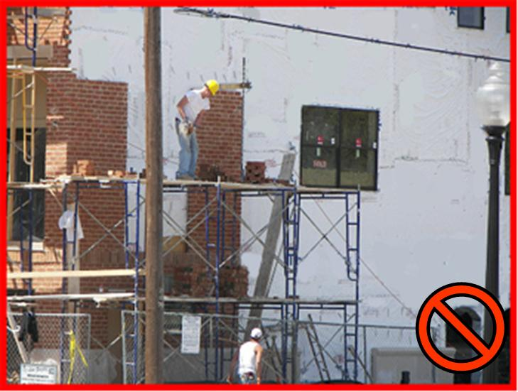
Struck-By Falling Objects
Working or walking below elevated work surfaces may expose you to falling objects.
Notes:
A falling object will eventually land on the ground. On a construction site, the falling object could be building materials, debris, bricks, tools, etc. Objects may fall from elevated work surfaces while they are being moved from one area to another or even while in storage.
If you are working on elevated work surfaces, you are a hazard to all workers who are working below you. Any materials or debris that you throw, drop or push off the work surface have the potential to fall on workers below you.
If you are working or walking below elevated work, you are exposed to falling objects. Falling objects may strike you on the head or any other part of your body. These falling objects are the primary reason you need to wear a hardhat on a construction site. Use toe boards, screens, nets, etc. Objects that can become airborne while pushing or pulling need to be secured. One method is to stack materials to prevent them from sliding, falling or collapsing.
Many times workers will toss materials from one level to another as a quick way to move them. This is extremely hazardous. If the material is not caught, gravity will always draw it back to the ground. Additionally, the materials could fracture and break causing pieces to rain down on the workers below. Never toss or throw materials from one level to another. The materials may fall on you and cause serious injuries or death.

Slide 10
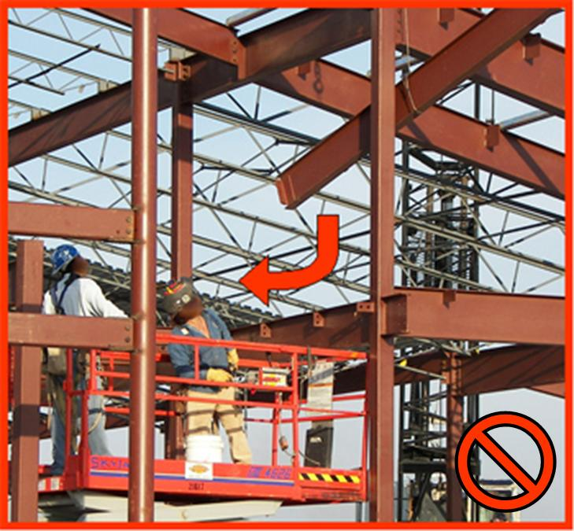
Struck-By Falling Objects
Materials being moved overhead expose you to falling objects.
Notes:
A tremendous amount of materials are moved on, off and around construction sites. Some are moved by hand, but most are moved by mechanical methods. Moving materials by elevated means exposes all workers in the path to potential struck-by hazards, especially if the materials fall.
Many times the materials being moved are not single pieces of material. As the materials are being bundled for handling, make sure all pieces are secured. Unsecured pieces may fall from the load onto workers.
Materials that are being lifted by a forklift can shift causing part or all of the load to fall. Be sure to properly secure the load and do not lift more than the forklift can handle.
Loads that are being moved overhead by cranes can create serious hazards. If the load has not been properly secured it can shift and fall. Anyone working under a falling load may be seriously injured or killed if a load falls on them.
Lifting equipment can place a load that exceeds the surface’s capacity. When placing loads on a concrete structure, especially a new one, make sure the concrete can support the load.

Slide 11
Struck-By Falling Objects
Keep a safe distance from suspended loads.
Notes:
Never place yourself under a suspended object or load of material. As materials are being placed, you need to keep a safe distance so you do not get hit by the load.

Slide 12
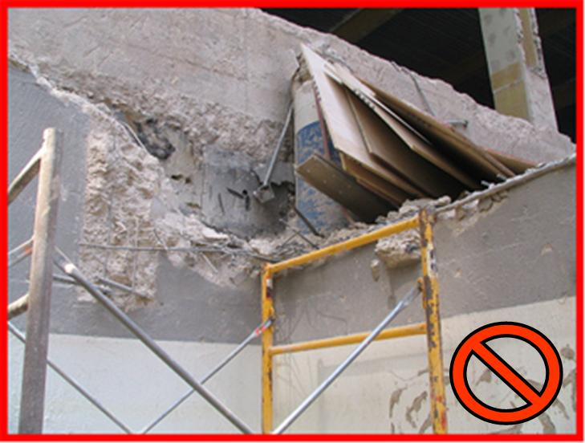
Struck-By Falling Objects
Store materials properly.
Notes:
Materials that are placed on an elevated storage or receiving area have the potential of falling onto workers. As materials are being moved the entire load can fall or parts of the load can fall onto workers below, possibly causing serious injury.
Working below material storage areas also exposes you to falling objects. Materials that are improperly stored have the potential to shift and fall.
Remember, objects that fall are dangerous. Anytime you are in the path of a falling object you can be injured or killed.

Slide 13
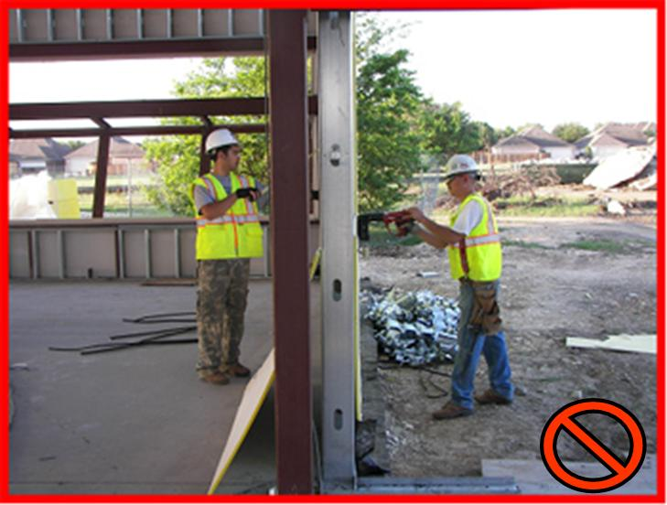
Struck-By Flying Objects
Power tools and activities such as pushing, pulling, or prying can create flying objects.
Notes:
Users of power-actuated tools must be trained and licensed to operate. Before using power tools make sure:
To wear appropriate PPE.
To be trained to properly operate the tool according to manufacturer’s instructions.
To inspect the tool before using.
That all guards are in place, and guard rotating and moving parts.
When using hand tools make sure not to use:
Wrenches when jaws are sprung; the wrench might slip.
Impact tools (chisel, wedges) when the heads have mushroomed; heads might shatter on impact sending fragments towards the worker or others.
Tools with loose, cracked or splintered handles; the head of the tool may fly off and strike the worker or others.
Screwdrivers as a chisel; the tip may break off and hit the worker or others.
There is a danger of being struck-by flying objects when using power tools, or when being involved in activities like pushing, pulling, or prying. These types of activities may cause objects to become airborne. Flying objects are those objects that have been discharged or dislodged from something. These objects are typically propelled from their source and can cause greater injury due to the forces behind them. An example of a discharged object is a nail from a nail gun. The nail is propelled from the gun by force, it is discharged. This force can be either pneumatic or powder actuated and is powerful enough to drive nails or other fasteners through concrete. It is definitely strong enough to drive a nail through you.
A cable under tension that suddenly breaks free is an example of a dislodged object. When striking metal with metal, such as when driving a stake into the ground with a sledge hammer, pieces of the metal can fly off and strike you.

Slide 14
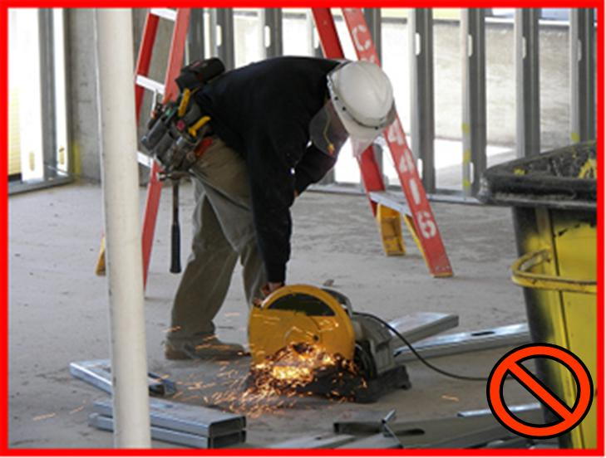
Struck-By Flying Objects
Grinding or striking materials can create flying object hazards.
Notes:
When you grind or strike objects, pieces can fly off and strike you. These flying objects can lodge in your eyes and cause blindness. If they strike you in other parts of your body, they may cause serious injuries, serious infections, or even death if they strike you in the head.
Always wear the proper PPE to protect yourself.

Slide 15
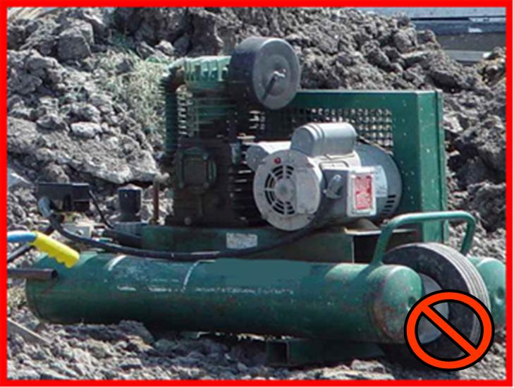
Struck-By Flying Objects
Air pressurized above 30 psi can drive oils and other particles through your skin.
Notes:
Compressed air is commonly used to clean surfaces. Unfortunately, many workers also use compressed air to clean dirt and debris off their clothing and body. Compressed air blows particles into the air around you and can blow those particles into your eyes or body. Air pressurized above 30 psi can drive oils and other particles through your skin.
Preventive measures are:
Reduce air pressure to 30 psi or less for cleaning
Use proper PPE (eye protection specially)
Don’t use on yourself to clean clothing
These flying particles can be extremely hazardous. These flying particles can cause serious permanent injury including blindness.

Slide 16
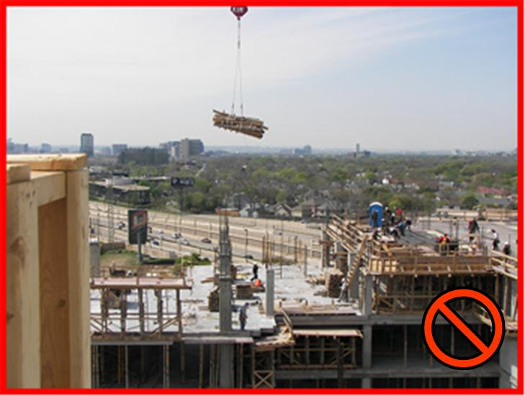
Swinging/Slipping Objects
Do not work under loads as they are being lifted.
Notes:
When materials are lifted, they have the potential to swing and strike workers. As the load is lifted, the materials may swing, twist or turn. This movement may catch workers by surprise and they may be hit by the swinging load. Depending on where the worker is standing and the force behind the load, the worker may fall to another level after being struck and sustain even greater injuries.
Windy conditions are especially hazardous because the load will swing even more. Never lift overhead loads on windy days.
Always lift loads evenly. An uneven load may swing out of control striking workers and damaging equipment.
Do not work under loads as they are being flown to upper levels.

Slide 17
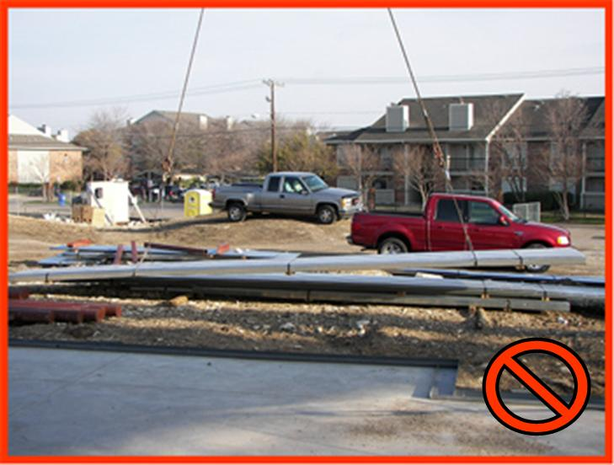
Swinging/Slipping Objects
Secure all loads and lift them evenly to prevent them from slipping.
Notes:
Loads must be lifted evenly. As the load is being secured, the rigging must be placed to evenly distribute the weight of the load. A load that is lifted unevenly has the potential to slip. Objects that slip may fall from their riggings and strike you or other materials. In addition to the personal injuries that may happen, building structures and other equipment can be damaged.
Once the load is properly secured and balanced, a tag line can be used to control the load. Even if a tag line is used, the load can still swing and strike workers. Remember, as the load is lifted, the tag line will lift until it is out of reach.

Slide 18
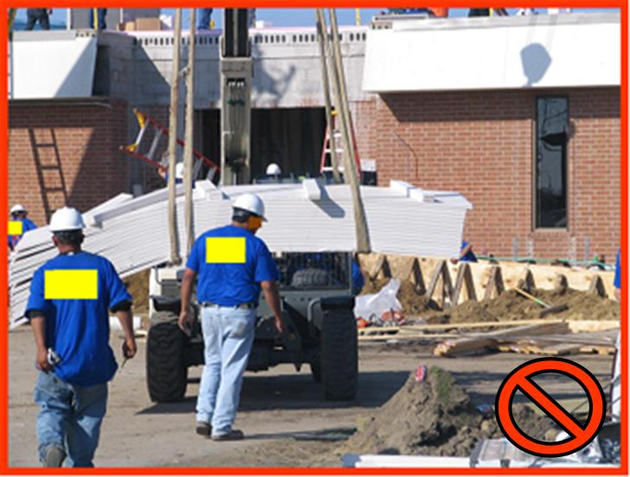
Objects on Ground Level
You may be struck by moving materials.
Notes:
You may be at the greatest risk for a struck-by accident when working at ground level. At ground level, you may be exposed to struck-by hazards from materials, heavy equipment, vehicular traffic, or traffic in a work zone area.
You may be struck-by materials as they are moved around the site. Equipment operators must lower the load so they have an unobstructed view while moving materials. You also have a responsibility to be aware of your surroundings and to stay out of harms way.
Operators of powered industrial trucks, such as forklifts, must be trained and certified to operate the forklift safely. Follow safe operating procedures for picking up, moving, putting down, and stacking loads. When stacking materials, height limitations must be observed. Do not handle loads that are heavier than the capacity rating indicated for the industrial truck or lift capacity. Operate at a safe speed and never exceed 5 mph and slow down in congested or slippery surfaces. Avoid traveling with elevated loads. Make sure that the brakes, horns, steering, forks, and tires are in good working condition. When lifting and lowering material, look around for hazards (workers and objects). Clear all personnel and lower the blades.

Slide 19
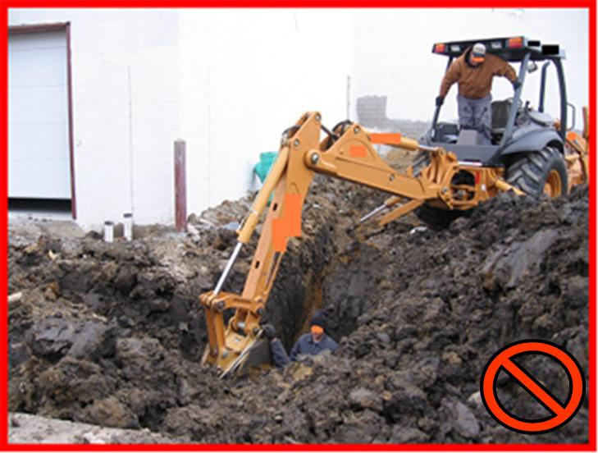
Objects on Ground Level
Heavy equipment can create serious struck-by hazards.
Notes:
Working around heavy equipment is very hazardous. All heavy equipment on the work site is a hazard. These machines are bigger than you and very powerful. Heavy equipment is used to dig holes, deliver concrete, tear down buildings, pick up materials and various other tasks as needed. Without them, construction as we know it would not exist.
The disadvantages of using heavy equipment are that they are dangerous and often the operators have a limited view. Your life is in danger if you assume that the operator has seen you. The operator must acknowledge that you have been seen; maintain eye contact with operator. Many workers have been struck and then run over by heavy equipment.
Heavy equipment also has many moving parts that you can be struck by. For instance, the arm of a backhoe or excavator swings in multiple directions as it works. If you are in its path, you may be struck. Many workers have been killed by the bucket of a backhoe or excavator. When working near these types of equipment, you need to stay beyond the reach of the arm and maintain eye contact with the operator.
Backhoe or excavator buckets can also drop dirt and other debris on you while you are working near them.

Slide 20
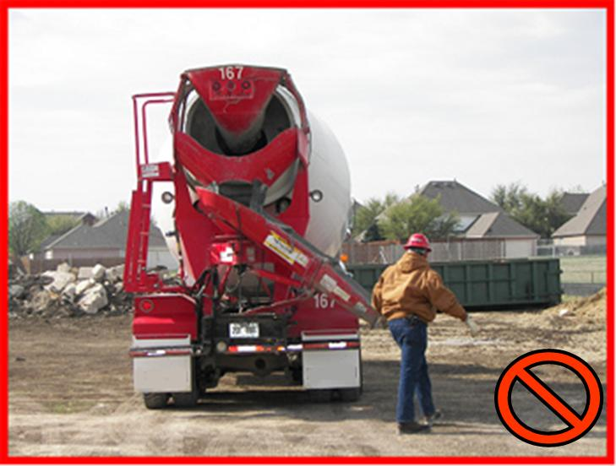
Objects on Ground Level
All traffic on construction sites can create struck-by hazards.
Notes:
Construction vehicle traffic is constant on construction sites. The traffic may be vehicles delivering materials to the site, heavy equipment working on the site, personal lifts, or equipment moving materials.
If you are driving the vehicle you must:
Always use the safety belt;
Always drive in designated areas;
Always use a spotter when backing and use audible reverse signals;
If on an incline, park, use safety brake, chock the wheels; and
When lifting and lowering materials look around for hazards (workers and objects)
Always watch for workers who may not be watching you.
If you are working near vehicles and equipment, you must:
Wear reflective vest;
Never place yourself between a vehicle and an immovable object such as a building;
Make eye contact with the operator before crossing the path of the vehicle; and
Always watch for operators who may not be watching you.
When working with vehicles that have moving parts, such as the chute on this concrete truck, do not let them swing freely. Secure all movable parts so they will not strike workers.

Slide 21
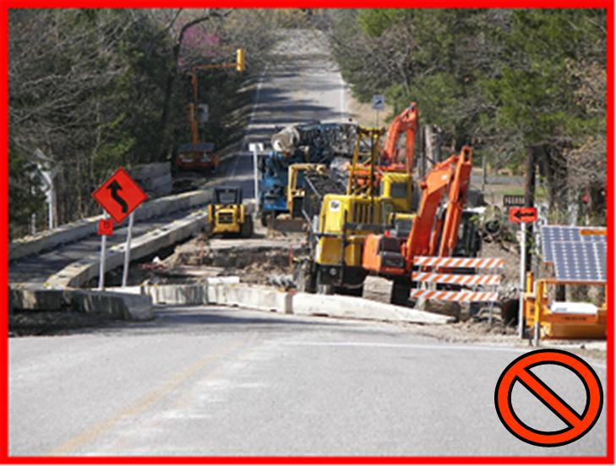
Objects on Ground Level
Workers in work zones are exposed to struck–by hazards from construction equipment and motorist vehicles.
Notes:
Workers in work zones are exposed to risk of injury from the movement of construction vehicles and equipment within the work zones, as well as from passing motor vehicle traffic. Flaggers and other workers on foot are exposed to the risk of being struck by traffic vehicles or construction equipment if they are not visible to motorists or equipment operators. These workers and others in traffic work zones must protect themselves from being struck-by motorists who are often driving too fast for the conditions, driving in unfamiliar areas, and those who are distracted while driving. For these reasons and others, workers are at great risk of being struck-by a motor vehicle.
One of the most important things you can do when working in a work zone is to be visible. You need to be visible to other workers as well as passing motorists

Slide 22
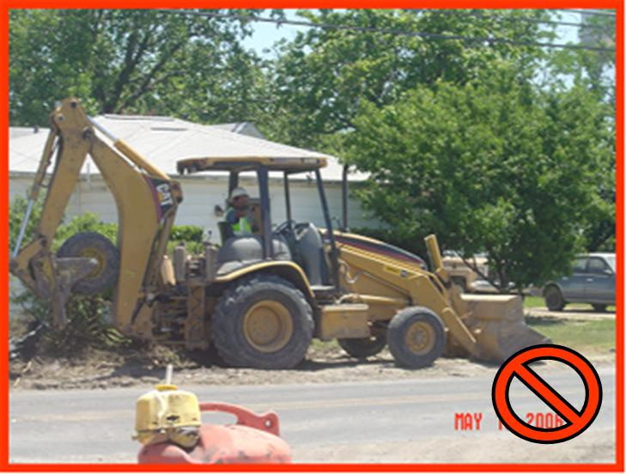
Objects on Ground Level
Never work near vehicle traffic without barricades.
Notes:
When working near roadways workers must be protected from vehicle traffic. Never work near vehicle traffic without barricades to keep motorists from entering the work zone.

Slide 23
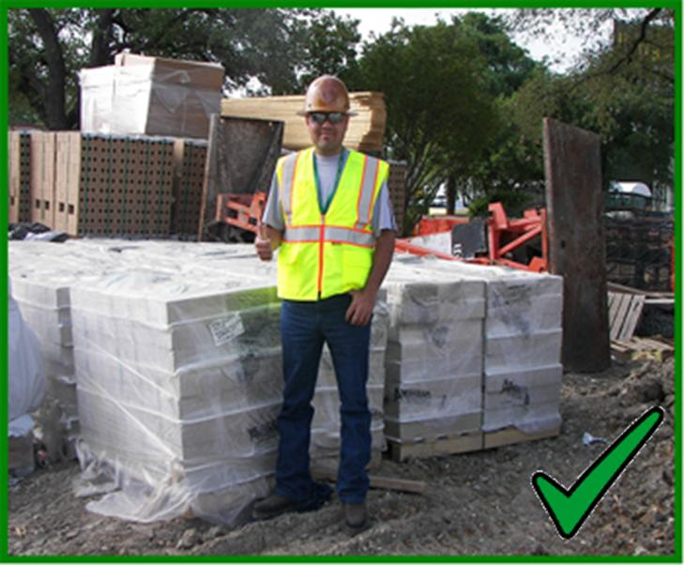
Accident Prevention
A willing, positive attitude towards safety will help make a safer work environment.
Notes:
You must recognize potential hazards around you and make every effort to avoid and reduce these hazards. The previous slides showing various struck-by hazards were used to help you recognize hazards on the job. Hazard recognition is the first step in having a safe workplace. But you must do more. Once you recognize the hazard, you must do something about it. By controlling or eliminating the hazard, you have made the workplace safer.
Remember, safety starts with you. You need to have a willing, positive attitude towards safety in the workplace. You have people depending on you everyday and they expect you to come home alive and well. Practicing safety on the job will allow you to go home to the ones you love.
In the following section we will focus on the methods used to control struck-by hazards.

Slide 24
Accident Prevention
Plan your work and look for potential hazards.
Each task will have different hazards.
Notes:
Struck-by hazards can be found in many different areas of construction work. For this reason it is important to plan your work and look at the possible hazards every day. Specific activities will have different hazards and you will have to deal with each hazard individually.
Prevention is the key to reducing struck-by injuries and fatalities. You have seen examples of struck-by hazards and now we will focus on how to prevent or correct the hazards.

Slide 25
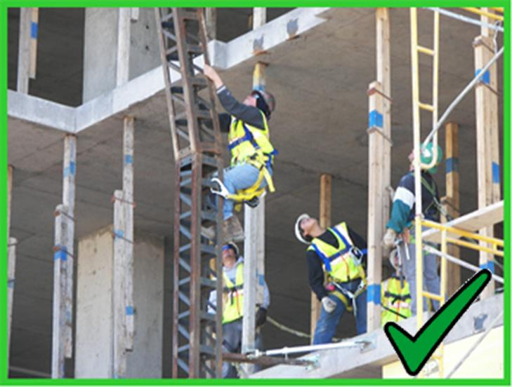
Personal Protective Equipment
Wear a hardhat if overhead hazards exist
Overhead hazards are for example falling and flying objects, or objects that you may bump into.
Notes:
One way to protect yourself from injury from struck-by hazards is to wear PPE. Anytime you work in an area where there are overhead hazards, you must wear a hardhat. The hardhat will prevent injury if materials fall on your head.
A hardhat can protect you from:
Objects that have fallen,
Objects that are flying, and
Objects that you may bump into.
Do not wear a hardhat backwards. Do not use a hardhat for storage. Never place anything between the inside of the hardhat and your head.
Never wear a damaged hardhat. If your hardhat is damaged, remove it and get another one. A damaged hardhat will not protect you.

Slide 26
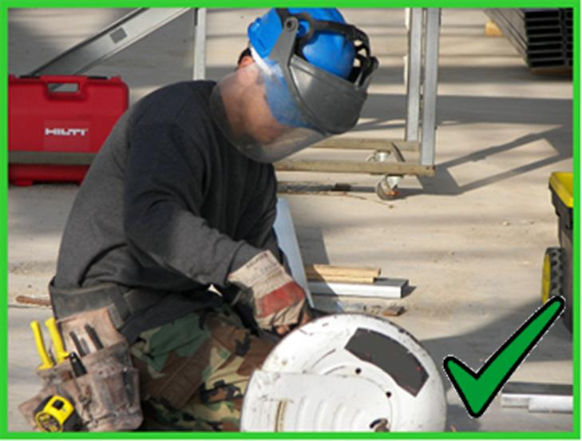
Personal Protective Equipment
Wear safety glasses or a face shield if flying hazards exist.
Notes:
Flying objects can strike you on any part of your body. Reduce injuries from these types of hazards by wearing appropriate PPE to protect, eyes, ears, face, head, feet and other parts of the body from the hazards present.
It is very important to protect your eyes, wear eye protection such as goggles to prevent serious injuries including blindness.
If you are in an area where pneumatic or powder actuated tools are used, you must use PPE (e.g. hearing protection, eye protection, proper foot protection and hard hat). Workers have been shot with nail guns in the head, eyes and other areas. In many instances PPE prevented serious injury and even death.
If you are using compressed air to clean with, you must wear eye and face protection to prevent flying particles from injuring you.
Always wear PPE when you can be struck-by flying objects.

Slide 27
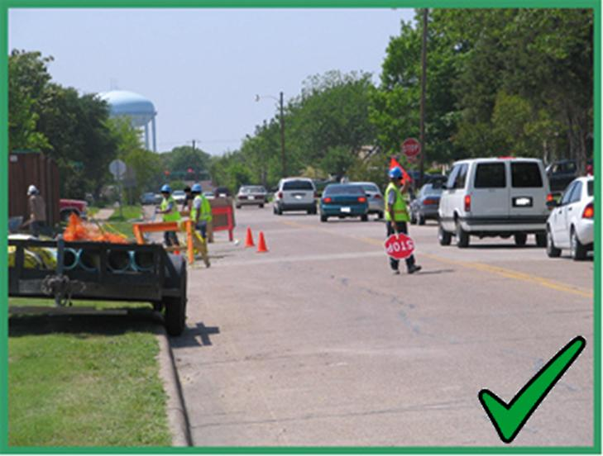
Personal Protective Equipment
A highly visible reflective vest will allow motorists and equipment operators to see you.
Notes:
In order to make yourself more visible to motorist traffic, you must always wear a reflective vest when working in or near a traffic work zone area. This traffic includes construction traffic and general motorist traffic.
A highly visible reflective vest may be the only thing that catches the eye of a motorist and prevents them from hitting you.
Working in a traffic work zone without wearing a safety vest is the same as wearing camouflage in the woods. You cannot be seen! It is extremely dangerous to blend into a work zone. You must be seen to be protected.

Slide 28
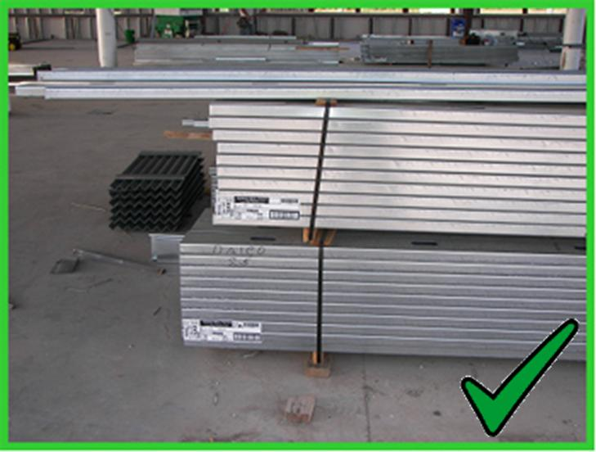
Material Storage
Secure materials so they do not fall on workers.
Notes:
All stored materials must be stored properly to prevent them from falling on workers. Proper storage means that all materials must be stored in such a way that they do not shift, lean, or fall. They must be stacked, racked, blocked, and interlocked to prevent them from sliding, falling, or collapsing.
Never store materials within 6 feet of a hoist way. Materials stored inside buildings under construction shall not be placed within 6 feet of any hoist way or floor openings, nor within 10 feet of an exterior wall which does not extend above the top of the material stored. Materials shall not be stored on scaffolds in excess of supplies needed for immediate operations.
When storing materials that will be picked up with a forklift or other mechanical means, place them on blocks so the forks can pick them up easier.
Secure materials with bands to keep them together so they will not fall.
Never stack materials on a surface that cannot hold the weight.

Slide 29
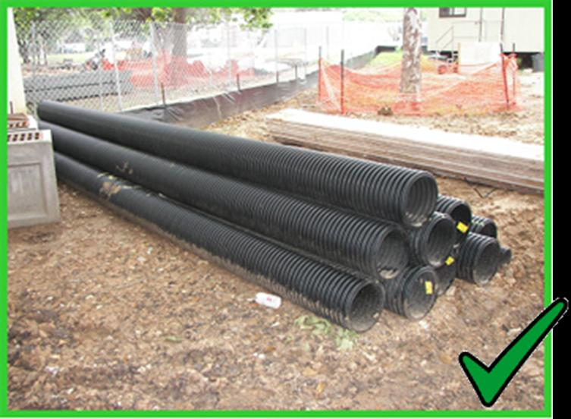
Material Storage
Maintain proper house-keeping in all storage areas.
Notes:
To prevent struck-by hazards in storage areas, make sure the area is kept free from tripping, fire, and explosion hazards.
Any of these hazards can lead to a struck-by injury.

Slide 30
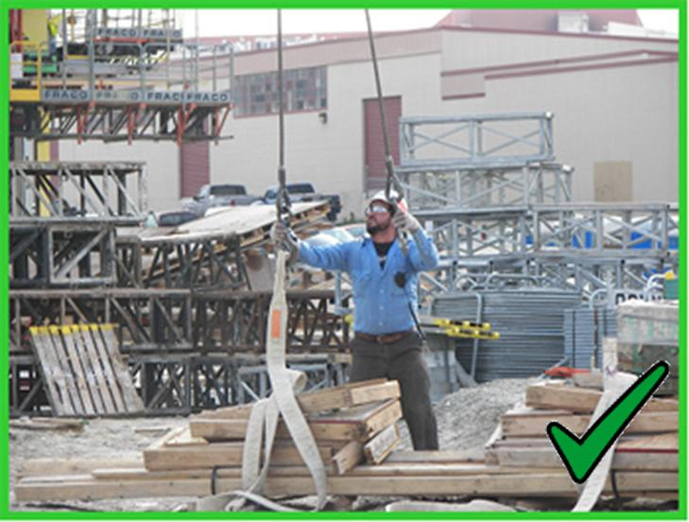
Proper Material Handling
Inspect all rigging before using.
Never work under a suspended load
Stay clear of loads as they are being lifted
Notes:
Material handling includes the moving, lifting and storing of materials. Handling materials properly means handling them so workers do not get injured.
Prior to lifting a load, all rigging must be inspected by those qualified to ensure that it is safe. The rigging includes slings, chains, wire rope, natural and synthetic rope, and shackles and hooks. If any part of the rigging is defective, it must be removed from service.
Once the rigging has been inspected, the materials need to be secured so the load does not shift, slip and fall onto others. Always remember not to exceed the lifting capacity.

Slide 31
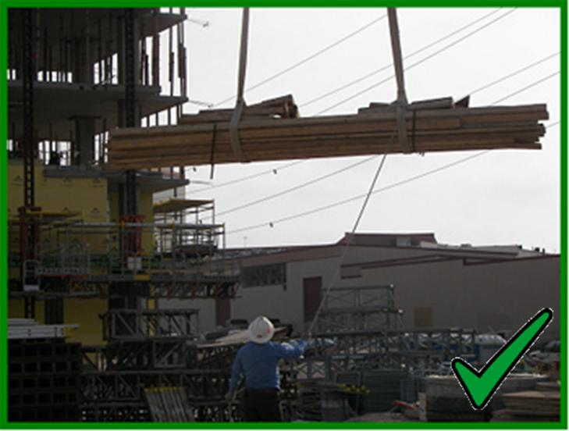
Proper Material Handling
Never walk or work under a load.
Notes:
Once the load is properly secured and rigged, it is ready to be lifted. Most often, loads are lifted using a crane that has a rated capacity to lift the weight.
As the load is being lifted, swinging and slipping hazards are likely to occur. If the load is properly secured, it should not slip. Swinging hazards can be caused by windy conditions or the act of lifting.
As the load is being picked up, it may swing or twirl as the weight is shifted. Workers need to stay clear of loads as they are being lifted and never walk or work under a suspended load.
Never lift loads on windy days. If the wind is high enough it can cause the load to swing out of control. Once the load starts swinging, it can injure workers, damage buildings, or even topple the crane.
The use of a tag line can help guide the load as it is being raised and lowered. Remember, even when using a tag line, do not walk under the load. You need to be out of the path of the load if it falls.

Slide 32
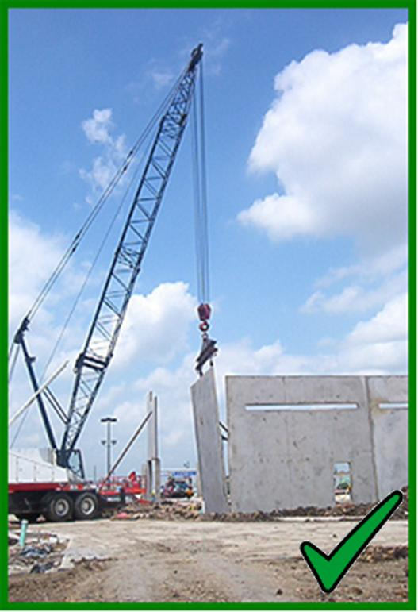
Proper Material Handling
Never lift a load that is greater than the crane’s lifting capacity.
Notes:
Cranes are carefully designed, tested, and manufactured for safe operation. When used properly they can safely lift or move loads. Because cranes have the ability to lift heavy loads to great heights, they also have an increased potential for catastrophic accidents. Safe lifting practices must always be followed.
Never try to lift a load that is greater than the crane’s lifting capacity.
Crane operators and personnel working with cranes need to know the basics of the crane’s lifting capacities, limitations, and specific job site restrictions. Operators and workers must also be aware of the location of overhead power lines, unstable soil, and high wind conditions.
Cranes must be inspected prior to the start of each day.
Workers working around crane operations also need to be aware of hoisting activities.

Slide 33
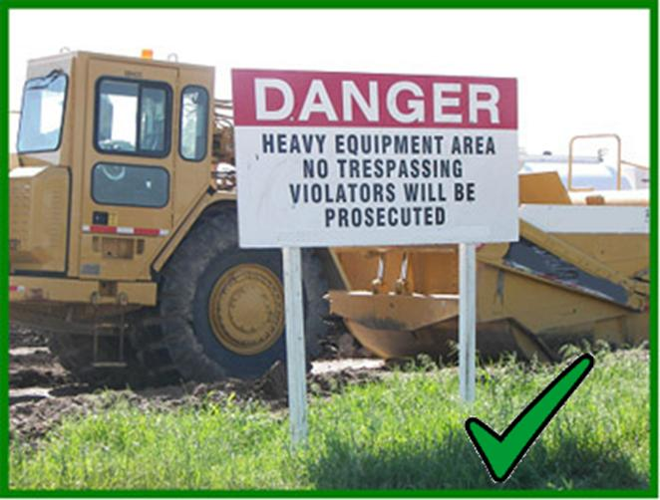
Work Zone Safety
Use extreme caution when approaching heavy equipment. Only authorized personnel are allowed to get in the work zone
If heavy equipment is been operated, always make eye contact with operator before approaching equipment
Never approach moving heavy equipment
When stopped, never approach it from behind, always approach if from the front or the sides as long as you are making eye contact with equipment operator.
Make sure you are wearing the appropriate PPE before you approach heavy equipment (eye, head, foot protection)
Notes:
Anytime you are working near heavy equipment or motor vehicle traffic you are at risk from serious struck-by injuries. Equipment operators and motorists may not be able to see you or may be unaware of your presence. Be sure to use safe work practices and make yourself visible.
Work Zone Safety:
Use proper illumination for night work.
Use flag personnel to direct and divert traffic.
Use barricades to alert others that the area is off limits or to approach with caution.
Wear a reflective vest and proper PPE as needed.
Make sure all construction vehicles have working back-up alarms that are audible above the surrounding noise level.
Inspect vehicles and equipment before each shift.
Install back-up alarms on all equipment. The operator will not be able to see you if you are behind the equipment. If a back-up alarm is installed workers will be able to hear when the equipment is moving. Make sure all equipment has working brakes. Always wear a seatbelt.

Slide 34
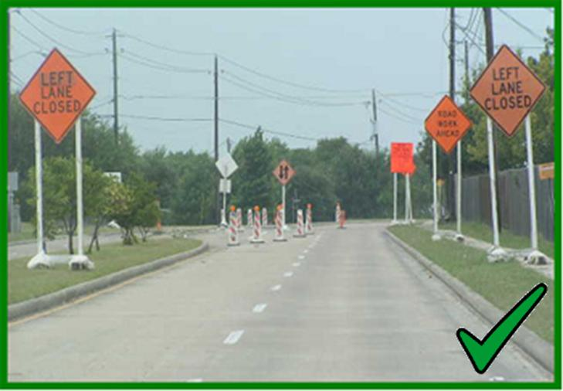
Work Zone Safety
Traffic work zones must be clearly marked to make motorists aware of the work ahead.
Notes:
Traffic work zones will always have serious hazards. You need to be aware of the hazards associated with work zones and protect yourself. Work zones have the added hazard of motorist traffic. Each year workers are killed when motorists cross into the work zone and strike workers. Motorists tend to be distracted and may be speeding while driving through a work zone. You need to protect yourself from them and their car.
When working in a traffic work zone, you must conform to the Manual on Uniform Traffic Control Devices. The Millennium Edition has been incorporated by reference into the OSHA standards. This manual sets the practices that must be used to keep workers safe while in work zones.
Traffic work zones must be clearly marked to make motorists aware of the work and to ensure your safety. In many states, traffic violations are increased in traffic work zones. When motorists are paying attention to their driving and the work going on, workers are safer.

Slide 35
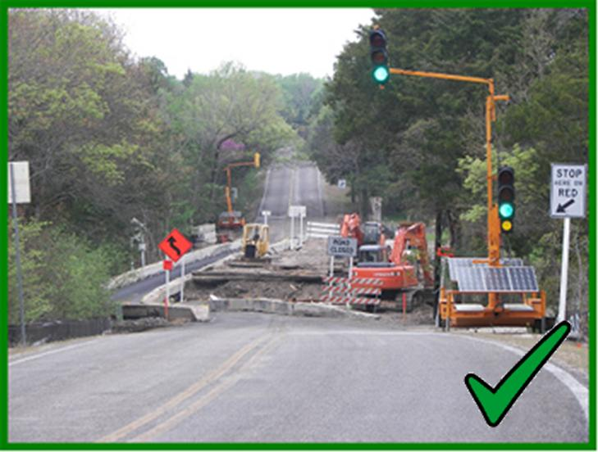
Work Zone Safety
Use physical barriers to protect workers from vehicle traffic.
Notes:
The purpose of traffic control devices is to promote highway safety. Traffic control devices notify road users of what is ahead and provides warnings for their safety and yours.
Physical barriers will protect workers from vehicle traffic and guide the motorist through the work zone. A physical barrier will prevent drivers from entering the zone where they can strike you.
Physical barriers can only protect workers if they separate the worker and the traffic. To protect workers while physical barriers are being placed, traffic must be stopped or re-routed to keep motorists out of the work zone.

Slide 36
Struck-By Hazard Prevention
To reduce struck-by hazards at a workplace, the following preventive actions are recommended:
Follow safety instructions and standard operating procedures
Training of personnel that use the equipment and orientation with the workplace
Supervision and monitoring
Safety inspections and audits
Use of appropriate personal protective equipment (PPE) by the workers, such as clothing, headgear, and safety glasses
Notes:
Always take the initiative to prevent struck-by and other hazards in the workplace! Here are some preventive actions for struck-by hazards:
Follow safety instructions and standard operating procedures
Training of personnel that use the equipment and orientation with the workplace
Supervision and monitoring
Safety inspections and audits
Use of appropriate personal protective equipment (PPE) by the workers, such as clothing, headgear, and safety glasses

Slide 37
Struck-By Hazard Prevention
Marking all hazardous areas and have administrative control for visitors including notices and signs
Maintaining good housekeeping, such as stacking and piling of materials appropriately
Arrange appropriate nets to prevent or catch falling objects
Secure tools and equipment with lanyards to the workers to prevent them from falling
No lifting equipment or loads beyond an equipment's designed capacity
All lifting equipment must be tested and inspected before use
Notes:
In addition to those already mentioned, here are some other prevention actions that should be followed:
Marking all hazardous areas and have administrative control for visitors including notices and signs
Maintaining good housekeeping, such as stacking and piling of materials appropriately
Arrange appropriate nets to prevent or catch falling objects
Secure tools and equipment with lanyards to the workers to prevent them from falling
No lifting equipment or loads beyond an equipment's designed capacity
All lifting equipment must be tested and inspected before use

Slide 38
Contact Information
Health & Safety Training Specialists
1171 South Cameron Street, Room 324
Harrisburg, PA 17104-2501
(717) 772-1635
RA-LI-BWC-PATHS@pa.gov
Like us on Facebook! - https://www.facebook.com/BWCPATHS

Slide 39
Questions

Slide 40
Working Team for this Program
UNIVERSITY OF PUERTO RICO
MEDICAL SCIENCES CAMPUS
Graduate School of Public Health, Dep. of Environmental Health
Sergio Caporali, Ph.D., CSP – Principal Investigator
Lida Orta-Anés, Ph.D., Field Trainer
Marcilyn Colón Colón, MSc., Training Coordinator
Harlyn Rivera, Administrative Assistant
Notes:
This presentation has been adapted from OSHA’s 10/30 hour Construction Safety Training Course.

Slide 41
Working Team
CONTRACTORS
Circe E. Niezen, ME, MBA, Training Evaluator, PUPR
Mark Fullen, Ph.D. Candidate, Field Trainer and Curriculum Developer, WVU
Carmen Vázquez, RN, Field Trainer
Migdalia Ruiz, MS, Field Trainer
Carlos Ortiz, Ph.D., Online Training Administrator, UPR-CPRS-OIRE
Eliel Melón Ramos – Online Training Adm. Assistant, UPR-CPRS-OIRE

