Slide 1
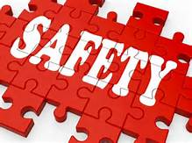
Safety Management System
Bureau of Workers’ Compensation
PA Training for Health & Safety (PATHS)
Notes:
The International Air Transport Association defines a Safety Management System (SMS) as being a systematic approach to managing safety, including the necessary organizational structures, accountabilities, policies and procedures.
Another definition of an SMS is a businesslike approach to safety. It is a systematic, explicit and comprehensive process for managing safety risks. As with all management systems, a safety management system provides for goal setting, planning, and measuring performance.

Slide 2
Safety Management System
A Safety Management System is:
A pro-active, risk based approach to managing safety throughout an organization
Notes:
An SMS provides a systematic way to identify hazards and control risks while maintaining assurance that these risk controls are effective.

Slide 3
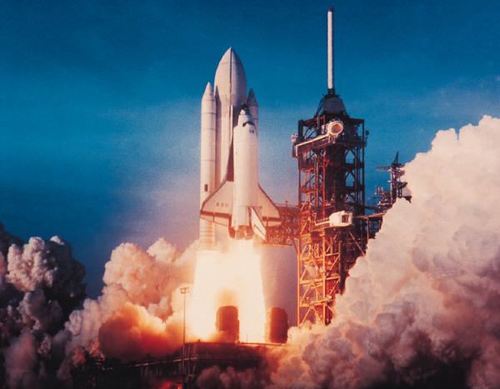
Safety Management System
A Safety Management System is not:
Rocket Science
Magic
Notes:
An SMS is not “rocket science” or “magic.”
There are three imperatives for adopting a safety management system for a business – these are ethical, legal and financial.

Slide 4
KISS method of a SMS
Four key elements:
Safety Policy
Risk Management
Safety Assurance
Safety Promotion
Notes:
To be effective an SMS needs the following four key elements:
Safety Policy
Risk Management
Safety Assurance
Safety Promotion

Slide 5
The Four SMS Components
Safety Policy Establishes senior management’s commitment to continually improve safety; defines the methods, processes and organizational structure needed to meet safety goals.
Safety Assurance Evaluates the continued
effectiveness of implemented risk control strategies; supports the identification of new hazards.
Safety Promotion
Policy
Safety Risk Management Determines the need for and adequacy of, new or revised risk controls based on the assessment of acceptable risk.
Safety Promotion Includes training, communication and
other actions to create a positive safety culture within all levels of the workforce.
SRM
SA
Notes:
To have a successful SMS each of the four key elements needs to be given the same “weight” when developing the system.

Slide 6
Safety Policy
Use clear unambiguous language
Incorporate two key principles
Do it safely or not at all
There is always time to do it right
Consider work-stop authority
Notes:
The first element of an SMS is the actual safety policy.
To ensure the policy is adequate and applicable to the organization the following should be given thought:
Use clear unambiguous language
Incorporate two key principles
1. Do it safely or not at all
2. There is always time to do it right
Consider work-stop authority

Slide 7
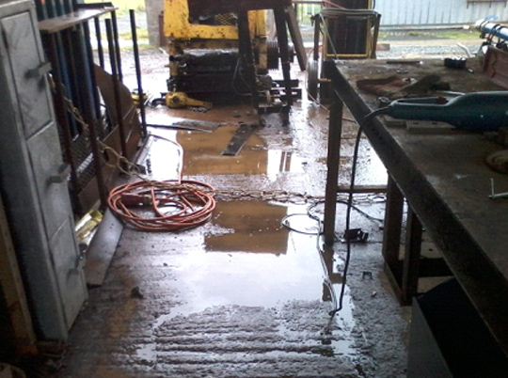
Risk Management
Risk Management is:
Recognizing a dangerous situation or condition
Looking at a situation and trying to see how it could fail
Notes:
The second element of a good SMS is Risk Management consists of:
Recognizing a dangerous situation or condition
Looking at a situation and trying to see how it could fail

Slide 8
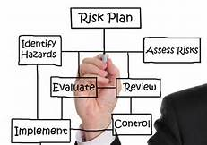
Risk Management
Risk Management is:
Analyzing job tasks, records, inspections, prioritizing issues and developing corrective action plans
Consider using a risk matrix
Notes:
Risk management is also:
Analyzing job tasks, records, inspections, prioritizing issues and developing corrective action plans
Consider using a risk matrix

Slide 9
Risk Management
SEVERITY
How much could hazard hurt? (“Ouch Factor”)
Not at All
Not Much
A Lot
HMMM? | OUCH! | OUCH!*@
PERHAPS | HMMM? | OUCH!
OKAY | PERHAPS? | HMMM?
A Lot
Not Often
Not at All
Notes:
In addition, Risk Management will take into consideration how often a hazard occurs as well as how much affect on the operation, people and facility the hazard can have.

Slide 10
Risk Management
Consider assigning responsibilities to certain staff members for managing risk in their department
Notes:
As part of the Risk Management element of an SMS consideration should be given to assigning responsibilities to certain staff members for managing risk within their department.

Slide 11
Safety Assurance
Constantly observe every aspect of your operations
“You can observe a lot by just watching”
Analyze your data. Are things getting better or worse?
Look as past claims, incidents, injuries
Record near misses
Look for processes that do not have the desired outcome, then ask what and why
Notes:
The next element of an SMS is Safety Assurance.
As part of this element:
Constantly observe every aspect of your operations
“You can observe a lot by just watching”
Analyze your data. Are things getting better or worse?
Look as past claims, incidents, injuries
Record near misses
Look for processes that do not have the desired outcome, then ask what and why

Slide 12
Safety Promotion
Managers and supervisors should talk it up!
Make safety part of daily conversations
Get people on board by making your organization’s commitment to safety known
Make it part of your culture, make it the way you do business
Notes:
The final element of the SMS is Safety Promotion.
The element is very important because it allows employees to understand that safety is a priority within the organization.
As part of this element:
Managers and supervisors should talk it up!
Make safety part of daily conversations
Get people on board by making your organization’s commitment to safety known
Make it part of your culture, make it the way you do business

Slide 13
The Reality
SMS implementation will not be effortless
Most “good” things do require some level of effort
Be patient
Results will not occur overnight
The positive changes are worth the patience and effort
Notes:
Establishing and maintaining a good SMS takes dedication and effort.
Expect that results will not occur quickly – don’t become discouraged!

Slide 14
Contact Information
Health & Safety Training Specialists
1171 South Cameron Street, Room 324
Harrisburg, PA 17104-2501
(717) 772-1635
RA-LI-BWC-PATHS@pa.gov
Like us on Facebook! - https://www.facebook.com/BWCPATHS

Slide 15
Questions

