Slide 1
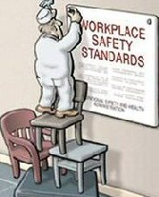
SAFETY CULTURE
Bureau of Workers’ Compensation
PA Training for Health & Safety (PATHS)
PART 2:
How to Establish and Maintain a Positive Safety Culture
Notes:
This presentation will give some ideas and information for consideration for organizations that would like to establish a positive Safety Culture. It is not meant as a comprehensive program nor is it designed to provide all the answers for establishing a “good” safety culture. However, the information provided can be used as a starting point for getting to the end result of incident prevention.

Slide 2
What We’ll Talk About
Safety Culture – Where to Start
Accident Causes
Employee Awareness
Accident/Injury Prevention
Teamwork/Teambuilding
Safety Accountability
Incentive Programs
Notes:
This presentation will address:
Safety Culture – Where to Start
Accident Causes
Employee Awareness
Accident/Injury Prevention
Teamwork/Teambuilding
Safety Accountability
Incentive Programs

Slide 3
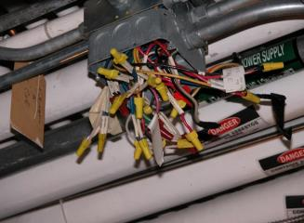
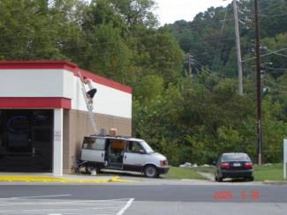
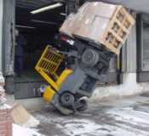
Who Needs Safety?
ALL OF US!
Notes:
Safety is something that all employees need to give a top priority to both on and off the job. Employees need to be responsible for and consider safety whether they just started at the company, have been employed there for a while, are “rank and file” or are part of management.

Slide 4
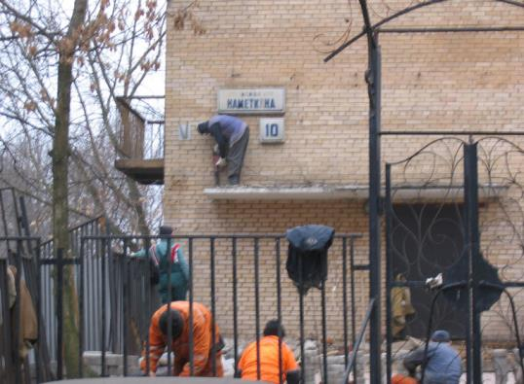
Safety Culture
Do you think your organization has a positive safety culture?
Let’s see the hands – how many think their company has a positive safety culture?
Notes:
This situation is certainly not safe and looks more like something from a 3 Stooges production than a job task being performed. Keep in mind that many times employees will do their best to accomplish a task whether they’ve been properly trained, have the correct tools and equipment, and/or are physically capable. Telling an employee to “get her done” but not ensuring they understand they are to complete all tasks in a safe and correct manner is basically inviting an incident to occur.

Slide 5
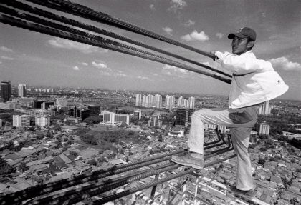
Safety Culture = Definition
“The enduring value and priority placed on worker and public safety by everyone in every group at every level of an organization.”
Human Factors & Ergonomics Society
Notes:
So how does a person know if their organization has a positive Safety Culture? How does management know how employees truly feel about safety? One method is to have employees complete a “Safety Culture Assessment” which is what we’re going to do right now. Once everyone has completed the survey we’ll discuss the rating system used on the last page as well as what the overall perception of everyone who just filled out the survey.

Slide 6
Safety Culture Defined
“The product of individual and group values, attitudes, perceptions, competencies and patterns of behavior that determine the commitment to, and style and proficiency of, an organization’s health and safety management.”
Notes:
Here’s another definition of safety culture. This definition focuses on the importance of individuals and groups and how they influence the overall safety culture within an organization.

Slide 7
Safety Culture Defined
“A mindset that has its roots in the organization’s policies, philosophies and management approaches.”
Angelo Pinheiro, Project EHS Manager, Marathon Oil Corporation
Safety Management System
Notes:
This is another definition of safety culture as put forward by a Safety Manager at an oil company.

Slide 8
Where’s Your Company Currently?
Let’s complete the “Safety Culture Assessment”
Notes:
So how does a person know if their organization has a positive Safety Culture? How does management know how employees truly feel about safety? One method is to have employees complete a “Safety Culture Assessment” which is what we’re going to do right now. Once everyone has completed the survey we’ll discuss the rating system used on the last page as well as what the overall perception of everyone who just filled out the survey.

Slide 9
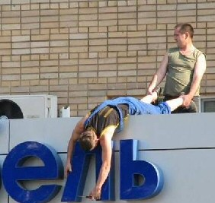
Let’s Discuss Some Safety Myths
Do any of the myths listed on the next slide exist in your current safety culture?
Notes:
Many organizations accept the “myths” we’re going to be discussing and therefore believe that there is not much that can be done to prevent incidents from occurring.

Slide 10
Some Safety Myths
Myth #1: Accidents just happen. Research shows that 99% of all accidents are preventable; we do have a great deal of control over our circumstances.
Myth #2: Being safe takes too much time and money. Consider the direct and indirect cost of any injury = downtime, pain and suffering, etc. Accidents and injuries cost money!
Myth #3: You cannot create an accident free workplace. It requires discipline, diligence, and support to recognize and mitigate every hazard, but if everyone will make and take the time, an accident free workplace is possible.
Notes:
There are management personnel within the workforce who’ve actually used some of these excuses when an incident occurs “on their watch.” Thinking like this and believing these statements are acceptable will continue to allow incidents to occur within the workplace.

Slide 11
If These Myths Exist in Your Company
You have your work cut out for you!
But don’t be discouraged, be creative!
Notes:
If any of these myths exist in your company it’s time to educate everyone to the fact that incidents are preventable.

Slide 12
Where do You Start?
Determine where you’re at currently:
Do you have a written Safety Program in place?
Is it actually followed or just a “paper tiger?”
Is the program reviewed and updated regularly?
Is there support from management for safety?
Is safety a priority or just talk, no action?
Are safety/hazard ID inspections done regularly?
Notes:
To determine where your organization is currently at regarding your Safety Culture, consider the following:
Do you have a written Safety Program in place?
Is it actually followed or just a “paper tiger?”
Is the program reviewed and updated regularly?
Is there support from management for safety?
Is safety a priority or just talk, no action?
Are safety/hazard ID inspections done regularly?

Slide 13
Where do You Start?
Determine where you’re at currently:
Are employees given encouragement to work safely and disciplined when they don’t?
Is there an active, trained, “State Certified” Safety Committee in place?
How many and what type of injuries have occurred in the past two years?
Notes:
You should also determine the following:
Are employees given encouragement to work safely and disciplined when they don’t?
Is there an active, trained, “State Certified” Safety Committee in place?
How many and what type of injuries have occurred in the past two years?

Slide 14
Employee Safety Attitudes?
What is the overall perception about safety:
What value do employees put on working safely?
Do employees think Management really cares about safety?
Do employees feel comfortable reporting safety issues?
If there’s a Safety Committee, are employees aware of it?
Notes:
When it comes to safety employee perception is 99.5% of “the game!” While management can believe that they have an excellent safety program, how employees think and feel about safety determines whether incidents occur and in many cases how severe those incidents will be.

Slide 15
Employee Safety Attitudes?
Use a “safety culture assessment” given to all employees.
Gather results of safety culture survey and review.
Develop Action Plan:
▫ Who will do what?
▫ Areas of focus
▫ Timeline
Action Plan
Notes:
One method for determining how employees perceive safety is by having them complete an anonymous assessment of the overall safety culture. Once this is done the results should be tallied and reported to all levels of management. After the results are tallied and reported then an Action Plan can be formulated to decide:
▫ Who will do what?
▫ Areas of focus
▫ Timeline

Slide 16
Now that you Know…
A decision should be made by upper level management as to whether they want to obtain a “positive safety culture.”
If the answer is yes, all involved need to understand this will take time, dedication, commitment, and support from everyone!
It could take between 5-10 years before you achieve a very low injury rate.
Notes:
Once a survey has been completed, the results totaled and reported and an Action Plan developed a decision should be made by upper level management as to whether they want to go forward with developing a positive Safety Culture.
If the answer to that question is “yes,” then all involved need to understand it will be no small task and will take time, commitment and support by everyone including the newest employee to the CEO.

Slide 17
Okay, now What?
Communicate!
Let all employees know what you are doing, why you are doing it, and what the intent is.
Send a “safety blast” through: newsletters, e-mails, memos, posters, paycheck stuffers, etc.
Notes:
If the decision is made to proceed with establishing a positive safety culture then it’s time to communicate that decision to all employees in every department/location. This can be done through the use of memos, e-mails, posters or any other suitable method.

Slide 18
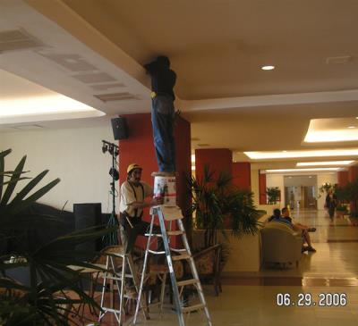
What are you Trying to Accomplish?
GOAL=Incident & injury prevention
How?
Change/adjust perceptions, attitudes and “norms”
Why?
Because most injuries that occur in the workplace are self-caused

Slide 19
4 Main Causes: Accidents/Injuries
Eyes not on task.
Mind not on task.
In the line of fire of potential injuries.
Loss of balance, traction, grip.
Notes:
There are basically four main causes of incidents to include:
Eyes not on task (someone not watching what they are doing or where they are going).
Mind not on task (thinking about something else other than the work being done; being distracted; not paying attention) .
In the line of fire of potential injuries (a piece of machine or product comes out of/away from the machine and injures someone) .
Loss of balance, traction, grip (resulting in a fall).

Slide 20
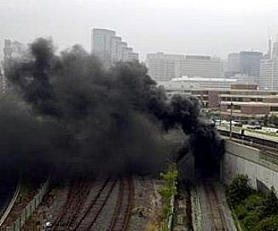
Incident Causes
Causes of any incident can
be grouped into five (5) basic
categories:
Task
Material
Environment
Personnel
Management
If we were doing accident investigation training we would discuss in detail
Notes:
Incident causes can be grouped into five basic categories as follows:
→ Task
→ Material
→ Environment
→ Personnel
→ Management

Slide 21
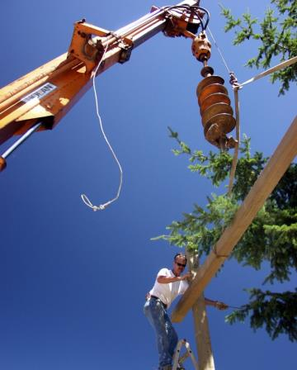
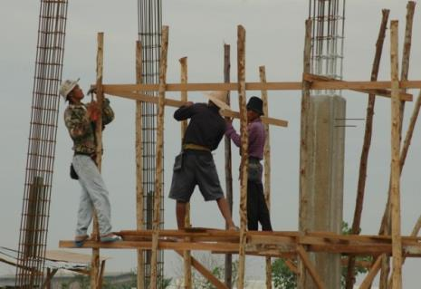
Incident Waiting to Happen?
Notes:
The employees in these pictures where given a task to complete and, as observed, are attempting to do what they were assigned. Unfortunately the employees pictured are not using safe methods to complete the tasks given.
In the picture on the left the employees certainly need fall protection since they’re working above six (6) feet (construction; 4 feet in general industry). Additionally, these employees should be the appropriate Personal Protective Equipment (PPE) such as hardhats and safety glasses.
In the picture on the right the individual is working close to an auger bit on a piece of equipment which was used to lift the beam in place to be bolted. Since the employee is working on a ladder he technically doesn’t need to use fall protection, however he appears to be working on the next rung to the top rung of the ladder and is precariously balanced in the position he’s in. Additionally, the auger bit on the equipment could strike him and if the rope gets to close to him he could “face the hangman’s noose!”

Slide 22
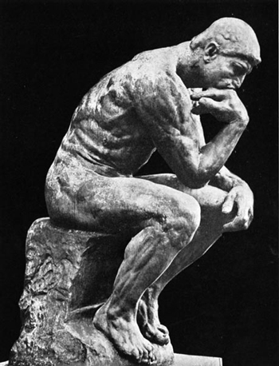
Get Employees to put Safety First
How can we do this?
Do you have any ideas?
Key to affecting safety culture = leadership.
Notes:
We’re now going to discuss what can be done to get employees involved and thinking about safety.

Slide 23
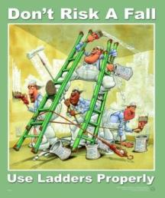
Awareness
What can you do to keep safety on the minds of employees?
▪ Posters ▪ Newsletters
▪ Toolbox Talks ▪ Signage
▪ Daily Meetings ▪ Games
▪ Paycheck Stuffers ▪ Training
▪ Message/Bulletin Boards
Notes:
Employees need to have their attention drawn to safety at all times. As described in the slide, there are numerous methods to use to keep safety on the minds of all employees.

Slide 24
Awareness
Establish acceptable safety behavior.
Set the example – always follow safety policies/procedures.
Frequently communicate & reinforce safety values.
Reinforce positive behavior; discipline poor/negative behavior.
Link positive behavior to cost savings
Notes:
Employees need to understand what acceptable behavior is regarding safety.
Management needs to set an example by always following safety policies/procedures and frequently communicating and reinforcing safety values and behaviors.
When an employee is observed doing something safe they need to be encouraged and complemented while those who are working in an unsafe manner are “called on the carpet” and disciplined as appropriate.
Employees should be made aware that safe, positive behavior leads to overall savings to company by not having to pay extra monies for incidents that could occur.

Slide 25
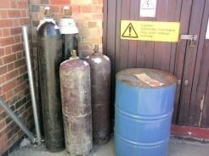
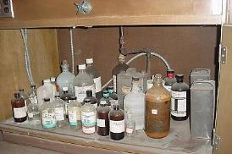
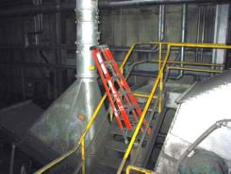
Awareness: Safety Inspections
Let’s discuss safety inspections:
What are they?
Why do we do them?
How often?
Who does them?
How to document?
Notes:
One way to prevent incidents is to have an active hazard identification and remediation program. Some call this their “Safety Inspection Program.” We will be discussing the importance and nuances of safety inspections and answer the questions listed in the slide.

Slide 26
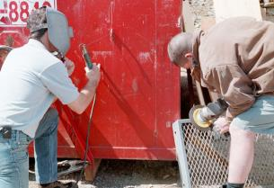
Inspections: Look for…
Unsafe Acts
Behaviors
Account for the vast majority of injuries
Won’t
Encourage & Enforce
Unsafe Conditions
Environment
Represent only a small fraction of injuries
Can’t
Recognize & Remedy
Notes:
When conducting a safety/hazard detection inspection there are basically two things to look for: unsafe acts and unsafe conditions.
Most incidents are caused by the unsafe acts (behaviors) of employees and sometimes involve employees not wishing to change the behavior that caused the incident.

Slide 27
Unsafe Acts vs. Unsafe Conditions
Unsafe Acts
Using Unsafe Equipment
Improper Lifting
Horseplay
Influence of Drugs or Alcohol
Operating Without Authority
Left File Drawer Open
Unsafe Conditions
Congested Area
Noise Exposure
Wet Floor
Inadequate Machine Guards
Inadequate Warning System
Defective/Damaged Tools
Notes:
Here are some examples of unsafe acts and unsafe conditions. These types of things are among those that should be looked for during a safety/hazard detection inspection.

Slide 28
What do You See?
Let’s identify some safety issues/hazards!
Notes:
We’ll now take time to identify some safety issues/hazards in the following pictures.

Slide 29
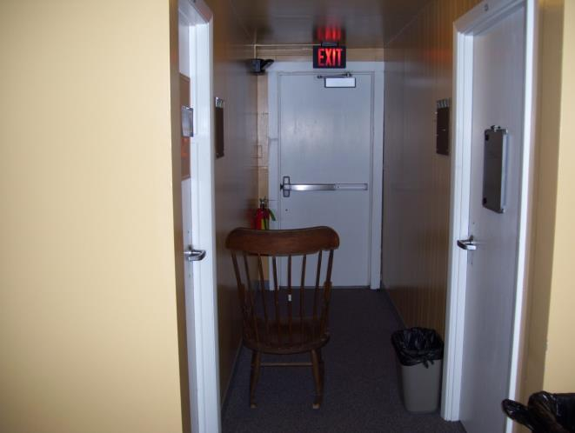
Identify the Hazard(s)
Unsafe act or unsafe condition?
Condition.
Chair obstructs exit width.
Notes:
Rocking chair obstructs exit access/corridor width, would interfere with safe exit of building occupants. Unsafe condition.

Slide 30
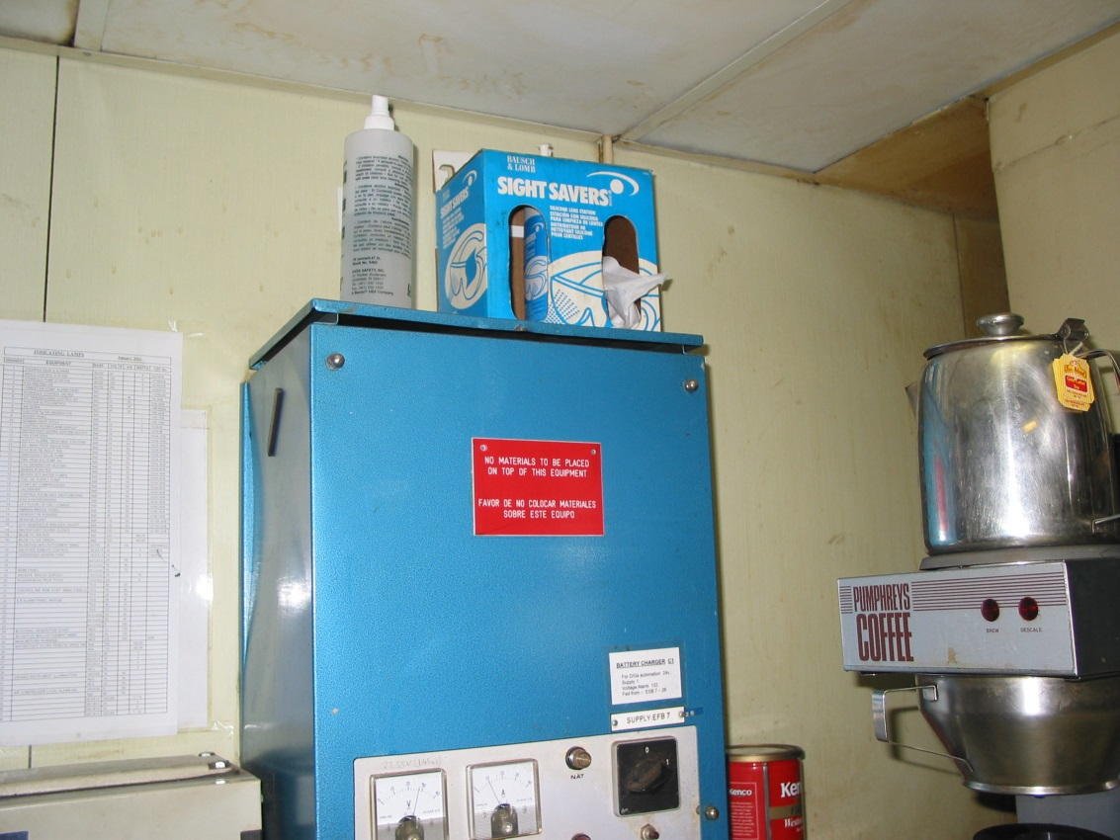
Identify the Hazard(s)
Items stored on top of electrical device.
Condition
Act or condition?
Notes:
Self-explanatory for hazards! Unsafe act.

Slide 31
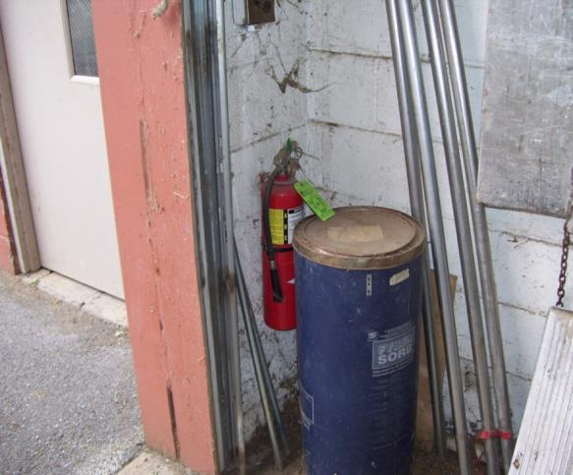
Identify the Hazard(s)
Access to fire extinguisher blocked/ obstructed.
Unsafe act or condition?
Condition
Notes:
Access to fire extinguisher blocked/obstructed. Cobwebs on extinguisher (possible spider bite when removing the extinguisher). Pipes standing against wall, could fall on somebody. Blue drum may or may not be labeled properly. Unsafe condition.

Slide 32
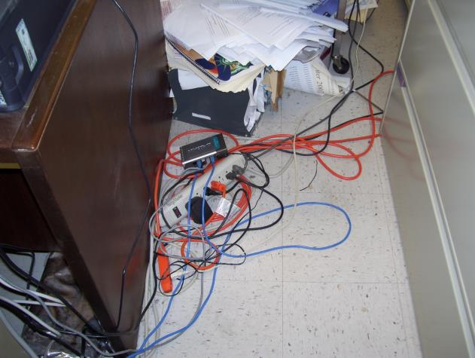
Identify the Hazard(s)
Act or condition?
Cords across walkway; extension cords plugged into “power strip”
Condition
Notes:
Wires across walkway – trip and fall hazard. Also, extension cords plugged into “power tap” with other devices plugged into them (possibly overload – electrical hazard). Unsafe condition.

Slide 33
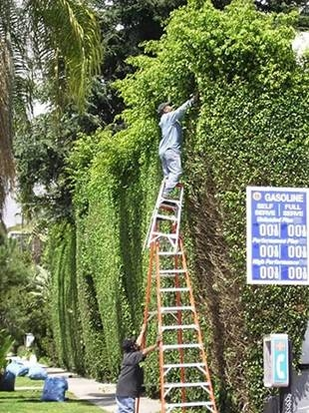
Identify the Hazard(s)
Improper use of ladders. No PPE.
Act!
Act or condition?
Notes:
Hazards are obvious – slip/loose balance & fall. Unsafe act.

Slide 34
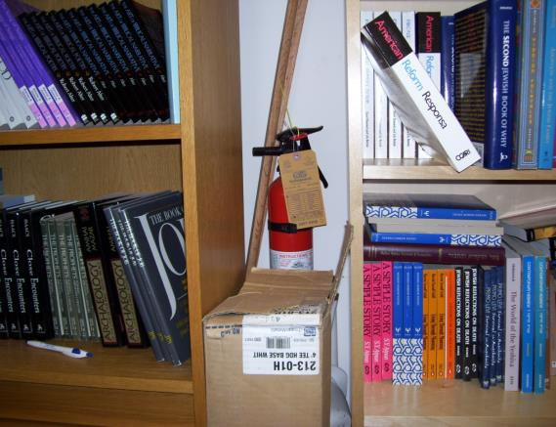
Identify the Issues
Act or condition?
Condition
Extinguisher mounted in poor location.
Access to fire extinguisher blocked/ obstructed by boxes.
Fire extinguisher location not identified.
Inside a library
Notes:
Extinguisher is mounted in a poor location and not properly identified. Access to the extinguisher is blocked/obstructed by boxes. Unsafe condition.

Slide 35
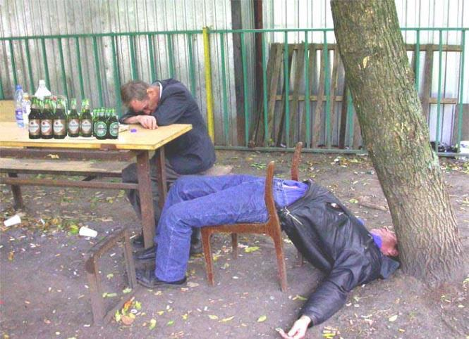
And Last but not Least!
Act or Condition?
Notes:
This looks like it’s an act that caused a condition!!!!

Slide 36
Safety Inspection Documentation
E-mail
Checklists
Memo
Written reports
OSHA = If it’s not in writing it didn’t
happen!
Safety
Inspections
Notes:
Maintaining proper documentation is very important when it comes to safety/hazard detection inspections. Not only does the documentation show evidence that the inspections were completed, but it also acts a reference point to determine if there are any trends or problem areas that should be addressed.

Slide 37
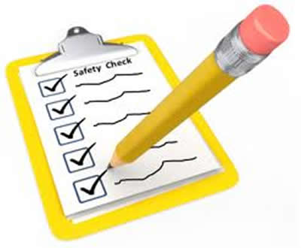
When & How to Inspect
Depends on size of facility, type of business, type of work done, shifts, etc.
Daily/weekly walk around (informal):
- One or more people
- Safety, security, maintenance
- Supervisor (rotate)
Monthly:
- Team approach
- Safety Committee
Quarterly.
Twice yearly.
Yearly.
Notes:
The frequency of inspections is determined by the following: size of the facility, type of business and work being done, number of shifts, number of hazardous operations, etc.
In an office setting it may be appropriate to conduct only one or two inspections a year, whereas a manufacturing facility may require weekly or monthly safety/hazard detection inspections.

Slide 38
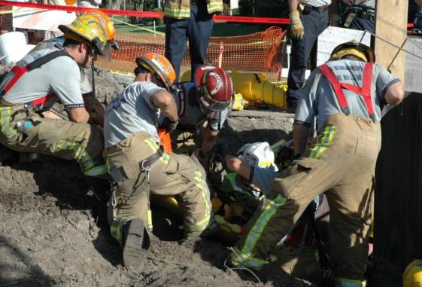
Incident/Injury Prevention
What is an incident?
An uncontrolled or unplanned release of energy that causes or contributes to illness, injury, death and/or damage to property, equipment, or materials.
All incidents have a cause and effect!
Notes:
The above slide has what is considered by some to be a “universal” definition of an incident/accident. Keep in mind that whether it is called an incident, accident or mishap, all of those have a cause and effect.

Slide 39
Factors Contributing to Incidents/Injuries
Fatigue
Stress
Complacency
Distractions
Notes:
There are numerous factors that contribute to incidents such as fatigue, stress, complacency, and distractions – each of those will be discussed now.

Slide 40
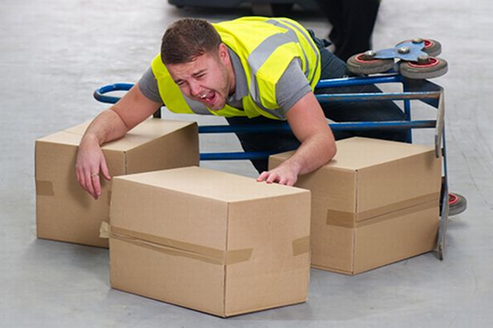
Other Contributing Factors
Assertiveness
Lack of Knowledge
Lack of Awareness
Personal stressors
Notes:
In addition to those already mentioned, there are other factors such as:
Assertiveness – Sometimes employees have a need to get a task completed as quickly as possible and therefore may do things recklessly or without concern for their or co-workers safety
Lack of Knowledge – There are times that employees are asked to complete a certain task that they have not been properly trained to complete. They may not have the necessary knowledge to do things safely or use the correct PPE, tools or equipment.
Lack of Awareness – Employees can go through a day not paying attention to there surroundings or not concentrating on what they’re doing which could lead to an incident.
Personal Stressors – Very few people have nothing within their lives that doesn’t bother them or cause them to be distracted from work. Depending on the task, an employee may be concentrating more on financial, health or family problems as opposed to what they’re doing or how safe they’re doing it.

Slide 41
Two Contributing Factors
To Accidents and injuries
Fatigue and Stress
Signs & Symptoms of Fatigue:
Forgetfulness
Poor decision making
Slowed reaction time
Reduced vigilance
Poor communication
Notes:
Fatigue and stress can cause a lot of issues for an employee. Management personnel need to be aware of and watch for the signs and symptoms of stress to include:
- Forgetfulness
- Poor decision making
- Slowed reaction time
- Reduced vigilance
- Poor communication

Slide 42
Fatigue: Signs & Symptoms
Fixated
Apathetic
Lethargic
Bad Mood
Nodding Off
Notes:
Here are additional signs and symptoms of fatigue for management folks to watch out for (this includes if they, themselves, are having any of the signs and symptoms listed).

Slide 43
Managing Fatigue
Balance: Rest & Activity
Learn your body’s signs of getting tired. Take breaks between tasks.
Pace yourself: do a heavy task, than light, than heavy, etc.
Allow plenty of time to get work done-avoid rushing (rushing causes accidents/injuries).
Notes:
Managing fatigue is an important part of work and life. An attempt should be made to balance activity and rest whether it’s a work activity or something done during off hours.

Slide 44
Managing Fatigue
Make work easier
Plan ahead, look at tasks needing to be done and schedule accordingly.
Combine work tasks when you can.
Use labor saving devices when possible.
Organize your work area so you can do more work with less energy.
Notes:
Another solution to managing fatigue is to attempt to make the work easier. Some may have heard the quote, “Work smarter, not harder,” which is certainly something that can be accomplished with some forethought.

Slide 45
Managing Fatigue
Get enough sleep
A good night’s sleep restores energy
& attitude.
Most people need between 6-8 hours
of uninterrupted sleep each night.
Notes:
Getting enough sleep is a very important way to manage fatigue and stress. The lack of sleep can contribute to health and attitude problems as well as causing a lack of concentration for employees.
The average adult needs at least 6-8 hours of uninterrupted sleep nightly to stay in good health and function “properly.” People who are teenagers should get between 7-8 hours of uninterrupted sleep each night.

Slide 46
Managing Fatigue
Exercise
Check with your doctor to establish an exercise program appropriate for you.
Exercises that increase heart rate for at least 30 minutes 3 times a week can be beneficial.
Stretching exercises before work and after lunch can help loosen “tight” muscles.
Notes:
Another way to manage fatigue and stress is to get regular exercise. Exercises that increase the heart rate for at least 30 minutes at least 3 times a week should be considered.
Of course before beginning and exercise program employees should check with their personal physician to ensure they’re able to safely perform the exercises they’re thinking about.

Slide 47
Fatigue Exercises: Stretches
STAND UP PLEASE!
Stretches Shoulders, Middle of Back
Notes:
And speaking of exercise, please stand up!
Put your arms straight in front of you and interlock you fingers so that your palms are facing you. Turn your palms away from you and stretch your arms and shoulders.

Slide 48
Fatigue Exercises: Stretches
Stretches Shoulder and Upper Arm
Okay, you can sit down again!
Notes:
Place one arm across your body and in the position shown. Use the other hand to slowly push the arm towards your face until you feel the stretch this causes. Do the same thing to the other arm.
After you’re done you may sit down.

Slide 49
What about Stress?
Some unhealthy ways of coping:
Smoking
Drinking
Drugs
Over or under eating
Procrastinating
Lashing out
Withdrawing from family/friends
Notes:
Stress can be an issue in and of itself. There are healthy and not so healthy ways of coping with stress. Some of the unhealthy ways include:
Smoking
Drinking
Drugs
Over or under eating
Procrastinating
Lashing out
Withdrawing from family/friends

Slide 50
Managing Stress
Avoid Unnecessary Stress
Learn to say “no”
Avoid people who stress you out
Take control of your environment
Avoid hot button topics
Scale down your “to do” list
Notes:
Most stress we encountered cannot be avoided, however there are ways to manage your stress level such as:
Learning to say “no”
Avoiding people who stress you out
Taking control of your environment
Avoiding hot button topics
Scaling down your “to do” list

Slide 51
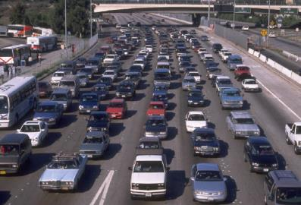
Managing Stress
Accept things you can’t change
Don’t try to control the uncontrollable
Look for the positive
Share your feelings
Learn to forgive
Notes:
Although it’s not easy, employees should try their best to learn to accept things they cannot change.
Some other ideas for managing stress include:
♦ Not trying to control the uncontrollable
♦ Looking for the positive
♦ Sharing your feelings
♦ Learning to forgive

Slide 52
Managing Stress
Relax
Go for a walk
Spend time in nature
Talk to a good friend
Exercise
Play with a pet
Listen to music
Take a long bath
Watch a comedy
Notes:
Trying to relax is another very good way to manage stress. Here are some ways of relaxing.

Slide 53
How do You Manage Stress?
Notes:
What do you do to manage stress?

Slide 54
Teamwork/Team Building
TEAM =
Together
Everyone
Achieves
More
Notes:
Achieving a positive safety culture requires people to work together as a team, starting with management and building from there. Teamwork will provide a good, solid framework to implement the necessary change that will be necessary to improve the current situation.

Slide 55
Importance of Teamwork
Achieving Goals
Fast Learning
Workload Distribution
Building Bonds
Healthy Competition
Notes:
The important aspects of teamwork include:
Achieving Goals
Fast Learning
Workload Distribution
Building Bonds
Healthy Competition

Slide 56
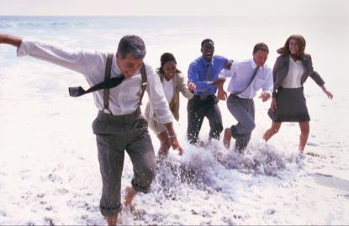
Importance of Teamwork
Goal Communication
Resolving Conflicts
Exploring Creativity
Job Satisfaction
Increased Speed of Work
Creating New Business Ideas
Notes:
Here are some other important aspects of teamwork:
Goal Communication
Resolving Conflicts
Exploring Creativity
Job Satisfaction
Increased Speed of Work
Creating New Business Ideas

Slide 57
Effective Teamwork
Good Leadership
Team leader has skills to maintain positive environment
Leader focused on team & member direction
Leader promotes high level of morale
Open Communication
Members able to articulate feelings, plans, ideas, etc.
Creating Procedures for Conflict Resolution
Structured methods
Allow direct confrontation if appropriate
Notes:
Effective teamwork evolves around good leadership, open communication and having procedures to resolve conflicts among team members and others.

Slide 58
Effective Teamwork
Define Clear-cut Roles
Know what team purpose is
Focus on role and scope of members
Setting a Good Example
Team leader’s responsibility
Team members emulate
Notes:
Effective teamwork also includes having clear-cut roles for all involved as well as having a leader who sets good examples.

Slide 59
The Effective Team
Important Characteristics
Positive approach during conflict resolution
Respect towards each others personal life
Constraint on office politics
Open approach to others views/opinions
Notes:
Having an effective team also includes ensuring there is:
Positive approach during conflict resolution
Respect towards each others personal life
Constraint on office politics
Open approach to others views/opinions

Slide 60
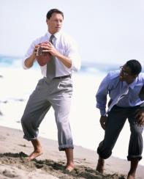
The Effective Team
Important Characteristics
Priority given to team, not individual, success
Understanding each others capabilities and limitations
Good dose of “team spirit”
Notes:
Here are more characteristics of an effective team:
Priority given to team, not individual, success
Understanding each others capabilities and limitations
Good dose of “team spirit”

Slide 61
Team Building Exercises
Questionnaire – each person receives and answers set of questions – group then discusses
Group Activities – e.g. assembling jig saw puzzle, problem solving, etc.
Sports – e.g. volleyball, bowling, etc.
Notes:
There are a lot of exercises that can be used to assist in building an effective team as listed. When determining what methods to use for teambuilding consideration should be given to the make-up of the team. For example, would all members be capable of and able to participate in sports or physical activities.

Slide 62
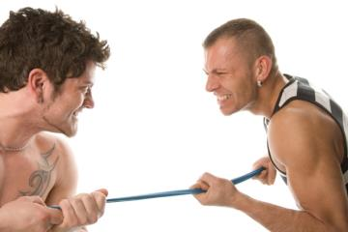
Team Building Exercises
Day Trips – to sporting events, State Parks, amusement parks, etc.
Games – Scavenger Hunt, “Great Egg Drop,” Relay Race, Company Board Game, Tug of War, etc.
Notes:
Here are some other teambuilding exercises that can be used, again depending on team make-up and interest.

Slide 63
Team Building Exercises
LET’S DO ONE!
Notes:
At this point the instructor should determine which exercise they would like to use. The type of activity chosen as well as the amount of time allotted for the exercise depends on where the instructor is at within the overall presentation’s timeframe.

Slide 64
Difficult People
How to Handle Non-Team Players
“Team schmeam, who cares, just let me do my job!”
Notes:
Unfortunately there are people within the workplace who can be argumentative, disruptive and do not want to be part of a team, and management personnel need to determine not only who these individuals are, but how to get them involved.
We will now be providing some ideas on what could be done to bring a difficult person onto the team.

Slide 65
Effective Listening
Listen for ideas-not facts
Judge content (first); not delivery (secondary)
Be an optimistic listener, from the beginning
Listen to the full message-don’t jump to conclusions
Be flexible-take notes
Concentrate on the speaker
Notes:
Just about every person has a desire to be heard, no matter how trivial others may think what they have to say is.
Being an effective listener takes practice and patience, but will reap rewards in the long run because employees will realize that what they have to say is important.

Slide 66
Effective Listening
Thought: 4 x faster than speech. Analyze message. (Read verbal/non-verbal signs)
Provide feedback
Keep open mind: don’t fall victim to “trigger” words or emotions; heed central theme of message
Stretch your mind by experiencing new information not just that with which you’re familiar
Notes:
Keep in mind that a thought is at least 4 times faster than someone’s speech. Many times we think we know what somebody is saying well before they’ve been finished saying it. This can certainly lead to problems, misunderstandings, and arguments.

Slide 67
Dealing with Difficult People
Assess the situation:
Is person normally uncooperative or is it just this particular situation
Listen to the person’s complaints/issues: legitimate or just negative behavior
Put yourself in their shoes
Resist urge to argue
Notes:
Dealing with difficult people can certainly be a challenge, that’s why it’s important to assess each situation:
▪ Is person normally uncooperative or is it just this particular situation
▪ Listen to the person’s complaints/issues: legitimate or just negative behavior
▪ Put yourself in their shoes
▪ Resist urge to argue

Slide 68
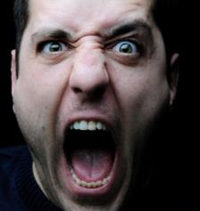
Dealing with Difficult People
Ask what person is upset about
Don’t interrupt while person is talking
Don’t “pass judgment”
Be aware of your body language &
tone of voice
Deal with the person genuinely
Deal with situation, don’t avoid
Notes:
When dealing with difficult people it’s also important to remain as calm as possible and:
Ask what person is upset about – Try to determine what the “root cause” of their anger so you have a starting point as to where the real issue is.
Don’t interrupt while person is talking – People don’t like to be interrupted, they want to know they’re being fully listening to.
Don’t “pass judgment” – Too many times we think we know what the person is talking about before they’ve even started and determine our actions based on that instead of what the real problem is.
Be aware of your body language & tone of voice – Sometimes just our tone of voice or body language can signal we’re not listening, don’t care or upset about being bothered.
Deal with the person genuinely – Do your best to truly care about the person who you are dealing with; don’t patronize them.
Deal with situation, don’t avoid – Do not delay dealing with the situation to another time because waiting may cause a situation to get worse.

Slide 69
Dealing with Difficult People
Don’t become defensive
Don’t spend a lot of time with person
Treat as adult, don’t be condescending
After listening, is compromise possible
If compromise not possible be assertive
Notes:
It’s easy and almost instinctive to come to our own defense – do your best to avoid doing that as it will just escalate the overall problem.

Slide 70
Dealing with Difficult People
Exercise = Let’ Role Play!
Notes:
At this point the instructor gives scenario to class and two people volunteer or are picked. The instructor should “coach” one of the individuals as to what to say, how to act, etc.

Slide 71
Accountability Defined
An obligation or willingness to accept responsibility or to account for one’s actions
Accountability ↔ Responsibility
Notes:
Having everyone in the organization responsible and accountable for their own actions when it comes to safety will go a long way in developing a positive safety culture.
There are many safety professionals who believe that accountability and responsibility are interchangeable - that you can’t have accountability without responsibility and vice versa.
From the CEO to the newest employees everyone has to know their responsibilities and understand they are accountable for what they do no matter how small the task is.

Slide 72
Accountability for Safety
Responsibility for safety defined at all levels (from top to bottom, bottom to top)
Employees follow safety policies/procedures (no exceptions allowed)
Employees report issues/hazards
Safety guards placed back on machinery after maintenance
Employees use PPE properly
Disciplinary procedures for non-compliance (communicated to all employees)
Notes:
Accountability/Responsibility could be defined in a job description.
Even though using discipline to ensure workers are being safe isn’t always the most desirable thing to do, there has to be a way to have employees realize that if they choose to disobey safety policies and procedures there will be consequences. Just telling somebody, “You shouldn’t do that because you’ll get hurt” and then watching them do it anyway because they don’t want to follow safety related policies and procedures will not contribute to injury prevention!

Slide 73
Accountability for Safety
Employees empowered to stop their/others work if unsafe situation
Maintenance Department’s role:
▫ Correct/repair building issues a.s.a.p.
▫ Order/use safe products
▫ Replace guards after machine maintenance
▫ Proper storage practices
▫ Machine/system knowledge
▫ Perform effective PM (prev. maintenance)
Notes:
There are many ways that employees can be held accountable for safety and responsible for their actions such as giving them the power to completely stop the work they or someone else is doing if they feel the situation is unsafe.

Slide 74
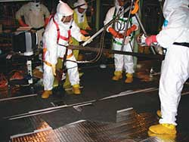
Safety Accountability
Hold EVERYONE’S feet to the fire:
▪ NO EXCUSES, NO SHORTCUTS
▪ Safety first = all the time, every time
Notes:
To have a good, positive safety culture everyone should be held accountable and responsible – excuses and/or shortcuts should not be tolerated no matter if the person involved is the highest level person in the organization or a brand new employee.
Employees need to understand that they must work safely all the time, every time!

Slide 75
In Your Organization
Who is accountable for Safety?
Notes:
The instructor should now go around the room and ask some attendees and then facilitate discussion.

Slide 76
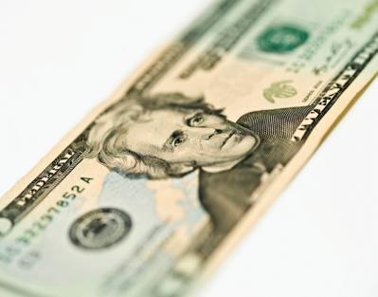
Safety Incentives
Reward systems for working safely=Pros & Cons
What are they based on
Do they work
How much involvement does it take
Notes:
Safety incentive/rewards programs can work if they’re properly organized and are not just based on employees not getting injured.
In the next several slides we will be discussing safety incentive programs.

Slide 77
Safety Incentives - Pros
Pros:
Gives something to strive for
Provides recognition to employees
Can promote safe behavior
Provides for employee involvement
Provides competition between areas
Could possibly share with family
Notes:
Safety incentive/rewards programs can have value and can accomplish a reduction in workplace incidents. Listed in this slide are some of the “Pros” of safety incentive/reward programs.
Before implementing a program, thought should be given as to what it will be based on, who will manage it, and how will the rewards/incentives be distributed.

Slide 78
Safety Incentives - Cons
Cons:
Under reporting
In-fighting between groups
Disharmony in workplace
Request for job transfers
Stealing
Union Action
Notes:
Under reporting: injuries, hazards, near-misses can all be the “Cons” of implementing a rewards/incentives program.
Another problem could be union action: challenges of “unfair practices” because people in an office setting do not have the risks those working in production do.

Slide 79
Safety Incentives - Basis
Can be based on:
▪ Reduction in total # of lost time injuries
▪ Reduction in total # of Recordable injuries
▪ Reduction in total # of Reportable injuries
▪ Reduction in total # of certain injuries
▪ Observation of employees working safely
Notes:
Many times safety incentive/reward programs are based on people not getting injured on the job. If the program is based on solely injuries and the lack thereof this could be a problem because it could lead to a lack of reporting by employees.
Additionally, OSHA does not “recognize” or recommend safety incentive/reward programs that are based only on people not suffering a workplace illness/injury.
Safety incentive/rewards programs could be based on other safety related criteria as well – the ones listed are just the main ones.

Slide 80
Do Safety Incentives Work?
Short term – yes; influence outcomes
Long term – no; no lasting behavior changes
Notes:
From study/article by Ron Prichard, PE, PhD, many times safety incentive/reward programs will be successful for a short term, but in the long term many not produce the lasting behavior changes necessary to ensure a safe working environment.
If an incentive/reward program has been in place for a while it could be a good idea to re-evaluate it to see if the results desired are still being produced; if not, and an incentive/reward program would like to be continued it may be a good idea to develop another type of system to use.

Slide 81
Safety Incentives
How Much Involvement/Time?
Can be very time consuming depending on system being used:
▪ Department specific or system wide
▪ Determining how to measure & numbers
▪ Determining goals & objectives
▪ Keeping track of criteria
▪ Posting results
▪ Distributing rewards
Notes:
In talking with folks who have incentives in place the necessary involvement could be as much as 1 to 8 hours a week depending on the system used, # of employees involved, etc.

Slide 82
Safety Incentives – Bottom Line
Don’t rely solely on incentive programs
Effective safety management process, not incentive programs = crucial to improving performance
Notes:
Incentive programs can only do so much as it’s the entire process from hazard detection to injury reporting to employee involvement that leads to overall workplace safety.

Slide 83
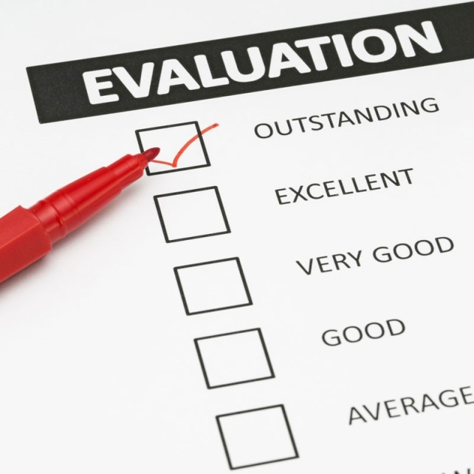
Final Exercise
Take 5 minutes and evaluate your current safety culture:
▪ Where are you at currently
▪ Where do you want to be
▪ How will you get there
Notes:
As a final “exercise,” attendees should be asked to think about what type of safety culture exists in their current environment. If their organization’s safety culture is less than what is desired then they need to determine where they would like to see their organization go and how it can get to that point.

Slide 84
Questions

Slide 85
Contact Information
Like us on Facebook! - https://www.facebook.com/BWCPATHS

