Slide 1

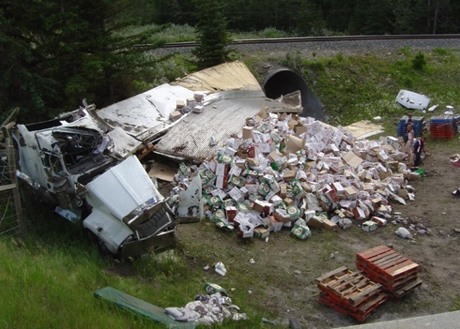
Safety Culture
Bureau of Workers’ Comp PA Training for Health & Safety (PATHS)
PPT-106-01
1
Notes:
Safety culture is the ways in which safety is managed in the workplace, and often reflects "the attitudes, beliefs, perceptions and values that employees share in relation to safety".^{[1]} In other words, "the way we do safety around here".^{[2]}
Cox, S. & Cox, T. (1991) The structure of employee attitudes to safety - a European example Work and Stress, 5, 93 - 106.
Jump up ^ ZCBI (1991) Developing a Safety Culture., Confederation of British Industry, London.

Slide 2

What we’ll Talk About
What is a “safety culture”
Incidents that prompted
Importance of safety culture
Negative safety culture
Positive safety culture
Enhance your safety culture
Evaluate your safety culture
PPT-106-01
2
Notes:
This presentation will address the following:
What is a “safety culture”
Incidents that prompted
Importance of safety culture
Negative safety culture
Positive safety culture
Enhance your safety culture
Evaluate your safety culture

Slide 3
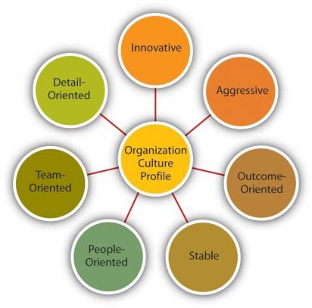
Organizational Safety Culture
How do we define
“Safety Culture”?
PPT-106-01
3
Notes:
There are numerous definitions for “safety culture” some as simple as “the way safety is perceived, valued and prioritized in an organization.”

Slide 4
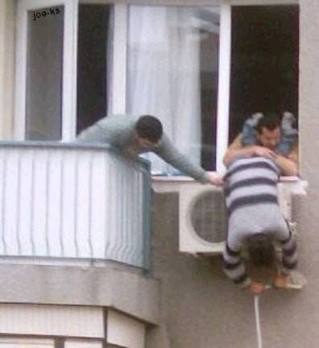
Safety Culture Defined
“The enduring value and priority placed on worker and public safety by everyone in every group at every level of an organization.”
Human Factors & Ergonomics Society
PPT-106-01
4
Notes:
Another definition of safety culture is “The enduring value and priority placed on worker and public safety by everyone in every group at every level of an organization.”
as defined by the Human Factors & Ergonomics Society.

Slide 5

Safety Culture Defined
“The safety culture of an organization is the product of individual and group values, attitudes, perceptions, competencies and patterns of behavior that determine the commitment to, and style and proficiency of, an organization’s health and safety management.”
PPT-106-01
5
Notes:
Another more comprehensive definition of a safety culture is the product of individual and group values, attitudes, perceptions, competencies and patterns of behavior that determine the commitment to, and style and proficiency of, an organization’s health and safety management.

Slide 6

Safety Culture Defined
“A mindset that has its roots in the organization’s policies, philosophies and management approaches.”
Angelo Pinheiro, Project EHS Manager, Marathon Oil Corporation
Safety Management System
PPT-106-01
6
Notes:
And finally, safety culture can be defined as “a mindset that has its roots in the organization’s policies, philosophies and management approaches” as offered by Angelo Pinheiro from Marathon Oil Corporation.

Slide 7
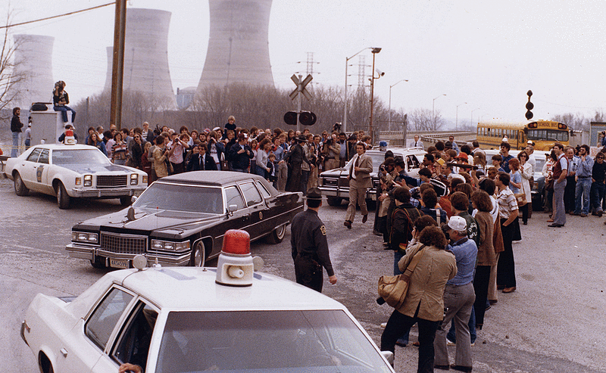
Safety Culture – Incidents
Inattention, lack of training.
Three Mile Island
1979
PPT-106-01
7
Notes:
There were numerous incidents that occurred which prompted employers to think about what a safety culture is and what type they had in their organization. One such incident was the situation that occurred at Three Mile Island on March 28, 1979. After all the investigations were completed it was determined that the basic cause of the incident was inattention and lack of training.

Slide 8
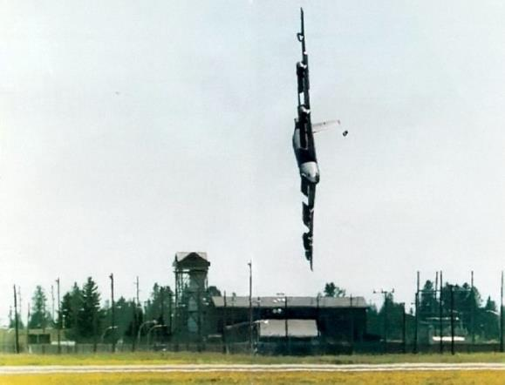
Safety Culture - Incidents
Leadership failed to correct known, overt rule breaking by aggresive pilot. All aboard perished.
Fairchild AFB
1994
PPT-106-01
8
Notes:
Another incident that occurred happened at the Fairchild Air Force Base near Spokane, Washington in 1994. The crash of a B-52 bomber during a “retirement run” killed all on board and was directed related to leadership failing to correct known, overt rule breaking by an aggressive pilot.

Slide 9
Safety Culture - Incidents
Inspections by regulatory agencies brief, perfunctory, extremely lax. Poor recordkeeping. Shortcuts taken.
Deepwater
Horizon
2010
PPT-106-01
9
Notes:
An incident that occurred more recently was the Deepwater Horizon disaster in which people were killed, the ocean was polluted and wildlife harmed due to a fire and subsequent oil leak that contaminated much of the golf coast. The cause of this incident was that inspections by regulatory agencies were brief, lax and didn’t have much “substance.” Poor recordkeeping and shortcuts taken also contributed to this situation.

Slide 10
Safety Culture
Extent Individuals & Groups will:
- Commit to personal responsibility and accountability.
Preserve, enhance and communicate safety concerns.
Adapt, & modify behavior learned from mistakes.
Rewards consistent with these values.
PPT-106-01
10
Notes:
Overall safety culture involves the extent individuals and groups will:
- Commit to personal responsibility and accountability.
Preserve, enhance and communicate safety concerns.
Adapt, & modify behavior learned from mistakes.
Rewards consistent with these values.

Slide 11
Safety Culture
A concept defined at group level
Concerned with formal safety issues
Emphasizes contribution from employees at every level
Impacts employees’ behavior
PPT-106-01
11
Notes:
In addition, safety culture:
Is a concept defined at group level
Is concerned with formal safety issues
Emphasizes contribution from employees at every level
Impacts employees’ behavior

Slide 12
Safety Culture
Reflected in contingency between reward systems & safety performance
Reflected in an organization’s willingness to develop & learn from errors, incidents, and accidents
Enduring, stable & resistant to change
PPT-106-01
12
Notes:
Safety culture is:
Reflected in contingency between reward systems & safety performance
Reflected in an organization’s willingness to develop & learn from errors, incidents, and accidents
Enduring, stable & resistant to change

Slide 13

Culture vs. Climate
Climate = can change with trends, leaders, other short-term changes
Culture = deeply embedded processes, behaviors, attitudes
PPT-106-01
13
Notes:
There is a definite difference between the climate of an organization and its culture.
Climate = can change with trends, leaders, other short-term changes (e.g. a new CEO wants to project a climate of caring for customers so all employees are required to answer their phones, “hello, this is so and so company, the place where customers come first”)
Culture = deeply embedded processes, behaviors, attitudes (e.g. employees treat one another like family members so when someone has a “life change event” such as a new baby everyone chips in to buy them something for the child)

Slide 14
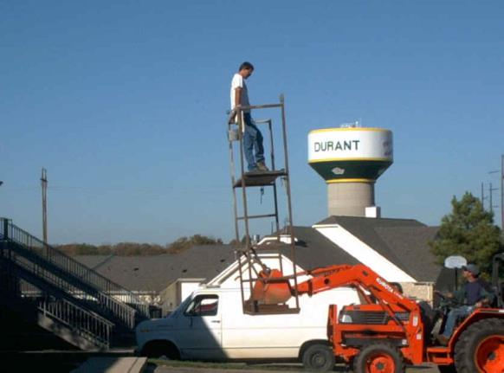
Why is a good Safety Culture Important?
To prevent things like this from happening!
Do you have that money you owe me?
PPT-106-01
14
Notes:
Having a good safety culture is very important, it can prevent incidents from occurring due to employees doing things a certain way for a long time that may not be the safe way. In other words, “get ‘er done” type of attitude prevails where perhaps safety takes a back seat.

Slide 15
Importance of Good Safety Culture
Management systems & associated policies/procedures depend upon actions of individuals & groups for implementation
Values of group helps shape beliefs, attitudes & behavior of individuals
If no “safety buy-in” from all concerned, accidents & injuries will continue to occur
PPT-106-01
15
Notes:
The importance of a good safety culture depends upon the attitudes and actions of all employees. Due to that fact:
Management systems & associated policies/procedures depend upon actions of individuals & groups for implementation
Values of group helps shape beliefs, attitudes & behavior of individuals
If no “safety buy-in” from all concerned, accidents & injuries will continue to occur

Slide 16

Good Safety Culture?
Maybe-if program is followed and all are on board!
Safety Program
Volume 1
Volume 2
PPT-106-01
16
Notes:
Just because an organization has a well written, well organized, “clean” looking safety program does not mean it has a good safety culture. If the program is not reviewed and updated (as required) annually, kept isolated from all employees or is not followed by all employees it may just be a “paper tiger.”

Slide 17
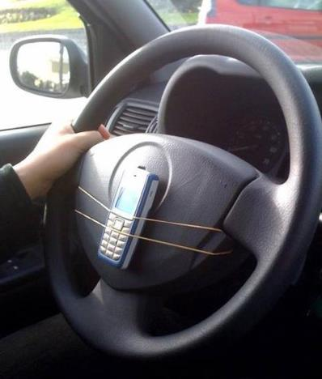
Prevention
Good safety culture = prevention of accidents, environmental issues, and injuries.
PPT-106-01
17
Notes:
Having a good safety culture can prevent accidents, environmental issues, and injuries.

Slide 18
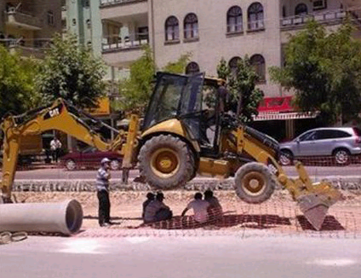
Safety Culture
Would your company allow this?
PPT-106-01
18
Notes:
Hopefully no employer in the United States would allow this situation, however there are those employees who may take shortcuts and circumvent existing safety policies so that “we can have shade!” If a supervisor was present perhaps his thoughts for allowing this to take place was that he was providing the necessary shade to keep his workers as comfortable as he could during their break.

Slide 19
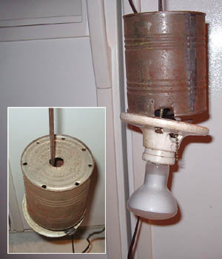
Safety Culture
Or this?
PPT-106-01
19
Notes:
This issue was actually discovered on a military base! The maintenance person who created this was told, “give these folks more light in their shower” so he found a way to do it! The large can over the light (which is a spot light and may get very hot) has holes in the top to allow heat to escape while keeping away most of the water (of course any water that may get in could drain from the light). Obviously this is not a safe situation, but again the maintenance person felt they were doing their job because they accomplished the task they were given.

Slide 20
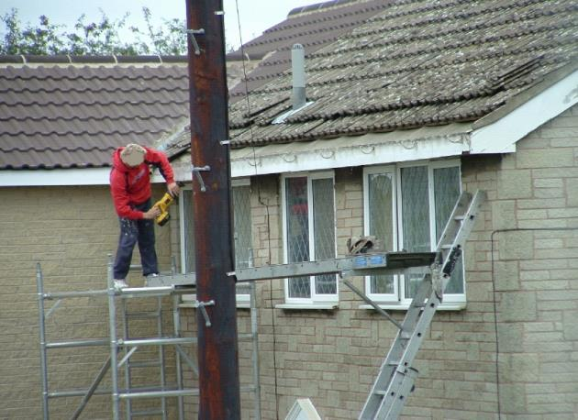
Safety Culture
What about this?
PPT-106-01
20
Notes:
This situation is not safe due to no fall protection in place (if general industry OSHA says fall protection is necessary above four feet while in construction it’s needed above six feet). In addition the individual is not using appropriate personal protective equipment (PPE) nor is the scaffolding and “walkway” he’s using set up safely (no railing, end of walkway anchored to ladder, etc.).

Slide 21
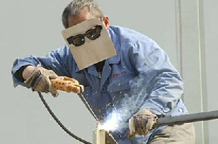
Safety Culture
Characteristics
of a
Negative Safety Culture
PPT-106-01
21
Notes:
Characteristics of a Negative Safety Culture.
Let’s take a look at some indicators or possible ‘red flags’ within your company.
These can be attributed to either individuals, groups, or both.

Slide 22

Characteristics of a Negative Safety Culture
Fatigue
PPT-106-01
22

Slide 23
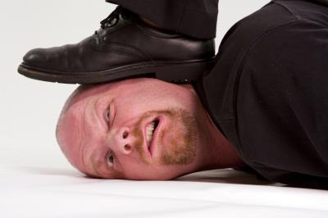
Characteristics of a Negative Safety Culture
Fatigue
Stress
PPT-106-01
23
Notes:
Another aspect of a negative safety culture is undue stress many times caused by the “get as much out the door” philosophy. When employees are concerned about their safety they can become stressed which can lead to mental and physical issues which can take their mind off of their work (thereby leading to injuries/illnesses).

Slide 24

Characteristics of a Negative Safety Culture
Fatigue
Stress
Distraction
PPT-106-01
24
Notes:
Distraction can certainly be a product of a negative safety culture within an organization. Employees can be distracted by many things happening on the job including co-workers. When safety isn’t given the necessary priority it deserves that fact that employees are being distracted by other employees may be tolerated.

Slide 25
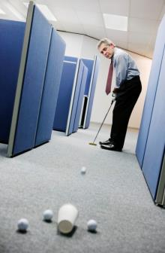
Characteristics of a Negative Safety Culture
Fatigue
Stress
Distraction
Complacency
PPT-106-01
25
Notes:
In an environment with a negative safety culture complacency can become an issue. Employees have been doing things a certain way for so long and perhaps not suffering injuries that they feel they can continue on without change.

Slide 26
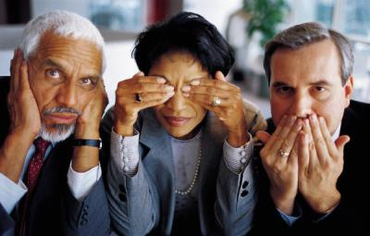
Characteristics of a Negative Safety Culture
Failed Communication
PPT-106-01
26
Notes:
Failed communication can be a result of a negative safety culture. Even something as common as having a machine “down” for servicing can turn into an issue if lock-out/tag-out or another similar means of communication is not used.

Slide 27

Characteristics of a Negative Safety Culture
Failed Communication
Inadequate Knowledge
PPT-106-01
27
Notes:
Another situation that may occur within a negative safety culture is employees not having the knowledge to perform their jobs safely or not being trained to operate certain equipment but being allowed to operate it anyway because the task needs to be completed.

Slide 28

Characteristics of a Negative Safety Culture
Failed Communication
Inadequate Knowledge
Lack of Assertiveness
PPT-106-01
28
Notes:
Many times employees will not take the initiative to report safety hazards because either nothing is done or employees have the impression that management doesn’t care as long as the job gets done.

Slide 29
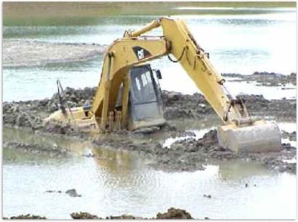
Characteristics of a Negative Safety Culture
Failed Communication
Inadequate Knowledge
Lack of Assertiveness
Poor Situational Awareness
PPT-106-01
29
Notes:
Poor situational awareness can become a real issue within a negative safety culture and can lead to injuries due to people not watching or paying attention to their surroundings or tasks.

Slide 30

Characteristics of a Negative Safety Culture
Inadequate Resources
PPT-106-01
30
Notes:
Too many times safety is not given the necessary resources it deserves whether that involves a lack of trained safety personnel or the money to provide adequately for safety needs.

Slide 31
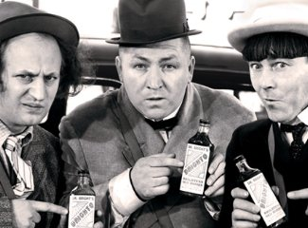
Characteristics of a Negative Safety Culture
Inadequate Resources
Dysfunctional Teamwork
The Three Stooges!
PPT-106-01
31
Notes:
Dysfunctional teamwork could be attributed to:
Personality clashes,
Differing leadership/management styles,
Turf battles,
Lack of common vision, etc.
Some leaders can be identified as “Mavericks” because they do things their own way as opposed to what policies and procedures indicate or allow. There are leaders who not only look the other way when it comes to employees not doing things safely, but even encourage unsafe behavior in order to get the job done.

Slide 32

Characteristics of a Negative Safety Culture
Inadequate Resources
Dysfunctional Teamwork
Production Pressure
PPT-106-01
32
Notes:
In a negative safety culture production pressure tends to take precedence over safety so therefore the overall goal becomes “get things out the door, period!” This can lead to injuries since employees can be working quickly or more often unsafely.

Slide 33

Characteristics of a Negative Safety Culture
Inadequate Resources
Dysfunctional Teamwork
Production Pressure
Organizational “Norms”
PPT-106-01
33
Notes:
Organizational “Norms” = “Old School.” In other words, “we’ve been doing things this way for this long so why should we change?” Many times with organizational norms or “old school” philosophy management/employees do not want to learn or use anything new and this includes safety.

Slide 34

External Influences
Outside Stressors
PPT-106-01
34
Notes:
Outside stressors have a definite affect on safety within the workplace. Employees who have problems with substance abuse, monetary issues, car/home problems, etc., tend to let those issues affect their on-the-job behavior and may not be concentrating on their work or how their performing their work which can lead to injuries.

Slide 35

External Influences
Outside Stressors
Family issues
PPT-106-01
35
Notes:
Family issues certainly affect a worker’s behavior! At times these problems are brought into the workplace such as an employee receiving phone calls from their children while on the job asking questions or causing stress due to their fighting; or an employee who has an issue with domestic abuse whereby a spouse comes on-site to continue with a fight or “put them in their place.”

Slide 36

External Influences
Outside Stressors
Family issues
Workforce Diversity
PPT-106-01
36

Slide 37

External Influences
Outside Stressors
Family Issues
Workforce Diversity
Inspections
PPT-106-01
37
Notes:
Inspections (compliance, Corporate, etc.) can definitely affect a workplace whether those inspections are from within or by organizations outside of the company such as OSHA, EPA, etc. Inspections can put people “on edge” and can possibly lead to work being slowed down which leads to people feeling they need to work faster after the inspection is complete.

Slide 38

Safety Culture
Myths
“You cannot create an accident free workplace”
“Safety takes too much time and money”
“Accidents just happen”
PPT-106-01
38
Notes:
There are numerous myths surrounding safety culture such as:
“You cannot create an accident free workplace.”
“Safety takes too much time and money.”
“Accidents just happen.”
If management/employees think this way then workplace injuries and illnesses will continue to happen!

Slide 39
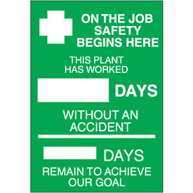
Your Organization?
PPT-106-01
39
Notes:
Now it’s time to think about where your company is at regarding safety and safety culture. What type of safety culture exists within your work environment?

Slide 40
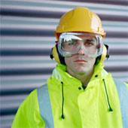
Positive Safety Culture
Creating a positive safety culture takes time and commitment
Positive Culture = Everyone takes responsibility for safety each day
PPT-106-01
40
Notes:
Creating a positive safety culture is not something that is done overnight or in a week or two – it takes time AND commitment by everyone.
Having a positive safety culture means that EVERYONE takes responsibility for safety each and every day!

Slide 41

Why have a Positive Safety Culture?
Accident = Tip of the iceberg!
Total Cost of Injuries = Direct & Indirect Expenses
Direct (insured costs) = e.g. wage loss, medical, vocational and physical rehabilitation
Indirect (uninsured, cost to company) = e.g. downtime, equipment & building damage, morale of injured worker/others in department, possible citations
Overall total could be very costly
PPT-106-01
41
Notes:
An accident is just the beginning. There are many costs and issues involved with an accident to include both direct and indirect expenses.
A direct cost (normally handled through insurance) consists of such things as wage loss and medical, vocational and physical rehabilitation. This cost can be calculated fairly easily after the injury/illness has occurred and the employee is back to work.
An indirect cost is something that normally is taken care of by the organization and includes but is not limited to downtime, equipment and building damage, morale of the injured employee and others. Most companies do no plan for these types of costs within their budget (workers’ comp insurance premiums can be planned for since they’re a known cost up front). Not too many organizations plan for a forklift striking a building or an employee falling through an unguarded skylight causing injury and property damage!

Slide 42

Benefits of a Positive Safety Culture
Injury Rate
Lost Time Rate
Downtime
Damage
Accident cost
PPT-106-01
42
Notes:
A positive safety culture can lead to a reduction in:
Injury Rate
Lost Time Rate
Downtime
Damage
Accident cost

Slide 43

Benefits of a Positive Safety Culture
Save Money!
PPT-106-01
43
Notes:
Establishing a positive safety culture can also result in the company saving money since they won’t have to worry about the indirect costs of workplace injuries/illnesses.

Slide 44
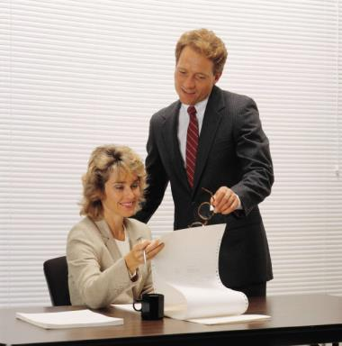
Management’s Role - Positive Safety Culture
    Commitment
    Support
    Communicate
    Involvement
PPT-106-01
44
Notes:
Management has a definite role in establishing a positive safety culture. The following is needed constantly from management:
Commitment
Support
Communicate
Involvement

Slide 45
What Should Management Do?
Emphasize safety over production
Maintain & support a high profile for safety
Attend Safety Committee meetings and safety inspections
Conduct face-to-face safety meetings
PPT-106-01
45
Notes:
Management needs to do the following things to assist in establishing a positive safety culture:
Emphasize safety over production
Maintain & support a high profile for safety
Attend Safety Committee meetings and safety inspections regularly
Conduct face-to-face safety meetings

Slide 46
What Should Management Do?
Develop job descriptions that include safety
Empower workers to stop their/others work if they feel situation is unsafe
Delegate responsibility for safety at all levels
Make safety a core value
PPT-106-01
46
Notes:
In addition management should also:
Develop job descriptions that include safety
Empower workers to stop their/others work if they feel situation is unsafe
Delegate responsibility for safety at all levels
Make safety a core value

Slide 47
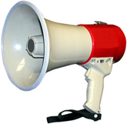
What Should Management Do?
    Provide channels of formal and informal communication (e.g.):
    - Safety bulletin boards
    - Toolbox talks
    - Newsletters
    - Memos
    Establish regular communication between management, supervisors and the workforce
PPT-106-01
47
Notes:
Management should establish both formal and informal methods of communication regarding safety. Some methods that can be used or at least considered are safety bulletin boards in areas where employees frequent regularly, “Toolbox safety talks” that can take as little as five (5) minutes, newsletters (whether they’re printed or accessible on-line) and memos addresses safety and safety concerns.
Communication needs to be a two-way process between management and employees, and management needs to be willing to listen to what employees are saying when it comes to safety.

Slide 48
Employee’s Role
    Accept responsibility for safety
    Follow safety policies/procedures
    Take initiative: report hazards/safety issues
    Commit to organization’s safety program
    Be a Team Player
PPT-106-01
48
Notes:
Employees also need to take an active role in establishing a positive safety culture and are many times the “hinge pin” when it comes to keeping the positive culture in place.
Employees need to:
Accept responsibility for safety
Follow safety policies/procedures
Take initiative: report hazards/safety issues
Commit to organization’s safety program
Be a Team Player

Slide 49
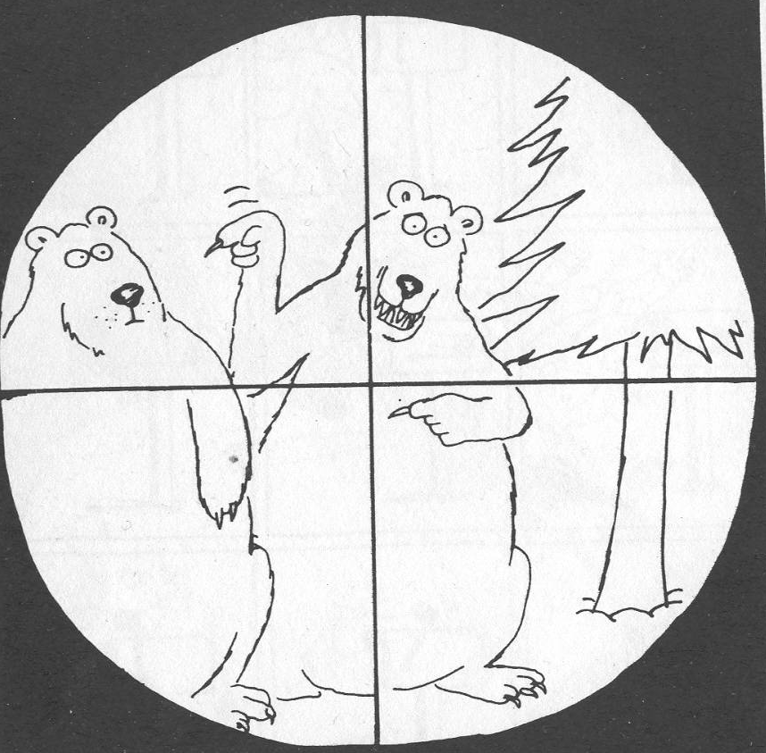
Don’t Pass the Buck!
Safety is everyone’s responsibility
PPT-106-01
49
Notes:
To have and maintain a positive safety culture all concerned need to realize that safety is EVERYONE’S responsibility not just managements or employees alone.

Slide 50
Steps for Creating a Positive Safety Culture
Awareness, support, cooperation from Management
Communicate intent to all employees
Review documentation, programs, & policies
Review injuries to determine types, frequency, trends, etc.
PPT-106-01
50
Notes:
The steps for creating a positive safety culture include but are not limited to:
Awareness, support, cooperation from Management
Communicate intent to all employees
Review documentation, programs, & policies
Review injuries to determine types, frequency, trends, etc.

Slide 51
Steps for Creating a Positive Safety Culture
Conduct a site tour to determine job tasks, logistics, safety issues
Determine employees’ safety awareness/attitudes
Ensure timely reporting of injuries, first aid cases, minor and near miss situations
Evaluate your accident/near miss investigation procedures
PPT-106-01
51
Notes:
Additional steps include:
Conduct a site tour to determine job tasks, logistics, safety issues
Determine employees’ safety awareness/attitudes (this can be done through a questionnaire or survey)
Ensure timely reporting of injuries, first aid cases, minor and near miss situations
Evaluate your accident/near miss investigation procedures

Slide 52
Steps for Creating a Positive Safety Culture
Ensure the Safety Committee is functioning appropriately
Evaluate incentives, rewards, disciplinary system
Provide ways for employees to give feedback: suggestion box, Hot Line, website, etc.
Develop tracking system to determine hazard correction timeline (e.g. spreadsheet, white board, computer program, etc.)
PPT-106-01
52
Notes:
More steps that can be used include:
Ensure the Safety Committee is functioning appropriately (e.g. having monthly meetings, looking at incidents, conducting safety inspections, etc.)
Evaluate incentives, rewards, disciplinary system
Provide ways for employees to give feedback: suggestion box, Hot Line, website, etc.
Develop tracking system to determine hazard correction timeline (e.g. spreadsheet, white board, computer program, etc.)

Slide 53
Steps for Creating a Positive Safety Culture
Develop realistic and measurable safety and health goals, objectives, & rewards
Provide awareness and seek support from all levels regarding goals, objectives, & rewards
Develop measurement criteria
PPT-106-01
53
Notes:
Finally, here are more steps that can be used:
Develop realistic and measurable safety and health goals, objectives, & rewards
Provide awareness and seek support from all levels regarding goals, objectives, & rewards
Develop measurement criteria

Slide 54

Steps for Creating a Positive Safety Culture
Action Plan:
Where do we start?
Who does what?
PPT-106-01
54
Notes:
To establish a positive safety culture a determination needs to be made as to where a company should start as well as who is going to do what tasks associated with the process.

Slide 55
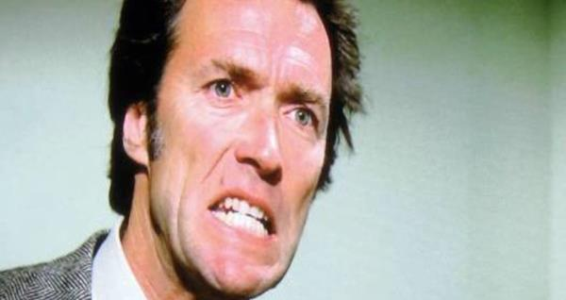
Steps for Creating a Positive Safety Culture
Tip: Don’t make the Safety Manager “the Enforcer!”
”Safety isn’t a one person job, friend!”
There should be no “safety police” in your organization
PPT-106-01
55
Notes:
One major mistake that companies can make in attempting to establish a positive safety culture is attempting to make the safety person the “safety cop” within the organization instead of using their expertise as a consultant instead. Safety is definitely NOT a one person job and should not be regulated to just one person. While a safety person could manage the overall safety program they should not have the overall responsibility to ensure a positive safety culture exists.

Slide 56
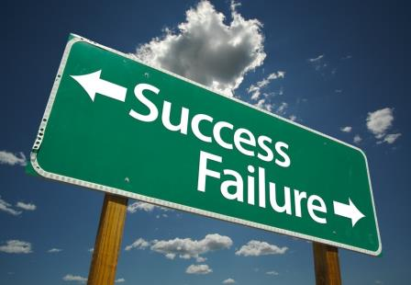
Defining Success
Safety is a core value
Strong leadership
High standards of performance
Allow for re-evaluation of methods
Mutual trust
How do we know where we’re at?
PPT-106-01
56
Notes:
As an organization how do you know when you’ve arrived when it comes to having a positive safety culture? Here are some indicators:
Safety is a core value
Strong leadership
High standards of performance
Allow for re-evaluation of methods
Mutual trust

Slide 57
Defining Success
Regularly scheduled Safety Committee and employee safety training
Good relations between management and employees
Unsafe work behaviors are reported and corrective actions are monitored
PPT-106-01
57
Notes:
Some additional ways to determine if you have a positive safety culture is to determine if:
Regularly scheduled Safety Committee and employee safety training is being conducted
Good relations exist between management and employees
Unsafe work behaviors are reported and corrective actions are monitored

Slide 58
Defining Success
Adherence to safety controls: ￫ Safety guards on machinery ￫ Appropriate PPE in use ￫ Appropriate signage in place ￫ Safety polices/procedures followed
Employees are empowered
Open & effective communication
PPT-106-01
58
Notes:
Several more methods for determining if a positive safety culture exists are to determine if:
Adherence to safety controls:
￫ Safety guards on machinery
￫ Appropriate PPE in use
￫ Appropriate signage in place
￫ Safety polices/procedures followed
Employees are empowered to report unsafe conditions as well as stop their or co-workers tasks
if they deem them unsafe
Open & effective communication between management and employees and vice versa

Slide 59

Defining Success
Low employee turn-over
Timely response: safety & health issues/concerns
Continuous monitoring of performance
PPT-106-01
59
Notes:
Establishing a positive safety culture will yield low employee turn-over and includes the timely response to safety and health concerns as well as the continuous monitoring of safety related performance.

Slide 60
Success Story
Governor’s Award for Safety Excellence:
Given each year to companies that exemplify a good safety culture.
Not every company that applies wins.
Winners are those that are “head and shoulders above the rest” when it comes to safety.
Something to strive for!
PPT-106-01
60
Notes:
One method used in Pennsylvania to determine companies who have a positive safety culture is the Governor’s Award for Safety Excellence. The GASE is given on an annual basis to those companies who exemplify a good, positive safety culture. It is something that is not given to every company who applies for the award but only those companies who prove they are “head and shoulders” above all others when it comes to safety within their organization. Any employer in Pennsylvania can apply for the award. Information about the award can be obtained by calling 717-772-1635, the Bureau of Workers’ Comp Health and Safety Division.

Slide 61
Summary
To have a great safety culture it takes:
Leadership
Teamwork
Commitment
Support
Communication
Values
PPT-106-01
61
Notes:
Remember, to have a good, positive safety culture it takes:
Leadership
Teamwork
Commitment
Support
Communication
Values

Slide 62
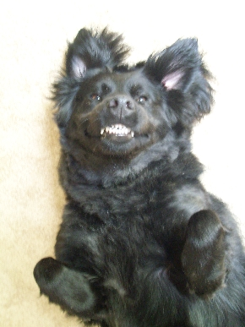
Having a Great Safety Culture….
Makes
everyone smile!
PPT-106-01
62

Slide 63


Contact Info
Bureau of Workers’ Compensation
Health & Safety Training Specialist
1171 Cameron Street, Room 324
Harrisburg, PA 17104-2501
717-772-1635
RA-LI-BWC-PATHS@pa.gov
Like us on Facebook! - https://www.facebook.com/BWCPATHS
PPT-106-01
63

Slide 64
Questions
PPT-106-01
64

