Slide 1

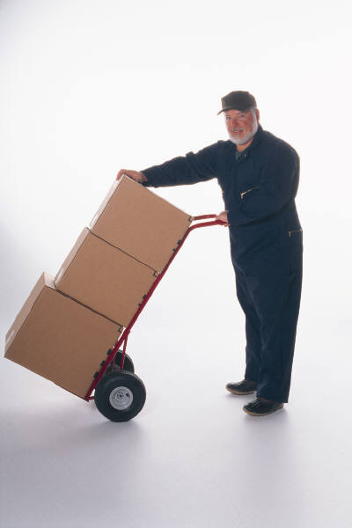
SAFE LIFTING/MATERIAL HANDLING
Bureau of Workers’ Compensation
PA Training for Health & Safety (PATHS)
Notes:
Depending upon the type of work in which we engage, the movement of materials and normal lifting we do, these activities can leave a negative lasting effect upon our bodies if done improperly.

Slide 2
What we’ll talk About
Material Handling Tips
Proper Lifting
Considerations
Tips for Safe Lifting
Exercises for Work and Home
Notes:
To reduce or eliminate the impact upon those involved in lifting and material handling we’ll discuss the following topics:
- Material handling tips,
- Proper lifting,
- Considerations before we attempt an action or activity,
- Tips for safe lifting, and
- Exercises useful for work and at home

Slide 3
Material Handling Tips
Check the object before you attempt to lift it.
Test every load before lifting = pushing object lightly with hands or feet to see how easily it moves (good indication as to how heavy it is).
Remember, a small size does not always mean a light load!
Make sure the load you are lifting is packed correctly.
Employees packing boxes should make sure weight is balanced and packed so it won’t move around.
Loose pieces inside a box can cause accidents if the box becomes unbalanced.
Notes:
Before you attempt to lift or move anything you should first test the weight of the object. Realizing that heavy items can be found in small containers, you should also test those containers first before handling them. This can be done by gently nudging the items lightly with your hand or foot.
Items can also be packaged off-balanced which will torque in your hands and possibly have you reaching to catch an unbalanced item. This can lead to further muscle stress.

Slide 4
More Tips
Make sure the load is easy to reach.
Don’t arch your back when lifting a load over your head.
Use a ladder instead of lifting something over your head.
Here’s the best way to pick up an object:
Use slow and smooth movements (hurried, jerky movements can strain the muscles in your back).
Keep your body facing the object while you lift it (twisting while lifting can injure your back).
Notes:
You also do NOT want to over-extend your reach for an object which can stress and stretch muscle and bone alignment.
When lifting, do so with a smooth action while facing the object minimizing twisting so you maintain correct skeletal and muscle alignment.
Any twisting or off-centered motions can strain your system.

Slide 5

Test the Load!
Always test the load before lifting to ensure it’s not too heavy for you to lift and carry by yourself!
If you determine the load is too heavy get assistance (either by using people or an appropriate mechanical aid).
Notes:
Test the load to ensure you can handle it alone. If you find the weight to be beyond your capabilities or beyond your capabilities due to distance to be transported-get assistance in the form or another helper or mechanical lifting device. Before lifting determine if a cart or other transport device is available and can be used.

Slide 6
Planning Ahead
Before moving a load plan both the load and the route (allows you to evaluate hazards, limitations, route safety, and final placement).
Evaluate the weight and shape of the load and also what material is made of.
Some items to check:
→ Is PPE or other safety gear necessary?
→ Size/shape/weight within your limits?
→ Can you get a firm hand hold?
→ Will you be able to see over the load?
→ Will you need assistance (people, cart,
forklift)?
Notes:
Pre-Plan the route of transport. Is it a short distance? Is it a circuitous route which will require you to change directions? Are there any pitfalls on the route such as stairs to be negotiated? Will you need to move around other objects in the walkway? Will there be vehicular hazards such as forklifts of which we will need to be mindful?
Will PPE be required? Gloves? Goggles? Safety shoes?
Is your hold on the item acceptable for short duration transport but will the load become bulky and unwieldy over a greater distance? All these need to be considered in your planning.

Slide 7
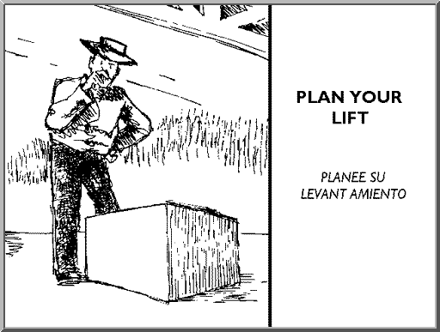
Prevention: Plan your Lift
Think about the weight, size, and shape of the object and the distance you will be moving it.
Is the object bulky? Will you need help?
Do you see any hazards that can be eliminated?
Think about the route you’ll be taking: any stairs, doors, obstacles?
If the object is heavy or awkward use a hand cart or pallet jack.
Notes:
Back injury prevention requires you plan the lift:
Weight, size and shape considerations,
Are there hazards in the immediate area, transport route or at destination which need to be removed?
Will you need assistance?

Slide 8
Plan Ahead – The Route
Check the route you will take and place where you will put the load down.
Injuries and property damage can occur when unexpected problems happen during the move.
Considerations for the route:
- Are there steps, tripping hazards, closed
doors, tight doorways or passageways?
- Are there blind corners or wet/slippery floors?
- What is the traffic situation (people, vehicles,
etc.)?
Notes:
Check the transport route.
Injuries can occur from a variety of intervening sources:
- Forklifts
- Other coworkers distracted by their jobs
- Shipping and receiving is usually busy with their daily routines
- Sometimes automatic doors don’t work
- Seasonal activities can make floors wet

Slide 9
Plan Ahead – the Drop Off Point
Some considerations:
▪ Where will you place the load?
▪ Is there room for the load?
▪ Is the site strong enough to hold the load?
▪ Will the load block traffic or create a hazard
when placed?
▪ Will the load have to be placed elsewhere or
will it be in the right location after you set it
down?
Notes:
Destination concerns.
Have you determined the area or room is ready to receive your item?
Survey the location before you transport the item.
Will the shelving hold the item?
Is there room to accommodate it?
Will you need to lower the item, perform some action to the receiving area first and then have to lift the load into place?
How do you reduce the amount of effort and energy you need to exert to complete the job?

Slide 10
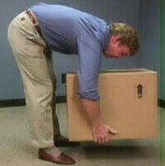
Lowering the Object
When lowering an object remember to bend at the knees not at the waist and avoid twisting motions while putting the load down. (the picture shown demonstrates how NOT to put an object down!).
If you must turn while lowering an object adjust your feet rather than twisting your
back.
Not the correct way to lower a box
Notes:
Lower the object by bending at the knees-not the waist.
Do not twist your body. If you must turn, do so with your feet and not your back.

Slide 11
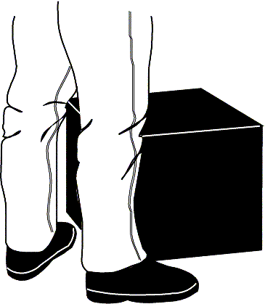
Lifting Properly – Step One
▫ Stand close to the load
with your feet spread
about shoulder width
apart.
▫ One foot slightly in
front of the other for
balance.
Notes:
Get as close to the load as possible, with your feet spread shoulder width apart, one foot slightly in front of the other to retain your balance.

Slide 12
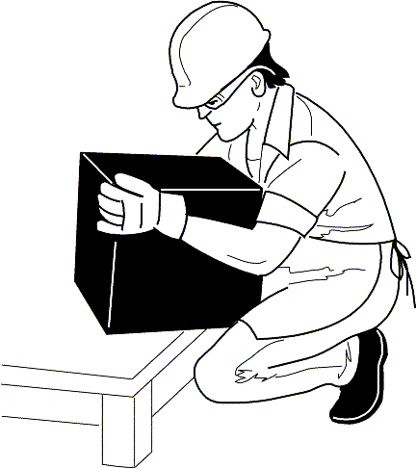
Lifting Properly – Step Two
Squat down bending at the knees (not your waist).
Tuck your chin while keeping your back as vertical as possible.
Notes:
Squat down, bending at your knees. Tuck your chin in while keeping your back as vertical as possible.

Slide 13
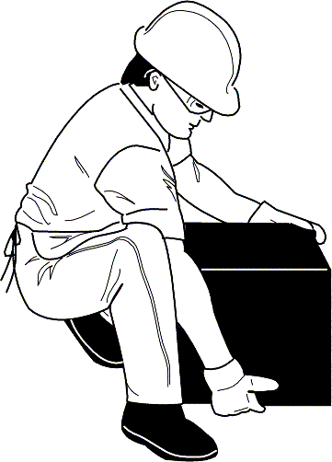
Lifting Properly – Step Three
Get a firm grasp of the object before beginning the lift.
Notes:
Get a firm grasp on the object before you attempt the lift. As you can see here, the load will be grasped underneath and at a remote corner to attain support and balance.

Slide 14
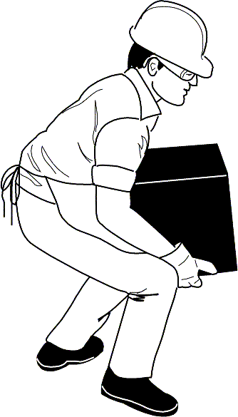
Lifting Properly – Step Four
Begin slowly lifting with your LEGS by straightening them. Never twist your body during this step!
Notes:
The 4th step is to begin the lift slowly using the legs to maintain a vertical rise without twisting the body.

Slide 15
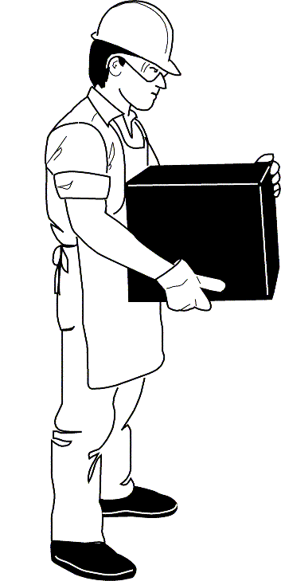
Lifting Properly – Step Five
Once lift is complete, keep object as close to your body as possible.
As load's center of gravity moves away from body, dramatic increase in stress to the lumbar region of the back.
Notes:
Having completed the lift, the object is kept as close to the body as possible. Think of your arms as part of a lifting mechanism.
As the load moves away from the body’s center of gravity you can determine strain the same way you would when measuring strain and stress of a load on a beam.
Example: A 40 lb item weighs 40 lbs if it is close to our body, but if we move that same 40 lb item 2 feet away from the body we have (Distance x weight=total force). Here, a 40 lb load 2 feet from the body may feel like 2 feet x 40 lbs= 80 lbs is being exerted on our arms.
If you’ve worked with cranes or forklifts and centers of gravity before, you can well understand the loads imposed on the human body.

Slide 16
Other Considerations
Team Lifting – More than one person required to lift a load: team of folks; one person “calls” directions and lifting steps so everyone will move at the same pace.
Stacking – Overlap and interlock rows. Never stack above the crush height or above height limits for the facility you’re working in. Make certain the base is clean, level and can support the weight.
Notes:
So, by going to a distributed, rather than a concentrated loading, we achieve greater efficiency without putting unnecessary stress and strain on our systems.
This is why Team Lifting is a great assist to the job; it distributes the load.
Stacking of stock should be done with an eye toward permanence, meaning once you’ve stocked at a location, to have to go back and redo the job means unnecessary effort on your part.

Slide 17
Other Considerations
Drums –
Use a lift truck with drum forks or a drum dolly to move, even a short distance.
If moving individual empty drums, roll on the side not the rim and always work on the down side of the drum with the hands on the “belly” of the drum, not the rim.
Notes:
Lift trucks, drum forks, drum dollies all make the moving of filled drums so much easier. Rolling on the rim may seem a quick way to move a drum—until it gets away from you and takes on its own mind and goes where it pleases!

Slide 18
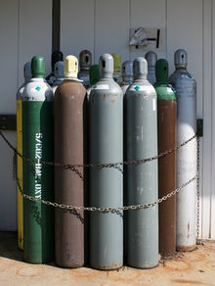
Considerations
Cylinders:
Compressed gas cylinders are like bombs with very short fuses!
Valves must be protected by a proper safety cap.
Use a special hand truck to move individual cylinders, and “walk” them only short distances to align them.
Cylinders must be stored in designated areas and secured with safety chains or bars.
Notes:
Professionals in the various gas industries used to “walk” cylinders (tilting them in an upright position with a hand on the safety cap). However, even members of these industries see how much safer it is to use a hand truck even over short distances.
Just a part of the total safety objective; safety caps, chained 2/3s of the way up and safe transport.

Slide 19
Considerations
Mechanical Aids –
Often the best way to move loads is with a mechanical aid like a hand truck or rolling cart.
Choose the right aid for the job and inspect it before use.
Place the heaviest items on the bottom with the weight concentrated between the wheels.
Keep your hands away from the edges so they won’t be scraped or crushed in doorways.
Notes:
Mechanical aids help us work smarter-not harder. Selecting the correct aid is a must. If you choose a cart with small wheels over one with larger wheels, the effort to move the item may still put strain on your body.
After selecting the right aid for the job, put heavier items on the bottom with the weight evenly spread between the wheels.
Keep your hands from the edges of the aid so they’re not scraped or crushed in doorways.
Also know the terrain over which you will move so you do not have weight shifting on changes of floor heights or ramps.

Slide 20
Tips for Safe Listing
PLAN THE LIFT.
REMOVE ANYTHING IN YOUR WAY.
PUSHING IS EASIER THAN PULLING.
PULLING IS EASIER THAN CARRYING.
GET HELP FOR HEAVY/BULKY LOADS.
Notes:
Some quick tips:
- Plan the lift
- Remove any obstructions in your way
- Remember the way we’re all constructed: pushing is easier than pulling
- And pulling is easier than carrying
- Be sure to get help for heavy or bulky loads.

Slide 21
More Tips for Safe Lifting
WARM UP YOUR MUSCLES WITH STRETCHES.
TEST THE WEIGHT OF THE LOAD FIRST.
FACE THE WAY YOU NEED TO MOVE.
HOLD THE LOAD CLOSE TO YOUR BODY.
Notes:
Here are some tips to lift safely:
Warm up your muscles with stretching exercises before lifting
Test the weight of the load first
Always face the way you need to move
Hold the load close to your body.

Slide 22
More Tips
LIFT WITH YOUR BACK AS STRAIGHT AS COMFORTABLE.
KEEP THE LOAD BETWEEN SHOULDER AND KNEE HEIGHT.
CHANGE YOUR POSITION.
STRETCH TO RELAX AND REST TIRED MUSCLES.
Notes:
Lift with your legs, keeping your back as straight as possible.
Store the load between shoulder and knee height.
Change your position by turning feet-not twisting your body.
Stretch to relax and rest tired muscles.

Slide 23
and More Tips
PLAN WHERE TO SET THE LOAD DOWN.
REST MORE OFTEN WHEN IT IS HOT/HUMID.
TAKE MORE TIME TO WARM UP YOUR MUSCLES IN THE COLD.
TAKE MORE BREAKS IF USING TOOLS/EQUIPMENT THAT VIBRATES.
Notes:
Survey the drop point. Where will you set the load down?
When it’s hot or humid, don’t exhaust yourself through exertion-rest more.
In cold weather-warm your muscles.
Tools that vibrate require you take more breaks to relax your muscles.

Slide 24
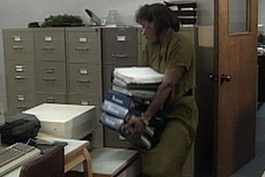
Any Problems?
Too many books – weight could injure shoulders and/or back
Drop off surface not big enough
Position/posture could injure neck, back, arms, shoulders
Notes:
Check out potential problems:
- Excessive load
- Drop off surface is not large enough to take the load. This will require you to find another holding surface while you prepare the true destination.
- Extreme severe posture which could injure your neck, back, arms and shoulders.

Slide 25
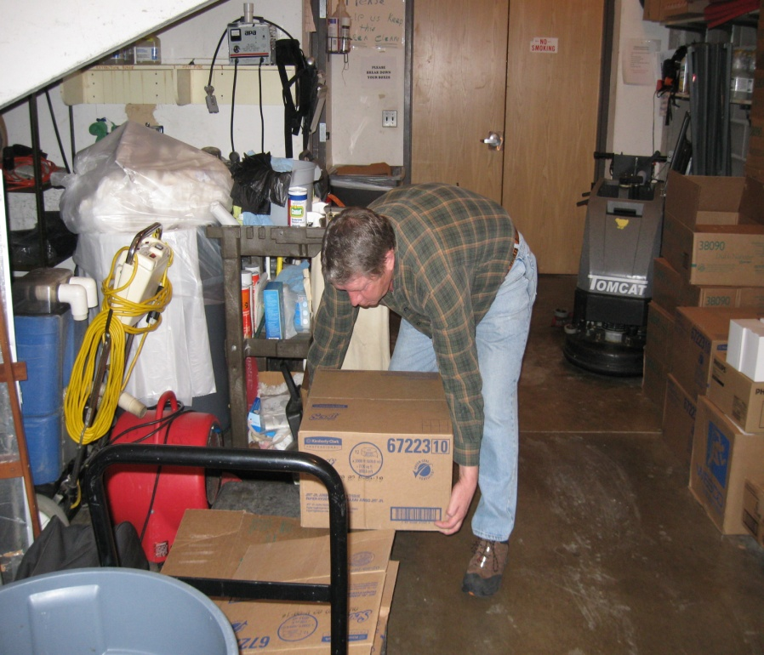
What about this?
Bending over at the
waist
Heavy lifting from
below knees
Improper posture
Notes:
Legs should be doing the lifting not bending at waist.
Improper posture creating back strain as well as stressing muscles of the legs.

Slide 26
Exercises you can do at Work
Be safe - check with your doctor before attempting any of these exercises!
Notes:
Check with your Doctor before you attempt any of the exercises shown to you here.
Although they are proven helpful to others, your condition and body type may not be suited for them.

Slide 27
Strengthening Exercise
Wall Slides to strengthen
your muscles . . . .
- Stand with your back
against a wall, feet
shoulder-width apart.
- Slide down into a crouch
with knees bent to 90 degrees.
- Count to 5 and slide back up
the wall. Repeat 5 times.
Notes:
Wall Slide: will strengthen your leg muscles.
While standing with back to a wall, spread your feet apart shoulder width.
Slowly slide down the wall into a crouch bending your knees 90 degrees (if possible)
Count to 5
Then slowly slide back up the wall
Repeat this action 5 times.

Slide 28
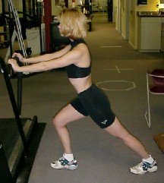
Stretching Exercises
Gastroc Stretch
▪Lean against a wall or other stationary object, both palms against the object.
▪Leg you want to stretch is back, several feet from wall, heel firmly positioned on the floor.
▪Other leg is flexed about halfway between back leg and wall.
▪Start with your back straight and gradually lunge forward until you feel the stretch in your calf.
▪Very important to keep back foot straight and angled 90 degrees from wall.
Notes:
Gastroc Stretch
Put both palms against a wall or other sturdy object and lean forward
Place the leg you want to stretch back several feet from the wall with heal firmly on the floor
Flex your other leg halfway between the stretched leg and the wall
With your back straight, gradually lunge forward until you feel the stretch in the calf
Remember: Keep your back foot straight and angled 90 degrees from wall.
Change legs and repeat motions.
This is recommended for Planters Fascia conditions.

Slide 29
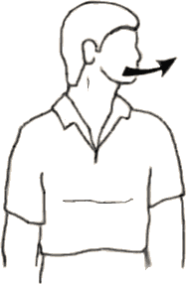
More Stretches
• Stretches for side of neck:
Sit or stand with arms hanging loosely at sides
Turn head to one side, then the other
Hold for 5 seconds, each side
Repeat 1 to 3 times
Notes:
This exercise helps stretch your neck muscles:
While sitting or standing with arms hanging loosely at your sides,
Turn your head slowly to one side, then the other
Hold the turn to each side for 5 seconds.
Repeat 1 to 3 times.

Slide 30
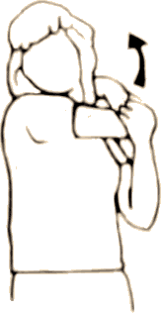
and More Stretches
Stretches for side of shoulder and back of upper arm
Stand or sit and place right hand on left shoulder
With left hand, pull right elbow across chest toward left shoulder and hold 10 to 15 seconds
Repeat on other side
Notes:
Stretches for your shoulders and back of upper arms:
Stand or sit and place right hand on left shoulder
With left hand, pull right elbow across chest toward your left shoulder
Hold for 10 to 15 seconds.
Repeat for other side.

Slide 31
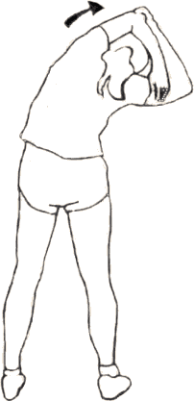
and Finally!
Stretches for triceps, top of shoulders, waist
Keep knees slightly flexed
Stand or sit with arms overhead
Hold elbow with hand of opposite arm
Pull elbow behind head gently as you slowly lean to side until mild stretch is felt
Hold 10 to 15 sec
Repeat on other side
Notes:
Stretches for triceps, top of shoulders, waist.
Keep knees slightly flexed
Stand or sit with arms overhead
Hold elbow with hand of opposite arm
Pull elbow behind head gently as you slowly lean to side until mild stretch is felt
Hold for 10 to 15 seconds.
Repeat for other side.

Slide 32
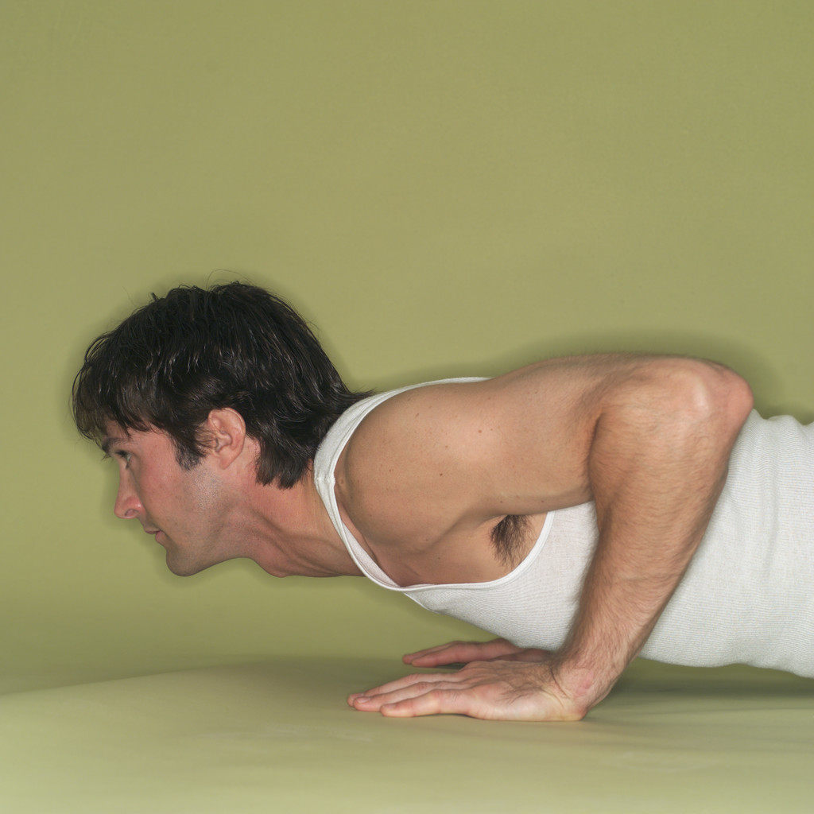
Exercises you can do at Home
Notes:
The previous exercises can be done at the office or at home. The following are for doing at home due to the extreme positioning.

Slide 33
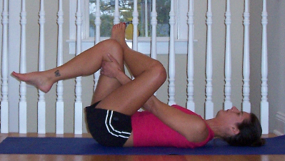
Stretching Exercises
Hip/Glute Stretch
Cross left foot over right knee.
Clasp hands behind right thigh and gently pull the leg in towards you, keeping upper body relaxed.
Switch Legs
Notes:
Hip and Glute Stretch
Lay on your back
Cross your left foot over your right knee
Clasp hands behind your right thigh and gently pull the leg in toward you while keeping your upper body relaxed
Switch legs

Slide 34
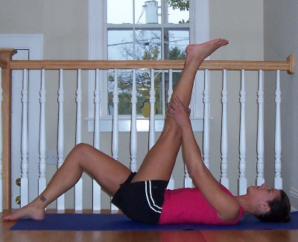
More Stretching Exercises
Hamstring Stretch
Lie on floor with knees bent.
Straighten one leg and slowly pull it towards you, clasping the thigh, calf or ankle.
Keep knee slightly bent.
Switch legs.
Notes:
Hamstring Stretch
Lie on the floor with knees bent
Straighten one leg and slowly pull it toward you, clasping the thigh, calf or ankle
Keep knee bent slightly
Switch legs

Slide 35
Bottom Line
If the load you are trying to manually lift is too heavy for you to handle, get help from co-workers or a mechanical aid – don’t risk getting injured!
Notes:
If the load you are trying to lift manually is too heavy-get help. This could be a coworker or mechanical lifting aid.
Don’t risk getting injured!!

Slide 36


Contact Information
Health & Safety Training Specialists
1171 South Cameron Street, Room 324
Harrisburg, PA 17104-2501
(717) 772-1635
RA-LI-BWC-PATHS@pa.gov
Like us on Facebook! - https://www.facebook.com/BWCPATHS

Slide 37

Questions
Notes:
If you have any questions or need further information please don’t hesitate to contact us at 717-772-1635.

