Slide 1
Restaurant/Food Service Safety
Bureau of Workers’ Compensation
PA Training for Health & Safety
(PATHS)
PPT-070-01
1
Notes:
Food industry workers have a 60 percent higher rate of occupational injury or illness than workers in other industries, according to a study from Emory University. Severe injuries that required time off work were "more than twice as frequent" among food service workers, and the risk of occupational death was 9.5 times higher than in non-food jobs.
The Restaurant and Food Service industries present a variety of potential hazards to employees concerning personal safety and other materials which may cause harm.

Slide 2
Topics
Safety with Sharp Objects
Preventing Burns and Fires
Preventing Slips, Trips and Falls
Safe Lifting/Material Handling
Safety with Chemicals
PPT-070-01
2
Notes:
This presentation will address the following topics which can also be hazards within the restaurant and food service industries:
Safety with Sharp Objects
Preventing Burns and Fires
Preventing Slips, Trips and Falls
Safe Lifting/Material Handling
Safety with Chemicals

Slide 3
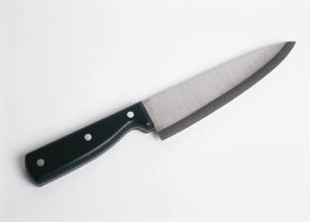
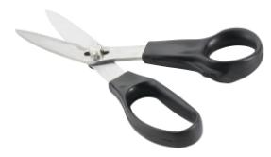
Safety with Sharps
PPT-070-01
3
Notes:
Many types of sharps are used in restaurant and food service industries and, if improperly handled, can lead to severe injuries.

Slide 4
Safety with Knives
Knives are very useful tools when you’re working in food service, but they can also be very dangerous if not handled and cared for properly.
Remember, knives are one of the most dangerous things around an establishment and should be handled with great caution.
PPT-070-01
4
Notes:
Knives are very useful tools when you’re working in food service, but they can also be very dangerous if not handled and cared for properly.
Remember, knives are one of the most dangerous things around an establishment and should be handled with great caution.

Slide 5
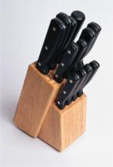
Knife Safety Tips
Use good, sturdy knives that are well balanced and do not easily bend.
Use a cutting board – do not use kitchen counters, metal, glass, or steel surfaces when chopping, slicing, or mincing.
Place a damp cloth under the cutting board to prevent it from slipping.
PPT-070-01
5
Notes:
Use good, sturdy knives that are well balanced and do not easily bend.
Use a cutting board – do not use kitchen counters, metal, glass, or steel surfaces when chopping, slicing, or mincing.
Place a damp cloth under the cutting board to prevent it from slipping.

Slide 6
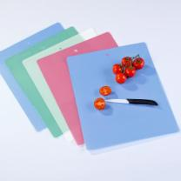
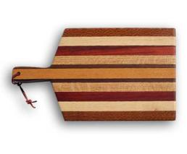
Knife Safety Tips
Use the proper cutting board – plastic boards are dishwasher safe and more sanitary than wooden boards, but they can dull knives quickly.
Wooden boards are ideal but need thorough cleansing to remain sanitary.
Protect your fingers by curling them under and positioning them on top of the item to be cut.
PPT-070-01
6
Notes:
Use the proper cutting board – plastic boards are dishwasher safe and more sanitary than wooden boards, but they can dull knives quickly.
Wooden boards are ideal but need thorough cleansing to remain sanitary.
Protect your fingers by curling them under and positioning them on top of the item to be cut.

Slide 7
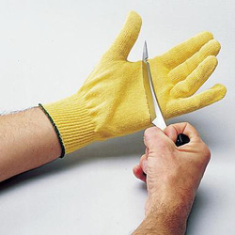
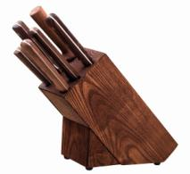
Knife Safety
Keep knives sharpened.
Always store knives in a knife holder or on a magnetic wall strip.
Store knives from largest to smallest with blades facing the same direction.
Use Kevlar gloves for added protection.
Never attempt to catch a falling knife!
Never cut anything held in your hand.
Never cut toward yourself.
PPT-070-01
7
Notes:
Keep knives sharpened.
Always store knives in a knife holder or on a magnetic wall strip.
Store knives from largest to smallest with blades facing the same direction.
Use Kevlar gloves for added protection.
Never attempt to catch a falling knife!
Never cut anything held in your hand.
Never cut toward yourself.

Slide 8
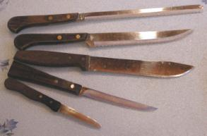
Knife Safety
Use knives for their intended purpose only.
Keep knives clean.
Select the correct knife for the job.
Carry knives down and by your side with the blade to the back.
Let people know you’re walking with a knife by saying something like “knife walking.”
Put knives down safely.
PPT-070-01
8
Notes:
Use knives for their intended purpose only.
Keep knives clean.
Select the correct knife for the job.
Carry knives down and by your side with the blade to the back.
Let people know you’re walking with a knife by saying something like “knife walking.”
Put knives down safely.

Slide 9
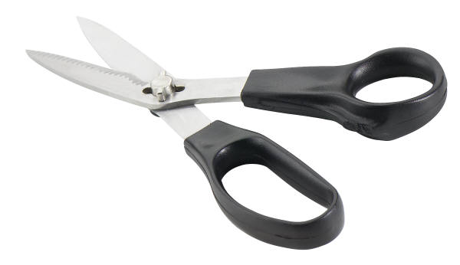
Safety with Sharps
Keep scissors sharpened.
Use proper scissors for the job being done.
Do not try and catch falling scissors.
Carry scissors with the blades closed.
Hand scissors to someone with the handle facing them.
PPT-070-01
9
Notes:
General Precautions when dealing with sharps:
Keep scissors sharpened.
Use proper scissors for the job being done.
Do not try to catch falling scissors.
Carry scissors with the blades closed.
Hand scissors to someone with the handle facing them.

Slide 10
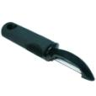
Sharps Safety
When using a box cutter, cut away from yourself.
Keep box cutters closed when not in use.
Put broken glass in a safe container & mark it.
Do not pick up broken glass with your bare hands.
Always turn a slicer off and dial the blade to “0” before moving product or cleaning.
Always wear the correct PPE when cleaning a slicer.
When using a potato peeler, peel away from yourself.
PPT-070-01
10
Notes:
When using a box cutter:
Cut away from yourself.
Keep box cutters closed when not in use.
Put broken glass in a safe container & mark it.
Do not pick up broken glass with your bare hands.
Always wear the correct PPE when cleaning an area.

Slide 11
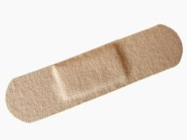
Cuts
If you cut yourself, wash the wound thoroughly under cold water.
If the wound is shallow and the bleeding stops, dry the skin around it with a paper towel/clean cloth.
If available, put an “infection prevention” cream/spray on the wound.
Cover the wound with a sterile bandage to keep the wound shielded and clean.
PPT-070-01
11
Notes:
If you cut yourself, wash the wound thoroughly under cold water.
If the wound is shallow and the bleeding stops, dry the skin around it with a paper towel/clean cloth.
If available, put an “infection prevention” cream/spray on the wound.
Cover the wound with a sterile bandage to keep the wound shielded and clean.
When in doubt as to severity, seek medical attention!!

Slide 12
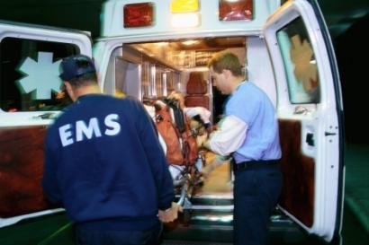
Cuts
To stop bleeding if the wound is deep:
→ Apply pressure
→ Raise the wound site above the heart
→ Seek medical attention a.s.a.p.
PPT-070-01
12
Notes:
To stop bleeding if the wound is deep:
→ Apply pressure
→ Raise the wound site above the heart
→ Seek medical attention a.s.a.p.

Slide 13
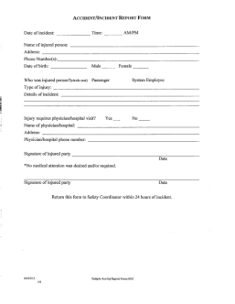
Report on the Job Injuries
Report any on the job injuries to your Supervisor as soon as possible, and make sure an injury report is completed a.s.a.p.
PPT-070-01
13
Notes:
Report any on-the-job injuries to your Supervisor as soon as possible, and make sure an injury report is completed a.s.a.p.

Slide 14
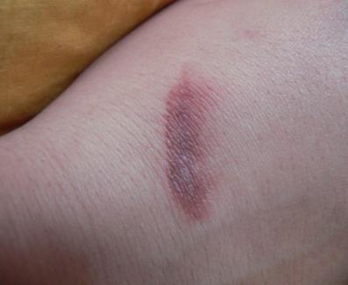
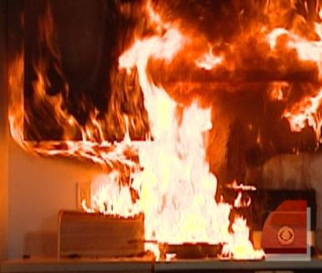
Preventing Burns & Fires
PPT-070-01
14
Notes:
Personal injuries due to burns can be debilitating or life-threatening.
Possible fires in an establishment can threaten lives and property.

Slide 15
Degrees of Burns
First Degree – minor and heal quickly.
Symptoms = reddened skin, tender, sore
Second Degree – serious and require immediate first aid & professional medical treatment.
Symptoms = blistered skin, very painful
Third Degree – severe and require immediate professional medical treatment.
Symptoms = white, brown, or charred tissue, often surrounded by blistered areas; little or no pain at first
PPT-070-01
15
Notes:
First Degree – minor and heal quickly.
Symptoms = reddened skin, tender, sore.
Second Degree – serious and require immediate first aid & professional medical treatment.
Symptoms = blistered skin, very painful.
Third Degree – severe and require immediate professional medical treatment.
Symptoms = white, brown, or charred tissue, often surrounded by blistered areas; little or no pain at first.

Slide 16
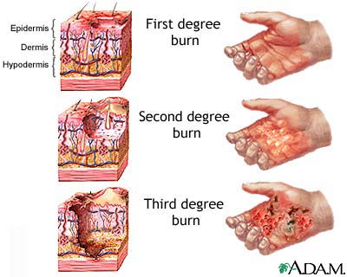
Degrees of Burns
PPT-070-01
16
Notes:
The slide shows the severity of burns which may be suffered. These can be a result of fire or chemical burns.

Slide 17
First Aid for Burns/Scalds
First & Second Degree = Cool the burned area with cool, running water for 10 minutes.
Third Degree = Get medical attention immediately! Cool only with wet, sterile dressings.
After the burned area has been cooled, cover with a clean, dry dressing.
Do NOT put butter or any other grease including medicated ointments on a burn!
PPT-070-01
17
Notes:
First & Second Degree = Cool the burned area with cool, running water for 10 minutes.
Third Degree = Get medical attention immediately! Cool only with wet, sterile dressings.
After the burned area has been cooled, cover with a clean, dry dressing.
Do NOT put butter or any other grease including medicated ointments on a burn!

Slide 18
First Aid for Burns/Scalds
Do NOT break blisters!
If clothing has been burned, remove that part which isn’t stuck to victim.
If possible, remove jewelry from around burned area before swelling begins.
Treat for shock by keeping the victim’s body temperature normal; cover unburned areas with a dry blanket.
PPT-070-01
18
Notes:
Do NOT break blisters!
If clothing has been burned, remove that part which isn’t stuck to victim.
If possible, remove jewelry from around burned area before swelling begins.
Treat for shock by keeping the victim’s body temperature normal; cover unburned areas with a dry blanket.

Slide 19
Deep Fat Fryer Safety
Never put water or other liquid into hot cooking oil – it turns to steam instantly and can violently explode hot oil in all directions.
Be careful when adding food to a deep fat fryer: if the fat is too hot or there are pockets of liquid in the prepared food the hot fat/oil will spray up.
Turn the Fryer off when leaving for the day.
PPT-070-01
19
Notes:
When using a deep fat fryer:
Never put water or other liquid into hot cooking oil – it turns to steam instantly and can violently explode hot oil in all directions.
Be careful when adding food to a deep fat fryer: if the fat is too hot or there are pockets of liquid in the prepared food the hot fat/oil will spray up.
Turn the Fryer off when leaving for the day.

Slide 20
Burn Prevention Tips
Remember that steam will rise from a pot of boiling water when the lid is removed.
Use a pot holder and lift lids so that the end farthest away from you comes up first.
Leave a cloth or oven mitts on a hot lid lying on a counter top to alert others the lid is hot.
Turn pot handles in so that they can’t be bumped or the pots knocked over.
PPT-070-01
20
Notes:
Some tips to prevent burns include:
Remember that steam will rise from a pot of boiling water when the lid is removed.
Use a pot holder and lift lids so that the end farthest away from you comes up first.
Leave a cloth or oven mitts on a hot lid lying on a counter top to alert others the lid is hot.
Turn pot handles in so that they can’t be bumped or the pots knocked over.

Slide 21
Burn Prevention Tips
Don’t leave spoons or other utensils in pots while cooking.
Don’t leave pots on stove unattended while cooking.
Turn off burners and ovens when they are not in use.
Keep plenty of dry pot holders and oven mitts near your cooking area.
PPT-070-01
21
Notes:
Here are even more burn prevention tips:
Don’t leave spoons or other utensils in pots while cooking.
Don’t leave pots on stove unattended while cooking.
Turn off burners and ovens when they are not in use.
Keep plenty of dry pot holders and oven mitts near your cooking area.

Slide 22
Burn Prevention Tips
When cooking wear clothing with tight fitting sleeves or roll your sleeves up.
When using a microwave, use only containers designed for safe use.
Before carefully removing covers on food cooked in a microwave, ensure the food has cooled down.
Keep things that burn such as dishtowels, paper, etc. at least 3 feet from the range top.
PPT-070-01
22
Notes:
Additional ways to prevent burns include:
When cooking wear clothing with tight fitting sleeves or roll your sleeves up.
When using a microwave, use only containers designed for safe use.
Before carefully removing covers on food cooked in a microwave, ensure the food has cooled down.
Keep things that burn such as dishtowels, paper, etc. at least 3 feet from the range top.

Slide 23
Burn Prevention Tips
Keep grease from building up on range tops, hoods, and appliances.
Keep hot pans, beverages, and trays away from the edge of a counter.
Use pot holders or oven mitts when moving/carrying hot pans, trays, etc.
Use caution when moving about within the kitchen due to hot grills, range tops, ovens.
PPT-070-01
23
Notes:
And finally:
Keep grease from building up on range tops, hoods, and appliances.
Keep hot pans, beverages, and trays away from the edge of a counter.
Use pot holders or oven mitts when moving/carrying hot pans, trays, etc.
Use caution when moving about within the kitchen due to hot grills, range tops, ovens.

Slide 24
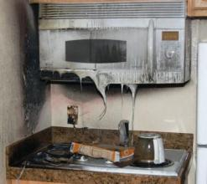
Kitchen Fires
Most kitchen fires start due to the heating of fat or oil.
Unattended cooking can also result in a kitchen fire.
When oil/fat gets hot it smokes a little at first, but if it gets hotter it bursts into flame.
PPT-070-01
24
Notes:
Kitchen fires occur more than people think and happen both at home and in restaurants or other areas where food is cooked:
Most kitchen fires start due to the heating of fat or oil.
Unattended cooking can also result in a kitchen fire.
When oil/fat gets hot it smokes a little at first, but if it gets hotter it bursts into flame.

Slide 25
Kitchen Fires
To extinguish a fat/oil fire cover it with a damp cloth, pot lid, or use a fire extinguisher.
Make sure you turn off the gas or power.
NEVER USE WATER on a fat/oil/grease fire!
Do NOT attempt to carry or move a pan that’s on fire.
Keep the appropriate lid close by while cooking so you can cover a pan that’s on fire.
PPT-070-01
25
Notes:
If a fire occurs in a kitchen or other cooking area:
To extinguish a fat/oil fire cover it with a damp cloth, pot lid, or use a fire extinguisher.
Make sure you turn off the gas or power.
NEVER USE WATER on a fat/oil/grease fire!
Do NOT attempt to carry or move a pan that’s on fire.
Keep the appropriate lid close by while cooking so you can cover a pan that’s on fire.

Slide 26
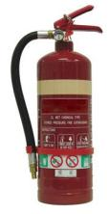
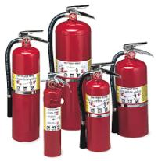
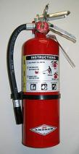
Fire Extinguisher Use
Fire extinguishers are marked to indicate the class of fire they can be used on.
Access to fire extinguishers should not be blocked/obstructed.
After a fire extinguisher is used it must be recharged, not put back in place.
Most fire extinguishers will make a mess!
PPT-070-01
26
Notes:
Fire extinguisher use requires each employee to familiarize themself with the extinguisher labels.
Labels will provide instructions on:
Class of fire for which used.
Instructions, in both written and graphics, on proper use.

Slide 27
Fire Extinguisher Classifications
PPT-070-01
27
Notes:
Provide proper signage for fire extinguisher locations and ensure extinguishers are properly mounted at that location.
This will aid in your inspection program.

Slide 28
Class of Fires
Class A = Ordinary Combustibles (e.g. Wood, Paper, Rubber)
Class B = Flammable Liquids/Gases (e.g. Gasoline, Methane)
Class C = Energized Electrical (e.g. Electrical appliance plugged in)
PPT-070-01
28
Notes:
The Fire Classes against which extinguishers are used include:
Class “A” Fires: ordinary combustibles, wood, paper, cloth and plastic. (Some include plastics in Class B due to being a petroleum by-product. This process relies on cooling the material).
Class “B” Fire: flammable or combustible materials. These include gases and liquids such as gasoline, kerosene and methane. The vapors given-off by these materials burn.
Therefore the mechanism used to extinguish may rely on: surface cooling, vapor suppression as well as eliminating the chemical chain reaction.
Class “C” fires recognize that energized electrical equipment is involved, so a non-electrically conductive agent is required to suppress the fire. Once a machine is de-energized, the fire could revert to whatever is included in the process. Example: A wood lathe fire occurs. Once the lathe is de-energized, it may leave only the wood (Class “A”) burning. Therefore, the original extinguisher took into account that it, 1) would not be electrically conductive, and 2) could extinguish the material (wood) on the lathe.

Slide 29
Class D Fires
Class D Fires = Combustible metals (e.g. titanium, aluminum)
Extinguishers for these classes of fire:
Often specific for type of metal in question
No picture designator
No rating; also not given multi-purpose rating
PPT-070-01
29
Notes:
Class “D” fires involve combustible metals such as titanium or magnesium. Most class D extinguishers will have a special low velocity nozzle or discharge wand to gently apply the agent in large volumes to avoid disrupting any finely divided burning materials.

Slide 30
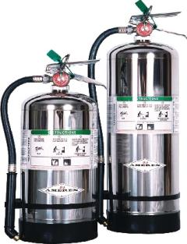
Class K Fires
Class “K” fires occur in cooking grease made from animal fat.
These fires usually burn very hot and can be dangerous to extinguish.
There are special fire extinguishers that are used for these types of fires and are usually in kitchen areas of restaurants/cafeterias.
PPT-070-01
30
Notes:
Class “K” Fires are those involving cooking grease made from animal fat.
These fires usually burn very hot.
Dangerous to extinguish.
Special fire extinguishers used for these classes of fires.
Usually in kitchen areas of restaurants/cafeterias.

Slide 31
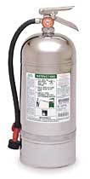
Class K Fire Extinguisher
Looks like a 2 ½ gallon pressurized water extinguisher – don’t get them mixed up!
Use the labels/markings on all extinguishers to ensure you have the correct one!
PPT-070-01
31
Notes:
Class K fire extinguisher
Looks like a 2 ½ gallon pressurized water extinguisher – don’t get them mixed up!
Use the labels/markings on all extinguishers to ensure you have the correct one!

Slide 32
Use a Fire Extinguisher = P.A.S.S.
P = Pull the pin on the fire extinguisher handle.
A = Aim the nozzle/horn of the extinguisher at the base/bottom of the fire.
S = Squeeze the fire extinguisher handles together to make the extinguisher work.
S = Sweep the extinguisher from side to side as if you were using a broom.
PPT-070-01
32
Notes:
To operate the extinguisher, use the anagram of P.A.S.S.
P = Pull the pin on the fire extinguisher handle.
A = Aim the nozzle/horn of the extinguisher at the base/bottom of the fire.
S = Squeeze the handles together to make the extinguisher work.
S = Sweep the extinguisher from side to side as if using a broom.

Slide 33
Used Extinguisher
Never put a fire extinguisher that’s been used back in place (even if it still feels heavy).
Even a short burst can cause the extinguisher to leak pressure after use.
Putting a used extinguisher back in place can mean it won’t work in the future.
Have used extinguishers checked and recharged by a reputable dealer.
PPT-070-01
33
Notes:
After using a fire extinguisher:
Never put the used extinguisher back up on the wall (even if used for only five seconds)!
A fire extinguisher that’s been used may not operate again due to the pressure inside leaking out.
Notify the appropriate individual/department so the used extinguisher can be replaced and recharged as quickly as possible.

Slide 34
Think Safety!
Burns can be VERY painful and kitchen fires can be devastating.
The “bottom line” in preventing burns and kitchen fires is to use common sense and safe practices.
Never take anything for granted when working in a kitchen – treat pots, pans, and cooking surfaces as being hot unless YOU know for sure they are not.
PPT-070-01
34
Notes:
Burns can be VERY painful and kitchen fires can be devastating.
The “bottom line” in preventing burns and kitchen fires is to use common sense and safe practices.
Never take anything for granted when working in a kitchen – treat pots, pans, and cooking surfaces as being hot unless YOU know for sure they are not.

Slide 35
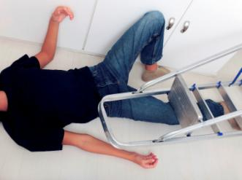
Preventing Slips, Trips & Falls
PPT-070-01
35
Notes:
Falls are one of the leading causes of unintentional injuries in the United States, accounting for approximately 8.9 million visits to the emergency department annually (NSC Injury Facts 2011). Adults 55 and older are more prone to becoming victims of falls…The number of fall deaths among those 65 and older is four times the number of fall deaths among all other age groups.
http://www.nsc.org/safety_home/HomeandRecreationalSafety/Falls/Pages/Falls.aspx
85% of worker’s compensation claims are attributed to employees slipping on slick floors (Industrial Safety & Occupational Health Markets 5th edition)
Workers’ compensation and medical costs associated with occupational fall incidents have been estimated at approximately $70 billion annually in the United Sates (National Safety Council, 2002).
http://www2a.cdc.gov/nioshtic-2/BuildQyr.asp?s1=20040877&f1=NN&View=e
According to Workers Compensation statistics from ITT-Hartford Insurance Company, falls account for 16% of all claims and 26% of all costs.
http://www.bergenerlaw.com/slip-and-fall-accident-statistics/
Falls account for over 8 million hospital emergency room visits, representing the leading cause of visits (21.3%).
Slips and falls account for over 1 million visits, or 12% of total falls.
Slips and falls are the leading cause of workers’ compensation claims and are the leading cause of occupational injury for people aged 15-24 years.
http://www.bergenerlaw.com/slip-and-fall-accident-statistics/
Slips, trips & falls make up majority of general industry accidents according to the US Department of Labor
The constitute 15% of all accidental deaths;
They’re the second leading cause behind motor vehicles at ~12,000/year
One of most frequently-reported injuries ~25% of reported claims/year
Over 17% of all disabling occupational injuries result from falls
The unfortunate aspect is that most could have been prevented
https://www.osha.gov/.../fy07/sh-16625-07/slipstripsfalls.ppt

Slide 36
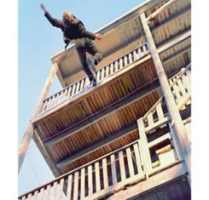
Two Types of Falls
On same level: high frequency, low severity
From elevations: low frequency, high severity
PPT-070-01
36
Notes:
Falls on the same level are approximately 60% of compensable fall cases according to Dr. W. Monroe Keyserling, Ph. D., 2000.
Half of all accidental deaths in the home are caused by a fall. Most fall injuries in the home happen at ground level, not from an elevation.
Falls on the same level as found by U.S. statistical reporting agencies, are responsible for well over 15% of nonfatal injuries that result in days away from work (U.S. Department of Labor, 2011).
Falls from elevation are approximately 40% of compensable fall cases and approximately 10% of occupational fatalities.
And http://www.bergenerlaw.com/slip-and-fall-accident-statistics/

Slide 37
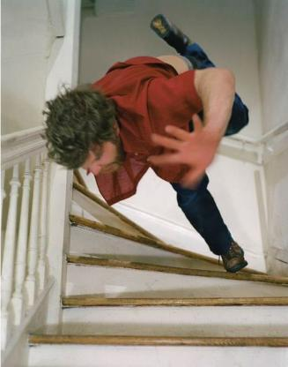
Causes
Wet, slippery, oily floors/stairs.
Loose irregular surfaces such as rocks.
Insufficient light.
Uneven walkways or sidewalks.
PPT-070-01
37
Notes:
According to the Consumer Product Safety Commission (CPSC), floors and flooring materials contribute directly to more than 2 million fall injuries each year.
The law firm of Bergener and Associates indicated five (5) leading causes of slips, trips and falls which should be considered in your program:
Walking surfaces
Footwear
Fraud
Hazard Identification
Training
http://www.bergenerlaw.com/slip-and-fall-accident-statistics/

Slide 38
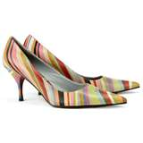
Causes
Shoes with slick soles or raised heels.
Moving too fast.
Carrying items (impair balance, obstruct vision).
Objects on the floor (e.g. paperclips, food).
PPT-070-01
38
Notes:
Although the walking surface is most likely to be identified as the primary cause of a slip, trip, and fall accident (comprising 55% of all falls), the remaining 45% are attributable to four other factors, including footwear, fraud, hazard identification, and training.
Proprietors and business owners should evaluate the probability of fall liability.
Example: a high profile 5-star restaurant should reasonably expect women to sometimes wear heels to their establishment, and therefore, reasonably protect against any impairments or obstacles that could lead to harm.
When evaluating your facility ask yourself what the foreseeable hazards might be and remedy them.
http://www.bergenerlaw.com/slip-and-fall-accident-statistics/

Slide 39
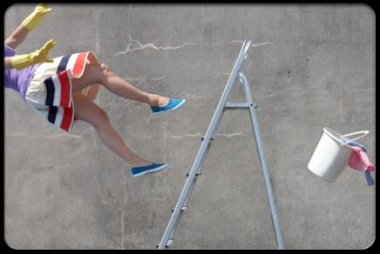
Causes
Poor housekeeping.
Loose handrails.
Uncovered/unguarded pits/floor openings.
Improper ladder usage.
PPT-070-01
39
Notes:
Additional causes for slips, trips and falls may also be:
Poor housekeeping.
Loose handrails.
Uncovered or unguarded pits and floor openings.
Improper ladder usage.

Slide 40
Causes
Shifting floor tiles.
Not watching while walking/moving.
Spilled liquids.
Cords across walkways.
PPT-070-01
40
Notes:
Other causes may include:
Shifting floor tiles.
Not watching while walking or moving.
Spilled liquids.
Cords across walkways.

Slide 41
What to Do?
Prevent!
Prevent!
Prevent!
Prevent!
PPT-070-01
41
Notes:
Depending on your agency, certain future occurrences may be posed:
Over 60% of nursing homes residents will fall each year
Total injuries due to falls are estimated at $13-14 million per year in U.S.
Disabling (temporary and permanent) occupational injuries due to falls are approximately $250,000-$300,000 per year.
For people aged 65-84 years, falls are the second leading cause of injury-related death; for those aged 85 years or older, falls are the leading cause of injury-related death.
http://www.bergenerlaw.com/slip-and-fall-accident-statistics/

Slide 42
Prevention - What to Do
Four Steps:
(1) Find the problem/hazard
(2) Check it out
(3) Fix it
(4) Look at it again
PPT-070-01
42
Notes:
Slip, trip and fall prevention as well as prevention of other incidents, involves viewing Four Steps in your Prevention Program:
(1) Find the problem or hazard
(2) Check it out
(3) Fix it
(4) Look at it again

Slide 43
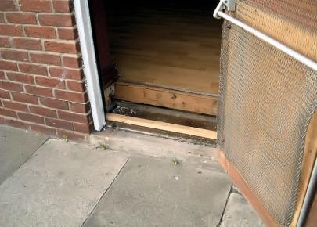
Step 1 – Find the Problem
Is the area wet, slippery, or cluttered?
Are employees moving too quickly?
Is the area poorly lit?
Are stairs steep or in poor condition?
Step up due to raised floor
PPT-070-01
43
Notes:
Step 1 – Find the Problem
Is the area wet, slippery, or cluttered? Is it likely to become this way due to processes?
Are employees moving too quickly?
Is the area poorly lit?
Are stairs steep or in poor condition?

Slide 44
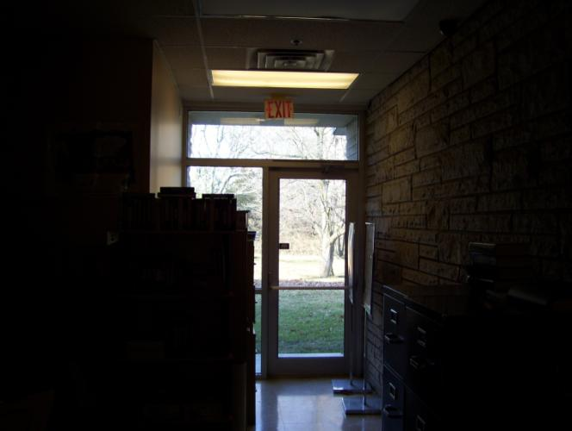
Any Problems Here?
Exit/Walkway Cluttered; More Lighting Needed
PPT-070-01
44
Notes:
Do you view any problems with this situation?
If so, what would be the remedy or remedies?

Slide 45
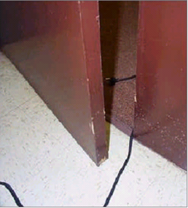
Step 1 (Continued)
Are handrails present?
Are there unguarded edges/openings?
Does layout make a slip, trip, fall situation?
Are there cords across the walkway?
PPT-070-01
45
Notes:
Step 1 – Find the Problem (cont.)
Are handrails present?
Are there unguarded edges or openings?
Does the facility layout make a slip, trip, fall situation?
Are there cords across the walkway?

Slide 46
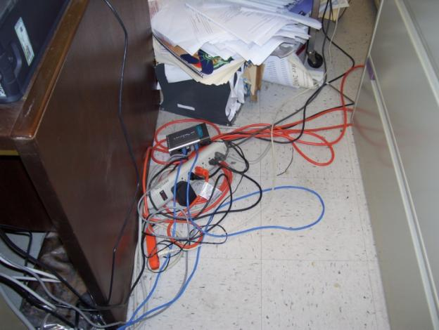
What about This?
Walkway cluttered; Cords across
PPT-070-01
46
Notes:
What about this situation?
Safe or unsafe?
If unsafe, what would you do to correct it?

Slide 47
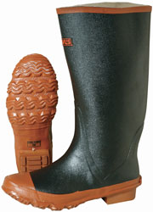
Step 2 – Check it Out
Is the problem area near moving machinery or is the area high traffic?
Is the area properly lit?
Are employees wearing proper footwear?
PPT-070-01
47
Notes:
Step 2 – Check It Out
Is the problem area near moving machinery or is the area one of high traffic?
Is the area properly lit?
Are employees wearing proper footwear? Does your policy stipulate what the proper footwear is?

Slide 48
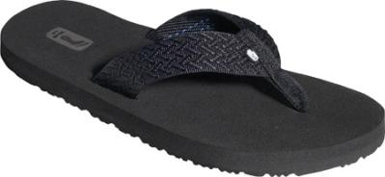
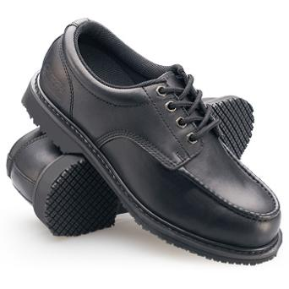
Which is Safer for Work?
These shoes are much safer!
PPT-070-01
48
Notes:
Some places do not have a dress code. The absence of such a code may permit all kinds of footwear as well as the resultant problems.
Evaluate the processes and match the proper personal protective equipment to it.
Create a policy stressing the proper footwear whether in the office or in the shop. If there is the possibility of office staff moving through the shop-require the highest and safest level of footwear even for office personnel.

Slide 49
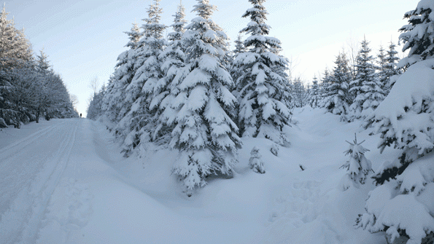
Step 2 (Continued)
Are “wet floor” signs in place?
Are floors being mopped ½ at a time?
Is walking surface more slippery due to its construction?
Is area outside and subject to weather?
PPT-070-01
49
Notes:
Step 2 – Check It Out (cont.)
Are “wet floor” signs in place? If you rely on vendors to provide maintenance, will they have the proper signs?
Are floors being mopped ½ at a time? This means one side of a corridor at a time to allow passage?
Is the walking surface more slippery due to its construction? If so, determine non-slip flooring and install?
Is the area outside and subject to weather? Or can the results of the weather be brought in to the facility?

Slide 50
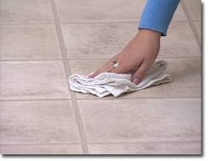
Step 3 – Fix It
If possible, eliminate or control the hazard immediately (e.g. having spills wiped up).
If not possible, take steps to alert people and then determine what can be done to eliminate or control the hazard.
PPT-070-01
50
Notes:
Step 3 – Fix It
If possible, eliminate or control the hazard immediately, such as having spills wiped up.
If not possible, take steps to alert people and then determine what can be done to eliminate or control the hazard.

Slide 51
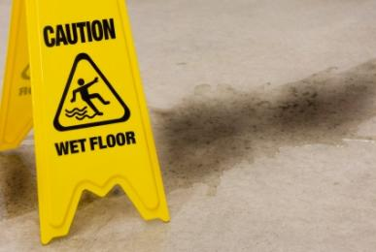
If can’t Fix Quickly, Alert People to the Hazard
PPT-070-01
51
Notes:
If the problem can not be immediately remediated, alert people to the hazard through signage, emails or announcements.

Slide 52
Step 4 – Look at it Again
Ensure the hazard/problem was repaired, eliminated, or controlled.
Does the area have to be checked periodically to ensure the hazard/problem does not return?
Determine if any training is required for
affected employees.
Should appropriate signage be posted?
PPT-070-01
52
Notes:
Step 4 – Look at it Again
Ensure the hazard or problem was repaired, eliminated, or controlled.
Check the area periodically to ensure the hazard or problem does not return.
Determine if any training is required for affected employees.
Determine if appropriate signage should be posted.

Slide 53
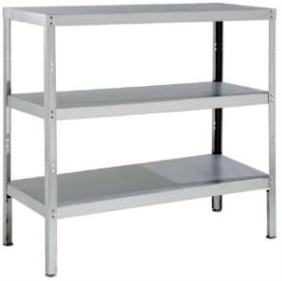
Prevention Measures
Install non-slip tape or “grip cleats” on stairs.
Have one hand free and use handrails when walking up or down stairs.
Store objects on shelves or in cabinets, not in aisles/walkways.
Don’t run while working.
Ensure aisles/walkways are kept clear and unobstructed.
PPT-070-01
53
Notes:
Prevention measures can also be used to show boundaries between safe and potentially unsafe areas.
Put yellow lines on the floors in the warehouse and storage areas to identify walkways and working spaces.
Store objects on shelves or in cabinets, not in aisles or walkways.
Train employees not to run.
Ensure aisles and walkways are kept clear and unobstructed.

Slide 54
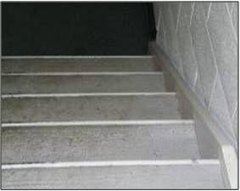
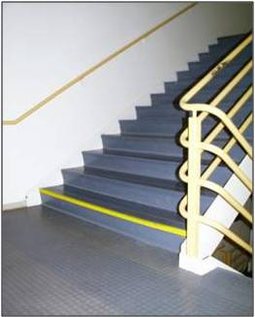
Stair Safety
Non-slip treads on stair edges
Reflective edging on last step
PPT-070-01
54
Notes:
Stair safety can be achieved with a 3-point contact based on the same premise for the safe use of ladders (one foot two hands, one hand two feet in contact with the stairs at all times).
Stairway “3-point contact” can be provided by non-slip treads and a handrail.

Slide 55
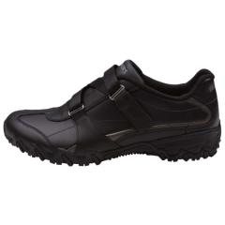
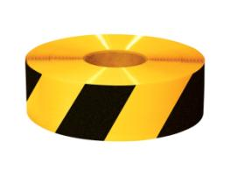
Prevention
Wear proper footwear and don’t run or move quickly while walking.
Have leaks/spills cleaned up quickly.
Place “caution tape” on uneven/drop off areas.
Develop and put into place a ladder safety and inspection program.
PPT-070-01
55
Notes:
22% of slip and fall incidents resulted in more than 31 days away from work according to the US Bureau of Labor Statistics (2002).
Educate employees to wear proper footwear and not to run or move quickly while walking.
Have leaks and spills cleaned up quickly.
Place “Caution” tape on uneven or drop-off areas.
Develop and put in place a ladder safety and inspection program.
http://www2a.cdc.gov/nioshtic-2/BuildQyr.asp?s1=20040877&f1=NN&View=e

Slide 56
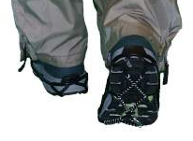
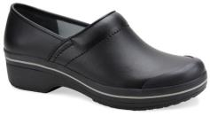
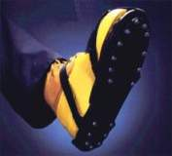
Wearing Proper Footwear
Wear shoes with slip-resistant soles or traction devices when walking or working on surfaces that are wet, greasy, icy, or otherwise slick.
No footwear has anti-slip properties for every condition – select the proper type of footwear for the work conditions and the type of flooring or walking/working surface.
Slip-resistant traction devices for snow and ice that fit over the soles
PPT-070-01
56
Notes:
There were about 293,990 slip-and-fall-related nonfatal occupational injuries involving days away from work in 2010, which accounted for about a quarter of all occupational injuries in the year. (U.S. Department of Labor, 2011).
From http://www.bergenerlaw.com/slip-and-fall-accident-statistics/
No footwear has anti-slip properties for every condition – select the proper type of footwear for the work conditions and the type of flooring or walking/working surface. Safety vendors can be a great assist in making this determination.

Slide 57
Prevention
Have “wet floor” signs posted where necessary.
Thoroughly investigate all slips, trips, and
falls.
Apply “non-skid” coating or place “non-skid strips” in areas where floors are likely to be slippery or wet.
Report hazardous situations as soon as possible.
PPT-070-01
57
Notes:
Additional prevention requires a prevention plan to be in place and used. This plan will ensure:
“Wet floor” signs are posted where necessary.
A thorough investigation of all slips, trips, and falls.
The application of “non-skid” coating or placement of “non-skid strips” in areas where floors are likely to be slippery or wet.
Employees report hazardous situations as soon as possible.

Slide 58
Prevention
Pick up objects that have fallen on the floor (e.g. food, paper clips, etc.).
Have carpets, rugs, and mats secured to the floor, and tape down raised ends.
Always close file cabinet drawers.
Do not place delivery carts in the middle of an aisle or walkway.
PPT-070-01
58
Notes:
Prevention:
Instruct employees to pick up objects that have fallen on the floor such as food, paper clips, etc.
Have carpets, rugs, and mats secured to the floor and tape down raised ends.
Always close file cabinet drawers.
Do not place delivery carts in the middle of an aisle or walkway.

Slide 59
Falling “Properly”
IF YOU DO FALL, YOU CAN REDUCE THE CHANCE OF SERIOUS INJURY IF YOU:
ROLL WITH THE FALL; DON’T REACH OUT. LET YOUR BODY CRUMPLE AND ROLL.
BEND YOUR ELBOWS AND KNEES AND USE YOUR LEGS AND ARMS TO ABSORB THE FALL.
GET MEDICAL ATTENTION AFTER A FALL TO TREAT ANYTHING TORN, SPRAINED, OR BROKEN.
PPT-070-01
59
Notes:
Falling Properly:
If you DO fall, you can reduce the chance of serious injury if you:
Roll with the fall; don’t reach out. Let your body crumple and roll
Bend your elbows and knees and use your legs and arms to absorb the fall
Get medical attention after a fall to treat anything torn, sprained or broken.

Slide 60
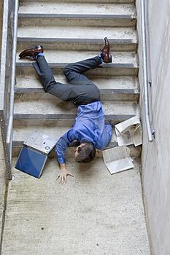
What may have Happened?
Running down stairs? Not using handrail? Shoelaces untied? Object on stairs above?
PPT-070-01
60
Notes:
If investigating this incident, what may have been the cause or causes?
What corrective actions will you take?

Slide 61
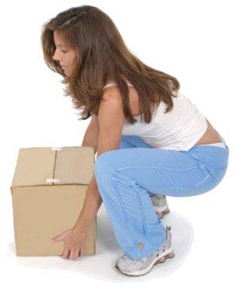
Safe Lifting/Material Handling
PPT-070-01
61
Notes:
Your body functions often like a machine; it can be subjected to excessive “torque” loading for which it was not designed which can only be sustained for short periods.
Understanding your limitations will aid you in developing a safe attitude when handling materials.

Slide 62
Material Handling Tips
Check the object before you attempt to lift it.
▪ Test every load before lifting = pushing object lightly with hands or feet to see how easily it moves (good indication as to how heavy it is).
▪ Remember, a small size does not always mean a light load!
Make sure the load you are lifting is packed correctly.
▪ Employees packing boxes should make sure weight is balanced and packed so it won’t move around.
▪ Loose pieces inside a box can cause accidents if the box becomes unbalanced.
PPT-070-01
62
Notes:
Before you attempt to lift or move anything you should first test the weight of the object. Realizing that heavy items can be found in small containers, you should also test those containers first before handling them. This can be done by gently nudging the items lightly with your hand or foot.
Items can also be packaged off-balanced which will torque in your hands and possibly have you reaching to catch an unbalanced item. This can lead to further muscle stress.

Slide 63
Tips
Make sure the load is easy to reach.
▪ Don’t arch your back when lifting a load over your head.
▪ Use a ladder instead of lifting something over your head.
Here’s the best way to pick up an object:
▪ Use slow and smooth movements (hurried, jerky movements can strain the muscles in your back).
▪ Keep your body facing the object while you lift it (twisting while lifting can injure your back).
PPT-070-01
63
Notes:
You also do NOT want to over-extend your reach for an object which can stress and stretch muscle and bone alignment.
When lifting, do so with a smooth action while facing the object minimizing twisting so you maintain correct skeletal and muscle alignment.
Any twisting or off-centered motions can strain your system.

Slide 64
Test the Load!
Always test the load before lifting to ensure it’s not too heavy for you to lift and carry by yourself!
If you determine the load is too heavy get assistance (either by using people or an appropriate mechanical aid).
PPT-070-01
64
Notes:
Test the load to ensure you can handle it alone. If you find the weight to be beyond your capabilities or beyond your capabilities due to distance to be transported-get assistance in the form or another helper or mechanical lifting device. Before lifting determine if a cart or other transport device is available and can be used.

Slide 65
Planning Ahead
Before moving a load plan both the load and the route (allows you to evaluate hazards, limitations, route safety, and final placement).
Evaluate the weight and shape of the load and also what material is made of.
Some items to check:
→ Is Personal Protective Equipment (PPE) or other safety gear necessary?
→ Size/shape/weight within your limits?
→ Can you get a firm hand hold?
→ Will you be able to see over the load?
→ Will you need assistance (people, cart)?
PPT-070-01
65
Notes:
Pre-Plan the route of transport. Is it a short distance? Is it a circuitous route which will require you to change directions? Are there any pitfalls on the route such as stairs to be negotiated? Will you need to move around other objects in the walkway? Will there be vehicular hazards such as forklifts of which we will need to be mindful?
Will PPE be required? Gloves? Goggles? Safety shoes?
Is your hold on the item acceptable for short duration transport but will the load become bulky and unwieldy over a greater distance? All these need to be considered in your planning.

Slide 66
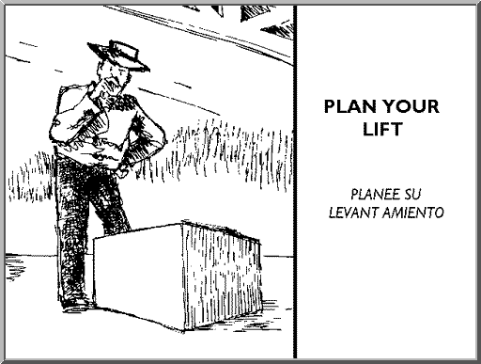
Back Injury Prevention: Plan your Lift
Think about the weight, size, and shape of the object and the distance you will be moving it.
Is the object bulky? Will you need help?
Do you see any hazards that
can be eliminated?
Think about the route you’ll be taking: any stairs, doors, obstacles?
If the object is heavy or awkward use a hand cart.
PPT-070-01
66
Notes:
Back injury prevention requires you plan the lift:
Consider weight, size and shape,
Are there hazards in the immediate area, transport route or at the destination which need to be removed?
Will you need assistance?

Slide 67
Planning Ahead – the Route
Check the route you will take and place where you will put the load down.
Injuries and property damage can occur when unexpected problems happen during the move.
Considerations for the route:
- Are there steps, tripping hazards, closed doors, tight doorways or passageways?
- Are there blind corners or wet/slippery floors?
- What is the traffic situation (people, tables,
carts, etc.)?
PPT-070-01
67
Notes:
Check the transport route. Injuries can occur from a variety of intervening sources:
- Forklifts
- Other coworkers distracted by their jobs
- Shipping and receiving is usually busy with their daily routines
- Sometimes automatic doors don’t work
- Seasonal activities can make floors wet

Slide 68
Planning Ahead-the Drop Off Point
Some considerations:
▪ Where will you place the load?
▪ Is there room for the load?
▪ Is the site strong enough to hold the load?
▪ Will the load block traffic or create a hazard when placed?
▪ Will the load have to be placed elsewhere or will it be in the right location after you set it down?
PPT-070-01
68
Notes:
Destination concerns:
Have you determined the area or room is ready to receive your item?
Survey the location before you transport the item.
Will the shelving hold the item?
Is there room to accommodate the item or material you’re moving?
Will you need to lower the item, perform some action to the receiving area first and then have to lift the load into place?
How do you reduce the amount of effort and energy you need to exert to complete the job?

Slide 69
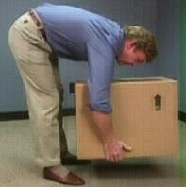
Lowering the Object
When lowering an object remember to bend at the knees not at the waist and avoid twisting motions while putting the load down. (
If you must turn while lowering an object adjust your feet rather than twisting your back.
Not the correct way to lower a box!
PPT-070-01
69
Notes:
Lower the object by bending at the knees-not the waist.
Do not twist your body. If you must turn, do so with your feet in short, measured movements, and not with your back.

Slide 70
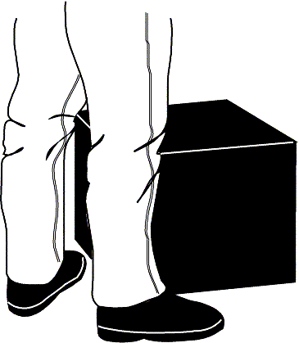
Lifting Properly – Step One
● Stand close to the load with your feet spread about shoulder width apart.
● One foot slightly in
front of the other for
balance.
PPT-070-01
70
Notes:
Step 1:
Get as close to the load as possible, with your feet spread shoulder width apart, one foot slightly in front of the other to retain your balance.

Slide 71
Lifting Properly – Step Two
● Squat down bending at the knees (not your waist).
● Tuck your chin while keeping your back as vertical as possible.
PPT-070-01
71
Notes:
Step 2:
Squat down, bending at your knees.
Tuck your chin in while keeping your back as vertical as possible.

Slide 72
Lifting Properly – Step Three
Get a firm grasp of the object before beginning the lift.
PPT-070-01
72
Notes:
Step 3:
Get a firm grasp on the object before you attempt the lift.
As you can see here, the load will be grasped underneath and at a remote corner to attain support and balance.

Slide 73
Lifting Properly –Step Four
Begin slowly lifting with your LEGS by straightening them. Never twist your body during this step!
PPT-070-01
73
Notes:
Step 4:
Begin the lift slowly using the legs to maintain a vertical rise without twisting the body.

Slide 74
Lifting Properly – Step Five
● Once lift is complete, keep object as close to your body as possible.
● As load's center of gravity moves away from body, dramatic increase in stress to the lumbar region of the back.
PPT-070-01
74
Notes:
Step 5:
Having completed the lift, the object is kept as close to the body as possible. Think of your arms as part of a lifting mechanism.
As the load moves away from the body’s center of gravity you can determine strain the same way you would when measuring strain and stress of a load on a beam.
Example: A 40 lb item weighs 40 lbs if it is close to our body, but if we move that same 40 lb item 2 feet away from the body we have (Distance x weight=total force). Here, a 40 lb load 2 feet from the body may feel like 2 feet x 40 lbs= 80 lbs is being exerted on our arms.
If you’ve worked with cranes or forklifts and centers of gravity before, you can well understand the loads imposed on the human body.

Slide 75
Is this Safe?
NO!
Bending over at the waist
Heavy lifting from below knees
Improper posture
PPT-070-01
75
Notes:
Legs should be doing the lifting not bending at waist.
Improper posture creating back strain as well as stressing muscles of the legs.

Slide 76
Strengthening Exercise
Wall Slides to strengthen
your muscles . . . .
- Stand with your back
against a wall, feet
shoulder-width apart.
- Slide down into a crouch
with knees bent to 90 degrees.
- Count to 5 and slide back up
the wall. Repeat 5 times.
PPT-070-01
76
Notes:
Wall Slide: will strengthen your leg muscles.
While standing with back to a wall, spread your feet apart shoulder width.
Slowly slide down the wall into a crouch bending your knees 90 degrees (if possible)
Count to 5
Then slowly slide back up the wall
Repeat this action 5 times.

Slide 77
Stretching Exercises
Gastroc Stretch
▪ Lean against a wall or other stationary object, both palms against the object.
▪Leg you want to stretch is back, several feet from wall, heel firmly positioned on the floor.
▪Other leg is flexed about halfway between back leg and wall.
▪Start with your back straight and gradually lunge forward until you feel the stretch in your calf.
▪Very important to keep back foot straight and angled 90 degrees from wall.
PPT-070-01
77
Notes:
Gastroc Stretch
Put both palms against a wall or other sturdy object and lean forward
Place the leg you want to stretch back several feet from the wall with heal firmly on the floor
Flex your other leg halfway between the stretched leg and the wall
With your back straight, gradually lunge forward until you feel the stretch in the calf
Remember: Keep your back foot straight and angled 90 degrees from wall.
Change legs and repeat motions.
This is recommended for Planters Fascia conditions.

Slide 78
Stretches
Stretches for side of neck:
Sit or stand with arms hanging loosely at sides
Turn head to one side, then the other
Hold for 5 seconds, each
side
Repeat 1 to 3 times
PPT-070-01
78
Notes:
This exercise helps stretch your neck muscles:
While sitting or standing with arms hanging loosely at your sides,
Turn your head slowly to one side, then the other
Hold the turn to each side for 5 seconds.
Repeat 1 to 3 times.

Slide 79
Stretches
Stretches for side of shoulder and back of upper arm
Stand or sit and place right hand on left shoulder
With left hand, pull right elbow across chest toward left shoulder and hold 10 to 15 seconds
Repeat on other side
PPT-070-01
79
Notes:
Stretches for your shoulders and back of upper arms:
Stand or sit and place right hand on left shoulder
With left hand, pull right elbow across chest toward your left shoulder
Hold for 10 to 15 seconds.
Repeat for other side.

Slide 80
and Finally
Stretches for triceps, top of shoulders, waist
Keep knees slightly flexed
Stand or sit with arms overhead
Hold elbow with hand of opposite arm
Pull elbow behind head gently as you slowly lean to side until mild stretch is felt
Hold 10 to 15 sec
Repeat on other side
PPT-070-01
80
Notes:
Stretches for triceps, top of shoulders, waist:
Keep knees slightly flexed
Stand or sit with arms overhead
Hold elbow with hand of opposite arm
Pull elbow behind head gently as you slowly lean to side until mild stretch is felt
Hold for 10 to 15 seconds.
Repeat for other side.

Slide 81
Chemical Safety
PPT-070-01
81
Notes:
Chemicals used in the restaurant and food services industries include those used for cleansing (laundry); pipe maintenance; stain removal and other duties.
These materials can be inherently corrosive or acidic, to cite but two (2) characteristics.

Slide 82
Food Service Chemicals
● There are often many chemicals in a food service environment such as:
- Drain Cleaners
- Bleaches
- Surface Cleaners
- De-greasers
- Floor Cleaners
• Chemicals can be harmful to your health and the environment – always use caution when working with any chemical!
PPT-070-01
82
Notes:
Food Service Chemicals. While some might not think of chemical hazards in the Housekeeping environment such as:
Drain Cleaners
Bleaches
Surface Cleaners
De-greasers
Floor Cleaners
Chemicals can be harmful to your health and the environment – always use caution when working with any chemical!

Slide 83
Chemical Safety
NEVER MIX CHEMICALS TOGETHER! A violent reaction could occur causing injury/damage.
Store flammable chemicals in cabinets designed for safe storage.
If chemicals are stored in the kitchen, store on shelves below foodstuffs so if they leak they will not contaminate food.
Wear appropriate PPE when using chemicals.
PPT-070-01
83
Notes:
NEVER MIX CHEMICALS TOGETHER! A violent reaction could occur causing injury/damage.
Store flammable chemicals in cabinets designed for safe storage.
If chemicals are stored in the kitchen, store on shelves below foodstuffs so if they leak they will not contaminate food.
Wear appropriate PPE when using chemicals.
Several stories relate how ammonia cleaner was mixed with a chlorine-based cleaner generating a toxic gas which inundated the cleaning crew.
Read and understand the hazards for a chemical by reading the corresponding SDS (Safety Data Sheet).

Slide 84
Types of PPE
EYE PROTECTION SUCH AS SAFETY GOGGLES:
HAND PROTECTION SUCH AS RUBBER GLOVES:
RESPIRATORY PROTECTION:
PPT-070-01
84
Notes:
Various PPE will be required depending upon the possible exposure;
Eye protection such as safety goggles to guard against splashed agents.
Hand protection (gloves) for safety against irritants and corrosives
Respiratory protection may also be required if dealing with cleaning a dusty environment.

Slide 85
Chemical Safety
Make sure chemicals are properly labeled and in appropriate containers.
Read and follow warning labels.
Review corresponding Safety Data Sheets (SDS’s) before working with chemicals.
Follow manufacturer’s recommendations when mixing water with chemicals.
PPT-070-01
85
Notes:
To enhance your chemical safety program:
Make sure chemicals are properly labeled and in appropriate containers.
Read and follow warning labels.
If available, review corresponding Safety Data Sheets (SDS’s) before working with chemicals.
Follow manufacturer’s recommendations when mixing water with chemicals.
Train staff so they fully understand hazards and safety precautions.

Slide 86
Chemical Safety
Wash hands thoroughly after using any chemicals.
Ensure lids are placed back on chemical containers when you’re done using them.
Dispose of used chemical containers safely (follow your establishment’s procedures).
Do not store pesticides and other chemicals together.
PPT-070-01
86
Notes:
General Safety:
Wash hands thoroughly after using any chemicals.
Ensure lids are placed back on chemical containers when you’re done using them.
Dispose of used chemical containers safely (follow your establishment’s procedures).
Do not store pesticides and other chemicals together.

Slide 87
Chemical Safety
Clean up spills immediately and dispose of clean up materials properly.
Ensure areas are well ventilated when using chemicals.
If you feel sick while using a chemical, get to fresh air and have your Supervisor notified as soon as possible.
Report any injuries or physical reactions you may have when using chemicals immediately.
PPT-070-01
87
Notes:
General Safety:
Clean up spills immediately and dispose of clean up materials properly.
Ensure areas are well ventilated when using chemicals.
If you feel sick while using a chemical, get to fresh air and have your Supervisor notified as soon as possible.
Report any injuries or physical reactions you may have when using chemicals immediately.

Slide 88
Review
Never mix chemicals!
Read warning labels and SDS’s.
Wear appropriate PPE.
Ensure chemicals are properly labeled.
Store chemicals safely.
Clean up spills immediately.
Notify your Supervisor if injured.
PPT-070-01
88
Notes:
When working with chemicals keep the following safety tips in mind:
Never mix chemicals!
Read warning labels and SDS’s.
Wear appropriate PPE.
Ensure chemicals are properly labeled.
Store chemicals safely.
Clean up spills immediately.
Notify your Supervisor if injured.

Slide 89
Remember
USE COMMON SENSE AND GOOD SAFETY PRACTICES WHEN WORKING WITH CHEMICALS!
NEVER BECOME COMPLACENT WHEN WORKING WITH ANY CHEMICAL.
CHEMICALS HAVE THE POTENTIAL TO HARM YOU OR THE ENVIRONMENT!
BE CAREFUL, BE SAFE, BE HAPPY!
PPT-070-01
89
Notes:
Remember:
Use common sense and good safety practices when working with chemicals.
Never become complacent when working with any chemical.
Chemicals have the potential to harm you or the environment.
Be careful, be safe, be happy.

Slide 90
Summary: Safe Actions Save Lives
Always use safe procedures and methods, never take shortcuts.
Use appropriate safety equipment.
Wear proper footwear.
Think before you lift anything.
Report safety hazards to your Supervisor/Manager as soon as possible.
Think safety all the time, every time!
PPT-070-01
90
Notes:
Safe actions save lives.
Always use safe procedures and methods, never take shortcuts.
Use appropriate safety equipment.
Wear proper footwear.
Think before you lift anything.
Report safety hazards to your Supervisor/Manager as soon as possible.
Think safety all the time, every time!

Slide 91
Contact Information
Health & Safety Training Specialists
1171 South Cameron Street, Room 324
Harrisburg, PA 17104-2501
(717) 772-1635
RA-LI-BWC-PATHS@pa.gov
Like us on Facebook! - https://www.facebook.com/BWCPATHS
PPT-070-01
91
Notes:
We invite you to contact us for additional information on other available free training and programs.

Slide 92
Questions
PPT-070-01
92

