Slide 1
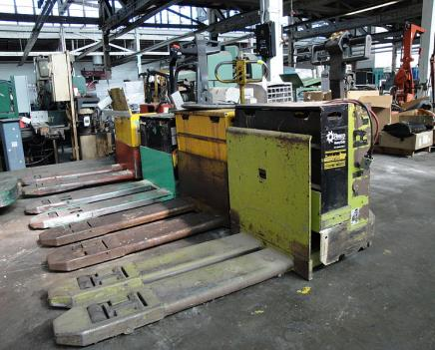
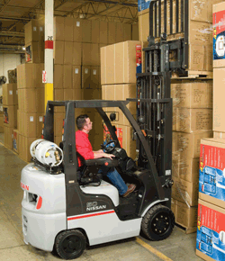
Powered Industrial Trucks (PIT)
Bureau of Workers’ Compensation
PA Training for Health & Safety (PATHS)
OSHA 29 CFR 1910.178
Notes:
Powered industrial trucks, commonly called forklifts or lift trucks, are used in many industries, primarily to move materials. They can also be used to raise, lower, or remove large objects or a number of smaller objects on pallets or in boxes, crates, or other containers

Slide 2
OSHA Standard for PIT
The scope provisions of 1910.178(a) which are based on ANSI B56.1-1969 cover:
Fork trucks, tractors, platform lift trucks, motorized hand trucks and other specialized industrial trucks powered by electric motors or internal combustion engines.
The standard does not apply to compressed air or non-flammable compressed gas-operated industrial trucks, farm vehicles, or vehicles intended primarily for earth moving or over the road hauling.
Notes:
OSHA’s Standard for Powered Industrial trucks covers fork trucks, tractors, platform lift trucks, motorized hand trucks and other specialized industrial trucks powered by
Electric motors or internal combustion engines.
However the Standard does not apply to compressed air or non-flammable compressed gas-operated industrial trucks, farm vehicles, or vehicles
intended primarily for earth moving or over the road hauling.

Slide 3
PIT - Definition
A mobile, power-propelled truck used to carry, push, pull, lift, stack, or tier materials (American Society of Mechanical Engineers definition).
Vehicles that are used for earth moving and over the road hauling are excluded.
PIT’s are commonly known as forklifts, pallet trucks, rider trucks, fork trucks, or lift trucks.
Can be powered through electric or combustion engines
Notes:
A PIT:
A mobile, power-propelled truck used to carry, push, pull, lift, stack, or tier materials (American Society of Mechanical Engineers definition).
Vehicles that are used for earth moving and over the road hauling are excluded.
PIT’s are commonly known as forklifts, pallet trucks, rider trucks, forktrucks, or lift trucks.
Can be powered through electric or combustion engines.

Slide 4
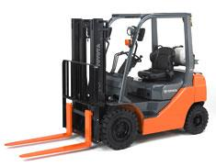
Performance Oriented
Powered industrial truck operator training requirements are performance oriented.
Allows employers to tailor a training program to characteristics of their workplaces and the particular types of powered industrial trucks used.
Notes:
OSHA’s standard allows employers to tailor a training program to the characteristics of their workplaces and the particular types of powered industrial trucks used.

Slide 5
Forklift Incidents
Generally these accidents result from:
Lack of operator training and awareness.
Lack of co-worker awareness
(A well known FLT manufacturer recently stated that 60% of
injuries/fatalities are sustained by co-workers)
Poor maintenance.
No safe systems of work regarding lift truck
operations.
Notes:
Forklift incidents/accidents can result from the following:
Lack of operator training and awareness.
Lack of co-worker awareness (a well known FLT manufacturer recently stated that 60% of injuries/fatalities are sustained by co-workers)
Poor maintenance.
No safe systems of work regarding lift truck operations.

Slide 6
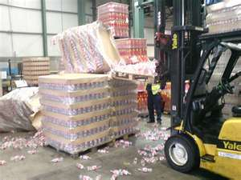
The main risks associated with FLTs are:
Being struck by an FLT.
The FLT rolling over.
Driver being struck by falling items.
Passengers falling off.
Unauthorized start up.
Inadequate braking.
Restricted driver visibility
Notes:
The main risks associated with FLTs are:
Being struck by an FLT.
The FLT rolling over.
Driver being struck by falling items.
Passengers falling off.
Unauthorized start up.
Inadequate braking.
Restricted driver visibility.

Slide 7
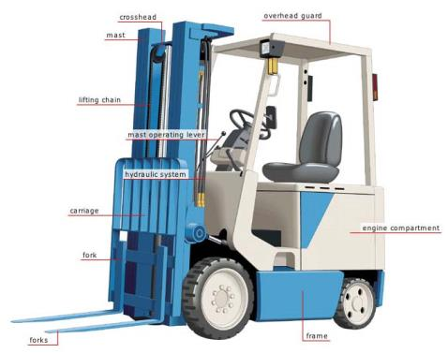
Operator Training
Only trained and authorized operators shall be permitted to operate fork trucks.
Employer must ensure training has been provided to include formal instruction (classroom), practical training (hands on), and evaluation.
Notes:
When it comes to the operation of PIT, only those employees who have been properly training and authorized are allowed to functions as operators.
The employer must ensure training has been provided to include formal instruction (classroom), practical training (hands on), and evaluation.

Slide 8
Operator Training
SAFE OPERATION:
The employer shall ensure that each powered industrial truck operator is competent to operate a powered industrial truck safely, as demonstrated by successful completion of the training and evaluation specified in the OSHA standard.
Prior to permitting an employee to operate a powered industrial truck (except for training purposes), the employer shall ensure that each operator has successfully completed the required training (or previously received appropriate training).
Notes:
For safe PIT operation:
The employer shall ensure that each powered industrial truck operator is competent to operate a powered industrial truck safely, as demonstrated by successful completion of the training and evaluation specified in the OSHA standard.
Prior to permitting an employee to operate a powered industrial truck (except for training purposes), the employer shall ensure that each operator has successfully complete the required training (or previously received appropriate training).

Slide 9
Training Program
Training shall consist of a combination of:
Formal instruction (e.g. lecture, discussion, interaction, computer learning, written material).
Practical training (demonstrations and exercises performed by the trainee).
Evaluation of the operator’s performance in the workplace.
Notes:
The PIT training program shall consist of a combination of the following:
- Formal instruction (e.g. lecture, discussion, interaction, computer learning, written material).
- Practical training (demonstrations and exercises performed by the trainee).
- Evaluation of the operator’s performance in the workplace.

Slide 10
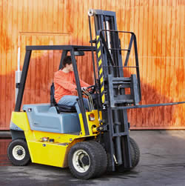
Training Program
Training and evaluation shall be conducted by a person with the knowledge, training, and experience to instruct powered industrial truck operators and evaluate their competence.
Notes:
Both the training and evaluation of a new operator shall be conducted by a person with the knowledge, training, and experience to instruct powered industrial truck
operators and evaluate their competence.

Slide 11
Training Program Content
PIT Operators shall receive initial training in the following topics (excepting topics that the employer can demonstrate are not applicable to safe operation in the employer’s workplace):
→ TRUCK RELATED TOPICS
→ WORKPLACE RELATED TOPICS
→ REQUIREMENTS OF THE STANDARD
Notes:
PIT operators shall receive initial training in the following (except those topics that the employer can demonstrate are not applicable to safe operation within the employer’s workplace):
TRUCK RELATED TOPICS
WORKPLACE RELATED TOPICS
REQUIREMENTS OF THE STANDARD

Slide 12
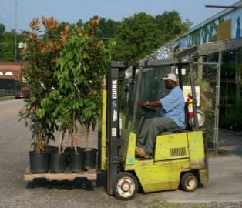
Training Program Content
TRUCK RELATED TOPICS:
Operating instructions, warnings, precautions
Differences from an automobile
Controls and instrumentation
Engine or motor operation
Steering and maneuvering
Visibility
Notes:
PIT related topics include but are not limited to:
▫ Operating instructions, warnings, precautions
▫ Differences from an automobile
▫ Controls and instrumentation
▫ Engine or motor operation
▫ Steering and maneuvering
▫ Visibility

Slide 13
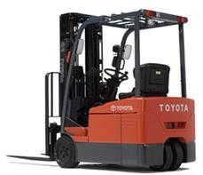
Training Program Content
TRUCK RELATED TOPICS:
Fork and attachment adaptation, operation, and use
Vehicle capacity and stability
Vehicle inspection/maintenance operator will perform
Operating limitations
Other instructions, etc.
Notes:
In addition, PIT related topics also include:
Fork and attachment adaptation, operation and use
Vehicle capacity and stability
Vehicle inspection/maintenance operator will perform
Operating limitations
Other instructions, etc.

Slide 14
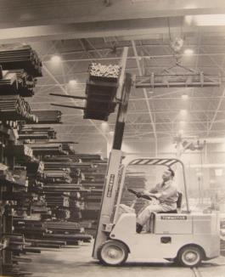
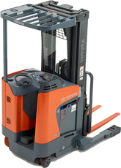
Training Program Content
WORKPLACE RELATED TOPICS:
Surface conditions
Composition and stability of loads
Load manipulation, stacking, un-stacking
Pedestrian traffic
Narrow aisles, restricted areas
Notes:
Training in workplace related topics includes but is not limited to:
Surface conditions
Composition and stability of loads
Load manipulation, stacking, un-stacking
Pedestrian traffic
Narrow aisles, restricted areas

Slide 15
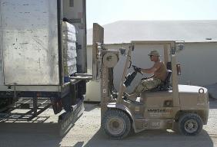
Training Program Content
WORKPLACE RELATED TOPICS:
Operating in hazardous locations
Operating on ramps and sloped surfaces
Potentially hazardous environmental conditions
Operating in closed environments or other areas where poor ventilation or maintenance could cause carbon monoxide or diesel exhaust buildup
Notes:
Workplace related topics also include:
Operating in hazardous locations
Operating on ramps and sloped surfaces
Potentially hazardous environmental conditions
Operating in closed environments or other areas where poor ventilation or maintenance could cause carbon monoxide or diesel exhaust buildup

Slide 16
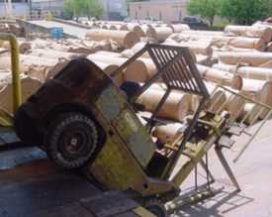
Training Program Content
THE REQUIREMENTS OF THE OSHA STANDARD MUST ALSO BE INCLUDED IN THE INITIAL OPERATOR TRAINING PROGRAM!
Notes:
The requirements of OSHA’s Standard on PIT must also be included in operator training.

Slide 17
Refresher Training/Evaluation
Refresher training, including evaluation of effectiveness of that training, shall be conducted to ensure the operator has the knowledge and skills needed to operate the powered industrial truck safely.
Refresher training is required when:
۰ Unsafe operation
۰ Accident or near-miss
۰ Evaluation indicates a need
۰ Different type of equipment is introduced
۰ Workplace condition changes
Notes:
Refresher training, including evaluation of effectiveness of the training shall be conducted to ensure the operator has the knowledge and skills needed to operate the powered industrial truck safely.
Refresher training is required under the following circumstances:
۰ Unsafe operation
۰ Accident or near-miss
۰ Evaluation indicates a need
۰ Different type of equipment is introduced
۰ Workplace condition changes

Slide 18
Refresher Training/Evaluation
An evaluation of each powered industrial truck operator’s performance must be conducted:
۰ After initial training
۰ After refresher training
۰ At least once every three (3) years
Notes:
Each PIT operator’s performance must be evaluated:
After initial training
After refresher training
At least once every three (3) years

Slide 19
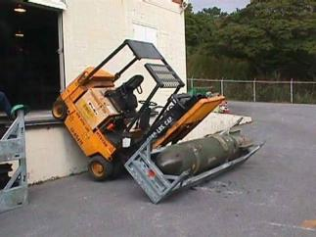
Avoiding Duplicate Training
If operator has previously received training in a topic specified in this section, and:
Training is appropriate to the truck and working conditions encountered
Additional training in that topic is not required
If operator has been evaluated and found competent to operate the truck safely.
Notes:
If an operator has previously received training in a topic listed in this section, and training is appropriate to the truck and working conditions encountered, additional
training in that topic is not required if operator has been evaluated and found competent to operate the truck safely.

Slide 20
Training Program Implementation
Trainees may operate a powered industrial truck only:
Under direct supervision of a person who has the knowledge, training, and experience to train operators and evaluate their competence; and
Where such operation does not endanger the trainee or other employees.
Notes:
Someone who is being trained in how to safely operate a PIT can only operate one:
Under direct supervision of a person who has the knowledge, training, and experience to train operators and evaluate their competence; and
Where such operation does not endanger the trainee or other employees.

Slide 21
Pre-Operational Inspection
Fluid levels/pressures
Leaks
Steering
Fuel/battery level
Tires
Horns/alarms
Mast/forks
Gauges/controls
Hoses/belts/cables
Safety equipment
NOTE: If the FLT is used 24-hours-a-day, it must also be inspected
at the end of each shift.
Notes:
Before each PIT is operated certain items should be inspected/checked to include:
Fluid levels/pressures
Leaks
Steering
Fuel/battery level
Tires
Horns/alarms
Mast/forks
Gauges/controls
Hoses/belts/cables
Safety equipment
If a PIT is used 24 hours a day it must also be inspected at the end of each shift.

Slide 22
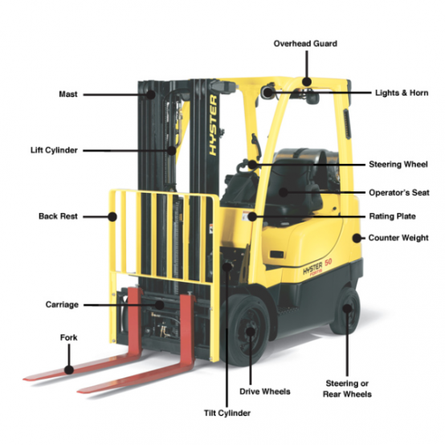
Forklift Components
Notes:
This slide indicates the components of a forklift truck.

Slide 23
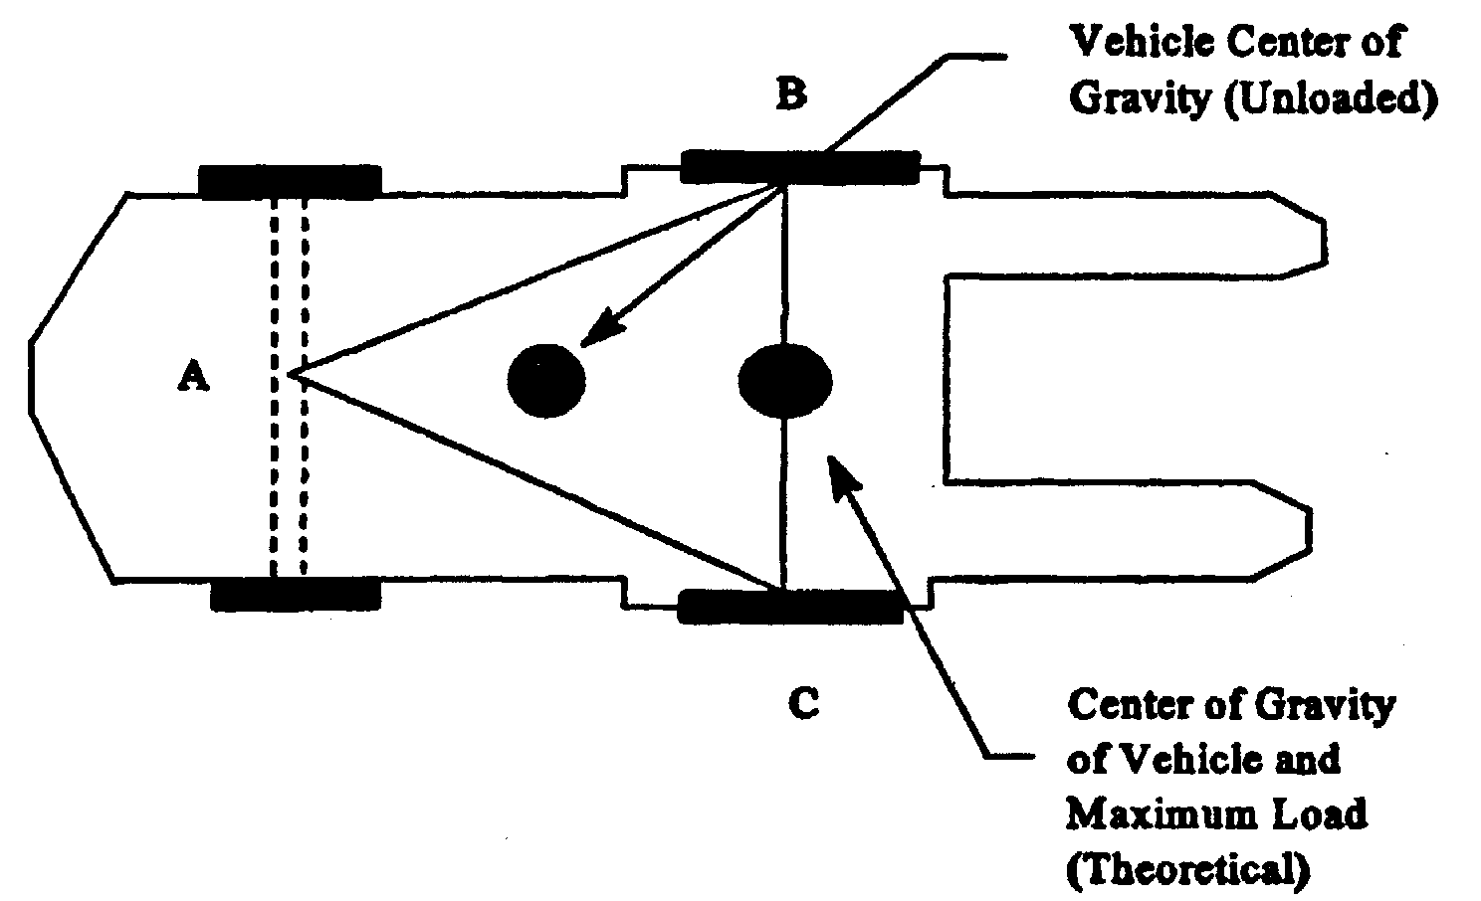
Stability Triangle
Notes:
This picture shows the “stability triangle” which an operator needs to be taken into consideration every time a forklift truck is operated. This “triangle” will be discussed in the next slide.

Slide 24
3-Point Suspension
The center of gravity for a FLT moves depending on the load & how its positioned, acceleration, braking & turning.
As long as the center of gravity remains inside the triangle formed by these three points, the vehicle should be stable.
Once the center of gravity moves outside this triangle, the vehicle will tip over.
Notes:
Here are some points about the “stability triangle:”
The center of gravity for a FLT moves depending on the load & how its positioned, acceleration, braking & turning.
As long as the center of gravity remains inside the triangle formed by these three points, the vehicle should be stable.
Once the center of gravity moves outside this triangle, the vehicle will tip over.

Slide 25
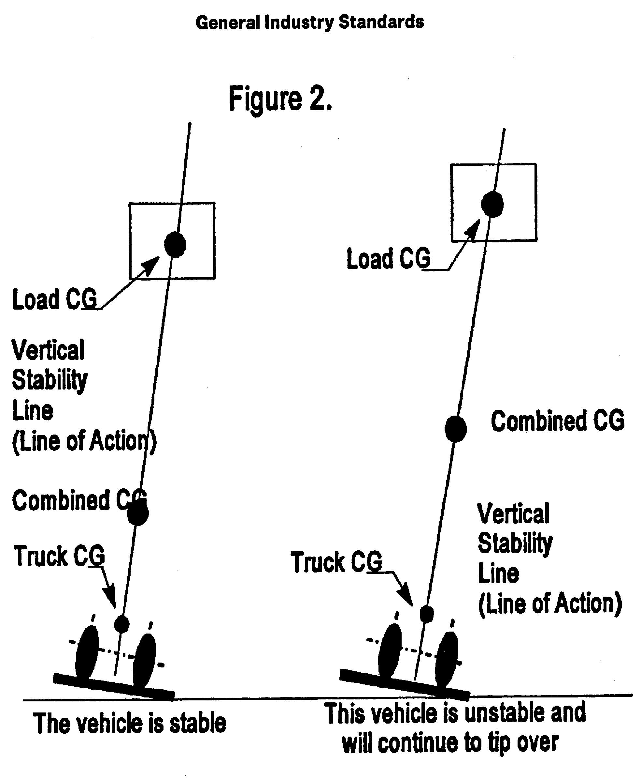
Vertical Stability
Notes:
When operating a PIT maintaining vertical stability must also be taken into consideration.

Slide 26
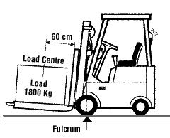
Load Center
Keep the load resting against the vertical face of the forks.
For every 1” past Load Center = Loss of 100lbs. of lifting capacity.
Notes:
To center a load:
Keep the load resting against the vertical face of the forks.
For every 1” past Load Center = Loss of 100lbs. of lifting capacity.

Slide 27
Steering: Forklift vs Auto
Automobile
Forklift
Notes:
This slide compares the steering of a forklift and an automobile. As the slide shows, a forklift has a much more compacted radius due to the rear wheels steering the vehicles as opposed to the front wheels in an automobile.

Slide 28
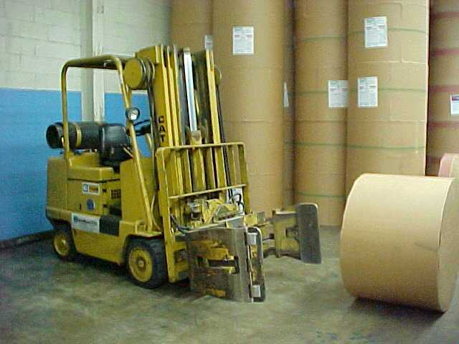
Stability of PIT
Appendix A provides non-mandatory guidance to assist employers in implementing the standard.
This appendix does not add to, alter, or reduce the requirements of this section.
Notes:
Consulting Appendix A in the PIT Standard provides information on maintaining the stability of forklift trucks.

Slide 29
Certification
The employer shall certify that each operator has been trained and evaluated as required by the standard.
Certification shall include:
◦ Name of the Operator
◦ Date of the Training
◦ Date of the Evaluation
◦ Identity of instructor/evaluator
Notes:
The employer shall certify that each operator has been trained and evaluated as required by the standard and this certification shall include:
Name of the Operator
Date of the Training
Date of the Evaluation
Identity of instructor/evaluator

Slide 30
Batteries
CHANGING AND RECHARGING BATTERIES:
Changing and/or charging must be located in designated areas for that purpose.
Area must have facilities to flush and neutralize spilled electrolyte.
Eyewashes and showers must be available.
Must have adequate fire protection.
“No smoking” in charging area.
Notes:
The batteries on PIT need to be charged or changed occasionally. When changing or recharging batteries the following should be kept in mind:
Changing and/or charging must be located in designated areas for that purpose.
Area must have facilities to flush and neutralize spilled electrolyte.
Eyewashes and showers must be available.
Must have adequate fire protection.
“No smoking” in charging area.

Slide 31
Batteries
Must protect chargers from vehicle damage.
Must adequately ventilate for vapors from gassing batteries:
  Hydrogen gas emitted
  Very flammable
Overhead hoist or equivalent must be used to handle batteries.
Wear appropriate PPE (Apron, gloves, face shield, goggles, etc..)
Notes:
When charging/changing batteries:
Must protect chargers from vehicle damage.
Must adequately ventilate for vapors from gassing batteries:
Hydrogen gas emitted
Very flammable
Overhead hoist or equivalent must be used to handle batteries.
Wear appropriate PPE (Apron, gloves, face shield, goggles, etc..)

Slide 32
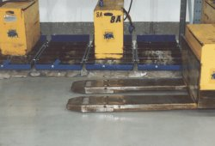
Batteries
A carboy tilter or siphon must be provided for handling electrolyte.
Pour acid into water not vice versa.
Open battery cover or compartment to dissipate heat.
Prevent any open flames, sparks, or electric arcs in battery charging areas.
Notes:
When dealing with batteries:
A carboy tilter or siphon must be provided for handling electrolyte.
Pour acid into water not vice versa.
• Open battery cover or compartment to dissipate heat.
Prevent any open flames, sparks, or electric arcs in battery charging areas.

Slide 33
Refueling
The greatest danger with refueling your FLT is fire.
Turn off the engine and any lights.
Do not smoke and make sure there are no open flames near your FLT.
Be sure there is contact between the spout and the fill pipe before pumping
If fuel is spilled, clean it up.
If you are using a container, make sure it is an approved container
Notes:
Refueling a forklift truck can pose safety issues as well. Keep the following in mind and take the necessary actions to ensure the process is done safely:
The greatest danger with refueling your FLT is fire.
Turn off the engine and any lights.
Do not smoke and make sure there are no open flames near your FLT.
Be sure there is contact between the spout and the fill pipe before pumping
If fuel is spilled, clean it up.
If you are using a container, make sure it is an approved container

Slide 34
Propane Refueling
Propane is a flammable, compressed gas.
Do not smoke and make sure there are no open flames near your FLT.
Make sure you are wearing the proper PPE (gloves, safety glasses, etc.)
Notes:
Propane, while contained in a cylinder, can cause issues as well:
Propane is a flammable, compressed gas.
Do not smoke and make sure there are no open flames near your FLT.
Make sure you are wearing the proper PPE (gloves, safety glasses, etc.)

Slide 35
Propane Refueling
Before replacing an LP gas tank, close the shut off valve and let the engine run until it stalls.
Turn off the engine and any lights.
Check for damage to connections and look for leaks.
Propane leaks can be detected by:
  ▪ Distinct odor
  ▪ Hissing sound
  ▪ Frost on fittings
Notes:
When replacing an empty propane cylinder:
Before replacing an LP gas tank, close the shut off valve and let the engine run until it stalls.
Turn off the engine and any lights.
Check for damage to connections and look for leaks.
Propane leaks can be detected by:
Distinct odor
Hissing sound
Frost on fittings

Slide 36
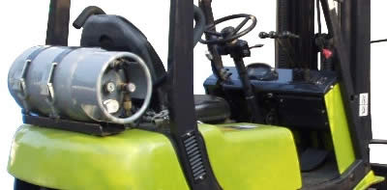
Propane Refueling
Warning: Since LP gas is heavier than air, make sure there is plenty of ventilation before changing or refilling LP tanks.
Notes:
When dealing with propane, remember this warning: since LP gas is heavier than air, make sure there is plenty of ventilation before changing or refilling LP tanks.

Slide 37

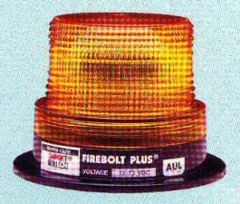





Lighting
Fork trucks must have lights on both ends where general lighting is less than 2 lumens per square foot.
Notes:
When considering lighting for forklift trucks, the following should be kept in mind:
Fork trucks must have lights on both ends where general lighting is less than 2 lumens per square foot.

Slide 38
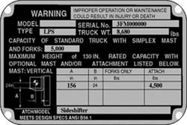
Data Plate
A properly loaded forklift does not exceed the rate capacity of the truck as listed on the truck’s data plate
◦ Capacity
◦ Load Center
◦ Modifications &
Attachments
Notes:
An operator should know the information contained on the data plate of the lift truck(s) they operate since a properly loaded forklift should not exceed the rate capacity of the truck as listed on the truck’s data plate.

Slide 39
Truck Operations
Trucks shall not be driven up to anyone standing in front of a bench/other fixed object.
No person shall be allowed to stand or pass under the elevated portion of any truck.
Only the operator shall be permitted to ride unless additional seats/seatbelts are provided.
If a truck is parked on an incline, the wheels shall be chocked/blocked.
Operate the forklift from the operator’s seat only.
Stay inside the forklift – overhead guard is for operator protection
Notes:
To operate PIT safely the following should be observed:
Trucks shall not be driven up to anyone standing in front of a bench/other fixed object.
No person shall be allowed to stand or pass under the elevated portion of any truck.
Only the operator shall be permitted to ride unless additional seats/seatbelts are provided.
If a truck is parked on an incline, the wheels shall be chocked/blocked.
Operate the forklift from the operator’s seat only.
Stay inside the forklift – overhead guard is for operator protection.

Slide 40
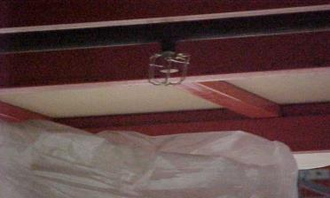
Truck Operations
Employees are required to keep arms and legs from being placed between the uprights of the mast or outside the running lines of the truck and must also wear seatbelts (as applies).
Keep stored materials at least 18 inches below sprinklers and away from lights and pipes.
Notes:
Safe operation of PIT also includes:
Employees are required to keep arms and legs from being placed between the uprights of the mast or outside the running lines of the truck and must also wear seatbelts (as applies).
Keeping stored materials at least 18 inches below sprinklers and away from lights and pipes.

Slide 41
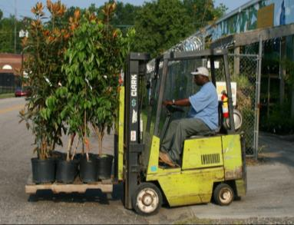
Truck Operations
On an unattended truck, the load shall be fully lowered, controls neutralized, power shut off, and the brake set.
Fork trucks shall not be used for opening or closing freight doors.
The flooring of trucks, trailers, and railroad cars must be checked for holes or weaknesses before entering.
Notes:
Additional information on safe truck operations includes:
On an unattended truck, the load shall be fully lowered, controls neutralized, power shut off, and the brake set.
Fork trucks shall not be used for opening or closing freight doors.
The flooring of trucks, trailers, and railroad cars must be checked for holes or weaknesses before entering.

Slide 42
Truck Operations
Picking Up A Load
Make sure the load does not exceed the capacity of your FLT.
Make sure the forks are positioned properly.
Make sure the load is balanced & secure.
Check for overhead obstructions.
Raise the forks to proper height.
Notes:
To safely pick up a load:
Make sure the load does not exceed the capacity of your FLT.
Make sure the forks are positioned properly.
Make sure the load is balanced & secure.
Check for overhead obstructions.
Raise the forks to proper height.

Slide 43
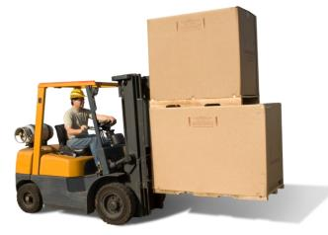
Truck Operations
Picking Up A Load (continued)
Drive into the load as far as possible.
Tilt the load back slightly & then lift it.
Back & lower the load to 2-4 inches from the floor before moving.
Notes:
Also, to safely pick up a load:
Drive into the load as far as possible.
Tilt the load back slightly & then lift it.
Back & lower the load to 2-4 inches from the floor before moving.

Slide 44
Truck Operations
Traveling With A Load
Pedestrians always have the right-of-way.
Never allow anyone to ride on your FLT.
Always watch where you are going.
Keep the forks low, 2-4 inches above the floor but do NOT exceed 8 inches.
Keep the load tilted back slightly.
Always drive at a safe speed & slow down when going around corners
Notes:
For safe travelling while transporting a load operators should also remember:
Pedestrians always have the right-of-way.
Never allow anyone to ride on your FLT.
Always watch where you are going.
Keep the forks low, 2-4 inches above the floor but do NOT exceed 8 inches.
Keep the load tilted back slightly.
Always drive at a safe speed & slow down when going around corners.

Slide 45
Truck Operations
Traveling With A Load
All traffic regulations must be observed.
Three truck lengths away from truck ahead.
Stunt driving, racing, horseplay never permitted.
Must drive slowly when floor is wet.
Never run over loose objects on the roadway.
Notes:
More information on safe travels with a load includes:
All traffic regulations must be observed.
Three truck lengths away from truck ahead.
Stunt driving, racing, horseplay never permitted.
Must drive slowly when floor is wet.
Never run over loose objects on the roadway.

Slide 46
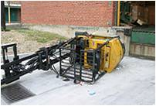
Truck Operations
Traveling With A Load
Only loads within rated capacity should be moved.
Fork trucks with defective parts must be removed from service until repaired.
Speed shall be reduced to a safe level while negotiating turns.
Only stable or safely arranged
loads shall be handled.
Cross railroad tracks diagonally
Notes:
Additionally, for safe travelling with a load operators should exercise the following:
Only loads within rated capacity should be moved.
Fork trucks with defective parts must be removed from service until repaired
Speed shall be reduced to a safe level while negotiating turns.
Only stable or safely arranged loads shall be handled.
Cross railroad tracks diagonally.

Slide 47
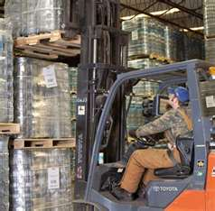
Truck Operations
Placing the Load
Stop the FLT completely before raising the load.
Move slowly with the load raised.
Never walk or stand under a raised
load.
Tilt the load forward only when
over a stack or rack.
Notes:
To safely place a load:
Stop the FLT completely before raising the load.
Move slowly with the load raised.
Never walk or stand under a raised load.
Tilt the load forward only when over a stack or rack.

Slide 48
Truck Operations
Placing the Load (continued)
Be certain the forks clear the pallet before turning or changing height.
Always stack the load square & straight.
Before backing, check behind & on both sides for pedestrians or other traffic.
Unusually shaped loads, such as rolls, may require special stacking. Be aware of requirements before picking up these loads.
Notes:
Also, to safely place a load operators should remember:
Be certain the forks clear the pallet before turning or changing height.
Always stack the load square & straight.
Before backing, check behind & on both sides for pedestrians or other traffic.
Unusually shaped loads, such as rolls, may require special stacking. Be aware of requirements before picking up these loads.

Slide 49
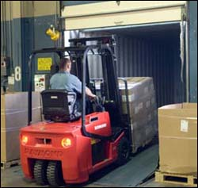
Truck Operations
Entering a Trailer, Truck or Railcar
Make sure the trailer, truck or railcar has been secured.
Countless injuries & deaths have occurred when a vehicle has rolled away from the dock as a forklift was driving into it.
Notes:
When entering a trailer, truck or railcar:
Make sure the trailer, truck or railcar has been secured.
Countless injuries & deaths have occurred when a vehicle has rolled away from the dock as a forklift was driving into it.

Slide 50
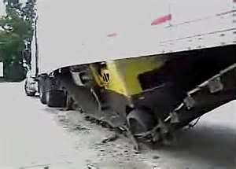
Truck Operations
Entering a Trailer, Truck or Railcar
Check:
  Dock plate
  Trailer floor
  Chocks
  ICC bar or any other
  restraint devices present
  Jacks (if trailer is not
  coupled to a tractor)
  Dockboard
  Dock lock
Notes:
Before entering a trailer, truck, or railcar the following should be checked:
Dock plate
Trailer floor
Chocks
ICC bar or any other restraint devices present
Jacks (if trailer is not coupled to a tractor)
Dockboard
Dock lock

Slide 51
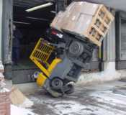
Additional Requirements
When grades are more than 10%, loaded trucks shall be driven with the load upgrade.
Only safely arranged loads should be handled.
Do not operate trucks with leaks in their fuel systems.
Notes:
Additional requirements include:
When grades are more than 10%, loaded trucks shall be driven with the load upgrade.
Only safely arranged loads should be handled.
Do not operate trucks with leaks in their fuel systems.

Slide 52
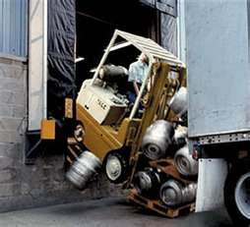
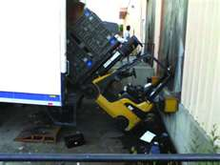
Forklift Hazards
Notes:
These pictures show some lift truck incidents. These types of incidents can happen when operators do not follow safety procedures or are not paying attention to what they are doing.

Slide 53
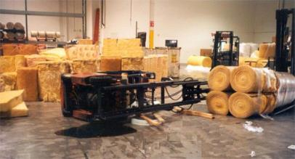
Forklift Hazards
Tipping Over
Do not jump off
Stay in the forklift
Hold onto the steering wheel
Brace your feet
Lean away from the fall
Notes:
One hazard of operating a PIT is tipping over. If the lift truck is tipping over:
Do not jump off
Stay in the forklift
Hold onto the steering wheel
Brace your feet
Lean away from the fall

Slide 54
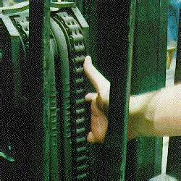
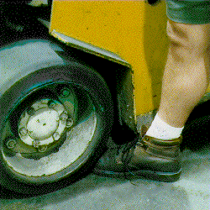
Forklift Hazards
Pinch Points
  Watch where you place your hands and feet.
  Stay clear of pinch points.
Notes:
Pinch points can also be a hazard of operating a lift truck. To avoid these hazards:
Watch where you place your hands and feet.
Stay clear of pinch points.

Slide 55
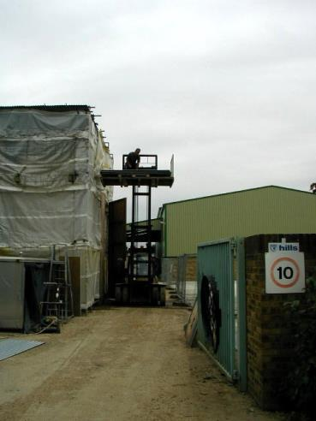
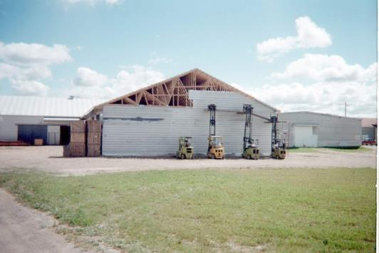
Forklift Hazards
Notes:
These pictures display some additional hazards that can be created while using a lift truck.

Slide 56
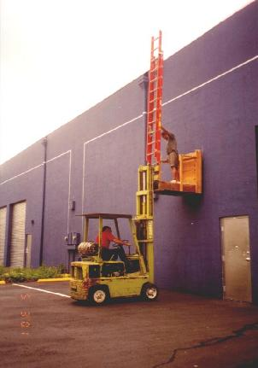
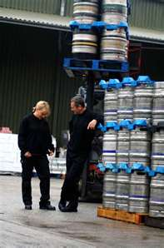
Forklift Hazards
Notes:
In the picture on the left side an employee is not only standing on a box that is carried by the lift truck, but is also attempting to put a ladder in place – this can lead to several different types of injuries which include fall from a height.
The picture on the right shows employees in an area where a lift truck is being operated with a load above them.

Slide 57
Free Training Websites
Website provides free self-paced on-line training for Fork Lift Operators: http://www.free-training.com/osha/forklift/forkmenu.htm.
The following site also has information on safe forklift operation: http://www.clarkmhc.com/safety/new.SafetyLiftTrucks.asp. (click on topic of interest on right hand side of page).
Notes:
The websites listed are a resource for free PIT training.

Slide 58
Things to Remember
Any Powered Industrial Truck operator should receive the appropriate training before they operate the equipment (which includes emphasizing seatbelt use as it applies).
Other PIT operators should be “certified” and a method should be established to prove their certification to any inspectors.
PIT operators should be evaluated by a qualified person at least every 3 years after their initial training/certification, and this evaluation should be documented.
Notes:
For the safe operation of a PIT remember:
Any Powered Industrial Truck operator should receive the appropriate training before they operate the equipment (which includes emphasizing seatbelt use as it applies).
Other PIT operators should be “certified” and a method should be established to prove their certification to any inspectors.
PIT operators should be evaluated by a qualified person at least every 3 years after their initial training/certification, and this evaluation should be documented.

Slide 59
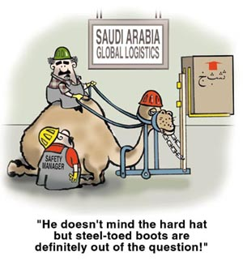
Think Safety!!!

Slide 60


Health & Safety Training Specialists
1171 South Cameron Street, Room 324
Harrisburg, PA 17104-2501
(717) 772-1635
RA-LI-BWC-PATHS@pa.gov
Like us on Facebook! - https://www.facebook.com/BWCPATHS

Slide 61
Questions

