Slide 1
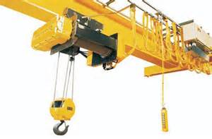
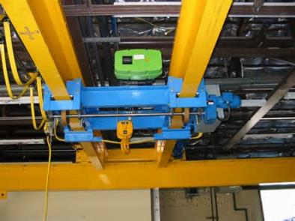
Overhead Crane Safety
Bureau of Workers’ Comp
PA Training for Health & Safety
(PATHS)
29 CFR 1910.179
Notes:
Overhead cranes are used in many industries to move heavy and oversized objects that other material handling methods cannot. These cranes have a railed support structure, also known as a bridge, and a wheeled trolley that travels across the bridge horizontally. Several varieties of overhead cranes exist including gantry, semi-gantry, cantilever gantry, storage bridge and wall cranes.
OSHA regulates overhead crane safety through 29 CFR 1910.179, overhead and gantry cranes. This regulation covers general requirements, design, inspection, maintenance requirements and operations.

Slide 2
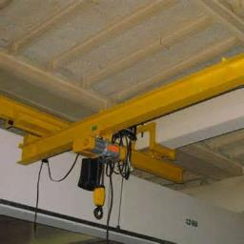
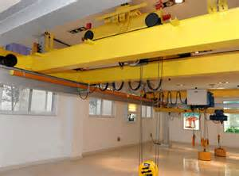
Overhead Crane Defined
Overhead Crane
A crane with a movable bridge carrying a movable or fixed hoisting mechanism and traveling on an overhead fixed runway structure.
Notes:
An overhead crane is defined as one that has a movable bridge carrying a movable or fixed hoisting mechanism and traveling on an overhead fixed runway structure.
Cranes can be modified and load capacity rerated as long as the modifications and associated structure is thoroughly checked for the new rated load by a qualified engineer or the equipment manufacturer.
The rated load of the crane shall be plainly marked on each side of the crane.
If more than one hoist is present, each hoist will have its rating shown.

Slide 3
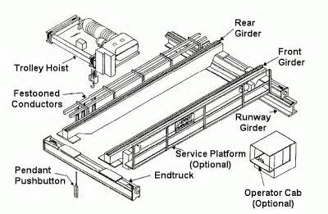
Parts of an Overhead Crane
Notes:
Parts of an overhead crane include:
Bridge - The main travelling structure of the crane which spans the width of the bay. The bridge consists of two end trucks and one or two bridge girders depending on the Equipment Type.
End trucks -Located on either side of the span, the end trucks house the wheels on which the entire crane travels. These wheels ride on the runway beam allowing access to the entire length of the bay.
Bridge Girder(s) -The principal horizontal beam of the crane bridge which supports the trolley and is supported by the end trucks.
Trolley Hoist -The unit consisting of both the hoist and the trolley frame. In situations where more than one hoist is required on one crane, both hoists can be supplied on a single trolley or on separate trolleys.
Trolley - The trolley carries the hoist across the bay along the bridge girder(s) traversing the span.
Hoist -The hoist is mounted to the trolley and performs the actual lifting function via a hook or lifting attachment. There are two basic types of hoists: Wire Rope and Chain.

Slide 4
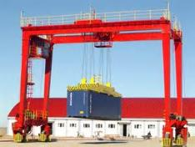
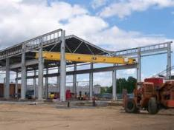
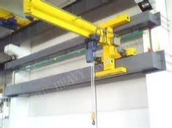
Types of Overhead Cranes
Gantry
Semi-Gantry
Cantilever Gantry
Storage Bridge
Wall Cranes
Notes:
Types of overhead cranes include:
Gantry
Semi-Gantry
Cantilever Gantry
Storage Bridge
Wall Cranes

Slide 5
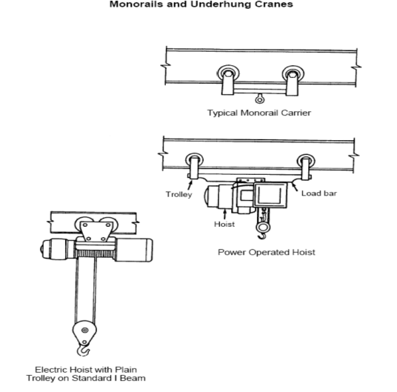
Types of Hoists
Notes:
The types of hoist “set ups” are shown in the slide.

Slide 6
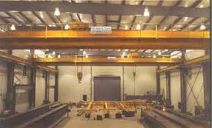
New Overhead Cranes
All new overheard cranes constructed and installed on or after August 31, 1971, shall meet the specifications set forth by the American National Standard Safety Code for overhead and gantry cranes, ANSI B30.2.0-1967.
Notes:
Overhead cranes constructed and installed after August 31, 1971 need to meet certain specifications which are listed in this slide.

Slide 7
Modifications
Cranes may be modified and rerated if the modifications and the supporting structure are checked thoroughly for the new rated load by a qualified engineer or the equipment manufacturer.
The new rated load must be plainly marked on each side of the crane.
If the crane has more than 1 hoisting unit, both shall have its rated load marked on them and shall be clearly legible from the ground or floor.
Notes:
Cranes may be modified and rerated if the modifications and the supporting structure are checked thoroughly for the new rated load by a qualified engineer or the equipment manufacturer.
The new rated load must be plainly marked on each side of the crane.
If the crane has more than 1 hoisting unit, both shall have its rated load marked on them and shall be clearly legible from the ground or floor.

Slide 8
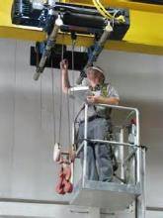
Initial Crane Inspection
Items to be inspected prior to each shift of operation:
Hoisting and lowering
Trolley travel
Bridge travel
Limit switches, locking and safety devices
Trip setting of hoist limit switches
Load test of no more than 125% of rated load
Notes:
Items to be Inspected:
Hoisting and lowering
Trolley travel
Bridge travel
Limit switches, locking and safety devices
Trip setting of hoist limit switches
Load test of not more than 125% of rated load

Slide 9
Visual Crane Inspection
Check for any loose or missing parts.
Check end stops. End stops prevent the trolley from running off the beam.
Know the location of disconnect switch that will cut the power off only to the hoist or crane. Be sure it is readily accessible and not blocked.
Make sure wire rope is properly seated in its drum and sheave grooves without any slack or overlapping.
Notes:
A visual inspection should be performed on each overhead crane to ensure its safety and the safety of operators before use.
Here are some items that should be inspected:
Check for any loose or missing parts.
Check end stops. End stops prevent the trolley from running off the beam.
Know the location of disconnect switch that will cut the power off only to the hoist or crane. Be sure it is readily accessible and not blocked.
Make sure wire rope is properly seated in its drum and sheave grooves without any slack or overlapping.

Slide 10
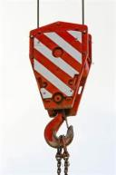
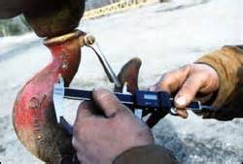
Frequent Inspections
Items to be inspected:
Operating mechanisms for maladjustment (Daily)
Deterioration or leakage in pneumatic and hydraulic parts (Daily)
Hooks with deformation or cracks – visual (Daily)
Hooks with deformation or cracks – written record with signature of inspector and date – (Monthly)
Notes:
The following items should be inspected using the frequency listed:
Operating mechanisms for maladjustment = Daily
Deterioration or leakage in pneumatic and hydraulic parts = Daily
Hooks with deformation or cracks (visual) = Daily
Hooks with deformation or cracks (written record with signature of inspector and date) = Monthly

Slide 11
Frequent Inspections
Items to be inspected:
Hoist chains and end connections for wear, twist or distortion – visual (Daily)
Hoist chains and end connections for wear, twist or distortion – written record with signature of inspector and date (Monthly)
Running Rope and end connections for wear, broken strands, etc. – written record with signature of inspector, rope identity and date – (Monthly)
Notes:
Other items and their inspection frequency include:
Hoist chains and end connections for wear, twist or distortion (visual) = Daily
Hoist chains and end connections for wear, twist or distortion (written record with signature of inspector and date) = Monthly
Running Rope and end connections for wear, broken strands, etc. (written record with signature of inspector, rope identity and date) = Monthly

Slide 12
Frequent Inspections
Items to be inspected:
Functional operating mechanisms for excessive wear (As Needed)
Rope reeving according to manufacturer’s recommendations (As Recommended)
Notes:
In addition to those already mentioned these other items should also be inspected:
Functional operating mechanisms for excessive wear = As needed
Rope reeving according to manufacturers' recommendations = As recommended

Slide 13
Periodic Inspections
Items to be inspected at intervals of 100 to 500 hours of use:
Deformed, cracked or corroded members
Loose bolts or rivets
Cracked or worn sheaves and drums
Worn, cracked or distorted parts, such as pins, bearings, gears, rollers, etc.
Excessive wear on brake-system parts
Notes:
The items listed below should be inspected when used between 100 to 500 hours:
Deformed, cracked or corroded members
Loose bolts or rivets
Cracked or worn sheaves and drums
Worn, cracked or distorted parts, such as pins, bearings, gears, rollers, etc.
Excessive wear on brake-system parts

Slide 14
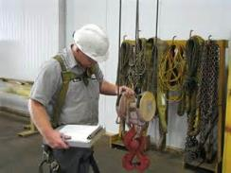
Periodic Inspections
Items to be inspected at intervals of 100 to 500 hours of use:
Inaccuracies in load, wind and other indicators
Electric or fossil fuel motors
Excessive wear of chain drive sprockets and chain
Deteriorated electrical components, such as pushbuttons, limit switches or contactors
Notes:
These items should also be inspected when used between 100 to 500 hours:
Inaccuracies in load, wind and other indicators
Electric or fossil fuel motors
Excessive wear of chain drive sprockets and chain
Deteriorated electrical components, such as pushbuttons, limit switches or contactors

Slide 15
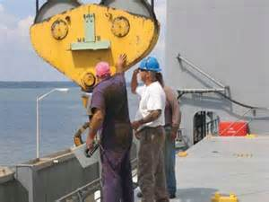
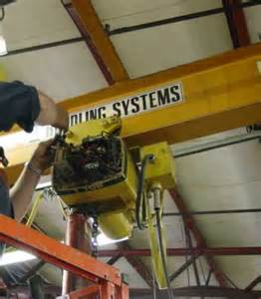
Annual Inspections
Annual inspections shall be performed at a minimum of once every 12 months, regardless of the severity of the crane usage.
Notes:
Annual inspections need to be performed at a minimum of at least once every 12 months regardless of the amount or severity of crane usage.

Slide 16
Written Report
A written report should contain any deficiencies or damage to the crane that need to be corrected or repaired on a scale of importance that is called out in the body of the report.
Written reports shall be kept by a designated person, on the company premises, so as to be available upon request by any regulatory person or agency.
Notes:
Written reports should contain any deficiencies or damage to cranes that need to be corrected or repaired on a scale of importance that is specified in the body of the report.
Written reports shall be kept by a designated person, on company premises, so as to be available upon request by any regulatory person or agency.

Slide 17
Maintenance
A preventive maintenance program based on the crane manufacturer’s recommendations must be implemented
Any unsafe conditions that are detected during the required inspections must be corrected prior to using the crane
Only trained, designated personnel should perform the required maintenance and repairs
Notes:
A preventive maintenance program based on the crane manufacturer's recommendations must be implemented.
If any deteriorated components or unsafe conditions are detected during the required inspections, they must be completed before the crane is allowed to be used.
Only designated personnel may perform the required maintenance and repairs.
The requirements of 29 CFR 1910.147, the control of hazardous energy or lockout/tagout, should be used to de-energize the crane

Slide 18
Maintenance
The following procedures must be followed when performing maintenance:
The crane to be repaired must be located where it will cause the least interference with other cranes and operations in the area.
All controllers must be at the off position.
The main or emergency switch must be open and locked-out in the open position.
Adequate lighting while maintenance is being performed.
Notes:
The following procedures must be followed when performing maintenance:
The crane to be repaired must be located where it will cause the least interference with other cranes and operations in the area.
All controllers must be at the off position.
The main or emergency switch must be open and locked-out in the open position.
Adequate lighting while maintenance is being performed.

Slide 19
Maintenance
Warning or out-of-order signs must be placed on the crane and on the floor beneath or on the hook where visible from surface level.
All guards must be reinstalled, safety devices reactivated and maintenance equipment removed prior to placing the crane back into operation.
Overhead and Gantry Cranes - Where other cranes are in operation on the same runway, rail stops should be in place.
Notes:
When performing maintenance on an overhead crane the procedures listed should be adhered to:
“Warning” or “out-of-order” signs must be placed on the crane and on the floor beneath or the hook where visible from surface level.
All guards must be reinstalled, safety devices reactivated and maintenance equipment removed prior to placing the crane back into operation.
Overhead and Gantry Cranes - Where other cranes are in operation on the same runway, rail stops should be in place.

Slide 20
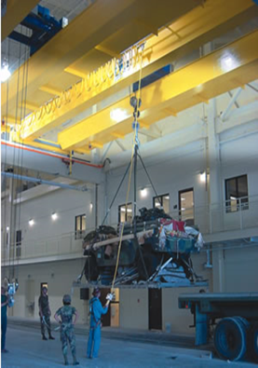
Before Moving a Load
Ensure all loose materials, parts, blocking and packing have been removed from the load before lifting.
Remove any slack from the sling and hoisting ropes before lifting the load.
Make sure that the lifting device seats in the saddle of the hook.
Notes:
Before moving a load:
Ensure all loose materials, parts, blocking and packing have been removed from the load before lifting.
Remove any slack from the sling and hoisting ropes before lifting the load.
Make sure that the lifting device seats in the saddle of the hook.

Slide 21
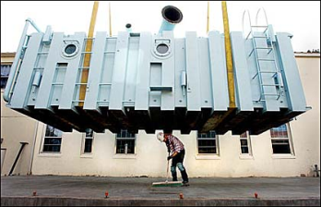
Operation
The crane warning signal or horn must be sounded when the load comes near personnel.
Loads should not be carried over personnel.
A load should not be left suspended.
Audible and voice communication should be kept with the operator at all times, if not a standard signal system should be used.
Notes:
In addition to the items listed in this slide, an operator should also:
Avoid sharp contact between trolleys or between trolleys and stops.
Do not use the primary upper limit device as an operating limit. Use other operational limits if they are available.
Do not lower the load beyond the point where less than two wraps of wire rope remain at each anchorage on the drum, unless a lower limit device is provided, in which
case no less than one wrap of wire rope shall remain at each anchorage on the drum.
Activate the manual warning device (if provided) before starting the bridge or trolley travel motion of the crane and intermittently during travel of the crane when
approaching people in the travel path of the load.
Verbally warn people before starting the bridge or trolley travel motion of a floor-operated crane that does not have a warning device that may be positioned in the
load’s travel path and during travel of the crane when approaching people in the load’s travel path.

Slide 22
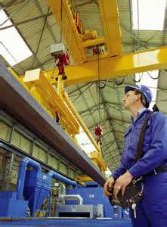
Operation
Operators cannot be engaged in activities that distract her or his attention while operating the equipment (for example, no cellular phone use unless used for signaling).
Notes:
Overhead crane operators need to concentrate on what they are doing and therefore operators cannot be engaged in activities that distract their attention while operating the equipment (for example, no cellular phone use unless used for signaling).

Slide 23
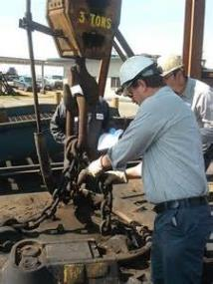
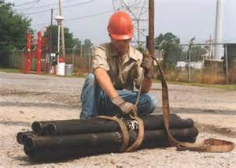
Operation
KEEPING CLEAR OF THE LOAD
When workers must be in the fall zone to handle a load, the load must be rigged by a qualified rigger.
Notes:
Anyone working with, near or around the crane should always use caution and pay attention to what is going on at all times!
If a worker must be in the “load fall zone” in order to handle the load that load should be rigged by a qualified rigger.

Slide 24
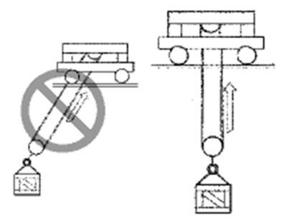
To Avoid Swinging Loads
Locate the hoist directly above the lifting point of the load before lifting.
Lower loads directly below the hoist.
Keep hoisting ropes vertical. Do not pull or push the load.
Maintain two full wraps of cable on the hoisting drum.
Notes:
To avoid swinging loads:
Locate the hoist directly above the lifting point of the load before lifting.
Lower loads directly below the hoist.
Keep hoisting ropes vertical. Do not pull or push the load.
Maintain two full wraps of cable on the hoisting drum.

Slide 25
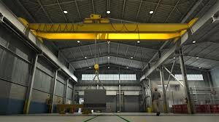
Lifting Loads at or Near Capacity
Test the hoist brakes by returning the master switch or push button to the “OFF” position after raising the load a few inches off the floor.
If the brakes do not hold, lower the load to the floor slowly and do not operate the crane.
Report the situation immediately and DO NOT USE until repaired.
Notes:
When lifting loads that are at or near capacity the following procedures should be used:
Test the hoist brakes by returning the master switch or push button to the “OFF” position after raising the load a few inches off the floor.
If the brakes do not hold, lower the load to the floor slowly and do not operate the crane.
Report the situation immediately and DO NOT USE until repaired.

Slide 26
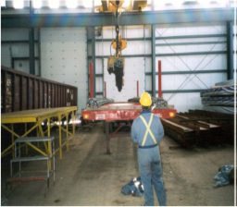
Leaving an Overhead Crane
Never leave the controls unattended while a load is suspended.
If it becomes necessary to leave the controls, lower the load to the floor.
Familiarize yourself with the location of the disconnect switch.
If loss of electrical power occurs, place controls in the “OFF” position to prevent unexpected startup upon restoration of power.
Notes:
If an operator has to leave an overhead crane for any reason they need to keep the listed information in mind:
Never leave the controls unattended while a load is suspended.
If it becomes necessary to leave the controls, lower the load to the floor.
Familiarize yourself with the location of the disconnect switch.
If loss of electrical power occurs, place controls in the “OFF” position to prevent unexpected startup upon restoration of power.

Slide 27
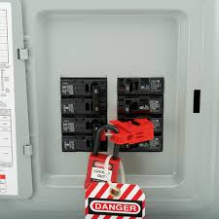
Unsafe Overhead Crane
Disconnect power to a hoist that is unsafe or in need of repair.
Arrange to have the disconnect switch locked and the control panel tagged with an “Out of Order”or “Do Not Operate” tag.
Never operate a hoist that has been tagged with an “Out of Order” or “Do Not Operate” tag, or in your opinion, is UNSAFE TO OPERATE…
Notes:
If an overhead crane is found to be unsafe for any reason:
Disconnect power to a hoist that is unsafe or in need of repair.
Arrange to have the disconnect switch locked and the control panel tagged with an “Out of Order”or “Do Not Operate” tag.
Never operate a hoist that has been tagged with an “Out of Order” or “Do Not Operate” tag, or in your opinion, is UNSAFE TO OPERATE…

Slide 28
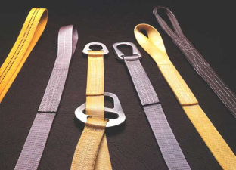
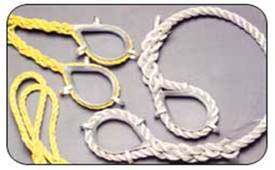
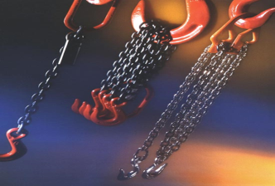
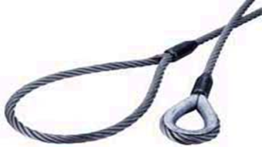
Rigging Equipment/Slings
Notes:
There are different types of rigging equipment and slings that can be used with examples provided in the pictures on this slide.

Slide 29
Sling Load Capacity & Angles
The load capacity of the sling is
determined by its weakest component.
Never overload a sling.
Remember, the wider the sling “legs” are spread apart, the less the sling can lift!
Notes:
For sling load capacity and angles:
The load capacity of the sling is determined by its weakest component.
Never overload a sling.
Remember, the wider the sling “legs” are spread apart, the less the sling can lift!

Slide 30
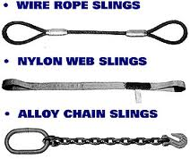
Sling Inspections
All slings are to be inspected each day prior to their use.
This includes chain, wire rope and synthetic slings and their attachments, i.e. master links, alligators, clips, hooks, quick-alloys etc.
A thorough facility-wide inspection is required to be performed at least once every 12 months.
Notes:
Slings should be inspected at least daily prior to their use.
Inspections should include chain, wire rope and synthetic slings and their attachments.
A thorough facility-wide inspected has to be performed at least once every 12 months.

Slide 31
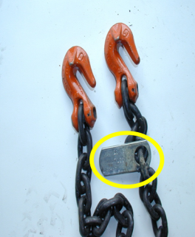
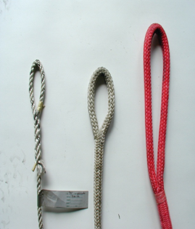
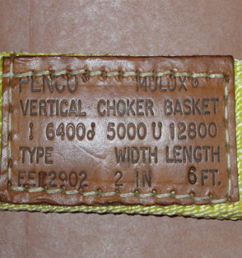
Sling Inspections
What is the capacity of the sling?
The tag must be present. (All Slings)
Notes:
During the sling inspection the capacity of the sling should be determined – this should be indicated by an attached tag/label (all slings should be appropriately labeled/tagged).

Slide 32
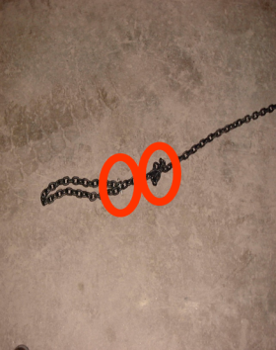
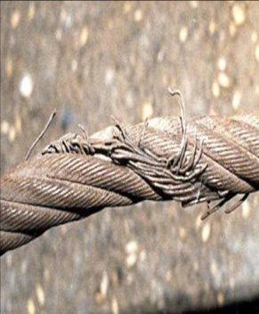
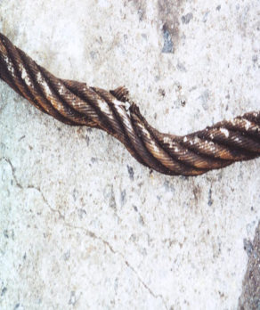
Sling Inspections
What is the condition of the sling?
Look for damage from:
Chemicals, stress, wear, cracks, knots, heat, kinks, melting, snags, tears, etc.
Notes:
During the inspection the overall condition of the sling should be determined. Damage from chemicals, wear, stress, cracks etc. should be observed and documented.

Slide 33
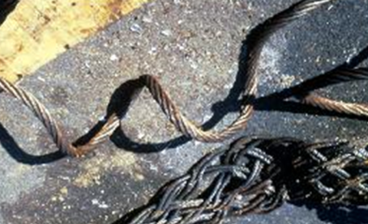
Damaged Sling
Take it out of service.
Tag it!
Contact your supervisor to get the item repaired or replaced.
Notes:
If a damaged sling is found it should be taken out of service, appropriately tagged and reported.

Slide 34
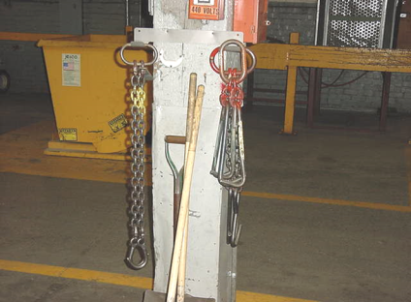
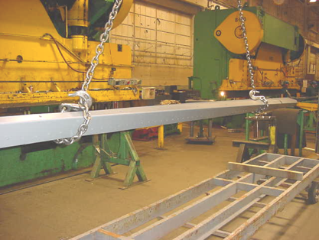
Safe Usage
Slings should be stored off of the floor and hung on racks whenever possible in a clean, dry environment.
Never drag slings across the floor.
Always hook with a “closed hook” arrangement (hooks facing out).
Notes:
For safe sling usage:
Slings should be stored off of the floor and hung on racks whenever possible in a clean, dry environment.
Never drag slings across the floor.
Always hook with a “closed hook” arrangement (hooks facing out).

Slide 35
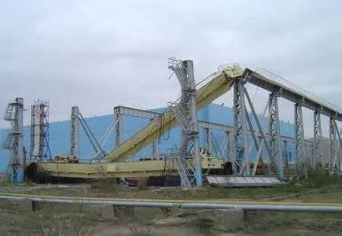
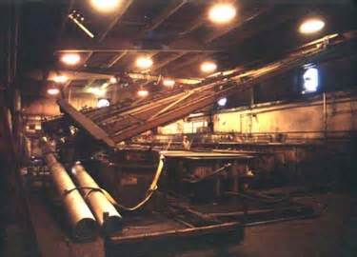
Overhead Crane Accidents
Notes:
Overhead crane accidents cause severe injuries and fatalities every year.
There are three major hazards that can contribute to overhead crane operations:
Coming into contact with an electrical power source,
Overloading
Materials Falling
Preventing accidents requires workers to recognize certain hazards that occur during operation and follow safety procedures to avoid them.

Slide 36
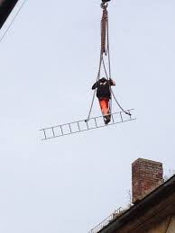
Overhead Crane Accidents
Is this safe?
No Way!
Notes:
Many times accidents are the result of workers taking shortcuts and not following safety procedures that are in place. This pictures shows an individual who may well do this sort of thing on a regular basis and because he/she has never been injured, injured anyone else or caused property damage he/she continues to do unsafe things on the job.

Slide 37
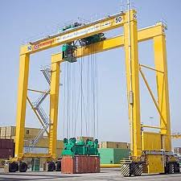
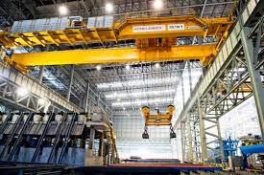
Operation-What to Avoid
Do not operate a crane if limit switches are out of order, or if cables show defects.
Do not allow anyone to ride on a load or hooks.
Do not leave slings dangling from the load hook.
Have sling hooks placed on the sling ring when carrying slings to the load.
Notes:
Operators of overhead cranes need to remember and heed the following:
Do not operate a crane if limit switches are out of order, or if cables show defects.
Do not allow anyone to ride on a load or hooks.
Do not leave slings dangling from the load hook.
Have sling hooks placed on the sling ring when carrying slings to the load.

Slide 38
Operation-What to Avoid
Do not raise loads higher than necessary to clear objects.
Do not pass a load over workers.
Do not reverse a motor until it has come to a full stop except to avoid accidents.
Do not walk on the crane runway.
Do not leave suspended loads unattended.
Notes:
In addition, operators also need to understand and follow these safety tips:
Do not raise loads higher than necessary to clear objects.
Do not pass a load over workers.
Do not reverse a motor until it has come to a full stop except to avoid accidents.
Do not walk on the crane runway.
Do not leave suspended loads unattended.

Slide 39
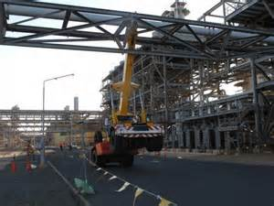
Clearance from Obstructions
A minimum clearance of 3” overhead and 2” laterally shall be provided and maintained between the crane and obstructions. *
* Crane Manufacturers Association of America, Inc., Specification No. 61
Notes:
While operating a crane there should be a minimum clearance of 3 inches overhead and at least 2 inches laterally between the crane and obstructions.

Slide 40
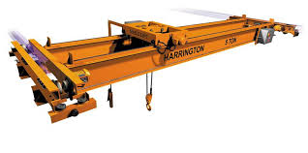
Bottom Line
Inspect your crane/hoist before use.
Inspect slings prior to use, removing from service any in question.
Remember the effect of sling angles on load capacities.
Properly store slings when finished to avoid damage.
Notes:
Operating an overhead crane can be dangerous if safety isn’t given priority. Operators and other employees need to keep in mind:
Inspect your crane/hoist before use.
Inspect slings prior to use, removing from service any in question.
Remember the effect of sling angles on load capacities.
Properly store slings when finished to avoid damage.

Slide 41
Contact Information
To contact a Health & Safety Training Specialist:
Bureau of Workers’ Compensation
1171 South Cameron Street Room 324
Harrisburg, PA 17104-2501
717-772-1635
RA-LI-BWC-Safety@pa.gov
Like us on Facebook! - https://www.facebook.com/BWCPATHS

Slide 42
Questions

