Slide 1
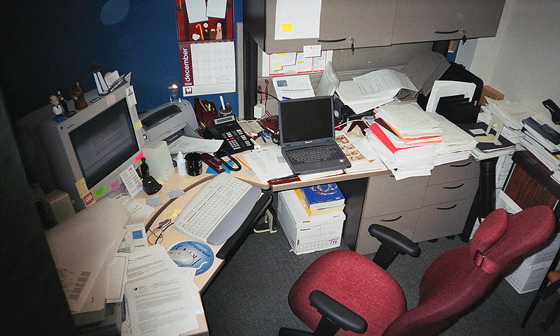
Office Safety
Bureau of Workers’ Compensation
PA Training for Health & Safety (PATHS)
Notes:
Although we may think of office work as safe and tame if compared to other work venues, accidents and injuries may occur in this theater of operations as well.

Slide 2
Topics
Leading Office Accidents
Common Office Safety & Health Hazards
Ergonomic Considerations
Fall Prevention
Emergency Action Plans
Exercises that can be done in the Office
Notes:
This program will view and discuss the following areas of possible injuries within the office environment:
Leading Office Accidents
Common Office Safety & Health Hazards
Ergonomic Considerations
Fall Prevention
Emergency Action Plans
Exercises that can be done in the Office

Slide 3
Office Safety
Offices of today are very different from the way they were 20 years ago.
Many hazards exist within an office environment that can cause injuries and health problems.
Slippery floors, open file drawers, poor lighting and machines that can emit noxious/hazardous gases are just some of the hazards that can be encountered.
Appropriate steps need to be taken to control and eliminate hazards and safety issues.
Notes:
Offices of today are very different from the way they were 20 years ago.
Many hazards exist within an office environment that can cause injuries and health problems.
Slippery floors, open file drawers, poor lighting and machines that can emit noxious/hazardous gases are just some of the hazards that can be encountered.
Appropriate steps need to be taken to control and eliminate hazards and safety issues.

Slide 4
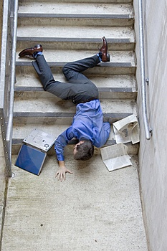
Leading Office Accidents
Falls
Strains and over-exertion
Struck by or striking objects
Caught in or between objects
Foreign substances in eyes
Burns from hot liquids/fires
Electrical shock
Notes:
Leading causes of office accidents include:
Falls.
Strains and over-exertion.
Struck by or striking objects.
Caught in or between objects.
Foreign substances in eyes.
Burns from hot liquids/fires.
Electrical Shock.

Slide 5
Common Office Hazards
Ventilation
Illumination
Noise
Physical Layout
Housekeeping
Exits/Egress
Fire Hazards
Electrical Equipment
Office Furniture
Office Machinery
Handling/Storage Hazards
Notes:
Common health hazards in offices
Ventilation
Illumination
Noise
Physical Layout
Housekeeping
Exits/Egress
Fire Hazards
Handling/Storage Hazards
Electrical Equipment
Office Furniture
Office Machinery

Slide 6
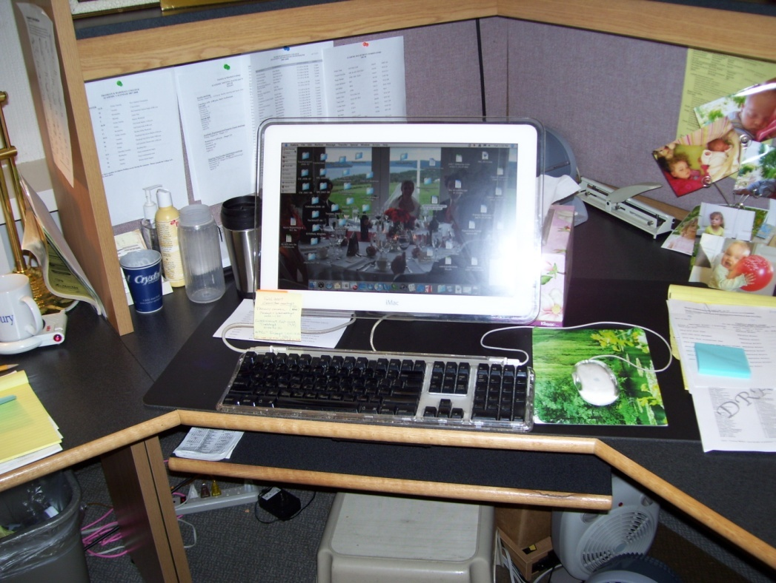
Common Office Hazards
Ladders
Stands
Stools
Office Tools
Copying Machines
Video Display Terminals
Notes:
Additionally, health hazards may result from the use or misuse of:
Ladders
Stands
Stools
Office Tools
Copying Machines
Video Display Terminals

Slide 7
Ventilation
Sources of office air pollution that can cause health problems include:
Natural agents (e.g. carbon monoxide, microorganisms, radon).
Synthetic chemicals (e.g. formaldehyde, cleaning fluids, cigarette smoke, asbestos).
Adequate office ventilation system delivering quality indoor air and providing comfortable humidity and temperature is necessary.
Notes:
When discussing ventilation, sources of office air pollution can include:
Natural agents (e.g. carbon monoxide, microorganisms, radon).
Synthetic chemicals (e.g. formaldehyde, cleaning fluids, cigarette smoke, asbestos).
Adequate office ventilation system delivering quality indoor air and providing comfortable humidity and temperature is necessary.

Slide 8
Ventilation
If copying or printing machines used = exhaust ventilation system that draws particulates and gases away from breathing zone should be present.
Office machines and ventilation system components should be checked and maintained on a regular basis.
Notes:
If copying or printing machines are used, an exhaust ventilation system should be used that draws particulates and gases away from breathing zone. Office machines and ventilation system components should be checked and maintained on a regular basis.

Slide 9
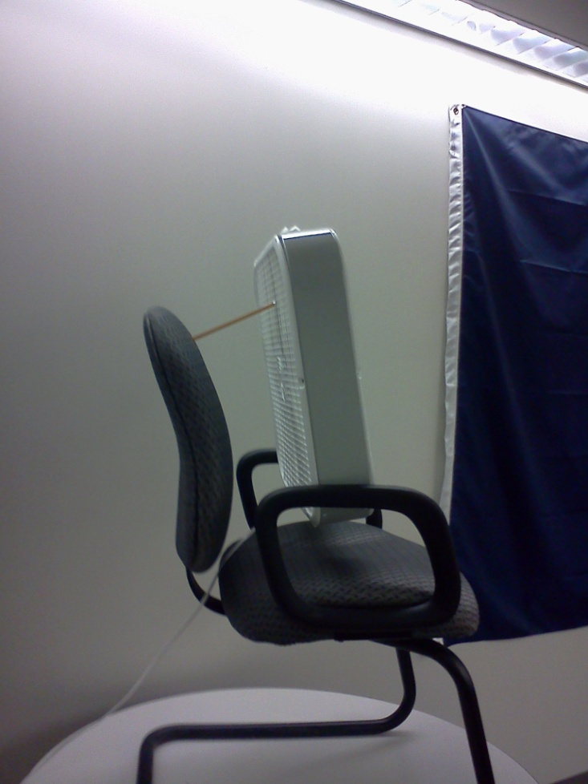
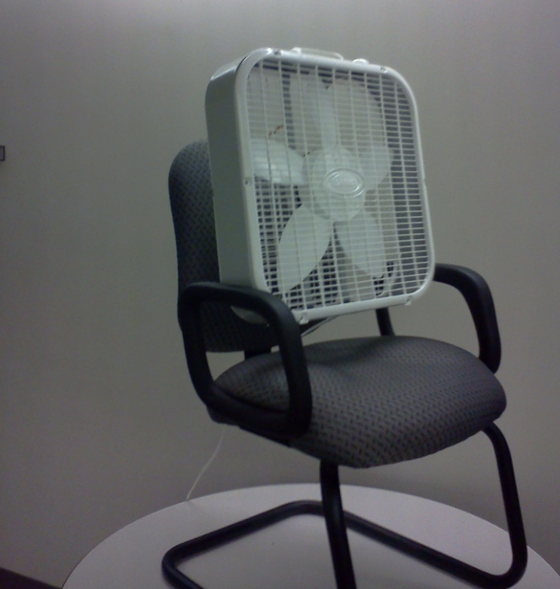
Ventilation-Safe Method?
Why is this fan being used? Ventilation provided not adequate or not working? Could somebody get injured from this?
Pencil holding up fan?
Definitely!
Notes:
There are safe, engineered, acceptable ventilation methods.
Problems may arise when we attempt to “create a better ventilation” method.

Slide 10
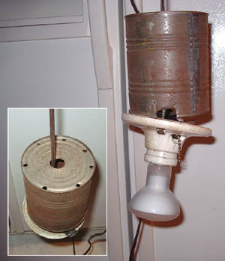
Illumination
Poor lighting can cause:
Glare
Shadows
Visual problems (e.g. eyestrain, fatigue, double-vision, etc.)
Accidents/injuries
Notes:
Poor lighting can cause:
Glare.
Shadows.
Visual problems (e.g. eyestrain, fatigue, double-vision, etc.).
Accidents/injuries.

Slide 11
Illumination
Controls to prevent poor lighting conditions:
Regular maintenance of the lighting system.
Light-colored dull finish on walls, ceilings, floors to reduce glare.
Adjustable shades on windows.
Indirect lighting.
Notes:
Controls to prevent poor lighting conditions would be:
Regular maintenance of the lighting system.
Light-colored dull finish on walls, ceilings, floors to reduce glare.
Adjustable shades on windows.
Indirect lighting.

Slide 12
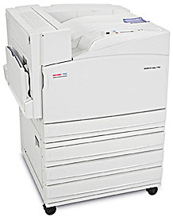
Noise
Noise can produce tension/stress.
Sources of noise:
Video display terminals.
High-speed printers.
Copying machines.
Telephones.
Human voices.
Housekeeping/Maintenance work.
Notes:
Noise can produce tension and stress, disrupting your concentration.
Sources of noise to reduce or modify would be:
Video display terminals.
High-speed printers.
Copying machines.
Telephones.
Human voices.
Housekeeping/Maintenance work.

Slide 13
Noise
Measures to control noise:
Place noisy machines in an enclosed space.
Use carpeting, draperies, and acoustical ceiling tiles.
Adjust telephone volumes to lowest level.
Rearrange traffic routes within the office = reduces traffic within/between work areas.
Use less noisy vacuums.
Schedule Housekeeping/Maintenance services after work hours.
Notes:
Some measures successfully implemented to control noise:
Place noisy machines in an enclosed space.
Use carpeting, draperies, and acoustical ceiling tiles.
Adjust telephone volumes to lowest level.
Rearrange traffic routes within the office = reduces traffic within/between work areas.
Use less noisy vacuums.
Schedule Housekeeping/Maintenance services after work hours.

Slide 14
Physical Layout
Poor design/layout can lead to crowding, lack of privacy, slips, trips, falls.
At least 3 feet distance between desks; 50 square feet per employee.
Keep telephone and electrical cords/wires out of aisles and walkways.
Keep office machines away from edges of desks/tables.
Regularly inspect, repair, and replace damaged carpets.
Place floor mats inside building entrances.
Notes:
The poor design or physical layout of an office can contribute to possible injuries.
Poor design or layout can lead to crowding, lack of privacy, as well as slips, trips, falls.
There should be at least 3 feet distance between desks with 50 square feet per employee.
Keep telephone and electrical cords/wires out of aisles and walkways.
Keep office machines away from edges of desks/tables.
Regularly inspect, repair, and replace damaged carpets.
Place floor mats inside building entrances.

Slide 15
Exits/Egress
All exits should be at least 28 inches wide.
Generally two exits should be provided.
Exits and access must be marked as such.
Means of egress should be free of obstructions and adequately lit (includes stairways used for emergency exit).
All employees should be aware of exit locations and trained in proper evacuation procedures
Notes:
Other considerations to promote safety during emergencies should be employed.
All exits should be at least 28 inches wide, minimum.
Generally two exits should be provided.
Exits and access must be marked as such.
Means of egress should be free of obstructions and adequately lit. This includes stairways used for emergency exit.
All employees should be aware of exit locations and trained in proper evacuation procedures.

Slide 16
Fires
Store unused records/papers in fire resistive files or vaults.
Use flame-resistive materials.
Smoke only in designated areas and use proper ashtrays.
Fire extinguishers and fire alarm pull stations should be clearly marked and unobstructed.
Flammable liquids should be kept to a minimum and stored in a metal cabinet.
Fire doors should be kept closed at all times.
Notes:
Fires are another potential health and safety hazard in offices although we may not think so. Some protective measures include:
Store unused records and papers in fire resistive files or vaults.
Use flame-resistive materials for decorations and furnishings.
Smoke only in designated areas and use proper ashtrays.
Fire extinguishers and fire alarm pull stations should be clearly marked and unobstructed.
Flammable liquids should be kept to a minimum and stored in a metal cabinet.
Fire doors should be kept closed at all times.

Slide 17
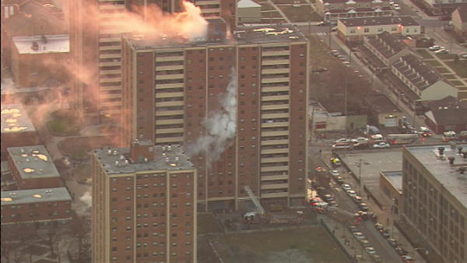
Fires
Do not hang anything from/on sprinklers, smoke detectors, heat detectors.
Keep storage at least 18 inches from sprinkler heads.
Report electrical hazards immediately (e.g. sparking outlets, damaged plugs, etc.).
Notes:
Do not hang anything from sprinklers, smoke detectors, or heat detectors.
Keep storage at least 18 inches from sprinkler heads.
Report electrical hazards immediately (e.g. sparking outlets, damaged plugs, etc.).

Slide 18
Handling & Storage
Improper lifting = musculoskeletal disorders such as sprains, strains, and inflamed joints.
Improperly stored objects can fall on people, cause poor visibility and fires.
Materials should not be stored on top of cabinets.
Heavy objects should be stored on lower shelves, stacked neatly.
Store materials inside cabinets, lockers, or files when possible.
Notes:
Handling and storage of materials may lead to injuries.
Improper lifting may lead to musculoskeletal disorders such as sprains, strains, and inflamed joints.
Improperly stored objects can fall on people, cause poor visibility and fires.
Materials should not be stored on the top of cabinets.
Heavy objects should be stored on lower shelves and stacked neatly.
Store materials inside cabinets, lockers, or files when possible.

Slide 19
Handling & Storage
Do not block/obstruct fire extinguishers, fire alarm boxes, or fire suppression equipment.
Identify and properly store flammable and combustible material.
Do not block or obstruct aisles or walkways.
Ensure shelves are secured to the wall to prevent tipping.
Do not step on shelves or stand on chairs to reach items
Notes:
Handling and storage recommendations include:
Do not block or obstruct fire extinguishers, fire alarm boxes, or fire suppression equipment.
Identify and properly store flammable and combustible material.
Do not block or obstruct aisles or walkways.
Ensure shelves are secured to the wall to prevent tipping.
Do not step on shelves or stand on chairs to reach items.

Slide 20
Ergonomic Considerations
If you do same tasks with your hands over and over: try not to bend, extend, or twist hands for long periods.
Don’t work with your arms too close or too far from your body.
Don’t rest your wrists on hard surfaces for long periods.
Switch hands during work tasks if possible.
Notes:
Proper ergonomic design can reduce physical injuries to staff.
If you do the same tasks with your hands over and over: try not to bend, extend, or twist your hands for long periods.
Don’t work with your arms too close or too far from your body.
Don’t rest your wrists on hard surfaces for long periods.
Switch hands during work tasks if possible.

Slide 21
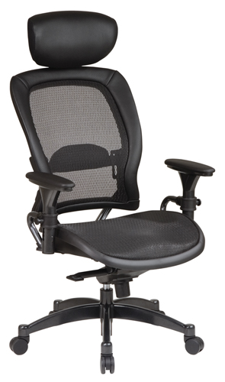
Ergonomic Considerations
Take regular breaks from repeated hand movements: gives your hands and wrists time to rest.
Don’t sit or stand in the same position all day.
Ensure your chair is adjusted so your forearms are level with your keyboard and you don’t flex your wrists to type.
Notes:
Take regular breaks from repeated hand movements. This gives your hands and wrists time to rest.
• Don’t sit or stand in the same position all day.
• Ensure your chair is adjusted so your forearms are level with your keyboard and you don’t flex your wrists to type.

Slide 22
Ergonomics - Computer
Screen – Top should be at or just below eye level and approximately 18-22 inches away.
Chair – Your back should be fully supported with feet flat on the floor or on a footrest. Knees should be approximately 90 degrees to floor when seated.
Keyboard – At a height so wrists are straight and elbows at approximately 90 degrees.
Document Holder – Place at same height and distance as screen.
Notes:
Computer work can be repetitious the same as motions on an assembly line. The following are considerations by task or equipment.
Screen – The top should be at or just below eye level and approximately 18-22 inches away.
Chair – Your back should be fully supported with feet flat on the floor or on a footrest. Knees should be approximately 90 degrees to the floor when seated.
Keyboard – At a height so wrists are straight and elbows at approximately 90 degrees.
Document Holder – Place it at same height and distance as screen.

Slide 23
Ergonomics-Computer
Eye Comfort – Reduce glare on screen by controlling light from uncovered windows. Set screen at right angle to window if possible.
Change Positions – Frequently change positions to release tension on the body.
Organize Work Area – Keep frequently used items such as the telephone within easy reach.
Exercise – Take mini-breaks throughout the day to relieve muscle tension and reenergize the body
Notes:
Eye Comfort – Reduce glare on the screen by controlling light from uncovered windows. Set screen at right angle to window if possible.
Change Positions – Frequently change positions to release tension on the body.
Organize Work Area – Keep frequently used items such as the telephone within easy reach.
Exercise – Take mini-breaks throughout the day to relieve muscle tension and reenergize the body.

Slide 24
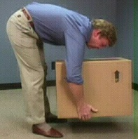
Causes of Back Problems
Heavy lifting from above the shoulders.
Heavy lifting from below the knees.
Twisting while lifting/carrying.
Bending over at the waist. → → → → → → → → →
Carrying objects to one side.
Notes:
Back problems may occur suddenly and persist for long term. Below are conditions which can lead to back problems.
Heavy lifting from above the shoulders.
Heavy lifting from below the knees.
Twisting while lifting/carrying.
Bending over at the waist.
Carrying objects to one side.

Slide 25
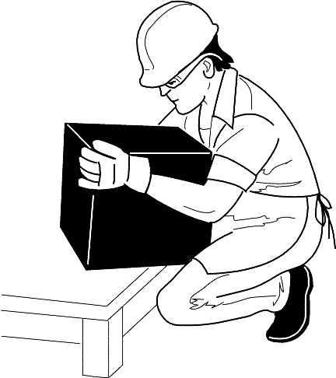
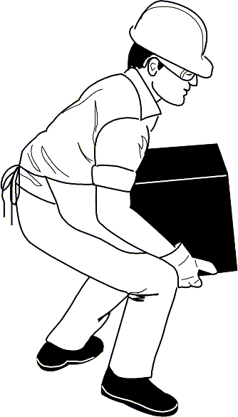
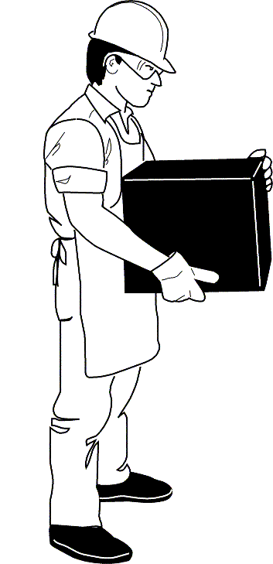
Lifting
Avoid bending at the waist
Squat down with your back straight and knees bent
Grasp the object
Bring it close to your body
Slowly rise
Let your thigh muscles do the lifting.
Notes:
When you lift,
Avoid bending at the waist.
Squat down with your back straight and knees bent.
Grasp the object .
Bring it close to your body.
Slowly rise.
Let your thigh muscles do the lifting.

Slide 26
Electrical Equipment
Equipment must be properly grounded to prevent shock injuries.
Ensure there are a sufficient number of outlets to prevent circuit overloading.
Do not use poorly maintained or non-approved equipment.
Do not drag cords over nails, hooks, or other sharp objects.
Check equipment and receptacles to ensure there are no bare/frayed wires.
Machines should be disconnected before cleaning or adjusting.
Notes:
Electrical equipment should be respected.
Equipment must be properly grounded to prevent shock injuries.
Ensure there are a sufficient number of outlets to prevent circuit overloading.
Do not use poorly maintained or non-approved equipment.
Do not drag cords over nails, hooks, or other sharp objects.
Check equipment and receptacles to ensure there are no bare or frayed wires.
Machines should be disconnected before cleaning or adjusting.

Slide 27
Furniture
Chairs should be properly designed and regularly inspected for missing casters, wobbly or cracked legs, loose parts.
Do not lean back on a chair with your feet on a desk.
Do not use a chair to move yourself from one area to another.
Do not stand on chairs to reach for something.
Open only one drawer at a time and only use the handles to close drawers.
Do not locate file cabinets close to doorways or in aisles.
Notes:
We often take furniture for granted. Office furniture use differs from home use furniture.
Chairs should be properly designed and regularly inspected for missing casters, wobbly or cracked legs, loose parts.
Do not lean back on a chair with your feet on a desk.
Do not use a chair to move yourself from one area to another.
Do not stand on chairs to reach for something.
Open only one drawer at a time and only use the handles to close drawers.
Do not locate file cabinets close to doorways or in aisles.

Slide 28
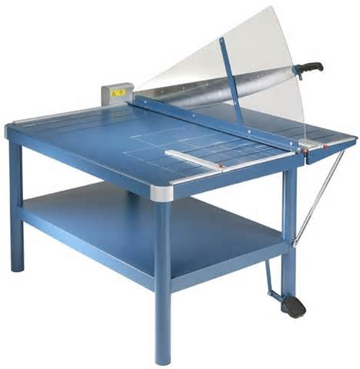
Machinery
Machines with “nip points” or rotating parts should be guarded to avoid accidental contact.
Machines such as hole punches, paper cutters, and conveyors should be guarded.
Fans must have substantial bases and blades must have guards that are no wider than ½ inch.
Notes:
Machinery have their own potential hazards.
Machines with “nip points” or rotating parts should be guarded to avoid accidental contact.
Machines such as hole punches, paper cutters, and conveyors should be guarded.
Fans must have substantial bases and blades must have guards that are no wider than ½ inch.
Read and adhere to manufacturers’ recommendations and precautions.

Slide 29
Ladders, Stands, Stools
Always face the ladder when going up or down.
Inspect ladders regularly to ensure they are in good condition.
Never stand or sit on the top step of a ladder.
Ladders should only be used when they are fully opened and the spreaders are locked.
Ensure the ladder/stool used is tall enough to be used safely.
Before using ensure ladders/stools/stands are on solid surfaces that are not slippery.
Notes:
Ladders, stands and stools are constructed for specific jobs. We run into trouble when we attempt to use other materials to do the job of these items. Some safety pointers when using a ladder would be,
Always face the ladder when going up or down.
Inspect ladders regularly to ensure they are in good condition.
Never stand or sit on the top step of a ladder.
Ladders should only be used when they are fully opened and the spreaders are locked.
Ensure the ladder or stool used is tall enough to be used safely.
Before using, ensure ladders, stools or stands are on solid surfaces that are not slippery.

Slide 30
Tools
Office tools such as pens, pencils, paper, letter openers, scissors, and staplers can cause cuts, scrapes, punctures with resulting infections.
Paper cutter blades should be closed when not in use and a guard should be in place.
Always use staple removers and never test a jammed stapler with your thumb.
Store sharp objects in a drawer or with the point down.
Never hand a sharp object to someone point first.
Notes:
Tools in the office can be misused due to expediency in trying to rush through a task.
Office tools such as pens, pencils, paper, letter openers, scissors, and staplers can cause cuts, scrapes, punctures with resulting infections.
Paper cutter blades should be closed when not in use and a guard should be in place.
Always use staple removers and never test a jammed stapler with your thumb.
Store sharp objects in a drawer or with the point down.
Never hand a sharp object to someone point first.

Slide 31
Photocopying Machine
May use toxic chemicals, produce excessive noise, intense light, as well as being a source of indoor air pollution.
Keep the document cover closed.
Reduce noise exposure by isolating the machine.
Place machines in well-ventilated rooms away from workers’ desks.
Have machines serviced regularly to prevent chemical emissions.
Avoid skin contact with chemicals and clean up all spills and dispose of waste properly.
Notes:
Photocopying machines
May use toxic chemicals, produce excessive noise or intense light, as well as being a source of indoor air pollution.
Keep the document cover closed.
Reduce noise exposure by insolating the machine.
Place machines in well-ventilated rooms away from workers’ desks.
Have machines serviced regularly to prevent chemical emissions.
Avoid skin contact with chemicals and clean up all spills and dispose of waste properly.

Slide 32
Video Display Terminals (VDT)
Health hazards = radiation, noise, eye irritation, low back, neck, shoulder pain, stress.
To minimize potential radiation exposure only use equipment for which you can obtain data on emissions.
To minimize noise, VDT’s should not be clustered; sound absorbent screens may also be used.
Ensure VDT is not too close to operator (not less than 18-22 inches away).
Notes:
Video Display Terminals (VDT) present health hazards.
Radiation, noise, eye irritation, low back, neck, shoulder pain, stress may result in improper use.
To minimize potential radiation exposure only use equipment for which you can obtain data on emissions.
To minimize noise, VDT’s should not be clustered; sound absorbent screens may also be used.
Ensure VDT is not too close to operator (not less than 18-22 inches away).

Slide 33
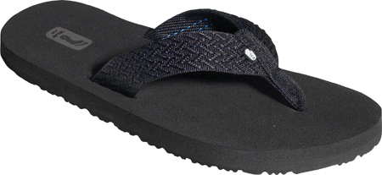
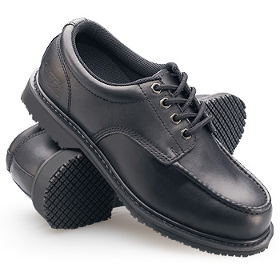
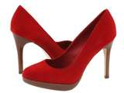
Fall Prevention
Wear appropriate footwear = sturdy shoes with non-slip soles.
These are much safer!
Which shoes are safer?
Notes:
Fall protection is best guarded against by wearing appropriate footwear. This means sturdy shoes with non-slip soles. Flip-flops are no good in an office environment.
Also, they do not look professional.

Slide 34
Fall Prevention
Maintain a clear line of vision.
Install convex mirrors around blind corners or cubicle walls to avoid collisions.
Don’t run electrical cords, telephone/computer wiring across walkways.
Do not stand on chairs or other furniture to reach for something.
Do not store boxes, files, or various other items in walkways.
Use handrails when walking up or down stairs.
Notes:
Fall protection in the office is always a possible concern. Uneven surfaces, slick surfaces and tripping hazards are always a possibility.
A good guard against falls should evaluate:
Maintain a clear line of vision.
Install convex mirrors around blind corners or cubicle walls to avoid collisions.
Don’t run electrical cords, telephone or computer wiring across walkways or under carpets.
Do not stand on chairs or other furniture to reach for something.
Do not store boxes, files, or various other items in walkways.
Use handrails when walking up or down stairs.

Slide 35
Fall/Injury Prevention
Close all file drawers immediately after use.
Close the file drawer using the drawer handle, not your feet.
Open only one file drawer at a time (to avoid causing cabinet to fall over).
Never leave an open drawer unattended.
Never open a drawer while someone is beneath it.
Never climb on open file drawers.
Notes:
Other fall preventive measures would be to:
Close all file drawers immediately after use.
Close the file drawer using the drawer handle, not your feet.
Open only one file drawer at a time (to avoid causing the cabinet to fall over).
Never leave an open drawer unattended.
Never open a drawer while someone is beneath it.
Never climb on open file drawers.

Slide 36
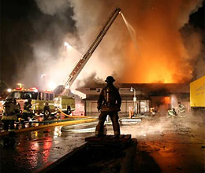
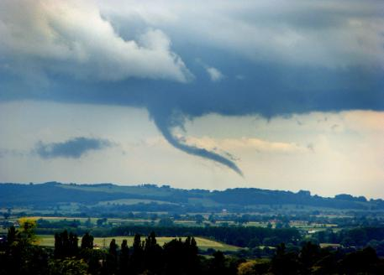
Emergency Action Plans
Know the plan for foreseeable emergencies such as fires, hurricanes, tornadoes, etc.
Know how to report emergencies.
Know the location of the closest exit, fire alarm pull station, and fire extinguisher.
Be familiar with emergency escape procedures and routes.
Notes:
To promote the safety of your staff as well as protection of records and facilities, emergency action plans should be constructed. Portions of such plans would engender:
Know the plan for foreseeable emergencies such as fires, hurricanes, tornadoes, etc.
Know how to report emergencies.
Know the location of the closest exit, fire alarm pull station, and fire extinguisher.
Be familiar with emergency escape procedures and routes.

Slide 37
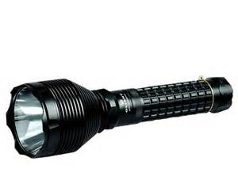
Emergency Action Plans
Know where to assemble after evacuation.
Know the procedure used to account for all employees after evacuation.
Know which employees are assigned rescue and medical duties.
Know where emergency equipment is stored (e.g. flashlights, medical supplies, etc.)
Notes:
Emergency Action Plans also let staff know:
Where to assemble after evacuation.
The procedure used to account for all employees after evacuation.
Which employees are assigned rescue and medical duties.
Where emergency equipment is stored (e.g. flashlights, medical supplies, etc.)

Slide 38
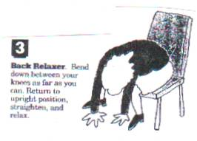
Office Exercises-Back Relaxer
Bend down between your knees for as long as you can.
Return to upright position, straighten, and relax.
Notes:
At-Your-Desk exercises can relax your and reduce strain and stress on your muscles.
For the Back Relaxer:
Bend down between your knees and hold this position as long as you can.
Return to an upright position, straighten and relax
Repeat several times.

Slide 39
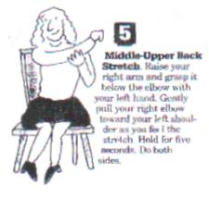
Middle/Upper Back Stretch
Raise your right arm and grasp it below the elbow with your left hand.
Gently pull your right elbow toward your left shoulder as you feel the stretch.
Hold for five seconds.
Do same for left side.
Notes:
You can perform the Middle/Upper Back Stretch.
Raise your right arm and grasp it below the elbow with your left hand.
Gently pull your right elbow toward your left shoulder as you feel the stretch
Hold for five (5) seconds.
Do the same for the left side.

Slide 40
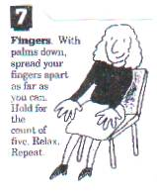
Finger Stretch
With palms down, spread your fingers apart as far as you can.
Hold for the count of five.
Relax and then repeat.
Notes:
The Finger Stretch is another muscle relaxer.
With palms down, spread your fingers apart as far as you can.
Hold for the count of five (5).
Relax and then repeat.

Slide 41
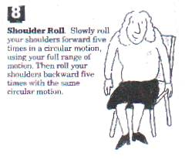
Shoulder Roll
Slowly roll your shoulders forward five times in a circular motion using your full range of motion.
Then roll your shoulders backward five times with the same circular motion.
Notes:
Perform the Shoulder Roll.
Slowly roll your shoulders forward five (5) times in a circular motion using your full range of motion.
Then roll your shoulders backward five (5) times with the same circular motion.

Slide 42
Bottom Line
There are many hazards associated with working in an office environment.
Be aware of safety issues/hazards; report them, correct them.
Realize an improper or careless act such as leaving a file drawer open can cause injuries.
Think safety, act safely!
Notes:
The Bottom Line concerning office safety is to realize hazards may exist.
There are many such hazards associated with the office environment.
Be aware of safety issues and hazards; report them and correct them.
Realize an improper or careless act such as leaving a file draw open can cause injuries.
Think safety and act safely!

Slide 43
Contact Information
Health & Safety Training Specialists
1171 South Cameron Street, Room 324
Harrisburg, PA 17104-2501
(717) 772-1635
RA-LI-BWC-PATHS@pa.gov
Like us on Facebook! - https://www.facebook.com/BWCPATHS
Notes:
For more information on free webinars and free training at your location, we invite you to contact us

Slide 44
Questions

