Slide 1
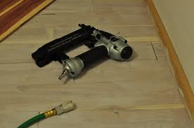
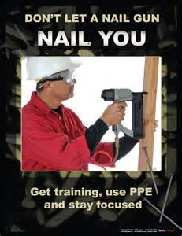
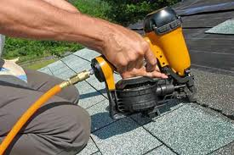
Nail Gun Safety
Bureau of Workers’ Comp
PA Training for Health & Safety
(PATHS)
PPT-085-01
1
Notes:
Nail gun injuries most often are the result of firings that occur inadvertently, in quick succession or from the way the nail penetrates a surface. Most of these injuries involve puncture wounds to the hands or fingers, but a number are serious and even fatal. Studies show that if a person has not been trained in how to use nail guns with either mechanism, their risk of injury is high.

Slide 2
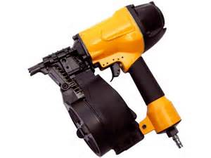
Topics
Introduction
Nail gun injuries
Know your triggers
Six steps to nail gun safety
Other hazards
Conclusion
PPT-085-01
2
Notes:
This presentation will address:
Nail gun injuries
Know your triggers
Six steps to nail gun safety
Other hazards

Slide 3
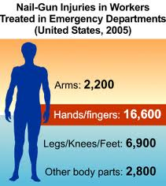
Introduction
Nail guns are powerful, easy to operate, and boost productivity.
They are also responsible for an estimated 37,00 emergency room visits each year.
68% of these visits involve workers.
32% involved are consumers.
More than half of reported injuries are to the hand and fingers.
PPT-085-01
3
Notes:
Nail guns are an extremely common tool used in many aspects of construction, particularly in residential applications. They can have a number of different configurations and drive a number of various sizes or types of fasteners into wood or concrete. They were developed in 1959 to increase productivity, as an average house will require 50,000-70,000 nails during its construction. Specifically, pneumatic powered guns for wood framing, interior carpentry, sheathing, and roofing are utilized the most often, and can easily drive a 3 to 3.5 inch nail into wood in less than a tenth of a second. But they can also injure and possibly even kill!

Slide 4
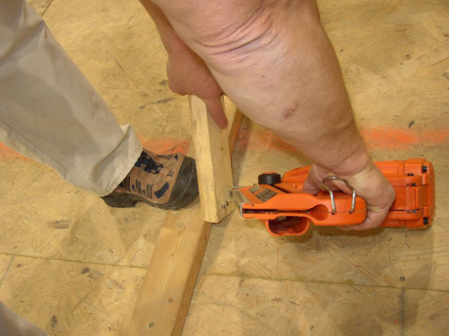
How do nail gun injuries happen?
Unintended nail discharges from double fire.
See any problem here?
PPT-085-01
4
Notes:
There are many different ways a nail gun can injure the user such as:
▫ Unintended nail discharges from double fire.
This picture shows the unsafe use of a nail gun. The nail can come into contact with the individual’s toes/foot due to the way the person has their foot positioned (the footwear the user is wearing may contribute to the problem if it’s not a safety shoe with a thick sole).

Slide 5
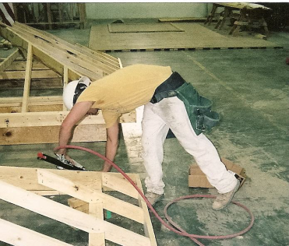
How do nail gun injuries happen?
Unintended nail discharge from knocking the
safety contact with the trigger squeezed.
What issues do you see?
PPT-085-01
5
Notes:
Another way injuries can happen is from unintended nail discharges from knocking the safety contact with the trigger squeezed.
The issue in this picture is the way the user is standing. He could be struck and injured by an errant nail. His position/posture could also contribute to a musculoskeletal injury.

Slide 6
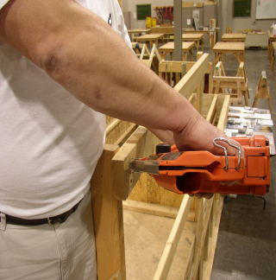
How do nail gun injuries happen?
Nail penetration through lumber work piece.
See any problem here?
PPT-085-01
6
Notes:
Nail penetration through a lumber work piece is another way that injuries occur while using a nail gun.
This picture shows another unsafe method of handling a nail gun since the individual is actually bracing the lumber against his waist.

Slide 7
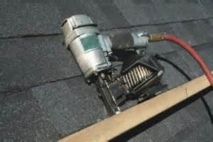
How do nail gun injuries happen?
Nail ricochet after striking a hard surface or metal.
Any safety concerns with this?
PPT-085-01
7
Notes:
Another source of nail gun injuries can be from a nail ricocheting after striking a hard surface or metal.
The angle of the nail gun could be an issue in this picture.

Slide 8
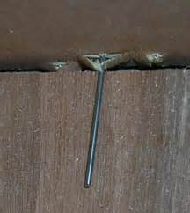
How do nail gun injuries happen?
Missing the work piece.
PPT-085-01
8
Notes:
In some instances missing the work piece with the nail could cause an injury to the user.

Slide 9
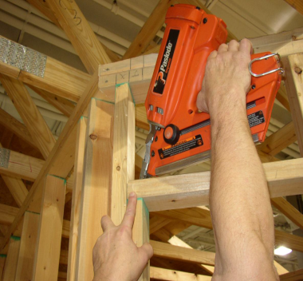
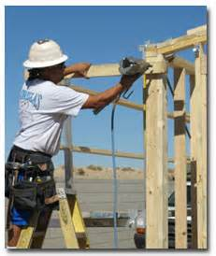
How do nail gun injuries happen?
Awkward position nailing.
What are the safety issues here?
PPT-085-01
9
Notes:
Working in an awkward position can definitely contribute to being injured while using a nail gun.
The position these individuals are working in could certainly be a problem and could result in an injury. Their position/posture could also contribute to a musculoskeletal injury.

Slide 10
How do nail gun injuries happen?
Bypassing safety mechanisms.
See any problem here?
PPT-085-01
10
Notes:
Users bypassing safety mechanisms can definitely cause injuries.
Look at the position this individual is in – he is above 6 feet and should definitely have fall protection in place. If he loses his balance he could cause an inadvertent discharge of the nail gun which could result in two injuries (one from the discharge and one from the fall).

Slide 11
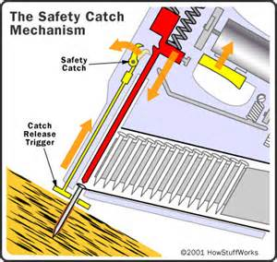
Know your Triggers
Nail gun safety starts with understanding
the various trigger mechanisms.
How triggers differ
All nailers rely on two basic controls
Finger trigger
Contact safety tip
Four trigger types.
PPT-085-01
11
Notes:
It is important to be totally familiar with the features of the nail gun, especially the type of triggers that are on it.
Nail gun safety starts with understanding the various trigger mechanisms.
How triggers differ
All nailers rely on two basic controls
Finger trigger
Contact safety tip
Four trigger types.

Slide 12
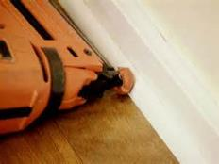
Full Sequential Trigger
This is the safest type of nail gun trigger.
This trigger will only fire a nail when the
controls are activated in a certain order.
Safety contact tip must be pushed into the work piece.
User squeezes the trigger to discharge a nail.
PPT-085-01
12
Notes:
One type of trigger is the Full Sequential:
This is the safest type of nail gun trigger.
This trigger will only fire a nail when the controls are activated in a certain order.
Safety contact tip must be pushed into the work piece.
User squeezes the trigger to discharge a nail.

Slide 13
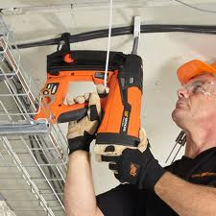
Full Sequential Trigger
Nails cannot be bump fired.
Also known as single-shot trigger, restrictive trigger, or trigger fire mode.
PPT-085-01
13
Notes:
With the Full Sequential Trigger the nail cannot be “bump fired.”
This type of trigger is also know as a single-shot trigger, restrictive trigger, or trigger fire mode.

Slide 14
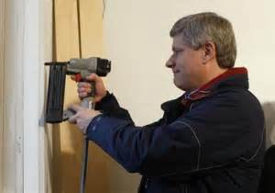
Contact Trigger
Fires a nail when the safety contact and trigger
are activated in any order.
You can push the safety contact tip first then
squeeze the trigger, or you can squeeze the
trigger first then push the safety contact tip.
PPT-085-01
14
Notes:
A Contact Trigger:
Fires a nail when the safety contact and trigger are activated in any order.
You can push the safety contact tip first then squeeze the trigger, or you can squeeze the trigger first then push the safety contact tip.

Slide 15
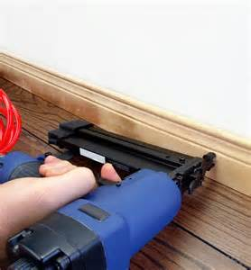
Contact Trigger
All nails can be bump fired.
Also known as bump trigger, multi-shot trigger,
successive trigger, dual-action, touch trip, contact
trip, and bottom fire.
PPT-085-01
15
Notes:
With a Contact Trigger all nails can be “bump fired.”
Also known as bump trigger, multi-shot trigger, successive trigger, dual-action, touch trip, contact trip, and bottom fire.

Slide 16
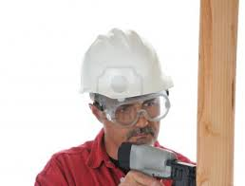
Single Sequential Trigger
Like a full sequential trigger, this trigger will only
fire when the controls are activated in a certain
order.
The safety tip must be pushed into the work
piece. Then, the user squeezes the trigger to
discharge a nail.
PPT-085-01
16
Notes:
Like a Full Sequential Trigger, this trigger will only fire when the controls are activated in a certain order.
The safety tip must be pushed into the work piece. Then, the user squeezes the trigger to discharge a nail.

Slide 17
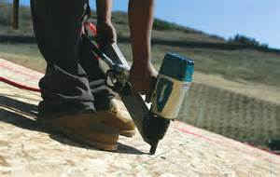
Single Sequential Trigger
To fire a second nail, only the trigger must be
released. The safety contact tip can stay pressed
into the work piece.
Nails cannot be bump fired.
PPT-085-01
17
Notes:
On a Single Sequential Trigger in order to fire a second nail, only the trigger must be released. The safety contact tip can stay pressed into the work piece.
Nails cannot be bump fired with a Single Sequential Trigger.

Slide 18
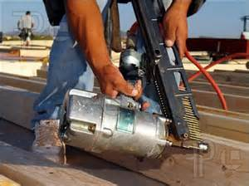
Single Actuation Trigger
Like the contact trigger, this trigger will fire a
single nail when the safety contact and trigger
are activated in any order.
The nail can be bump fired with a single actuation
trigger but not with a true single sequential trigger.
PPT-085-01
18
Notes:
With a Single Actuation Trigger this trigger will fire a single nail when the safety contact and trigger are activated in any order. (similar to the Contact Trigger).
With a Single Actuation Trigger the nail can be bump fired, however not with a true Single Sequential Trigger.

Slide 19
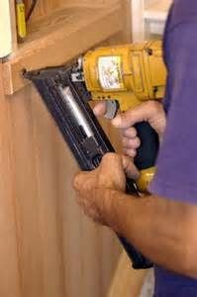
Single Actuation Trigger
A second nail can be fired by releasing the trigger, moving the tool and squeezing the trigger again without releasing the safety contact tip.
PPT-085-01
19
Notes:
When using a nail gun with a Single Actuation Trigger a second nail can be fired by releasing the trigger, moving the tool and squeezing the trigger again without releasing the safety contact tip.

Slide 20
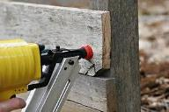
Six Steps to Nail Gun Safety
Use the full sequential trigger
The full sequential trigger is always the safest trigger mechanism for the job.
At a minimum, provide full sequential trigger nailers for placement work.
Consider restricting inexperienced employees to full sequential trigger nail guns starting out.
PPT-085-01
20
Notes:
Here are six steps for using a nail gun safely:
Use the full sequential trigger
The full sequential trigger is always the safest trigger mechanism for the job.
At a minimum, provide full sequential trigger nailers for placement work.
Consider restricting inexperienced employees to full sequential trigger nail guns starting out.

Slide 21
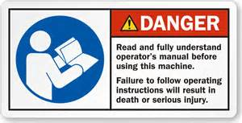
Six Steps to Nail Gun Safety
2. Provide training
How nail guns work and how triggers differ.
Main causes of injuries – especially differences
among types of triggers.
Instructions provided in manufacturer tool
manuals and where the manual is kept.
PPT-085-01
21
Notes:
The second step is to provide training on:
How nail guns work and how triggers differ.
Main causes of injuries – especially differences among different types of triggers.
Instructions provided in manufacturer tool manuals and where the manual is kept.

Slide 22
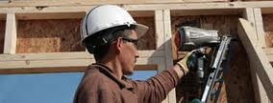
Six Steps to Nail Gun Safety
2. Provide training (cont.)
Hands on training with the actual nail guns to be used on the job.
How to load the nail gun.
How to operate the air compressor.
PPT-085-01
22
Notes:
The second step should also include the following:
Hands on training with the actual nail guns to be used on the job.
How to load the nail gun.
How to operate the air compressor.

Slide 23
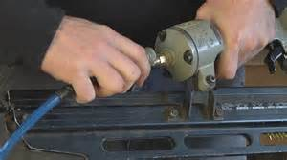
Six Steps to Nail Gun Safety
2. Provide training (cont.)
How to fire the nail gun.
How to hold the lumber during placement work.
What to do when a nail gun malfunctions.
PPT-085-01
23
Notes:
In addition, training within the second step should be given on:
How to fire the nail gun.
How to hold the lumber during placement work.
What to do when a nail gun malfunctions.

Slide 24
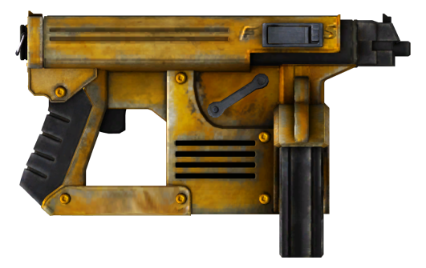
Six Steps to Nail Gun Safety
2. Provide training (cont.)
How to recognize and approach ricochet-prone
surfaces.
How to best handle special risks associated such
as nail gun recoil and double fires.
Training should also cover nail gun procedures,
PPE, injury reporting, and first aid and medical
treatment.
PPT-085-01
24
Notes:
Training should also cover:
How to recognize and approach ricochet-prone surfaces.
How to best handle special risks associated such as nail gun recoil and double fires.
Nail gun procedures, PPE, injury reporting, and first aid and medical treatment.

Slide 25
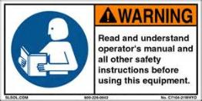
Six Steps to Nail Gun Safety
3. Establish nail gun procedures
Make sure that tool manuals for the nailers
used on the job are always available on the
jobsite.
Make sure the manufacturers’ tool labels
and instructions are understood and followed.
Check tools and power sources before
operating to make sure they are in proper
working order.
PPT-085-01
25
Notes:
Step Three should include establishing nail gun procedures:
Make sure that tool manuals for the nailers used on the job are always available on the jobsite.
Make sure the manufacturers’ tool labels and instructions are understood and followed.
Check tools and power sources before operating to make sure they are in proper working order.

Slide 26
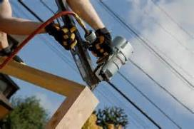
Six Steps to Nail Gun Safety
3. Establish nail gun procedures (cont.)
Set up operations so that workers are not in
the line of fire from nail guns being operated
by co-workers.
Check lumber surfaces before nailing. Look
for knots, nails, straps, hangers, etc. that
could cause recoil or ricochet.
PPT-085-01
26
Notes:
As part of establishing safe nail gun operations procedures, the following should be taken into account:
Set up operations so that workers are not in the line of fire from nail guns being operated by co-workers
Check lumber surfaces before nailing. Look for knots, nails, straps, hangers, etc. that could cause recoil or ricochet.

Slide 27
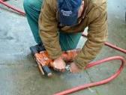
Six Steps to Nail Gun Safety
3. Establish nail gun procedures (cont.)
Always disconnect the compressed air when:
Leaving a nail gun unattended;
Traveling up and down a ladder or stairs;
Passing the nail gun to a co-worker;
Clearing jammed nails;
Performing maintenance on the nail gun.
PPT-085-01
27
Notes:
Step Three should also include the following:
Always disconnect the compressed air when:
Leaving a nail gun unattended;
Traveling up and down a ladder or stairs;
Passing the nail gun to a co-worker;
Clearing jammed nails;
Performing any other maintenance on the nail gun.

Slide 28
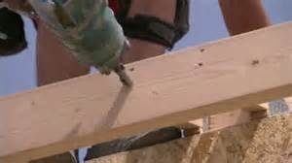
Six Steps to Nail Gun Safety
3. Establish nail gun procedures (cont.)
For placement work, keeps hands at least 12
inches away from the nailing point at all times.
Always shoot nail guns away from your body
and away from your co-workers.
Take extra care when toe-nailing.
PPT-085-01
28
Notes:
In addition, when establishing safe nail gun use procedures remember the following:
For placement work, keeps hands at least 12 inches away from the nailing point at all times.
Always shoot nail guns away from your body and away from your co-workers.
Take extra care when toe-nailing.

Slide 29
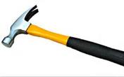
Six Steps to Nail Gun Safety
3. Establish nail gun procedures (cont.)
Use a hammer if you cannot reach the work
while holding the nailer with your dominant
hand.
Use a hammer or reposition for work at face
or head height.
Use a hammer or full sequential trigger nail
gun when working in a tight space.
PPT-085-01
29
Notes:
Safe nail gun use also includes:
Use a hammer if you cannot reach the work while holding the nailer with your dominant hand.
Use a hammer or reposition for work at face or head height.
Use a hammer or full sequential trigger nail gun when working in a tight space.

Slide 30
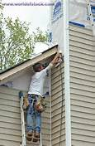
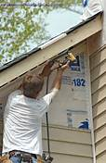
Six Steps to Nail Gun Safety
3. Establish nail gun procedures (cont.)
Set up jobs to minimize the need for nailing
at height.
Consider using scaffolds instead of ladders.
Position ladders so you don’t have to reach
too far.
PPT-085-01
30
Notes:
Safe use procedures should also take into account the following:
Set up jobs to minimize the need for nailing at height.
Consider using scaffolds instead of ladders.
Position ladders so you don’t have to reach too far.

Slide 31
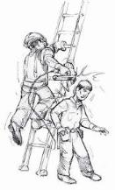
Six Steps to Nail Gun Safety
Establish nail gun procedures (cont.)
NEVER bypass or disable nail gun safety
features.
NEVER lower the nail gun from above or drag the tool by the hose.
NEVER use the nail gun with the
non-dominant hand.
PPT-085-01
31
Notes:
Step Three should include:
NEVER bypass or disable nail gun safety features.
NEVER lower the nail gun from above or drag the tool by the hose.
NEVER use the nail gun with the non-dominant hand.

Slide 32
Six Steps to Nail Gun Safety
4. Provide Personal Protective Equipment (PPE)
Safety Shoes
High Impact eye protection (ANSI Z87.1)
Hard Hats
Hearing protection
PPT-085-01
32
Notes:
Step Four deals with the providing appropriate Personal Protective Equipment (PPE) which should include:
Safety Shoes
High Impact eye protection (ANSI Z87.1)
Hard Hats
Hearing protection

Slide 33
Six Steps to Nail Gun Safety
Encourage reporting and discussion of
injuries and close calls.
Reporting helps ensure that employees
get medical attention.
It also helps to identify unrecognized job site risks.
Injuries and close calls provide teachable moments that can help improve crew safety.
PPT-085-01
33
Notes:
Step Five addresses the reporting and discussion of injuries and close calls.
Reporting helps ensure that employees get medical attention.
It also helps to identify unrecognized job site risks.
Injuries and close calls provide teachable moments that can help improve crew safety.

Slide 34
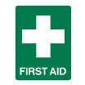
Six Steps to Nail Gun Safety
6. Provide First Aid and medical treatment
Employers and workers should seek medical
attention immediately after nail gun injuries.
Studies suggest that 1 out of 4 nail gun hand
injuries can involve some type of structural
damage such as a bone fracture.
Seeking medical attention immediately can help
avoid any complications that may occur from the
injury.
PPT-085-01
34
Notes:
Step Six deals with providing First Aid and medical treatment.
Employers and workers should seek medical attention immediately after nail gun injuries.
Studies suggest that 1 out of 4 nail gun hand injuries can involve some type of structural damage such as a bone fracture.
Seeking medical attention immediately can help avoid any complications that may occur from the injury.

Slide 35
Other Hazards may Include
Compressed Air
Regulated under OSHA 29 CFR 1926.302(b)
Noise
Most nail gun manufacturers recommend
that users wear hearing protection.
Musculoskeletal Disorders
Framing nail guns can weigh up to 8
pounds and many framing jobs require
workers to hold and use these guns for
long periods of time.
PPT-085-01
35
Notes:
Other hazards that may be encountered when using a nail gun include:
Compressed Air
Regulated under OSHA 29 CFR 1926.302(b)
Noise
Most nail gun manufacturers recommend that users wear hearing protection.
Musculoskeletal Disorders
Framing nail guns can weigh up to 8 pounds and many framing jobs require workers to hold and use these guns for long periods of time.

Slide 36
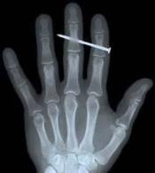
Conclusion
Nail gun injuries are painful. Some cases severe injuries or death.
Nail gun injuries have been on the rise along with the increased popularity of these powerful tools.
These injuries can be prevented, and more and more contractors are making changes to improve nail gun safety.
PPT-085-01
36
Notes:
Nail gun injuries can be VERY painful and in some cases lead to death.
Unfortunately, nail gun injuries are on the rise along with the increased use of these tools.
Keep in mind that injuries can be prevented by following nail gun safety procedures and using appropriate fall protection and personal protective equipment (PPE).

Slide 37
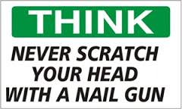
Conclusion
A good safety tip for sure!!!
PPT-085-01
37

Slide 38
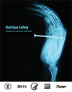
References
https://www.osha.gov/Publications/NailgunFinal_508_02_optimized.pdf
https://www.osha.gov/doc/topics/nailgun/index.html
PPT-085-01
38
Notes:
There are very good references listed here. Many other good references can be found by searching “nail gun safety” or “safe use of nail guns” on the internet.

Slide 39
Contact Information
To contact a Health & Safety Training Specialist:
Bureau of Workers’ Compensation
1171 South Cameron Street Room 324
Harrisburg, PA 17104-2501
717-772-1635
RA-LI-BWC-Safety@pa.gov
Like us on Facebook! - https://www.facebook.com/BWCPATHS
PPT-085-01
39

Slide 40
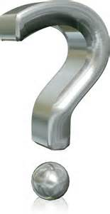
Questions
PPT-085-01
40

