Slide 1

Materials Handling
Bureau of Workers’ Compensation
PA Training for Health & Safety (PATHS)
Including Storage, Use and Disposal
Notes:
1926 Subpart H ‑ Materials Handling, Storage, Use, and Disposal
This presentation is designed to assist trainers conducting OSHA 10-hour Construction Industry outreach training for workers. Since workers are the target audience, this presentation emphasizes hazard identification, avoidance, and control – not standards. No attempt has been made to treat the topic exhaustively. It is essential that trainers tailor their presentations to the needs and understanding of their audience.
This presentation is not a substitute for any of the provisions of the Occupational Safety and Health Act of 1970 or for any standards issued by the U.S. Department of Labor. Mention of trade names, commercial products, or organizations does not imply endorsement by the U.S. Department of Labor.

Slide 2

Overview: Handling & Storing
Involves diverse operations:
Manual material handling
  Carrying bags or materials
  Unpacking materials
Material handling via machine
  Forklift
  Crane
  Rigging
Stacking or storing drums, barrels, kegs, lumber,
loose bricks or other materials
Notes:
The efficient handling and storing of materials is vital to industry. These operations provide continuous flow of raw materials, parts, and assemblies through the workplace, and ensure that materials are available when needed. Yet, the improper handling and storing of materials can cause costly injuries.
This presentation addresses handling and storing of materials using manual and machine lifting (e.g. forklifts, cranes and slings), and material disposal.

Slide 3

Injuries
Lifting objects is a major cause of back injuries in the work place
maj
Improper storing and handling of material and equipment can cause struck by and crushed by injuries
r cause of back injuries in the work place
Notes:
The weight and bulkiness of objects lifted is a major contributing factor to injuries. Workers also frequently cited body movement as contributing to their injuries. Bending, followed by twisting and turning, were the more commonly cited movements that caused back injuries.
In 2000, 410,000 workplace accidents resulted in back injuries.
Back injuries accounted for more than 20 percent of all occupational illnesses, according to data from the National Safety Council.
By 1994, the U.S. Bureau of Labor Statistics reported there were 613,251 over-exertion cases with lost-workdays. The majority of those cases were due to lifting (367,424), pushing/pulling (93,325), and carrying (68,992). Those cases represent 27 percent of all lost-workday cases.
Struck by accidents accounted for 22% of all injuries in construction in 2000.

Slide 4
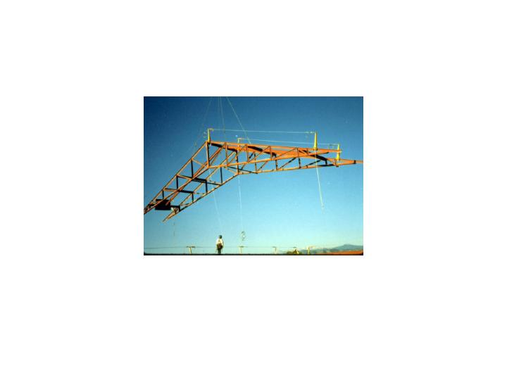
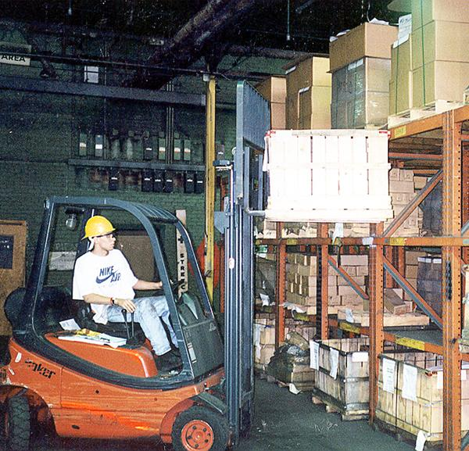
Hazards
Improper manual lifting or carrying loads that are too large or heavy
Being struck by materials or being caught in pinch points
Crushed by machines, falling materials or improperly stored materials
Incorrectly cutting ties or securing devices
Notes:
Employers and employees can and should examine their workplaces to detect any unsafe or unhealthful conditions, practices, or equipment and take the necessary steps to correct them.
General safety principles can help reduce workplace accidents. These include work practices, ergonomic principles, and training and education. Whether moving materials manually or mechanically, employees should be aware of the potential hazards associated with the task at hand and know how to control their workplaces to minimize the danger.

Slide 5
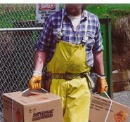
Manual Handling
Seek help when:
A load is too bulky to properly grasp or lift
You can’t see around or over the load
You can’t safely handle the load
Attach handles to loads to reduce the chances of getting fingers smashed.
Notes:
Manual materials handling is the principal source of compensable injuries in the American work force, and four out of five of these injuries will affect the lower back.
Material handling tasks should be designed to minimize the weight, range of motion, and frequency of the activity.
Work methods and stations should be designed to minimize the distance between the person and the object being handled.
Repetitive or sustained twisting, stretching, or leaning to one side are undesirable. Corrections could include repositioning bins and moving employees closer to parts and conveyors.
Store heavy objects at waist level.
Provide lift-assist devices, and lift tables.
When placing blocks under a load:
- Ensure the load is not released until hands are removed from under the load.
- Blocking materials should be large and strong enough to support the load safely.

Slide 6
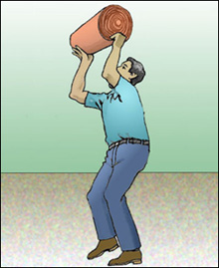
Safe Lifting
Break load into parts
Get help with heavy or bulky items
Lift with legs, keep back straight, do not twist
Use handling aids-such as steps, trestles, shoulder pads, handles and wheels
Avoid lifting above shoulder level
Notes:
Reference – OSHA Technical Manual - Back Disorders and Injuries
www.osha.gov/dts/osta/otm/otm_vii/otm_vii_1.html

Slide 7

Safe Lifting Training
What should be taught:
How to lift safely
How to avoid unnecessary physical stress and strain
What you can comfortably handle without undue strain
Proper use of equipment
Recognizing potential hazards and how to prevent and correct them
Notes:
Training should include general principles of ergonomics, recognition of hazards and injuries, procedures for reporting hazardous conditions, and methods and procedures for early reporting of injuries.
Safe lifting training should also include:
• Health risks related to improper lifting
• The basic anatomy of the spine, the muscles, and the joints of the trunk, and the contributions of intra-abdominal pressure while lifting.
• Awareness of individual body strengths and weaknesses—determining one’s own lifting capacity.
• Recognition of physical factors that might contribute to an accident and how to avoid the unexpected.
• Knowledge of body responses—warning signals—to be aware of when lifting.

Slide 8
Personal Protective Equipment
For loads with sharp or rough edges, wear gloves or other hand and forearm protection
When loads are heavy or bulk, wear steel-toed safety shoes to prevent foot injuries if the load is dropped.

Slide 9
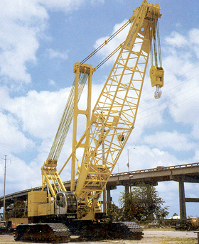
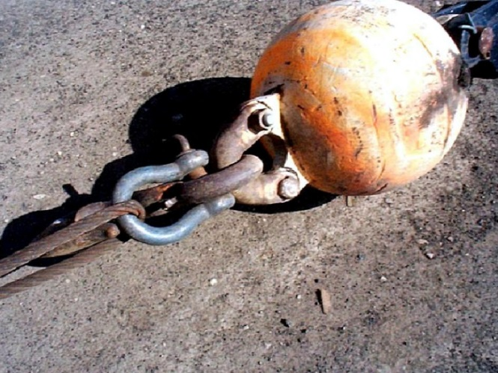
Materials Handling Equipment
Employees must be trained in the proper use and limitations of the equipment they operate
This includes knowing how to effectively use
equipment such as forklifts, cranes, and slings

Slide 10
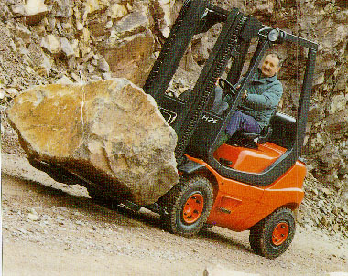
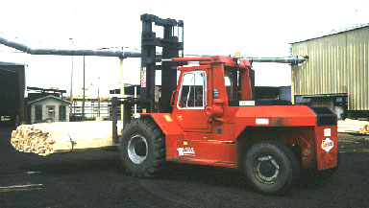
Forklifts
Center the load on the forks and as close to the mast as possible to minimize the potential for the truck tipping or load falling
Overloading a lift truck makes it hard to control and could make it tip over
Place the load at the lowest position for traveling
Don’t place extra weight on the rear of a counterbalanced forklift to allow an overload
Notes:
References:
1926.602
1910.178
ASME B56 series
OSHA’s technical links page - www.osha.gov/SLTC/poweredindustrialtrucks/index.html
Commonly used types include:
High lift trucks, counterbalanced trucks, cantilever trucks, rider trucks, forklift trucks, high lift trucks, high lift platform trucks, low lift trucks, motorized hand trucks, pallet trucks, straddle trucks, reach rider trucks, high lift order picker trucks, motorized hand/rider trucks, and counterbalanced front/side loader lift trucks.
A single type of truck can only be described by calling it by all of its characteristics, (e.g., a high lift, counterbalanced, sit down rider truck).
Powered industrial truck accidents
- cause approximately 100 fatalities and 36,340 serious injuries a year
- are caused, at least in part, by inadequate training (20 – 25% estimate)

Slide 11
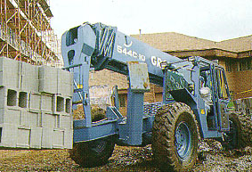
Operating Forklifts Safely
Keep arms and legs inside the truck
Handle only stable loads
Keep speed low - you may have to
stop
Be careful when making sharp turns
with a raised load
If a load blocks your view, travel in reverse
No riders, unless there’s an approved seat
Don’t drive with forks raised
Wear safety belts or other restraint devices
Notes:
When transporting loads, never raise the load more than 8 inches from the ground. Keep your load tilted back.
Take time to adjust the forks on your lift to fit the load you will be carrying. Adjusting the forks outward for wide loads, helps you to center the load, and make it more stable.
When driving an empty truck, travel in reverse up an incline, and forward down an incline. The center of gravity for the truck is above the front drive wheels.
If you are driving a loaded truck, travel forward up an incline, and backward down an incline.
NEVER turn while driving up or down a ramp or incline.
NEVER drive across a ramp or incline. Because lift trucks are built "narrow," the center of gravity can quickly shift outside the stability triangle, causing the truck to tip over.

Slide 12
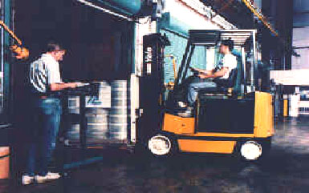
Powered Industrial Truck Training
Truck-related topics
Workplace-related topics
Standard requirements
Trainees must be supervised
by a competent person and
not endanger others
Formal instruction
Practical training
Evaluation of performance
Notes:
Reference – OSHA’s webite link at:
www.osha.gov/Training/PIT/pit_menu.htm
The training provided must be applicable to the work site and working conditions. Trainees must be supervised by a competent persons and may not operate trucks where they would endanger anyone.
The requirements of the standards must be taught, as well as truck-related and workplace-related topics.
Three separate aspects of powered industrial truck training must be completed:
1. Formal training – lecture, discussion, interactive computer learning, written materials
2. Practical training – demonstrations and exercises performed by the trainee
3. Evaluation – practical observance and determination of the trainees’ competence and capability

Slide 13

Dock Boards (Bridge plates)
Dock boards must
have handholds, or
other effective means
for safe handling.
Notes:
1926.250(d)
Dockboards must be strong enough to carry the load on them.
Secure portable dockboards in position, either by anchoring or equipping with devices which prevent their slipping.

Slide 14
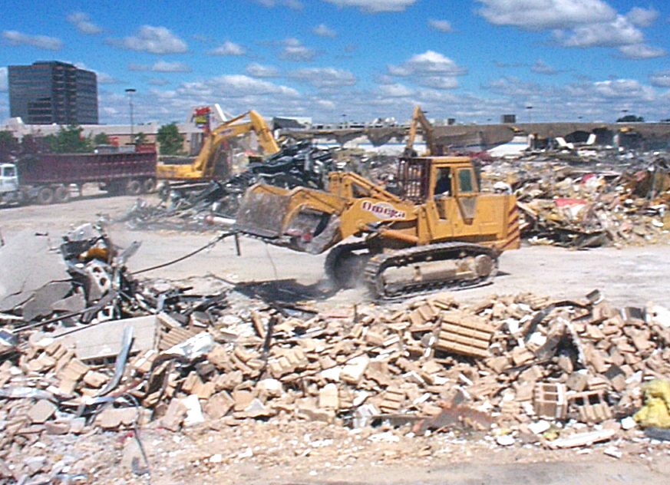
Earthmoving Equipment
Scrapers, loaders, crawler or wheel tractors, bulldozers, off-highway trucks, graders, tractors
Provide seat belts
Equipment with an obstructed rear view can’t be used in reverse unless the equipment has a signal alarm

Slide 15
Cranes
Check the load chart in the cab
Frequently inspect
Never lift people
Check overhead power lines
Ensure area of travel is clear
Notes:
Cranes are an important piece of equipment on a construction site.
The OSHA 10-hour program recommends a separate presentation on cranes. A separate lesson plan and presentation is provided on OSHA’s web site.

Slide 16
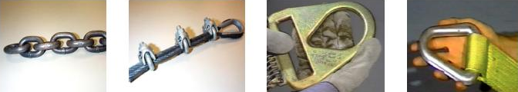
Rigging Equipment Slings
Types of slings covered are those made from alloy steel chain, wire rope, metal mesh, natural or synthetic fiber rope, and synthetic web.
Chain
Wire Rope
Metal mesh
Synthetic
Notes:
1926.251(a)(5)
Reference - Technical links page for sling safety www.osha.gov/doc/outreachtraining/htmlfiles/slings.html
This section applies to slings used in conjunction with other material handling equipment for the movement of material by hoisting, in employments covered by this part.
The types of slings covered are those made from alloy steel chain, wire rope, metal mesh, natural or synthetic fiber rope (conventional three strand construction), and synthetic web (nylon, polyester, and polypropylene).
Three types of slings are discussed in detail in this presentation: alloy steel chain, wire rope and synthetic web.

Slide 17
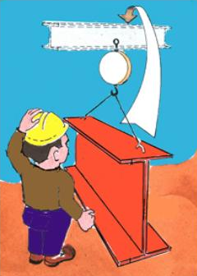
Sling Inspection
Inspect slings:
Each day before use
Where service
conditions warrant
Remove them from service
if damaged or defective
Notes:
1926.251(a)(6)
Each day before being used, the sling and all fastenings and attachments shall be inspected for damage or defects by a competent person designated by the employer. Additional inspections shall be performed during sling use, where service conditions warrant. Damaged or defective slings shall be immediately removed from service.

Slide 18
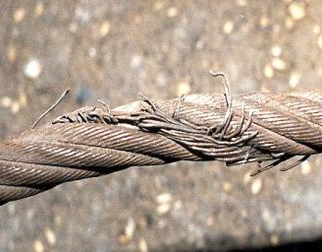
Remove From Service
Immediately remove damaged or
defective slings from service.

Slide 19
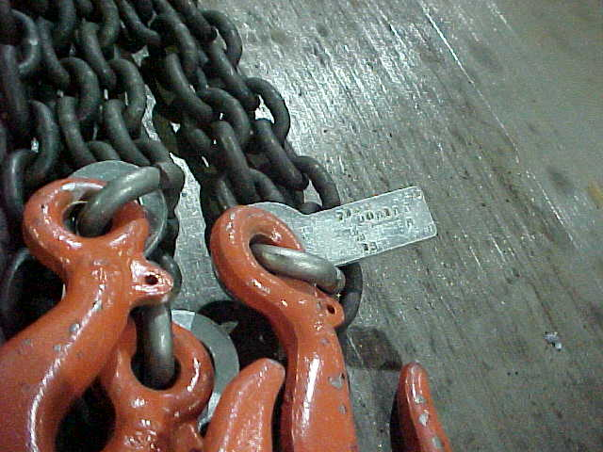
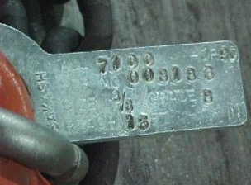
Alloy Steel Chains
Adapts to shape of the load
Can damage by sudden shocks
Best choice for hoisting very hot materials
Must have an affixed tag stating size, grade, rated capacity, and sling manufacturer
Notes:
1926.251(b)(1)
Welded alloy steel chain slings shall have permanently affixed durable identification stating size, grade, rated capacity, and sling manufacturer.

Slide 20
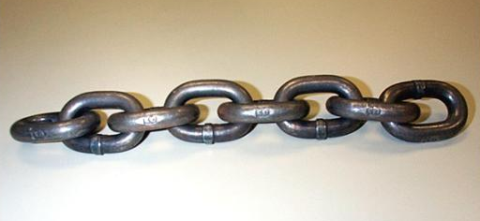
Markings: Alloy Steel Chain
It must be marked with grade or manufacturer’s mark
Notes:
1926.251(a)

Slide 21
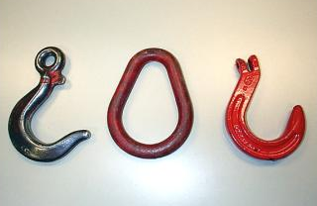
Alloy Steel Chain Attachments
Rated Capacity
Hooks, rings, oblong links, or other attachments, when used with alloy steel chains, must have a rated capacity at least equal to that of the chain
Notes:
1926.251(a)(2)

Slide 22
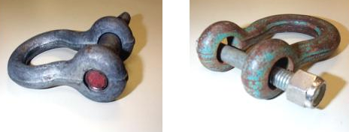
Unsuitable Attachments
For Ally Steel Chain
  Job or shop hooks and links, or makeshift fasteners, formed from bolts, rods, etc., or other such attachments, can’t be used
Right
Wrong
Notes:
1926.251(a) and 1926.251(b)(3)

Slide 23
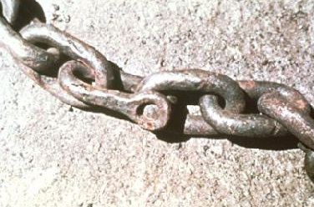
Chain Wear
  When a chain shows excessive wear, or is cracked or pitted, remove it from service
  Non-alloy repair links can not be used
Notes:
1926.251(b)(5)

Slide 24
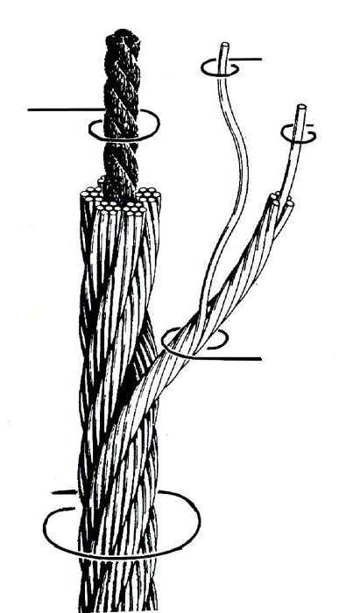
Wire Rope Slings
Used to hoist materials
Selection considerations:
• Strength
• Ability to bend without cracking
• Ability to withstand abrasive wear
• Ability to withstand abuse
Notes:
Strength — Function of size, grade, and construction. It must be sufficient to accommodate the maximum load that will be applied. The maximum load limit is determined by means of a multiplier. This multiplier is the number by which the ultimate strength of a wire rope is divided to determine the working load limit. Thus a wire rope sling with a strength of 10,000 pounds and a total working load of 2,000 pounds has a design factor (multiplier) of 5. New wire rope slings have a design factor of 5. As a sling suffers from the rigors of continued service, the design factor and the sling's ultimate strength are proportionately reduced.
Fatigue — A wire rope must have the ability to withstand repeated bending without the failure of the wires from fatigue. Failure is the result of the development of small cracks under repeated applications of bending loads. It occurs when ropes make small radius bends. The best way to prevent this is to use blocking or padding to increase the radius of the bend.
Abrasive Wear — The ability to withstand abrasion is determined by the size, number of wires, and construction of the rope. Smaller wires bend more readily and therefore offer greater flexibility but are less able to withstand abrasive wear. Conversely, larger wires of less flexible ropes are better able to withstand abrasion.
Abuse — Abuse will cause a wire rope sling to become unsafe long before any other factor. Abusing a wire rope sling can cause serious structural damage to the wire rope, such as kinking or bird caging which reduces the strength of the wire rope. (In bird caging, the wire rope strands are forcibly untwisted and become spread outward.) Therefore, in order to prolong the life of the sling and protect the lives of employees, the manufacturer's suggestion for safe and proper use of wire rope slings must be strictly adhered to.

Slide 25
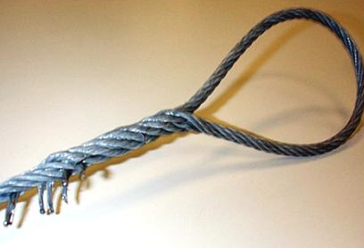
Wire Rope Slings: Eye Splices
Eye splices made in any wire rope must have at least three (3) full tucks
Notes:
1926.251(c)(4), (5) and (6)
These limitations apply to the use of wire rope:
- An eye splice made in any wire rope shall have not less than three full tucks. However, this requirement shall not operate to preclude the use of another form of splice or connection which can be shown to be as efficient and which is not otherwise prohibited.
- Except for eye splices in the ends of wires and for endless rope slings, each wire rope used in hoisting or lowering, or in pulling loads, shall consist of one continuous piece without knot or splice.
- Eyes in wire rope bridles, slings, or bull wires shall not be formed by wire rope clips or knots.
- Wire rope shall not be used if, in any length of eight diameters, the total number of visible broken wires exceeds 10 percent of the total number of wires, or if the rope shows other signs of excessive wear,
corrosion, or defect.
When U-bolt wire rope clips are used to form eyes, Table H-20 shall be used to determine the number and spacing of clips.
Slings shall not be shortened with knots or bolts or other makeshift devices.

Slide 26
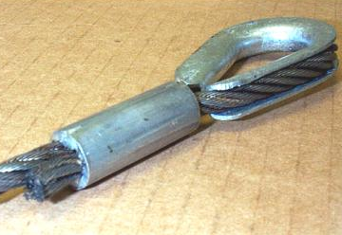
Protruding Ends
Cover or blunt protruding ends of strands
Notes:
Reference 1926.251(c)(2)

Slide 27
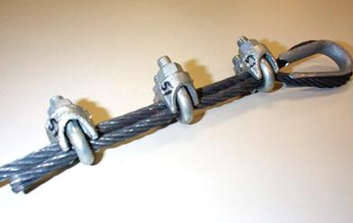
Wire Rope Clips
When using U-bolt wire rope clips to form eyes, ensure the "U" section is in contact with the dead end of the rope
Dead End
This is the correct method
Notes:
1926.251(c)(5)(i) and 1926.251(c)(4)(iii)
Only use for non lifting purposes.

Slide 28
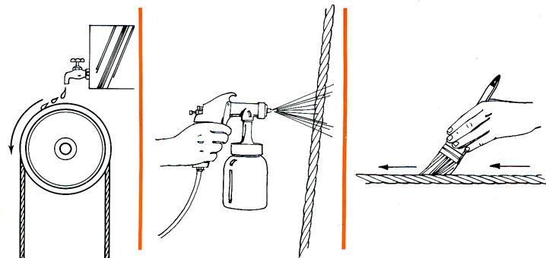
Lubrication
Regularly lubricate ropes and chains
Notes:
Although every wire rope sling is lubricated during manufacture, to lengthen its useful service life it must also be lubricated "in the field."
There is no set rule on how much or how often this should be done. It depends on the conditions under which the sling is used. The heavier the loads, the greater the number of bends, or the more adverse the conditions under which the sling operates, the more frequently lubrication will be required.

Slide 29
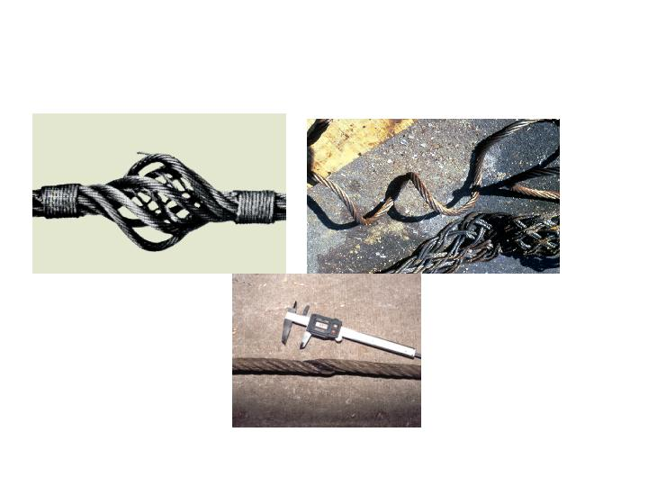
Wire Rope Slings
Remove From Service if these happen,
Bird Caging
Kinking
Crushing
Notes:
Wire Rope Sling Inspection. Visually inspect before each use. Check the twists or lay of the sling. If ten randomly distributed wires in one lay are broken, or five wires in one strand of a rope lay are damaged, do not use the sling. End fittings and other components should also be inspected for any damage that could make the sling unsafe.
Bird cage -- Wire rope strands are untwisted and become spread outward. Caused by sudden release of tension and the rebound of the rope from the overloaded condition. These strands and wires will not return to their original positions.

Slide 30

Synthetic Web Sling Markings
Mark or code to show:
  Name or trademark of manufacturer
  Rated capacities for the type of hitch
  Type of material
Notes:
1926.251(e)
Synthetic webbing (nylon, polyester, and polypropylene).
Synthetic webbing shall be of uniform thickness and width and selvage edges shall not be split from the webbing's width.

Slide 31

Synthetic Web Slings Fittings
Fittings must be:
  At least as strong as that of the sling
  Free of sharp edges that could damage the webbing
Notes:
1926.251(e)(4)

Slide 32
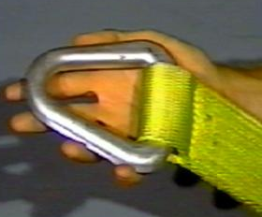
Synthetic Web Sling Stitching
Stitching
Stitching is the only method allowed to attach end fittings to webbing or to form eyes
Notes:
Reference 1926.251(e)(5)
The thread shall be in an even pattern and contain a sufficient number of stitches to develop the full breaking strength of the sling.
When using synthetic web slings, take the following precautions:
- Nylon web slings shall not be used where fumes, vapors, sprays, mists or liquids of acids or phenolics are present.
- Polyester and polypropylene web slings shall not be used where fumes, vapors, sprays, mists or liquids of caustics are present.
- Web slings with aluminum fittings shall not be used where fumes, vapors, sprays, mists or liquids of caustics are present.
Do not use synthetic web slings of polyester and nylon at temperatures in excess of 180 deg. F (82 deg. C). Polypropylene web slings shall not be used at temperatures in excess of 200 deg. F (93.33 deg. C).

Slide 33

Synthetic Web Slings
Remove From Service if any of these are present:
Acid or caustic burns
Melting or charring of any part
Snags, punctures, tears or cuts
Broken or worn stitches
Distortion of fittings
Heat Damage
Notes:
1926.251(d)(8)

Slide 34

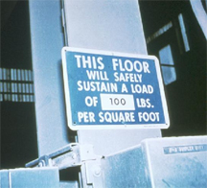
Storing Materials
Secure materials stored in tiers by stacking, racking, blocking, or interlocking to prevent them from falling
Post safe load limits of floors
Keep aisles and passageways clear
Notes:
1926.250(a)
Maximum safe load limits of floors within buildings and structures, in pounds per square foot, shall be conspicuously posted in all storage areas, except for floor or slab on grade.
Aisles and passageways shall be kept clear to provide for the free and safe movement of material handling equipment or employees.
When a difference in road or working levels exist, means such as ramps, blocking, or grading shall be used to ensure the safe movement of vehicles between the two levels.
Bags and bundles must be stacked in interlocking rows to remain secure. Bagged material must be stacked by stepping back the layers and cross-keying the bags at least every ten layers. To remove bags from the stack, start from the top row first.
Boxed materials must be banded or held in place using cross-ties or shrink plastic fiber.
Drums, barrels, and kegs must be stacked symmetrically. If stored on their sides, the bottom tiers must be blocked to keep them from rolling. When stacked on end, put planks, sheets of plywood dunnage, or pallets between each tier to make a firm, flat, stacking surface. When stacking materials two or more tiers high, the bottom tier must be chocked on each side to prevent shifting in either direction.
When stacking, consider the need for availability of the material. Material that can’t be stacked due to size, shape, or fragility can be safely stored on shelves or in bins. Structural steel, bar stock, poles, and other cylindrical materials, unless in racks, must be stacked and blocked to prevent spreading or tilting. Pipes and bars should not be stored in racks that face main aisles; this could create a hazard to passers-by when removing supplies.

Slide 35
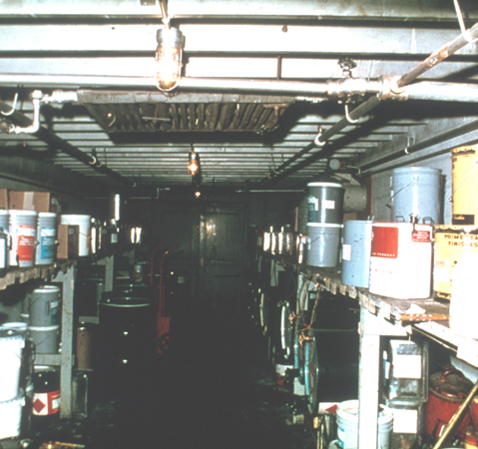
Storing Materials
Don’t store incompatible materials together
In buildings under construction, don’t place stored materials within 6 feet of a hoistway or floor opening
Notes:
1926.250(b)(1) and 1926.152
Do not place material stored inside buildings under construction within 10 feet of an exterior wall which does not extend above the top of the material stored.
Store flammable and combustible materials according to their fire characteristics.
-- Flammable liquids, for example, must be separated from other material by a fire wall.
-- Also, other combustibles must be stored in an area where smoking and using an open flame or a spark-producing device is prohibited.

Slide 36
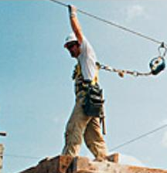
Fall Protection
Employees who work on stored materials in silos, hoppers, or tanks, must be equipped with lifelines and harnesses
Notes:
1926.250(b)(2)
The personal fall arrest equipment must meet the requirements of Subpart M.

Slide 37
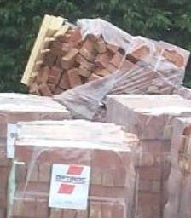
Brick Storage
Stack bricks in a manner that will keep them from falling
Do not stack them more than 7 feet high
Taper back a loose brick stack after it is 4 feet high
Notes:
1926.250(b)(6)
When a loose brick stack reaches a height of 4 feet, taper it back 2 inches in every foot of height above the 4-foot level.

Slide 38

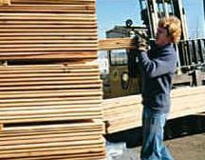
Lumber
Remove nails before stacking
Stack on sills
Stack lumber so that it is stable and self supporting
Notes:
1926.250(b)(8)
Lumber piles shall not exceed 20 feet in height provided that lumber to be handled manually shall not be stacked more than 16 feet high.

Slide 39

Housekeeping
Keep storage areas free from accumulated materials that cause tripping, fires, or explosions, or that may contribute to harboring rats and pests
Notes:
1926.250(c)

Slide 40
Disposal of Waste Materials
Use an enclosed chute when you drop material more than 20 feet outside of a building
If you drop debris through holes in the floor without chutes, enclose the drop area with barricades
Notes:
1926.252(a) and (b)
When debris is dropped through holes in the floor without chutes, enclose the drop area with barricades at least 42 inches high and at least 6 feet back from the edge of the opening.
Signs warning of falling materials shall be posted at each level.

Slide 41

Disposal of Scrap & Flammables
Remove all scrap lumber, waste material, and rubbish from the immediate work area as work progresses
Keep all solvent waste, oily rags, and flammable liquids in fire resistant covered containers until removed from worksite
Notes:
1926.252(c) and (e)
All solvent waste, oily rags, and flammable liquids shall be kept in fire resistant covered containers until removed from worksite.

Slide 42
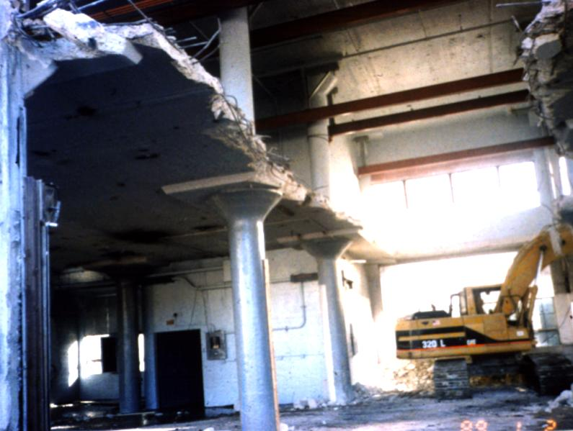
Disposal: Demolition Materials
Removal of materials through floor openings
Openings must be less than 25% (percent) of the whole floor
Floors weakened or made unsafe by demolition must be shored so they can safely carry the demolition load
Notes:
Subpart T – Demolition - 1926.853
Openings cut in a floor for disposal of materials shall be less than 25 percent of the aggregate floor area, unless the lateral supports of the removed flooring remain in place.

Slide 43
Summary
Manually handling materials:
  When lifting objects, lift with your legs, keep your back straight, do not twist, and use handling aids
Using cranes, forklifts, and slings to move materials:
  Watch for potential struck by and crushed by dangers
  For slings, check their load capacity, inspect them, and remove them from service when they display signs of stress or wear

Slide 44
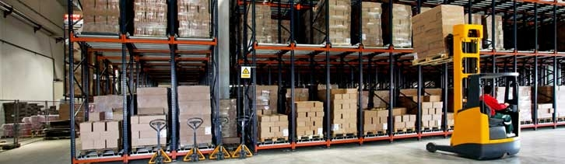
Summary
Also –
  Keep work areas free from debris and materials
  Store materials safely to avoid struck by/crushed by hazards

Slide 45


Contact Information
Health & Safety Training Specialists
1171 South Cameron Street, Room 324
Harrisburg, PA 17104-2501
(717) 772-1635
RA-LI-BWC-PATHS@pa.gov
Like us on Facebook! - https://www.facebook.com/BWCPATHS
Notes:
We invite you to contact us regarding other free training available to your organization.

Slide 46

Questions

