Slide 1
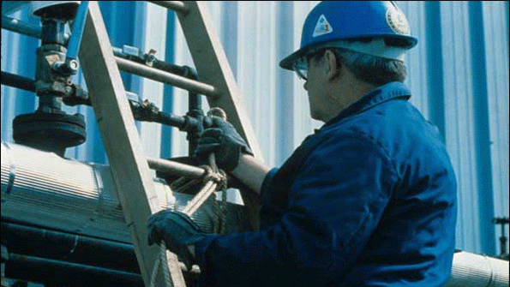
Ladders
Bureau of Workers’ Compensation
PA Training for Health & Safety (PATHS)
Basic Information & Safe Use
Based on OSHA 29 CFR 1910.25-29
And 1926.1053
Notes:
Quite a few jobs require workers to function at elevated heights. A variety of methods exist by which this height may be achieved. The easiest maneuver seems to be the use of ladders to advance to an elevated location or perform work “just out of reach.”

Slide 2
Selecting a Ladder
Ladders are manufactured for specific a use; e.g. jobs that can be safely performed with step ladders could become dangerous if extension ladders used instead.
You must evaluate the work environment and know what ladders are available before you can choose the right ladder for the job. Keep in mind all potential hazards:
→ Electricity
→ Uneven surfaces
→ People and materials
→ Overhead obstructions
Notes:
Ladders are manufactured for a specific use. Accidents may occur when a ladder designed for one use is used for an unintended purpose.
Pre-job planning and an evaluation of the work to be performed will indicate the ladder to be used.
Hazards within proximity to the ladder and worker must also be evaluated. Some of these hazards include:
Electricity
Uneven surfaces
People and materials also to be found in the same area
Overhead obstructions

Slide 3
Selecting a Ladder
You must keep in mind the physical requirements of the job:
How much room will there be to position the ladder?
How much weight-combining the user, tools, and materials-will be on the ladder?
How long should the ladder be to safely perform the job?
Notes:
When selecting a ladder for a job:
Keep in mind the physical requirements of the job:
How much room will there be to position the ladder?
How much weight-combining the user, tools, and materials-will be on the ladder?
How long should the ladder be to safely perform the job?

Slide 4
Duty Rating
A ladder duty rating tells you its maximum weight capacity. There are four categories of the duty ratings:
Type IA – These ladders have a duty rating of 300 pounds and are recommended for extra heavy-duty industrial use.
Type I – These ladders have a duty rating of 250 pounds and are manufactured for heavy-duty use.
Type II – These ladders have a duty rating of 225 pounds and are approved for medium-duty use.
Type III – These ladders have a duty rating of 200 pounds and are rated for light-duty use
Notes:
Be mindful of the ladder duty rating.
It tells the maximum weight capacity. There are four categories of the duty ratings:
Type IA – These ladders have a duty rating of 300 pounds and are recommended for extra heavy-duty industrial use.
Type I – These ladders have a duty rating of 250 pounds and are manufactured for heavy-duty use.
Type II – These ladders have a duty rating of 225 pounds and are approved for medium-duty use.
Type III – These ladders have a duty rating of 200 pounds and are rated for light-duty use.
Be mindful of the ladder duty rating.
It tells the maximum weight capacity. There are four categories of the duty ratings:
Type IA – These ladders have a duty rating of 300 pounds and are recommended for extra heavy-duty industrial use.
Type I – These ladders have a duty rating of 250 pounds and are manufactured for heavy-duty use.
Type II – These ladders have a duty rating of 225 pounds and are approved for medium-duty use.
Type III – These ladders have a duty rating of 200 pounds and are rated for light-duty use.

Slide 5

Step Ladders
Free from sharp edges, splinters, wane, & decay
Type & Height:
I = 3-20’ (Industrial)
II = 3-12’ (Commercial)
III= 3-6’ (Home)
Have a metal spreader or locking device
Notes:
Portable stepladders are not longer than 20 feet.
Type I stepladder is an industrial stepladder. It has a length of 3 to 20 feet and is used for heavy duty work, such as utilities, contractors, or industrial use.
Type II stepladder is a commercial ladder. It has a length of 3 to 12 feet, and is used for medium duty chores. These could include painting, office duties, and light industrial duties.
Type III stepladder is a household ladder. It has a length of 3 t o 6 feet and is typically used for light duties. These could include changing light bulbs, etc. These ladders are never to be used in industry.

Slide 6
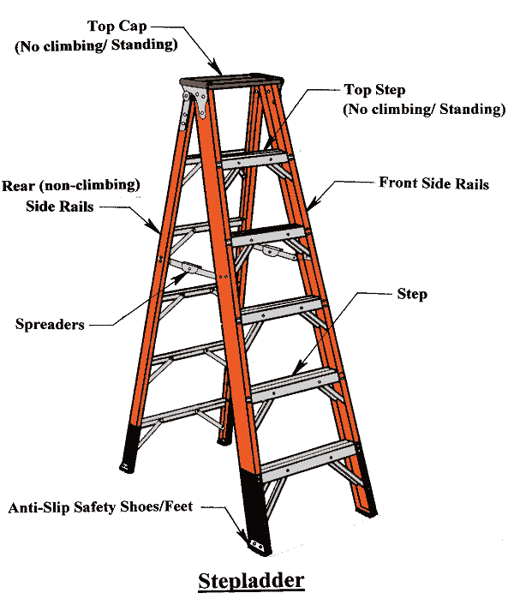
Parts of a Step Ladder
Notes:
Portable stepladders are usually not longer than 20 feet and are used for numerous different tasks within the home and workplace.
It is a good idea to learn and be familiar with the parts of a step ladder as shown in the diagram.
As indicated in the diagram an individual should not be standing or climbing on the top two steps of step ladder as doing that could lead to a fall and injury.

Slide 7

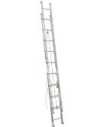
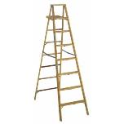
Portable Ladders
Single/Straight ladder
  30 feet or less
Extension ladder
  60 feet or less
Painter’s ladder
  12 feet or less
Notes:
The length of a stepladder is measured by the length of the front rail. To be classified as a standard length ladder, the measured length must be within
plus or minus one-half inch of the specified length.
Stepladders must not exceed 20 feet.
The bottom four rails are to be supplied with an insulating non-slip material for the safety of the user.
Metal ladders conduct electricity.

Slide 8
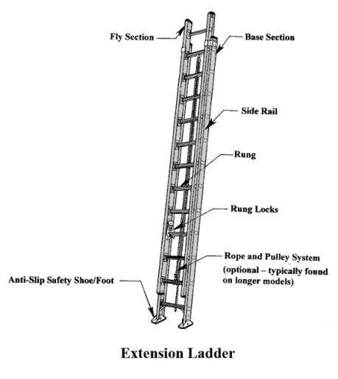
Parts of Extension Ladders
Notes:
Extension ladders are normally used to reach areas on roofs or those that are above ten (10) feet. Extension ladders can be metal, fiberglass or wooden, and can be very light or extremely heavy (especially those that are wooden). As with step or another other types of ladders it is a very good idea to learn and become familiar with the parts of an extension ladder as shown in the diagram.
The definition of the parts of an extension ladder is included below:
Bed Section - Base or lowest section of an extension ladder
Fly Section - Upper section of an extension ladder (moveable section of the ladder)
Butt - Bottom of the ladder
Spurs - Metal safety plates on butt of some ladders used for stabilization (aluminum or steel); normally used in an exterior setting on dirt/ground
Foot - Anti-slip rubber plate that provides more stability for the ladder especially on interior applications
Beam - Main structural member of ladder that supports the rungs
Rungs - Cross pieces that are used to climb the ladder
Dogs/Pawls/Locks - Locks that hold the fly section up
Halyard - Nylon rope used to extend fly section
Pulley - Grooved wheel that halyard is pulled through
Anchor – Connected to the bottom of the bed to hold halyard rope
Guides - Slots or channels that fly section is raised
Stops - Metal pieces that prevent fly from extending to far
Tips - Top of the ladder

Slide 9
Ladder Care & Maintenance
Ladders must be maintained in good condition at all times:
  Joints must be tight
  Metal bearings of lock, wheels, pulleys, etc., must be lubricated
  Frayed or badly worn rope must be replaced
  Safety “feet” and other auxiliary equipment must be in good condition
Ladders must be inspected frequently.
Notes:
If a ladder is involved in the following, it must be immediately inspected;
If a ladder tips over, inspect the side rails for dents or bends, or excessively dented rungs; check all rung-to-side-rail connections; check hardware connections; check rivets for shear.If ladders are exposed to oil and grease, equipment should be cleaned of oil, grease for slippery materials. This can be done with a solvent or steam cleaning.
Portable ladders are designed as a one-person working ladder based on a 200-pound load.
The ladder base section must be placed with a secure footing.

Slide 10
Inspecting Ladders
Recommended before each use.
Check for broken, split, cracked, corroded or missing rungs and side rails.
Check carefully for cracks (hard to see; cracks weaken ladders).
Check for rungs or side rails with excessive bends (bent areas are greatly weakened and may fail during use).
Check for loose, corroded, or weakened fasteners and hardware.
Notes:
Ladder inspections are recommended before each use.
Check for:
Broken, split, cracked, corroded or missing rungs and side rails.
For cracks (hard to see; cracks weaken ladders).
Rungs or side rails with excessive bends (bent areas are greatly weakened and may fail during use).
Loose, corroded, or weakened fasteners and hardware

Slide 11
Inspecting Ladders
Check ladders for missing or damaged feet (ladder feet may have both non-skid pads for hard surfaces and metal feet for soft surfaces).
Check for paint or other coating hiding defects (wooden ladders shall not be painted or coated with any opaque covering except for identification or warning labels placed on one face only of a side rail).
Painted Aluminum, Fiberglass ladders = very hard to observe defects/damage.
Notes:
Also check for:
Missing or damaged feet (ladder feet may have both non-skid pads for hard surfaces and metal feet for soft surfaces).
Check for paint or other coatings which may hide defects (wooden ladders shall not be painted or coated with any opaque covering except for identification or warning labels placed on one face only of a side rail).
Painted Aluminum, Fiberglass ladders = very hard to observe defects/damage.

Slide 12

Inspecting Ladders
Check for oil, grease, moisture or other slippery materials before use and clean as necessary.
Check capacity label and make sure ladder has sufficient capacity to hold you and everything you are wearing/carrying.
Notes:
Check for oil, grease, moisture or other slippery materials before use and clean as necessary.
Check capacity label and make sure ladder has sufficient capacity to hold you and everything you are wearing/carrying

Slide 13
Safe Use of Ladders
Make sure the ladder is strong enough and long enough for the job.
Carefully inspect your ladder before you use it.
Place the ladder on a firm, level surface with its feet parallel to the wall it is resting against.
When ascending or descending, face the ladder and maintain 3 points of contact.
Lift equipment and materials with a rope specifically for that purpose (don't carry equipment up a ladder with one hand).
Carry smaller tools in pouches around the waist
Notes:
Certain points for safe ladder use must be guaranteed by the user.
Make sure the ladder is strong enough and long enough for the job.
Carefully inspect your ladder before you use it.
Place the ladder on a firm, level surface with its feet parallel to the wall it is resting against.
When ascending or descending, face the ladder and maintain 3 points of contact.
Lift equipment and materials with a rope specifically for that purpose (don't carry equipment up a ladder with one hand).
Carry smaller tools in pouches around the waist

Slide 14
Safe Use of Ladders
Don’t over-extend sideways.
Use the belt buckle rule: Keep your belt buckle positioned between the side rails at all times (this will maintain your center of gravity in the proper position).
Do not move, shift, or extend the ladder while you are standing on it.
Never “walk” a ladder.
Notes:
Don’t over-extend sideways.
Use the belt buckle rule: Keep your belt buckle positioned between the side rails at all times (this will maintain your center of gravity in the proper position).
Do not move, shift, or extend the ladder while you are standing on it.
Never “walk” a ladder.

Slide 15
Safe Use of Ladders
Do not load the ladder beyond its maximum intended load.
Never allow more than one worker on the ladder at a time.
Never stand on the top two steps of any ladder or the top cap of a step ladder (could cause you to become off-balance resulting in a fall).
Carry ladders parallel to the ground.
Tie ladders down securely when transporting.
Notes:
Do not load the ladder beyond its maximum intended load.
Never allow more than one worker on the ladder at a time.
Never stand on the top two steps of any ladder or the top cap of a step ladder (could cause you to become off-balance resulting in a fall).
Carry ladders parallel to the ground.
Tie ladders down securely when transporting

Slide 16
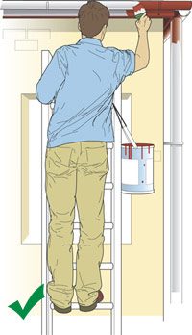
Safe Use of Ladders
Always maintain 3 points of contact when working from a ladder
Employee is maintaining three points of contact while working
Notes:
Always maintain 3 points of contact when working from a ladder

Slide 17
Safe Ladder Use
Is it safe to use a ladder as a scaffold?
NO!
NO!
NO!
Notes:
It is never safe to use a ladder as a scaffold. Loads are applied and displaced in a different manner.

Slide 18
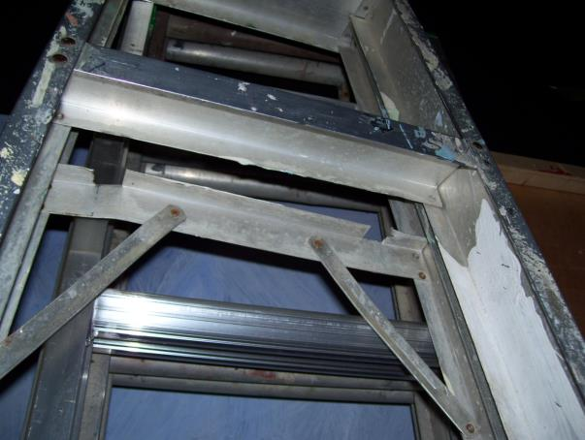
Safety Issues Here?
Rail Bent
Bracket Bent & Shelf Missing
Notes:
The issues with this ladder are:
Bent rail,
Bent bracket and
A missing shelf

Slide 19
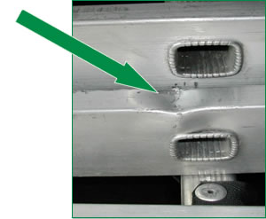
Safety Issues Here?
Rail Bent
Notes:
The rail of this ladder is bent

Slide 20
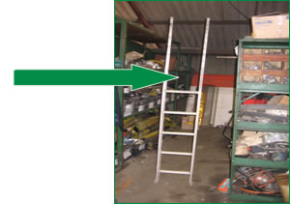
Safety Issues Here?
Missing Rungs
Notes:
Missing rungs affect this ladder’s stability.

Slide 21
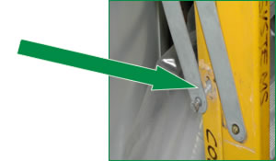
Finally, Any Issues Here?
Pin Loose- Coming Out
Notes:
The ladder’s rigidity is compromised due to the loose pin which is coming out

Slide 22
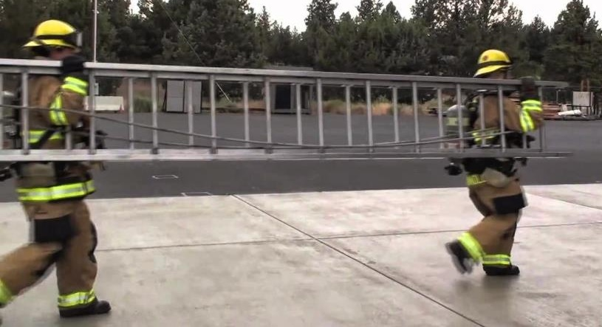
Ladder Carry
Two Person-Shoulder Carry
Notes:
Anytime a ladder has to be moved from one area to another or from a vehicle to the place where it will be used, safety should be the number one priority which includes properly carrying the ladder.
If an extension ladder is heavy or is taller than approximately 15-20 feet it is a very good idea to use two individuals to carrying it. The photo shows two individuals using a shoulder carry to transport the ladder to the place of use. As the photo demonstrates these two individuals are evenly spaced and are on the same side of the ladder. In the event that one worker is taller than the other the shorter of the two should be in the “front” of the ladder while carrying it.
A tip when carrying an extension ladder is to carry it with the “foot” end first for easy placement once the using destination is reached.

Slide 23
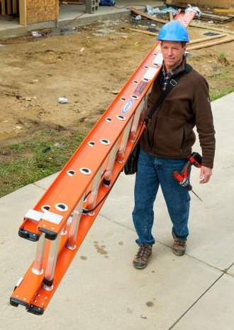
Ladder Carry
One Person-Shoulder Carry
Safety: Worker not carrying drill by hand, but may want to remove bit while walking
Notes:
If an extension ladder is not heavy or is within the 15-20 foot range it may be able to be carried safely by one person as shown.
The photo shows one individual using a shoulder carry to transport the ladder to the place of use. As the photo demonstrates this worker is positioned so that he is in the center of the ladder to provide the appropriate balance necessary to control the ladder while moving it. Notice that the worker has the ladder positioned so that it is slightly lower in front of him – doing this provides more control and visibility while moving the ladder.
As with the two person shoulder carry, a tip when carrying an extension ladder is to carrying it with the “foot” end first for easy placement once the using destination is reached.

Slide 24
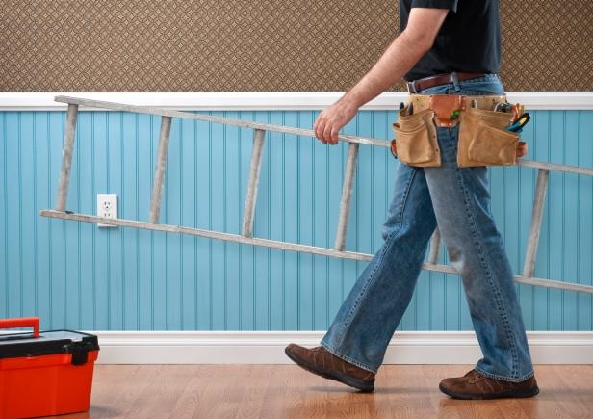
Ladder Carry
One Person-Arm’s Length Carry
Notes:
Another method for one person to carry a ladder that is not heavy or tall is to use an “arm’s length” carry as shown in the photo. Notice that the individual is positioned so that he is holding the ladder in the middle to ensure it is balanced.

Slide 25
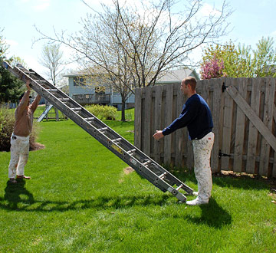
Straight Raise of Ladder
Notes:
A safe way to raise an extension ladder is by using two people. The method shown in the photo is called a “straight raise” and requires one individual to actually “foot” the ladder by placing their feet on the bottom while the other worker grabs the ladder and using the rungs “walks” the ladder to a standing position after which it is properly positioned for use.

Slide 26
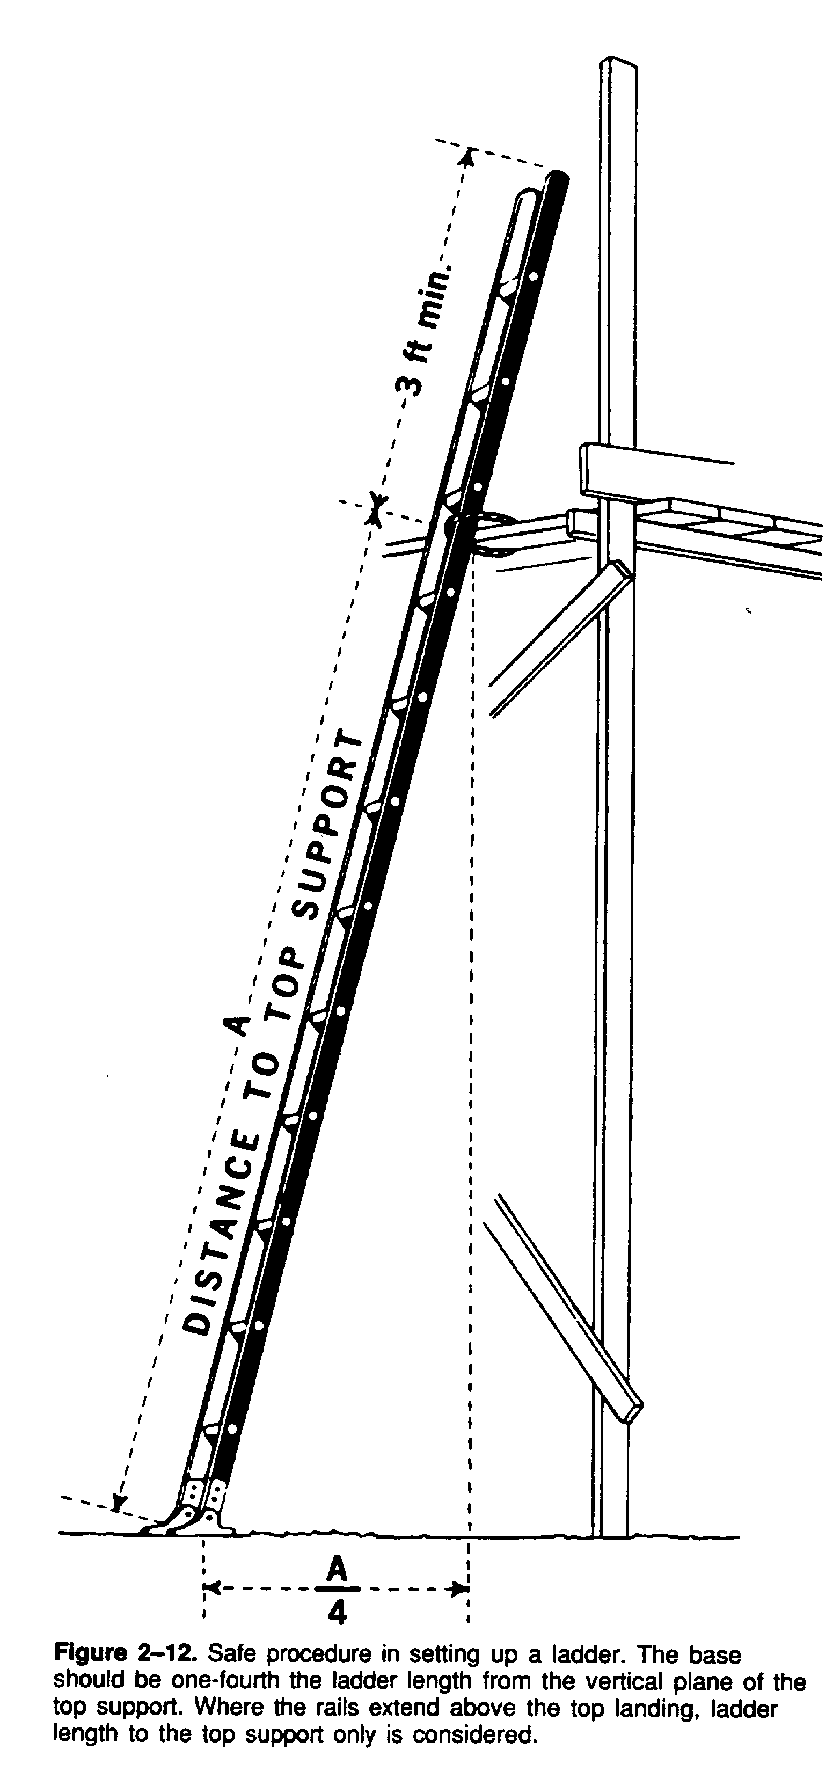
Safe Ladder Set-Up
No ladder used to gain access unless it extends
3 feet above the point of
support.
Your ladder must be tied off or placed to prevent slipping.
When setting a ladder against a wall use the
4-to-1 ladder rule.
Notes:
No ladder used to gain access unless it extends 3 feet above the point of support.
Your ladder must be tied off or placed to prevent slipping.
When setting a ladder against a wall use the 4-to-1 ladder rule.

Slide 27
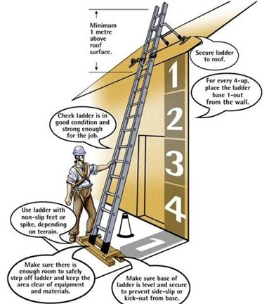
Safe Ladder Set-Up
Notes:
Make sure all those who will use a ladder are familiar with all the safety points and possible hazards of use.

Slide 28
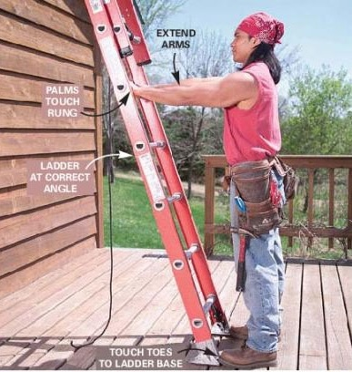
Safe Climbing Angle
Notes:
To determine the best climbing angle:
Face the ladder
Place your toes on the ladder base as shown
Extend your hands, palms down. They should touch the ladder rung when you’re standing upright

Slide 29
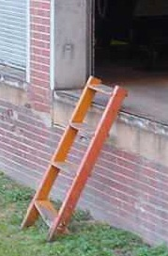
Ladder Safety Precautions
Ladders that have defects or are in need of repair must be removed from service.
Shorter ladders must not be spliced together to make one big ladder.
Rungs must be kept free from grease.
Notes:
Take the following precautions with ladders:
Ladders that have defects or are in need of repair must be removed from service.
Shorter ladders must not be spliced together to make one big ladder.
Rungs must be kept free from grease.

Slide 30
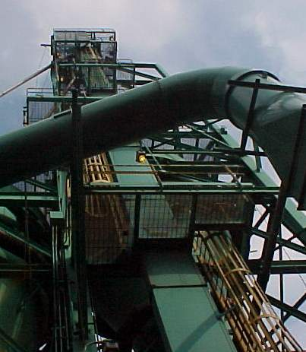
Fixed Ladders
The minimum design live load must be a single concentrated load of 200 pounds.
All metal ladders and appurtenances must be painted.
Rungs, cleats, and steps must be kept free of splinters, sharp edges, or burrs.
Notes:
All ladders, appurtenances and fastenings must be designed to meet load requirements. The minimum design must be a single concentrated load of 200 pounds. The number and position of additional concentrated live-load units of 200 pounds each to be determined from the anticipated usage of the ladder shall be considered in the design.
The weight of the ladder and attached appurtenances together with the live-load must be considered in the design of the rails and fastenings.
Rungs and cleats shall have a minimum diameter of 3/4-inch for metal ladders and 1 1/8 inch for wood ladders.

Slide 31
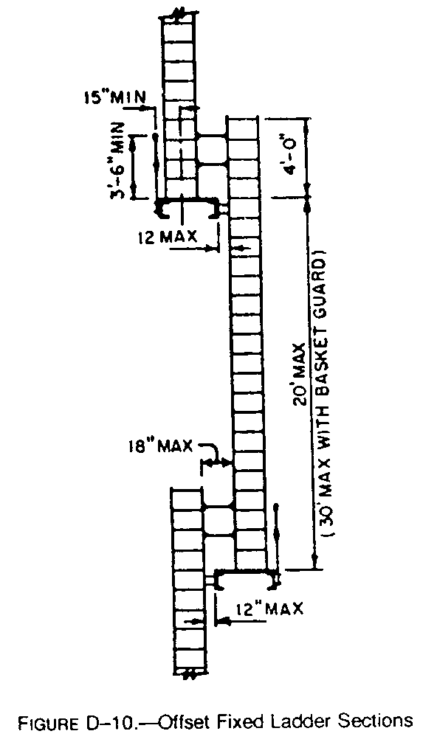
Offset Fixed Ladders
When ladders used to ascend to heights exceeding 20 feet, landing platforms must be provided for each 30 feet of height.
All platforms shall be equipped with the standard railings and toeboards.
Notes:
When ladders extend to heights exceeding 20 feet (except on chimneys), landing platforms must be provided for each 30 feet of height or fraction thereof, except that, where no cage, well, or ladder safety device is provided, landing platforms shall be provided for each 20 feet of height or fraction thereof. Each ladder section shall be offset from adjacent sections. Where installation requires that adjacent sections be offset, landing platforms shall be provided at each offset. Where a man has to step a distance greater than 12 inches from the centerline of the rung of a ladder, a landing platform must be provided.
All landing platforms must be equipped with standard railings and toeboards, and so arranged as to give safe access to the ladder. Platforms shall not be less than 24 inches in width and 30 inches in length.
One rung of any section of the ladder shall be located at the level of the landing laterally served by the ladder.

Slide 32
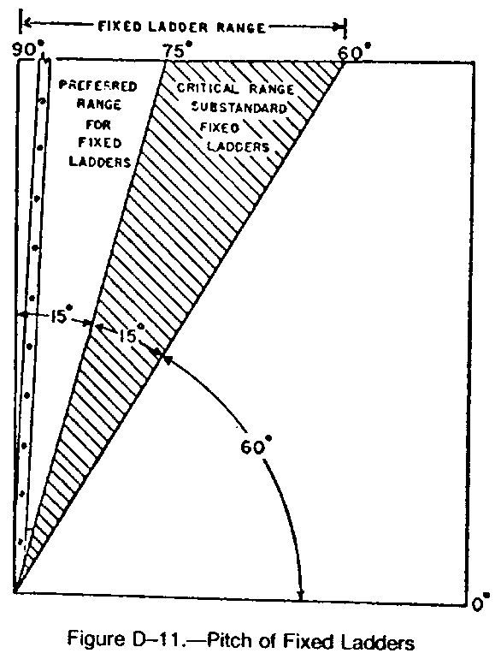
Pitch of Fixed Ladders
The preferred pitch of fixed ladders is considered to come in the range of 75 and 90 degrees with the horizontal.
Substandard pitch is within the range of 60 and 75 degrees.
Notes:
The preferred pitch of ladders shall be considered to come in the range of 75 degrees and 90 degrees with the horizontal.
Fixed ladders shall be considered substandard if they are installed within the substandard pitch range of 60 degrees and 90 degrees with the horizontal. Ladders having a pitch in excess of 90 degrees with the horizontal are prohibited.
All ladders (fixed or not) shall be maintained in a safe condition. All ladders must be inspected regularly.

Slide 33
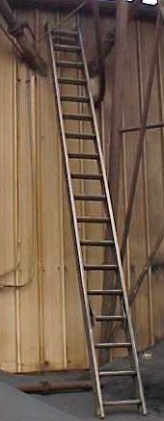
Ladders and Electricity
Metal ladders conduct electricity.
Use care when placing.
Suggest sign on metal ladders, “not for use around electricity or electric lines.”
Notes:
Great care should be taken for metal ladders around electricity.

Slide 34
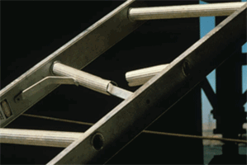
Summary
Always choose the proper type of ladder for the job being done.
Ladders need to be set up properly – check surface and placement.
Ladders should be used per manufacturer’s recommendations.
Never overload a ladder.
A ladder inspection program should be in place.
Defective ladders should be taken out of service and labeled appropriately.
Notes:
No matter how many times employees use ladders they still need to practice ladder safety including checking the ladder to ensure it is in good repair and safe to use.
Falls from a ladder can happen quickly and can alter a person’s life – employees who use ladders should take their safety seriously and never become complacent!

Slide 35

Bibliography
29 CFR 1910.25 Portable Wood Ladders
29 CFR 1910.26 Portable Metal Ladders
29 CFR 1910.27 Fixed Ladders
29 CFR 1926.1053 Ladders

Slide 36


Contact Information
Health & Safety Training Specialists
1171 South Cameron Street, Room 324
Harrisburg, PA 17104-2501
(717) 772-1635
RA-LI-BWC-PATHS@pa.gov
Like us on Facebook! - https://www.facebook.com/BWCPATHS
Notes:
For more information on webinars and free training at your location, we invite you to contact us.

Slide 37
Questions

