Slide 1
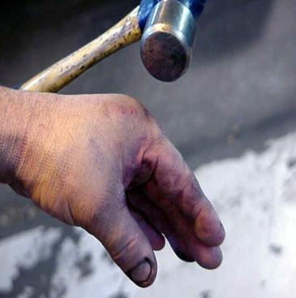
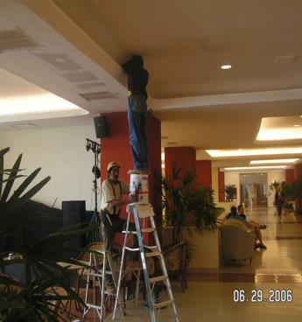
Incident Investigation-Reporting-Prevention
Bureau of Workers’ Compensation
PA Training for Health & Safety (PATHS)
For Safety Committee Members, Supervisors & Managers
Notes:
In the real world setting, sometimes all the precautions and safety measures you take may still allow accidents to occur. Such is the nature of the environment where machines, persons and a myriad of other variables intervene.
Once an incident occurs, it requires investigation for root cause while reporting through in-house policies and procedures to inform and implement preventive measures.

Slide 2
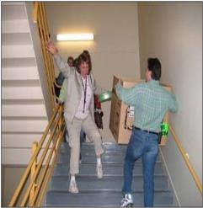
Incident Investigation and Prevention
Incidents can occur at any time during an employee’s work shift.
● Incidents can be prevented through:
Employee awareness
Training
Immediate correction of identified hazards
Notes:
Although incidents can occur anytime during a work shift, they can be prevented by:
Employee awareness of hazards
Training , and
The immediate correction of hazards identified.

Slide 3
You’re Important
As a safety committee member, supervisor or manager your involvement is key in reducing the amount of incidents or injuries.
Your direct involvement in
the process of preventing
and investigating employee,
contractor and visitor
incidents can ensure that
future incidents are prevented.
Notes:
Your importance as a safety committee member, supervisor or manager is your involvement to reduce incidents or injuries.
Your direct involvement in preventing and investigating incidents impacting on employees, contractors and visitors best insures the prevention of future incidents.

Slide 4
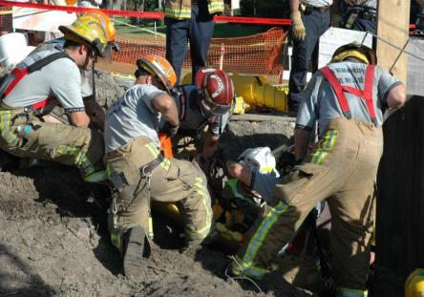
What is an Incident?
An uncontrolled or unplanned release of energy that causes or contributes to illness, injury, death and/or damage to property, equipment or materials.
All incidents have a cause and effect
Notes:
By definition, an incident would be…
“An uncontrolled or unplanned release of energy that causes or contributes to illness, injury, death and/or damage to property,
equipment or materials.”
All incidents, we will discover, have a cause and effect.

Slide 5
Incident Ration Model-Heinrich’s Theory
Serious Injury or Death
Most Incident
Investigations Conducted
1
1
29
Biggest percentage of injury-causing potential!
Minor Injury
Few Investigations
Conducted
300
Near-Miss
3,000
Unsafe Acts, Behaviors or Conditions
Notes:
This pyramid was developed in 1931 by William Heinrich showing a total of 3,330 incident/accident situations from a defined breakdown according to:
1. Unsafe acts, behaviors or conditions
2. 300 near-miss situations (these first 2 categories are not often investigated due to lack of injury)
3. 29 minor injuries occur, and
4. 1 serious injury or death that may result from this total of events.
Although categories 1 & 2, unsafe acts, behaviors or conditions, and near-misses are not investigated as rigorously if at all, they have the potential to escalate to more intense conditions.

Slide 6
Why Investigate Incidents?
To prevent reoccurrence
To determine the cost associated with an incident
To determine compliance with applicable safety regulations
To process workers’ compensation claims
Notes:
The reason we investigate incidents is to determine causal factors as well as to:
Prevent reoccurrence,
Determine the cost associated with an accident,
Determine compliance with applicable safety regulations, and
To process workers’ compensation claims.

Slide 7
Who Should Investigate?
Safety committee members
Immediate supervisor
Department manager
Safety officer
Other safety & health professional
Notes:
Those who should become involved in the investigative process would be:
Safety committee members
Immediate supervisor
Department manager
Safety officer
Other safety & health professional

Slide 8
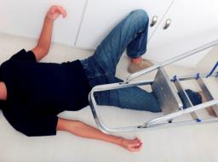
Incident Investigation
Suppose an incident occurs in your facility and you are the one who has to investigate it, what do you do?
Keep in mind that all incidents should be investigated as soon as possible.
A good, thorough investigation needs to be conducted so that future occurrences can be prevented.
Notes:
If an incident occurs in your facility, certain questions arise.
Suppose an accident occurs in your facility and you are the one who has to investigate it, what do you do?
Keep in mind that all accidents should be investigated as soon as possible.
A good, thorough investigation needs to be conducted so that future occurrences can be prevented.

Slide 9
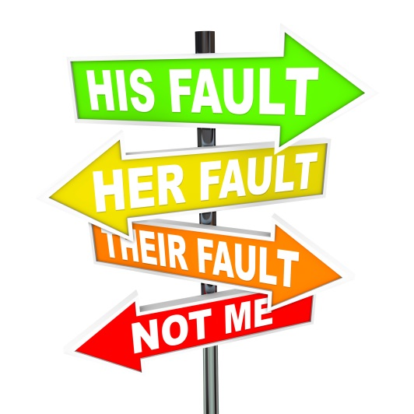
The Aim of the Investigation
Is Not To:
Exonerate individuals or management
Satisfy insurance requirements
Defend a position for legal argument
Assign blame
Remember, fact finding – not fault finding
Notes:
Foremost in the investigator’s mind should be that the investigation is NOT TO:
Exonerate individuals or management
Satisfy insurance requirements
Defend a position for legal argument
Assign blame
Investigations are about fact finding - - not fault finding.

Slide 10
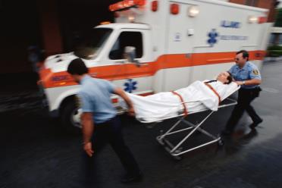
Incident Investigation Steps
First and foremost, provide first aid/medical care to the injured party.
Identify the cause of the incident.
Report the findings (using the appropriate incident/injury report).
Notes:
Investigative steps include:
First and foremost, provide first aid/medical care to the injured party.
Identify the cause of the accident.
Report the findings (using the appropriate accident/injury report).

Slide 11
Incident Investigation Steps
Develop a plan for corrective action.
Implement the corrective action plan.
Evaluate the effectiveness of the actions taken.
Make changes for continuous improvement.
Notes:
Other steps include:
Develop a plan for corrective action.
Implement the corrective action plan.
Evaluate the effectiveness of the actions taken.
Make changes for continuous improvement.

Slide 12
Remember-Time is of the Essence!
As little time as possible should pass between the moment of the incident and the start of the investigation!
Starting the investigation a.s.a.p. after the incident occurs enables a supervisor or manager to:
Observe conditions as they were at the time of the incident.
Prevent disturbance of evidence.
Identify witnesses.
Notes:
Time is very important in an investigation.
Starting the investigation a.s.a.p. after the accident occurs enables a supervisor or manager to:
Observe conditions as they were at the time of the accident.
Prevent disturbance of evidence.
Identify witnesses.

Slide 13
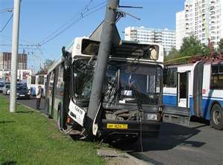
Incident Causes
What are the causes of an incident? There are two basic causes of incidents:
Unsafe Acts, and
Unsafe Conditions
Notes:
Two (2) basic causes of an accident may be attributed to either an
Unsafe act, or
Unsafe condition.

Slide 14
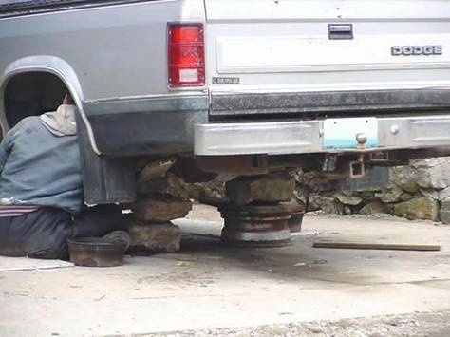
Unsafe Acts vs. Unsafe Conditions
80-90 percent of all incidents are caused by unsafe acts of people, as opposed to unsafe mechanical or physical conditions.
Human failure is the primary cause of incidents.
Notes:
Human failure is the primary cause of accidents 80-90% of the time rather than unsafe mechanical or physical conditions.

Slide 15
Unsafe Acts vs Unsafe Conditions
Unsafe Acts
Using unsafe equipment
Improper lifting
Horseplay
Influence of drugs/alcohol
Operating without
authority
Left file drawer open
Unsafe Conditions
Congested area
Noise exposure
Wet floor
Inadequate machine
guards
Inadequate warning
system
Defective/damaged tools
Notes:
A review of the above chart will provide various categories of unsafe acts or unsafe conditions which can contribute to accidents. You could use these categories during your safety inspection tour.

Slide 16
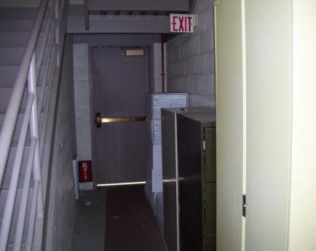
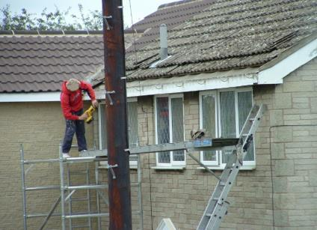
Unsafe Act or Unsafe Condition?
Act – Individual set up scaffolding unsafely, no PPE, no fall protection.
Condition – Exit access is blocked/obstructed.
Notes:
Right side: Unsafe Act, Individual set up scaffolding unsafely, no PPE, no fall protection.
Left side: Unsafe Condition – Exit access blocked/obstructed.

Slide 17
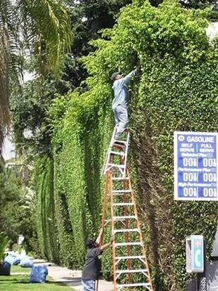
Unsafe Act or Unsafe Condition?
Act – Individual standing on ladders that are set up unsafely.
Notes:
Unsafe Act – Individual standing on ladders he set up unsafely.

Slide 18
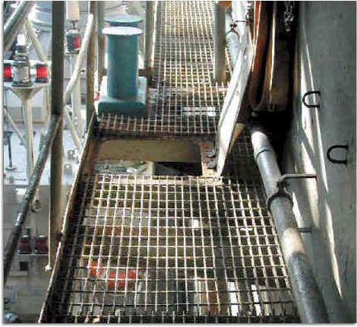
Unsafe Act or Unsafe Condition?
Condition – Open access hatch (fall hazard).
Notes:
Unsafe Condition – Open access hatch (fall hazard).

Slide 19
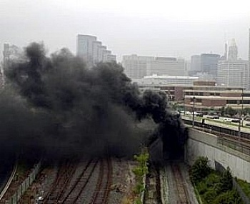
Incident Causes
Causes of any accident can be grouped into five (5) basic categories:
Task
Material
Environment
Personnel
Management
Notes:
Incident causes can be grouped into five (5) basic categories.
Task
Material
Environment
Personnel
Management

Slide 20
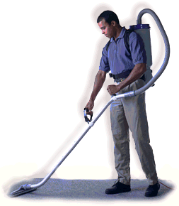
Task
In this category, the actual work procedure being performed at the time of the incident is looked at.
Was a safe work procedure used?
Did conditions change to make the normal procedure unsafe?
Were the appropriate tools and materials available and used?
Were safety devices (example: machine guards) in place and working properly?
Notes:
Task: The actual work procedure being performed at the time of the incident is looked at.
Was a safe work procedure used?
Did conditions change to make the normal procedure unsafe?
Were the appropriate tools and materials available and used?
Were safety devices (example: machine guards) in place and working properly?

Slide 21
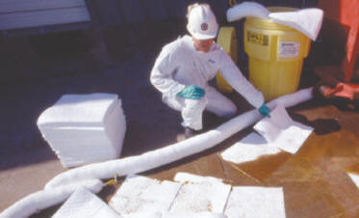
Material
In this area, look for possible causes resulting from the equipment and materials used.
Equipment failure? If so, what caused the failure?
Was the machinery poorly designed?
Were hazardous substances involved? If yes, were they clearly identified and properly labeled?
Notes:
Material: possible causes resulting from the equipment and materials used.
Equipment failure? If so, what caused the failure?
Was the machinery poorly designed?
Were hazardous substances involved? If yes, were they clearly identified and properly labeled?

Slide 22
Material (cont.)
Was a less-hazardous alternative substance available?
Was the raw material substandard in some way?
Was PPE used? If yes, was it appropriate for the task being performed and was it in “serviceable condition?”
Notes:
Materials also include determining if:
A less-hazardous alternative substance available?
Was the raw material substandard in some way?
Was PPE used? If yes, was it appropriate for the task being performed and was it in “serviceable condition?”

Slide 23
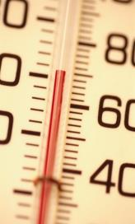
Environment
The physical environment, including sudden changes to it, are factors that need to be identified.
What were the conditions in the work area (example: cold, hot, damp, etc.)?
Was poor housekeeping a problem?
Was noise a problem?
Was there adequate light?
Were toxic or hazardous gases, dusts or fumes present?
Notes:
Environment would be the physical environment, including sudden changes.
What were the conditions in the work area (example: cold, hot, damp, etc.)?
Was poor housekeeping a problem?
Was noise a problem?
Was there adequate light?
Were toxic or hazardous gases, dusts or fumes present?

Slide 24
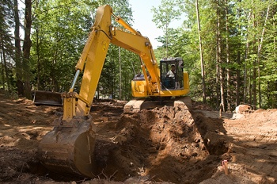
Personnel
The physical and mental conditions of those individuals directly involved in the accident must be explored.
Was the employee experienced in the work he/she was doing?
Was the employee adequately trained for the task being completed?
Can the employee physically perform the work?
Notes:
Personnel takes into account the physical and mental conditions of those directly involved in the incident. This must explore:
1. Was the employee experienced in in the work
2. Was the employee adequately trained for the task
3. Could the employee physically perform the work

Slide 25
Personnel (cont.)
What was the status of the employee’s health at the time of the incident?
Was the employee tired at the time of the incident?
Was the employee under work or personal stress at the time of the incident?
Notes:
Personnel considerations also view:
The status of the employee’s health at the time of the accident.
Was the employee tired at the time of the accident?
Was the employee under work or personal stress at the time of the accident?

Slide 26
Management
Management holds the legal responsibility for safety in the workplace!
Were safety rules communicated to and understood by all employees?
Were written procedures available?
Were the procedures/rules being enforced?
Was there adequate supervision?
Notes:
Management is legally responsible for safety in the workplace and should ask:
Were safety rules communicated to and understood by all employees?
Were written procedures available?
Were the procedures/rules being enforced?
Was there adequate supervision?

Slide 27
Management (cont.)
Were workers trained to do the work being performed?
Were hazards previously identified?
Had procedures been developed to overcome the hazards identified?
Were unsafe conditions corrected?
Was regular maintenance of equipment done?
Were safety inspections completed?
Notes:
Management must also consider if
Workers were trained to do the work?
Were hazards previously identified?
Were procedures developed to overcome hazards found?
Were unsafe conditions corrects?
Was regular maintenance of equipment performed?
Were safety inspections completed?

Slide 28
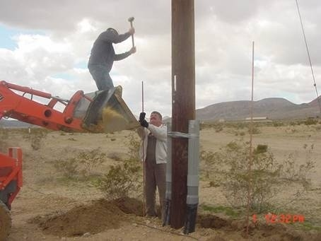
Root Cause?
To prevent future occurrences you need to determine the root cause!
Notes:
To prevent future occurrences, we need to determine the root cause of the incident.

Slide 29
WEED OUT THE CAUSES OF INJURIES AND ILLNESSES
Direct causes of injury/illness
Strains
Burns
Cuts
Unguarded machine
Horseplay
Broken tools
Create a hazard
Surface Causes of the Accident
Chemical spill
Ignore a hazard
Defective PPE
Fail to report injury
Conditions
Untrained worker
Fail to inspect
Behaviors
Lack of time
Fail to enforce
Too much work
Fail to train
Inadequate training
No recognition
No discipline procedures
Inadequate labeling procedures
No orientation process
Outdated procedures
Root Causes of the Accident
Inadequate training plan
No recognition plan
No accountability policy
No inspection policy
If you eliminate the root cause of an accident, you will eliminate those accidents in the future!
Notes:
Review this slide. On the left, “above-ground” conditions that could contribute to injuries are listed; these are contributing factors to an injury.
The same is true on the right side dealing with behaviors. The visible, “above-ground” behaviors are but surface causes.
You need to determine the invisible “root causes” of both conditions and behaviors, remove them and your injuries may go away!

Slide 30
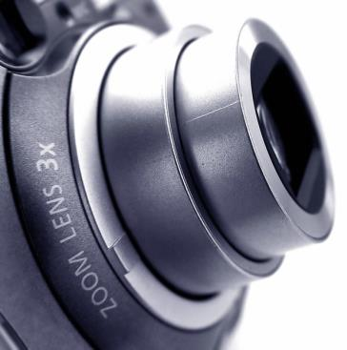
Pictures
If possible, take a picture of the accident scene noting the date, time and your location on the back of the picture.
Pictures can be very helpful if further investigation is necessary or a dispute occurs.
Notes:
To obtain a history of the incident, take pictures or videotapes.
Note the date, time and your location on the back of the picture.
Photos can be very helpful for those who were not there to understand spatial relationships.

Slide 31
Incident Witnesses
Every effort should be made to interview any witnesses.
Witnesses can be a very good source of information regarding the cause of an accident and the conditions associated with it.
Notes:
Importance of witnesses:
Every effort should be made to interview any witnesses.
Witnesses can be a very good source of information regarding the cause of an accident and the conditions associated with it.

Slide 32
Eyewitness Accounts
Witnesses should be interviewed as soon as possible after the incident.
Witnesses should be interviewed alone, rather than in a group.
Have witnesses document their statements and ask them to date and sign.
Notes:
Witnesses should be interviewed as soon as possible after the incident.
Witnesses should be interviewed alone, rather than in a group.
Have witnesses document their statements and ask them to date and sign.

Slide 33
Interviewing Witnesses
When interviewing a witness do not:
Attempt to intimidate
Interrupt
Prompt
Ask leading questions
Show your emotions
Make lengthy notes while the witness is talking
Notes:
When interviewing, DO NOT
Attempt to intimidate
Interrupt
Prompt
Ask leading questions
Show your emotions
Make lengthy notes while the witness is talking

Slide 34
Interviewing Witnesses
Do:
Ask open-ended questions.
Use probing questions to get more information.
Repeat witness’s answer back to them.
Have the witness write their statement and then sign, date, time (you also sign, date, time).
Notes:
During interviews, Do:
Ask open-ended questions.
Use probing questions to get more information.
Repeat witness’s answer back to them.
Have the witness write their statement and then sign, date, time (you also sign, date, time).

Slide 35
Reporting
Incidents need to be reported immediately after occurrence!
To report an employee incident/injury, use the appropriate incident/injury report form.
Make sure the form is completely filled out with all applicable information.
Notes:
Reporting of incidents:
Should be done immediately after occurrence!
Should be done using the appropriate incident/injury report form.
Should prompt the reporting person to ensure the injury/incident report form is completely filled out with all applicable information.

Slide 36
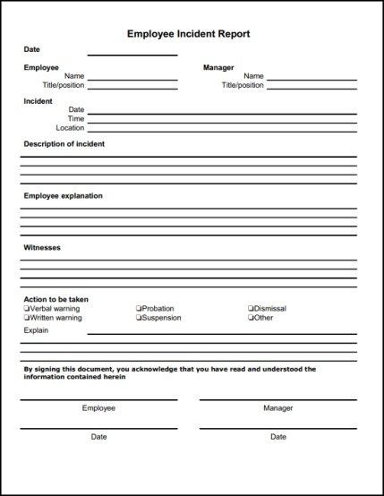
Incident-Injury Report
Some important information to remember:
Ensure there is a detailed description of what happened to cause the incident.
Make sure there are appropriate/detailed comments as to what action(s) will be taken to prevent future incidents.
Notes:
Incident-injury report should ensure:
There is a detailed description of what happened to cause the accident.
There are appropriate/detailed comments as to what action(s) will be taken to prevent future accidents.

Slide 37
Incident-Injury Report
WHAT SHOULD BE INCLUDED IN A REPORT?
All the facts, statements, documents, photos, etc. that were obtained during the investigation
Remember, no opinions (e.g. “I think that, I believe that”…)
Analysis of the cause
Corrective actions
Notes:
What to include in an incident/injury report:
ALL THE FACTS! Statements, documents, photos, etc. that were obtained during the investigation
No opinions!! Statements like, “I think that” or “I believe that” should not be included – no conjecture or deductions
An analysis of the cause to include the root cause
Corrective actions recommended

Slide 38
Corrective Actions
Told to be more careful
Explained safety rule on lifting
Instructed employee to read Safety Data
Sheet (SDS)
Had co-worker review proper procedures
ARE THESE EFFECTIVE MEANS OF CORRECTIVE ACTION? WHAT DO YOU THINK?
Hint: Not really! These actions do not really correct anything.
Notes:
Examples of actions that really are not “good” corrective actions:
Told to be more careful
Explained safety rule on lifting
Instructed employee to read Safety Data Sheet (SDS)
Had co-worker review proper procedures

Slide 39
Good Corrective Actions
Met with employee to discuss incident and reviewed proper procedures and then...
Observed employee perform the procedure
Showed employee SDS, reviewed how to interpret; use of appropriate PPE
Checked for understanding
Plan to discuss the incident with all employees in the department at the next meeting
Notes:
Here are some better/good corrective actions because they actually do something to prevent future occurrences:
Met with employee to discuss incident and reviewed proper procedures and then...
Observed employee perform the procedure
Showed employee SDS, reviewed how to interpret; use of appropriate PPE
Checked for understanding
Plan to discuss the incident with all employees in the department at the next meeting

Slide 40
Where to Report
Employees should report incidents a.s.a.p. as specified in company guidelines.
Follow directions provided in employee handbook or from the HR department as to where completed report forms should be forwarded to.
Notes:
Employees should report incidents as soon as possible as specified in company guidelines.
Follow directions provided in the employee handbook or from the company HR department as to where completed report forms should go.

Slide 41
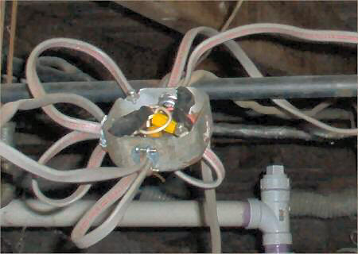
Incident Prevention
Incidents can be prevented by early detection, reporting and abating!
Notes:
Incidents can be prevented by early detection, reporting and abating.

Slide 42
Hazard Recognition
Detection/identification of hazards before they cause injuries is important. To accomplish this, conduct periodic “walk around” inspections looking for items such as:
Slip, trip and fall hazards (e.g., wires across a walk way)
Broken/damaged equipment (e.g., stool with a broken leg)
Exposed electrical wiring (e.g., frayed electrical cord)
Machinery with missing guards (e.g., cutting machine with missing blade guard.)
Damaged PPE (e.g., gloves with rips/tears)
Notes:
Detect and identify hazards before they cause injuries. Conduct periodic “walk around” inspections looking for items such as:
Slip, trip and fall hazards (e.g., wires across a walk way)
Broken/damaged equipment (e.g., stool with a broken leg)
Exposed electrical wiring (e.g., frayed electrical cord)
Machinery with missing guards (e.g., cutting machine with missing blade guard.)
Damaged PPE (e.g., gloves with rips/tears)

Slide 43
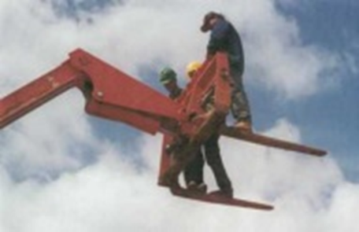
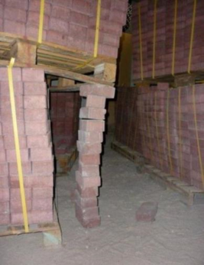
Hazard Recognition
What hazards do you see?
Employees standing on MHE “forks;” above 4/6 feet with no fall protection
Bricks holding up pallet containing bricks
Notes:
Picture on left = workers standing on Mechanical Handling Equipment (MHE) “forks;” working above 4 feet in general industry, 5 feet in shipbuilding and 6 feet in construction fall protection is needed
Picture on right = bricks holding up pallet with bricks on it – poor/unsafe storage/loading

Slide 44
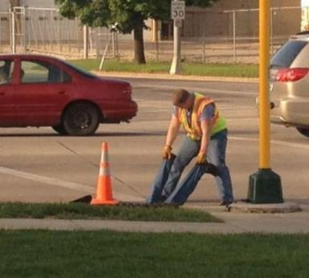
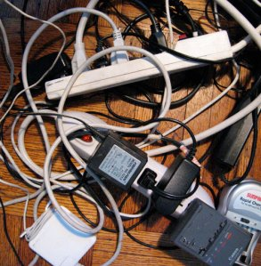
Hazard Recognition
What hazards do you see?
Man holding other man’s legs while other man in confined space; no safety equipment in use
Over-loaded power strips - “shock” and fire hazards; cords are trip and fall hazard
Notes:
Picture on left = improper/unsafe confined space entry; should have safety equipment such as a tripod, wench, body harness, gas detection equipment, etc.
Picture on right = overloaded “power strips;” cords create a trip and fall hazard

Slide 45
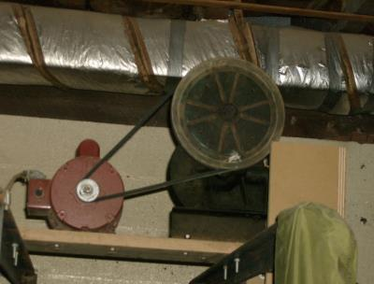
Hazard Recognition
What hazards do you see?
Unguarded pulleys
Exit blocked/obstructed
Fire extinguisher missing (below fire extinguisher sign)
Notes:
Picture on left = unguarded pulleys
Picture on right = exit blocked/obstructed by miscellaneous items; fire extinguisher is missing (below fire extinguisher sign)

Slide 46
Report Hazards
Once hazards have been identified, they need to be reported to the appropriate area (e.g., broken floor tile that could cause a trip and fall should be reported to building maintenance for repair).
Safety officer, safety committee or maintenance department should keep a log of items reported and follow up to ensure hazards reported have been corrected.
Notes:
Report hazards found.
Once hazards have been identified, they need to be reported to the appropriate area (e.g., broken floor tile that could cause a trip and fall should be reported to building maintenance for repair).
Safety officer, safety committee or maintenance department should keep a log of items reported and follow up to ensure hazards reported have been corrected

Slide 47
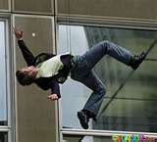
Hazard Abatement
Hazard abatement = The elimination or reduction of a safety/health hazard by complying with applicable safety and health standards or taking equivalent protective measures.
Take the steps necessary to abate hazards; this will provide a safer environment for employees, contractors and visitors alike.
Notes:
Hazard abatement is the elimination or reduction of a safety/health hazard by complying with applicable safety and health standards or taking equivalent protective measures.
Take the steps necessary to abate hazards; this will provide a safer environment for employees, contractors and visitors alike.

Slide 48
Incident Prevention
Here are some ways to prevent incidents:
Ensure work areas are not cluttered and trash is removed regularly.
Provide necessary training/retraining for all employees.
Ensure that necessary controls are in place [engineering (e.g., machine guarding), administrative (e.g., labels/signs), PPE (e.g., safety goggles)].
Have spills cleaned up immediately.
Notes:
Several ways to prevent incidents would be to
Ensure work areas are not cluttered and trash is removed regularly.
Provide necessary training/retraining for all employees.
Ensure that necessary controls are in place [engineering (e.g., machine guarding), administrative (e.g., labels/signs), PPE (e.g., safety goggles)].
Have spills cleaned up immediately.

Slide 49
Incident Prevention (cont.)
Ensure proper lifting/carrying techniques are being used.
Ensure mechanical handling equipment (MHE) is being used properly.
Ensure walking/working surfaces are free of slip, trip and fall hazards.
Enforce safety rules, policies and procedures.
Ensure safety inspections are being conducted regularly.
Notes:
Preventive measures would also include:
Ensure proper lifting/carrying techniques are being used.
Ensure mechanical handling equipment, or MHE, is being used properly.
Ensure walking/working surfaces are free of slip, trip and fall hazards.
Enforce safety rules, policies and procedures.
Ensure safety inspections are being conducted regularly.

Slide 50
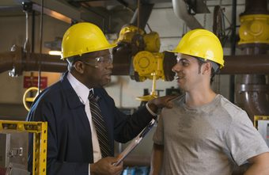
You are the Key!
Safety committee members, supervisors and managers are truly the first line of defense in incident prevention!
Committee members, supervisors and managers must realize that their actions and attitudes regarding injury/incident prevention and safety in general have a very big impact on the “safety consciousness” of employees.
Notes:
You are the Key to accomplish the safety tasks
Safety committee members, supervisors and managers are truly the first line of defense in accident prevention!
Committee members, supervisors and managers must realize that their actions and attitudes regarding injury and accident prevention and safety in general have a large impact on the “safety consciousness” of employees.

Slide 51
You are they Key! (cont.)
If committee members/managers/supervisors place safety and incident prevention on the back burner, tolerate unsafe acts or conditions, conduct poor accident investigations and/or only “talk safety” employees are likely to disregard safety and suffer on-the-job injuries or illnesses.
As a safety committee member, supervisor or manager you can contribute to making your company a safe, injury-free place to work or visit!
Notes:
You are also the Key to safety
If committee members/managers/supervisors place safety and incident prevention on the back burner, tolerate unsafe acts or conditions, conduct poor incident investigations and/or only “talk safety” employees are likely to disregard safety and suffer on-the-job injuries or illnesses.
As a safety committee member, supervisor or manager you can contribute to making your company a safe, injury-free place to work or visit!

Slide 52
Your Requirements
As a Safety Committee Member, Manager or Supervisor:
You need to “act safely as you talk safety!”
Support safety all the time, every time!
Remember, employees are watching!
Notes:
Your requirements as a Safety Committee Member, Manager or Supervisor:
You need to walk the talk!
Support safety all the time, every time!
Remember, employees are watching!

Slide 53
Contact Information
Health & Safety Training Specialists
1171 South Cameron Street, Room 324
Harrisburg, PA 17104-2501
(717) 772-1635
RA-LI-BWC-PATHS@pa.gov
Like us on Facebook! - https://www.facebook.com/BWCPATHS
Notes:
We invite you to contact us concerning other free power point programs, toolbox talks and short videos to assist your training program.

Slide 54
Any Questions?

